Slide 1
Border Health Strategies to Contain the Spread of COVID-19
Name
Title
Date

Slide 2
Objectives
Discuss border health strategies to stop the spread of coronavirus disease 2019 (COVID-19)
Discuss benefits and limitations of screening at points of entry (POE)

Slide 3
COVID-19 Background

Slide 4
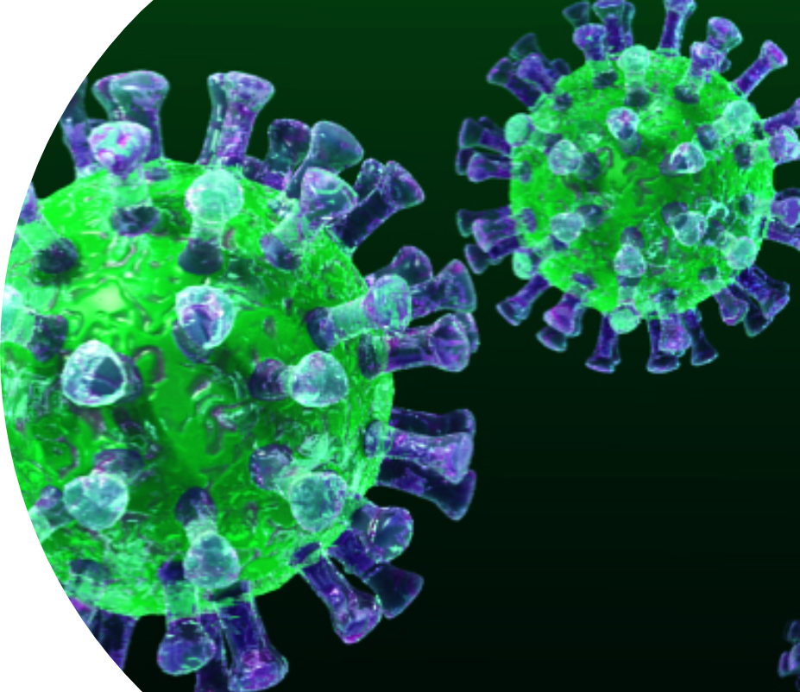
What is coronavirus?
Coronaviruses are a family of viruses named after the crown-like outer structure of the virus. They have zoonotic origins and have caused the following recent epidemics:
Severe acute respiratory syndrome (SARS)
2002-2003
Middle East respiratory syndrome (MERS)
2012, 2015, 2018
Coronavirus disease 2019 (COVID-19)
December 2019 to present

Slide 5
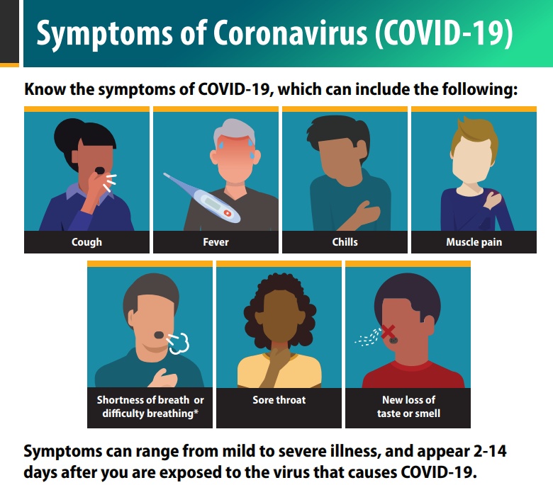
Signs and symptoms of COVID-19
Reported symptoms of COVID-19 range from mild to severe
Symptoms may appear 2-14 days after exposure to the virus and include:
Fever or chills
Cough
Shortness of breath or difficulty breathing
Fatigue
Muscle or body aches
Headache
New loss of taste or smell
Sore throat
Congestion or runny nose
Nausea or vomiting
Diarrhea
Signs and symptoms from CDC: https://www.cdc.gov/coronavirus/2019-ncov/symptoms-testing/symptoms.html

Slide 6
COVID-19 background
31 Dec. 2019
First reported as a pneumonia outbreak in Wuhan, Hubei Province, China
11 Jan. 2020
WHO alerted to an outbreak associated with one seafood market in Wuhan
13 Jan. 2020
Thailand Ministry of Public Health confirms first case outside of China
31 Jan. 2020
WHO declares the outbreak a Public Health Emergency of International Concern
11 Feb. 2020
WHO officially names the disease COVID-19
11 Mar. 2020
WHO declares COVID-19 outbreak a pandemic
WHO = World Health Organization

Slide 7
COVID-19
Primary signs and symptoms
Fever (not always present)
Cough
Difficulty breathing
Most people with COVID-19 have mild symptoms
Clear evidence for human-to-human transmission
Incubation period is up to 14 days post-exposure (ranges from 2-14 days)

Slide 8
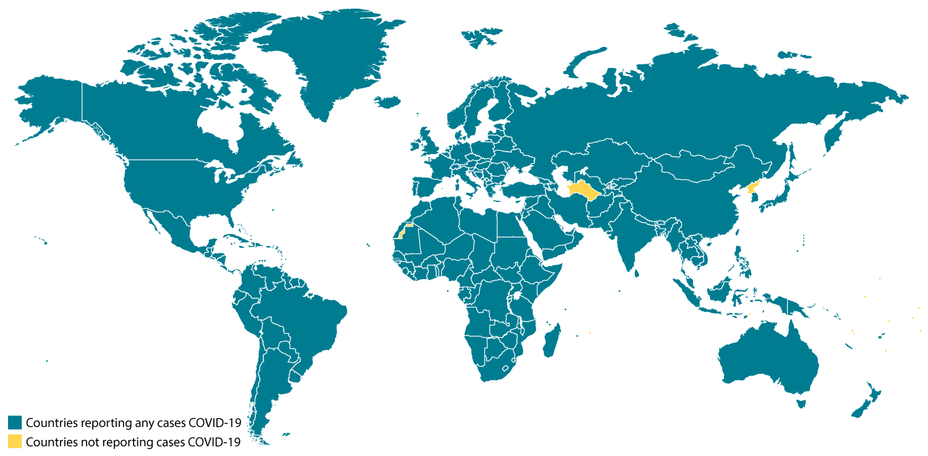
Countries with COVID-19 cases as of 28 May 2020
Map from CDC: https://www.cdc.gov/coronavirus/2019-ncov/global-covid-19/world-map.html

Slide 9
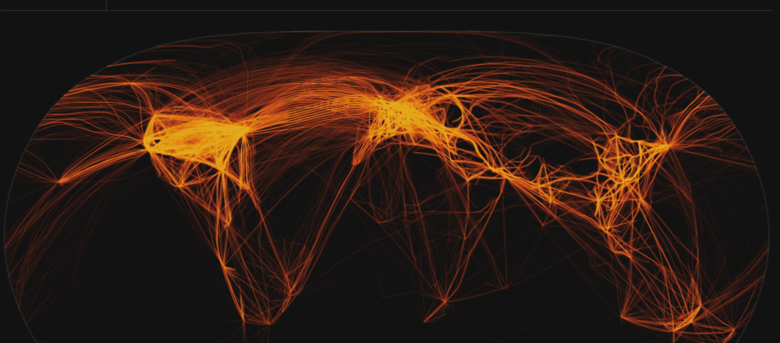
Travel-associated case surveillance and reporting
“Travel-associated” refers to a probable case of COVID-19 in which:
The person recently travelled from or had contact with travellers from another country
The person could have acquired the disease in another country or could have been in an outbreak country during the incubation period and be contagious now
The person could have been exposed in another country
The person has imminent plans to travel to another country
The collaboration of other countries is required for investigation and control of the disease

Slide 10
Travel-associated case surveillance and reporting
Responses that should alert travel surveillance system:
Responds yes to having travelled to another country
Responds yes to having contact with someone who has recently travelled to another country
Has imminent plans to travel to another country
Steps to follow if above criteria are met:
Surveillance officer conducts a follow-up interview to gather more information about travel history or intent to travel
Regional and/or national authorities are notified, when appropriate
Counterparts in other countries are notified, when appropriate

Slide 11
WHO recommendations for screening at POE
Travel measures (e.g., travel restrictions) that interfere with international traffic for more than 24 hours may have a public health rationale at the beginning of an outbreak
May allow affected countries time to implement sustained response measures
May allow non-affected countries time to initiate and implement preparedness measures
Restrictions should ideally last a short time and be proportionate to public health risks; re-evaluate as situation evolves
Countries should undertake active surveillance, early detection, isolation and case management, and contact tracing to prevent onward spread of COVID-19
Countries should share data with WHO and must inform WHO about additional health protection measures that significantly interfere with international traffic
Notes:
In accordance with their obligations under the Article 43 of the International Health Regulations (2005), States Parties must inform WHO about additional health measures that significantly interfere with international traffic.

Slide 12
Why conduct screening at POE?
It is a flexible, scalable intervention that can be rapidly deployed or shifted based on the needs and resources of the POE.
Objectives of screening:
Reduce the international spread of communicable diseases
Educate travellers about the signs and symptoms of diseases, like COVID-19
Ensure travellers know what to do if they get sick
Inform travellers whom to call if they get sick
Sample CDC Travel Health Alert Notice for COVID-19
Notes:
Objectives of screening:
Reduce the international spread of communicable diseases by detecting departing and arriving travellers who are sick or have been exposed to the disease
Link travellers to public health by providing information about who to call if sick
Educate travellers about the signs and symptoms of diseases, like COVID-19
Ensure travellers know what to do should they become ill

Slide 13
Screening protocols
Assess travellers for signs of COVID-19 using pre-established criteria
Ensure correct personal protective equipment (PPE) use based on role in screening
Primary screening:
-Maintain at least 1m distance
-Observe travellers for obvious signs of illness
-Measure temperature
-Use POE screening form
-Educate travellers about COVID-19
Secondary screening:
-Separate travellers and conduct a medical evaluation and interview
-Follow standard operating procedures for POE regarding isolation and alerts
WHO guidance: https://apps.who.int/iris/bitstream/handle/10665/331512/WHO-2019-nCoV-POEmgmt-2020.2-eng.pdf

Slide 14
Screening protocols – primary screening
Review answers on primary screening form
Note any ‘yes’ answers, travel history, or visible signs of illness that would indicate the traveller needs to be referred to secondary screening
Measure the traveller’s temperature
Not all people with COVID-19 present with fevers, and temperature should not be the only determining factor for letting travellers continue
If criteria are met, refer the traveller to secondary screening
Collect contact information for the traveller’s companions
Refer contacts to secondary screening for further evaluation, if needed
Notes:
Comparison of EVD screening and COVID-19 to highlight the limitations of screening for COVID-19:
EVD has a lower volume of travellers and is transmitted only when symptoms are showing
COVID-19 has a higher volume of travellers, asymptomatic transmission is likely

Slide 15
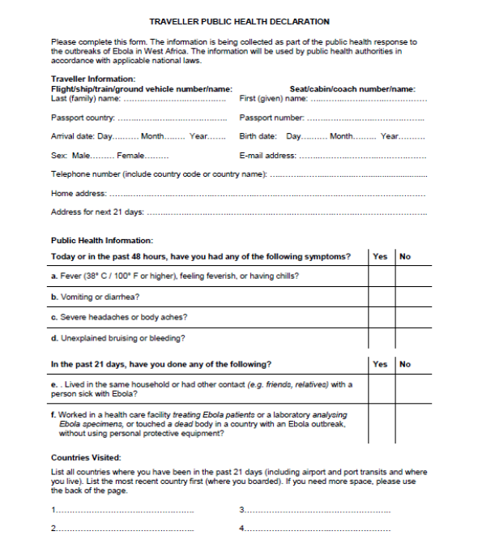
Example primary screening form

Slide 16
Preventive measures for primary screeners
WHO recommendations as of May 21, 2020
Maintain physical distance of at least 1m
Have a glass or plastic screen to create a barrier between screener and traveller
No required PPE unless physical distance is not possible, then use mask and eye protection
Perform hand hygiene
1m
WHO guidance: https://apps.who.int/iris/bitstream/handle/10665/331695/WHO-2019-nCov-IPC_PPE_use-2020.3-eng.pdf
Notes:
WHO recommendations for primary screening

Slide 17
Screening protocols - secondary screening
Observe the traveller for signs and symptoms
Retake temperature at least 15 minutes after initial temperature was taken
Conduct a risk assessment
Determine if the traveller needs to be referred to a healthcare facility

Slide 18
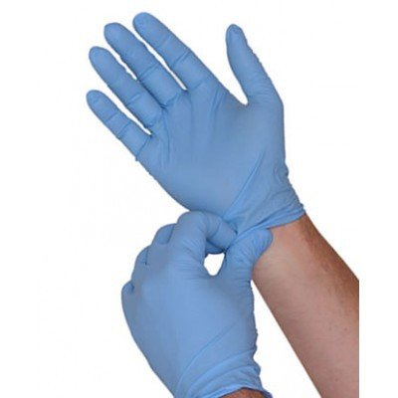
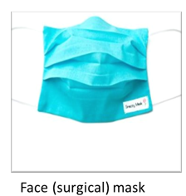
Preventive measures for secondary screeners
WHO recommendations as of May 21, 2020
Maintain physical distance of at least 1m
Wear personal protective equipment (PPE)
Medical mask
Gloves
Perform hand hygiene
Gloves
WHO guidance: https://apps.who.int/iris/bitstream/handle/10665/331695/WHO-2019-nCov-IPC_PPE_use-2020.3-eng.pdf
Notes:
WHO recommendations for secondary screening

Slide 19
Limitations of screening
Can detect only overtly ill travellers
May miss infected people who are asymptomatic or have only mild symptoms
Reliable temperature readings are affected by multiple factors
If the environment is extremely hot or cold
If the screener is using the thermometer improperly, per manufacturer standards
People need to behave in a manner that may be outside their personal interest
Travellers may not reveal their illness, may take medicine to mask it, or may not disclose exposure history
Will miss people who are currently incubating infection and do not have symptoms (2-14 days incubation period)
If the traveller has taken fever-reducing medication (e.g., paracetamol, ibuprofen)
If the thermometer has not been properly calibrated

Slide 20
Limitations of screening for COVID-19
Large-scale screening may not be the most effective way to prevent the spread of COVID-19
Screening is only one tool for responding to COVID-19; other tools include traditional epidemiology and community mitigation
Asymptomatic transmission can occur; travellers may not have any signs of COVID-19 but can still be spreading the virus
COVID-19 is widespread globally and travellers are likely to be coming from an affected area, have come in contact with someone from an affected area, or have passed through an affected area
Worldwide travel restrictions have greatly limited the number of people travelling and the places they can travel to and from

Slide 21
Combining screening and education
Screening:
Identifies travellers with visible signs; however, it may not catch the majority of people with COVID-19 as they frequently experience no or mild symptoms, but can still spread disease
Education:
Alerts travellers to signs and symptoms of COVID-19 and what to do if they are sick
Ensures travellers receive accurate information
Provides an opportunity to educate travellers on how to protect themselves and others
Informs travellers how to reach local health resources
Requires coordination between POE and health authorities

Slide 22
Education strategies: communication
Distributing Travel Health Alert Notices (T-HAN) to arriving and departing travellers
Displaying health messages at POE
Audio and video messages about signs, symptoms, and what to do if sick
Social media to share information about current guidance for travel
Traveller Health Alert Notice from CDC regarding COVID-19

Slide 23
Regulatory considerations
Does the country have legal and regulatory authority to detain, isolate, or quarantine travellers passing through the POE?
Do authorities have an established, controlled pathway to direct travellers to specific airports for systematic screening?
Is there a way that travellers can bypass the screening location?
Screening at POEs slows travel and it can be easy to bypass by detouring around a screening location
Is it safe to screen at this location?
Screening should only be implemented at POE where the safety and security of travellers and screening personnel can be assured
Notes:
Directing travellers to specific airports – US requires international travellers to arrive at 13 specific airports where entry screening has been stood up

Slide 24
Context-specific considerations
What is the volume of travellers at the POE?
What kind of travellers use the POE? Mostly foreign? Mostly domestic? What languages do they speak?
Is the POE connected to a geographic area where there has been community spread of COVID-19?
Are there cases nearby the POE?
Does the POE meet previous regulatory considerations?
Notes:
Importance of knowing language – translation of educational materials

Slide 25
National-level resource considerations
Funding to pay for screening and follow-up actions? Short-term and long-term?
Screeners’ salaries
Supplies and equipment for screening
Food, water, and other necessities for quarantined travellers
Ability to follow up on travellers who may have been exposed
Location for prolonged quarantine of travellers?
Ability to procure and provide necessities to quarantined travellers?
Referral to designated healthcare facilities where ill travellers will be sent for diagnosis and care?
Funding to produce educational/communication materials?
Mechanism to send traveller information to health departments for follow-up?

Slide 26
POE resource considerations
Does the POE have protocols for primary and secondary screening?
A clear definition for suspected cases
Ability to follow up when a suspected case or exposed person is identified
An adequate number of trained primary and secondary screeners who demonstrate competency in screening tasks and appropriate use of PPE?
Adequate personal protective equipment (PPE) and screening tools?
Ability to isolate suspected cases safely and away from other travellers and POE personnel?
An isolation area with access to potable water, toilet, handwashing facilities, and a place to sit or lie down?

Slide 27
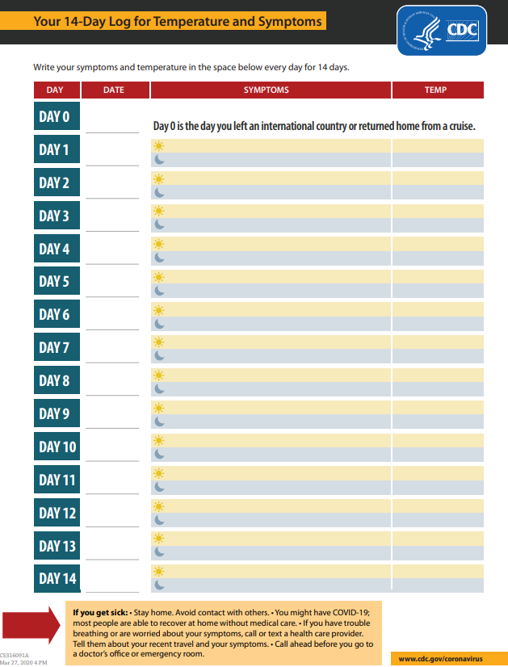
Risk assessment and movement restrictions of travellers
Risk assessment of who is most likely to introduce or spread the disease
Traveller arriving from or recent travel to a country with widespread transmission
Traveller from a country with community transmission
Considerations for restricting movement into or out of country
Considerations for restricting movement of travellers to facilitate surveillance once admitted into the country
Stay home for 14 days after arrival and maintain a distance of 1m from others
Self-monitor for symptoms (check temperature twice daily, watch for cough, shortness of breath, and other symptoms of COVID-19)
Avoid contact with people at higher risk for severe infection
Temperature log used by CDC

Slide 28
Summary
Screening can reduce the international spread of communicable diseases - one of many tools
Limitations exist for detecting COVID-19 cases through POE screening
Screening provides an opportunity to educate travellers
Designing the best use of border health resources involves many considerations
Border health strategies are one of many tools that can complement other measures (e.g., epidemiology, community mitigation)

Slide 29
Contact information
Presentation created by the Global Border Health Team, Centers for Disease Control and Prevention, April 2020
Point of Contact: Sadie Ward- seward1@cdc.gov
The findings and conclusions in this presentation are those of the author(s) and do not necessarily represent the views of the Centers for Disease Control and Prevention.

