Slide 1
COVID-19 Surveillance Seminar
Mortality Surveillance for COVID-19
Erin Nichols, CDC/National Center for Health Statistics (NCHS)
Emily Cercone, NCHS / CDC Foundation
Stanley Kamocha, CDC Zambia

Slide 2
Outline
Objectives, goals and indicators of mortality surveillance
How mortality surveillance systems can meet objectives
  Short term activities: rapid mortality surveillance
  Long term activities: system strengthening and integration
Considerations and processes for mortality surveillance during the COVID-19 pandemic
Mortality surveillance in Zambia

Slide 3
Objectives, Goals and Indicators for Mortality Surveillance
Erin Nichols
International Task Force, Epidemiology Team
Global Civil Registration and Vital Statistics Team
National Center for Health Statistics
igd1@cdc.gov

Slide 4
Objective of Mortality Surveillance (for COVID-19)
Identify:
  mortality patterns
  deaths attributable to disease
Estimate:
  case fatality proportions
  risk factors associated with mortality
https://www.who.int/publications-detail/surveillance-strategies-for-covid-19-human-infection
Notes:
Broadly speaking, the objective of mortality surveillance is to identify mortality patterns and deaths attributable to disease and to estimate case fatality proportions and risk factors associated with mortality. But the way that mortality surveillance is designed and applied depends on the country’s specific needs. Specifically for mortality surveillance in the context of COVID-19, we note the general objectives offered in the WHO document on surveillance strategies for COVID-19 human infection.

Slide 5
Objectives of COVID-19 surveillance
(WHO Surveillance Strategies for COVID-19 infection)
Enable rapid detection, isolation, testing, and management of suspected cases
Identify and follow up contacts
Guide the implementation of control measures
# deaths in confirmed cases (case fatality rate)
Detect and contain outbreaks among vulnerable populations
Evaluate the impact of the pandemic on health-care systems and society
Monitor longer term epidemiologic trends and evolution of COVID-19 virus
Understand the co-circulation of COVID-19 virus, influenza and other respiratory viruses
Notes:
The COVID-19 surveillance objectives are listed on this slide. One of the short term or immediate needs of COVID-19 surveillance is to characterize the outbreak to guide control measures and limit spread of disease. One of the key measurements to target control measures is the # of deaths in confirmed cases (or the case fatality rate), which is also one of the weekly reporting indicators to WHO.

Slide 6
Objectives of COVID-19 surveillance
(WHO Surveillance Strategies for COVID-19 infection)
enable rapid detection, isolation, testing, and management of suspected cases
identify and follow up contacts
guide the implementation of control measures
# deaths in confirmed cases (case fatality rate)
detect and contain outbreaks among vulnerable populations
evaluate the impact of the pandemic on health-care systems and society
estimate of excess all-cause mortality (the degree to which currently measured mortality exceeds historically established level)
monitor longer term epidemiologic trends and evolution of COVID-19 virus
understand the co-circulation of COVID-19 virus, influenza and other respiratory viruses
Notes:
As the epidemic progresses, you want to evaluate the impact of the pandemic on health care systems and society, which can be evaluated by various direct and indirect measures including excess death, which may show health system strain or food insecurity.

Slide 7
Monitor longer term epidemiologic trends and evolution of COVID-19 virus
Changes in deaths (by region, age, sex, and race)
# deaths in confirmed cases (case fatality rate (CFR))
# confirmed COVID-19 deaths among hospitalized cases (hCFR (%))
# deaths of COVID-like illness (pneumonia, influenza-like illness (ILI), severe acute respiratory illness (SARI))
Estimate of excess all-cause mortality
Changes in risk factors or co-morbidities (by region, age, sex)
% deaths among confirmed cases with risk factors (by underlying conditions or co-morbidity)
Notes:
In monitoring the long term epidemiologic trends and evolution of the COVID-19 virus, patterns of deaths can indicate levels of severity and co-morbidities associated with severe disease and mortality. Listed here are multiple mortality indicators that examine changes in deaths by various aggregators, as they relate to severe disease outcome. To note, the first two indicators would require testing to confirm COVID-19 status, but such testing or even cause of death is not necessarily required for the others.

Slide 8
Indicators available from mortality surveillance
Daily/weekly and cumulative reporting of total deaths:
(note: deaths need to be reported by date/week of occurrence, accounting for any delayed reporting)
by age/age group and sex
by geographic catchment area (by place of usual residence and/or occurrence)
by type of place of occurrence (e.g., hospital, home, etc.)
by ethnic group or minority status
by manner and/or cause, where available
# deaths due to:
  COVID-19, where virus is identified (based on case-based # deaths due to COVID-19 surveillance)
  COVID-19, based upon clinical/ epi. evidence, without virus identification (probable and suspected cases)
  COVID-like illnesses (pneumonia, ILI/SARI, and others)
# deaths in confirmed cases (CFR)
% deaths due to COVID-19 (confirmed and not confirmed)
cause specific mortality fractions across various causes
estimate of excess deaths, % excess deaths
Notes:
Summarized here are various indicators available from mortality surveillance. You can decide which are most appropriate, taking into consideration country specific needs for mortality surveillance as well as available resources and systems to work from. With these indicators, you can look at total mortality on a daily or weekly basis– among various populations; get an estimate of COVID-19 attributable mortality; or estimate excess mortality among select sites or areas in the country. These can be used to monitor impact of COVID-19 on mortality; determine potential underestimation, particularly where testing is lacking; or identify potential new transmission areas.

Slide 9
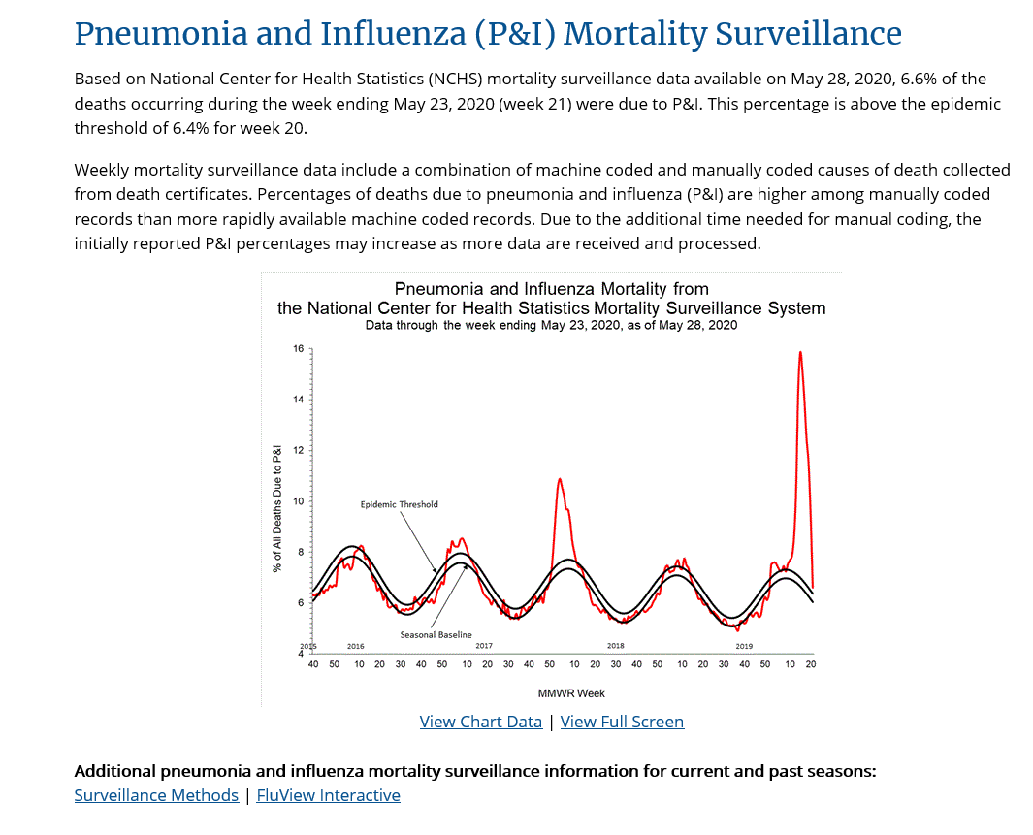
https://www.cdc.gov/flu/weekly/index.htm
Notes:
There are many approaches to mortality surveillance, involving all-cause and cause-specific mortality systems in the health sector, as well as civil registration systems and medicolegal death investigation systems. In the ideal case, countries have a digitized, unified, real time death notification and registration system with high levels of coverage and completeness that captures all deaths from all causes in all settings, including hospitals; care facilities; homes; or prisons– and this death information can, therefore, be used to generate all necessary mortality data promptly.
Here is an example of a visualization from CDC’s pneumonia and influenza mortality surveillance program, showing the percentage of all deaths due to pneumonia and influenza on a weekly basis. As noted with the yellow lines, this information is based on causes of death from death certificates compiled by the National Center for Health Statistics as part of their vital statistics program.

Slide 10
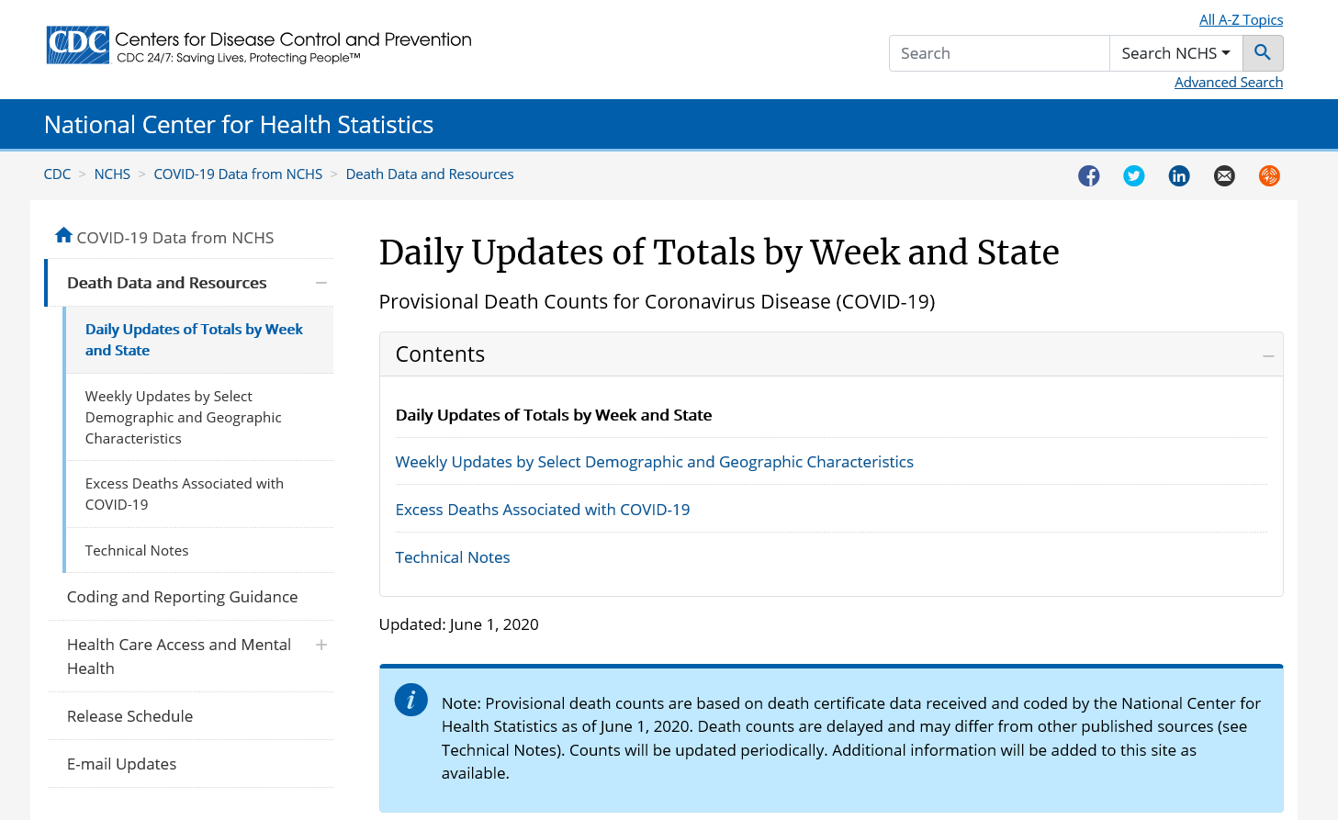
https://www.cdc.gov/nchs/nvss/vsrr/covid19/index.htm
Notes:
In these systems, for surveillance purposes, we introduce the concept of rapid mortality surveillance for COVID-19. Where you have death certificate data, the focus of rapid mortality surveillance is on encouraging frequent, regular reporting, like weekly or daily updates, as shown by the National Center for Health Statistic’s Daily Updates of death count totals by week and state. To note, as explained in the blue box, these numbers will generally be considered provisional, as it takes time for death certificates to be nationally compiled, coded, verified, and tabulated. With this,

Slide 11
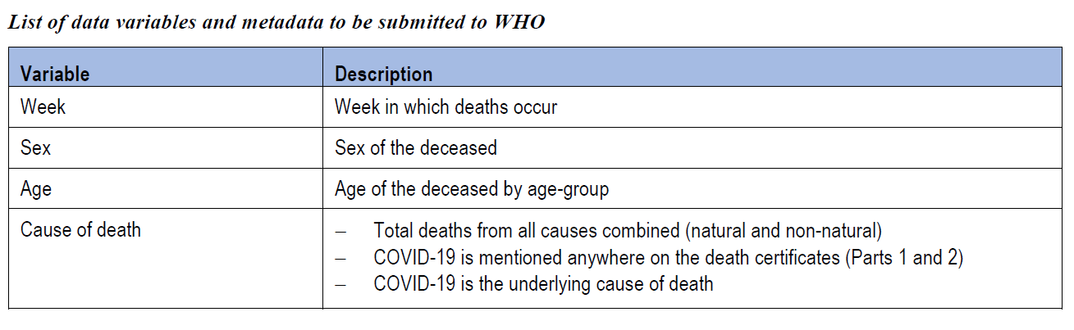
WHO Request to Member States to submit weekly mortality data related to COVID-19 in the context of the public health emergency
https://www.who.int/publications/i/item/WHO-2019-nCoV-mortality-reporting-2020-1
Notes:
At the global level, WHO has just issued a request to Member States to submit weekly mortality data related to COVID-19 in the context of the public health emergency. The Data for Delivery and Impact Division at WHO, who maintains WHO’s general mortality database, has issued a technical note on medical certification, ICD mortality coding, and reporting mortality. They are establishing a portal for authorized users to submit weekly mortality data from death certificates – authorized users are usually the government agency responsible for submitting the national official statistics, in this case the annual mortality data to WHO. This submission is targeted for data from death certificates.

Slide 12
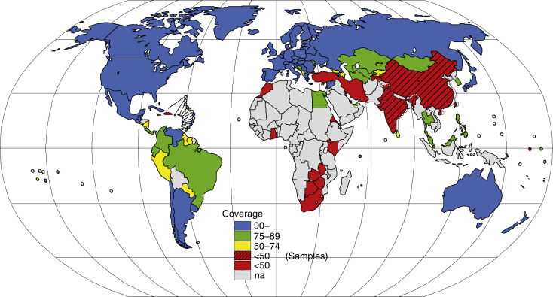
Registration of causes of death mortality (since 1995) with cause of death available to WHO
Source: Jakob, R., Disease Classification, in International Encyclopedia of Public Health. 2nd Edition, S.R. Quah, Editor. 2017, Elsevier
Notes:
But the reality is that globally, 2/3 of deaths go unreported without a cause of death each year, and in many low- and middle-income countries, the coverage and completeness of civil registration of deaths is often below 20%. Hospitals, as the main source of cause-of-death data, are frequently not integrated into the civil registration system, and many systems are only partially digitized– and this leads to significant lag times in reporting. Furthermore, not all countries use the international standard form of the medical certificate of cause of death and hence are unable to apply the International Classification of Diseases (ICD) rules of mortality coding. This makes it difficult to statistically analyze cause-of-death data over time and to compare between jurisdictions—even where deaths are carefully certified.
For mortality surveillance in such areas, we need to consider alternative sources of data beyond the death certificates and ways to improve data flow and timeliness where data exist.

Slide 13
Rapid Mortality Surveillance
To inform decision-makers about the scale and direction of an epidemic with a focus on excess mortality
Provides insights into:
  health consequences of the epidemic
  disparities in disease burden across geographic and demographic groups
  ongoing population transmission patterns and trends in community transmission
  gaps in the performance of surveillance systems
  the impact of public health and social measures
  the indirect impact of an epidemic (e.g., due to societal and health care system disruptions)
https://www.who.int/publications/i/item/revealing-the-toll-of-covid-19
Notes:
A rapid mortality surveillance approach has been introduced that, in the absence of quality death certificate data, focuses on measuring total, all-cause mortality, to estimate excess mortality. Such an approach has been described in a recently released technical package that is now available on the WHO website. The goal is to provide decision makers with information about the scale and direction of an epidemic with a focus on excess mortality measurement which can provide insight into multiple elements of an epidemic, as listed on the slide here.

Slide 14
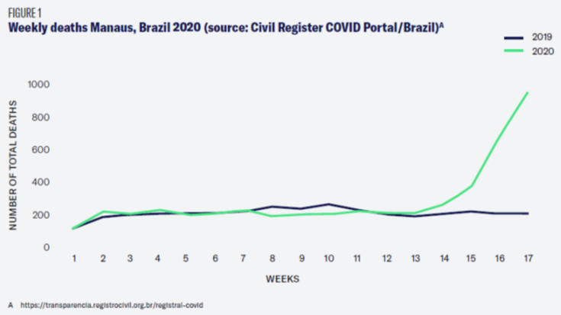
Rapid Mortality Surveillance
To generate the data needed to analyze excess mortality by age and sex on a weekly basis
Core information for reporting where death certificates are not available
  Age – decedent’s age at death
  Sex
  Place of usual residence – geographic location where the deceased usually resided
  Date of occurrence – the date (day, month, and year) the death occurred
  Site of occurrence – e.g., health facility, at home, or elsewhere
Notes:
A key aim for rapid mortality surveillance for low resource settings is to generate a visualization of mortality trends or excess mortality as demonstrated in the figure here from Manaus, Brazil, showing weekly death counts with 2019 counts in blue and 2020 counts in green. This kind of visualization requires both a source of rapidly and routinely reported deaths by age, sex and location; and some means to establish a baseline of pre-epidemic mortality levels by age and sex against which to compare the current reports. Listed in the right column are core indicators recommended to collect for each death. To note, cause of death is not needed for measurement of excess mortality.

Slide 15
Considerations and Processes for Mortality Surveillance during the COVID-19 Pandemic
Emily Cercone
Technical Advisor
CDC Foundation, Data for Health Initiative
ecercone@cdc.gov

Slide 16





Rapid Mortality Surveillance (RMS)
Daily or Weekly Transmission (of patient-level or aggregated information)
Facility-based reporting
Sentinel (or universal)
All deaths by:
  age,
  sex,
  place of death,
  place of residence,
  day/week of death,
  identifier
Manner or cause of death
if feasible
Community-based reporting
Sentinel (or universal)
All deaths by:
  age,
  sex,
  place of death,
  place of residence,
  day/week of death,
  identifier
Manner or cause of death
if feasible
Compilation, quality assurance, analysis
Decision-making
Notes:
This is a visual to represent the structure of a rapid mortality surveillance system.
The idea is to collect the most basic information about all deaths, and transmit this on a daily or weekly basis, for analysis and decision-making.
However, there is a lot to consider when adopting this model.
Given the different contexts that countries may be working with, we’ll discuss how to operationalize rapid mortality surveillance, while also considering other mortality surveillance considerations and long-term system strengthening.

Slide 17
Country process for mortality surveillance during COVID-19 pandemic
Define country objectives
  Confirm country government buy-in
  Engage other partners and stakeholders
  Identify desired core indicators
    COVID-19 specific or all-cause/total mortality?
    Facility-based data, community-based, or both?
    How many sites/facilities/cities/districts?
    High-risk populations?
Differentiate between short-term and long-term goals
  Short-term: e.g. COVID-19-specific mortality, total/excess mortality
  Long-term: e.g. unified mortality surveillance systems
Notes:
First, countries need to engage partners and stakeholders, establish buy-in within the government and key leaders, and work together to define their objectives.
(Given each country’s unique COVID-19 epidemic, consider whether the priority is to identify deaths with undiagnosed COVID-19 infection or to measure potential increases in total mortality due to direct or indirect consequences of the pandemic (such as reduced health-seeking practices, interrupted health services, or reduced household income).)
Countries can determine the feasibility of looking at both facility-based and community-based data. They can prioritize sites or populations as needed. Countries can start small – working with a few key facilities or high-risk communities.
It is also important to differentiate between short-term and long-term objectives, understanding what’s feasible and appropriate for immediate implementation during the current crisis, and what can be done afterwards to put systems in place for long-term needs.

Slide 18
Country process for mortality surveillance during COVID-19 pandemic
Assess the existing mortality information landscape (and pandemic-specific systems)
  Where is data available across the health system and partner efforts?
  Assess data coverage, completeness, quality, etc.
  Where is baseline data available?
Identify opportunities to adapt and strengthen existing systems
  Where can simple modifications of existing systems lead to rapid data
  Where may existing electronic systems be leveraged?
Consider implementation requirements/feasibility
  What human, financial, and technical resources will be required?
  Assess whether any proposals will require additional protective measures for surveillance workers, e.g. PPE?
Notes:
The next step includes assessing the existing mortality information landscape – where is data available across the health system? Which systems are producing reliable, valid data? Where is baseline data available – while not necessary, it is helpful.
Where can simple modifications of existing systems lead to rapid data availability? And are there existing electronic systems that can easily be leveraged?
What is feasible, given the human, financial, and technical resources required, including PPE and other protection for surveillance workers.

Slide 19
HMIS/DHIS2
Total Inpatient Deaths
Integrated Disease Surveillance and Response
(IDSR)
Malaria deaths
Countrywide Mortality Surveillance for Action (COMSA)
Maternal and Perinatal Death Surveillance and Response (MPDSR)
Total Population Deaths
TB deaths
HIV mortality surveillance systems
Civil Registration and
Vital Statistics (CRVS)
Health and Demographic Surveillance Systems (HDSS)
Child Health and Mortality Prevention Surveillance Network (CHAMPS)
Influenza deaths
NCD deaths
Village Health Registers
Notes:
Where to begin?
Shown here is a probable starting point – a complex landscape of systems that collect death information – they may be disease-specific, population-specific, location-specific, etc.; they may involve various degrees of digitization.
Many countries have an abundance of mortality data, but no single comprehensive, reliable source.

Slide 20
Deaths among known COVID-19 Cases
Deaths among those with COVID-19-like illnesses
Total Population Deaths
Systems collecting deaths from all causes
Deaths among those without COVID-19-like illnesses
Deaths missed from cause-specific systems
Notes:
For the purpose of today’s presentation, I will look at these systems by the types of deaths they collect, relative to the COVID-19 pandemic.
- Systems may capture deaths among those WITH or WITHOUT COVID-19-like illnesses.
- The COVID-19 case-reporting system captures deaths among known COVID-19 cases,
- and some systems collect all-cause mortality.
Each of these systems can be leveraged for mortality surveillance during this pandemic.

Slide 21
Deaths among known COVID-19 Cases
Active case-finding
ILI/SARI surveillance
AFI surveillance
Case-report
Outcome = death
Total Population Deaths
Notes:
The pie chart represents all deaths in a population, within a given time. The distribution shown is hypothetical. However, most likely, the smallest percentage – that black portion at the top – represents deaths among known COVID-19 cases. These deaths, ideally, are being captured through the case-reporting system, which is identifying cases through active case-finding and leveraging other surveillance platforms…

Slide 22
Deaths among known COVID-19 Cases
Active case-finding
ILI/SARI surveillance
AFI surveillance
Case-report
Outcome = death
Opportunity:
Improve outcome/death reporting among known COVID-19 cases
Total Population Deaths
Notes:
We also have heard from WHO HQ that they are receiving outcome information on only about 1/3 of known cases, suggesting there’s a sizeable gap in tracing and reporting these outcomes and potential deaths.
There is an opportunity to strengthen the reporting of outcomes, including death, among known COVID-19 cases.

Slide 23
Deaths among known COVID-19 Cases
Active case-finding
ILI/SARI surveillance
AFI surveillance
Deaths among those with COVID-19-like illnesses
ILI/SARI/AFI
Malaria mortality
TB mortality
Dengue mortality
IDSR/Notifiable diseases (e.g. pertussis, etc.)
Etc., country-specific
Case-report
Outcome = death
Total Population Deaths
Notes:
The next section of the pie chart represents deaths among those with COVID-19-like illnesses. This may include malaria, TB, and dengue, in addition to ILI/SARI, AFI, and others. These systems warrant additional attention during this pandemic…

Slide 24
Deaths among known COVID-19 Cases
Active case-finding
ILI/SARI surveillance
AFI surveillance
Deaths among those with COVID-19-like illnesses
ILI/SARI/AFI
Malaria mortality
TB mortality
Dengue mortality
IDSR/Notifiable diseases (e.g. pertussis, etc.)
Etc., country-specific
Case-report
Outcome = death
Opportunities:
Rapid Mortality Surveillance: include all-cause mortality in reporting system
Look at changes in numbers of cause-specific deaths
Screen deaths for COVID-19
Consider co-morbidities
Total Population Deaths
Notes:
There may be opportunities to modify the systems that capture these deaths to include measures of total mortality, following the rapid mortality surveillance concept.
Alternatively, a country may want to observe cause-specific deaths, e.g. pneumonia or malaria, to monitor trends that may show direct or indirect impacts of the COVID-19 pandemic.
Additionally, these deaths could be screened or tested for potential COVID-19 infection, in cases of misdiagnosis or co-morbidity.

Slide 25
Deaths among known COVID-19 Cases
Active case-finding
ILI/SARI surveillance
AFI surveillance
Deaths among those with COVID-19-like illnesses
ILI/SARI/AFI
Malaria mortality
TB mortality
Dengue mortality
IDSR/Notifiable diseases (e.g. pertussis, etc.)
Etc., country-specific
Case-report
Outcome = death
Total Population Deaths
Deaths among those without COVID-19-like illnesses
HIV mortality
Maternal mortality/MPDSR
IMCI or ETAT** (Emergency Triage Assessment and Treatment)
NCD mortality
EPI-related mortality (e.g. measles)
Oncology mortality
External causes (accidents, homicide, suicide)
Etc., country-specific
Notes:
The largest portion, though hypothetical and highly context-specific, represents deaths that are captured through other cause-specific systems that are more easily differentiated from COVID-19, such as those from HIV, NCDs, or maternal causes…

Slide 26
Deaths among known COVID-19 Cases
Active case-finding
ILI/SARI surveillance
AFI surveillance
Deaths among those with COVID-19-like illnesses
ILI/SARI/AFI
Malaria mortality
TB mortality
Dengue mortality
IDSR/Notifiable diseases (e.g. pertussis, etc.)
Etc., country-specific
Case-report
Outcome = death
Opportunities:
Rapid Mortality Surveillance: include all-cause mortality to reporting system
Look at changes in numbers of cause-specific deaths
Total Population Deaths
Deaths among those without COVID-19-like illnesses
HIV mortality
Maternal mortality/MPDSR
IMCI or ETAT** (Emergency Triage Assessment and Treatment)
NCD mortality
EPI-related mortality (e.g. measles)
Oncology mortality
External causes (accidents, homicide, suicide)
Etc., country-specific
Notes:
These systems, particularly HIV information systems, may be among the strongest health information systems in a country that can be immediately leveraged for rapid mortality surveillance.
This could involve adding total mortality variables to otherwise HIV-specific platforms, or observing deaths from these causes to monitor potential increases that may be directly or indirectly related to the COVID-19 pandemic, including co-morbidities.

Slide 27
Deaths among known COVID-19 Cases
Active case-finding
ILI/SARI surveillance
AFI surveillance
Deaths among those with COVID-19-like illnesses
ILI/SARI/AFI
Malaria mortality
TB mortality
Dengue mortality
IDSR/Notifiable diseases (e.g. pertussis, etc.)
Etc., country-specific
Case-report
Outcome = death
Total Population Deaths
Deaths among those without COVID-19-like illnesses
HIV mortality
Maternal mortality/MPDSR
IMCI or ETAT** (Emergency Triage Assessment and Treatment)
NCD mortality
EPI-related mortality (e.g. measles)
Oncology mortality
External causes (accidents, homicide, suicide)
Etc., country-specific
Deaths missed from cause-specific systems
Notes:
The last section shows deaths that are missed from cause-specific systems. This highlights the need for comprehensive, all-cause, mortality systems.

Slide 28
Deaths among known COVID-19 Cases
Active case-finding
ILI/SARI surveillance
AFI surveillance
Deaths among those with COVID-19-like illnesses
ILI/SARI/AFI
Malaria mortality
TB mortality
Dengue mortality
IDSR/Notifiable diseases (e.g. pertussis, etc.)
Etc., country-specific
Case-report
Outcome = death
Systems collecting deaths from all causes
Civil registration death report/notification forms in facilities and communities, including sample-based registration
Total inpatient deaths in facilities/mortality registers in facilities/EMR systems
Village/community health registers in communities
Mortuary surveillance
Health and Demographic Surveillance Systems (HDSS)
COMSA, CHAMPS, etc.
Total Population Deaths
Deaths among those without COVID-19-like illnesses
HIV mortality
Maternal mortality/MPDSR
IMCI or ETAT** (Emergency Triage Assessment and Treatment)
NCD mortality
EPI-related mortality (e.g. measles)
Oncology mortality
External causes (accidents, homicide, suicide)
Etc., country-specific
Deaths missed from cause-specific systems
Notes:
This bottom right corner – which points to the dotted square encompassing the entire set of deaths – lists such all-cause systems.
This includes civil registration systems, total inpatient death counts in facilities, village health registers in communities, mortuary-based surveillance systems, and health and demographic surveillance systems where available. It also includes systems such as COMSA, Countrywide Mortality Surveillance for Action, which establishes nationally-representative systems to capture vital events as well as encouraging the legal registration of these events…

Slide 29
Deaths among known COVID-19 Cases
Active case-finding
ILI/SARI surveillance
AFI surveillance
Case-report
Outcome = death
Opportunities:
Easily leveraged for all-cause RMS – focus on obtaining data faster (daily or weekly)
Screen deaths for COVID-19
Systems collecting deaths from all causes
Civil registration death report/notification forms in facilities and communities, including sample-based registration
Total inpatient deaths in facilities/mortality registers in facilities/EMR systems
Village/community health registers in communities
Mortuary surveillance
Health and Demographic Surveillance Systems (HDSS)
COMSA, CHAMPS, etc.
Total Population Deaths
Deaths among those without COVID-19-like illnesses
HIV mortality
Maternal mortality/MPDSR
IMCI or ETAT** (Emergency Triage Assessment and Treatment)
NCD mortality
EPI-related mortality (e.g. measles)
Oncology mortality
External causes (accidents, homicide, suicide)
Etc., country-specific
Deaths missed from cause-specific systems
Notes:
…There may be limitations in coverage or completeness, however these systems are likely the most easily leveraged for all-cause rapid mortality surveillance.
Focus on obtaining this data faster, on a daily or weekly basis.

Slide 30

Deaths among known COVID-19 Cases
Active case-finding
ILI/SARI surveillance
AFI surveillance
Deaths among those with COVID-19-like illnesses
ILI/SARI/AFI
Malaria mortality
TB mortality
Dengue mortality
IDSR/Notifiable diseases (e.g. pertussis, etc.)
Etc., country-specific
Case-report
Outcome = death
Systems collecting deaths from all causes
Civil registration death report/notification forms in facilities and communities, including sample-based registration
Total inpatient deaths in facilities/mortality registers in facilities/EMR systems
Village/community health registers in communities
Mortuary surveillance
Health and Demographic Surveillance Systems (HDSS)
COMSA, CHAMPS, etc.
Total Population Deaths
Deaths among those without COVID-19-like illnesses
HIV mortality
Maternal mortality/MPDSR
IMCI or ETAT** (Emergency Triage Assessment and Treatment)
NCD mortality
EPI-related mortality (e.g. measles)
Oncology mortality
External causes (accidents, homicide, suicide)
Etc., country-specific
Deaths missed from cause-specific systems
Notes:
Countries will need to assess their own mortality data landscape, particularly if they lack a single, comprehensive, reliable mortality system.
Civil registration focuses on the necessity for continuous mortality data – we aim to know, comprehensively, how many people are dying? Who are these people? Where are these people? and, if possible, what is causing these deaths?
This pandemic has underscored the need for harmonized and timely mortality surveillance systems.
After assessing the mortality information landscape, consider where you can make the easiest modifications to get the fastest data available to meet the country’s objectives.
If you have any systems currently collecting routine and reliable mortality data, do not delay in monitoring weekly death counts from those sources.

Slide 31
Rapid Mortality Surveillance (RMS)
Daily or Weekly Transmission (of patient-level or aggregated information)
Facility-based reporting
Sentinel (or universal)
All deaths by:
  age,
  sex,
  place of death,
  place of residence,
  day/week of death,
  identifier
Manner or cause of death
if feasible
Community-based reporting
Sentinel (or universal)
All deaths by:
  age,
  sex,
  place of death,
  place of residence,
  day/week of death,
  identifier
Manner or cause of death
if feasible
Compilation, quality assurance, analysis
Decision-making
Notes:
This is a visual to represent the structure of a rapid mortality surveillance system.
The idea is to collect the most basic information about all deaths, and transmit this on a daily or weekly basis, for analysis and decision-making.
However, there is a lot to consider when adopting this model.
Given the different contexts that countries may be working with, we’ll discuss how to operationalize rapid mortality surveillance, while also considering other mortality surveillance considerations and long-term system strengthening.

Slide 32
Examples: Leveraging systems for Rapid Mortality Surveillance (RMS)
Civil Registration and Vital Statistics (CRVS) systems (facility and community deaths)
  South Africa*, USA, EuroMOMO:
  CRVS → Weekly reports (“provisional death counts”)
HMIS – total inpatient deaths (facility deaths)
  HMIS/DHIS2 → Daily updates from interactive USSD** system generated specifically to obtain general health facility information (e.g. supplies, bed capacity, etc.) for COVID-19
*Reference: https://www.samrc.ac.za/reports/report-weekly-deaths-south-africa?bc=254
**Unstructured Supplementary Service Data
FACT OF DEATH
Age ● Sex ● Date of Death ● Place of Residence ● Place of Death ● Identifier
Notes:
Examples of how various systems have been leveraged during this pandemic for all-cause rapid mortality surveillance.
Many countries are leveraging their death registration systems for RMS. South Africa, the United States, the EuroMOMO reports, and many more, provide strong examples of this.
For South Africa, in the context of the emerging COVID-19 pandemic, they felt it was essential to track deaths on a weekly basis. Deaths that are reported through the death registration process are now also weekly reported to the Medical Research Council. These deaths are being transmitted in near real-time, prior to official registration, given the need for rapid surveillance data. In this situation, the US and other governments have called these “provisional” death counts.
Another example is a country that has proposed setting up an interactive USSD system to obtain daily and weekly information from key health facilities on PPE supplies, bed capacity, and other essential data. We have encouraged them to at least collect total deaths, on a weekly basis, from these facilities – essentially following the same processes that are typically used to report monthly information on “total inpatient” deaths, but broken down into weekly updates. These weekly counts can easily be collated for entry into their DHIS2 system at the end of each month.

Slide 33
Examples: Leveraging systems for Rapid Mortality Surveillance (RMS), cont.
Mortuary surveillance (facility and community)
  Zambia: routine mortuary-based death reporting → weekly death counts to MOH
Integrated Disease Surveillance and Response (IDSR) (facility/community)
  Rwanda: eIDSR → proposed to include all-cause deaths
COVID-19 EOC Alert Center (facility and community)
  Kenya: EOC system → proposed to report all deaths in select priority counties
FACT OF DEATH
Age ● Sex ● Date of Death ● Place of Residence ● Place of Death ● Identifier
Notes:
In Zambia, they are undertaking mortuary surveillance, reporting total death counts on a weekly basis to the Ministry of Health.
In Rwanda, there are preliminary discussions about adding all-cause deaths to their eIDSR platform. While some countries implementing IDSR do report deaths among notifiable conditions, this would be a new approach, from what we know, to report all deaths through the IDSR system.
In Kenya, the country has proposed leveraging their existing COVID-19 EOC Alert system, where potential COVID-19 deaths are reported through a Call Center. They have proposed reporting all community and facility deaths through this hotline, creating a line-list of deaths with key variables, as recommended by the rapid mortality surveillance guidance. They will also follow up with COVID-19 specific screening.

Slide 34
Levels of Manner and Cause of Death (COD) Investigation – where feasible
Manner of death (natural/unnatural)
COD Level 1: Short screening for potential COVID-19 infection
COD Level 2: Medically certified cause of death with correct ICD coding
COD Level 3: Medical autopsy (postmortem COVID-19 testing or full autopsy)
COD Level 4: Verbal autopsy
Notes:
With basic fact-of-death information alone, countries can observe trends and watch for unexpected increases in mortality, or excess mortality compared to historical trends. However, there may be many settings that can leverage existing means for COD ascertainment, or where identifying COD is preferred.

Slide 35
Levels of Manner and Cause of Death (COD) Investigation – where feasible
Manner of death (natural/unnatural)
COD Level 1: Short screening for potential COVID-19 infection
COD Level 2: Medically certified cause of death with correct ICD coding
COD Level 3: Medical autopsy (postmortem COVID-19 testing or full autopsy)
COD Level 4: Verbal autopsy
Notes:
…The manner of death simply refers to whether a death was a natural or unnatural death. Unnatural deaths occur from external causes, such as accidents, homicides, suicides, or medical malpractice. This can be ascertained by asking a simple question, such as, “in the two weeks before death, did the deceased suffer an injury or accident that led to death?”
In the context of COVID-19, some countries, such as South Africa, have reported decreases in unnatural deaths, and others, such as Kenya, have reported increases in unnatural deaths. It is therefore important, when possible, to disaggregate by manner of death, so that the effect of the pandemic on natural deaths can be differentiated from its effect on unnatural deaths.

Slide 36
COD Level 1: Screening questions to determine deaths due to suspected COVID-19, other natural, and non-natural causes
www.interval.net/crms
Notes:
COD Level 1 is a short screening question that has been developed by the WHO Verbal Autopsy Reference Group. Shown is the entire set of questions. This set of questions screens for manner of death as well as asks about the most common symptoms associated with COVID-19.
This is described in more detail in the official RMS guidance. There is also a website with further information, including ready-made software for data entry and analysis, and user guide. www.interval.net/crms

Slide 37
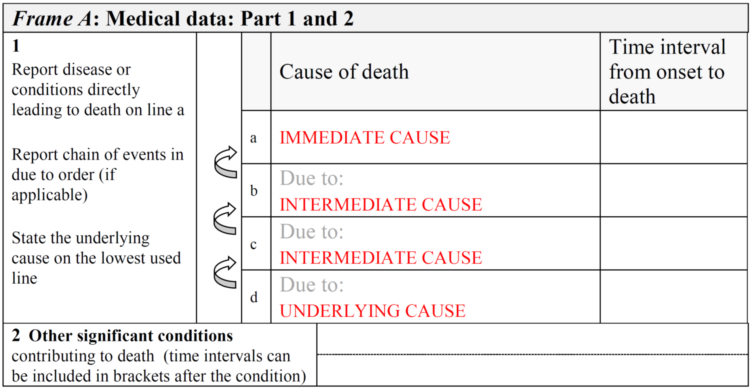
COD Level 2: Medical Certification of Death and COD (MCCD)
WHO’s guidance on Medical certification, ICD mortality coding, and reporting mortality associated with COVID-19 https://www.who.int/publications/i/item/WHO-2019-nCoV-mortality-reporting-2020-1
  Provides guidance for medical certification for all countries using WHO’s standard international medical certificate of cause of death
  Provides emergency use ICD mortality codes for COVID-19
    U07.1: COVID-19, virus identified
    U07.2: Probable or suspected COVID-19, virus not identified
CDC/NCHS’s Guidance for Certifying Deaths Due to COVID-19 https://www.cdc.gov/nchs/data/nvss/vsrg/vsrg03-508.pdf
Notes:
Where health facilities can provide quality medical certification of cause of death (MCCD), it is possible to produce a weekly listing of “provisional” death counts that include certain causes (e.g. COVID-19), and to monitor trends accordingly.
WHO is encouraging weekly compilation and reporting of total mortality from death certificates, indicating the number that include “any mention of COVID-19”, through its data web portal.
WHO has also provided specific COVID-19 guidance on medical certification and ICD coding, including the introduction of two new ICD codes.
Medical certification ultimately allows for the differentiation between a “death with COVID-19” as identified through basic case-reporting and a “death due to COVID-19”
It also allows investigation into co-morbidities, as any condition contributing to the death can be accounted for within the medical certificate.
There are full webinars on this topic.
WHO has provided codes applicable to both ICD-10 (online browser: https://icd.who.int/browse10/2019/en#/U07.1) and ICD-11 (online browser: https://icd.who.int/browse11/l-m/en)

Slide 38
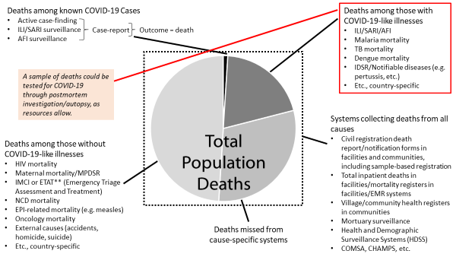
COD Level 3: Medico-legal Death Investigation (MLDI) Systems
Postmortem COVID-19 testing or full autopsy – COVID-19 specific guidance available for both
Could be applied to probable or suspected cases, or among high-risk populations
Notes:
Postmortem testing could be applied to probable or suspected cases identified through the screening question, medical certification, or verbal autopsy. It could be applied to mortuary surveillance or among individuals believed to have died from influenza, malaria, TB, dengue, or other COVID-19-like symptoms – that were not previously tested for COVID-19 - to identify potential COVID-19 infections or co-infections.
There are number of COVID-19-specific resources available to guide postmortem testing and autopsies of COVID-19 infected patients.

Slide 39
COD Level 4: Verbal Autopsy
Verbal autopsy (VA) determined cause of death for community deaths, where no medical certification of cause of death or postmortem examination is possible
WHO VA Reference Group has introduced COVID-19-specific guidelines and added questions to the current VA questionnaire
VA is a significant undertaking, but can be conducted at a later time
As with any of methods for ascertaining COD, these should not delay the provision of weekly reports of total mortality based upon fact-of-death
Notes:
Verbal autopsy can be used to determine the percentage of community deaths that are likely due to COVID-19, for deaths occurring where no medical certification of cause of death or postmortem examination is possible.
Verbal autopsy is a significant undertaking, and implementation challenges should not be understated, particularly in the context of a pandemic. But, verbal autopsies could be conducted at a later time, without delaying the provision of more readily-available mortality data.

Slide 40
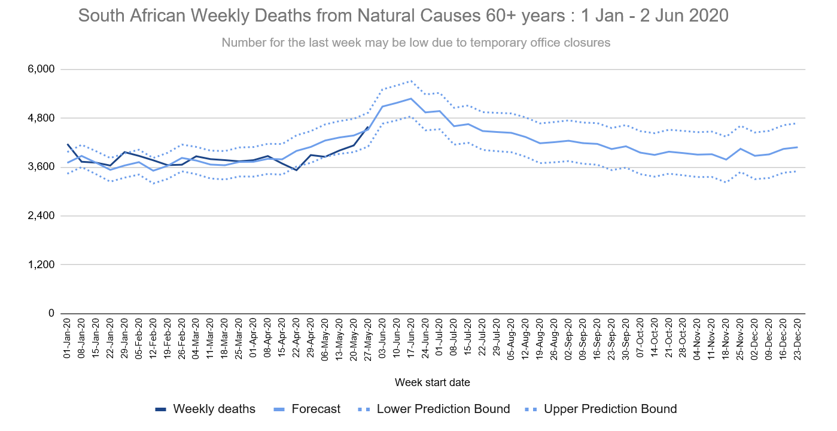
Data Analysis and Use: South Africa
https://www.samrc.ac.za/reports/report-weekly-deaths-south-africa?bc=254
Notes:
We will share resources related to data analysis at the end of the presentation, but here are examples of output.
South Africa example shows the number of total deaths by week, compared to forecasted deaths, including lower and upper prediction bounds, based upon historical data.
This specific table focuses on natural deaths only, among those 60 and above.

Slide 41
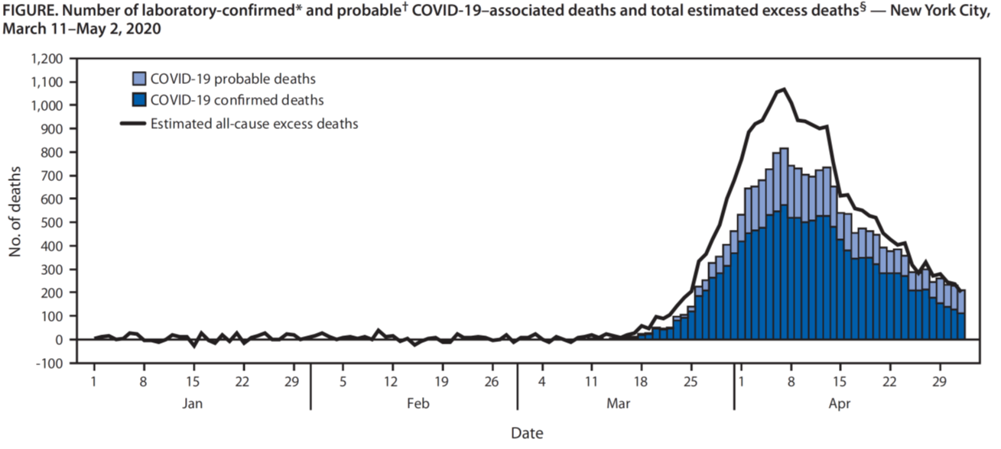
Data Use: New York City
https://www.cdc.gov/mmwr/volumes/69/wr/mm6919e5.htm#F1_up
Notes:
Between March 11 and May 2, NYC estimated that roughly 75% of observed deaths were excess deaths.
The dark blue represents 13,831 laboratory-confirmed COVID-19-associated deaths. The light blue shows 5,048 probable COVID-19-associated deaths.
And the white section represents an estimated 5,293 excess deaths (22% of all excess deaths) – that were not associated with COVID-19, though ultimately may have been directly or indirectly attributable to the pandemic.
This underscores the importance of measuring all-cause mortality in understanding the impact of this pandemic, particularly given global challenges of interrupted health services, reduced health-seeking practices, reduced household income, and other stressors.

Slide 42
Deaths among known COVID-19 Cases
Active case-finding
ILI/SARI surveillance
AFI surveillance
Deaths among those with COVID-19-like illnesses
ILI/SARI/AFI
Malaria mortality
TB mortality
Dengue mortality
IDSR/Notifiable diseases (e.g. pertussis, etc.)
Etc., country-specific
Case-report
Outcome = death
Deaths among those without COVID-19-like illnesses
HIV mortality
Maternal mortality/MPDSR
IMCI or ETAT** (Emergency Triage Assessment and Treatment)
NCD mortality
EPI-related mortality (e.g. measles)
Oncology mortality
External causes (accidents, homicide, suicide)
Etc., country-specific
Systems collecting deaths from all causes
Civil registration death report/notification forms in facilities and communities, including sample-based registration
Total inpatient deaths in facilities/mortality registers in facilities/EMR systems
Village/community health registers in communities
Mortuary surveillance
Health and Demographic Surveillance Systems (HDSS)
COMSA, CHAMPS, etc.
Harmonized Mortality Surveillance System
National Death Registration System
Notes:
When we think longer-term, we need to think about harmonizing efforts and establishing national mortality surveillance systems and strategies. These systems need to be able to provide nationally-representative, real-time data, to inform health leaders of basic demographic information and unanticipated health concerns.
For civil registration, we encourage the registration of the fact of death for all death events that occur in a country, through the national system. Civil registration systems are driven by four key principles – they are intended to be universal, compulsory, continuous, and permanent – and provide legal proof of death and cause of death. However, the greatest challenge for death registration in low-resourced settings is capturing the event of death in the first place.
Ideally, countries can work towards universal registration, while also supporting real-time mortality surveillance and COD ascertainment in at least a representative sample of the population. Many countries are at the point where the health sector can greatly support the identification and notification of death events to the civil registration system, but as civil registration systems mature, they will become the systems to leverage for real-time mortality surveillance as seen in so many countries during this pandemic.

Slide 43
Mortality Surveillance during COVID-19 in Zambia
Stanley Kamocha Leigh Tally Jonas Hines
CDC-Zambia ESI Branch Chief Medical Officer
hod5@cdc.gov yml4@cdc.gov j7@cdc.gov

Slide 44
COVID-19 in Zambia
First reported 18 March 2020
1,358 cases as of 14 June 2020
  >42,000 tests performed (~3.5% positivity)
  11 deaths (<1.0% CFR)
All 10 provinces affected
>60% males
>60% 15-44yo
Truck drivers & HCWs
commonly infected
Notes:
The first case of COVID-19 was reported on March 18th. There are now 1,358 cases from 42,000 testes that have been performed with 3.5% positivity and 11 deaths. All 10 provinces have cases. More than 60% of all cases are among males and the age group 15-44 has the majority of cases. Health care workers and truck drivers are among those affected.

Slide 45
Mortality Surveillance during COVID-19 in Zambia
Mortality is a key indicator of the impact of COVID-19
Two approaches to monitor mortality during the COVID-19 epidemic in Zambia
  Deaths from all causes (‘all-cause mortality’)
      Compared to historical trends to estimate ‘excess mortality’ for a given time period
  Deaths among persons with probable or confirmed COVID-19
Approaches complement each other
  Excess mortality is more sensitive
  Confirmed COVID-19 deaths is more specific
Notes:
Mortality is a key indicator for measuring the impact of COVID-19
In Zambia, we are employing two approaches to monitor mortality during the COVID-19 pandemic in Zambia
The first approach will involve the collection of data on deaths from all causes as well as historical mortality for the purposes of comparing trends to estimate excess mortality for a given period
The second approach entails the screening of all community deaths and testing of all community deaths with probable or confirmed COVID-19
The two approaches complement each other
Excess mortality is more sensitive
Confirmed COVID-19 deaths is more specific

Slide 46
Objectives: All-Cause Mortality Surveillance
To monitor the overall impact of COVID-19 on mortality in Zambia
To determine the potential underestimation of COVID-19 related mortality
To identify potential new areas of COVID-19 transmission
Notes:
The objectives of all cause mortality surveillance are:
1. To monitor the overall impact of COVID-19 on mortality in Zambia
2. To determine the potential underestimation of COVID-19 related mortality &
3. To identify potential new areas of COVID-19 transmission

Slide 47
Background of reporting all-Cause Mortality in Zambia
All-cause mortality data routinely captured via two separate data streams:
  Health Management Information System (HMIS)
  Civil Registration & Vital Statistics (CRVS) system:
HMIS
  Maintained by the Ministry of Health Monitoring & Evaluation directorate
  Captures monthly aggregate in-patient deaths and community deaths brought to facility mortuaries
  Data entered by facility health information officers (HIOs)
  Due to limited demand, data are inconsistently reported. Concerns with coverage and quality
  More complete than CRVS system nationally but lower in certain areas
    I.e. Reported Lusaka 2019 Deaths:
      HMIS: 15,000 vs CRVS: 35,000
Notes:
All-cause mortality data in Zambia are routinely captured through two separate data streams:
The Health Management Information System &
The Civil Registration & Vital Statistics (CRVS) system:
HMIS
The HMIS is maintained by the MoH Monitoring & Evaluation directorate
The system currently captures monthly aggregate data on in-patient deaths and community deaths brought to facility mortuaries
The information is entered by facility health information officers (HIOs) in DHIS2
However due to limited demand for mortality data, data are inconsistently reported. There are concerns with coverage and quality of these data.
The HMIS has mortality data that are more complete than the CRVS system nationally but has lower coverage in certain geographic areas where the CRVS system has been improved
I.e. Reported Lusaka 2019 Deaths:
HMIS: 15,000 vs CRVS: 35,000

Slide 48
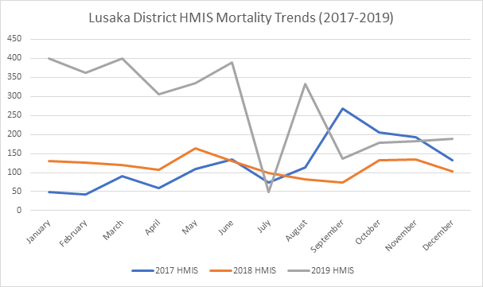
Background of reporting all-Cause Mortality in Zambia
Notes:
This slide shows mortality trend data for one city in Zambia from the HMIS and highlights the difficulties in using several years’ worth of data as baseline (given increasing completeness every year)

Slide 49
Background of reporting all-Cause Mortality in Zambia
CRVS
  Data collected by the Department of National Registration, Passports & Citizenship (DNRPC) from the council burial offices, analyzed and disseminated through the Zambia Statistical Agency
  Long lag between when data is collected and registered
  National coverage for death registration is estimated around only 22% but higher completeness and coverage in certain areas supported by CDC/NCHS & Data for Health (D4H)
    Lusaka all-cause mortality data coverage estimated ~90%
  System continuing to improve and is supported by NCHS/D4H
  The legal process for registering deaths should not impede leveraging this data source for RMS. However, the process is lengthy, and thus not suitable for timely surveillance
Notes:
The CRVS data are collected by the Department of National Registration, Passports & Citizenship from the council burial office, analyzed and disseminated through the Zambia Statistical Agency
There is a long time lag between when data on deaths are collected and registered
The national coverage for death registration is estimated around 22%
The CRVS system is continuing to improve and is supported by NCHS/D4H
D4H is supporting the implementation of verbal autopsies (VAs) for all community deaths in 6 districts in 8 facilities
D4H also supporting the collection of all-cause mortality data
All-cause mortality coverage in the D4H-supported 6 districts is better than the rest of the country
The legal process for registering deaths should not impede leveraging this data source for RMS. However, the process for collecting information on death and registering these deaths is lengthy, and thus not suitable for timely surveillance

Slide 50
Approach to rapid mortality surveillance in Zambia
  Neither the HMIS nor the CRVS system have complete data on all-cause mortality to inform the COVID-19 response
  To address the gaps in timeliness and coverage, MoH plans to implement a rapid mortality surveillance (RMS) system
    Fact and manner of death from death certification form at Health Facility
    Individual-level data (age/sex)
    Weekly data granularity
      HMIS reports on a monthly basis;
      Assessing the feasibility of improving the completeness of mortality data in HMIS and changing the reporting timeline to weekly
    Initially 21 districts will be covered & then coverage extended to all districts
Notes:
Both the HMIS and CRVS systems have data that can be leveraged for rapid mortality surveillance. However, neither the HMIS nor the CRVS system data that has the completeness nor the coverage on all-cause mortality to inform the COVID-19 response.
To address the gaps in timeliness and coverage, MoH plans to implement a rapid mortality surveillance (RMS) system
The RMS system will collect data on fact and manner of death from death certification forms at Health Facilities
We plan to collect Individual-level data on a weekly basis
The HMIS reports on a monthly basis; MoH is assessing the feasibility of improving the completeness of mortality data in HMIS and changing the reporting timeline to a weekly basis
We Initially plan to implement this system in 21 districts and later extend coverage to all districts

Slide 51
Methods: Rapid mortality surveillance system
The RMS will leverage the existing HIV-associated mortality surveillance system
  Implemented in 21 districts (Central, Copperbelt, Eastern, Lusaka, Southern and Western provinces) since May/June 2020
  Each district has 1 or 2 mortality surveillance officers & report to HIOs
    Staff will assist the HIOs with data abstraction and will also use MS IT resources
  Surveillance officers will abstract all-cause mortality data from the facility registers (out-patients, in-patient report books, patient files & mortuary registers)
    Information from the MCCD is recorded in the facility registers
The following variables will be collected:
  District, Facility name
  Age, Sex
  Place of death [facility or community (brought-in dead)
  Cause of death (as determined by the physician in the facility on MCCD form)
Notes:
The RMS will leverage the existing HIV-associated mortality surveillance system resources.
Mortality surveillance is currently implemented in 21 districts in 6 provinces. (Central, Copperbelt, Eastern, Lusaka, Southern and Western provinces) since May/June 2020
Each district has either 1 or 2 mortality surveillance officers & administratively report to HIOs
Staff will assist the HIOs with data abstraction and will also use MS IT resources
Surveillance officers will abstract all-cause mortality data from the facility registers (out-patients, in-patient report books, patient files & mortuary registers)
Information from the MCCD is recorded in the facility registers
The following variables will be collected:
District, Facility name
Age, Sex
Place of death [facility or community (brought-in dead)
Cause of death (as determined by the physician in the facility on MCCD form)

Slide 52
Data management and analysis
RMS data will be entered in an excel-based tool
Shared via KoboCollect tool (in development) with MoH
Establishing baseline mortality
  HMIS and/or CVRS data
  Additionally, RMS will retroactively collect data over past year for a weekly baseline
Notes:
The RMS data will be entered in an excel-based tool
The data will be shared via KoboCollect tool which is still in development
We plan to collect historical data to serve as a baseline data for this activity

Slide 53
Considerations/Challenges/Limitations
Likely poor state of facility registers in some facilities
HIOs may not be keen on the additional task.
  Will utilize MS officers where available to buffer additional task
Potential difficulty interpreting excess deaths in the context of improving death registration coverage from 2014-2019
May strengthen the quality of routinely reported HMIS data through routine cross-checks & engagement of all HIOs & MoH HQ M&E staff
Notes:
We anticipate some challenges as we attempt to collect historical data form the facilities to establish a baseline for this activity. It is likely that the registers in some facilities may not have been well kept or misplaced or have missing pages thus making it difficult to collect historical data.
It is likely that the HIOs may not be keen on the additional task that they may not appreciate. We propose utilizing the MS officers where available to buffer the additional task
We anticipate potential difficulty in interpreting excess deaths in the context of improving death registration coverage from 2014-2019
There may be opportunities to strengthen the quality of routinely reported HMIS data through routine cross-checks & engagement of all HIOs & MoH HQ M&E staff

Slide 54
COVID-19 Mortality Surveillance: Mortuary Screening & Testing

Slide 55
Objectives: Mortuary Screening & Testing
To perform COVID-19 active case finding
To identify potential new areas of COVID-19 transmission
To better estimate the case fatality ratio of COVID-19 in Zambia
Notes:
Mortuary screening and testing is the second approach that we are using to monitor mortality during the COVID-19 pandemic. The objectives are listed on the slides.

Slide 56
Methods: Mortuary testing of facility & community deaths
  COVID-19 testing for any mortality with a respiratory cause of death (COD)
  Active engagement with the mortuaries in public and private facilities for COVID-19 testing of bodies with respiratory CODs
  This includes mortalities that occurred outside the health facilities (i.e., Brought-in-Dead “BID”)
A screening tool will be administered for all community deaths brought to the mortuary for respiratory illness
1st attempt: Found InterVA ICD not useful because a several day lag to receive results and low coverage
On April 10, MoH issued guidance for active screening for COVID-19 in both private and public health facilities. Including:
Respiratory COD:
- Fever
- Cough
- Shortness of breath
- Difficulty breathing
- Myalgia
- Headache
Notes:
Several months ago, we attempted to use verbal autopsy results to inform COVID testing of BID. Unfortunately, due to a delay in processing and receipt of VA results and low coverage of this project (~15 facilities), we recommended that a simple screening tool be used at all facilities where BID are accepted.
The MOH released guidance in early April that outlined COVID screening and testing procedures in facilities and associated mortuaries. Specifically for mortality surveillance, it asked that any mortality with a respiratory cause of death be tested and that all BID be screened for fever, cough, difficulty breathing, myalgia, or headache just before death also be tested.

Slide 57
Testing in mortuaries for COVID-19
DEATH
A cadaver is received at the Mortuary (i.e., BID)
Complete Respiratory *Death Screen or verbal Autopsy to determine presumed cause of death
Inpatient death
Was death due to Respiratory complication?
Was death due to Pulmonary complication?
No
DO NOT TEST
No
Yes
Was COVID-19 testing conducted and COVID-19 ruled out?
Yes or Unknown
Yes
*Death Screen: Did patient experience any of the following: fever, cough, shortness of breath/difficulty breathing, flu-like symptoms, myalgia, headache?
No
TEST for COVID-19
Notify In-Charge and appropriate channels
Following strict Infection Prevention Precautions and perform COVID-19 testing
Anyone handling the body must wear appropriate PPE, pending test results
If results positive, initiate Contact Tracing
Notes:
The process flow shown in the slide shows which cadaver should or should not be tested for COVID-19

Slide 58
Data Management
2 forms will be completed by mortuary staff:
  Standardized COVID-19 laboratory requisition form
  Mortuary surveillance report form (for mortuary-based testing only)
Notes:
We are using two forms for collecting information on all community deaths brought to the mortuary. The laboratory requisition form and the mortuary surveillance report form.

Slide 59
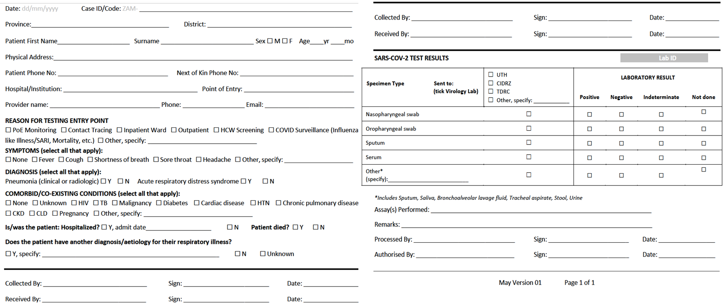
Data Management: Laboratory Request Form
NB: Mortality surveillance data can also be analyzed through data submitted via this form
Notes:
The laboratory request form is being used for recording information for all COVID-19 specimens. It was modified to allow us to use data collected via this form for surveillance purposes, including identifying tests that resulted from mortality surveillance

Slide 60
Data Management: Mortuary Surveillance Report Form
All community deaths screened documented, regardless of testing status
Inpatient deaths screened and tested for COVID-19 are captured in a facility monitoring tool. Expect very few inpatient deaths to be screened/tested post-mortem as should be tested while admitted (i.e., for SARI)
 |  |  |  | To be completed for those who screened positive only:
Date of Death | Date of Screening | Name (Surname, First Name) | Screen Results (+ or -) | Reason for Test Tick all that apply |  |  |  |  | Specimen Collection Date | Lab Requisition ID | COVID19 Test Result
dd/mm/yyyy |  |  |  | Fever | Headache | Myalgia | Cough | Difficulty breathing, fast breathing | dd/mm/yyyy | Auto-generated | pos, neg, ind
Notes:
This is a screening tool that Zambia is using to identify suspect covid-19 cases at the mortuary for all community deaths bought to the mortuary.
All community deaths that are screened are documented, regardless of testing status.
Inpatient deaths that are screened and tested for COVID-19 are captured in a separate facility monitoring tool. We do not anticipate that many inpatient deaths will be screened or tested post-mortem as they should have already been tested while admitted in hospital.
The screening questions are shown on the slide.

Slide 61
Summary
Mortality surveillance is a critical element of COVID-19 surveillance system
  Deaths among confirmed cases only tells part of the story
  All-cause mortality surveillance is needed to inform policy makers
Gaps in data completeness may limit geographic scope of all-cause mortality surveillance
Lag in data capture is a critical hurdle to timely action
Zambia is leveraging existing systems and creating new structures where needed
Partnering across ministries is critical to success
  CDC playing a supportive role to facilitate implementation
Notes:
In summary, mortality surveillance is a critical element of COVID-19 surveillance system. Deaths among confirmed cases only tells part of the story. All-cause mortality surveillance is needed to inform policy makers
Gaps in data completeness may limit geographic scope of all-cause mortality surveillance.
Time lag in data capture is a critical hurdle to timely action
Zambia is leveraging existing systems and creating new structures where needed
Creating partnerships across ministries and sharing data is critical to success

Slide 62
WHO Mortality Surveillance Resources
Surveillance strategies for COVID-19 human infection
(https://www.who.int/publications-detail/surveillance-strategies-for-covid-19-human-infection)
Global Surveillance of COVID-19: WHO process for reporting aggregated data
Excel tool for weekly reporting, including “number of NEW CONFIRMED CASES DEATHS country-wide” (https://www.who.int/publications/i/item/aggregated-weekly-reporting-form)
Technical Note: Medical certification, ICD mortality coding, and reporting mortality associated with COVID-19 (https://www.who.int/publications/i/item/WHO-2019-nCoV-mortality-reporting-2020-1)
Portal for weekly reporting from death certificates (for authorized users)
Revealing the Toll of COVID-19: a Technical Package for Rapid Mortality Surveillance and Epidemic Response (https://www.who.int/publications/i/item/revealing-the-toll-of-covid-19)
Excess mortality calculator (https://preventepidemics.org/covid19/resources/excess-mortality/)
Portal for weekly reporting of total all-cause mortality forthcoming (for authorized users)
WHO Bulletin. Mortality surveillance during the COVID-19 pandemic (https://www.who.int/bulletin/volumes/98/6/20-263194/en/)
Notes:
Listed here is a compilation of resources from WHO, starting with the general surveillance strategies document, followed by the global surveillance of COVID-19 tool for reporting aggregated data. This Excel tool for weekly reporting includes one indicator on the “number of new confirmed case deaths country-wide.”
The Data for Delivery and Impact Division at WHO has published a technical note on medical certification, coding, and reporting, and they have a portal to submit weekly mortality data from death certificates.
The Rapid Mortality Surveillance Technical Package has also been released. Vital Strategies has developed an excess mortality calculator tool, and WHO is in the process of updating their portal to also include the total all-cause mortality from various sources in its weekly reporting.

Slide 63
Mortality Surveillance Webinars
Bloomberg Philanthropies Data for Health – Data for COVID-19 Webinars
Rapid Mortality Surveillance
Recording, session slides [English version]
Certification and Coding of COVID-19 & Iris Recommendations for COVID-19
Recording, session slides [English version, Spanish version, French version]
Verbal Autopsy in the Context of COVID-19
Recording, session slides [English version, Spanish version, French version]
Measuring Excess Mortality due to COVID-19
Recording, session slides [English version, Spanish version, French version ]
Notes:
The Bloomberg Philanthropies Data for Health Initiative has hosted a series of webinars on various topics related to mortality surveillance for COVID-19. They are listed here with the webinar recording and session slides in English, Spanish, and French.

Slide 64
Other Resources
ITF SharePoint: Documents > Surveillance > Mortality Surveillance
CDC/NCHS. Guidance for Certifying Deaths Due to COVID-19 (https://www.cdc.gov/nchs/data/nvss/vsrg/vsrg03-508.pdf)
CDC/NCHS. Excess Deaths Associated with COVID-19 (https://www.cdc.gov/nchs/nvss/vsrr/covid19/excess_deaths.htm)
CDC. Collection and Submission of Postmortem Specimens from Deceased Persons with Known or Suspected COVID-19, Interim Guidance (https://www.cdc.gov/coronavirus/2019-ncov/hcp/guidance-postmortem-specimens.html)
WHO/AFRO. Response to COVID-19 Pandemic: Interim guidance notes for member states on monitoring and detecting deaths at community levels. (https://www.afro.who.int/sites/default/files/Covid-19/Techinical%20documents/Interim%20Guidance%20note%20for%20Member%20States%20on%20Detecting%20and%20Reporting%20Deaths%20at%20the%20Community-level.pdf)
JAMA. The Importance of Proper Death Certification During the COVID-19 Pandemic (https://jamanetwork.com/journals/jama/fullarticle/2767262)

Slide 65
Thank you!
Mortality Surveillance for COVID-19
Erin Nichols, igd1@cdc.gov
Emily Cercone, ecercone@cdc.gov
Stanley Kamocha, hod5@cdc.gov

