Slide 1
Standard Operating Procedure (SOP) for Triage of Suspected COVID-19 Patients in non-US Healthcare Settings
Intended for use in non-US healthcare settings. Document can be found at:
https://www.cdc.gov/coronavirus/2019-ncov/hcp/non-us-settings/sop-triage-prevent-transmission.html
This triage SOP should be used in addition to and not as a replacement to routine clinical triage already in place in healthcare facilities
Some slides contain additional information in the Slide Notes.

Slide 2
Outline
COVID-19 background
Definition of triage
What patients can do before and upon arrival to healthcare facility
What healthcare facilities can do to minimize risk of infection among patients and healthcare workers
What healthcare workers can do to protect themselves and their patients during triage
Considerations to maintain healthcare delivery as number of COVID-19 cases increases

Slide 3

COVID-19 background
Caused by a newly emergent coronavirus, SARS-CoV-2
Leads to respiratory tract infection, including pneumonia
Transmitted mainly via respiratory droplets (sneezing, coughing, etc.), but transmission via contaminated surfaces can also occur
Cause a variety of symptoms including fever, cough, fatigue, myalgia, sore throat, difficulty breathing, or loss of taste or smell.
For list of symptoms refer to: https://www.cdc.gov/coronavirus/2019-ncov/symptoms-testing/symptoms.html or
https://www.who.int/publications/i/item/clinical-management-of-covid-19

Slide 4
What is triage?
The sorting out and classification of patients to determine priority of need and proper place of treatment
For COVID-19 outbreak, triage is particularly important to separate patients likely to be infected with the virus that causes COVID-19
Effective triage can prevent transmission of the virus that causes COVID-19 to patients and healthcare workers (HCWs)

Slide 5
What Patients Can Do

Slide 6








What patients can do
Inform healthcare providers if they are seeking care for symptoms suggestive of COVID-19
Wear a medical mask, if available
Immediately notify registration desk
about symptoms
1m
Carry a tissue or other alternative to cover mouth or nose
Maintain social distance in accordance with WHO recommendations
Wash hands at healthcare facility entrance

Slide 7
What Healthcare Facilities Can Do

Slide 8

What healthcare facilities (HCFs) can do
Communicate with patients before they arrive for triage
Set up and equip triage (e.g., availability of medical masks for people with COVID-19 symptoms)
Set up a separate COVID-19 waiting area
Establish triage process
Train staff on infection prevention and control measures including proper use of personal
protective equipment
WPRO: The COVID-19 risk communication package for healthcare facilities

Slide 9

Communicate with patients before they arrive at HCF
Establish a hotline for patients to call before arrival to HCF to determine the need for a visit
Inform general public through mass media about availability of a hotline and the signs and symptoms of COVID-19 that require care
Consider telemedicine (telephone, audio-video interaction, or secure messaging system) for clinical support of non-emergency cases
Advise patients with warning signs of medical emergency to seek care immediately

Slide 10

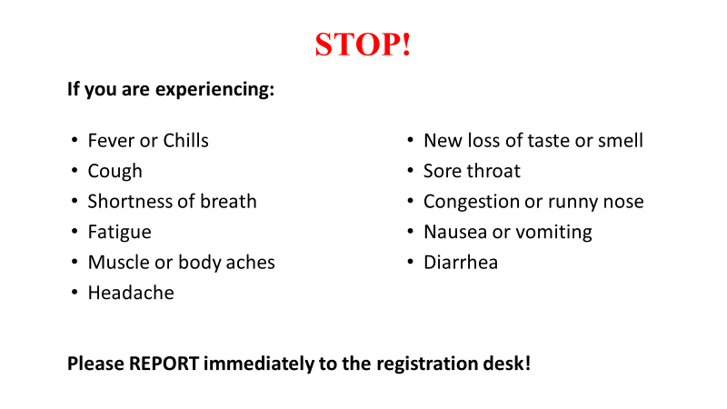
Set up and equip triage
Strategically place clear signs directing patients with COVID-19 symptoms to immediately report to the registration desk
If possible, consider having a separate registration desk for patients coming in with symptoms suggestive of COVID-19
  Ensure the signs direct patients to the dedicated registration desk

Slide 11
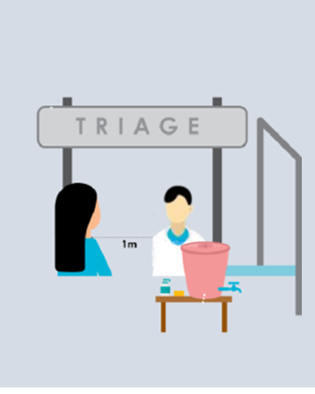
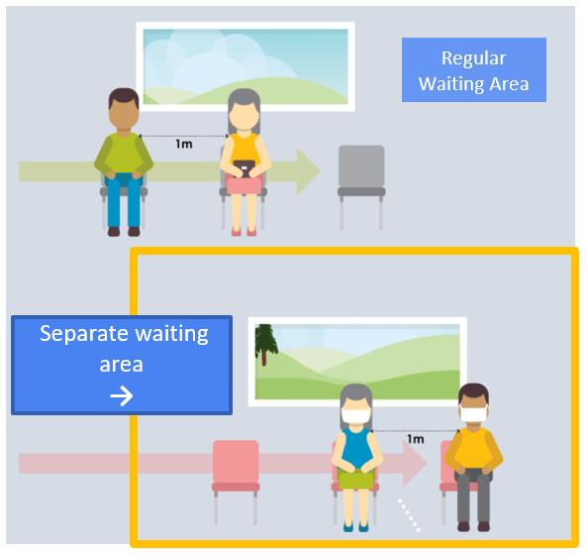

Set up and equip triage
Medical mask and paper tissues at registration desk
Physical barriers (glass or plastic screens)
A bin with lid for discarding used paper tissues
Hand hygiene stations
WPRO: The COVID-19 risk communication package for healthcare facilities

Slide 12
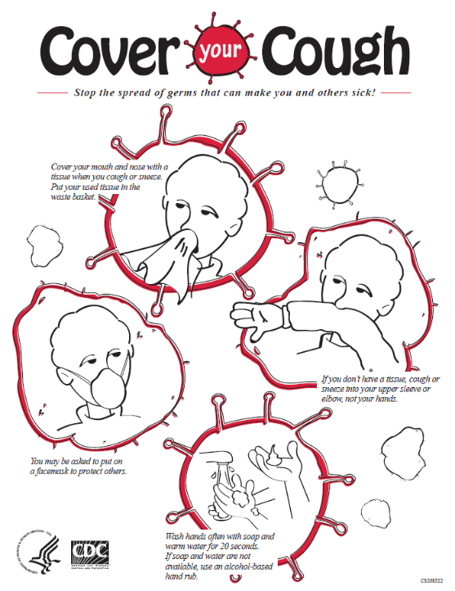
Visual alerts
Place alerts at the entrance of the facility and in strategic areas (waiting areas or elevators)
Alerts should cover:
Cough etiquette
Disposal of contaminated items
Hand hygiene

Slide 13
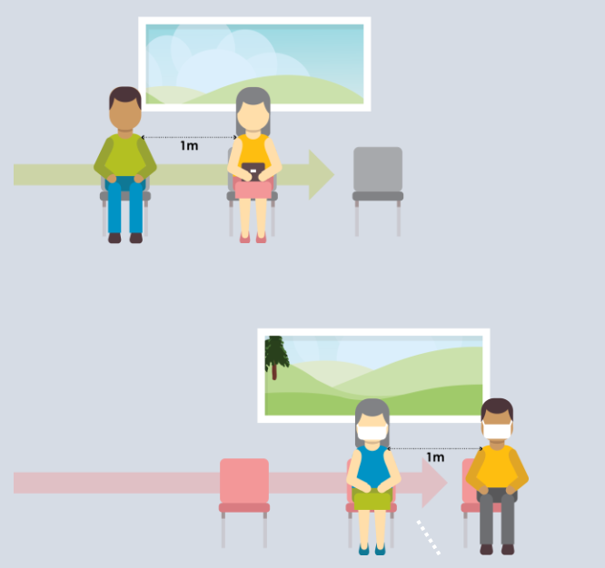
Set up a separate waiting area
A separate, well-ventilated area where patients with suspected COVID-19 can wait
This area should have:
Benches, stalls or chairs separated
by at least one-meter distance ​
Dedicated toilets and hand hygiene stations​
Paper tissue, alcohol-based hand sanitizer, and trash bin with lid​
Clear signs informing the location of a separate COVID-19 waiting area
Regular Waiting Area
Separate waiting area
→

Slide 14


Triage process
Assign dedicated clinical staff (physicians or nurses) for physical evaluation of patients presenting with symptoms suggestive of COVID-19 at triage
Train administrative personnel working in the reception area
Use a Standardized triage flow algorithm based on epidemiologic scenarios
No or limited COVID-19 community transmission
Widespread COVID-19 community transmission

Slide 15
Example of Triage Flow for Countries with No or Limited Community Transmission

Slide 16
Triage of patients with suspected COVID-19 (no or limited community transmission)
Identify common signs and symptoms of COVID-19:
Acute onset of fever (>38°C or history of fever) and cough*
-OR-
At least 3 signs or symptoms of COVID-19 (e.g., cough, myalgia, headache, sore throat, loss of smell or taste)
No
Continue with usual triage, assessment and care
Yes
Place medical mask on patient
Identify Travel and Direct Exposure History:
Has the patient traveled or resided in another country where COVID-19 is spreading during the 14 days prior to symptom onset?
- or -
Has the patient had contact with an individual with suspected or confirmed COVID-19 during the 14-days prior to symptom onset?
Continue with usual triage, assessment and care
No
Yes
Separate from other patients:
Place the patient in a single-person well-ventilated room with the door closed or in other designated area
Ensure healthcare workers (HCW) caring for the patient adhere to Standard, Contact, and Droplet Precautions
Only essential HCW with designated roles should enter the room and wear appropriate personal protective equipment
Inform: Notify the hospital infection control program and other appropriate staff
*Elderly or immunosuppressed people may not develop fever, but atypical symptoms (e.g., reduced mobility, confusion) or new-onset of cough or worsening respiratory symptoms. In countries where fever-inducing pathogens (e.g., malaria, dengue) are not endemic, fever alone can be used as a sole criterium for COVID-19.

Slide 17
Example Triage Flow for Countries with Widespread Community Transmission

Slide 18
Triage of patients with suspected COVID-19
(widespread community transmission)
Identify common signs and symptoms of COVID-19:
Acute onset of fever (>38°C or history of fever)* and cough
-OR-
At least 3 signs or symptoms of COVID-19 (e.g., cough, myalgia, headache, sore throat, loss of smell or taste)
Continue with usual triage, assessment and care
No
Yes
Place medical mask on patient
Yes
Separate from other patients:
Place the patient in a single-person well-ventilated room with the door closed or in other designated area
Ensure healthcare workers (HCW) caring for the patient adhere to Standard, Contact, and Droplet Precautions
Only essential HCW with designated roles should enter the room and wear appropriate personal protective equipment
Inform
Notify the hospital infection control program and other appropriate staff
* Elderly or immunosuppressed people may not develop fever, but atypical symptoms (e.g., reduced mobility, confusion) or new-onset of cough or worsening respiratory symptoms. In countries where fever-inducing pathogens (e.g., malaria, dengue) are not endemic, fever alone can be used as a sole criterium for COVID-19.

Slide 19
Triage process
Follow the appropriate triage algorithm
Give a medical mask to patients with respiratory symptoms
Immediately isolate/separate patients with suspected COVID-19 in:
  single-person room with door closed
  OR
  separate waiting areas
Limit the number of accompanying family members in the waiting area (no more than 1 family member per patient)

Slide 20

Cleaning and disinfection of triage area
Clean and disinfect triage area, including separate COVID-19 waiting areas,
at least twice a day
Focus on frequently touched surfaces
Disinfect with 0.1% (1000ppm) chlorine
OR
70% alcohol for surfaces that do not tolerate chlorine

Slide 21
What Healthcare Workers Can Do

Slide 22
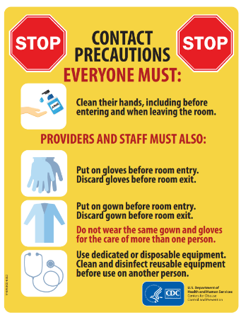
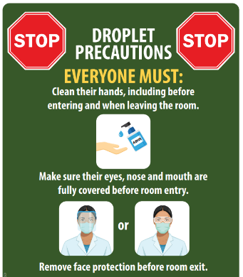
Infection prevention and control precautions
Adhere to Standard Precautions
Be trained on and familiar with Contact and Droplet Precautions
Ensure that environmental cleaning and disinfection procedures are followed consistently and correctly
Stay home if develop fever and/or symptoms suggestive of COVID-19 (cough, myalgia, fatigue, sore throat, new loss of smell or taste)

Slide 23
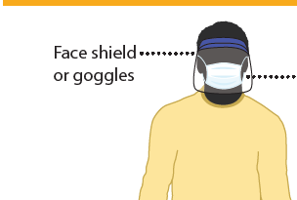

Personal Protective Equipment (PPE)
HCWs who do not come in contact with suspected or confirmed COVID-19 patients
Physical barrier AND
Physical distance of at least 1 m
No physical barrier AND
Physical distance is not feasible
Medical mask
Glass or plastic barrier
No PPE required
Use mask and eye protection

Slide 24
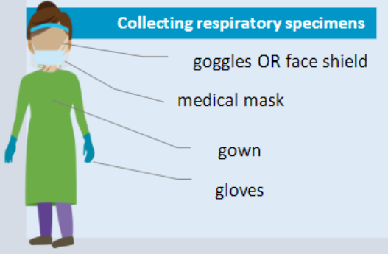
Personal Protective Equipment (PPE)
HCWs who come in contact with suspected or confirmed COVID-19 patients should wear appropriate PPE
Conducting examinations of patients with respiratory symptoms

Slide 25
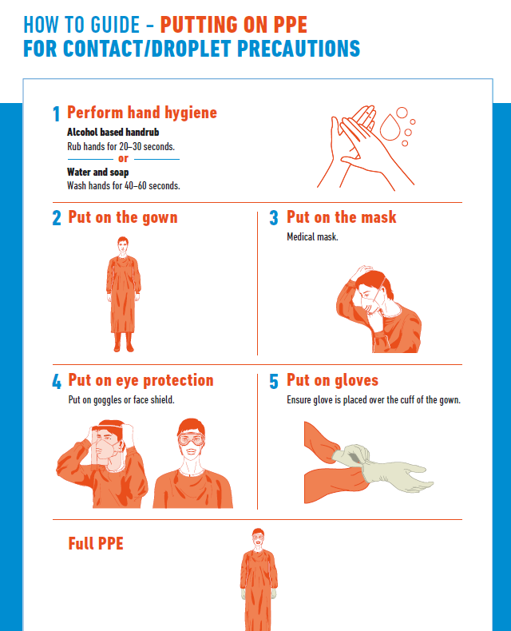
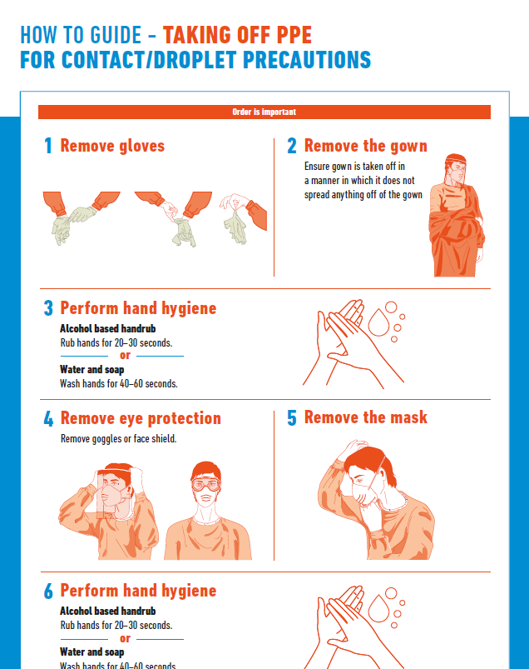
WHO

Slide 26
Important Measures During Periods of COVID-19 Community Transmission

Slide 27
Strategies to avoid overcrowding at triage and preserve PPE
Cancel non-urgent outpatient visits to ensure enough HCWs are available to provide support for COVID-19 clinical care, including triage services
  If outpatient visit is critical (such as immunization of infants or pre-natal care for high-risk pregnancy), identify separate/dedicated entrance for these patients
  Reinforce telemedicine or other alternative to face-to-face visit
Postpone or cancel elective procedures and surgeries to minimize exposures and to preserve PPE for HCWs caring for COVID-19 patients
Expand hours of operation, if possible, to limit crowding in triage during peak hours

Slide 28
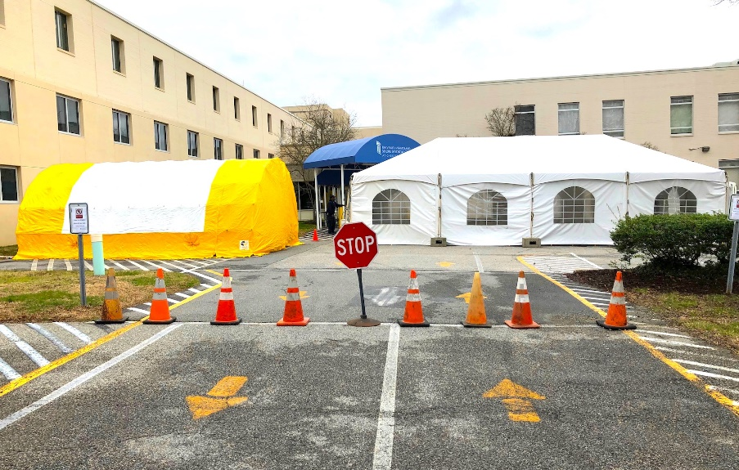
COVID-19 evaluation centers
Designate an area near the facility where patients with symptoms of COVID-19 can seek evaluation and care
Photo Credit to the Kent County News

