Slide 1

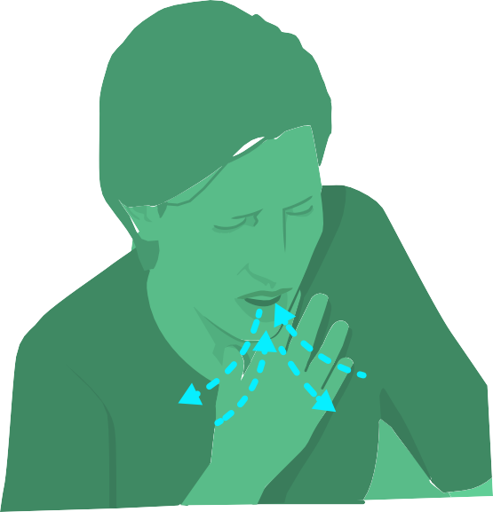
VISITORS
DO NOT enter the health facility if you have any of the following symptoms:
FEVER
COUGH
SHORTNESS OF BREATH
If you have symptoms, notify your healthcare provider or public health officials immediately by calling: _______________________

