Slide 1
Operational Considerations for Personal Protective Equipment in the Context of Global Shortages for COVID-19 Pandemic
Intended for use in non-US healthcare settings

Slide 2
Disclaimer
CDC does not recommend or endorse any strategies for personal protective equipment (PPE) use that differ from standard infection prevention and control (IPC) practice.
In times of crisis and global supply shortages, emergency strategies are temporary approaches for consideration. However, efforts to scale up rapid production of PPE should be prioritized.
Whenever possible, emergency PPE strategies should not be used in hospital wards housing severe or critically ill patients with COVID-19, as well as those with known co-infections of multi-drug resistant or other organisms transmitted by contact (e.g., Klebsiella pneumoniae) or droplet (e.g., influenza virus).

Slide 3
Purpose and Scope of Presentation
Purpose: to provide operational considerations to be used in conjunction with WHO’s guidance on the Rational use of personal protective equipment for coronavirus disease 2019 (COVID-19) which defines strategies to optimize the availability of PPE and a summary of temporary measures during severe shortage of PPE*
Scope: provides practical operational considerations for:
  1) Temporary measures included in WHO’s guidance
  2) Several additional measures which are being utilized in some settings
* Because this presentation is intended to be used in conjunction with WHO PPE guidance, WHO terminology is used (e.g., medical masks) and WHO recommendations for healthcare worker PPE
Notes:
This document draws from CDC strategies for US-healthcare settings on COVID-19: Strategies for Optimizing the Supply of PPE | CDC and includes potential strategies that may be considered in non-US contexts.

Slide 4
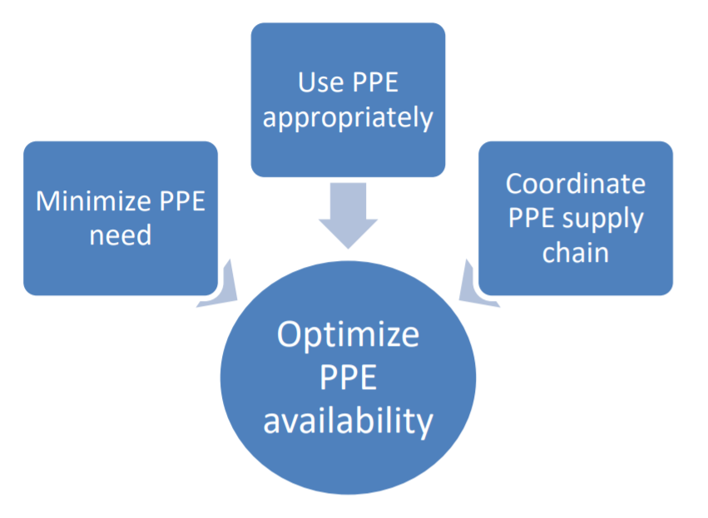
Strategies to Optimize the Availability of PPE
High-level and continued efforts will be needed to maintain and scale-up the PPE supply chain to ensure availability of PPE in healthcare settings where it is needed, to avoid supply shortages, and allow adherence to IPC standard practice
Notes:
Rational use of personal protective equipment for coronavirus disease (COVID-19) and considerations during severe shortages: https://apps.who.int/iris/bitstream/handle/10665/331695/WHO-2019-nCov-IPC_PPE_use-2020.3-eng.pdf

Slide 5
Minimize PPE Need
Facilities should implement engineering and administrative control measures for patients with COVID-19
  Reducing or cancelling elective surgical procedures and non-critical/non-urgent outpatient visits
  Reducing face-to-face healthcare worker (HCW) encounters with patients
  Limiting the number of visitors to healthcare facilities
  Cohorting patients and HCWs
  Maintaining adequate space between patients and HCWs

Slide 6
Use PPE Appropriately
Facilities should ensure PPE use is rational and appropriate
PPE should be used based on:
  The risk of exposure (e.g., type of activity)
  The transmission dynamics of the pathogen (e.g., contact, droplet or aerosol)
PPE is generally intended to protect the wearer
  The appropriate use of PPE can also protect others
Facilities should provide HCWs with education and training
Notes:
WHO | HOW TO PUT ON AND TAKE OFF Personal Protective Equipment (PPE)

Slide 7


Coordinate PPE Supply Chain
Facilities should communicate with local public health partners such as public health emergency preparedness and response staff and sub-national and national authorities regarding identification of additional supplies
Facilities should understand their inventory and utilization rate
  Personal Protective Equipment (PPE) Burn Rate Calculator | CDC
  WHO COVID-19 Essential Supplies Forecasting Tool

Slide 8
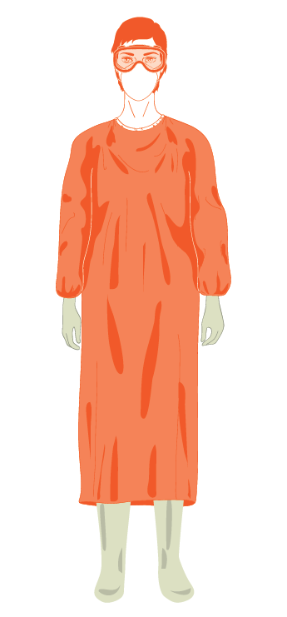
Recommended Healthcare Worker PPE for COVID-19
Gown
Medical mask
(Respirator only if performing aerosol generating procedures)
Eye protection (face shield or goggles)
Gloves
Notes:
WHO IPC guidance: https://www.who.int/publications-detail/infection-prevention-and-control-during-health-care-when-novel-coronavirus-(ncov)-infection-is-suspected-20200125

Slide 9
Operational Considerations

Slide 10
Before Getting Started
Review WHO’s guidance on the Rational use of personal protective equipment for coronavirus disease 2019 (COVID-19) including the:
  Considerations for decision making processes during severe shortages of PPE
  Summary of temporary measures in the context of severe PPE shortage

Slide 11
Applying Appropriate Operational Considerations for Your Setting
Review the general strategies for optimizing PPE availability, then, apply as appropriate
Review the PPE-specific strategies and each of the associated considerations carefully, then, apply as appropriate based on:
  The current PPE shortage scenario
  The prioritized order as described in the flow-chart

Slide 12
General Strategies

Slide 13
Use PPE beyond Expiration Date
When using PPE beyond the manufacturer-designated shelf life or expiration date, healthcare facilities should:
  Inspect items closely prior to use to be sure they are in good condition with no degradation, tears, or wear that could affect performance

Slide 14
Use Reusable PPE
When using reusable PPE, such as cloth gowns and reusable goggles, healthcare facilities should:
  Follow manufacturer’s instructions for reprocessing including cleaning and disinfecting and augment support staff as needed to ensure that equipment is reprocessed after each use
  Establish systems to 1) routinely inspect, 2) maintain by such means as replacing missing fastening ties, and 3) replace reusable PPE when they are damaged, such as when gowns become thin or ripped (upon which time they should be disposed)

Slide 15
PPE-Specific Strategies

Slide 16
PPE Shortage Scenarios
Limited supplies: PPE for direct clinical care is still available where recommended, but the supply is insufficient to enable full adherence to standard IPC practice
No PPE available: PPE for direct clinical care is NOT available where recommended, due to supply shortages. Strategies under this scenario include potential alternatives to recommended PPE as a last resort during a crisis where standard PPE is not available
Notes:
For each type of PPE, a brief description is provided as well as operational considerations under each of several potential strategies for scenarios.

Slide 17
Prioritized Order of Actions
Assess PPE needs
Supplies still available but limited
1) Consider extended use as a temporary measure
2) Consider reuse as a temporary measure
Stock-outs are reported or anticipated in the near future
3) Consider potential alternatives as a temporary measure
Recommended order
Resources:
CDC Burn calculator
WHO Supplies Forecasting Tool
In some facilities, alternatives may be considered preferable to reuse (use operational considerations to guide decision-making)
Notes:
CDC Burn calculator
WHO Supplies Forecasting Tool

Slide 18
Definitions
Extended use: By one HCW among multiple patients with suspected or confirmed COVID-19 (one donning and doffing)
Reuse: By one HCW among multiple patients with suspected or confirmed COVID-19 (multiple donning and doffing)
Potential alternatives: Use of alternative items to recommended PPE as a last resort during a crisis where standard PPE is not available

Slide 19
Medical Masks
Use for care of multiple patients with suspected or confirmed COVID-19 (multiple single-rooms when seen in succession or cohort of patients) by one HCW during a single shift
Reprocessing and reusing medical masks for one HCW to use on multiple patients with suspected or confirmed COVID-19 for a limited time-period (multiple shifts) (*different than WHO temporary measures)
Use a face shield only OR
Use a combination of a non-medical mask (also known as a face covering) and a face shield (*different than WHO temporary measures)
Extended use
Reuse
Potential Alternatives

Slide 20
Medical Masks – Key Operational Considerations
Extended use
If the mask becomes moist, damaged, visibly soiled, or difficult to breathe through, it should be removed and disposed following local protocols
If the mask is removed for any other reason such as taking a break or completing a shift, it should be disposed following local protocols
The potential duration of extended use depends on local and individual factors such as humidity and shift length
  Likely a maximum of six hours
This strategy should be prioritized over reuse or any other approaches

Slide 21
Medical Masks – Key Operational Considerations
Reuse
Effectiveness of reprocessing methods for medical masks have not been established
Potential reprocessing methods may be resource-intensive and therefore not feasible in many settings nor at facility level
Facilities should establish standardized methods and protocols for ensuring the effectiveness of the process and that the integrity of the medical mask is maintained after reprocessing
HCWs should inspect the mask prior to each reuse
If the mask becomes damaged, soiled or difficult to breathe through, it should be removed from circulation and disposed following local protocols
Notes:
Note: Many potential reprocessing methods are resource-intensive and may not be feasible in many low- and middle-income countries nor at a facility-level (Darnell et al, 2004; Feldmann et al, 2019). (think this important to have up in the text)

Slide 22
Medical Masks – Key Operational Considerations
Potential Alternatives
Non-medical fabric masks (also knowns as face coverings) are not considered PPE and their ability to protect HCWs is currently unknown
Efforts should be made to obtain standardized masks made of fabrics that are approved by national or sub-national authorities and offer some level of filtration as well as a hydrophobic outer layer to allow some level of fluid resistance
Masks should be removed and disposed following local protocols whenever needed such as when they become moist, visibly soiled, or damaged and upon exiting the isolation area per standard practice

Slide 23
Gowns
Use during care of multiple patients with suspected or confirmed COVID-19 (multiple single-rooms when seen in succession or cohort of patients) during a single shift
Potential alternatives: disposable aprons, disposable laboratory coats, reusable patient gowns or laboratory coats, combinations of clothing
Extended use
Potential Alternatives

Slide 24
Gowns – Key Operational Considerations
Extended use
If it becomes visibly soiled, the gown must be removed using appropriate technique for reprocessing or disposal following local protocols (followed by appropriate donning of a new gown)
If it is removed for any other reason such as taking a break or completing a shift, the gown should be sent for reprocessing or disposed of following local protocols
This strategy should be prioritized over reuse or other approaches

Slide 25
Gowns – Key Operational Considerations
Potential Alternatives
Selection of potential alternatives should take into consideration the availability and attributes, such as impermeability and comfort of the wearer, and whether there are enough available to allow frequent replacement
Alternatives should be removed using appropriate technique for either reprocessing or disposal following local protocols whenever needed (e.g., when moist, visibly soiled, or damaged) and upon exiting the isolation area

Slide 26
Eye Protections (Goggles and Face Shields)
Extended use
Use during care of multiple patients with suspected or confirmed COVID-19 during a single shift
Reprocessing and reusing disposable face shields for one HCW to use on multiple patients with suspected or confirmed COVID-19 OR
Dedicating a supply of reusable goggles or face shields to an isolation area
Using safety glasses such as trauma glasses
Reuse
Potential Alternatives

Slide 27
Eye Protections – Key Operational Considerations
Extended use
If eye protection becomes visibly soiled, it should be removed using appropriate technique and sent for reprocessing or disposal following local protocols
If eye protection is removed for any other reason such as taking a break or completing a shift, it should be sent for reprocessing or disposed following local protocols

Slide 28
Eye Protections – Key Operational Considerations
Reuse
Option A. Reprocessing and reusing disposable face shields for one HCW to use on multiple patients with confirmed or suspected COVID-19
A face shield should be dedicated to one HCW
They should be immediately reprocessed when they are visibly soiled, whenever they are removed such as when leaving the isolation area, and at least daily (after every shift)
After reprocessing, store face shield in a transparent plastic container and label with the HCW name to prevent accidental sharing between HCW
Examine prior to each reuse to ensure the integrity of the foam pad, elastic strap, and clarity of the visor
Notes:
Note: The number of times a disposable face shield could potentially be reprocessed is unknown; therefore, face shields should be closely examined prior to each reuse to ensure the integrity of the foam pad, elastic strap, and clarity of the visor.

Slide 29
Eye Protections – Key Operational Considerations
Reuse
Option B. Dedicating a supply of reusable goggles or face shields to an isolation area
Items should be reprocessed after each use and stored at the entry to the isolation area, in a dedicated area equipped for reprocessing adjacent to the isolation area (dirty and clean storage area)
The selection of potential alternatives should include those that have extensions to cover the side of the eyes
Potential Alternatives

Slide 30
Respirators
Extended use
Use on multiple patients with suspected or confirmed COVID-19 (multiple single-rooms when seen in succession or cohort of patients) during a single shift
Reprocessing and reusing respirators for one HCW to use on multiple patients with suspected or confirmed COVID-19
Reuse

Slide 31
Respirators – Key Operational Considerations
Extended use
The potential number of hours of extended use would be dependent on local and individual factors such as humidity and shift length. In practice, this would likely be a maximum of six hours
If the respirator becomes damaged, soiled or difficult to breathe through, it should be removed from circulation and disposed following local protocols
Reuse

Slide 32
Decontamination of Respirators
At present, there are no CDC and/or NIOSH-approved methods for filtering facepiece respirator (FFR) decontamination prior to reuse (guidance available)
Most promising methods (not validated) for respirator reprocessing:
  Vapor of hydrogen peroxide
  UV radiation lamp
  Moist heat
  Dry heat

Slide 33
Overall Summary of Actions in Presentation
Step 1
Step 2
Step 3
Familiarize yourself with WHO’s guidance on the options for temporary measures during severe shortage of PPE
Apply these operational considerations as appropriate for your setting
Ensure that broader efforts to improve supply chain are continued in order to return to standard practices
Notes:
Rational use of personal protective equipment for coronavirus disease (COVID-19) and considerations during severe shortages: https://apps.who.int/iris/bitstream/handle/10665/331695/WHO-2019-nCov-IPC_PPE_use-2020.3-eng.pdf

