Slide 1
Summary of Changes
Updated transmission slide to reflect CDC guidance (linked on slide)
Added a slide on circumstances that could increase the risk of becoming infected with COVID-19 and added references to CDC and WHO on ventilation guidance
Updated symptoms list based on WHO reference (linked on slide)
Updated People at higher risk slide to reflect WHO and CDC guidance on those at higher risk for severe COVID-19 illness including the mention that those at higher risk should be prioritized for vaccination (references linked on slide)
Expanded the preventative actions slide by including one on vaccination. Since this PPT is meant for non-US settings, the slide was added to emphasize the preventative action of getting vaccinated but to also continue other preventative actions
Added a preventative slide describing the wearing of masks to reflect CDC guidance (linked on slide)
Added additional preventative slide to emphasize the importance of other preventative actions in addition to vaccination and mask wearing
Added a slide to describe IPC in the context of vaccination delivery based on WHO guidance (linked on slide)
Updated the list of AGPs currently listed in WHO guidance (linked on slide)

Slide 2
COVID-19 Overview and Infection Prevention and Control Priorities in non-US Healthcare Settings
Document can be found at:
https://www.cdc.gov/coronavirus/2019-ncov/hcp/non-us-settings/overview/index.html

Slide 3
Outline
Coronavirus Background
Coronavirus Disease 2019 (COVID-19)
  Emergence of COVID-19
  Transmission
  Symptoms
COVID-19 Prevention and Treatment
Infection Prevention and Control (IPC) for COVID-19

Slide 4
Coronavirus Background

Slide 5
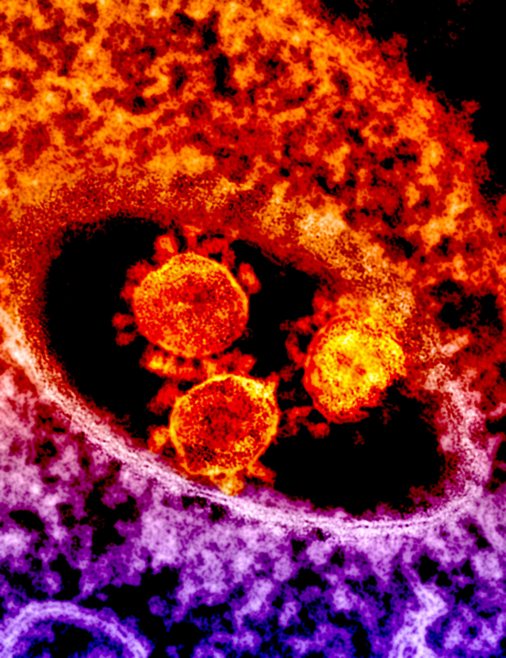
Coronaviruses (CoV)
Coronaviruses are a large family of viruses that can cause illness in animals or humans
In humans, several known coronaviruses can cause respiratory infections
  Ranging from the common cold to more severe diseases such as severe acute respiratory syndrome (SARS), Middle East respiratory syndrome (MERS) and coronavirus disease 2019 (COVID-19)
Notes:
Coronaviruses are a large family of viruses that are common in many different species of animals including camels, cattle, cats and particularly bats
There are 4 known global coronaviruses that mainly cause common cold symptoms
Rarely, animal coronaviruses can infect people and then spread person-to-person such as with MERS, SARS and the newly identified COVID-19

Slide 6
Coronavirus Disease 2019 (COVID-19)

Slide 7

COVID-19: Emergence
Identified in Wuhan, China in December 2019
COVID-19 is caused by the virus SARS-CoV-2
Early in the outbreak, many patients were reported to have a link to a large seafood and live animal market
  Later, no link to the market indicating person-to-person spread of the disease
Travel-related exportation of cases reported
https://www.healthpolicy-watch.org/
Notes:
The 2019 novel coronavirus (SARS-CoV-2) is a new virus in humans that causes respiratory illness and can be spread from person-to-person
SARS-CoV-2is a betacoronavrius, like MERS and SARS, all of which have their likely origin in bats
The sequences of SARS-CoV-2 from China and other countries are very similar to each other suggesting a likely single emergence of this virus from an animal reservoir sometime in late 2019

Slide 8

COVID-19: Transmission
There are three main ways that COVID-19 can be spread:
Breathing in air when close to an infected person who is exhaling small droplets and particles that contain the virus
Having small droplets and particles that contain virus land on the eyes, nose or mouth - especially through splashes and sprays like a cough or sneeze
Touching the eyes, nose or mouth with hands that have virus on them
CDC Guidance: How COVID Spreads

Slide 9
COVID-19: Circumstances that can increase risk
Poor ventilation
  In enclosed and poorly ventilated space, the amount of virus in the air can build up and cause infections further away from an infectious space^{1,2}
Prolonged exposure to someone who might be infected
Close contact – less than 1.8 meter (6 ft)*
Activities that lead to exposure to a greater amount of respiratory fluids (i.e. aerosol generating procedures)
* Based on CDC recommendation. WHO recommends at least 1 meter apart
¹CDC Guidance: Ventilation in Buildings , ² WHO Roadmap to improve and ensure good indoor ventilation in the context of COVID-19

Slide 10
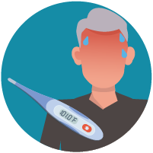

COVID-19: Symptoms
Wide range of symptoms reported*
  Fever or chills
  Cough
  Muscle or body aches
  Anorexia
  Sore throat
  Nasal congestion or runny nose
  Headache
  Diarrhea
  Nausea
  Shortness of breath or difficulty breathing
  Loss of smell or taste
*COVID-19 Clinical management: living guidance
Estimated incubation period: 2 to 14 days
Notes:
Symptoms of COVID-19 are usually mild and begin gradually
Some people become infected and do not develop any symptoms or do not feel unwell

Slide 11
COVID-19: People at higher risk for severe illness
In some cases, people who get COVID-19 can become seriously ill and develop difficulty breathing
  These severe complications can lead to death
The risk of severe disease increases steadily as people age
Those of all ages with underlying noncommunicable diseases, such as diabetes & cardiac disease, appear to be at higher risk to develop severe COVID-19 compared to those without these conditions
  Those at higher risk should be prioritized for vaccination*
As more data become available, additional risk factors for severe COVID-19 may be identified
*WHO SAGE Roadmap for Prioritizing COVID-19 Vaccines in the context of limited supply
WHO COVID-19 Clinical Management: living guidance
CDC COVID-19 Underlying Medical Conditions
Notes:
Medical conditions in adults that can lead to severe illness from COVID-19:
Cancer
Chronic kidney disease
Chronic lung diseases (COPD, asthma, cystic fibrosis, etc.)
Dementia or other neurological conditions
Diabetes (type 1 or 2)
Down syndrome
Heart conditions
HIV infection
Immunocompromised states
Liver disease
Overweight and obesity
Pregnancy
Sickle cell disease or thalassemia
Smoking, current or former
Solid organ or blood stem cell transplant
Stroke or cerebrovascular disease
Substance use disorders

Slide 12
COVID-19 Prevention

Slide 13

COVID-19: Preventative actions – vaccination
Get vaccinated
  Be sure to check that your country is offering the vaccine and you are eligible
Safe and effective vaccines are a great tool for prevention, but it is important to continue other preventative actions, such as wearing masks, hand hygiene, cough etiquette especially as new COVID-19 strains emerge and vaccination coverage in some countries continue to be low.
There are several vaccine candidates, and many have been listed under WHO’s emergency use
Notes:
Safe and effective vaccines are a great tool for prevention, but it is important to continue other preventative actions such as wearing masks
Research is still ongoing into how much vaccines protect against disease and also against infection and transmission
https://www.who.int/emergencies/diseases/novel-coronavirus-2019/covid-19-vaccines

Slide 14
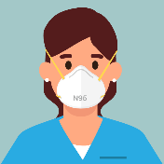

COVID-19: Preventative actions - masks
Wear masks that*:
  Have two or more layers of washable, breathable fabric
  Completely cover the nose and mouth
  Fit snug against the sides of the face and not have gaps
  Have a nose wire to prevent air from leaking out of the top of the mask
It is important to determine and wear the appropriate type of mask based on the setting
*CDC Guide to Masks

Slide 15

COVID-19: Other preventative actions to continue
Stay at least 1.8 meters*, or further, apart from others
Avoid crowded spaces and spaces with poor ventilation
Perform hand hygiene
Keep high-touch surfaces clean
Monitor symptoms and get tested if ill
*1.8 meter based on CDC recommendations. WHO recommends at least 1 meter apart
Notes:
Physical distancing should be at least 1.8 meters (6 ft) based on CDC recommendations
Hand washing should be done for at least 40-60 seconds based on WHO‘s recommendation
Alcohol-based hand rub should contain at least 60% alcohol
Additional guidance:
Guide to local production: WHO-recommended Handrub Formulations (https://www.who.int/gpsc/5may/Guide_to_Local_Production.pdf)

Slide 16
Infection Prevention and Control (IPC) for COVID-19

Slide 17
What is IPC?
The practice of preventing or stopping the spread of infections during healthcare delivery
  Hospitals, outpatient clinics, dialysis centers, long-term care facilities, traditional practitioners
IPC Goal for COVID-19: To support the maintenance of essential healthcare services by containing and preventing COVID-19 transmission within healthcare facilities to keep patients and healthcare workers healthy and safe
Notes:
IPC is a critical part of health system strengthening and must be a priority
In the context of COVID-19, infection control is important because there is currently no vaccine and no anti-viral treatment
Healthcare personnel are at high risk for infection if they do not follow infection control rules
Strict infection control is the only way to help stop the spread of COVID-19 in healthcare facilities

Slide 18
COVID-19: IPC Priorities
Rapid identification of suspect cases
  Screening/triage at initial healthcare facility encounter and rapid implementation of source control
  Limiting entry of healthcare workers and/or visitors with suspected or confirmed COVID-19
Immediate isolation and referral for testing
  Group patients with suspected or confirmed COVID-19 separately
  Test all suspected patients for COVID-19
Safe clinical management
  Immediate identification of inpatients and healthcare workers with suspected COVID-19
Adherence to IPC practices
  Appropriate personal protective equipment (PPE) use
Strategic Priority IPC Activities for Containment and Prevention

Slide 19
COVID-19: IPC in the context of vaccination delivery
Key IPC measures should be implemented for vaccine delivery*
  Hand hygiene
    All staff on arrival and leave, should wash their hands with soap and water
    Functioning hand hygiene stations should be available
  PPE
    Staff administering vaccine should wear a medical mask and individual receiving vaccine should wear a medical or fabric mask
  Injection safety
    Perform hand hygiene before preparing injection materials
    Pierce the septum with a sterile needle every time it is used
  Environmental cleaning and waste management
    Discard used syringes as a single unit into a sharps container immediately
    Perform regular environmental cleaning and disinfection of areas at least twice daily
*WHO IPC principles and procedures for COVID-19 vaccination activities

Slide 20
Standard and Transmission-Based Precautions
Standard Precautions
  Set of practices that apply to care of all patients in all healthcare settings
Transmission-Based Precautions
  Set of practices specific for patients with known or suspected infectious agents that require additional control measures to prevent transmission
  Used in addition to Standard Precautions

Slide 21

Standard Precautions
Hand hygiene
Personal protective equipment (PPE)
Respiratory hygiene and cough etiquette
Cleaning and disinfection of devices and environmental surfaces
Safe injection practices
Medication storage and handling
Notes:
Standard precautions remain the cornerstone for infection prevention in all healthcare settings
Standard precautions are recommended for the care of all patients, regardless of suspected or confirmed infection
Application of standard precautions depends on the nature of health worker personnel-patient interaction and the anticipated exposure to known infectious agents

Slide 22

COVID-19: Transmission-Based Precautions
Wear PPE for contact and droplet precautions*
  Unless an aerosol-generating procedure is performed, in which case airborne precautions are needed
Use disposable or dedicated patient care equipment (e.g., stethoscopes, blood pressure cuffs)
  If equipment needs to be shared among patients, clean and disinfect it between use for each patient by using ethyl alcohol of at least 70%
*WHO Infection prevention and control during healthcare when COVID-19 is suspected or confirmed
Notes:
Current WHO guidance for HCW caring for suspected or confirmed COVID-19 patients recommends the use of contact and droplet precautions, in addition to standard precautions which should always be used by all HCW for all patients.

Slide 23

COVID-19: Transmission-Based Precautions
Use adequately ventilated single rooms (preferable) or dedicated COVID-19 ward rooms with dedicated bathrooms
  Bathrooms should be cleaned and disinfected twice daily
Avoid transporting COVID-19 patients out of room unless medically necessary
  Place a mask on COVID-19 suspected or confirmed patients if transport out of a room is medically necessary
  Healthcare workers should wear appropriate PPE during transport*
Designate healthcare workers to care for patients with COVID-19
Restrict the number of visitors allowed
*WHO Rational Use of personal protective equipment for COVID-19
Notes:
For general ward rooms with natural ventilation, adequate ventilation for COVID-19 patients is considered to be 60 L/s per patient
When single rooms are not available, suspected COVID-19 patients should be grouped together
All patient’s beds should be at least 1 meter apart

Slide 24
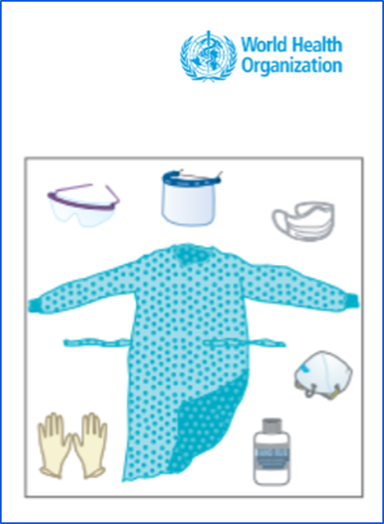
COVID-19: PPE
Healthcare workers should:
  Use a medical mask (i.e., at least a surgical/medical mask)
    N95 respirator in units where aerosol-generating procedures are performed
  Wear eye protection (goggles) or facial protection (face shield)
  Wear a clean, non-sterile, long-sleeved gown
  Use gloves
Healthcare workers should be trained on correct use of PPE, including putting on and taking off PPE
  Extended use and re-use of certain PPE items (e.g., mask, gown) can be considered if supply shortage
Risk of self-contamination is high when removing PPE
Instructions for putting on and removing PPE
Notes:
Contact and droplet precautions include wearing disposable gloves to protect hands, and clean, non-sterile, long-sleeve gown to protect clothes from contamination, medical masks to protect nose and mouth, and eye protection (e.g., goggles, face shield), before entering the room where suspected or confirmed COVID-19 patients are admitted. Respirators (e.g. N95) are only required for aerosol generating procedures
The use of boots, coverall, and apron is NOT required during routine care
After patient care, the appropriate doffing techniques, disposal of PPE and hand hygiene should be followed (see link in slide for more detail)
HCWs that are transporting patients should perform hand hygiene and wear the appropriate PPE described on this slide

Slide 25
Aerosol-Generating Procedures*
PPE Recommendations for aerosol-generating procedures performed on COVID-19 patients:
A fitted respirator (N95, FFP2, or equivalent) as opposed to surgical/medical masks
Gloves
Long-sleeved gown
Eye protection (goggles/face shield)
Endotracheal intubation
Bronchoscopy
Non-invasive ventilation
Tracheotomy
Manual ventilation before intubation
Cardiopulmonary resuscitation
Sputum induction
*current list provided by WHO - COVID-19 Clinical management: living guidance
Notes:
For healthcare workers performing any of the aerosol generating procedures listed above on patients with COVID-19 in the ICU, it is recommended that a fitted respirator mask (N95 respirators, FFP2, or equivalent) is used as opposed to surgical/medical masks
In addition to wearing a fitted respirator mask, HCWs should also wear PPE including gloves, gown and eye protection (goggles/face shield)

Slide 26
Infection Prevention and Control Resources for COVID-19 in non-US Healthcare Settings
Strategic Priority IPC Activities for Containment and Prevention
Triage SOP
Identification of Healthcare Workers and Inpatients with Suspected COVID-19
Management of Visitors to Healthcare Facilities
Interim Operational Considerations for Public Health Management of Healthcare Workers Exposed to or Infected with COVID-19
Operational Considerations in Outpatient Facilities
Notes:
Strategic Priority IPC Activities for Containment and Prevention
https://www.cdc.gov/coronavirus/2019-ncov/hcp/non-us-settings/ipc-healthcare-facilities-non-us.html
Triage SOP
https://www.cdc.gov/coronavirus/2019-ncov/hcp/non-us-settings/sop-triage-prevent-transmission.html
Identification of Healthcare Workers and Inpatients with Suspected COVID-19
https://www.cdc.gov/coronavirus/2019-ncov/hcp/non-us-settings/guidance-identify-hcw-patients.html
Management of Visitors to Healthcare Facilities
https://www.cdc.gov/coronavirus/2019-ncov/hcp/non-us-settings/hcf-visitors.html
Interim Operational Considerations for Public Health Management of Healthcare Workers Exposed to or Infected with COVID-19
https://www.cdc.gov/coronavirus/2019-ncov/hcp/non-us-settings/public-health-management-hcw-exposed.html

