Slide 1
Indicators for Monitoring COVID-19 Community Levels and COVID-19 and Implementing COVID-19 Prevention Strategies
Accessible Version: https://www.cdc.gov/coronavirus/2019-ncov/science/community-levels.html
Overview and Scientific Rationale
February 25, 2022
Notes:
As we see the Omicron wave continue to wane, we know that you may have questions regarding what prevention strategies are really necessary for this moment, especially as people are so eager to remove them. At CDC, we provide public health guidance to help communities make decisions based on the risk at the local level — community-level guidance that offers the public information they need to stay safe and protect others. We are looking at all of our guidance based not only on where we are right now in the pandemic, but also on the tools we now have at our disposal — such as vaccines, boosters, tests, and treatments — and our latest understanding of the disease. As we consider future metrics, we recognize the importance of not just cases which continue to result in substantial or high community transmission in over 97 percent of our counties in the country, but critically, medically severe disease that leads to hospitalizations. We must consider hospital capacity as an additional important barometer. Our hospitals need to be able to take care of people with heart attacks and strokes. Our emergency departments can’t be so overwhelmed that patients with emergent issues have to wait in line. We are assessing the most important factors based on where we are in the pandemic, and align them to guidance that is relevant and encourages prevention measures when they are most needed to protect public health and our hospitals.

Slide 2
Why refocus efforts for monitoring COVID-19 in communities?
Shift from eliminating SARS-CoV-2 transmission towards more relevant metrics given current levels of population immunity and tools available
Current high levels of population immunity reduce risk of severe outcomes
High rates of vaccination in population as a whole
Availability of boosters, and booster coverage among populations at high risk
In unvaccinated, high rates of infection-induced protection
Breadth of tools available for public health and clinical care
Broad access to vaccines, therapeutics, testing
Community measures should focus on minimizing the impact of severe COVID-19 illness on health and society
Preventing medically significant illness
Minimizing burden on the healthcare system
Protecting the most vulnerable through vaccines, therapeutics, and COVID-19 prevention

Slide 3
CDC’s Indicators of Community Transmission
Indicator | Low Transmission | Moderate Transmission | Substantial Transmission | High Transmission
Total new cases per 100,000 persons in the past 7 days | 0-9 | 10-49 | 50-99 | ≥100
Percentage of Nucleic Acid Amplification Test results that are positive during the past 7 days | <5.0% | 5.0%-7.9% | 8.0%-9.9% | ≥10.0%
First released in September 2020
Relied on two metrics to define community transmission: Total new cases per 100,000 persons in the past 7 days, and percentage of Nucleic Acid Amplification Test results that are positive during the past 7 days
Used by CDC to inform setting-specific guidance and layered prevention strategies (e.g., screening testing in schools, masking, etc.)
Public health practitioners, schools, businesses, and community organizations also rely on these metrics to inform decisions about prevention measures

Slide 4
The current state of the pandemic requires a refined approach to monitoring COVID-19
Community transmission indicators were developed in fall 2020 (prior to availability of vaccines) and reflect goal of limiting transmission in anticipation of vaccines being available
Neither of the community transmission indicators reflects medically significant disease or healthcare strain
Community transmission levels are largely driven by case incidence, which does not differentiate mild and severe disease

Slide 5
Criteria for Selecting Community Indicators
Indicators had to meet several criteria:
Data available at the county level or allocated to county level from health service areas
Data source provides nation-wide coverage
Data reflect intended goals of emphasizing medically significant disease and healthcare strain
Data reported at least weekly (or more often) with sufficient timeliness to allow data to inform decisions about prevention measures

Slide 6
Selecting COVID-19 Community Indicators
Criteria were established to assess potential candidate indicators
Review of historical data from 18 months of the pandemic
Compiled available indicators across data systems
Assessed trends in increases and declines in cases, hospital capacity, other indicators
Reviewed historical data and thresholds used in COVID-19 Community Profile Report | HealthData.gov and State Profile Report
Assessed candidate indicators against criteria and eliminated those that did not fully meet established criteria
Deaths, while an important metric, are a lagging indicator and have low numbers which result in unstable estimates at local levels
Emergency Department visits from the National Syndromic Surveillance Program are a promising indicator, but include 71% of emergency departments, so do not have national coverage

Slide 7
Final Selection of COVID-19 Community Indicators
Narrowed the list of candidate indicators based on criteria:
New hospital admissions with confirmed COVID-19/100,000 people and percent of inpatient beds occupied with COVID-19 patients selected as best candidates
ICU beds occupied, new hospital admissions/100 beds, test positivity, and metrics reflecting percent change (e.g., in new admissions, new cases) eliminated
New cases retained as a potential candidate to assess performance as leading indicator

Slide 8
Establishing Thresholds for COVID-19 Community Levels
Used correlation analyses and thresholds from Community Profile Reports and State Profile Reports to assess potential thresholds
Correlations indicate:
100 cases/100,000 population per week corresponds to about 3-4% of COVID-19 inpatient bed utilization, 6-10 new admissions/100,000 population
Inpatient bed occupancy is about half that of ICU occupancy
Fewer new admissions, fewer admissions per case, and lower inpatient bed utilization in areas with higher vaccination coverage
Established candidate thresholds, then tested to calibrate levels

Slide 9
Indicator Performance Analysis Results
Question | Answer
What is the appropriate outcome variable? | Deaths, with ICU bed utilization as a secondary indicator. Both are correlated with transmission levels and COVID-19 community levels.
What is the optimal lag between the community level/transmission level and the outcome? | Correlation with death rates for new cases, hospital admissions and bed utilization peaks when the lag is set at 3 weeks.
How do individual indicators such as admissions, inpatient bed utilization predict outcomes? | Individual indicators have moderate correlation with deaths/100k three weeks later (~0.3) at the county level and high correlation (~0.8) at the state level. COVID-19 community levels (county: 0.3, state: 0.7) have higher correlations with death rates than transmission levels (county: 0.2, state: 0.5)
Which scheme (transmission levels or COVID-19 community levels) is more useful for identifying regions that will experience severe outcomes? | COVID-19 community levels are a more effective categorization scheme for identifying regions that will experience high death rates 3 weeks later according to multiple metrics (correlation, AUROC).
Should the thresholds be adjusted in response to this analysis? | Adjusting thresholds shifts the balance between levels and more balanced categorizations are more informative. COVID-19 community levels result in more balanced categories/levels.

Slide 10
Do community transmission levels or COVID-19 community levels better predict deaths and ICU utilization in counties?
Do higher transmission levels and higher COVID-19 community levels correspond to more severe outcomes 3 weeks later?
Multiple analyses using different indicator thresholds were conducted to optimize the levels. COVID-19 community levels provided consistently better prediction compared with community transmission.
Analyses used AUROC (area under receiver operating characteristic). This can be interpreted as the probability that given two randomly selected observations from different levels, the one with the more severe outcome comes from a higher transmission/COVID-19 community level. Data analyzed included historical data from March 2021-January 2022
A score of 0.5 would correspond to random guessing and a score of 1 would indicate that worse outcomes always correspond to higher COVID-19 community levels/transmission levels.
COVID-19 community levels are better predictors of deaths and ICU utilization 3 weeks later than community transmission levels at the county level.
Analyses using AUROC, Spearman’s correlation, and Pearson’s correlation coefficient provide consistent results.
Analyses used 4-level schemes for COVID-19 community levels and then were pared down to 3 levels based on end-user feedback.

Slide 11
Indicator Thresholds were Further Refined
Compared different combinations of thresholds
With/without case threshold, and with different case thresholds (100, 200, 500, 1000 cases/100,000/week)
Different levels of new COVID-19 hospital admissions and inpatient beds occupied by COVID-19 patients
Optimized levels based on thresholds with consistently higher performance at predicting ICU bed utilization, deaths, new admissions, and inpatient bed use 3 weeks later

Slide 12
CDC’s COVID-19 Community Levels and Indicators
New Cases (per 100,000 population in the last 7 days) | Indicators | Low | Medium | High
Fewer than 200 | New COVID-19 admissions per 100,000 population (7-day total) | <10.0 | 10.0-19.9 | ≥20.0
 | Percent of staffed inpatient beds occupied by COVID-19 patients (7-day average) | <10.0% | 10.0-14.9% | ≥15.0%
200 or more | New COVID-19 admissions per 100,000 population (7-day total) | NA | <10.0 | ≥10.0
 | Percent of staffed inpatient beds occupied by COVID-19 patients (7-day average) | NA | <10.0% | ≥10.0%
The COVID-19 community level is determined by the higher of the inpatient beds and new admissions indicators, based on the current level of new cases per 100,000 population in the past 7 days

Slide 13
COVID-19 community levels are better predictors of deaths and ICU utilization in communities
The proposed COVID-19 community levels provide a sizeable improvement over the community transmission levels in identifying regions that will experience severe outcomes 3 weeks later
To prevent deaths and ICU bed use, COVID-19 community levels using new indicator metrics provide more robust measures
COVID-19 community levels result in more meaningful differences between categories

Slide 14
COVID-19 community levels on March 30, 2021 (post Alpha)
Winter 2020-2021
Delta
Omicron

Slide 15
COVID-19 Community Levels on March 30, 2021
COVID-19 Community Level
Community Transmission
 | % of Counties | % of Pop.
Low | 67.3% | 56.9%
Medium | 22.0% | 23.4%
High | 10.6% | 19.7%
 | % of Counties | % of Pop.
Low | 9.3% | 1.4%
Moderate | 22.0% | 17.3%
Subst. | 28.3% | 26.4%
High | 40.5% | 54.9%

Slide 16
COVID-19 community levels on July 30, 2021 (rise of Delta)
Winter 2020-2021
Delta
Omicron

Slide 17
COVID-19 Community Levels on July 30, 2021
COVID-19 Community Level
Community Transmission
 | % of Counties | % of Pop.
Low | 49.6% | 57.7%
Medium | 20.2% | 18.3%
High | 30.1% | 23.9%
 | % of Counties | % of Pop.
Low | 4.8% | 0.4%
Moderate | 15.7% | 12.1%
Subst. | 18.2% | 28.0%
High | 61.3% | 59.4%

Slide 18
COVID-19 community levels on September 3, 2021 (peak of Delta)
Winter 2020-2021
Delta
Omicron

Slide 19
COVID-19 Community Levels on September 3, 2021
COVID-19 Community Level
Community Transmission
 | % of Counties | % of Pop.
Low | 8.1% | 14.9%
Medium | 12.2% | 20.5%
High | 79.6% | 64.7%
 | % of Counties | % of Pop.
Low | 0.5% | 0.0%
Moderate | 0.4% | 0.0%
Subst. | 2.0% | 1.2%
High | 97.0% | 98.8%

Slide 20
COVID-19 community levels on November 5, 2021 (between Delta and Omicron)
Winter 2020-2021
Delta
Omicron

Slide 21
COVID-19 Community Levels on November 5, 2021
COVID-19 Community Level
Community Transmission
 | % of Counties | % of Pop.
Low | 38.3% | 58.5%
Medium | 21.5% | 16.5%
High | 40.1% | 25.0%
 | % of Counties | % of Pop.
Low | 2.6% | 0.6%
Moderate | 9.4% | 8.6%
Subst. | 16.8% | 32.5%
High | 71.2% | 58.2%

Slide 22
COVID-19 community levels on January 15, 2022 (peak of Omicron)
Winter 2020-2021
Delta
Omicron

Slide 23
COVID-19 Community Levels on January 15, 2022
COVID-19 Community Level
Community Transmission
 | % of Counties | % of Pop.
Low | 0.2% | 0.0%
Medium | 3.2% | 0.5%
High | 96.5% | 99.5%
 | % of Counties | % of Pop.
Low | 0.3% | 0.0%
Moderate | 0.0% | 0.0%
Subst. | 0.1% | 0.0%
High | 99.6% | 100.0%

Slide 24
Proposed Framework for Monitoring and Prevention
Community Metrics
Community Actions
COVID-19 Vaccination Coverage
Overall coverage of people up to date
Coverage among people at increased risk of severe illness and health equity
Vaccine Activities
Outreach
Campaigns
Distribution
Equity
Inform
Higher vaccination coverage likely to result in lower community levels
COVID-19 Community Indicators
Healthcare strain
Hospital admissions of severely ill patients
New cases (leading indicator)
Prevention Measures
Masking
Testing
Other individual prevention behaviors
Other community-level prevention strategies
Local vaccine activities and recommended prevention measures for different community levels inform local decisions
Inform
Local metrics and information provide context to interpret community level
Local Metrics and Information
Wastewater surveillance
Circulating novel variants of concern
Local high-risk congregate settings
Upcoming large events
Health equity
Local Decisions
Inform

Slide 25
Implications for Using COVID-19 Community Levels to Inform Public Health Recommendations
COVID-19 community levels can inform recommendations for community-level preventive strategies and individual preventive behaviors
At higher COVID-19 community levels recommendation would include:
Masking
Testing Strategies (e.g., screening testing)
High-risk individuals and their household or social contacts (e.g., masking, testing, and access to treatments)
Setting-specific recommendations (e.g., K-12 schools, healthcare)
High-risk congregate settings (e.g., masking and screening testing)

Slide 26
Key Considerations
Vaccination is the leading public health prevention strategy to prevent severe disease and deaths from COVID-19.
People who are up to date on vaccines have much lower risk of severe illness and death from COVID-19 compared with unvaccinated people.
When making decisions about individual preventive behaviors and community prevention strategies in addition to vaccination, people and health officials should consider the COVID-19 community level.
Health departments should consider health equity, and make use of other surveillance information (wastewater, ED surveillance, etc.), if available, to inform local decisions.
Layered prevention strategies — like staying up to date on vaccines and wearing masks — can help prevent severe disease and reduce strain on the healthcare system.

Slide 27
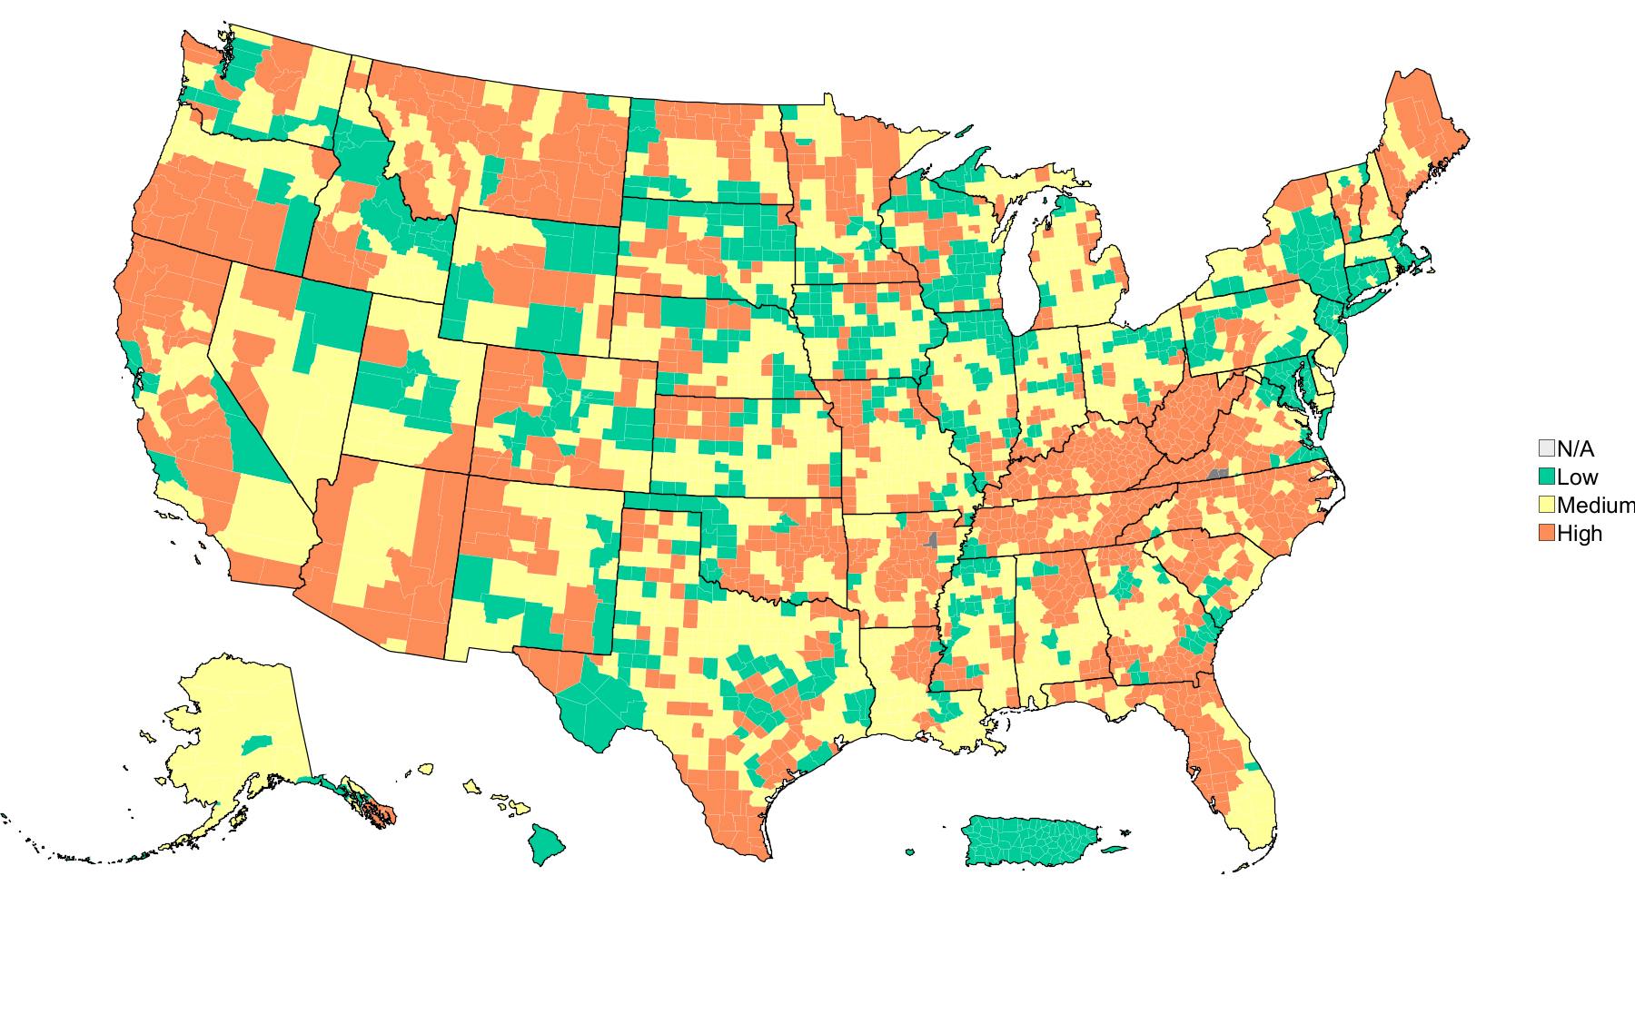
COVID-19 community levels on February 24, 2022
 | % of Counties | % of Pop.
Low | 23.0% | 29.5%
Medium | 39.6% | 42.2%
High | 37.3% | 28.2%

Slide 28
Data sources and acknowledgments
Data sources
Unified Hospital Data Surveillance System (UHDSS)
Aggregate Case and Death Counts (ACDC)
Acknowledgments
Johns Hopkins University’s Applied Physics Laboratory
CDC COVID-19 Response

