Slide 1


Training for Health Systems:
The CDC Health Systems Scorecard v2.0
Your agency/name here
See speaker’s notes for additional information.

Slide 2

Overview
Background and Purpose
Implementation of HSSC in the Field
Benefits of the HSSC v2.0
Updates informed by HSSC v1.0 Evaluation
Evidence-Based Modules
Module Structure and Scoring
Requesting Access to the HSSC v2.0
Establishing a Formsite® account
Using the HSSC v2.0 in Formsite®
New Save & Return Feature
E-Version Demonstration
Accessing the HSSC v2.0 Data in Formsite®
Future steps
HSSC v2.0 = Health Systems Scorecard v2.0

Slide 3
Background and Purpose
A voluntary quality improvement tool to assist:
  State and local public health programs better understand implementation of evidence-based strategies in partner health systems
  Small- to medium-sized health systems to assess current primary care practices, identify possible gaps, and prioritize strategies with the highest impact
  Create dialogue on chronic disease management and potential improvements
Health conditions included:
  High blood pressure, high cholesterol, prediabetes or diabetes, obesity, chronic obstructive pulmonary disease (COPD), cancer, and tobacco use
Notes:
Addressing chronic diseases and associated health risk factors is a pressing and costly challenge for the U.S. health care system. Yet, there is a lack of standard approaches to assess the current state of primary care management strategies and processes for adults with high blood pressure, high cholesterol, prediabetes or diabetes, obesity, COPD, cancer, or who smoke.
The Health Systems Scorecard was developed as a voluntary quality improvement tool that can be used by health departments to
better understand how evidence-based strategies are being implemented by small to medium-sized health systems in their state,
and to identify possible gaps and prioritize high impact strategies for the improved management of chronic disease.
Results from the Scorecard can be used by health systems and health departments to guide a dialogue on chronic disease management and potential improvements.

Slide 4
Implementation of HSSC in the Field
A health department successfully deployed the CDC HSSC to more than 250 health systems to understand the use of evidence-based interventions to manage high blood pressure and diabetes.
Results helped them refine the implementation of interventions designed to address high blood pressure and diabetes among health systems.
  Ensure ongoing systematic support for quality improvement.
  Identify combinations of interventions with the biggest impact on clinical quality of health systems and health outcomes of the populations served.
Notes:
You may enter your own case example here.

Slide 5
Benefits of the HSSC v2.0
Better understand implementation of evidence-based strategies in health systems.
Address comprehensive chronic disease focus areas, using strategies supported by best available evidence.
Assess and identify possible gaps and prioritize strategies with the highest impact.
Use for quality improvement and evaluation purposes.
Immediate user score report with tailored implementation resources.

Slide 6
Updates Informed by HSSC v1.0 Evaluation
Selectively added items and resources
Revised item wording for clarity/relevance to multiple audiences
Added terms to the glossary and content to the resource guide
Reordered and added links between the tool’s content
Added a feature that enables users to save progress
Added slide decks for health department and health system training
Improved access to sample HSSC questions and feedback report
Notes:
A rapid evaluation was conducted in which semi-structured interviews were conducted with 9 state health departments to get their recommendations regarding possible improvements to the first version of the HSSC.
Here are just a few examples the updates that resulted in the 2nd version of the HSSC and its supporting documentation, which is now going live.
In addition, its worth noting that an HSSC workgroup consisting of health department representatives informed these efforts.

Slide 7
Evidence-Based Modules
A: Using multidisciplinary teams for care management
B: Clinical guidelines*
C: Electronic health record (EHR) systems and patient tracking systems
D: Clinical decision support and protocols*
E: Patient education*
F: Self-management and care management*
G: Tobacco use and dependence cessation
H: Guidelines for screening for breast, cervical, and/or colorectal cancer*
* Bolded and starred modules are stratified by disease.
Notes:
Four modules—clinical guidelines, clinical decision supports and protocols, patient education, and self-management and care management—are stratified by disease type. And module H is stratified by cancer type. Stratifying these modules allowed for a more targeted assessment and scoring process.
For each Scorecard item, the user indicates “yes” or “no” to whether their health system has a policy in place in the past 12 months to support the strategy. A score of either 1, 2 or 3 is assigned to each “yes” response. The scoring is based on the quality and strength of evidence that the strategy can impact the disease or condition outcome, using the QuIC methodology which I’ll explain a little later.

Slide 8
Module Structure and Scoring
Stratified modules:
  By disease (high blood pressure, high cholesterol, prediabetes or diabetes, obesity, or COPD) — Modules B, D, E, F
  By cancer type (breast, cervical, colorectal) — Module H
User indicates existence/nonexistence of evidence-based policy in health system
“Yes” answers are scored 1–3 pts based on strength of evidence and expert opinion
  Extensive literature search, Quality and Impact of Component evidence assessment methodology
Notes:
After the user completes a module or modules, the system will produce a final score and a list of recommended resources for areas where the health system scored low.
Ideally, the health system can choose to share the results with the partner health department to guide a dialogue about potential improvements and useful resources.
And, just as a reminder, no data will be shared with or stored by CDC.

Slide 9
Requesting Access to the HSSC v2.0
To obtain access to the HSSC v2.0, users can reach out to participating state health department representatives.
Users can review the comprehensive list of HSSC questions at https://www.cdc.gov/dhdsp/evaluation_resources/guides/index.htm.

Slide 10
Establishing a Formsite® Account
HSSC v2.0 uses the web-based survey software Formsite® (www.formsite.com).
Health systems are not required to create an account to complete the HSSC v2.0. However, your partner health department may have already established one for you.
It is recommended that health systems check with their health department on the status of the account prior to completing the Scorecard.
Health departments will have access to the HSSC v2.0 and can send the link to you at no cost.
HSSC v2.0 results are then available to the health department, but not to the CDC.
Notes:
If enabled by your health department, users can save their progress thus far by utilizing the Save and Return button, typically located on the first page. The link to the form can then be shared with other users who can access it through the same account.
We recommend logging into your account provided by your health department prior to beginning answering the questions. If you do not have an account, information will not be saved to complete the form or retrieve entered information or results.

Slide 11
Using the HSSC v2.0 in Formsite®
Answer “Yes,” “No,” or “not applicable” (“N/A”) for each HSSC item.
All questions should be answered consistently according to the policies or protocols that are currently in place or were established within the last 12 months in the health system.
Navigate between modules by pressing the “Next” and “Previous” buttons at the bottom of each page.
Glossary terms are bolded in blue. Citations links are available at the top of each module.
User responses to the HSSC v2.0 questions and raw data will be housed in the health department’s Formsite® account.
NOTE: No data will be shared with or stored by the CDC.

Slide 12
New Save & Return Feature
If your partner health department enables this feature, you can save your progress and return to complete at another time or share the form with another member of your team.
  We recommend users contact their health department to inquire if this feature is enabled.
There are two options for usernames under Save & Return:
  Your partner health system can provide a username and password for you.
  You can create your own username and password (it is recommended that you inform your partnering health department of your username).
Notes:
New to Formsite is the Save & Return feature. Under this feature, you can save their progress and return to complete the ScoreCard at another time. You can also share the login information with another member of their team to enter responses that they may be more familiar with.
Your partnering health department can provide a username and password for you, or you can create your own username and password. Either option will allow your partnering health department to view your responses and completion status. We do, however, recommend that you inform your partnering health department of your username if you create your own so they may associate your responses to the username account.

Slide 13
E-Version Demonstration

Slide 14
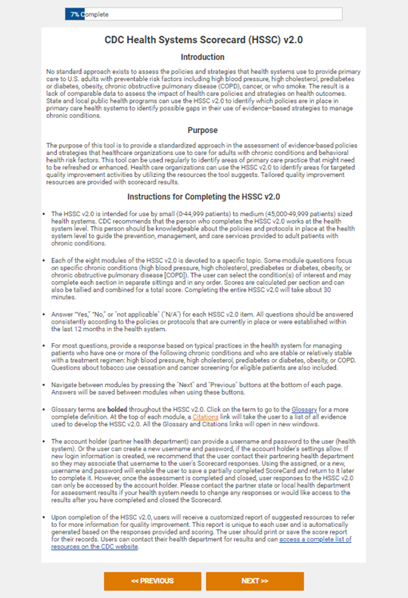
Step 1: Introduction to CDC HSSC v2.0
It is recommended the user completing the HSSC v2.0 should be:
  Someone at the health system level.
  Knowledgeable about the policies and protocols in place related to prevention, management, and care of chronic disease.
  Familiar with key data systems.
The HSSC v2.0 introduction page includes basic instructions for how to complete the Scorecard.

Slide 15
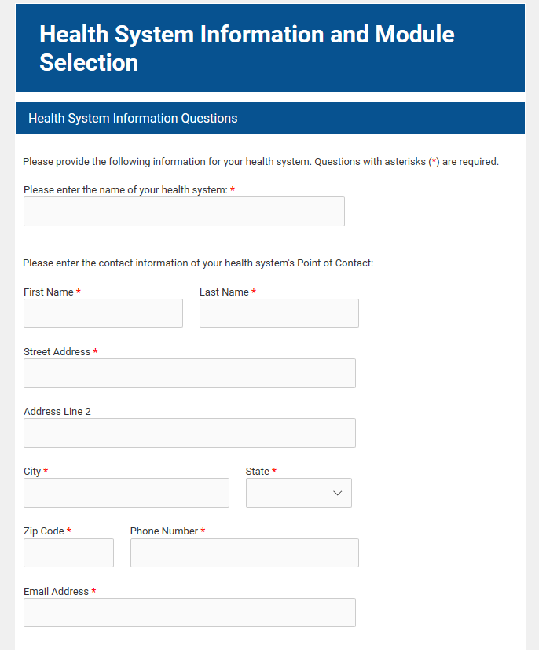
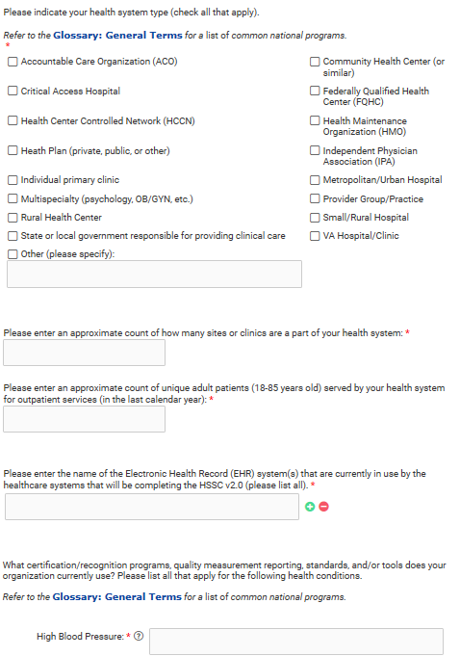
Step 2: Health System Information
Enter your health system information:
  Name
  Contact information
  Demographics

Slide 16
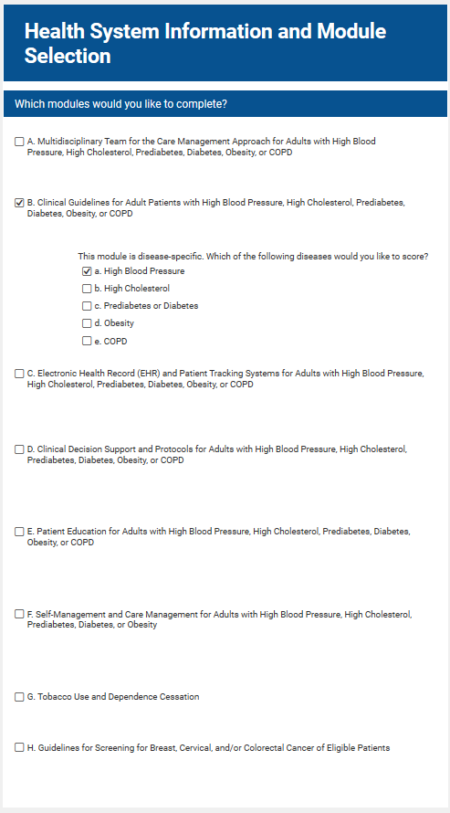
Step 3: Selecting Modules
Select the modules you wish to complete.
Consider working with your health department to select modules that can inform the highest-priority areas for health care quality improvement.
Users can save and return to complete later (provided the Save & Return feature is enabled).

Slide 17
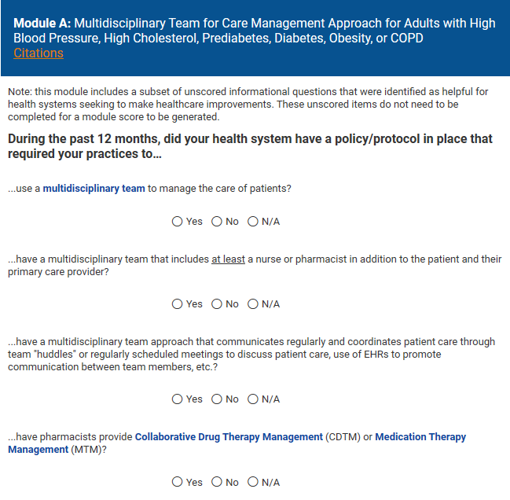
Step 4a: Completing Modules
The Citations link on every module page will bring you to the evidence supporting each module.
Hovering over or clicking the bolded blue terms will provide definitions of the terms.

Slide 18
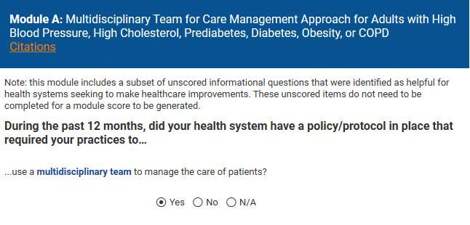
Step 4b: Skip Patterns
Some modules utilize skip patterns based on the user’s answers (Module A is an example of this).
The first question in this module asks if the health system has a policy to use multidisciplinary teams.
If you select Yes, the informational question asking who is included on the multidisciplinary teams will appear.
It is important to note that some modules include skip patterns similar to this example.

Slide 19
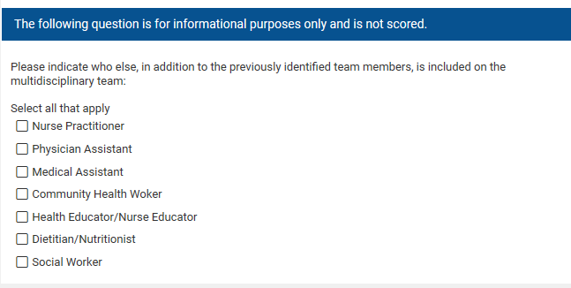
Step 4c: Informational Questions
Some questions will be noted as “for informational purposes only” and are not scored.
These questions will provide important contextual information related to a given module.

Slide 20
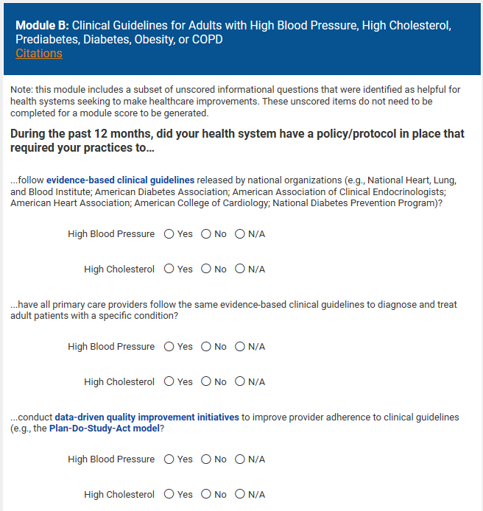
Step 4d: Disease-specific Questions
Some modules are stratified by chronic disease (Module B contains an example of this).*
For stratified modules, only the conditions you selected at the beginning of the Scorecard will appear.
*Please see slide 8 for a full list of modules stratified by chronic disease.

Slide 21
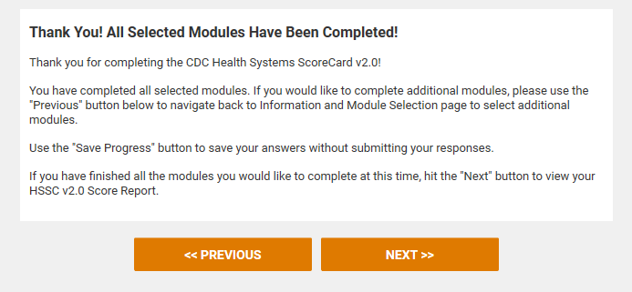
Step 5: Completion of HSSC v2.0
This is what the completion screen should display at completion of all selected modules.
If you decide to complete additional modules, select Previous at the bottom of the page to navigate to the beginning and add modules.
Select Next to go to the “HSSC v2.0 Score Report.”
Notes:
Note: If Save & Return is enabled, the blue “Save Progress” button will appear in between the previous and next buttons.

Slide 22
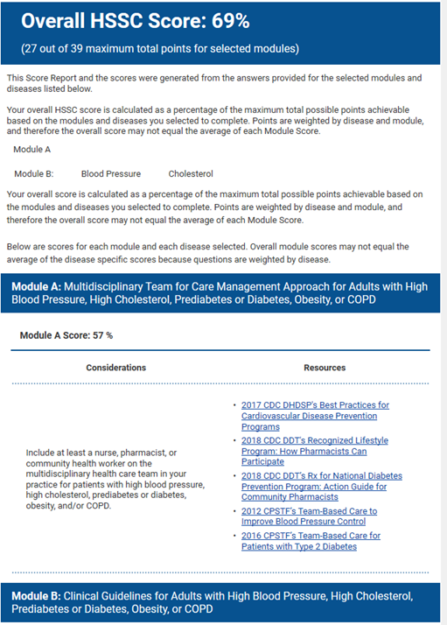
Step 6: Understanding the Score Report
The score report is automatically generated each time the scorecard is filled out.
It provides 3 percentage scores:
  An overall score based on the answers provided to all completed questions in all selected modules
  An overall score for each module
  Scores for each disease selected for the stratified modules
Scores are calculated as a percentage of the maximum total points the user could achieve given the selected modules and/or disease.
For each module, the report provides some helpful considerations and additional resources based on the user’s answers.

Slide 23
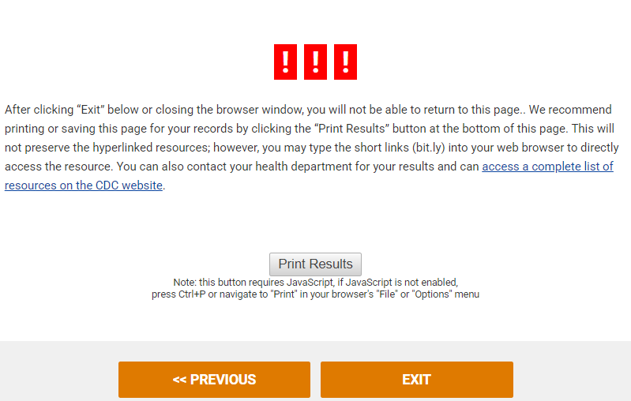
Step 7: Save the Score Report
Once completed, you can select Exit to close the window.
Users can download it as a PDF version.
  NOTE: The hyperlinks will not be active, but short URLs (bit.ly) have been added for easy access to resources.
It is highly recommended to download or save this score report. After this point, only users who accessed the form through a Save and Return link can access their responses and score report.
After this point, only state health departments will have access to the raw data.
Health systems may share results with partner health departments to guide a dialogue about potential improvements and resources.
NOTE: No data will be shared with or stored by the CDC.

Slide 24
Accessing HSSC v2.0 Data in Formsite®
All raw data will reside in the health department’s Formsite® account.
Users must reach out to their health department partners to access raw data.
NOTE: No data will be shared with or stored by the CDC.

Slide 25
Future Steps
We recommend that you complete the HSSC v2.0 periodically to reprioritize health care quality improvement efforts.
For more information regarding the HSSC v2.0 and the implications of results, please visit https://www.cdc.gov/dhdsp/evaluation_resources/guides/index.htm.

Slide 26

Thank you!
Questions and Discussion
For more information, contact: youremail@abc.gov
Notes:
*Note to presenter: Include your contact information on this slide.

