Slide 1


Introduction to the CDC Health Systems Scorecard v2.0
Applied Research and Evaluation Branch
See speaker’s notes for additional information.

Slide 2

Overview
Background and Purpose
Implementation of HSSC in the Field
Benefits of the HSSC v2.0
Updates informed by HSSC v1.0 Evaluation
Evidence-Based Modules
Module Structure and scoring
Requesting Access to the HSSC v2.0
Establishing a Formsite® account
Using and Sharing the HSSC v2.0 in Formsite®
New Save & Return Feature
E-Version Demonstration
Managing HSSC v2.0 Data in Formsite®
Future steps
HSSC v2.0 = Health Systems Scorecard v2.0

Slide 3
Background and Purpose
A voluntary quality improvement tool to assist:
  State and local public health programs better understand implementation of evidence-based strategies in partner health systems
  Small- to medium-sized health systems to assess current primary care practices, identify possible gaps, and prioritize strategies with the highest impact
  Create dialogue on chronic disease management and potential improvements
Health conditions included:
  High blood pressure, high cholesterol, prediabetes or diabetes, obesity, chronic obstructive pulmonary disease (COPD), cancer, and tobacco use
Notes:
Addressing chronic diseases and associated health risk factors is a pressing and costly challenge for the US healthcare system. Yet, there is a lack of standard approaches to assess the current state of primary care management strategies and processes for adults with high blood pressure, high cholesterol, prediabetes or diabetes, obesity, COPD, cancer, or who smoke.
The Health Systems Scorecard was developed as a voluntary quality improvement tool that can be used by health departments to
better understand how evidence-based strategies are being implemented by small to medium-sized health systems in their state,
and to identify possible gaps and prioritize high impact strategies for the improved management of chronic disease.
Results from the Scorecard can be used by health systems and health departments to guide a dialogue on chronic disease management and potential improvements.

Slide 4
Implementation of HSSC in the Field
A health department successfully deployed the CDC HSSC to more than 250 health systems to understand the use of evidence-based interventions to manage high blood pressure and diabetes.
Results helped them refine the implementation of interventions designed to address high blood pressure and diabetes among health systems.
  Ensure ongoing systematic support for quality improvement
  Identify combinations of interventions with the biggest impact on clinical quality of health systems and health outcomes of the populations served

Slide 5
Benefits of the HSSC v2.0
Better understand implementation of evidence-based strategies in health systems
Address comprehensive chronic disease focus areas, using strategies supported by best available evidence
Assess and identify possible gaps and prioritize strategies with highest impact
Use for quality improvement and evaluation purposes
Immediate user score report with tailored implementation resources

Slide 6
Updates Informed by HSSC v1.0 Evaluation
Selectively added items and resources
Revised item wording for clarity/relevance to multiple audiences
Added terms to the glossary and content to the resource guide
Reordered and added links between the tool’s content
Added a feature that enables users to save progress
Added slide decks for health department and health system training
Improved access to sample HSSC questions and feedback report
Notes:
A rapid evaluation was conducted in which semi-structured interviews were conducted with 9 state health departments to get their recommendations regarding possible improvements to the first version of the HSSC.
Here are just a few examples of the updates that resulted in the 2nd version of the HSSC and its supporting documentation, which is now going live.
In addition, it is worth noting that an HSSC workgroup consisting of health department representatives informed these efforts.

Slide 7
Evidence-Based Modules
A: Using multidisciplinary teams for care management
B: Clinical guidelines*
C: Electronic health record (EHR) systems and patient tracking systems
D: Clinical decision support and protocols*
E: Patient education*
F: Self-management and care management*
G: Tobacco use and dependence cessation
H: Guidelines for screening for breast, cervical, and/or colorectal cancer*
* Bolded and starred modules are stratified by disease.
Notes:
Four modules—clinical guidelines, clinical decision supports and protocols, patient education, and self-management and care management—are stratified by disease type. And module H is stratified by cancer type. Stratifying these modules allowed for a more targeted assessment and scoring process.
For each Scorecard item, the user indicates “yes” or “no” to whether their health system has a policy in place in the past 12 months to support the strategy. A score of either 1, 2 or 3 is assigned to each “yes” response. The scoring is based on the quality and strength of evidence that the strategy can impact the disease or condition outcome, using the QuIC methodology which I’ll explain a little later.

Slide 8
Module Structure and Scoring
Stratified modules:
  By disease (high blood pressure, high cholesterol, prediabetes or diabetes, obesity, or COPD) — Modules B, D, E, F
  By cancer type (breast, cervical, colorectal) — Module H
User indicates existence/nonexistence of evidence-based policy in health system
“Yes” answers are scored 1–3 pts based on strength of evidence and expert opinion
  Extensive literature search, Quality and Impact of Component evidence assessment methodology
Notes:
After the user completes a module or modules, the system will produce a final score and a list of recommended resources for areas where the health system scored low.
Ideally, the health system can choose to share the results with the partner health department to guide a dialogue about potential improvements and useful resources.
And, just as a reminder, no data will be shared with or stored by CDC.

Slide 9
Requesting Access to the HSSC v2.0
Send an email requesting access to the HSSC v2.0 to hssc@cdc.gov.
  “HSSC v2.0 Access Request” in the subject line of the email
  The username you created and the name of your health department in the body of the email
CDC will send the HSSC v2.0 directly to your Formsite® account within 5 business days. It will be available under “My Forms.”
You will then be able to use and share the HSSC v2.0 with health system partners.
Users can review the comprehensive list of HSSC v2.0 questions at https://www.cdc.gov/dhdsp/evaluation_resources/guides/index.htm.
You may request a copy of the HSSC v2.0 codebook or a HSSC v1.0-v2.0 comparison codebook by emailing hssc@cdc.gov.

Slide 10
Establishing a Formsite® Account
HSSC v2.0 uses the web-based survey software Formsite® (www.formsite.com).
To administer the HSSC v2.0, a health department must hold a Formsite® account.
  Account prices vary depending on the estimated number of HSSC v2.0 end users.
With an account, health departments will have access to the HSSC v2.0 and can send a link to any user (health system) to complete at no cost.
Notes:
The HSSC uses the web-based survey software Formsite. To administer the HSSC, a health department must hold a Formsite account. Formsite account prices range from about 25 dollars per month to 40 dollars per month*. Accounts can be created online through the Formsite website. With a Formsite account, the health department will have access to the HSSC as long as the account remains open. With access to the HSSC, health departments will be able to administer the scorecard using a link to it that is unique to the health department. Any user may follow this link to complete the HSSC at no cost to the user.
Because the health department is administering the scorecard through their own Formsite account, data resulting from the scorecard may be returned to the health department’s Formsite account but will not be returned to CDC.
Detailed instructions on how to create a Formsite account and access the scorecard are included in the CDC HSSC v2.0 Technical Assistance and Resource Guide for Public Health Departments.
*Note to presenter: Check https://www.formsite.com/pricing/ for most up to date pricing information.

Slide 11
Using and Sharing the HSSC v2.0 in Formsite®
Under “My Forms”, there is a table of forms available to your account. In the “Form Name” column of the table, you will see “Health Systems Scorecard [health department name].”
Hovering over the HSSC v2.0 will show buttons for Edit, Settings, Share, and Results directly under the name Form name.
Select Share to be brought to the “Links” page.
Two link options will appear: “Form” and “Pre-populate.” The “Form” link is the link to the HSSC v2.0 assessment that is unique to your Formsite® and can be shared and used by any user to complete at no additional cost.
User responses to the HSSC v2.0 questions and raw data will be housed in your Formsite® account.
NOTE: No data will be shared with or stored by the CDC.

Slide 12
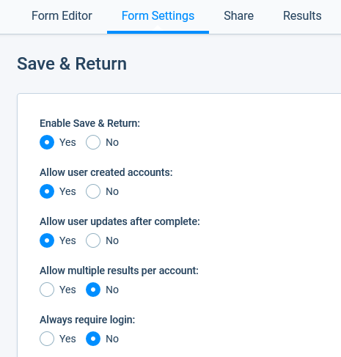
New Save & Return Feature
Users can save their progress and return to complete at another time or share the form with another member of their team.
On your Health Systems Scorecard form’s page, under “Form Settings” you will see the option to enable the “Save & Return” feature.
  This feature is only available on Pro 1 accounts or higher. If you enable this feature, be sure to also embed the Save & Return button on the Form Editor.
In your account settings, you can select whether you would like them to use only the username and password set by you within your account or a username and password of their choice.
  Either option will allow you to view their responses and completion status.
Notes:
New to Formsite is the Save & Return feature. This feature is only available on Pro 1 accounts or higher and can be enabled under “Form Settings” in your account. Under this feature, users can save their progress and return to complete the ScoreCard at another time. They can also share the login information with another member of their team to enter responses that they may be more familiar with. In your account settings, you can select whether you would like your health systems to only use the username and password set by you within your account (see bottom image), or a username and password of their choice. This setting will apply to all health systems that you share the form link with. Either option will allow you to view their responses and completion status.

Slide 13
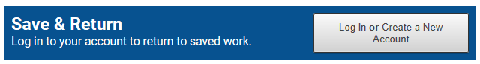
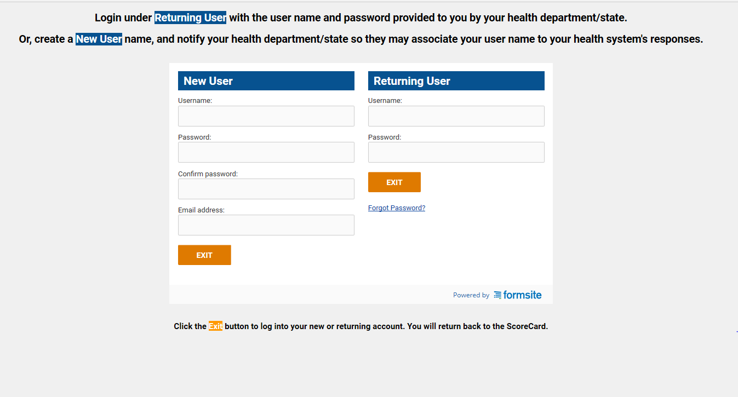
New Save & Return Feature, cont.
Notes:
The top image is an example of the Save and Return login button. Ideally, this button should be placed on the first page of the ScoreCard form, so users can log in prior to entering their responses. Then, they can periodically use the “save progress” button on each module’s page as they complete the ScoreCard.
The bottom image is an example of the landing page users see when they click the Save and Return login button. The image shown is what your page will look like when “Allow User Created Accounts” is enabled: The health systems will have the option to create their own login or use the login information you may have created for them. You can hide the new user option by disabling “Allow User Created Accounts.”
Lastly, the instruction language, headers, and text on the buttons can be modified to fit your needs.

Slide 14
E-Version Demonstration
Notes:
Now we will provide an e-version demonstration of the Scorecard in the platform called FormSite.
(Switch over to Formsite to walk through the tool. This should take about 8 minutes.)
We’ll now run through a quick demonstration of the e-version of the score card to show you exactly how it works.
We start off with some basic instructions. We recommend the person completing the scorecard be someone at the health system level who is most knowledgeable about the policies and protocols in place related to prevention, management, and care of chronic disease. We then include some basic instructions for how to complete the scorecard, which I’ll go over as we proceed through the demo.
The HSSC first asks the respondent to enter the name of their health system. This question is optional. The next question asks which of the 9 modules the user would like to complete. They could choose to complete the scorecard for all included topics at once, or they could choose to just complete one or a few modules at a time. For this demo, we’ll just go through the first two.
You can see module B is one that we have stratified by disease. Similar to the modules themselves, users can choose whether they’d like to complete the scorecard for all included diseases or just a subset. For now, let’s go with high blood pressure and cholesterol.
We then move on to the first selected module, in this case module A. Before getting into the questions, I want to note a couple features that are common across all modules. First, you’ll note the link to the citations included in the heading of every module. Following this link will bring the user to the full list of references for the supporting sources used for the development of the scorecard and its questions. While the link in each module will bring you straight to that module’s sources, the full list for all topics is included.
You’ll also note the terms bolded in blue in the questions. These are our glossary terms that some users may want extra info or clarifications on. For each of these terms, the user can hover over it to see a brief definition, or they can click to be brought to the full glossary. In the glossary, we provide full definitions for each term, as well as some extra resources where more information can be found.
Now let’s get into actually completing the scorecard questions. The first in this module asks if the health system has a policy to use multidisciplinary teams; we’ll go with “yes” here. You can see that after selecting “yes,” another question appeared. For a couple modules, we include some skip patterns like this. In this case, since we responded that the health system does have a policy to use multidisciplinary teams, the scorecard asks a follow-up question related to those teams, whether they include at least a nurse or pharmacists. If we had selected “no,” a different question appears, asking if the system refers patients to specialized clinics, the next best option after team-based care. For our example, we’ll stay with yes.
Carrying on through the questions, let’s say this health system does have collaborative practice agreements in place for pharmacists or CHWs, and say the pharmacists do not provide CDTM or MTM.
You’ll also note this extra question at the bottom. This question is not included in the scoring, but having it allows the user to still see and think about the question. In this case, the user can see the possible options that exist for members of health care teams, and they can think about who they normally include or where they could add.
Let’s move on to module B. If you recall, module B is one that is stratified by disease. In this case, we picked high blood pressure and cholesterol, so those are the only two options that appear. For this example, although it may not be realistic for most systems, I’ll alternate between “yes” and “no” for the two conditions in order to demonstrate features on the next page. And again we have one of those informational questions at the bottom that is not being scored.
We’ve now completed the two modules we selected. However, if we decided we actually would like to complete additional modules now, we can use the arrows at the bottom of the page to navigate back to the beginning and add additional modules to complete, and all answers will be saved. The user can even navigate back to the beginning and add a module while in the middle of completing the scorecard. However, although all answers are saved while the scorecard is being completed, once the user hits the exit button at the end or closes the window, all answers are gone and the user would have to start the HSSC over if they were not finished.
We’re now brought to the end report. This report is automatically generated each time the scorecard is filled out based on the answers given. It first provides an Overall score for all the modules selected as a whole. This score is calculated as a percentage of the maximum total points the user could achieve given the modules selected. Because the score is a percentage, the maximum total points and the specific modules the score corresponds to are provided for clarity. CDC recommends referring to this information when comparing the overall scores on multiple end reports. The report then provides the scores for each module, as well as some helpful considerations and additional resources that are specific to how the user answered the questions.
For module A, you can see we did fairly well, scoring 75%. The percentages given are the percentage of the maximum number of points you could have scored on that module, and I will get into the scoring methodology for each module a little more soon. You’ll remember that the one question we answered no for in module A was about having pharmacists provide CDTM and MTM. Therefore, the scorecard generated this consideration as well as some helpful resources to give some general information to help guide the user to learn more and consider taking steps to implement this strategy at their health system.
Moving on to module B, you can see we have different scores for each disease since we answered differently for both diseases in the questions. Likewise, you’ll note the considerations and resources provided for these questions are specific to the disease.
At the end, we provide instructions on how to save this report for your records. The user could print out this page, or we also give instructions to save it as a PDF, which will allow you to go back and click the links to the provided resources. Once complete, you can hit the exit button or close the window. CDC highly recommends the user print or save this end report, as once the window is closed, the report will be gone and cannot be returned to.
[click exit] That completes the demo, I’ll now briefly go over the process of accessing the HSSC.

Slide 15
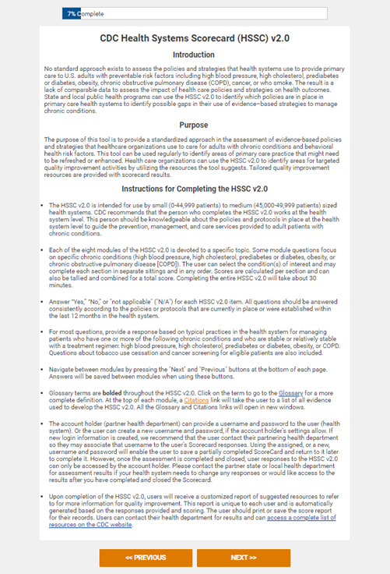
Step 1: Introduction to CDC HSSC v2.0
It is recommended the user completing the HSSC v2.0 should be:
  Someone at the health system level.
  Knowledgeable about the policies and protocols in place related to prevention, management, and care of chronic disease.
  Familiar with key data systems.
The HSSC v2.0 introduction page includes basic instructions for how to complete the Scorecard.

Slide 16
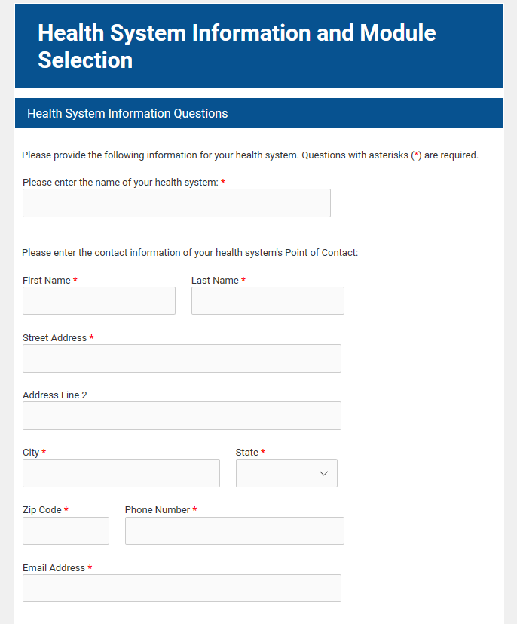
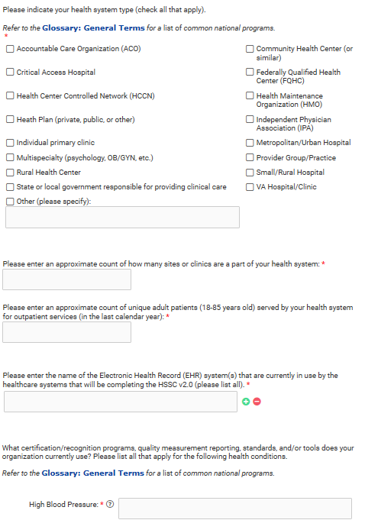
Step 2: Health System Information
Enter your health system information:
  Name
  Contact information
  Demographics

Slide 17
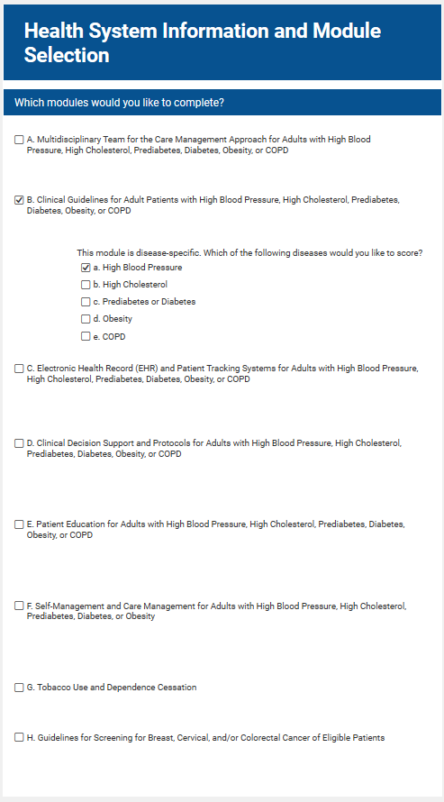
Step 3: Selecting Modules
Select the modules you wish to complete.
Consider working with your health system to select modules that can inform the highest-priority areas for health care quality improvement.

Slide 18
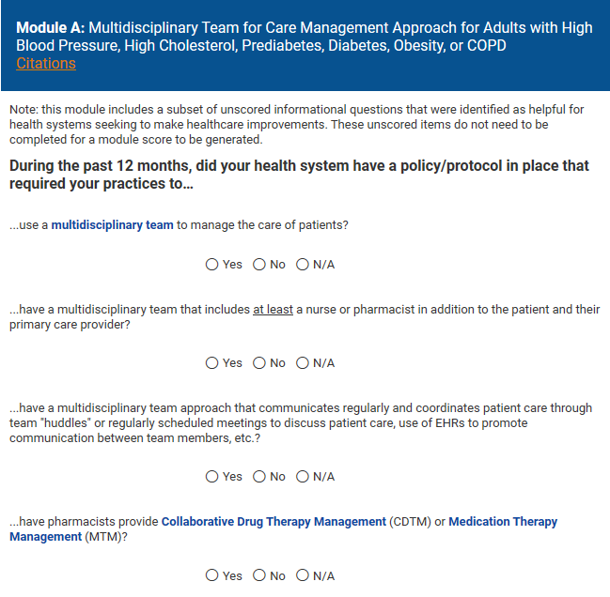
Step 4a: Completing Modules
The Citations link on every module page will bring you to the evidence supporting each module.
Hovering over or clicking the bolded blue terms will provide definitions of the terms.

Slide 19
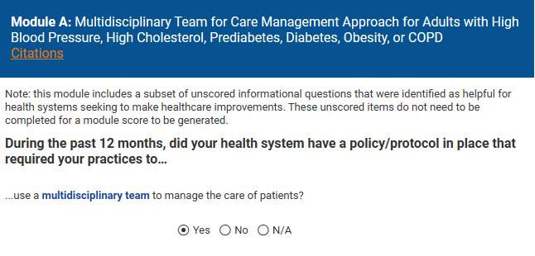
Step 4b: Skip Patterns
Some modules utilize skip patterns based on the user’s answers (Module A is an example of this).
The first question in this module asks if the health system has a policy to use multidisciplinary teams.
If you select Yes, the informational question asking who is included on the multidisciplinary teams will appear.
It is important to note that some modules include skip patterns similar to this example.

Slide 20
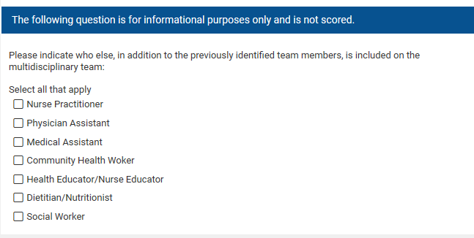
Step 4c: Informational Questions
Some questions will be noted as “for informational purposes only” and are not scored.
These questions will provide important contextual information related to a given module.

Slide 21
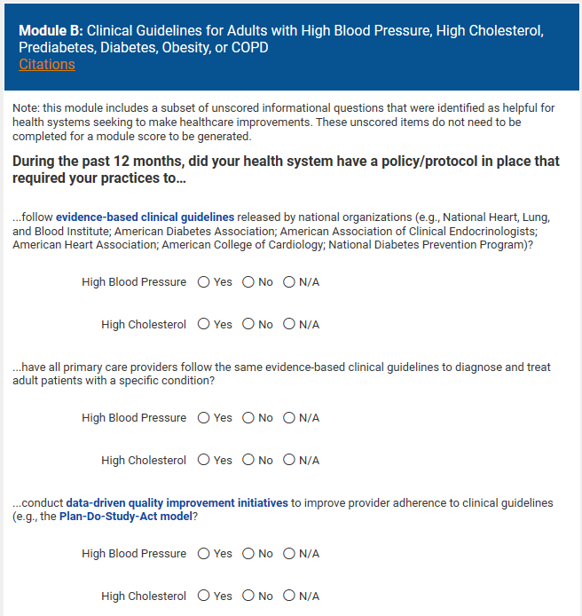
Step 4d: Disease-Specific Questions
Some modules are stratified by chronic disease (Module B contains an example of this).*
For stratified modules, only the conditions you selected at the beginning of the Scorecard will appear.
*Please see slide 8 for a full list of modules stratified by chronic disease.

Slide 22
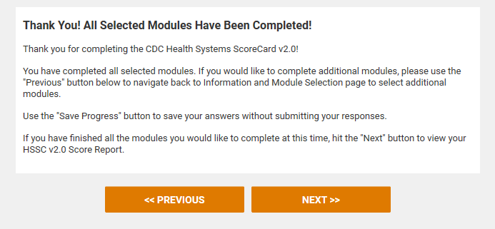
Step 5: Completion of HSSC v2.0
This is what the completion screen should display at completion of all selected modules.
If you decide to complete additional modules, select Previous at the bottom of the page to navigate to the beginning and add modules.
Select Next to go to the “HSSC v2.0 Score Report.”
Notes:
Note: If Save & Return is enabled, the blue “Save Progress” button will appear in between the previous and next buttons.

Slide 23
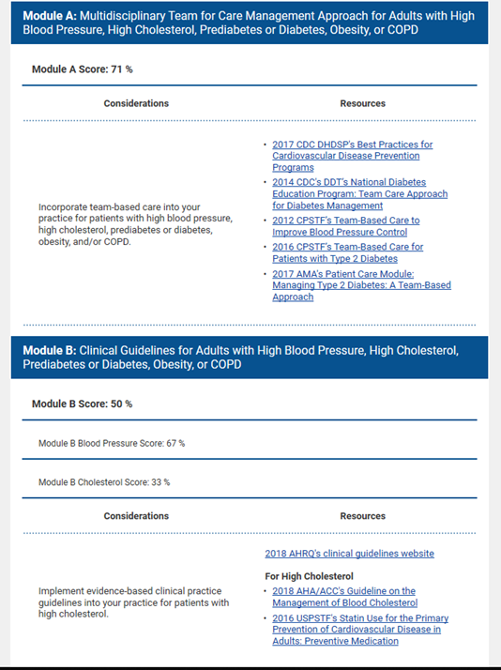
Step 6: Understanding the Score Report
The score report is automatically generated each time the scorecard is filled out.
It provides 3 percentage scores:
  An overall score based on the answers provided to all completed questions in all selected modules
  An overall score for each module
  Scores for each disease selected for the stratified modules
Scores are calculated as a percentage of the maximum total points the user could achieve given the selected modules and/or disease.
For each module, the report provides some helpful considerations and additional resources based on the user’s answers.

Slide 24
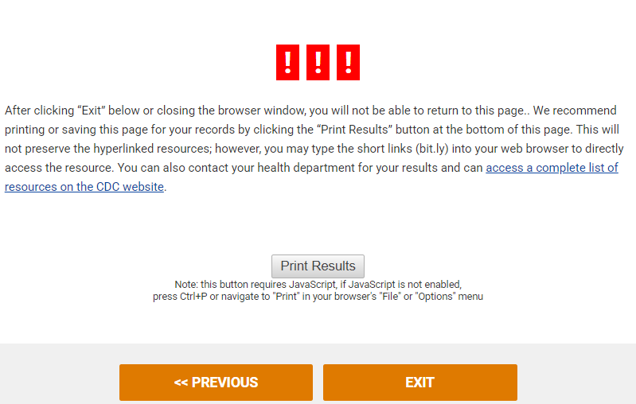
Step 7: Save the Score Report
Once completed, you can select Exit to close the window.
Users can download it as a PDF version.
  NOTE: The hyperlinks will not be active, but short URLs (bit.ly) have been added for easy access to resources.
It is highly recommended to download or save this score report. After this point, only users who accessed the form through a Save and Return link can access their responses and score report.
Health systems may share results with partner health departments to guide a dialogue about potential improvements and resources.
NOTE: No data will be shared with or stored by the CDC.

Slide 25
Managing HSSC v2.0 Data in Formsite®
All data will be collected in the form of a Results table in your Formsite® account.
  Under the user My Forms, hover your mouse over the HSSC v2.0 and Select Results.
  The data will be exported to an Excel file.
The Results per form limit associated with your account level refers to the number of results data in this table. Once this limit is reached, HSSC v2.0 will no longer be usable until data are removed/exported or the account level is changed to increase the limit.
Each row of data in the table corresponds to one entry of the HSSC v2.0 through your unique HSSC v2.0 link. It contains the answers selected by the user and the scores calculated from those answers.
All scores from the Save and Return link and the One-time link will appear together in your Form’s results.

Slide 26
Managing HSSC v2.0 Data in Formsite® (continued)
To export data to Excel:
  Select Export located on the right side of the results page.
  Under Results format, choose Summary.
  Under Data delimiter, choose whether you would like the file to be in a standard Excel file or a CSV file.
  Under Results View, select Detailed Results from the drop down menu.
  Click Export at the bottom of the page to download the results file.

Slide 27
Future Steps
We recommend that health systems complete the HSSC v2.0 periodically to reprioritize health care quality improvement efforts.
For more information regarding the HSSC v2.0 detailed instructions and the implication of results, please visit https://www.cdc.gov/dhdsp/evaluation_resources/guides/index.htm.
Notes:
CDC is planning a rapid evaluation following the first 3 months after the tool is released to learn more about its utility by health departments and health systems in the field. And will continue with a longer term outcome evaluation study.
We also plan to offer a future training webinar directed more to health systems and how they can navigate the Scorecard.

Slide 28

Thank you!
Questions? Discussion…
For more information, contact:
hssc@cdc.gov
Notes:
Thank you for your attention. Any questions?

