Slide 1


Voluntary Guidelines for Managing Food Allergies in Schools and Early Care and Education Programs
Notes:
Notes to Facilitator: Introduce yourself. Take the opportunity to get to know your audience. If the group is small, perhaps each participant can introduce themselves and describe their role in schools. Larger groups might be prompted by a show of hands to identify their roles, or take a moment to introduce themselves to the participants around them. Another idea is to have participants write down one question they have about food allergies on a piece of paper. At the end of the presentation, you can ask for participants to share questions that were not answered during the presentation.

Slide 2

Objectives
Describe the symptoms of food allergies and life-threatening reactions.
Identify three actions administrators can take to support the management of food allergies in schools.
Identify two resources that can be used to support the development of healthy and safe schools for students with food allergies.
Notes:
NARRATIVE
The purpose of this presentation is to explain the role of school administrators in supporting the implementation of practices and policies to effectively manage food allergies in schools. In addition, the purpose is to share the CDC resource of the Voluntary Guidelines for Managing Food Allergies in Schools and Early Care and Education Programs.
After this presentation, school administrators will be able to do the following:
Describe the symptoms of food allergies and life-threatening reactions.
Identify three actions administrators can take to support the management of food allergies in schools.
Identify two resources that can be used to support the development of healthy and safe schools for students with food allergies.
Before we review action steps for school administrators, I will share some information about the guidelines and the nature of food allergies in lives of the students we serve.

Slide 3
Overview
These guidelines can help schools manage the risk of food allergies and severe allergic reactions in students.
Managing food allergies requires a partnership between families, health care providers, and schools.
Notes:
NARRATIVE
In 2013, the CDC published the Voluntary Guidelines for Managing Food Allergies in Schools and Early Care and Education Programs, to help schools manage the risk of food allergies and severe allergic reactions in students. Managing food allergies can be accomplished through a partnership between families, health care providers, and schools. As a school administrator, you provide the leadership necessary to ensure that comprehensive plans are in place for protecting students with food allergies and for responding to food allergy emergencies. This presentation will give you the information you need to lead your school’s food allergy management response.

Slide 4
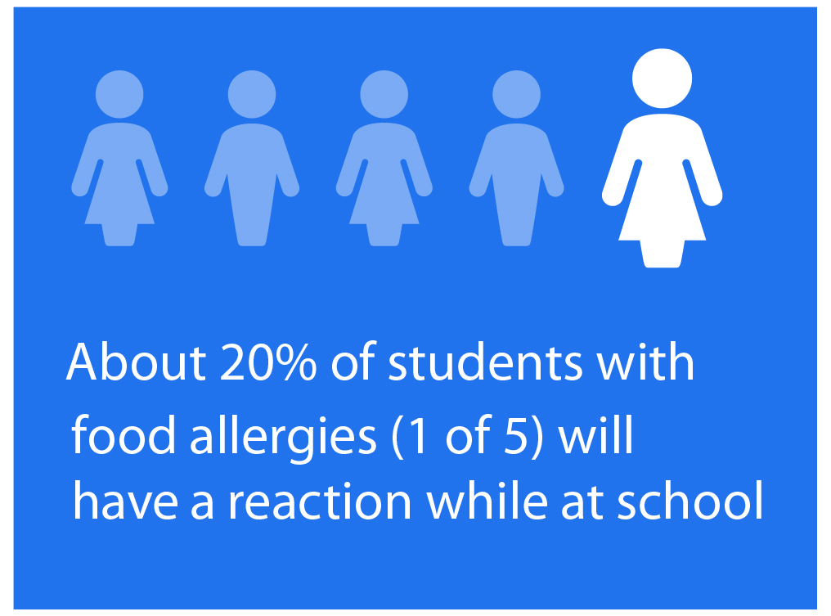
Did you know ?
4% of students are affected by food allergies, and the incidence is increasing.
1 in 5 students with food allergies will have a reaction while at school.
25% of severe food allergy reactions at school happen to students with no previous known food allergy.
Notes:
NARRATIVE
Food allergies are a growing concern for health and education officials alike. Food allergies affect approximately 4% of school-aged children. For reasons that are not completely understood, the incidence of food allergies is also increasing. ^{1,2}
Another alarming statistic is that 1 of 5 students (20%) with food allergies will have a reaction while at school and up to 25% of students who have a severe and potentially life threatening reaction at school have no previous known food allergy.^{3,4}
Notes to Facilitator: This may be a good time to have participants who have ever worked with a student with food allergies or have had a family member with life threatening allergies stand up. This could help emphasize the importance of learning more about managing food allergies in schools.

Slide 5

Did you know ?
A food allergy is an adverse immune system reaction that occurs soon after exposure to a certain food.
Food allergy symptoms can include multiple organ systems including, respiratory, gastrointestinal tract, skin, cardiovascular, and neurological.
A severe life-threatening allergic reaction is called anaphylaxis.
Notes:
NARRATIVE
Understanding the nature of food allergies is the first step to being able to effectively manage food allergies in schools.
A food allergy is an adverse immune system response that occurs soon after exposure to a certain food. There are more than 170 different foods which can cause food allergies, but most food allergies are caused by milk, eggs, fish, shellfish, wheat, soy, peanuts, and tree nuts.
Food allergy reactions can range from mild to very severe and the severity of reactions is difficult to predict. This immune response can include and affect the respiratory system, gastrointestinal tract, skin or cardiovascular system. Symptoms can include swollen lips, tongue, or eyes; itchiness, rash, or hives; nausea, vomiting, or loss of consciousness; and mood change or confusion.
Anaphylaxis is best described as a severe allergic reaction that is rapid in onset and may cause death. Not all allergic reactions will develop into anaphylaxis. In fact, most are mild and resolve without problems. However, early signs of anaphylaxis can resemble a mild allergic reaction. Unless obvious symptoms, such as throat hoarseness or swelling, persistent wheezing, or fainting or low blood pressure are present, it is not easy to predict whether these initial, mild symptoms will progress and become an anaphylactic reaction that can result in death.¹ Therefore, all children with known or suspected ingestion of a food allergen and the appearance of symptoms consistent with an allergic reaction must be closely monitored and possibly treated for early signs of anaphylaxis.
There is no treatment to prevent food allergy reactions. Strict avoidance of the food allergen is the only way to prevent a reaction. Since avoidance is not always possible, school staff must be prepared to deal with allergic reactions, including anaphylaxis. The recommended first line treatment for anaphylaxis is the prompt use of epinephrine. Epinephrine is typically given by an auto-injector, which is a spring loaded syringe used to deliver a measured dose of epinephrine. Epinephrine auto-injectors are designed so that they can be administered by nonmedical personnel.

Slide 6
What can you do?
If you suspect anaphylaxis, do the following:
Activate the student’s food allergy emergency plan.
Be ready to administer an epinephrine auto-injector
if you are delegated and trained to do so.
Call 911 or the emergency medical system
immediately. All students with anaphylaxis must be
monitored closely and evaluated as soon as possible
in an emergency care setting.
Notes:
NARRATIVE
If you suspect anaphylaxis, do the following:
Activate the student’s food allergy emergency plan.
Be ready to administer an epinephrine auto-injector if you are delegated and trained to do so.
Call 911 or the emergency medical system immediately. All students with anaphylaxis must be monitored closely and evaluated as soon as possible in an emergency care setting.

Slide 7

Important Anaphylaxis Response
All students with anaphylaxis must be monitored closely and transported by ambulance for evaluation as soon as possible in an emergency care setting.
Notes:
NARRATIVE
The importance of seeking emergency care as soon as possible must be emphasized. While epinephrine can quickly improve a person’s symptoms, the effects are not long-lasting and symptoms can recur, resulting in the need for additional doses of epinephrine. It is very important to remember, that even when epinephrine is used, 911 or other emergency medical services (EMS) must be called so the student can be transported quickly in the emergency vehicle to the nearest hospital emergency department for further medical treatment and observation.⁶

Slide 8

What can you do?
Lead your school’s planning for managing food allergies
Coordinate planning and implementation of your school’s Food Allergy Management and Prevention Plan (FAMPP).
Identify a team leader.
Notes:
NARRATIVE
Notes to Facilitator: This may be a good time to ask participants if they are aware of a food allergy plan in their school or school district, and if they know where to locate this plan. Depending on their responses, you could charge them with becoming familiar with the contents of the existing plan, or be instrumental in coordinating the development of a Food Allergy Management and Prevention Plan for their schools.
School principals and assistant principals are in key positions to lead their school in planning for the management of food allergies. Your leadership can ensure that your school is prepared to manage food allergies and food allergy emergencies. Some of the key action steps include the following:
Coordinate the planning and implementation of your school’s food allergy plan, also sometimes referred to as the food allergy management and prevention plan or FAMPP. This plan is needed to manage and monitor students with food allergies on a daily basis, whether they are at school or at school-sponsored events.
You should identify a qualified team leader to take responsibility for development and implementation of your school plan in coordination with you and a team of school staff chosen for this work. Often this team leader is the school nurse or other district health official. Your school plan should include developing procedures for identifying children with food allergies and creating individual food allergy emergency plans for these students

Slide 9
Food Allergy Management and Prevention Plan Priorities
Ensure the daily management of food allergies for individual children.
Prepare for food allergy emergencies.
Provide professional development on food allergies for staff members.
Educate all students and their family members about food allergies.
Create and maintain a healthy and safe educational environment.
Notes:
NARRATIVE
Your school’s food allergy plan should address the following five priorities:
Ensure the daily management of food allergies for individual children.
Prepare for food allergy emergencies.
Provide professional development on food allergies for staff members.
Educate all students and their families about food allergies.
Create and maintain a healthy and safe educational environment.

Slide 10

What can you do?
Support professional development on food allergies for school staff:
Provide training for all school staff.
Ensure staff understands the school’s legal responsibilities under federal law.
Communicate district policies and school’s plan to all school staff, volunteers and families.
Notes:
NARRATIVE
Another key role for school administrators is to provide support for staff professional development.
You should make sure that all school staff receive annual training on food allergies in coordination with the school nurses or other licensed health care professionals.
Additionally, you need to ensure that your staff understands the school’s legal responsibilities to provide services to students who may be eligible for Section 504 or IDEA accommodations. It is also important that they understand and comply with the Family Educational Rights and Privacy Act of 1974, also called FERPA, and any other federal and state laws that protect the privacy of student information.
School administrators additionally should take responsibility for communicating district policies and the school’s food allergy emergency plan to all school staff, volunteers, and families.

Slide 11
What can you do?
Oversee the daily management of food allergies for students
Ensure implementation of district food allergy policies, school Food Allergy Management and Prevention Plan, and student emergency care plans.
Arrange appropriate accommodations for students with 504 and IDEA eligible services.
Ensure exchange of information occurs on a need to know basis in accordance with FERPA and other confidentiality laws.
Notes:
NARRATIVE
Another responsibility of the school administrator is to oversee the daily management of food allergies for students.
One way to begin accomplishing this is to ensure that the school district’s food allergy policies, school Food Allergy Management and Prevention Plan, and individual student emergency care plans are created and that all plans are implemented consistently by all school staff.
You also are in a position to ensure that provisions for students with 504 and IDEA eligible services are met.
You also need to make sure that the staff members who need to know, have information about students with food allergies. You must ensure that this exchange of information occurs in accordance with FERPA and other federal and state confidentiality laws.

Slide 12

What can you do?
Support practices that protect and promote the health of students with food allergies across the school environment.
Ensure that students with food allergies have an equal opportunity to participate in all school activities and events.
Notes:
NARRATIVE
School administrators also need to support practices that promote the health of students with food allergies across the school environment.
This includes ensuring that food allergy management practices and policies address before-and after-school activities and the transportation of students. For example, rules that prohibit eating and drinking on school buses go a long way to protect students with food allergies on school buses.

Slide 13

What can you do?
Prepare your school to be ready to respond to food allergy emergencies:
Ensure that responding to food allergy emergencies is a part of your school’s emergency plan.
Set up an easy-to-use communication system for staff who may need to respond to food allergy reactions and emergencies.
Notes:
NARRATIVE
Another action for you as a school administrator is to prepare your school to be ready to respond to food allergy emergencies. You can make sure that responding to food allergy emergencies is part of your school’s emergency plan and that an easy-to-use communication system is available for staff who may need to respond to food allergy reactions and emergencies. Also, as with other emergencies, your food allergy emergency response plan should clearly specify the roles and responsibilities of staff.

Slide 14
What can you do?
Communicate food allergy management and policies to parents and families.
Ensure that staff who are trained and delegated to administer epinephrine auto-injectors can get to them quickly and easily.
Plan and prepare for field trips.
Practice responding to food allergy emergencies with emergency response drills.
Notes:
NARRATIVE
Part of being ready to respond is making sure that food allergy management and policies are communicated to all parents and families.
In addition, you need to ensure that staff who are trained and delegated to administer emergency epinephrine auto-injectors can get to them quickly and easily.
Make sure that staff plan for the needs of students with food allergies during class field trips and during other extra curricular activities. Make sure that students with food allergies have an equal opportunity to participate in all school activities and events.
Just as with other potential school emergencies like fires and storms, one of the most important activities that you can conduct are periodic emergency response drills to practice how to handle a food allergy emergency.

Slide 15
Steps to Take Within 24 Hours of a Nonfatal Food Allergy Reaction
Call parent or guardian to follow up on student condition.
Review anaphylactic or allergic episode with parent or guardian and student.
Discuss family role with parent or guardian to improve outcomes.
Discuss school and home concerns to improve prevention, response and student outcomes.
Ask parent or guardian to replace the epinephrine dose that was given, if needed.
Ask parent or guardian to follow up with health care provider.
Source: National Association of School Nurses, 2011
Notes:
NARRATIVE
If you experience a nonfatal food allergy emergency at your school, there are several important steps you can take after the event to evaluate the school response. These include the following:
✓Call parent or guardian to follow up on student condition.
✓Review anaphylactic or allergic episode with parent or guardian and student. This review should include identifying the allergen and route of exposure and discussing the signs and
symptoms with the parent or guardian. The actions that were taken should also be reviewed with a discussion of the positive and negative outcomes. Any needed revision to the care
plan on the basis of the experience or outcome should also be discussed.
✓Discuss family role with parent or guardian to improve outcomes.
✓Discuss school and home concerns to improve prevention, response, and student outcomes.
✓Ask parent or guardian to replace the epinephrine dose that was given, if needed.
✓Ask parent or guardian to follow up with health care provider.

Slide 16

What can you do?
Take the lead to create and maintain a healthy school environment:
Establish policies that address competitive foods.
Teach children, parents, and families about food allergies.
Enforce school rules that prohibit discrimination and bullying.
Notes:
NARRATIVE
As a school leader, you can take the lead to create and maintain a healthy school environment for students with food allergies. Establishing food allergy policies and practices that address competitive foods, such as those available in vending machines or school stores, at fundraisers or athletic events, and during class parties, or after-school programs is another way that you can take the lead and help to create and maintain a healthy school environment for students with food allergies.
Educating students, parents, and families about food allergies can also help to ensure a safer school environment
Finally, school administrators can create a positive psychosocial climate that reduces bullying and social isolation and promotes acceptance and understanding of children with food allergies. Administrators should reinforce the school’s rules as that prohibit discrimination and bullying as they relate to students with food allergies.

Slide 17
What can you do?
Know your legal responsibilities
Laws that prohibit discrimination on the basis of disability.
Section 504 of the Rehabilitation Act of 1973.
Americans with Disabilities Act of 1990.
Individuals with Disabilities Education Act (IDEA).
Richard B. Russell National School Lunch Act.
Family Educational Rights and Privacy Act of 1974 (FERPA).
Notes:
NARRATIVE
There are several federal laws and regulations that address the responsibilities of schools to help students manage food allergies that may constitute a disability under federal law and to ensure that children are not subject to discrimination on the basis of their disability. These include the statues of the Section 504 of the Rehabilitation Act of 1974 and the Americans with Disabilities Act of 1990 and the Individuals with Disabilities Education Act, or IDEA.
The Richard B. Russell National School Lunch Act also provides directions for schools to provide meal accommodations for students with disabilities.
FERPA, or the Family Educational Rights and Privacy Act of 1974, protects the confidentiality of student information.
The CDC’s Voluntary Guidelines for Managing Food Allergies in Schools and Early Care and Education Programs provides more detailed information and links to guidance related to these federal laws and can serve as a good resource if you need more information to understand your legal responsibilities.

Slide 18
Where can you find more information?
Voluntary Guidelines for Managing Food Allergies in Schools and Early Care and Education Programs. Available at
www.cdc.gov/healthyyouth/foodallergies/
Food Allergy Resource and Education (FARE). Available at http://www.foodallergy.org/resources/schools
National Association of School Nurse (NASN), Food Allergy and Anaphylaxis Tool Kit. Available at http://www.nasn.org/ToolsResources/FoodAllergyandAnaphylaxis
National School Boards Association, Safe at School and Ready to Learn Policy Guide. Available at http://www.nsba.org/services/school-board-leadership-services/food-allergiesschool-health
Notes:
Notes to Facilitator: Take a moment to ask participants to share any questions that were not addressed during the presentation and answer these questions. You can also ask participants to turn to the person next to them and name one action that they will take in the near future to help better manage students with food allergies at school.

Slide 19

Questions ?
Notes:
NARRATIVE
Managing food allergies can be accomplished through a partnership between families, health care providers, and schools. Educators need to know how to help students with food allergies be safe and supported at school. This presentation presented an overview of the CDC Voluntary Guidelines for Managing Food Allergies in Schools and Early Care and Education Programs. Thank you for being part of this critical team effort to support students with food allergies so that they can be healthy and safe at school.

Slide 20

Thank You

Slide 21
References
Branum AM, Lukacs SL. Food allergy among U.S. children: trends in prevalence and hospitalizations. NCHS Data Brief. 2008;10:1-8.
Liu AH, Jaramillo R, Sicherer SH, et al. National prevalence and risk factors for food allergy and relationship to asthma: results from the National Health and Nutrition Examination Survey 2005-2006. J Allergy Clin Immunol. 2010;126(4):798-806.e13.
McIntyre CL, Sheetz AH, Carroll CR, Young MC. Administration of epinephrine for life-threatening allergic reactions in school settings. Pediatrics. 2005;116(5):1134-1140.
Sicherer SH, Furlong TJ, DeSimone J, Sampson HA. The US Peanut and Tree Nut Allergy Registry: characteristics of reactions in schools and day care. J Pediatr. 2001;138(4):560-565.
Nowak-Wegrzyn A, Conover-Walker MK, Wood RA. Food-allergic reactions in schools and preschools. Arch Pediatr Adolesc Med. 2001;155(7):790-795.
Boyce JA, Assa’ad A, Burks AW, et al; NIAID-Sponsored Expert Panel. Guidelines for the diagnosis and management of food allergy in the United States: report of the NIAID-sponsored expert panel. J Allergy Clin Immunol. 2010;126(suppl 6):S1-S58.

