Slide 1

Voluntary Guidelines for
Managing Food Allergies in Schools and Early Care and Education Programs
Notes:
Notes to Facilitator: Introduce yourself. Take the opportunity to get to know your audience. If the group is small, perhaps each participant can introduce themselves and describe their role in schools. Larger groups might be prompted by a show of hands to identify their roles, or take a moment to introduce themselves to the participants around them. Another idea is to have participants write down one question they have about food allergies on a piece of paper. At the end of the presentation, you can ask for participants to share questions that were not answered during the presentation.

Slide 2

Objectives
Describe the symptoms of food allergies and life-threatening reactions.
Identify three actions to help support the daily management of students with food allergies.
Identify two ways to support healthy and safe classrooms and schools for students with food allergies.
Notes:
NARRATIVE
School mental health professionals play a key role in helping students with social and emotional supports so that they can be healthy and ready to learn. The purpose of this presentation is to explain the role of school mental health professionals in helping students with food allergies be safe and supported at school. The purpose also is to share the CDC resource of the Voluntary Guidelines for Managing Food Allergies in Schools and Early Care and Education Programs.
Following this presentation, school counselors, social workers and psychologists will be able to do the following:
Describe the symptoms of food allergies and life-threatening reactions.
Identify three actions to help support the daily management of students with food allergies.
Identify two ways to support healthy and safe classrooms and schools for students with food allergies.
Before we review action steps, I will share some information about the guidelines and the nature of food allergies in lives of the students we serve.

Slide 3
Overview
The guidelines can help schools manage the risk of food allergies and severe allergic reactions in students.
Managing food allergies requires a partnership between families, health care providers, and schools.
Notes:
NARRATIVE
In 2013, the CDC published the Voluntary Guidelines for Managing Food Allergies in Schools and Early Care and Education Programs, to help schools manage the risk of food allergies and severe allergic reactions in students. Managing food allergies can be accomplished through a partnership between families, health care providers, and schools. As a mental health professional, you need to know how to help students with food allergies be safe and supported at school. This presentation will give you the information you need for managing food allergies and responding to food allergy emergencies.

Slide 4
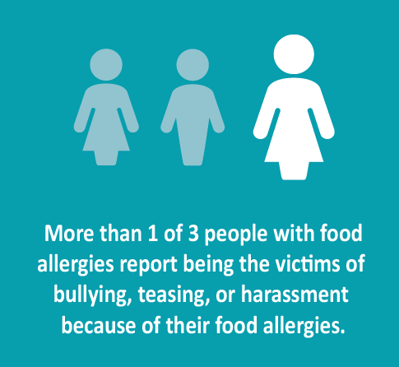
Did you know?
In a classroom of 25 students, at least 1 student is likely to be affected by food allergies.
Students with food allergies may experience more anxiety and fear than their nonallergic peers.
More than 1 of 3 people with food allergies report being the victims of bullying, teasing, or harassment because of their food allergy.
Notes:
NARRATIVE
Food allergies are a growing concern for health care providers and school officials alike.
Food allergies affect approximately 4% of school-aged children. In a class of 25 children, at least 1 student is likely to be affected by food allergies. For reasons that are not completely understood, the incidence of food allergies is also increasing.^{1,2}
There is also concern that students with food allergies may experience more anxiety and fear than their non-allergic peers.
More than 1 out of 3 people with food allergies report being victims of bullying, teasing, or harassment because of their food allergy.
Notes to Facilitator: This may be a good time to have participants who have ever worked with a student with food allergies or have had a family member with life threatening allergies stand up. This could help emphasize the importance of learning more about managing food allergies in schools.
So, what do you need to know about food allergies and what you can do to help keep students supported, healthy and safe?

Slide 5

What can you do?
Plan!
  Know your school district’s food allergy policies and rules.
  Know your school’s Food Allergy Management and Prevention Plan.
  Become familiar with student emergency care plans.
Notes:
NARRATIVE
The first action step you can take is to participate in your school’s planning for managing food allergies. Ask your school nurse or school administrator for information on your school district’s current policies and practices for managing students with food allergies. It is also very important to know your school’s Food Allergy Management and Prevention Plan, and to help carry out this plan throughout the school day. Students with food allergies should also have emergency care plans which will give direction for responding to food allergy reactions. Become familiar with the Food Allergy Management and Prevention Plans for the students you serve

Slide 6

What can you do?
Get trained!
  Participate in training and review resources.
  Know the signs and symptoms of food allergies and how to respond in an emergency.
Notes:
NARRATIVE
Another important action step for all school staff members is to get trained. Plan to participate in your school-based food allergy training and review resources to help you recognize the signs and symptoms of food allergies and how to respond in an emergency. Let’s take a moment to learn more about food allergies, their symptoms and how to respond to a food allergy emergency.

Slide 7

What can you do?
Learn about food allergies!
  A food allergy is an adverse immune system reaction that occurs soon after exposure to a certain food.
  Any food can cause a food allergy, but most are caused by milk, eggs, fish, shellfish, wheat, soy, peanuts, and tree nuts.
  A severe life-threatening allergic reaction is called anaphylaxis.
Notes:
NARRATIVE
Learning about food allergies is essential to being able to effectively help manage food allergies in schools.
A food allergy is an adverse immune system response that occurs soon after exposure to a certain food.
There are more than 170 different foods which can cause food allergies, but most food allergies are caused by milk, eggs, fish, shellfish, wheat, soy, peanuts, and tree nuts.
Anaphylaxis is best described as a severe allergic reaction that is rapid in onset and may cause death.
Not all allergic reactions will develop into anaphylaxis. In fact, most are mild and resolve without problems. However, early signs of anaphylaxis can resemble a mild allergic reaction. Unless obvious symptoms, such as throat hoarseness or swelling, persistent wheezing, or fainting or low blood pressure are present, it is not easy to predict whether these initial, mild symptoms will progress and become an anaphylactic reaction that can result in death.¹ Therefore, all children with known or suspected ingestion of a food allergen and the appearance of symptoms consistent with an allergic reaction must be closely monitored and possibly treated for early signs of anaphylaxis.

Slide 8
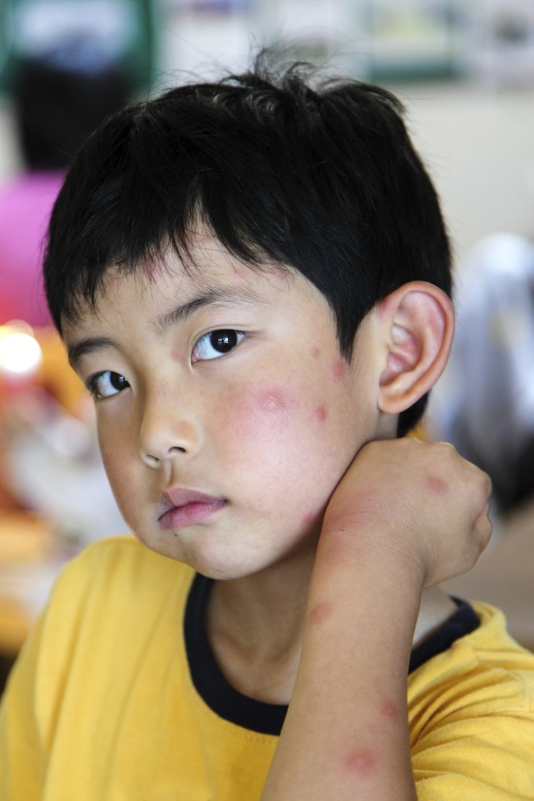
What can you do?
Recognize food allergy symptoms!
  Food allergy symptoms can include
    Swollen lips, tongue, or eyes.
    Itchiness, rash, or hives.
    Nausea, vomiting, or diarrhea.
    Congestion, hoarse voice, or trouble swallowing.
    Wheezing or difficulty breathing.
    Dizziness, fainting, or loss of consciousness.
    Mood change or confusion.
Notes:
NARRATIVE
You can learn to recognize food allergy symptoms. The symptoms of allergic reactions to food vary both in type and severity among different people and even in one person over time. Signs and symptoms of an allergic reaction can become evident in a few minutes or up to 1 to 2 hours after exposure to an allergen, or rarely, even several hours later. Food allergy symptoms can include swollen lips, tongue or eyes; itchiness, rash, or hives; nausea, vomiting, diarrhea; congestion, hoarse voice, or trouble swallowing; wheezing or difficulty breathing; dizziness or fainting, or loss of consciousness; and mood change or confusion.
In children, food allergy reactions can be difficult to see. Some children may not be able to clearly communicate their symptoms due to development or age. Children with food allergies might communicate their symptoms in the following ways:
It feels like something is poking my tongue.
My tongue (or mouth) is tingling (or burning).
My tongue (or mouth) itches.
My tongue feels like there is hair on it.
My mouth feels funny.
There’s a frog in my throat; there’s something stuck in my throat.
My tongue feels full (or heavy).
My lips feel tight.
It feels like there are bugs in there (to describe itchy ears).
It (my throat) feels thick.
It feels like a bump is on the back of my tongue or throat.⁸
Source: The Food Allergy & Anaphylaxis Network. Food Allergy News. 2003; 13(2).

Slide 9

What can you do?
If you suspect anaphylaxis
    Activate the student’s Food Allergy Management and Prevention Plan and contact the school nurse or administrator.
    Be ready to administer an epinephrine auto-injector if you are delegated and trained to do so.
    Call 911 or the emergency medical system immediately. All students with anaphylaxis must be monitored closely and evaluated as soon as possible in an emergency care setting.
Notes:
NARRATIVE
If you suspect anaphylaxis do the following:
Activate the student’s Food Allergy Management and Prevention Plan and contact the school nurse or administrator.
Be ready to administer an epinephrine auto-injector if you are delegated and trained to do so.
Call 911 or the emergency medical system immediately. All students with anaphylaxis must be monitored closely and evaluated as soon as possible in an emergency care setting.

Slide 10

What can you do?
Help with the daily management of students with food allergies.
  Provide assistance with the development of a Section 504 or an Individualized Education Program, if needed.
  Address immediate and long-term mental health problems, such as anxiety, depression, social isolation, and stress.
  Help connect families with community health providers and resources.
Notes:
NARRATIVE
You can help with the daily management of students with food allergies. Students with life-threatening food allergies may have Section 504 or IEP plans which provide for classroom and school accommodations. As school support team members, you can help develop and carry out these important plans for students. Address immediate and long-term mental health problems, such as anxiety, depression, social isolation, and stress and help connect families with community health providers and resources.

Slide 11

What can you do?
Support a healthy and safe school environment for students with food allergies.
  Support other school health professionals by providing training and education for staff and parents on the mental and emotional health issues faced by students with food allergies.
  Report all bullying to the administrator.
  Work with parents, classroom teachers, and other school staff to prevent bullying and discrimination against students with food allergies.
Notes:
NARRATIVE
You also can support a healthy and safe school environment for students with food allergies.
Support other school health professionals, such as the school nurse, by providing training and education for staff and parents on the mental and emotional health issues faced by students with food allergies.
Report all bullying to the administrator.
Work with parents, classroom teachers and other school staff to prevent bullying and discrimination against students with food allergies.⁴

Slide 12
Where can you find more information?
Centers for Disease Control and Prevention. Voluntary Guidelines for Managing Food Allergies in Schools and Early Care and Education Programs. 2013. Available at www.cdc.gov/healthyyouth/foodallergies/
National Association of School Psychologists: Available at http://www.nasponline.org/resources/bullying/index.asp

Slide 13

Questions ?
Notes:
NARRATIVE
Managing food allergies can be accomplished through a partnership between families, health care providers, and schools. Educators need to know how to help students with food allergies be safe and supported at school. This presentation presented an overview of the CDC Voluntary Guidelines for Managing Food Allergies in Schools and Early Care and Education Programs. Thank you for being part of this critical team effort to support students with food allergies so that they can be healthy and safe at school.

Slide 14
References
Branum AM, Lukacs SL. Food allergy among U.S. children: trends in prevalence and hospitalizations. NCHS Data Brief. 2008;10:1-8.
Liu AH, Jaramillo R, Sicherer SH, et al. National prevalence and risk factors for food allergy and relationship to asthma: results from the National Health and Nutrition Examination Survey 2005-2006. J Allergy Clin Immunol. 2010;126(4):798-806.e13.
Cummings AJ, Knibb RC, King RM, Lucas JS: The psychosocial impact of food allergy and food hypersensitivity in children, adolescents and their families: a review. Allergy. 2010;65:933-945.
Lieberman J, Weiss C, Furlong TJ, Sicherer SH. Bullying among pediatric patients with food allergy. J Allergy Clinical Immunol. 2010;105:267-271.
Ravid NL, Annunziato RA, Ambrose MA, et al. Mental health and quality-of-life concerns related to the burden of food allergy. Immunol Allergy Clin N Am. 2012:32(1):83-95.
Nowak-Wegrzyn A, Conover-Walker MK, Wood RA. Food-allergic reactions in schools and preschools. Arch Pediatr Adolesc Med. 2001;155(7):790-795.
McIntyre CL, Sheetz AH, Carroll CR, Young MC. Administration of epinephrine for life-threatening allergic reactions in school settings. Pediatrics. 2005;116(5):1134-1140.
Sicherer SH, Furlong TJ, DeSimone J, Sampson HA. The US Peanut and Tree Nut Allergy Registry:
Houle CR, Leo HL, Clark NM. A developmental, community, and psychosocial approach to food allergies in children. Curr Allergy and Asthma Rep. 2010;10(5):381-386

Slide 15

Thank You

