Slide 1

Voluntary Guidelines for Managing Food Allergies in Schools and Early Care and Education Programs
Notes:
Notes to Facilitator: Introduce yourself. Take the opportunity to get to know your audience. If the group is small, perhaps each participant can introduce themselves and describe their role in schools. Larger groups might be prompted by a show of hands to identify their roles, or take a moment to introduce themselves to the participants around them. Another idea is to have participants write down one question they have about food allergies on a piece of paper. At the end of the presentation, you can ask for participants to share questions that were not answered during the presentation.

Slide 2

Objectives
Describe the symptoms of food allergies and life-threatening reactions.
Identify three action steps for schools to prepare for and respond to food allergy emergencies.
Identify three ways specific school staff can create and maintain healthy and safe classrooms and school environments for students with food allergies.
Notes:
NARRATIVE
The purpose of this presentation is to explain the role of schools in helping students with food allergies be safe and supported at school. The purpose also is to share the CDC resource of the Voluntary Guidelines for Managing Food Allergies in Schools and Early Care and Education Programs.
At the end of this presentation, participants will be able to
Describe the symptoms of food allergies and life-threatening reactions.
Identify three action steps for schools to prepare for and respond to food allergy emergencies.
Identify three ways specific school personnel can create and maintain healthy and safe classrooms and school environments for students with food allergies.
Before we review action steps, I will share some information about the guidelines and the nature of food allergies in the lives of the students we serve.

Slide 3
Overview
The guidelines can help schools manage the risk of food allergies and severe allergic reactions in students.
Managing food allergies requires a partnership between families, health care providers, and schools.
Notes:
NARRATIVE
In 2013, CDC published the Voluntary Guidelines for Managing Food Allergies in Schools and Early Care and Education Programs, to help schools manage the risk of food allergies and severe allergic reactions in students. Managing food allergies can be accomplished through a partnership between families, health care providers, and schools. All members of the school community need to know how to help students with food allergies be safe and supported at school. This presentation will give you information schools need for managing food allergies and responding to food allergy emergencies.

Slide 4
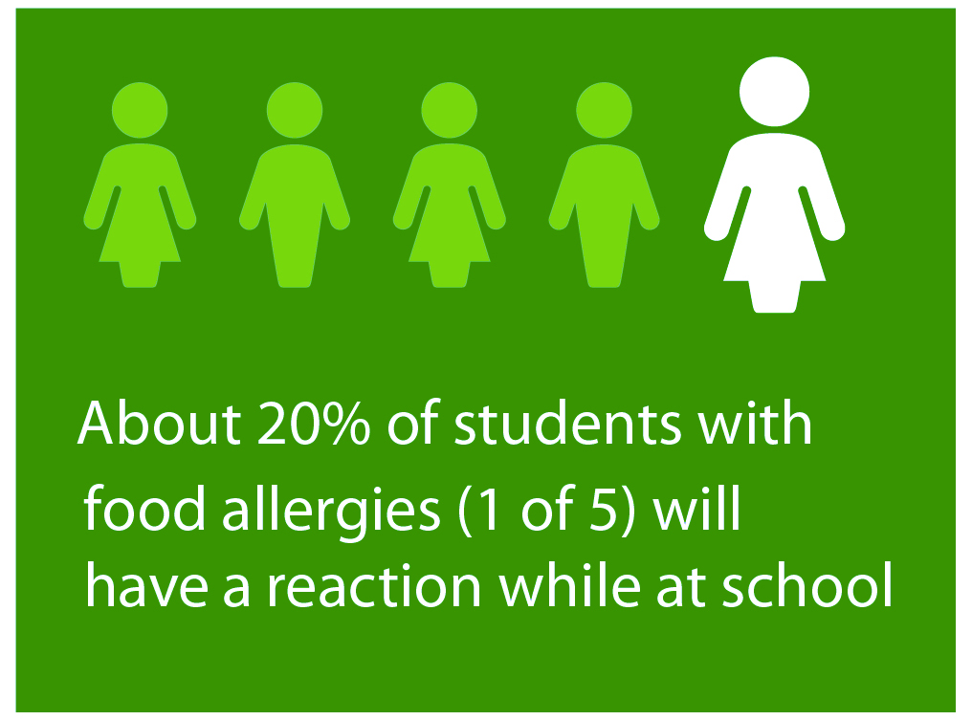
Did you know?
4% of students are affected by food allergies, and the incidence is increasing.
1 of 5 students with food allergies will have a reaction while at school.
25% of severe food allergy reactions at school happen to students with no previous known food allergy.
Notes:
NARRATIVE
Food allergies are a growing concern for health and education officials alike. Food allergies affect approximately 4% of school-aged children. For reasons that are not completely understood, the incidence of food allergies is also increasing.^{1,2}
Another alarming statistic is that 1 of 5 students (20%) with food allergies will have a reaction while at school and up to 25% of students who have a severe and potentially life threatening reaction at school have no previous know food allergy.^{3,4}
Notes to Facilitator: This may be a good time to have participants who have ever worked with a student with food allergies or have had a family member with life threatening allergies stand up. This could help emphasize the importance of learning more about managing food allergies in schools.

Slide 5

Did you know?
A food allergy is an adverse immune system reaction that occurs soon after exposure to a certain food.
Food allergy symptoms can include multiple organ systems including, respiratory, gastrointestinal tract, skin, cardiovascular, and neurological.
A severe life-threatening allergic reaction is called anaphylaxis.
Notes:
NARRATIVE
Understanding the nature of food allergies is the first step to effectively manage food allergies in schools.
A food allergy is an adverse immune system response that occurs soon after exposure to a certain food. There are over 170 different foods which can cause food allergies, but most food allergies are caused by milk, eggs, fish, shellfish, wheat, soy, peanuts, and tree nuts.
Food allergy reactions can range from mild to very severe and the severity of reactions is difficult to predict. This immune response can include affect the respiratory system, gastrointestinal tract, skin or cardiovascular system. Symptoms can include swollen lips, tongue or eyes; itchiness, rash or hives; nausea, vomiting, loss of consciousness; and mood change or confusion.
Anaphylaxis is best described as a severe allergic reaction that is rapid in onset and may cause death. Although not all allergic reactions will develop into anaphylaxis, early signs of anaphylaxis can resemble a mild allergic reaction. Unless obvious symptoms, such as throat hoarseness or swelling, persistent wheezing, or fainting or low blood pressure are present, it is not easy to predict whether these initial, mild symptoms will progress and become an anaphylactic reaction that can result in death.¹ Therefore, all children with known or suspected ingestion of a food allergen and the appearance of symptoms consistent with an allergic reaction must be closely monitored and possibly treated for early signs of anaphylaxis.
There is no treatment to prevent food allergy reactions. Strict avoidance of the food allergen is the only way to prevent a reaction. Since avoidance is not always possible, school staff must be prepared to deal with allergic reactions, including anaphylaxis. The recommended first line treatment for anaphylaxis is the prompt use of epinephrine. Epinephrine is typically given by an auto-injector, which is a spring loaded syringe used to deliver a measured dose of epinephrine.

Slide 6

Food Allergy Management and Prevention Plan Priorities
Ensure the daily management of food allergies for individual children.
Prepare for food allergy emergencies.
Provide professional development on food allergies for staff members.
Educate children and family members about food allergies.
Create and maintain a healthy, safe, and inclusive educational environment.
Notes:
NARRATIVE
Each school’s food allergy management and prevention plan should address the following five priorities:
Ensure the daily management of food allergies for individual children.
Prepare for food allergy emergencies.
Provide professional development on food allergies for staff members.
Educate children and family members about food allergies.
Create and maintain a healthy, safe, and inclusive educational environment.
Notes to Facilitator: You could ask participants if they are aware of a food allergy emergency plan in your school or school division and if they know where to locate this plan.

Slide 7

Actions for School Administrators
Lead school’s planning for managing food allergies.
Oversee the daily management of food allergies for students.
Notes:
NARRATIVE
School principals and assistant principals are in key positions to lead their schools in planning for the management of food allergies. School leaders can ensure that their schools are prepared to manage food allergies and food allergy emergencies. Some of the key action steps include
Coordinate the implementation of the school district’s food allergy policies and the planning and implementation of school’s food allergy plan, also sometimes referred to as the food allergy management and prevention plan or FAMPP. The school administrator also should identify a qualified team leader to take responsibility for development and implementation of the school plan in coordination with school leadership and a team of school staff chosen for this work. Often this team leader is the school nurse or other district health official. The school plan should include developing procedures for identifying children with food allergies and creating food allergy emergency plans for these students.
Another responsibility of the school administrator is to oversee the daily management of food allergies for students.
One way to accomplish this is to ensure that the school district’s food allergy policies, school management and emergency plans and individual student emergency care plans are created and that all plans are implemented consistently by all school staff. The school administrator is in a position to ensure that provisions for students receiving 504 and IDEA eligible services are met.
The school administrator also needs to make sure that the staff members who need to know, have information about students with food allergies. This exchange of information should occur in accordance with FERPA and other federal and state confidentiality laws.
School administrators also need to support practices that promote the health of students with food allergies across the school environment. This includes ensuring that food allergy management practices and policies address before-and-after school activities and the transportation of students. For example, rules that prohibit eating and drinking on school buses go a long way to protect students with food allergies on school buses. Another important consideration is to ensure that students with food allergies have an equal opportunity to participate in all school activities and events.

Slide 8

Actions for School Administrators
Prepare schools to be ready to respond to food allergy emergencies:
Ensure that response to food allergy emergencies is a part of each school’s emergency plan.
Set up an easy-to-use communication system for staff who may need to respond to food allergy reactions and emergencies.
Notes:
NARRATIVE
Another action for school administrators is to prepare schools to be ready to respond to food allergy emergencies. They can make sure that response to food allergy emergencies is part of each school’s emergency plan and that an easy-to-use communication system is available for staff who may need to respond to food allergy reactions and emergencies.
Part of being ready to respond is to make sure that food allergy management practices and policies are communicated to all parents and families.
In addition, school administrators need to ensure that staff who are trained and delegated to administer emergency epinephrine auto-injectors can get to them quickly and easily.
Ensuring that staff plan for the needs of students with food allergies during class field trips and during other extra curricular activities is another action step for school leaders. Students with food allergies must have an equal opportunity to participate in all school activities and events.
Just as with other potential school emergencies like fires and storms, one of the most important activities that school administrators can conduct are periodic emergency response drills to practice how to handle a food allergy emergency.

Slide 9

Actions For Entire School Team
Get trained and know now how to respond to food allergy emergencies!
If anaphylaxis is suspected, act!
Plan!
Notes:
NARRATIVE
While school administrator support and leadership is critical, managing food allergies in school is a team effort. Let’s take a moment to look at key actions that all school staff, including teachers, paraeducators, school support teams, food service staff and transportation staff, can all do to support students with food allergies.
First, all staff need to be trained to recognize and respond to food allergies. All school staff should participate in school-based food allergy training and review resources to help them recognize the signs and symptoms of food allergies and how to respond in an emergency.
There is no treatment to prevent food allergy reactions. Strict avoidance of the food allergen is the only way to prevent a reaction. Since avoidance is not always possible and accidental exposures happen, school staff must be prepared to deal with allergic reactions, including anaphylaxis.
If an allergic reaction is suspected, the student’s food allergy emergency plan should be activated and the school nurse or administrator should be called immediately.
A student with a suspected allergic reaction should never be sent to the school nurse alone. Allergic reactions can progress rapidly and therefore, a student with a suspected allergic reaction should never be left alone.
The recommended first-line treatment for anaphylaxis is the prompt use of an injectable medication called epinephrine. This medication is given by an auto-injector and is designed to be able to be easily administered by anyone.
Let’s review the important anaphylaxis action steps.
If anaphylaxis is suspected, school staff should
Activate the student’s food allergy emergency plan.
Be ready to administer an epinephrine auto-injector if the staff member delegated and trained to do so.
Call 911 or the emergency medical system immediately. All students with anaphylaxis must be monitored closely and evaluated as soon as possible in an emergency care setting.
While epinephrine can quickly improve a person’s symptoms, the effects are not long-lasting and symptoms can recur, resulting in the need for additional doses of epinephrine. It is very important to remember, that even when epinephrine is used, 911 or other emergency medical services (EMS) must be called so the student can be transported quickly in the emergency vehicle to the nearest hospital emergency department for further medical treatment and observation.⁵
Planning for the management of food allergies is another key action step for schools. The school nurse or school administrator should be able to provide information on current policies and practices for managing students with food allergies, including how to manage medications and respond to a food allergy reaction. It is also very important to know the school’s food allergy emergency plan, and to be able to help carry out this plan in the classroom and throughout the school day. Students with life-threatening food allergies may have Section 504 or IEP plans which provide for classroom and school accommodations. School teachers and support teams can help develop and carry out these important plans for students. Students with food allergies should also have emergency care plans which will give direction for responding to food allergy reactions. Staff should become familiar with the food allergy emergency plans for the students they serve.

Slide 10

Actions for Teachers and Paraeducators
Help manage food allergies at your school.
Help prevent food allergy emergencies.
Notes:
NARRATIVE
Teachers and paraeducators are key to managing food allergies in the classroom and school. First of all, educators need to know which students in their classes have food allergies. Student emergency care plans should be kept in an easy to reach and secure location. For students who travel to more than one teacher, this may mean keeping a copy of the emergency plan in each classroom where the student spends time. Also, teachers should share information and responsibilities with other school staff, including substitute teachers and staff who work regularly in the classroom. At the same time, it is very important to respect the privacy of each student and only share information on a “need to know” basis. It is always wise to gain parental consent prior to sharing confidential information.
Prevention is the primary goal of managing food allergies in school and there are several important steps that teachers and other educators can take to help prevent food allergy emergencies.
Making classroom modifications to ensure that all students can participate fully in class is one such strategy. This can include to clean surfaces, get rid of nonfood materials that contain food allergens (for example, clay and paste), and prevent cross contact of allergens when meals or snacks are served in the classroom. Cross contact occurs when someone comes in contact with a surface or object that is contaminated with an allergen. Avoiding the use of allergens in activities that you plan including arts and crafts, counting, science projects, parties, holidays and celebrations, and cooking can go a long way to creating a safe classroom environment for students with food allergies. Ideas for nonfood items for celebrations, rewards or incentives, can include providing special privileges, extra recess, and small non-food prizes. A resource with ideas for celebrating without food can be found at the end of this presentation.
If you cannot avoid using a food or known allergen in the classroom, always inform parents and the school nurse and administrator prior to these activities.

Slide 11

Actions for Teachers and Paraeducators
Create and maintain a healthy, safe, and inclusive classroom.
Create and maintain healthy, safe, and inclusive eating environments.
Carefully plan field trips.
Notes:
NARRATIVE
Creating and maintaining a healthy, safe, and inclusive classroom also means following and enforcing the school district’s rules and practices for dealing with food allergies. Teachers should take the responsibility also for communicating these rules with students and parents.
Teachers can also partner with other school professionals including school nurses and mental health professionals to provide the support necessary for students with food allergies and to work with individual students to help them learn to manage their food allergies. Managing food allergies in the classroom and school is a team effort.
Another key action is to work with parents, school administrators and other school staff to prevent bullying and discrimination against students with food allergies. Teachers can be great role models by respecting the needs of all students and encouraging supportive and positive interactions between students. All incidents of bullying should be reported to parents and the school administrator.^{6,7}
Ensuring safe and inclusive eating environments for students can also be accomplished by providing supervision in the cafeteria, when meals or snacks are served in the classroom, on field trips, and during extracurricular activities.
Always enforce hand washing before and after eating. Clean surfaces to prevent cross-contact of allergens and do not allow students to trade or share food.
Preparing ahead of time for field trips is very important to ensure that field trip activities are safe for students with food allergies and that there is a plan in place to handle food allergy emergencies during a field trip.

Slide 12

Actions for School Nutrition Professionals
Help prevent food allergy reactions in the cafeteria.
Develop and follow procedures for handling food allergens in the cafeteria.
Notes:
NARRATIVE
The actions and planning of school nutrition professionals are also important to ensure healthy and safe schools for students with food allergies. School nutrition staff should be able to recognize students with food allergies in the cafeteria. They should use point of purchase alerts to identify students with food allergies, if possible. They also need to work with the school nurse or administrator to identify students with food allergies in a way that does not compromise students’ privacy or confidentiality rights.
Another key action is to understand how to read food labels to identify allergens in foods and beverages served in school meals and snacks. Ingredients can change frequently.
They should be prepared to share information with parents and school nurses about ingredients in recipes and in all food served by the school nutrition program. Preventing cross-contact of potential food allergens during food preparation and service on utensils, equipment, and surfaces is additionally very important. Food service personnel should wash hands during food preparation.⁸
One of the best ways to prevent accidental food allergy exposures in the cafeteria is to develop and follow procedures for handling food allergens in the cafeteria, even if a student is not participating in the school meal program. These actions can help support this goal
Develop and follow procedures for cleaning food preparation areas and cafeteria tables and chairs.⁸
Support hand washing by students before and after eating.
Discourage trading or sharing of food.
On the advice of health care providers and parents, some schools may establish special cafeteria seating for students with life-threatening food allergies. Sometimes these tables are referred to as “peanut-free” or “allergy safe” tables. If these arrangements are made, every effort should be made to allow other students to also sit at the allergen-free tables as long as they also do not have the allergen on their trays and packaged lunches.

Slide 13

Actions for School Mental Health Professionals
Help with the daily management of students with food allergies.
Support a healthy and safe school environment for students with food allergies.
Notes:
NARRATIVE
School mental health professionals are also important food allergy team members. Students with life-threatening food allergies may have Section 504 or IEP plans which provide for classroom and school accommodations. School mental health professionals can help develop and carry out these important plans for students. They are also able to address immediate and long-term mental health problems, such as anxiety, depression, social isolation, and stress, and can help connect families with community health providers and resources.
In addition to helping with the daily management of students with food allergies, school mental health professionals are also in a position to help support a healthy and safe school environment by providing training and education for staff and parents on the mental and emotional health issues faced by students with food allergies. They also can help encourage a climate of kindness and work with parents, classroom teachers and other school staff to prevent bullying and discrimination against students with food allergies.⁴ All bullying should be reported to the school administrator.

Slide 14

Actions for School Transportation Staff
Help prevent food allergy emergencies.
Support healthy and safe transportation.
Take immediate action if a severe food allergy reaction is suspected.
Notes:
NARRATIVE
For all school districts, the goal of transporting students is to get them to their homes and schools safely. There are several important actions that bus drivers and attendants can do to help prevent food allergy emergencies on school buses.
First, transportation staff should enforce district food policies for all students riding a school bus. Rules that prohibit eating and drinking on school buses help to protect students from food allergy reactions while riding the bus. Exceptions may need to be made for individual students who need to eat due to medical conditions, such as diabetes.
Also, food or candy should not be given to students riding the bus. Many allergens are hidden in candy and could pose a danger to students with food allergies. Bus drivers should consider rewarding children with praise or small nonfood items. A kind word of praise will linger with a child much longer than a piece of candy.
Finally, school districts should develop cleaning procedures for bus surfaces, such as seats and handrails. This will help decrease the possibility of cross contact with allergens.
Another important consideration for bus drivers is to support healthy and safe transportation. Several actions are critical. These include to ensure that two-way communication systems between schools and school buses are working properly, to encourage students to treat each other with kindness and respect, and to report all cases of bullying to parents and the school administrator.
There is no treatment to prevent food allergy reactions. Strict avoidance of the food allergen is the only way to prevent a reaction. Since avoidance is not always possible, school transportation staff, like all school staff, must be prepared to deal with allergic reactions, including anaphylaxis.
If a severe food allergy reaction, or anaphylaxis, is suspected on the bus, staff should take immediate action:
Call 911 or the emergency medical system (EMS) and ask for emergency transportation of any student showing signs of anaphylaxis.
Transportation staff need to know the location of emergency medication and be ready to administer an epinephrine auto-injector if they are a delegated and trained staff member.³⁻⁴
Finally, if a food allergy emergency does happen on the bus, the school administrator should be informed of the actions taken and the need for someone to contact the student’s parents.

Slide 15
Where can you find more information?
Voluntary Guidelines for Managing Food Allergies in Schools and Early Care and Education Programs. Available at www.cdc.gov/healthyyouth/foodallergies/.
Allergyhome. org resources for schools. Available at http://www.allergyhome.org/schools/.
Food Allergy Resource and Education (FARE). Available at http://www.foodallergy.org/resources/schools .
Michigan State University Extension, Alternatives to Using Food as a Reward. Available at http://www.michigan.gov/documents/mde/foodrewards_290201_7.pdf.
National Association of School Nurse (NASN), Food Allergy and Anaphylaxis Tool Kit. Available at http://www.nasn.org/ToolsResources/FoodAllergyandAnaphylaxis.
NEA Health Information Network. Food Allergy Book: What School Employees Need to Know. Available at http://www.neahin.org/educator-resources/foodallergybook.html.

Slide 16

Questions ?
Notes:
NARRATIVE
Managing food allergies can be accomplished through a partnership between families, health care providers, and schools. Educators need to know how to help students with food allergies be safe and supported at school. This presentation presented an overview of the CDC Voluntary Guidelines for Managing Food Allergies in Schools and Early Care and Education Programs. Thank you for being part of this critical team effort to support students with food allergies so that they can be healthy and safe at school.

Slide 17
References
Branum AM, Lukacs SL. Food allergy among U.S. children: trends in prevalence and hospitalizations. NCHS Data Brief. 2008;10:1-8.
Liu AH, Jaramillo R, Sicherer SH, et al. National prevalence and risk factors for food allergy and relationship to asthma: results from the National Health and Nutrition Examination Survey 2005-2006. J Allergy Clin Immunol. 2010;126(4):798-806.e13.
Nowak-Wegrzyn A, Conover-Walker MK, Wood RA. Food-allergic reactions in schools and preschools. Arch Pediatr Adolesc Med. 2001;155(7):790-795.
McIntyre CL, Sheetz AH, Carroll CR, Young MC. Administration of epinephrine for life-threatening allergic reactions in school settings. Pediatrics. 2005;116(5):1134-1140.
Boyce JA, Assa’ad A, Burks AW, et al; NIAID-Sponsored Expert Panel. Guidelines for the diagnosis and management of food allergy in the United States: report of the NIAID-sponsored expert panel. J Allergy Clin Immunol. 2010;126(suppl6):S1-S58.
Lieberman J, Weiss C, Furlong TJ, Sicherer SH. Bullying among pediatric patients with food allergy. J Allergy Clinical Immunol. 2010;105:267-271.
Cummings AJ, Knibb RC, King RM, Lucas JS: The psychosocial impact of food allergy and food hypersensitivity in children, adolescents and their families: a review. Allergy. 2010;65:933-945.
The Food Allergy & Anaphylaxis Network. Food Allergy News. 2003;13(2).
Sampson HA, Muñoz-Furlong A, Campbell RL, et al. Second symposium on the definition and management of anaphylaxis: summary report—Second National Institute of Allergy and Infectious Disease/Food Allergy and Anaphylaxis Network Symposium. Ann Emerg Med. 2006;47(4):373-380.

Slide 18

Thank You ! !

