Slide 1

Parents for Healthy Schools: Making a Difference in Your Child’s School
Parents for Healthy Schools:
Making a Difference in Your Child’s School
Notes:
NARRATIVE:
Welcome! This presentation shares why schools are an important place to support the health of students, highlights what is currently happening in schools, and explains best practices and actions that parents can advocate for and do, respectively, to improve the school health environment and support healthy and successful students. Although there are many aspects of a healthy school environment, this presentation focuses on school nutrition, physical activity, and managing chronic health conditions. These three areas are particularly important because of the effect they have on the health of students now and throughout their lives. We want students to eat healthy, be active, and take care of their health by getting the health care they need. Parents can help schools identify and implement concrete practices that will help students make the healthy choice at home and in school.
NOTES FOR PRESENTER:
Presenters can personalize this presentation by adding local policy and activity references to the slides, where appropriate. Places for personalization will also be noted in the “NOTES FOR PRESENTER” section. Depending on audience interaction and questions, allow 15 to 20 minutes to present the information provided in this presentation.

Slide 2
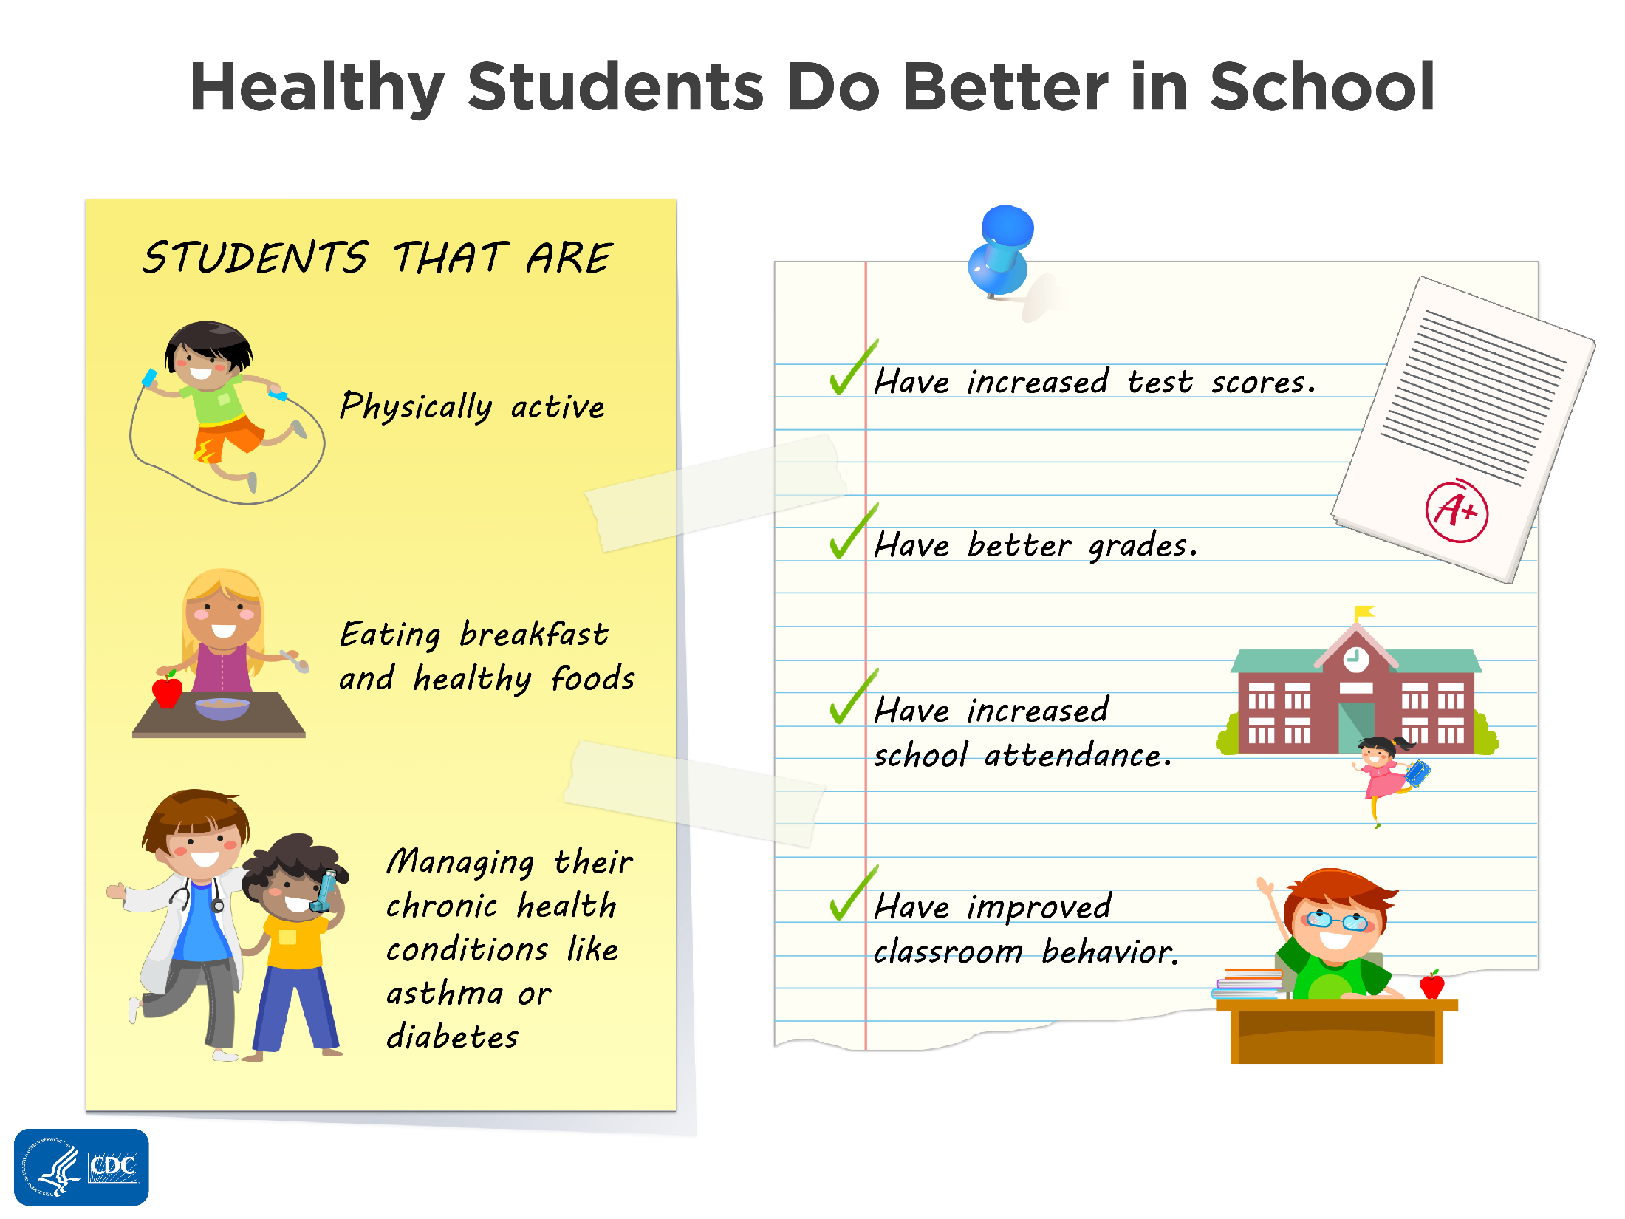
Healthy Students Do Better in School
Notes:
NARRATIVE:
Schools are an important setting to promote healthy eating and physical activity and to address chronic health conditions. More than 95% of young people in the United States are in school for 13 critical years of their development.
Health and learning are strongly connected. Evidence supports that healthy students perform better in school. For example, the connection between students being physically active, eating healthy foods, and managing their chronic health conditions, and improved test scores, grades, school attendance, and classroom behaviors, such as being focused and not getting into trouble, is supported by research.
Research shows that education and health for students must go hand-in-hand for students to succeed. In addition to making sure students are learning, there are school health policies and practices that need to be in place, such as offering healthy food options, providing opportunities for students to be physically active, and having a school nurse.
NOTES FOR PRESENTER:
Health behaviors clearly influence the quality of life for youth and their ability to contribute to and live productively in society. It boils down to the fact that students’ success in schools is not just about academics.

Slide 3



What’s Happening in Your Child’s School?
3
Notes:
NARRATIVE:
There are many opportunities for students to learn about and practice healthy behaviors in schools. In class, especially in health education and physical education, students learn about nutrition and healthy eating, physical activity, and chronic health conditions. However, schools can be doing a better job of aligning what they are teaching with the health practices in the school.
What are your concerns about your child’s health in school? How about
The foods and beverages offered or sold in the school building?
Having opportunities for your child to be physically active during the school day?
Your child having access to school health services staff, including a full-time school nurse?
Let’s take a look at what’s happening in general and then specifically in your child’s school.
NOTE TO PRESENTER:
ASK the audience to provide examples or ADD personalized examples from your school or district.

Slide 4

4
Notes:
NARRATIVE:
The school nutrition environment and services include many different aspects, such as the federal school meal programs, snack foods that are sold in different locations of the schools, items sold for fundraising purposes, and foods that are given to students as rewards for good behavior and academic performance, or during school celebrations and classroom parties.
The CDC and other national organizations recommend that schools do the following: provide a quality school meal program; ensure that students have only appealing, healthy food and beverage choices offered outside of the school meal program; market healthy foods and beverages; and use fundraising activities and student rewards that support health. The goal is to ensure that students have access to healthy food choices during the school day and messages that reinforce these choices. However, there is still much work to be done. The reality is that
74% of schools sell soft drinks to students; (this includes all venues, not just during the school day).
Nearly one-fourth (22%) of schools allow soft drink companies to advertise soft drinks on vending machines. The percentage is higher among high schools compared with middle and elementary schools.
There has been an increase since 2006 in the percentage of schools that holds fundraiser nights at fast food restaurants, where a portion of the sales made on a particular night benefit the school (from 25% to 37%), and over half of schools sell baked goods not low in fat, such as cookies for school fundraisers.
Students can purchase fruits or vegetables from vending machines, school stores, or snack bars in only 6% of schools. In addition, less than one-fourth (23.2%) of schools have a policy stating that if food is served at student parties, then fruits or vegetables will be among the foods offered, and only 5.1% of schools have a similar policy related to concession stands.
Less than half (46.6%) of schools prohibit or actively discourage staff from using food or food coupons as a reward for good behavior or good academic performance.
These data show what was happening in schools across the country before we started to implement Smart Snacks—a set of federal nutrition standards for foods sold in schools.
(Data from the 2014 School Health Policies and Practices Study [SHPPS] support these bullet points.)
NOTE TO PRESENTER:
Reference: Centers for Disease Control and Prevention. Results from the School Health Policies and Practices Study 2014. Atlanta, GA: US Dept of Health and Human Services; 2015.

Slide 5
WHAT’S HAPPENING IN OUR SCHOOL? SCHOOL NUTRITION ENVIRONMENT AND SERVICES
5
Notes:
NOTE TO PRESENTER:
ADD personalized examples from your school or district. Give some examples of what is happening in your school or district related to
School meals.
Competitive foods.
Fundraisers.
Student rewards.
Events and celebrations.
Drinking water availability.
Food and beverages marketing.
What are you and other parents concerned about related to the school nutrition environment?
You can DELETE this slide if you don’t want to highlight what is happening at your school or district. Instead of creating a slide, you can the ASK audience to provide examples.

Slide 6
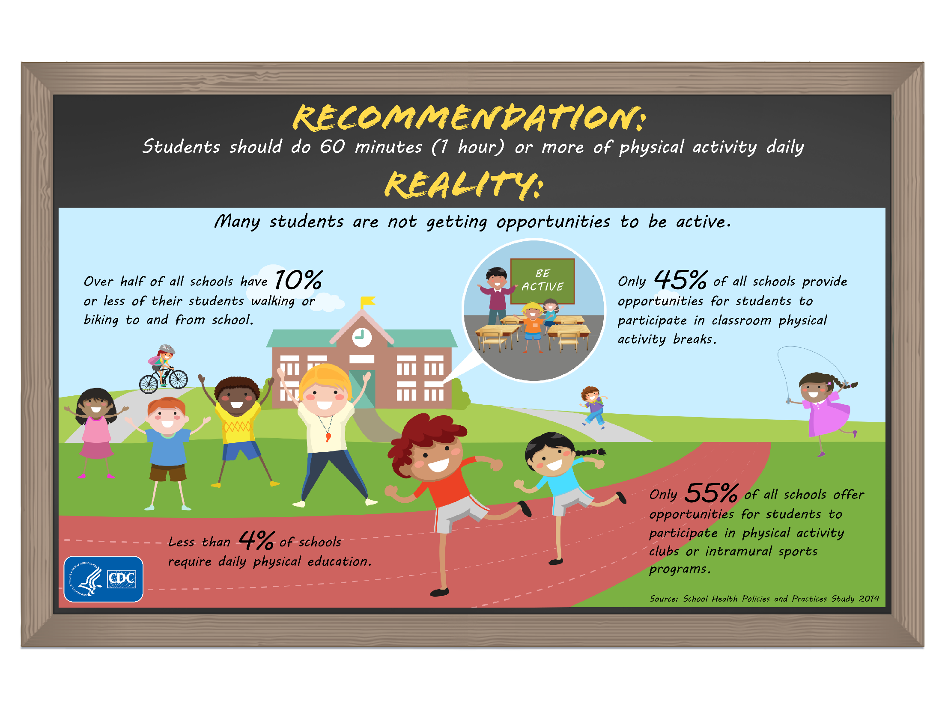
6
Notes:
NARRATIVE:
The federal Physical Activity Guidelines for Americans recommends that children and adolescents should do 60 minutes (1 hour) or more of physical activity daily. However, data from the 2013 Youth Risk Behavior Survey (YRBS) showed that only 27.1% of students had been physically active at least 60 minutes per day on all 7 days.
Here’s the reality: many students are not getting opportunities to be active, which provides them with the knowledge and skills needed to establish and maintain physically active lifestyles. Data from the 2014 School Health Policies and Practices Study (SHPPS) showed the following:
Less than 4% of all schools require daily physical education for the entire school year.
Only 45% of all schools provide opportunities for students to participate in classroom physical activity breaks.
Only 55% of all schools offer opportunities for students to participate in physical activity clubs or intramural sports programs.
More than half of all schools have 10% or less of their students walking or biking to and from school.
NOTE TO PRESENTER:
Reference: Centers for Disease Control and Prevention. Results from the School Health Policies and Practices Study 2014. Atlanta, GA: US Dept of Health and Human Services; 2015.

Slide 7
WHAT’S HAPPENING IN OUR SCHOOL? PHYSICAL EDUCATION AND PHYSICAL ACTIVITY
7
Notes:
NOTE TO PRESENTER:
ADD personalized examples from your school or district. Give some examples of what is happening in your school or district related to the following:
Physical education.
Student fitness assessments
Physical activity during schools.
Recess.
Classroom physical activity.
Physical activity before and after school, such as walking or biking to school and intramural or interscholastic sports.
School staff involved in modeling and providing physical activity in their classrooms.
Family and community engaged in supporting physical activity in schools.
What are you and other parents concerned about related to physical activity in school and physical education?
You can DELETE this slide if you don’t want to highlight what is happening at your school or district. Instead of creating a slide, you can ASK the audience to provide examples.

Slide 8

8
Notes:
NARRATIVE:
During the past few decades, chronic health conditions and mental health problems have increased among children. As a consequence, demand for school health services has risen dramatically as more complex needs are being addressed.
The National Association of School Nurses states that every school-aged child deserves a registered nurse, and every school should have a full-time school nurse all day, every day; however, many schools across the United States do not meet this recommendation.
According to School Health Policies and Practices Study (SHPPS) 2014 data, only about 50% of the nation’s public schools have a full-time registered nurse, and others may have one who works part-time, often dividing his or her hours between several school buildings. Sadly, approximately 20% have no nurse at all. One study shows that for every dollar invested in school health services delivered by full-time registered nurses, society gains $2.20 in savings from medical costs and lost productivity associated with caring for children with chronic health conditions.
NOTE TO PRESENTER:
References: Wang LY, Vernon-Smiley M, Gapinski MA, Desisto M, Maughan E, Sheetz A. Cost-benefit study of school nursing services. JAMA Pediatr. 2014;168:642-648.
Centers for Disease Control and Prevention. Results from the School Health Policies and Practices Study 2014. Atlanta, GA: US Dept of Health and Human Services; 2015.

Slide 9
WHAT’S HAPPENING IN OUR SCHOOL? MANAGING CHRONIC HEALTH CONDITIONS
9
Notes:
NOTE TO PRESENTER:
ADD personalized examples from your school or district. Give some examples of what is happening in your school or district related to the following:
Health services
Healthy Weight
Asthma
Food allergy
Diabetes
Seizure disorders
Oral health
What are you and other parents concerned about related to school health services? For example, if there is not a school nurse available, what happens in an emergency?
You can DELETE this slide if you don’t want to highlight what is happening at your school or district. Instead of creating a slide, you can ASK the audience to provide examples.

Slide 10

What Can Parents Do?
10
Notes:
NARRATIVE:
Parents can help make a difference in the types of foods students are eating at school, the opportunities students get to be physically active, and the support that students get in managing their chronic health conditions, such as asthma or diabetes.
We will
Briefly highlight school practices that should be in place for a healthy school nutrition environment and services, physical education and school-based physical activity, and managing chronic health conditions in school.
Identify some general actions that parents can take to address all three of these topics.
Identify 2 specific next steps that parents can take to start making a difference.
NOTES TO PRESENTER:
You can personalize the narrative by replacing “you” for “parents.”

Slide 11


Help Promote Healthy School Practices Healthy school nutrition environment and services
11
Notes:
NARRATIVE:
The CDC recommends that schools promote access to and participation in school meals, including the National School Lunch Program and School Breakfast Program. Schools should ensure that these meals meet or exceed federal requirements. Schools should also ensure that foods sold outside of the school meal programs, including through vending machines, school stores, fundraisers, and snack bars, meet or exceed the Smart Snacks in School nutrition standards.
Schools can also encourage that healthy options be made available for school parties and other school celebrations and events, and ensure that students have access to drinking water throughout the day.
Schools should provide opportunities for students to learn about healthy eating, including through nutrition education classes, school gardens, and opportunities to taste test new foods. Schools can ensure that students receive consistent messages about healthy eating by only marketing and promoting healthy foods and beverages.
Parents can support a healthy school nutrition environment and services by participating in the school health council, encouraging participation in the school meals, and volunteering their time with healthy school fundraisers and nutrition education activities.
NOTES TO PRESENTER:
Refer to Ideas for Parents.

Slide 12
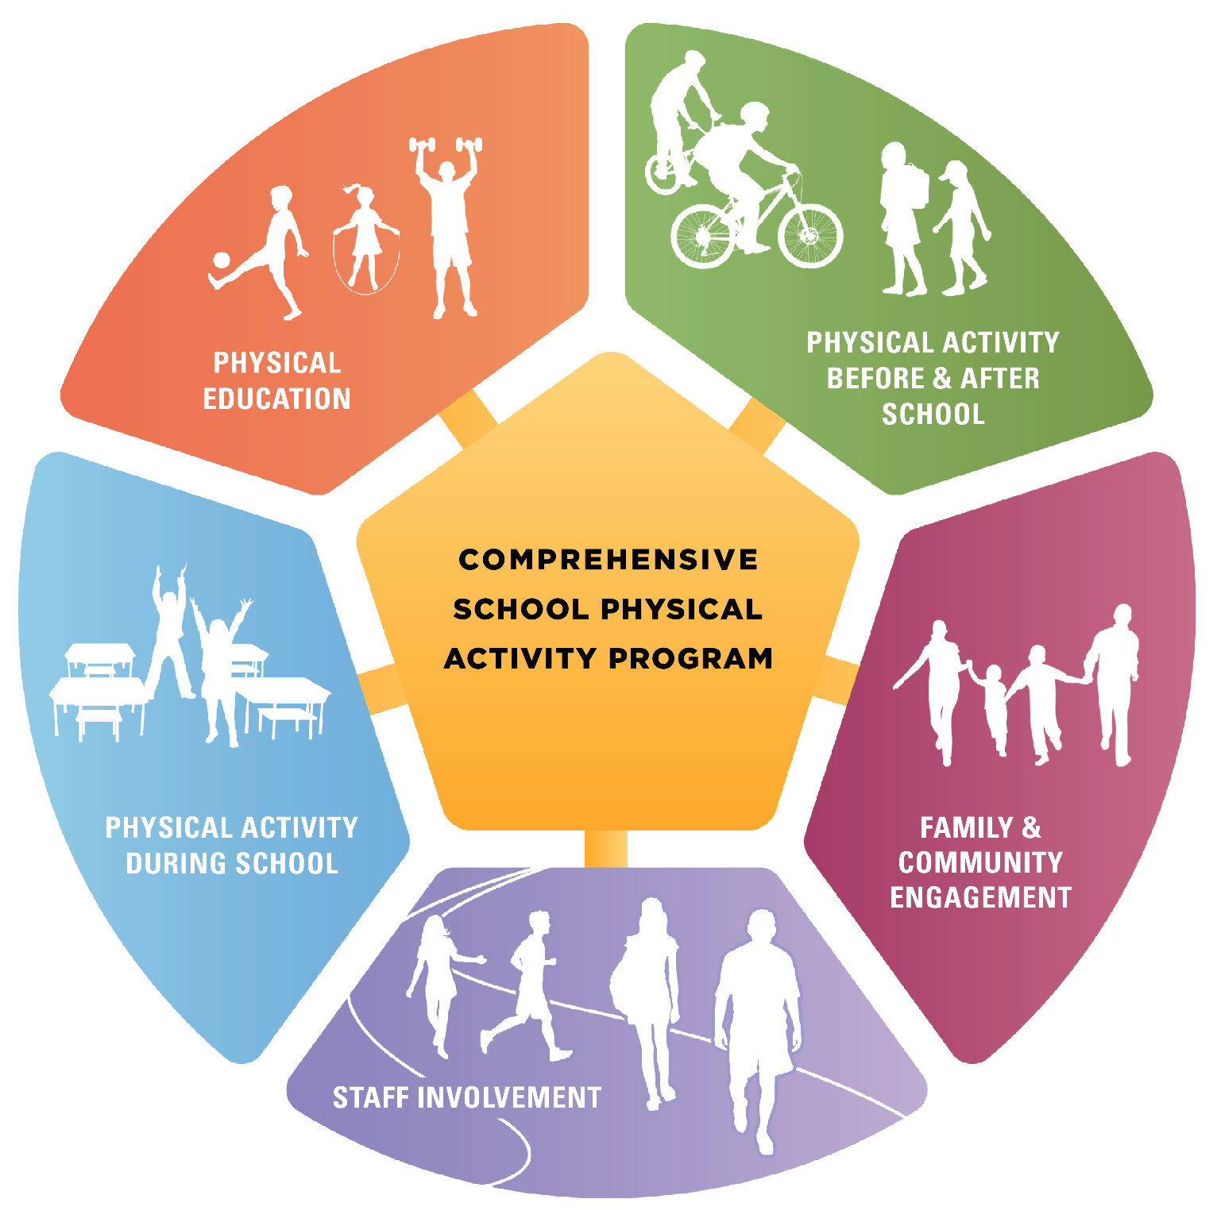
Help Promote Healthy School Practices Physical Education and School-based Physical Activity
12
Notes:
NARRATIVE:
The CDC and other national organizations recommend a comprehensive, school-wide approach to physical activity that provides opportunities for students to be physically active throughout the school day and after school. A Comprehensive School Physical Activity Program (CSPAP) has five components: physical education, physical activity during school, physical activity before and after school, staff involvement, and family and community engagement. Parents can help by participating on the team or committee for comprehensive school physical activity programs. They can also encourage the school leadership to support this effort.
Physical education is the foundation of a CSPAP. It provides the opportunity for students to learn knowledge and skills needed to establish and maintain physically active lifestyles. Physical activity during school includes classroom activity breaks and recess; both of these contribute to activity levels and help kids get their 60 minutes.
Parents can play an important role in getting schools to have daily physical education, recess, and classroom physical activity. They can be the voice at school board meetings and school health council meetings. They can also volunteer their time to help with physical education, recess, and classroom physical activity.
NOTES TO PRESENTER:
Refer to Ideas for Parents.
The Centers for Disease Control and Prevention (CDC), in collaboration with SHAPE America, developed a step-by-step guide for schools and school districts to develop, implement, and evaluate comprehensive school physical activity programs. The document is call A Comprehensive School Physical Activity Program Guide for Schools and is available at http://www.cdc.gov/healthyyouth/physicalactivity/pdf/13_242620-A_CSPAP_SchoolPhysActivityPrograms_Final_508_12192013.pdf.

Slide 13
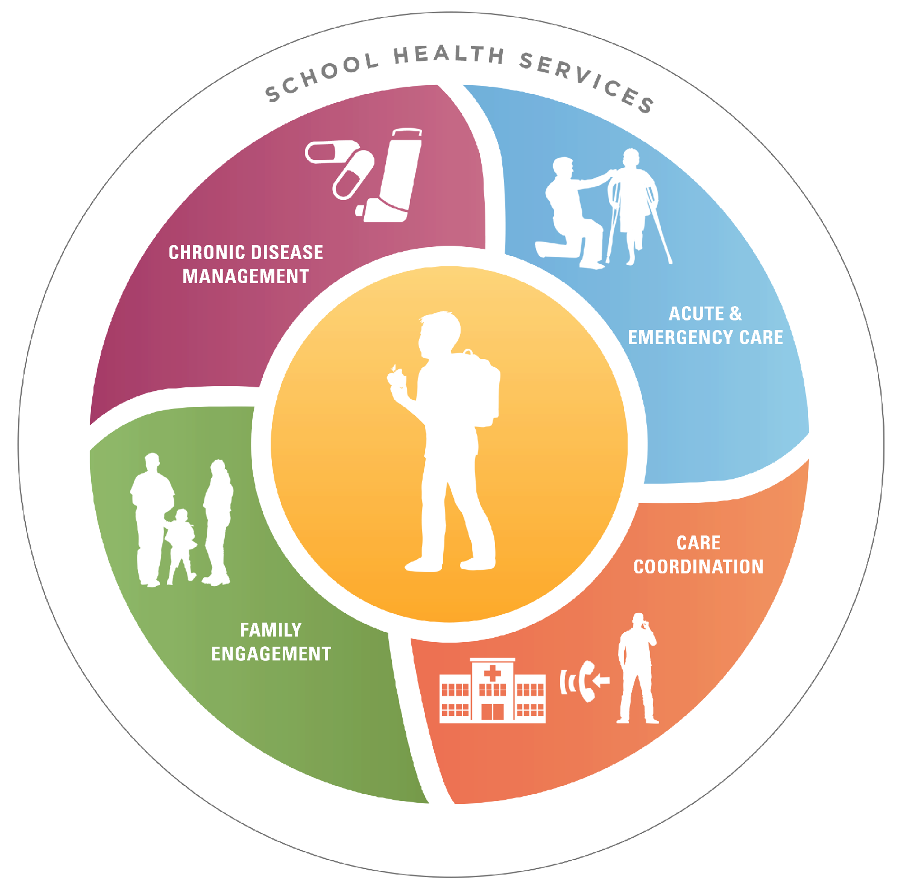
Help Promote Healthy School Practices Managing Chronic Health Conditions in Schools
13
Notes:
NARRATIVE:
For children who have chronic health conditions, having access to student health services is critical. Every school should have a registered nurse available for all students, ideally with a ratio of 1 nurse for every 750 healthy children. Parents can advocate for a school nurse. Parents can also advocate for school health services that can assist all students with health concerns, including first aid and emergency care. School health services can be an integral part of managing chronic conditions, such as asthma or diabetes, as well as promoting prevention and wellness by ensuring appropriate vaccination status, encouraging proper nutrition and physical activity, and providing health education for both students and parents.
It is important for parents and families to be engaged, especially if the student has a chronic health condition. Together with the school nurse and other appropriate school officials, the family can help with the development of an individualized health care plan.
Parents should give permission to the school nurse to communicate with the family’s health care provider and update any changes, as needed. Care coordination is essential to students with chronic health conditions and will help them with their daily management and needs.
In case of an emergency or disaster, a student’s medication or medical devices, such as asthma inhalers or insulin, should be readily available. Parents can ensure this is in place.
NOTES TO PRESENTER:
Refer to Ideas for Parents.

Slide 14
Key Actions For Parents
Bring your voice and expertise to help with school health activities in your child's school.
Help your school put into action the local school wellness policy or other school board policies.
Ask the school to provide educational opportunities for parents.
Join a school group that addresses a healthy school environment.
14
Notes:
NARRATIVE:
We just shared some specific examples of how parents [you] can help promote a healthy school nutrition environment, physical education and physical activity, and manage chronic health conditions. Although there are many ways and activities to support these different health topics, there are four key actions that are consistent across them and help promote a healthy school environment. These include
Bringing your voice and expertise to help with school health activities in your child's school—this can be done by attending classes on health topics supported by the school, communicating with the school about health issues, volunteering to support health activities, making decisions related to school health policies and practices, and reinforcing health messages taught in school at home.
Helping your school implement the local school wellness policy or other school board policies that focus on nutrition education, foods and beverages sold at school, physical activity, physical education, and managing chronic health conditions.
Asking the school to provide educational opportunities for you to learn about the connection between health and academic achievement, the importance of healthy eating and physical activity, and ways to support your child with a chronic health condition in school.
Joining a group that supports and can address a healthy school environment, such as the Parent Teacher Association (PTA), school wellness council, school health advisory council, or action team for partnerships (http://www.csos.jhu.edu/p2000/nnps_model/school/atp.htm).
NOTES TO PRESENTER:
Please edit these actions, as needed, so they are consistent to what is possible at your school.

Slide 15

What Should Be Your Next Steps?
What Should Be Your Next Steps?
Learn more about
The healthy school nutrition environment
Opportunities for physical activity in schools
Helping students manage chronic health conditions in schools
Get involved in a school group that addresses the healthy school environment.
Learn more about
The healthy school nutrition environment
Opportunities for physical activity in schools
Helping students manage chronic health conditions in schools
Get involved in a school group that addresses the healthy school environment.
15
Notes:
NARRATIVE:
What should be your next steps? There are 2 things you can do immediately.
First, you can learn more about a healthy school nutrition environment, opportunities for physical activity in schools, and helping students manage chronic conditions in schools. This information is located at [ADD LINK TO PARENT IDEA SHEETS]. At this website, you will find one-page overview documents that suggest key questions and ideas parents should consider for taking action on school-related nutrition, physical activity and physical education, and chronic conditions.
Second, get involved in a school group that is already addressing these health issues, such as the Parent Teacher Association (PTA), school wellness council, school health advisory council, or action team for partnerships (http://www.csos.jhu.edu/p2000/nnps_model/school/atp.htm).
NOTES TO PRESENTER:
Please include on this slide the person(s) whom parents should contact in the school to join this school group(s), or what meeting(s) they should attend. You can also create another slide with this information.

Slide 16
Thank You!
For more information, please contact the Centers for Disease Control and Prevention:
4770 Buford Highway NE, Atlanta Georgia 30341 USA
Visit http://www.cdc.gov/healthyschools/
Email CDC-INFO www.cdc.gov/cdc-info
Call: 1-800-CDC-INFO (232-4636); TTY: 1-888-232-6348
16
Notes:
NARRATIVE:
Thank you for your participation!

