Slide 1
CDC’s School Health Index: A Self-Assessment and Planning Guide
Notes:
I will now provide an overview of CDC’s School Health Index (SHI): A Self-Assessment and Planning Guide and describe how this tool can be used to assess and improve school health policies and programs.

Slide 2


School Health Index
Notes:
The School Health Index (SHI) was developed by the Centers for Disease Control and Prevention (CDC) in partnership with school administrators and staff, school health experts, parents, and national nongovernmental health and education agencies.

Slide 3
What is the Purpose of the SHI?
Enables schools to identify strengths and weaknesses of health promotion policies and programs.
Enables schools to develop an action plan for improving student health.
Engages teachers, parents, students, and the community in promoting health-enhancing behaviors and better health.
Notes:
The School Health Index enables schools to identify the strengths and weaknesses of their health and safety policies and programs, as well as helps schools develop an action plan for improving school health. One of the SHI’s most important attributes is that it gives teachers, parents, and community members a means of making a difference in the lives of young people by providing specific opportunities to involve them in the assessment process and by inviting them to help shape plans to improve school programs.

Slide 4






CDC Guidelines and Strategies for
School Health Programs
Notes:
The questions in the School Health Index are derived from CDC’s research-based guidelines and strategies for school health programs, which identify the policies and practices most likely to be effective in improving healthy behaviors among students.

Slide 5

Coordinated School Health (CSH)
Health Education
Family/Community
Involvement
Physical Education
Health Services
Health Promotion
for Staff
Healthy School
Environment
Nutrition Services
Counseling,
Psychological, &
Social Services
Notes:
The SHI is structured around the CDC Coordinated School Health approach (CSH). There are eight modules in the SHI which correspond to the eight components of CSH. This model highlights the importance of involving and coordinating the efforts of all eight interactive components to maintain the well-being of young people. The eight components are: physical education and other physical activity programs; health services; nutrition services; counseling, psychological, and social services; healthy school environment; health promotion for staff; family and community involvement; and health education.
For example, if a school wants to improve its physical activity programs, it should certainly enhance the physical education program. However, the school should also think about other ways to increase physical activity among students. Students should be taught about physical activity in health education class; families should be taught about the importance of physical activity and encouraged to model healthy behaviors; schools should seek out physical activity opportunities in the community; staff should model physical activity; the environment should be conducive to physical activity (e.g., having sidewalks around the school, having adequate gyms and tracks), health and social services providers in the school could provide individual counseling related to physical activity or weight management; and so forth.

Slide 6
Health Topics in the SHI
(2014 edition)
Physical activity
Nutrition
Tobacco-use prevention
Safety (unintentional injury and violence prevention)
Asthma
Sexual health
Notes:
The 6th edition of the SHI released in 2014 addresses six health topics: physical activity; nutrition; tobacco-use prevention; safety (unintentional injury and violence prevention); asthma; and sexual health.

Slide 7
Uses of the SHI
Used in at least 46 U.S. states
Adapted for use in Canada, Mexico, and Saudi Arabia
> 300 schools in Missouri
200-250 schools in Georgia
109 schools in Kansas
All metro Nashville schools
93 schools in Austin; more than half of middle schools in Houston
One of CDC’s Division of Adolescent and School Health’s most popular publications
Notes:
The SHI is being widely implemented throughout the United States and has even been adapted for use in Canada, Mexico, and Saudi Arabia. In some areas of the country, the SHI has been used in high concentrations. For example, in hundreds of schools in Missouri, Georgia, and Kansas; in addition, all metro Nashville schools, 93 schools in Austin, and more than half of the middle schools in Houston. “SHI” is one of the most searched terms on the Division of Adolescent and School Health (DASH) Web site. School Health Index online has more than 19,000 registered users. From 2007 through 2011, the CDC warehouse shipped more than 27,000 copies of SHI.

Slide 8
Making a Difference
As a result of implementing the SHI, schools have
Created a school health team.
Moved healthier options to the front of the lunch line.
Increased time for physical education.
Started student and staff walking clubs.
Added healthy choices to vending machines.
Offered access to the gym outside of school hours.
Provided parent education through newsletters and healthy activity nights.
Replaced fried foods with baked items.
Provided conflict resolution training to staff.
Offered health screenings for staff.
Notes:
As a result of implementing the SHI, schools have made a wide variety of changes in their school health and safety policies and programs. For example, schools have:
Created a school health team.
Moved healthier options to the front of the lunch line.
Increased time for physical education.
Started staff and student walking clubs.
Added healthy choices to vending machines.
Offered access to the gym outside of school hours.
Provided parent education through newsletters and healthy activity nights.
Replaced fried foods with baked items.
Provided conflict resolution training to staff.
Offered health screenings for staff.

Slide 9
Clarifying Points
Low scores on the SHI do NOT indicate
“low-performing” schools.
Many actions will NOT require new resources or responsibilities.
For actions requiring new resources, results can help
  Provide information to stimulate school board or community support.
  Establish data and justification for funding requests.
Notes:
It is important to note that the SHI is not designed to compare schools with each other. Low scores on the SHI do not indicate that you have a “low-performing” school. The SHI is a tool to help your school make an accurate and fair assessment of its health and safety programs and policies for the sole purpose of better serving the needs of your students, families, and staff.
Completion of the SHI will conclude with the development of an action plan. The actions recommended in your plan often will not require any changes in staff responsibilities or additional resources.
Of course, some actions might require new resources. Completing the SHI, however, can provide you with the information to help stimulate support and justify funding requests.

Slide 10
What SHI Is and What SHI Is NOT
Self-assessment and
planning tool
Research or evaluation tool
Educational and
community-organizing
process
Tool to audit or punish
school staff
Notes:
There are some common misconceptions about the SHI and how it is used, so I’d like to talk to you a little bit about what the SHI is and what it is not.
The SHI is a self-assessment and planning tool, not a tool meant for research or evaluation.
The SHI is an educational and community-organizing process, not a tool to audit or punish school staff.

Slide 11
What SHI Is and What SHI Is NOT
Identifies low-cost or
no-cost changes
Requires
expensive changes
Focused, reasonable, and
user-friendly experience
Long, bureaucratic, and
painful process
Notes:
The SHI is a process that identifies low-cost or no-cost changes, not a process that will require expensive changes.
The SHI is a focused, reasonable, and user-friendly experience, not a long, bureaucratic, and painful process.

Slide 12
Time Commitment
The SHI can be completed in as little as 6 hours:
  Modules 1-4: ~1 hour each
  Modules 5-8: ~30 minutes each
A small investment of time can pay big dividends in improving students’ well-being, readiness to learn, and prospects for a healthy life.
Notes:
Field testing of the School Health Index has shown that it can be completed in as little as 6 hours. Each of the first four modules may take about 1 hour to complete, and each of the last four modules take about 30 minutes to complete. Of course, some questions may require you to seek additional information or engage in open discussion, both of which will require some extra time.
Remember that a small investment of time can pay big dividends in improving students’ well-being, readiness to learn, and prospects for a healthy life.

Slide 13
SHI Format
Completed by school health teams
Two separate versions:
  Elementary School
  Middle School/High School
Self-Assessment: 8 modules corresponding to Coordinated School
Health
Planning: Planning for Improvement
section
Notes:
The most essential thing to remember is that completing the SHI should be a team effort. The strength of the process comes from having people from different parts of the school community sit down together and plan ways to work towards improving school policies and programs. The connections that develop among SHI participants are among the most important outcomes of the process.
There are two separate versions of the publication: one for elementary schools and one for middle schools and high schools. The majority of the questions are identical in the two versions. However, there are some questions that are targeted to the school level. For example, the elementary SHI includes a question about playgrounds meeting safety standards, whereas the middle/high school SHI asks about physical activity facilities meeting safety standards.
The SHI is composed of two main parts: the self-assessment process and the planning process. The self-assessment process consists of a series of questions organized into eight modules, corresponding to the eight components of Coordinated School Health.
Following the completion of the self-assessment modules, school health teams are guided through the planning process, which will help them create an action plan to improve high priority areas.

Slide 14
Modules = CSH Components
School Health and Safety Policies and Environment
Health Education
Physical Education and Other Physical Activity Programs
Nutrition Services
School Health Services
School Counseling, Psychological, and Social Services
Health Promotion for Staff
Family and Community Involvement
Notes:
Here is a list of the eight modules. Remember, the eight modules of the SHI correspond to the components of CDC’s model of Coordinated School Health.

Slide 15
Question Coding
CC = cross-cutting
PA = physical activity
N = nutrition
T = tobacco-use prevention
S = safety (unintentional injury and violence prevention)
A = asthma
SH = sexual health
Notes:
In addition to questions for each of the SHI’s six health topic areas (physical activity, nutrition, tobacco-use prevention, safety, asthma, and sexual health), each module contains cross-cutting questions, meaning that these questions apply to ALL SIX topic areas. For example, one cross-cutting question in the module that relates to policies and environment asks, “Does your school or district have written health and safety policies that include the following components? The listed components, for example, policy rationale or procedures for addressing policy infractions, are important regardless of health topic.
Although we would love schools to implement the entire SHI (i.e., all six health topics and all cross-cutting questions in all eight modules), we recognize that some schools might want to focus their assessment on particular topics of interest. To assist in the selection, we have grouped and labeled the questions by health topics: cross-cutting (CC), physical activity (PA), nutrition (N), tobacco-use prevention (T), safety (i.e., unintentional injury and violence prevention) (S), asthma (A), and sexual health (SH). Regardless of the health topic(s) a school selects, it should always address the cross-cutting issues. If you use the interactive online version of the SHI, the system will sort the questions for you. We will talk a little more about the online SHI a little later.

Slide 16
Implementing the SHI
Assemble SHI team
Conduct SHI introduction meeting
Complete self-assessment modules
Conduct SHI planning meeting
Notes:
How does a school go about implementing the SHI? I will discuss four basic steps of the implementation process.

Slide 17
Implementing the SHI
Assemble SHI team
Conduct SHI introduction meeting
Complete self-assessment modules
Conduct SHI planning meeting
Notes:
First, a SHI team is assembled that represents various segments of the school population. Some schools choose to use an existing committee or council. The strength of the team is critical for success, so oftentimes using a pre-existing group may be effective.

Slide 18
Possible Team Members
Principal or assistant principal
Physical education teacher
School nutrition services manager
Health education teacher
Classroom teacher
School nurse
School counselor
School psychologist or social worker
Janitor or custodian
Parents
Students
Community-based health care and social services providers
Community health organization representative
(e.g., ACS)
Local health department staff member
Cooperative extension service representative
Notes:
Who should be on the School Health Index team? Possible members include the school principal or assistant principal, physical education teacher, school nutrition services manager, health education teacher, classroom teachers, school nurse, school counselor, school psychologist or social worker, and janitor or custodian.
The SHI team may also include parents and students; community-based health care and social services providers; a representative from a community health organization, such as the American Cancer Society; a staff member from the local health department; and a representative from the cooperative extension service.

Slide 19
Implementing the SHI
Assemble SHI team
Conduct SHI introduction meeting
Complete self-assessment modules
Conduct SHI planning meeting
Notes:
After the SHI team members are selected, the team meets to begin the SHI implementation process.

Slide 20
Introduction Meeting
Explain the SHI
Assign modules to groups
Identify module coordinators
Notes:
During the first SHI team meeting, the facilitator or coordinator will explain the SHI process, using an overview presentation much like I am giving you today. The team will also decide how the SHI should be implemented in their school. Some SHI teams decide to complete all eight modules of the SHI together in one sitting. Typically, a smaller group will be created for each of the eight modules. When the module groups are being formed, it is very important to have at least two people work on each module because having more than one person will increase accuracy and elicit a variety of creative insights for improving school health policies and programs. Each SHI team member will be assigned to a module based on their area of interest. The person most knowledgeable about the module topic will serve as that module’s coordinator. For example, the school nutrition services manager may choose to participate in Module 4, Nutrition Services, along with a classroom teacher and a parent. The nutrition services manager would serve as the coordinator for that module.

Slide 21
Implementing the SHI
Assemble SHI team
Conduct SHI introduction meeting
Complete self-assessment modules
Conduct SHI planning meeting
Notes:
If the entire SHI team is completing the self-assessment modules together, all team members will work on the eight modules by answering a series of questions and developing a set of recommendations. If the SHI team has broken up into smaller groups, each of the eight groups will meet and complete the series of questions and recommendations for their assigned module.

Slide 22
Module 1: School Health and Safety Policies and Environment (sample topics)
Representative school health committee or team
Positive school climate
Prohibit using physical activity as punishment
Adequate physical activity facilities
Prohibit sugar sweetened beverages
Access to free drinking water
Enforce tobacco-use policies
Maintain safe physical environment
Implement indoor air quality practices
Confidentiality of HIV status
Notes:
Let’s talk in a little bit more detail about what the self-assessment process involves.
Module 1 of the School Health Index focuses on school policies and environment and may be the most broad of the eight modules because it addresses a wide range of topics. The questions in Module 1 address all six health topic areas as well as questions that cut across all of these content issues. Some sample question topics include:
Representative school health committee or team
Positive school climate
Prohibit using physical activity as punishment
Adequate physical activity facilities
Prohibit sugar sweetened beverages
Access to free drinking water
Enforce tobacco-use policies
Maintain safe physical environment
Implement indoor air quality practices
Confidentiality of HIV status

Slide 23
Question CC.1
Representative school health committee or team
Does your school have a representative committee or team that meets at least four times a year and oversees school health and safety policies and programs?
Notes:
Here is an example, using a cross-cutting question, of how SHI questions are written. Each question is summarized in a phrase that is presented above the question and used on the scorecard. For this question the phrase reads, “Representative school health committee or team.” Directly beneath the phrase, the full question is written: “Does your school have a representative committee or team that meets at least four times a year and oversees school health and safety policies and programs?”

Slide 24
Question CC.1
Representative means that it includes school administrators, health education teachers, physical education teachers, mental health or social services staff members, nutrition services staff members, health services staff members, maintenance and transportation staff members, students, parents, community members, local health departments or organizations, faith-based organizations, businesses, and local government representatives.
Notes:
When needed, definitions and examples are included in a glossary to help the user understand the terminology. In the SHI online, these definitions are provided as hyperlinks.
This example provides more detail about what is meant by representative in question CC.1. “Representative means that it includes school administrators, health education teachers, physical education teachers, mental health or social services staff members, nutrition services staff members, health services staff members, maintenance and transportation staff members, students, parents, community members, local health departments or organizations, faith-based organizations, businesses, and local government representatives.”

Slide 25
Question CC.1
3 = Yes.
2 = There is a committee or team that does this, but it could be more representative.
1 = There is a committee or team, but it is not representative, or it meets less often than four times a year.
0 = No.
Notes:
The last part of each question is the scoring description. All questions in the School Health Index use a 4-point scale. For each question, a score of 3 points means that the school is achieving the “gold standard,” the ideal goal that schools should be achieving. A score of 2 points means that the school is doing very good but falls somewhat short of the goal. A score of 1 point means that the school is doing something in this area but falls far short of the goal. Finally, 0 points indicates that the school is not doing anything to meet the goal. Later, these scores will be used to identify strengths and weaknesses. The 3’s and 2’s are strengths, and the 1’s and 0’s are weaknesses.

Slide 26
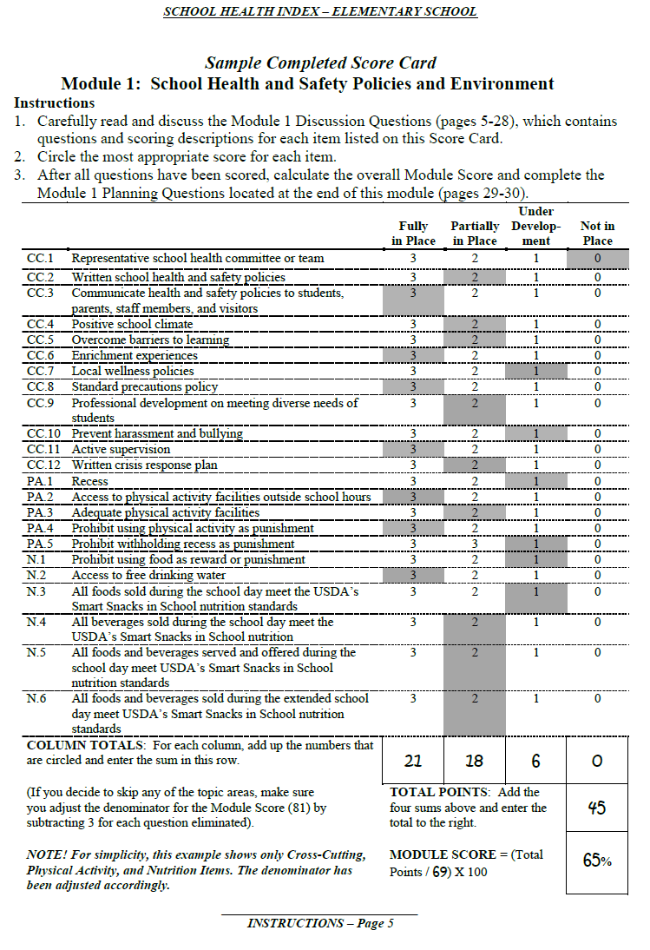
Completed Module Scorecard
Notes:
Teams will complete each of the discussion questions, inserting their scores on the Module Scorecards. They will then calculate their module scores. Here is an example of a completed Scorecard for Module 1.
To calculate the module score
First add up each of the column scores. In this example, the columns total up to 21, 18, 6, and 0.
Then add the column scores together across the bottom. Here they add up to 45.
Divide the total score by the total points possible for the module. We divide 45 by the 69 total possible points.
Lastly, multiply that number by 100 to get a percentage score. The score for Module 1 in this example is 65%.

Slide 27
Module Planning Questions 1 & 2
Planning Question 1: Look back at the scores you assigned to each question. According to these scores, what are the strengths and weaknesses of your school’s policies and environment related to health and safety?
Planning Question 2: For each of the weaknesses identified above, list several recommended actions to improve the school’s scores (e.g., create and maintain a school health committee).
Notes:
Each module ends with three planning questions that will result in a list of recommendations.
The first planning question asks the group to list the strengths and weaknesses found in the module based on the scores earned for each item. In general, strengths will be those questions that were scored as 3’s or 2’s, and the weaknesses will be those scored as 1’s or 0’s.
The second question asks the group to identify actions to improve each weakness identified in the first planning question. These are meant to be simple statements converting the items that were weaknesses into actions. For example, if your school scored a 0 on having a representative school health committee, your action item could be to create and maintain a school health committee.
The third question will have the group prioritize the actions. We will look at that in a moment.

Slide 28

Completed Planning Questions 1 & 2
Notes:
Here’s an example of what the first two completed planning questions would look like.
In this example, the group has decided that some actions the school could take to address its weaknesses are:
Form a school health committee.
Have the school health committee review the district local wellness policy.
Conduct staff development on dealing with bullying.
Make sure all teachers are providing daily, 20 minute recess.
Work with the nutrition service staff to make sure all foods meet the new standards.
Change vending machines to not sell sugar-sweetened beverages outside school hours.

Slide 29
Module Planning Question 3
Planning Question 3: List each of the proposed actions identified in Planning Question 2 in the table. Use the scales to rank each action on the five dimensions below. Add the points for each action to get the total points.
  Importance
  Cost
  Time
  Commitment
  Feasibility
Notes:
The third planning question asks the group to rate from 1 to 5 each proposed action in terms of five dimensions. This enables actions to be prioritized for implementation.
The five dimensions ask the following questions:
Importance – How important is the action to my school?
Cost – How expensive would it be to plan and implement the action?
Time – How much time and effort would it take to implement the action?
Commitment – How enthusiastic would the school community be about implementing the action?
Feasibility – How difficult would it be to complete the action?

Slide 30
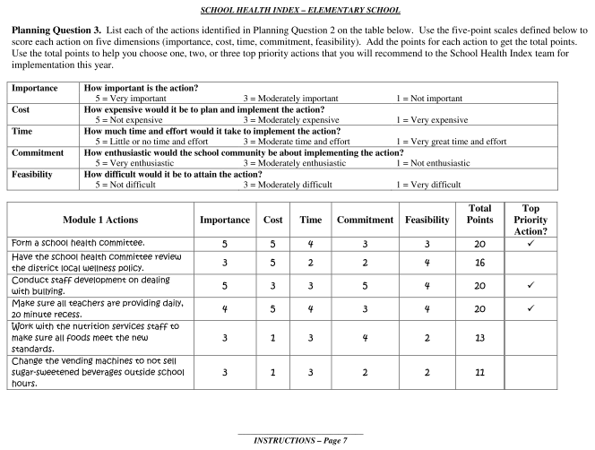
Completed Planning Question 3
Notes:
Here is an example of how a module’s third planning question may appear. The module group has entered into the left-hand column actions brainstormed during the previous planning question. These actions have also been prioritized based on the five dimensions just described.

Slide 31
Keep in Mind…
Answer questions as accurately as possible. This is a self-help tool, not an instrument for punishing staff.
There is no passing grade. This is designed to help you understand your school, not to compare your school with other schools.
You should EXPECT to get at least some low scores. Low scores can help you build awareness of areas needing improvement.
Notes:
While completing the modules, it is important to keep a few things in mind. First, answer all questions as accurately as possible. The SHI is a self-help tool designed solely to help you understand your school’s environment. There is no such thing as a passing grade, and your scores are not intended to be compared among schools. Also, low scores should be expected. These scores will help you build awareness of areas that need improvement.

Slide 32
Implementing the SHI
Assemble SHI team
Conduct SHI introduction meeting
Complete self-assessment modules
Conduct SHI planning meeting
Notes:
Following the self-assessment process is the planning step. All members of the SHI team meet to participate in the planning process. This is the time for the SHI team to summarize results, reflect on the school’s strengths, and discuss areas that need improvement.

Slide 33
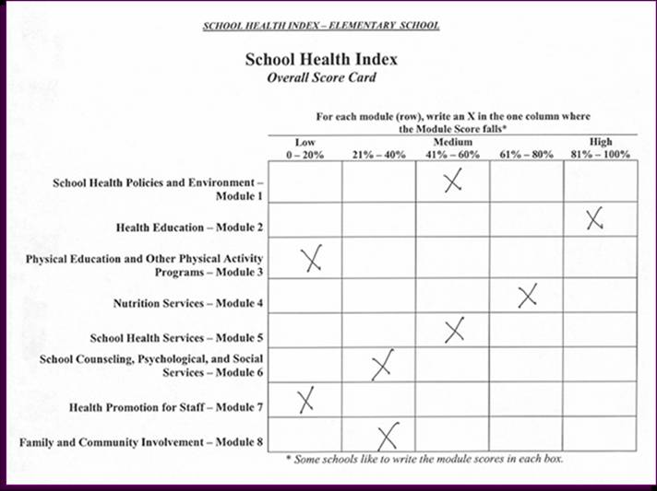
Completed Overall Scorecard
Notes:
As seen here, the module groups transfer their module scores onto the Overall Scorecard. Schools can place an X to indicate the range in which each module score falls. For example, if a school received a score of 48% on Module 1, the team would place an X in the range of 41-60%. This Score Card provides a snapshot of the scores received on all eight modules relative to each other and allows the school health team to see an overall picture of the strengths and weaknesses of the school’s health policies and programs. It will assist them in determining which areas are most in need of improvement.

Slide 34
Action Plan
Module groups present two or three actions
SHI team selects manageable number
of actions
Team mixes both short- and long-term actions
Team completes action plan (action, steps to completion, person responsible, timeline)
Notes:
If the SHI team has broken into smaller groups to complete the self-assessment modules, each module group will present two or three actions that it believes should be implemented first based on its assessment.
The SHI team will then select a manageable number of actions to address, mixing both short- and long-term goals. Generally, it is recommended that the team select no more than three to five actions for the next school year. The actions that are not selected can be kept on a list to address in future school years.
Finally, the team will complete the action plan. The School Health Improvement Plan asks for the SHI team to identify priority actions, list specific steps that need to be taken to implement each action, and designate who will be responsible for each step. Assigning tasks increases accountability, making team members more likely to follow through with their tasks. It is important to be as specific as possible when listing the steps to complete an action.

Slide 35
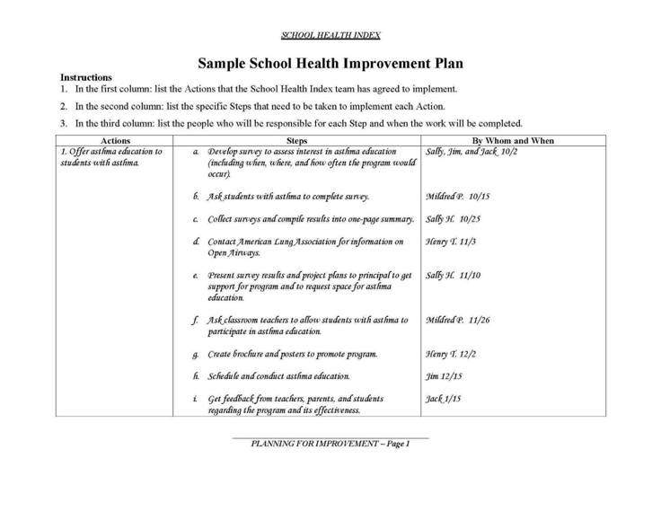
Completed Action Plan
Notes:
Here is an example of a completed action plan for one action. The SHI team plans to offer asthma education to students with asthma.
The steps for completion are as follows:
a. Develop survey to assess interest in asthma education (including when, where, and how often the program would occur).
b. Ask students with asthma to complete survey.
c. Collect surveys and compile results into one-page summary.
d. Contact American Lung Association for information on Open Airways.
e. Present survey results and project plans to principal to get support for program and to request space for asthma education.
f. Ask classroom teachers to allow students with asthma to participate in asthma education.
g. Create brochure and posters to promote program.
h. Schedule and conduct asthma education.
i. Get feedback from teachers, parents, and students regarding the program and its effectiveness.

Slide 36
Keep in Mind…
Some actions will involve simply making better use of existing resources.
Other actions may require additional resources.
Keep the team together to monitor progress.
Notes:
There are some important things to keep in mind when completing the planning process. First, some recommended actions may require additional resources, whereas other actions may simply involve making better use of existing resources. Remember to keep the SHI team together to monitor progress and also to schedule annual assessments of your school.

Slide 37




Resources
www.cdc.gov/HealthyYouth/publications
Notes:
A comprehensive and up-to-date list of school health and safety resources is available online at www.cdc.gov/HealthyYouth/publications. The online list includes resources for each of the health topics addressed in SHI and for cross-cutting topics such as coordinated school health.
[On this page are images of the following:
CDC’s Health Education Curriculum Analysis Tool
CDC’s Parent Engagement: Strategies for Involving Parents in School Health
Directors of Health Promotion and Education’s School Employee Wellness: A Guide for Protecting the Assets of Our Nation’s Schools
Action for Healthy Kids’ Wellness Policy Tool]

Slide 38
What are the keys to success?
School health champion (strong leadership)
Administrative buy-in
Team representation, cohesion, and commitment
Clear, organized, and well-facilitated process (many schools are using outside facilitators)
Starting with small, achievable goals
Highlighting and build on successes
Notes:
There is no single way to implement the SHI. Schools have developed many approaches, and you need to find the approach that best meets your school’s needs. Regardless of the approach a school uses, we have found that there are some important keys to success in the SHI process.
The identity of the school health champion will vary from school to school. He or she may be a school nurse, a classroom teacher, a health education teacher, a principal, or even a concerned parent or student. Whoever this individual is, his or her leadership and commitment can help maintain the momentum to get the SHI process going and ensure that the team follows through with the action plan.
Gaining support from school administrators before you begin greatly improves commitment to the process of completing the SHI and following through with the action plan.
Remember, the SHI should always be a group effort: the strength of the process comes from having individuals from different parts of the school community sit down together and plan ways to work towards improving school policies and programs. It is important to ensure that the team is representative of the school and local communities and that the team members are committed to making a difference in the lives of your school’s students. The connections that develop among SHI team members are among the most important outcomes of the process and, if sustained, can greatly affect future efforts to improve school health.
It is important to have a clear, organized, and well-facilitated process. Many schools have found that it is best to have someone from outside the school facilitate the SHI process. Because an outside facilitator is removed from school politics, this individual can be more neutral and help the staff deal with internal conflicts.
When creating and implementing action plans, try to start with small, achievable goals and then build on those successes.

Slide 39
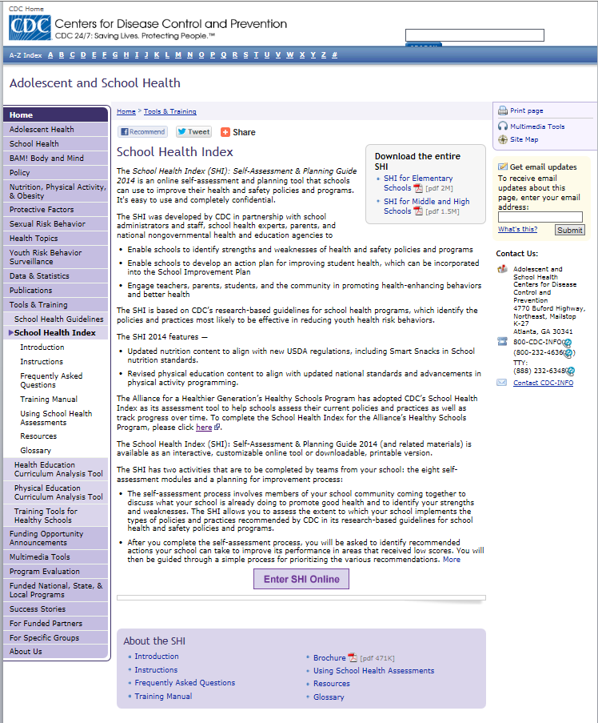
SHI Online
Notes:
The SHI is available in both downloadable PDF files and online. The interactive online system allows schools to select health topics they want to address, complete their SHI directly online, and archive older versions of the SHI.

Slide 40
How can I access the SHI?
Complete the SHI interactively on the Web http://www.cdc.gov/HealthyYouth/shi/
Download or print from Web site
Notes:
Perhaps the most exciting thing of all about the School Health Index is that it is available free of charge. You may interactively complete the SHI on the Web. You may also download or print copies from the CDC Web site.

Slide 41
CDC’s School Health Index: A Self-Assessment and Planning Guide

