Slide 1

Professional Development 101: The Basics – Part 1
A Professional Development Series from the
CDC’s Division of Population Health
School Health Branch

Slide 2


Introduction
Section One:

Slide 3

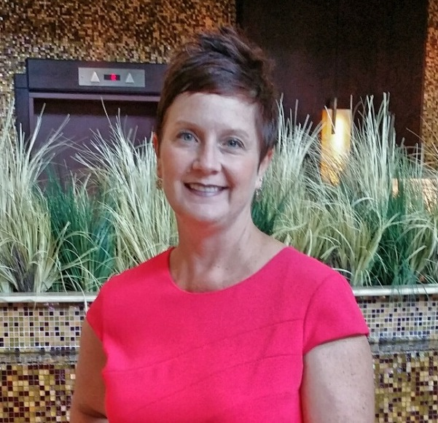
Welcome
Bridget Borgogna
Health Education Specialist/Project Officer
Melissa Fahrenbruch
Team Lead, Program and Professional Development Team
Notes:
B: Welcome to Professional Development 101: The Basics, the first course in the Professional Development series. My name is Bridget Borgogna, and I am a health education specialist and project officer at CDC’s Division of Population Health, School Health Branch. I’m joined by Melissa Fahrenbruch, who is the team lead for the Program and Professional Development team in the School Health Branch.
M: Hello. I’m looking forward to kicking off the series with you.

Slide 4



Purpose
Professional development strengthens education delivery and increases skill-building capacity.
Notes:
B: In Part 1 of this course, we’ll introduce you to Professional Development Practices that are based on research and best practices. The practices were developed in partnership with Rocky Mountain Center for Health Promotion and Education, or RMC Health.
M: Yes, we have worked with RMC Health for a number of years. We partnered with them in 2012 to help funded partners strengthen their education delivery through professional development activities.
B: By providing courses like this, we believe we can help you increase the skill-building capacity of your staff, as they work toward improving health and educational outcomes among youth.

Slide 5
Learning Objectives
Define professional development.
Identify key professional development terms.
Identify three professional developmental practices.
Describe how these practices can improve your state’s professional development capabilities.
Identify strategies to support each professional development practice.
Notes:
These are the points we’ll cover over the next hour.
We’ll define what we mean by professional development and go over key terms. We’ll introduce you to three of the six practices that, if used, can enhance your state’s professional development capabilities. Finally, we will share some strategies you can use with each practice.
Throughout the course, you’ll have opportunities to review, test your knowledge, and get more information. At the end, we’ll want to know your opinions about Part 1 of the course before we wrap up this session.
All right, let’s get started!

Slide 6
Professional development defined
Section Two:

Slide 7
What is Professional Development?
Systematic process that strengthens how professionals obtain and retain knowledge, skills, and attitudes
Consciously designed processes and activities developed to improve organizational practices
PD
Notes:
M: What is that? Police Department?
B: No! Professional development is commonly referred to as PD. And you’ll hear me use it throughout this course. What does professional development mean to you?
M: It is a systematic process that strengthens how professionals obtain and retain knowledge, skills, and attitudes.
B: You’re right. Put another way, we can say it is the consciously designed processes and activities developed to improve organizational practices.

Slide 8
But, wait… there’s more!
Adult learning principles to engage learners
Systematic process: planning, designing, marketing, delivering, evaluating, and following up
Events, information and presentation sessions, and technical assistance
Notes:
B: There is more to it than just having some offerings available in your program. Effective professional development offerings should follow adult learning principles to engage learners. That means following a systematic process that includes planning, designing, marketing, delivering, following up, and evaluating.
M: That sounds like a very extensive process!
B: It can be. Professional development will come together as we talk more about strategies to implement a useful process.
M: But first… what is considered an offering?
B: Good question. Offerings are events, information and presentation sessions, and technical assistance. Let’s break down what each of these terms mean.

Slide 9
Professional development activities
Section Three:

Slide 10



Events
Set of skill-building processes and activities designed to assist individuals in obtaining new knowledge and skills
Purpose: to reach specific goals and improve workplace performance
Targeted to a specific audience, learner-centered, call to action
Notes:
B: Simply put, an event is something that happens.
A professional development event is a set of skill-building processes and activities designed to assist individuals in obtaining new knowledge and skills. The purpose is to reach specific goals and improve workplace performance.
Events can be face-to-face training, distance learning, workshops, training of trainers, or webinars. Events have in common three things: they are targeted to a specific audience, they are centered on the learner, and they have a call to action.

Slide 11

Adult Learning Principles
Respected
Safe and supportive
Relevant
Varied
Opportunities to practice
Delivered in a time span that is adequate to cover the topic in detail
Notes:
B: Events should incorporate characteristics of adult learning principles. A successful event shows:
Participants feel respected.
The learning environment is safe and supportive.
The content is relevant to participants’ needs.
Learning activities are varied to address the needs of a diverse audience.
Participants have opportunities to practice skills and apply new knowledge.
Also, they should be delivered in a time span that is adequate to cover the topic in detail, typically around 3 hours.
M: So, what if I do two one-and-a-half-hour sessions? Does that count as an event?
B: Sure! As long as both sessions are related to mastering the same learning objectives.
M: How do you know whether or not the event was effective?
B: Evaluation is the key! We’ll be talking more about that when we discuss the Evaluate Professional Development Practice in Part 2 of this course.

Slide 12
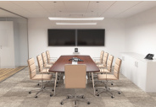

What is the difference?
Workshop
Educational program
Techniques and skills in a particular field
Long-term benefits
Training
Instructional experience
New skills and knowledge
On-the-job application
Notes:
B: I mentioned that an event can include training or workshops. Let me talk a little bit about the differences between the two.
A workshop is usually an educational program for a small group of people that focuses on techniques and skills in a particular field. Participants gain long-term benefits, like sustainable skills.
Training is an instructional experience provided primarily by employers for employees. It is designed to develop new skills and knowledge that are expected to be applied immediately on the job.
M: Let me see if I have this straight. Attending a mandatory session on recognizing e-mail phishing scams to prevent identity theft would be compliance training, while attending a session on learning how to implement the School Health Index to improve my school’s healthy eating policy would be a workshop, right?
B: You got it! What’s the key difference between the two scenarios?
M: With the compliance training, employees would be expected to recognize phishing scams on the job and apply the skills learned right away. With the workshop, participants would reap the long-term benefit of knowing how to use the School Health Index but might not use the skills immediately following the workshop.
B: Exactly.

Slide 13
Distance Learning
Skill-building process, targeted to a specific audience
Individuals who are separated by time, or distance, or both
Modes of delivery:
Synchronous
Asynchronous
Notes:
B: Distance learning is also an event because it is a skill-building process, targeted to a specific audience.
Distance learning is a mode of delivering instruction using technology to individuals who are separated by time, or distance, or both. Technology can include modalities as archaic as the U.S. Postal Service to mail correspondence courses or CDs to insert in computer drives. Today, the most common technology is, of course, the Internet.
There are two modes of delivery: synchronous and asynchronous.

Slide 14


Synchronous Delivery
All participants present at the same time
Organized timetable
Instructor present
Interaction
Notes:
B; In synchronous delivery, instruction is conducted in real time. That is, all participants are present at the same time.
M: Synchronous delivery most closely resembles a traditional classroom, despite the participants being located remotely.
B: Exactly. It requires an organized timetable and an instructor to be present. Participants can typically interact with the instructor, and they may even interact with each other. Web-, video-, or phone-conferencing, live streaming, and Internet radio are all examples of synchronous technology.
M: Web-conferencing software, such as Adobe Connect, usually contains interactive tools such as hand raising, polling, and chatting.
B: Yes. These tools are helpful for the instructor to engage participants.

Slide 15



Asynchronous Delivery
Self-paced
Access materials on own schedule
Not required to be together
Notes:
B: In asynchronous delivery, instruction is self-paced. Participants access course materials on their own schedules and are not required to be together at the same time. Delivery technology includes video and audio recordings, discussion board forums, e-mail, and self-directed print materials.
M: The good ole postal service and CDs you mentioned earlier are also good examples.
B: Ha…that’s true! When synchronous and asynchronous technologies are combined, that is called hybrid or blended learning.

Slide 16
Information and Presentation Sessions
Provide a familiarity level of knowledge
Enough information to decide whether or not to pursue
Notes:
B: Another form of offerings is the information and presentation session. Presentations are tailored to specific audiences also, but their purpose is to provide a familiarity level of knowledge on a specific topic. At the end of the session, participants have enough information to decide whether or not to pursue further investigation or implementation of the topic.
M: Your audience for an information session could be school administrators, faculty, education and health professionals, adolescents, parents, college students, legislators, or community groups.
B: Yes, those are good examples.

Slide 17


Delivery
One-time or series of events
Delivered in a short period of time
Notes:
B: Information sessions can be delivered in a variety of ways: in person, online, or in paper-based formats. Sessions can be one-time events or a series of events. They are delivered in a short time, usually between 30 minutes and an hour, and definitely not more than three hours.
M: So, if I’m marketing a training idea, such as using the School Health Index, and I give a 20-minute presentation about it—that’s not training. That’s an information session, right?
B: Yes, that’s correct. In that case, the focus is on providing information rather than building skills.

Slide 18

Technical Assistance
Process of providing targeted support to an organization with a development need or problem
Involves communication between a specialist or consultant and the organization
Notes:
B: We’ve talked about events and information and presentation sessions. The final offering we need to talk about is technical assistance. Technical assistance is the process of providing targeted support to an organization with a development need or problem. It is an effective method for building the capacity of an organization.
M: It’s also known as TA and commonly referred to as consulting.
B: Right! TA involves communication between a specialist or consultant and the organization. The specialist should be aware of the organizational culture and any specific circumstances related to the development need.

Slide 19

Core Principles
Collaborative
Systematic
Targeted
Adaptive
Customized
Results-driven
Notes:
B: Core principles of good technical assistance means that it is:
Collaborative. Work jointly with the organization’s staff to identify underlying needs.
Systematic. Use an orderly approach.
Targeted. Determine where technical assistance will have the greatest impact.
Adaptive. Be flexible.
M: Flexibility is always key—especially given different audiences.
B: Right! Continuing with the core principles, good technical assistance is:
Customized. Respond to the unique needs of the organization.
Results-driven. Identify measures that indicate improvement.

Slide 20
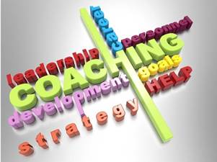
Structure
One-on-one consultation
Small-group facilitation
In person
Phone
E-mail
Internet technologies
Notes:
B: There is flexibility in how technical assistance is provided and what it looks like. The structure can be one-on-one consultation or small-group facilitation, which can be provided in person or by phone, e-mail, and of course, Internet technologies such as Web-conferencing.
M: One-on-one technical assistance is also known as coaching or mentoring.
B: That’s a good point. I should also point out that TA is typically delivered over an extended period.

Slide 21
Summary of Activities
Events
Information and presentation sessions
Technical assistance
Notes:
B: That wraps up our discussion of professional development activities. We talked about how events, information and presentation sessions, and technical assistance are delivered and their average length.
Now, let’s take a minute to review.

Slide 22

REVIEW OF Terminology
Learning Activity One:

Slide 23
Professional development practices
Section Four:

Slide 24






Six Professional Development Practices
Sustain a PD infrastructure
Design PD offerings
Market PD services
Deliver PD offerings
Follow up with support
Evaluate PD processes
Notes:
B: Now, we will turn our attention to six professional development practices that we will refer to as PD Practices. In this section, we will talk about the PD Practices framework and potential outcomes.
These are the six practices.

Slide 25
Framework
DESIGN
MARKET
DELIVER
FOLLOW UP
EVALUATE
SUSTAIN
Notes:
B: The PD Practices emphasize quality over quantity, with a solid framework supported by best practices. Although not a step-by-step formula, the PD Practices do follow a logical flow, from one practice to the next.

Slide 26






Infrastructure
Sustain: professional and agency capacity
Design: instructionally sound activities
Market: focused
Deliver: streamlined, responsive, timely
Follow up: growth
Evaluate: continuous improvement
Notes:
B: Sustaining a PD infrastructure builds professional and agency capacity. PD Practices allow you to design instructionally sound professional development activities under optimal conditions. Marketing becomes more focused because of sustained contacts and consistent services. Delivery is streamlined to be responsive and timely. Follow-up efforts support growth to meet goals. Evaluation of the processes allows continuous improvement.
M: I do see a logical flow here.
B: Exactly.

Slide 27

Organizational Outcomes
Increases in:
Skills and knowledge
Implementation
Quality, quantity, or cost-effectiveness
Sustainability
Notes:
B: Promoting professional development allows organizations to augment their professional capacity. The ability to achieve the organization’s mission increases when program staff receive the support they need to do their best work.
M: What improvements can organizations expect to see when they follow PD Practices?
B: Measurable outcomes include increases in:
Skills and knowledge;
Implementation of programs, practices, and policies;
Quality, quantity, or cost-effectiveness of programs, practices, and policies; and
Sustainability of the infrastructure or systems that support programs, practices, and policies.

Slide 28

Partnerships
Cooperation
Collaboration
Notes:
B: Partnerships between program staff and professional development providers involve cooperation and collaboration as professional development teams.
M: Yes, I can see where collaboration can lead to sustained conversations and awareness. Activities are more likely to be designed to meet identified needs. Partnerships could also allow PD teams to build on previous evaluation results.

Slide 29
Effective Partnerships
Mutual respect
Coordination
Reciprocal roles
Shared participation
Mutual accountability
Transparency
Notes:
B: Characteristics of good partnerships include:
Mutual respect;
Coordination of administrative responsibility;
Reciprocal roles;
Shared participation in decision making;
Mutual accountability; and
Transparency

Slide 30
Partnership Outcomes
Increased contributions
Synergy
Program resilience
Better alignment
Notes:
M: What are some outcomes that organizations have seen through partnerships?
B: As organizations grow in professional capacity and effective partnerships, they see outcomes such as:
Increased contributions from program staff because of improved skills and knowledge;
Synergy through collaboration;
Increased program resilience; and
Better alignment between professional and organizational goals.

Slide 31
Summary
Professional development practices framework
Organizational outcomes
Characteristics of effective partnerships
Notes:
B: OK! That wraps up our section on the PD Practices framework and potential outcomes organizations can derive by following the practices. Now, let’s take a minute to do an exercise to review those potential outcomes.

Slide 32
REVIEW OF Potential outcomes
Learning Activity Two:

Slide 33
SUSTAIN, DESIGN, MARKET
Section Five:

Slide 34
Six Professional Development Practices
Sustain a PD infrastructure
Design PD offerings
Market PD services
Deliver PD offerings
Follow up with support
Evaluate PD processes
Notes:
B: Earlier, we described what the six professional development practices are. Now, we’ll go into detail for the first three practices: Sustain, Design, and Market. We will cover the remaining three practices, Deliver, Follow-Up, and Evaluate, in Part 2 of this course.

Slide 35


Sustain a Professional Development Infrastructure
Provides the underlying foundation for all the practices
Stage for success:
Leadership
Advocacy
Skilled staff
Alignment
Evaluation
Notes:
B: The first PD Practice is: Sustain a Professional Development Infrastructure.
This practice provides the underlying foundation for all the other practices. We can think of the sustain practice in the same way that we think of the architecture of a house: it provides the framework of your professional development program.
A solid framework establishes the standard of practice for building and sustaining a strong PD infrastructure. Without a viable infrastructure, it is difficult to achieve sustainable change.
This practice sets the stage for success through:
Strong leadership;
Advocacy for PD;
A skilled team of staff and trainers;
Alignment with planning tools, such as your strategic plan or work plan; and a
Plan for evaluation

Slide 36

Key Characteristics
Continuous learning
Focus on relevant content
Professional collaboration
Notes:
M: So, what would you say are key characteristics of an effective infrastructure?
B: Top on the list is a culture of continuous learning that includes both formal and informal PD, with substantial contact hours for formal PD.
M: An appropriate number of contact hours would be between 30 and 100 hours. An example of informal PD is the use of self-reflection tools, such as personality type indicators or personal learning journals.
B: Yes! Next on the list of key characteristics is a focus on specific, relevant content, closely followed by professional collaboration.
M: Learning teams are excellent for collaboration! Teamwork leads to increases in consistency, problem solving, and willingness to share.
B: Exactly! And teams also provide a balance of pressure and support.
M: What do you mean by pressure? Busy professionals have enough pressure to deal with!
B: True, but this kind of pressure is good. It leads to accountability of team members, and support offers encouragement and sharing of resources among the team.
M: I see what you mean. That is a good balance! I know of some helpful tools. RMC Health developed several a few years ago to identify gaps in PD infrastructures. One is “How Strong Is Our Program PD Infrastructure?” It helps evaluate the status of your team-building, advocacy, evaluation, and cadre-development processes. Another is the “Professional Development Practices Inventory.” It walks you through suggested processes for each practice and helps you determine priorities and next steps.
B: Yes! Thanks for pointing that out. These tools are available in the Additional Resources section of this course. We will share other resources with you as we go along.

Slide 37
Key Strategies
Identify a person to provide leadership.
Secure financial and human resources.
Establish and implement a PD plan.
Develop a process to ensure qualified PD providers.
Notes:
B: here are a number of strategies to follow to ensure a sustainable infrastructure. In the interest of time, I’ll go over just a few, and you can download a more comprehensive list from the Additional Resources section.
Identify a person to provide leadership for PD efforts.
Secure financial and human resources to support professional development and collaboration.
Establish and implement a PD plan.
Develop a process to ensure qualified PD providers that includes recruitment, development, and assessment.

Slide 38

Design Professional Development Offerings
Solid PD offerings are thoughtfully designed with a specific purpose.
Groups
One-on-one settings
In person
Online
Notes:
B: The next practice we will cover is: Design Professional Development Offerings.
In keeping with our architectural analogy, the design practice can be viewed as the solid construction of the house. Solid PD offerings are thoughtfully designed with a specific purpose.
Remember, offerings are events, information sessions, and technical assistance. These are either designed for group or one-on-one settings, in person or online.
M: Group settings are typically training and presentation events, while one-on-one usually means technical assistance.
B: Absolutely.

Slide 39

Effective Training Objectives
Without clear objectives, participants:
With clear objectives, design has:
Are unclear about what is expected
Fail to grasp intended outcomes
Lack transfer of learning
Logical intended outcomes
Strong foundation
Intent
Boundaries
Notes:
B: The key to a good design strategy is to start with effective training objectives.
M: Unclear objectives, too many objectives, or too much content in general are the most common mistakes people make when designing training.
B: You’re so right! Without thoughtful planning about the intent of the event, it is difficult to develop specific, measurable objectives and keep the agenda from spreading all over the place.
M: Ah, yes! Design ooze! That happens when there is an overabundance of content or irrelevant activities crammed into the agenda with little thought about the intent of the event. That’s a good way for participants to feel overwhelmed or become complacent.
B: Without clear objectives, participants are not clear about what is expected of them and fail to grasp the intended knowledge and skills. This ultimately leads to a lack of transfer of learning to the workplace.
M: So, what can designers do to stop the ooze?
B: I’m glad you asked. The bottom line is be intentional in your design! And that starts by beginning with the end in mind.
M: What do you mean?
B: After creating clearly written, feasible objectives, you end up with logical intended outcomes and a strong foundation that sets the intention and boundaries needed to guide the training design. Any potential content piece that does not align with the objectives is tossed out.
M: You mention feasible objectives. You mean the objectives must be doable within your training time frame, right?
B: Yes, that’s what I mean. Remember, we said earlier: training should be delivered in a time span that is adequate to cover the topic in detail, typically at least three hours.

Slide 40
SMART Objectives
S
Specific
M
Measurable
A
Achievable
R
Reasonable
T
Time-based
Notes:
B: When crafting objectives, it’s important to keep in mind the specific change you wish to see in participant knowledge, skills, or attitudes as a result of what you are providing. As you plan your next PD event, ask yourself:
What, specifically, do I want learners to know and be able to do as a result of this training?
What evidence would I accept to verify their learning?
M: This will make evaluation of learning possible because you can measure pre- and post- behaviors.
B: An acronym to remember when crafting your objectives is SMART. You’ll hear the term “SMART” objectives frequently used.
“S” stands for Specific. The objective is clear because it answers the six “W” questions.
M: Who, what, where, when, which, and why.
“M” stands for Measurable. You can tell when the objective has been achieved because criteria to measure progress have been set.
“A” stands for Achievable. It is likely to happen.
“R” stands for Realistic. Relevant factors have been taken into account.
“T” stands for Time-based. It is grounded within a specific time frame.

Slide 41
Adult Learning Principles
Adults:
Need to know
Are motivated to learn
Have previous experience
Need variety
Need to be involved
Notes:
B: You also need to keep adult learning principles in mind during the design phase.
Adults need to know why they are learning.
Adults are motivated to learn by the need to solve problems.
Their previous experience must be respected and built upon.
They need learning approaches that match their background and diversity.
And, adults need to be actively involved in the learning process.
As a sneak preview: we will dig deeper into adult learning principles in the next course of this series, “From Basic to Dynamic.”
Finally, another important concept to remember when we design with the end in mind is follow-up. We’ll go into a lot of detail about how to systematically plan for follow-up support of your PD activities in Part 2 of this course.
M: Follow-Up is practice number five of the PD Practices! Two templates you can use to help you record things to remember, such as activities, required materials, and provisions for follow-up support, as you design your trainingare available in Additional Resources.

Slide 42
Key Strategies
Group settings:
Identify the target audience
Develop SMART objectives
Develop a comprehensive agenda
Develop plans for evaluation and follow-up support
Technical assistance:
Response time
Topics to be covered
Follow-up support
Notes:
B: As with the Sustain practice, there are a number of strategies to implement effective design. I’ll go over a few, and remember that you can download the comprehensive list from the Additional Resources section.
A few strategies for group settings include:
Identify the target audience;
Develop SMART objectives;
Develop a comprehensive agenda; and
Develop plans for evaluation and follow-up support.
For one-on-one settings, your technical assistance protocol should include:
Response time;
Topics to be covered; and
Follow-up support
And remember—be intentional in your design!

Slide 43


Market Professional Development Services
Contact people
Know your audience segments
Promote health benefits
Utilize various approaches
Use models that work
Build partnerships
Notes:
B: Now we’ll move on to the third PD practice: Market Professional Development Services. Using our architectural analogy, the house has now been constructed and a realtor is ready to put it on the market. Just as a realtor has a marketing strategy to sell the house, you also employ marketing tactics to capture the attention of your target audience. Marketing can seem overwhelming, but we have some tips to help you draw hard-to-reach audiences to your professional development events:
B: The first tip is: contact the people you are trying to reach.
M: Adding two or three questions to your evaluation forms can give you good feedback from your audience.
B: Know who your audience segments are.
M: There could be more than one type of participant, or there could even be a gatekeeper that you need to convince first.
B: Promote the benefits of your events.
M: Think about resources that showcase what you offer.
B: Utilize various approaches.
M: Like TV, radio, print ads, or closed-circuit TV channels in your school district. The key is to stick to one main look and feel that your audience can recognize.
B: Use models that work.
M: Talk to colleagues about what has worked for them.
B: The final tip is: build partnerships with key allies.
M: Connecting with community organizations, non-profits, and local businesses can bring attention and credibility to your PD efforts.

Slide 44
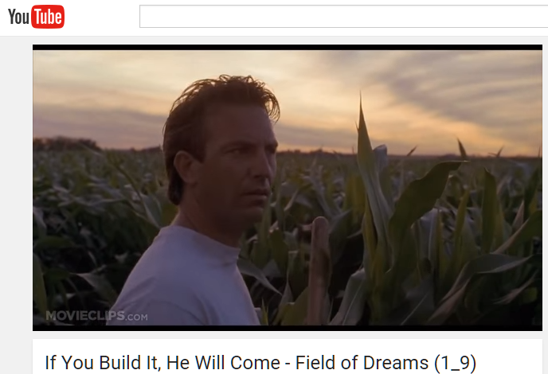
Field of Dreams
Notes:
B: Let’s talk about a common trap that describes the attitude of some professional developers, but first, let’s watch this short clip.
[VIDEO CLIP, 00:33 seconds]
https://www.youtube.com/watch?v=HMcQKz3H0yY
B: Borrowing from the movie, Field of Dreams with Kevin Costner, I call this trap, “If I provide it, they will come!”
This is wishful thinking that often does not work! The key is to have a marketing strategy that will help your target audience access your valuable events and services.

Slide 45
Marketing Steps
Determine services
Develop a comprehensive marketing plan
Implement the marketing plan
Use data
Notes:
B: When we take a closer look at marketing, we see that strategy involves four steps:
B: Step 1: Determine the services that match your audience’s needs.
M: Start with an audience profile for insight on how to impact your audience and discover their vested interests. Then, frame your messages in a way that addresses their perspective and needs. A needs assessment will help you identify how to focus your efforts.
B: Step 2: Develop a comprehensive marketing plan.
M: Set good marketing goals. Remember to develop SMART objectives to accomplish those goals. Then relate them to your program goals and develop key messages that will resonate with your audience and end with a call to action.
B: Step 3: Implement the marketing plan, followed by Step 4: Use data.
B: You collect data to measure your success and see how your efforts have paid off. Evaluation improves the effectiveness of your marketing efforts.
M: And evaluation helps you gather data in the form of feedback from your audience to learn how they are responding to your messages.
B: Exactly, and with limited resources, evaluation helps you determine how to effectively distribute your marketing investments.

Slide 46
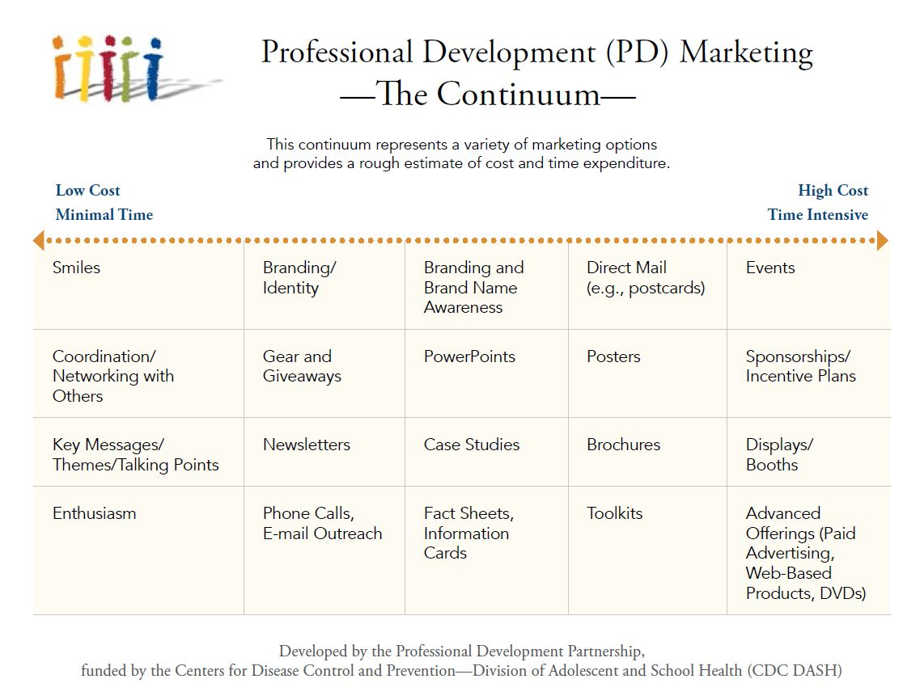
Professional Development (PD) Marketing - The Continuum
E-mail hue8@cdc.gov for a copy of the Marketing Toolkit.
Notes:
MARKETING CONTINUUM
B: There are lots of options for your marketing campaign, which can range from low-cost, minimal time investments all the way to costly, time-intensive efforts. When you look at the continuum from left to right, you see the lower end gives examples like smiles and enthusiasm. Moving toward the middle, you can see how effort increases. For example, developing fact sheets and information cards would be the mid-range of cost and time. Finally, high-cost marketing options can be activities like sponsoring events or developing displays for marketing booths.
M: RMC Health developed a “Marketing Plan Workbook,” which can help you organize your marketing strategy by answering guided questions in the workbook, available in Additional Resources. There is also a “Marketing Toolkit,” which can be obtained by contacting Bridget. Send an e-mail to hue8@cdc.gov. The toolkit is a comprehensive, step-by-step guide full of customizable work sheets, tools, and resources that you can use to implement your marketing plan.
B: Yes, these are excellent resources.

Slide 47
Key Strategies
Link PD services to target audience needs
Develop and implement a marketing plan
Monitor and adjust, as appropriate
Notes:
B: So, to recap the marketing strategies; they are:
Link your PD services to your target audience’s needs.
Develop and implement a marketing plan.
Use evaluation data to monitor and adjust your marketing plan, materials, and messages.
Remember, a more detailed list is available in Additional Resources.

Slide 48
Summary of Three Practices
Sustain
Market
Design
Notes:
B: We have now covered half of the PD Practices. Let’s wrap up Part 1 of this course with an exercise to review the Sustain, Market, and Design practices.

Slide 49
REVIEW OF Sustain, design, market
Learning Activity Three:

Slide 50
conclusion
Section Six:

Slide 51
Summary
Sustain a PD infrastructure
Design PD offerings
Market PD services
Notes:
B: Remember we started our discussion of Professional Development basics by introducing you to the six PD Practices. Then, we went into detail for three of the six practices.
We talked about how sustaining a PD infrastructure builds capacity and how PD Practices allow you to design instructionally sound activities under optimal conditions. We also talked about how to market your PD services.

Slide 52

Next Steps
Professional Development 101: The Basics – Part 2
Deliver
Follow-Up
Evaluate
Professional Development 201: From Basic to Dynamic
Adult learning principles
Facilitation tips
Webinar development
Notes:
B: Throughout this course, I’ve given you several sneak previews into Part 2 of this course and about the next course in the series, “Professional Development 201: From Basic to Dynamic.” I hope that has piqued your interest to participate!
PD101 – Part 2 will continue digging into the Professional Development Practices. We will cover the remaining practices in detail, offering you more strategies on how to enhance your state’s professional development capabilities.
PD201 will build on the first course, going further into adult learning principles, facilitation tips for online delivery, and lots of information on developing webinars, from pre-production to post-production.

Slide 53
Evaluation
Thank you for taking a few minutes to let us know your thoughts about this course.
https://orausurvey.orau.org/n/PD101a.aspx
We value your feedback.
Notes:
B: Thank you so much for participating in “Professional Development 101: The Basics – Part 1.” We hope you’ve enjoyed it as much as we have.
Please take a few minutes to let us know what you thought of Part 1 of the course. We value your feedback and will use it for continuous improvement, as we continue to develop courses of interest.
Take care, and we hope to see you for Part 2!
M: Take care!

