Slide 1

Professional Development 101:
The Basics – Part 2
A Professional Development Series from the
CDC’s Division of Population Health
School Health Branch

Slide 2


Introduction
Section One:

Slide 3
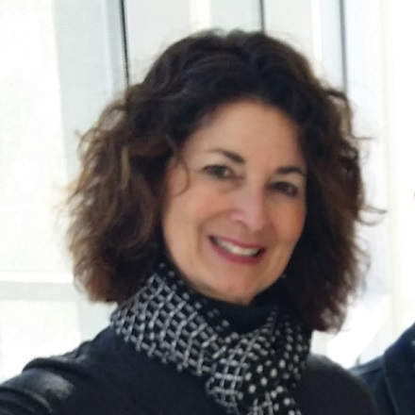
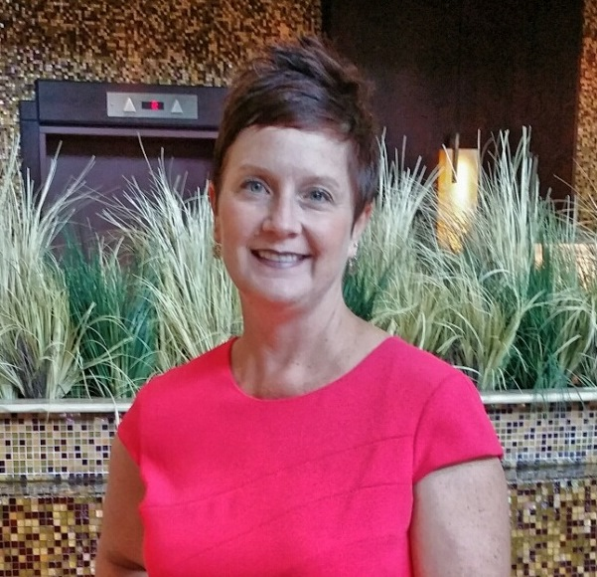
Welcome
Bridget Borgogna
Health Education Specialist/Project Officer
Melissa Fahrenbruch
Team Lead, Program and Professional Development Team
Notes:
B: Welcome to Professional Development 101: The Basics – Part 2. This is the second part of the Professional Development Basics course. My name is Bridget Borgogna, and I am a health education specialist and project officer at CDC’s Division of Population Health, School Health Branch. I’m joined by Melissa Fahrenbruch, who is the team lead for the Program and Professional Development team in the School Health Branch.
M: Hello. I’m looking forward to continuing on with Part 2.

Slide 4



Purpose
Professional development practices strengthen education delivery and increase skill-building capacity.
Notes:
B: In Part 1, we introduced you to six Professional Development Practices and examined the first three practices: Sustain, Design, and Market. In Part 2, we will continue with our discussion of the remaining three practices: Deliver, Follow Up, and Evaluate.
M: The Professional Development practices were developed in partnership with Rocky Mountain Center for Health Promotion and Education, or RMC Health.
B: By providing courses like this, we believe we can help you increase the skill-building capacity of your staff, as they work toward improving health and educational outcomes among youth.

Slide 5

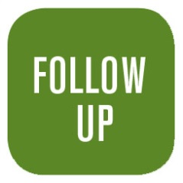


Learning Objectives
Describe three professional development practices.
Describe characteristics of effective use.
Identify strategies to support each professional development practice.
Notes:
These are the points we’ll cover over the next hour.
B: We will briefly review the first three practices and then dig deeper to understand the remaining three practices: Deliver, Follow Up, and Evaluate. As we go, we will highlight characteristics of effective use and share key strategies for the remaining practices.
Throughout the course, you’ll have opportunities to review, get more information, and test your knowledge. You can print out a certificate of completion at the end, and we’ll want to know your opinions about the course before we wrap up this session.
All right, let’s get started!

Slide 6
Professional development PRACTICES
Section Two:

Slide 7



Sustain, Design, Market
Sustain a Professional Development Infrastructure
Design Professional Development Offerings
Market Professional Development Services
Notes:
B: Let’s begin with a review of the Sustain, Design, and Market practices.
In Part 1, we talked about the Sustain practice as being the underlying foundation for all the other practices because it provides the framework for your professional development program. A solid framework establishes the standard of practice for building and sustaining a strong PD infrastructure.
We talked about how important it is to start with effective training objectives and thoughtful planning about the intent of the event when we talked about the Design practice. We also talked about keeping adult learning principles in mind and systematically planning for follow-up support during the design phase.
Lastly, we provided some marketing tips to reach your audience. We used the Marketing Continuum to illustrate various marketing options, from low-cost, minimal time investments to costly, time-intensive efforts to employ marketing tactics to capture the attention of your target audience.
M: If you haven’t taken Part 1 of this course, we highly recommend it so that by the end of this course, you have a complete picture of the six professional development practices.

Slide 8

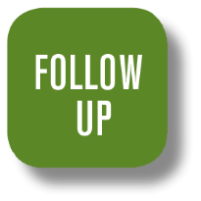

Deliver, Follow Up, Evaluate
Notes:
B: We are now ready to dig in to the remaining practices: Deliver, Follow Up, and Evaluate.

Slide 9
DELIVER PRACTICE
Section Three:

Slide 10
Deliver Professional Development
Execution phase
Opportunity to impact learning and create change
Delivered in a variety of ways
Notes:
B: We will start with the fourth PD Practice, Deliver Professional Development. This is the execution phase of all the effective training and technical assistance that you have designed and marketed. Now is your opportunity to impact learning and create change.
Activities are delivered in a variety of ways, from in-person to online, but an awareness of adult learning principles is essential, regardless of the format, to engage participants and bring the training to life.

Slide 11

Adult Learning Principles Revisited
Experience is respected and built upon
Safe and supportive learning environment
Opportunities to practice skills and apply new knowledge
Notes:
B: For this portion of the PD series, we’ll focus on in-person delivery. Here is a sneak preview of the next course in the series: we’ll go into online delivery techniques in “From Basic to Dynamic.” But first, let’s talk about adult learning principles because it is so important to incorporate these principles to enhance learning.
M: Adult learning theory has been around since the 1970’s. While the principles may vary in phrasing, they have remained consistent in substance.
B: Yes, because they really do work when educators and trainers implement them.
In Part 1, we talked about keeping adult learning principles in mind during the design phase. Well, it is just as important to incorporate adult learning principles during delivery as well.
We talked about building upon previous experience. This may be the most important principle because adults enter any training activity with some level of prior knowledge and significant life experience that impact their perceptions.
M: We should capitalize on that rich experience. Drawing out prior experiences sometimes uncovers inaccurate information that people think is correct. This is the largest impediment to new learning!
B: Excellent point! We also talked about creating a safe and supportive environment. Learning new stuff can be a vulnerable experience, so a great delivery technique is to support learning with low-risk activities, presented in a strategic sequence.
M: Like going from simple to complex concepts, or doing group activities before flying solo.
B: Yes! The last item I want to go over again is the opportunity to practice. It is so important for adults to be able to practice the new skill learned because that is what increases the likelihood of behavior change.
M: Yes, learning activities move the participants beyond the cognitive learning skills of integrating new information intellectually. Activities foster exploration to enhance learning.
B: Right!

Slide 12
Training Versus Facilitation
Training
Facilitation
Unknowns to knowns
Pre-established objectives
Specific set of skills or knowledge
Knowns to unknowns
Work toward outcomes
Open discussion in safe environment
Notes:
B: The difference between training and facilitation is a grey area, and many people use the two terms interchangeably. But there are distinct differences between the two. Training involves moving from unknowns to knowns to meet objectives that were established beforehand. It focuses on a specific set of skills or knowledge that can be applied in the workplace. Both outcomes and steps to meet the objectives are determined before training begins.
M: Trainers might use a facilitative style where they act as a guide, but if the purpose of the session is for participants to acquire knowledge and skill, it is still training.
B: Absolutely! Facilitation is the exact opposite because it involves moving from the knowns to the unknowns. It is a process where participants start with information about a topic or problem and work toward an outcome. The outcome is not set when the facilitation process begins. Instead, it emerges as the group works on the situation through open discussion in a safe environment. The facilitator creates the nurturing environment where participants can be honest and where discussion can take place without fear of being bullied or ridiculed.

Slide 13
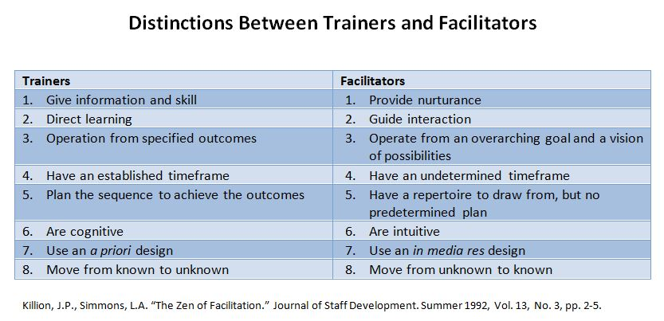
Notes:
M: So, an example of training might be how to create documents in Excel, while an example of facilitation might be a discussion of which software to use to create the document. The main distinction between training and facilitating is in attitude. Trainers operate from a pre-established plan to direct participants to a specified outcome, while facilitators are driven by the nature of the interactions among participants.
B: Yes, other distinctions are noted on this chart.

Slide 14


Characteristics of Effective Delivery
Notes:
B: The delivery for in-person sessions can be the difference between an engaging or sleep-inducing event, whether it is training or facilitation.

Slide 15
Re-Energize and Engage
Take a break
Change the pace
Move on
Notes:
B: To re-energize participants during training, you can:
Take a break. Do an energizer or an activity, alternating between activity, instruction, and discussion.
M: Physical activity breaks are perfect to do!
B: Break into pairs for a change of pace from whole-group discussion.
M: Think; Pair; Share is a good activity. This is where participants think individually about a topic, then collaborate in pairs to share ideas.
B: A tip to keep things moving during facilitated sessions is redirecting conversations and moving on to something else when participants become too involved in either the abstract or too much detail.
M: You can park the matter in a “parking lot,” “bike rack,” or something similar to return to the topic when participants are fresher.
B: That’s right.

Slide 16
Team-Teaching or Co-Facilitating
Clarify roles
Agree on when and how to give feedback
Develop communication signals
Intervene when necessary
Have open communication
Notes:
B: Let’s talk very briefly about team-teaching or co-facilitating. It’s always a good idea to know each other’s styles and rehearse before your event, if possible. Beyond that, it is important to:
Clarify roles and expectations.
Agree on when and how to give feedback to each other.
Develop communication signals.
M: It’s also important to recognize that things could go wrong. An instructor or facilitator may need to intervene if it’s apparent that the co-facilitator is hindering the process.
B: If you have open and honest communication in advance about how you will handle conflict with each other, you’ll be better prepared to address the situation if it does happen. We have provided a “Co-Facilitator Checklist” that you might find helpful.
M: That’s a great tool, whether you are a trainer or a facilitator!

Slide 17
Key Strategies
Provide an environment conducive to learning.
Use qualified professional development providers.
Collect evaluation data.
Notes:
B: Overall, important strategies to keep in mind when delivering training are:
Provide an environment conducive to learning, such as a conversation circle where everyone can see each other and not have barriers like desks or tables in front of them.
Use qualified professional development providers if you are not facilitating your own PD event.
Collect evaluation data.
A more detailed list of strategies is available under Additional Resources.
Let’s take a minute to review what we have discussed about the Deliver practice.

Slide 18

REVIEW OF DELIVER PRACTICE
Learning Activity One:

Slide 19
FOLLOW-UP practice
Section Four:

Slide 20
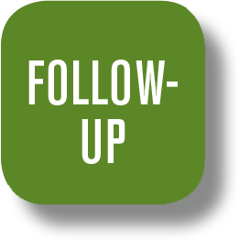
Provide Follow-Up Support
Knowledge and skill levels become strengthened
Planned during design phase
Intentional
Notes:
B: So, that brings us to the fifth PD Practice: Provide Follow-Up Support. It’s not over when your participants walk away after the PD activity! No, this is when their knowledge and skill levels will become strengthened because you provide continued, targeted follow-up support.
M: It’s important to point out that follow-up support does not include any new information, and it’s not just a matter of calling the participants after your event to see if they have any questions.
B: Absolutely! In fact, support should be systematically planned during the design phase. I used the word “intentional” when I was describing the characteristics of good design in Part 1; follow-up support should be intentional as well!

Slide 21

Follow-Up Support Plan
Summary
Detailed description of support activities
Action plan
Detailed timeline
Notes:
B: A good follow-up support strategy is very important to ensure transfer of learning. So, what’s your follow-up game plan? Let’s talk about the basic framework of a good game plan.
M: This practice is so important that it’s worth noting that the planning you mentioned that is done during the design phase should include a documented plan for follow-up support.
B: That’s right. Your written Follow-Up Support Plan should have four components that, when put together, provide a complete picture that participants can agree to in advance. These are:
A summary that includes a brief time line.
M: This section can be used as a checklist or even shared with your project officer.
A detailed description of support activities to be conducted before, during, and after your PD event.
M: This way, there are no surprises. Your participants know what they are committing to prior to, during, and after the PD event.
An action plan for implementation of new skills.
M: This captures next steps and assigns responsibilities.
A detailed time line that includes intervals of when support activities will be conducted.
M: Again, no surprises. In the past, I’ve recommended participants acknowledge their commitment to the process by indicating “Yes” on registration forms for PD events.
B: That lends itself to accountability, doesn’t it?

Slide 22
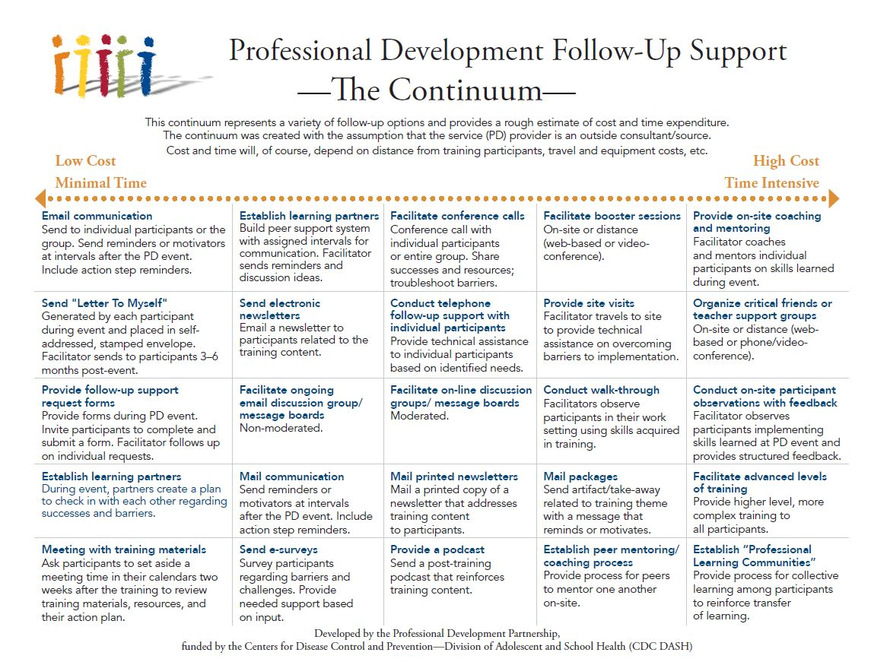
Notes:
B: Remember the range of marketing options when we discussed the Marketing practice? Likewise, there are lots of options for your follow-up support as well, depending on your available resources in cost and time.
Looking at the continuum, you can see a range of activities—from low-cost, minimal time investments all the way to costly, time-intensive efforts. Starting on the left, low-cost examples include sending e-mail reminders or motivators to your participants or sending “Letters to Myself” that are generated by your participants during your PD event. Moving toward the middle, you can see how time and cost investments increase in examples like moderating an online discussion group or providing a podcast. The examples on the right represent high-cost, time-intensive activities, such as on-site coaching, advanced levels of training, or establishing professional learning communities.

Slide 23
Hypothetical 14-Month Plan
Two weeks
E-mail
One month
Website
Tools
Three months
Action plan
Ten months
E-mail
One year
Phone interviews
Fourteen months
Letters
Notes:
B: Let’s review a hypothetical 14-month plan to show how support activities are spaced at intervals after your PD event.
At two weeks: An initial e-mail that encourages participants to begin implementation, provides resources, and lists highlights from the training. Technical assistance is offered at this point.
At one month: A website provides information and easy access to tools that participants can use to begin implementation.
At three months: Action plans can be resent to remind participants of their intentions and commitment.
M: This may prompt dialogue about their progress, and technical assistance can be offered once again to address potential barriers.
B: At seven months: A “booster” event provides additional resources and training on specific trouble spots that participants have identified in post-event evaluations.
M: Post-event evaluations are typically sent six months after the PD event. Evaluations after the booster provide feedback as well. It’s one more opportunity to collect data! By the way, the booster does not introduce any new information. It only reinforces content from the initial event.
B: That’s a good point! At ten months: Another e-mail can reinforce content again and continue to address the barriers identified at seven months.
M: This is also a good time to offer technical assistance again and send out any self-assessment tools that were used during the PD event.
B: One year later: Phone interviews with team leads a year after the initial event provides an opportunity to share successes and discuss needs.
M: Don’t forget to follow-up with any needed resources that were identified during the call!
B: At 14 months: How about sending out commendation letters? Participants should have lots to celebrate if they kept their commitments and took advantage of all the offers for technical assistance that you provided!
M: The intervals may differ for you, but what we’re trying to emphasize is consistent, continued, and intentional contact during a specified time frame. We have some great Follow-Up Support tools in Additional Resources for you.
The “Online Support Tools” describes lots of different techniques to connect using online technologies.
And the “Guide for Follow-Up Support Planning” walks you through everything you need to consider as you develop your own plan.
B: We hope you take advantage of the wealth of resources we have for you in Additional Resources!

Slide 24
Key Strategies
Groups:
  Plan for follow-up support in the design phase.
  Share expectations.
  Provide support.
Technical assistance:
  Plan for follow-up support in the design phase.
  Schedule follow-up support.
  Provide intentional follow-up support.
Notes:
B: As usual, you can find the comprehensive list of strategies in Additional Resources. Here are just a few for group settings:
Plan for follow-up support prior to each event.
Share expectations prior to and during the event.
Provide support at appropriate intervals.
M: The strategies are similar for technical assistance:
Plan for follow-up support during the initial provision of technical assistance.
Schedule follow-up support.
Provide intentional follow-up support.
B: Before we move on to the final practice, let’s take a minute to review.

Slide 25
REVIEW OF FOLLOW-UP PRACTICE
Learning Activity Two:

Slide 26
EVALUATE PRACTICE
Section Five:

Slide 27
Evaluate Professional Development Practices
Systematically monitoring and evaluating professional development events
Collecting data
Using data to improve future efforts
Notes:
B: Finally, we have reached the last of the PD Practices, Evaluate Professional Development Processes. This is the process of systematically monitoring and evaluating your professional development events by collecting data and using it to improve future efforts.
This goes beyond the standard evaluation form that participants typically fill out at the conclusion of most events. You want to be able to assess how they used the information you provided long after your event is over and what impact it had three, six, nine months, or even a year or more later. You want your participants to develop and use new skills and knowledge learned in your Professional Development event, but how can you know they are using what they have learned?
M: The simple answer is to ask them! In other words, obtain their feedback and use it to evaluate your event. Evaluation is a powerful tool to help you determine if you need to refine your training designs to make your events more powerful and sustainable.

Slide 28

Data
Uses
  For future professional development planning
  To make revisions to technical assistance protocols
  To report success
Collection methods
  Pre- and post-questionnaires
  Evaluation forms
Notes:
B: The data you collect can be used for future professional development planning, to make revisions to your technical assistance protocols, and to report indicators of success to your stakeholders.
M: There are several data collection methods to measure the success of your PD events.
B: Two methods we will talk about are using pre- and post-questionnaires and evaluation forms now.

Slide 29

Pre- and Post-Questionnaires
Two questionnaires
  Pre-questionnaire on a set of items before training
  Post-questionnaire on same set of items using same rating scale at end of training
Difference in responses represents effects of training
Notes:
B: Traditionally, participants complete a pre-questionnaire on a set of items before training and then complete a post-questionnaire on the same set of items using the same rating scale at the end of the training.
M: The assumption is that the difference in reported awareness, knowledge, or confidence between the pre- and post-questionnaires represents the effects of the training.
B: Yes, but in recent years research has shown that this method may underestimate the impact of training. Participants frequently overestimate their knowledge or skills on the pre-assessment! As a result, the difference in pre- and post-responses will be biased because of overestimating the original competency.

Slide 30
Retrospective Method
One questionnaire
  Assessment of before and after knowledge or skill level
  Completed at end of training
Lessens the probability of bias
Notes:
B: A better method is what is called the “retrospective pre-post method.” Participants complete one questionnaire at the end of the training.
M: Yes, they are asked to estimate, retrospectively, their knowledge or skill level before the training and then to assess it now, after the training.
B: Exactly. This lessens the probability of bias because the participants use the same frame of reference to answer both pre-and post-questions.
M: The data you collect will only be as good as the questions you ask.
B: That’s so true. Careful wording is important, but remember when we were talking about developing objectives during the Design practice? Starting with a set of clear learning objectives is THE most important element of good evaluation because it is those objectives that are the basis for measuring participant change.

Slide 31
Guidelines for Design
Use concise instructions
Place the pre-training question first
Format the questionnaire in a way that helps respondents
Notes:
B: General guidelines for designing a good retrospective pre-post questionnaire are:
Use concise instructions that clearly guide the respondent in what to do.
M: This is a good time to remind the respondent to provide two answers for each question: one for past assessment of knowledge, skills, and attitudes and one for a current assessment.
B: Place the pre-training question first on the form.
M: There’s less confusion that way.
B: Format the questionnaire in a way that helps respondents understand what they are being asked to do.
M: For example, use shading, font styles, and question layouts that call attention to the pre-post ratings.

Slide 32
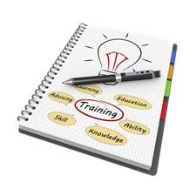
Evaluation Forms
Quantitative responses
  Direct questions
Qualitative responses
  Open-ended questions
Notes:
B: Another method to collect data is the evaluation form. Good design includes options for both quantitative and qualitative responses; that is, developing both direct and open-ended questions.
M: Quantitative response options can take the form of yes-no answers, checklists, and rating scales.
B: Exactly!

Slide 33
Guidelines for Design
Clear response options
Standardized response categories and scales
Avoidance of biased words, phrases, and jargon
Response options linked to a single issue
Notes:
B: When developing questions for quantitative responses, a couple of things to keep in mind are:
Make response options as clear as possible.
Standardize response categories and scales to make them uniformly consistent.
Avoid biased words or phrases and jargon.
Ensure response options are linked to an item that expresses a single issue.
M: This makes interpretation of responses generally straightforward.
B: Qualitative or narrative responses to open-ended questions provide opportunities for participants to share detailed comments or information that was not addressed in previous questions.
M: It also provides you with an opportunity to ask additional questions for follow-up information.
Another resource we’ve provided to help you develop your evaluation questions is the “Data Collection Framework.”

Slide 34
Key Strategies
Develop plan.
Create evaluation instruments.
Collect data.
Notes:
B: Finally, key strategies to implement include:
Develop a plan to measure your stated objectives.
Identify or create instruments to collect evaluation data.
Collect process and outcome data.
M: As always, refer to the list of strategies in Additional Resources. Also, check out the “Five Critical Levels of Evaluation” to help you determine how far you want to go with the evaluation of your PD event.
B: We have now covered the rest of the PD Practices. Let’s do one more exercise to go over the Evaluate practice before we wrap up.

Slide 35
REVIEW OF evaluate PRACTICE
Learning Activity Three:

Slide 36
conclusion
Section Six:

Slide 37
Summary of Professional Development Practices
Sustain a PD infrastructure
Design PD offerings
Market PD services
Deliver PD offerings
Follow up with support
Evaluate PD processes
Notes:
B: Remember, we started our discussion of Professional Development basics by introducing you to the six PD Practices.
In Part 1, we talked about how sustaining a PD infrastructure builds capacity and how PD Practices allow you to design instructionally sound activities under optimal conditions. We also talked about how to market your PD services.
In Part 2, you learned some delivery tips to make your offerings streamlined, responsive, and timely, and you learned about the importance of follow-up efforts and evaluation to allow for continuous improvement.

Slide 38

Professional Development 201:
From Basic to Dynamic
Adult learning principles
Facilitation tips
Webinar development
Notes:
B: Throughout this course, I’ve given you several sneak previews about the next course in the series, “Professional Development 201: From Basic to Dynamic.” I hope that has piqued your interest to participate!
PD201 will build on what we presented today, going further into adult learning principles, facilitation tips for online delivery, and lots of information on developing webinars, from pre-production to post-production.
Let’s end with a final activity that you can use to help you get started on using the PD Practices we’ve discussed today.

Slide 39
practices to implement
Real-World Application:

Slide 40
Conclusion
Thank you for your participation in
Professional Development 101: The Basics
Notes:
B: Thank you so much for participating in “Professional Development 101: The Basics.” We hope you’ve enjoyed it as much as we have.

Slide 41
Evaluation
Please let us know what you thought!
https://orausurvey.orau.org/n/PD101b.aspx
We value your feedback.
Notes:
B: Please take a few minutes to let us know what you thought of the course. We value your feedback and will use it for continuous improvement, as we continue to develop courses of interest.

Slide 42
Certificate of Completion
Download your
Certificate of Completion
now.
Notes:
B: Before you go, you can download a Certificate of Completion. Take care!
M: Take care!

