Slide 1



Gastroschisis
Presenter
Notes:
This presentation is about gastroschisis. You probably already listened to the omphalocele presentation, and you will find here topics for discussions that are important for both defects.

Slide 2
Learning Objectives
By the end of this presentation participants will be able to
  Describe clinical features of gastroschisis
  Understand main epidemiological features of gastroschisis
  Apply helpful tips for coding and reporting
  Recognize the differences between gastroschisis and omphalocele
Gastroschisis | 2
Notes:
By the end of this presentation you will be able to:
Describe some clinical features of gastroschisis, understand some epidemiological features of gastroschisis, learn some tips for coding and reporting, and will be able to recognize the differences between gastroschisis and omphalocele.

Slide 3
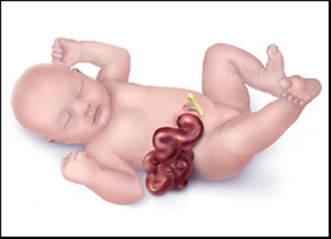
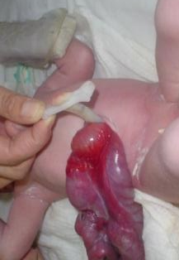
Definition
Defect (schisis) of the anterior abdominal wall, accompanied by herniation of the small and part of the large intestines, and occasionally other abdominal organs, into the amniotic cavity, and not in the umbilical cord.
Umbilical cord
Photo courtesy of: ECLAMC
http://www.cdc.gov/ncbddd/birthdefects/Gastroschisis-graphic.html
Gastroschisis | 3
Notes:
As you can see in the illustration and picture, gastroschisis is a defect of the abdominal wall through which the intestines are herniated into the amniotic cavity. In some cases, when the opening is large, other organs such as the stomach and liver may also stick outside of the abdominal cavity. Note that the intestines and other abdominal organs are not coming out through the umbilical cord, but through an opening to the side of the cord, usually the right side.
I’m not sure if we need the following:
You will think that the name gastroschisis comes from “gastric,” term related to stomach, but in fact it derives from the Greek term “gaster” that means abdomen and schisis that means opening.

Slide 4
Gastroschisis etiology:
Disruption or Malformation?
Disruption
  Vascular origin: abnormality of the omphalomesenteric artery, leading to infarction and necrosis of the base of umbilical cord with subsequent gut herniation*
Malformation
  Primary abnormality of body wall closure: occurrence proposed during the 3rd to 5th weeks (21-35 days) post-conception**
*Source: Hoyme et al. J Pediatr, 1981
** Source: Feldkamp et al. AJMG, 2007
The difference is relevant when interpreting etiologic studies
Gastroschisis | 4
Notes:
The pathogenesis of gastroschisis is a matter of controversy. Currently, there are two main hypothesis. One postulates a vascular disruption hypothesis stating that interruption of the right terminal branch of the omphalomesenteric artery (also known as the vitelline or yolk sac artery) causes ischemia and necrosis of the paraumbilical tissues and results in gastroschisis. An alternative hypothesis proposes that gastroschisis is a malformation resulting from and abnormality in the closure of the body wall that normally occurrs during the 3rd to 5th week of embryonic development.

Slide 5
Main Clinical Features
Opening occurs lateral to the umbilical cord (generally to the right)
The herniated organs lack a protective membrane
The extruded abdominal contents can be matted and covered by a thick fibrous material
Feature | Typical Findings
Associated malformations | 16.6% (1.7% chromosomal)*
Syndromes | Extremely rare
* Source: Stoll et al 2008. Am J of Med Gen Part A 146A:1280-1285
Gastroschisis | 5
Notes:
This slide reviews the main clinical features of gastroschisis. These include:
Opening almost always occurs to the right of the umbilical cord
The herniated intraabdominal organs lack a protective membrane and usually are matted and covered by fibrous material
Associated malformations are present in about 16% of cases, chromosomal anomalies are rare, and syndromes are extremely rare. This contrasts with omphalocele in which associated malformations occur in 30-70% of cases and chromosome abnormalities as well as other syndromes and complexes are common – 12-29% and 10-15%, respectively.

Slide 6
Main Epidemiological Features
Feature | Typical Findings
Prevalence | 4.4 per 10,000 (USA)* 2.98 per 10,000 (Europe)** Increasing in some countries*, **, and more common among young mothers**
Reasons for variability of prevalence | Misclassification with omphalocele Differences in proportion of young mothers and/or in prevalence of risk factors
*Source: Kirby RS, Marshall J, Tanner JP et al. Prevalence and Correlates of Gastroschisis in 15 States, 1995 to 2005. Obstet Gynecol. 2013 Aug;122(2, PART 1):275-281.
**Source: Loane M, Dolk H, Morris JK; EUROCAT Working Group. Maternal age-specific risk of non-chromosomal anomalies. BJOG. 2009 Jul;116(8):1111-9.
Gastroschisis | 6
Notes:
The prevalence of gastroschisis has been steadely increasing in different countries throughout the last two or three decades, and is more common among young mothers. Currently, the estimated birth prevalence is about 4.4 cases per 10,000 in the USA and close to 3 per 10,000 in Euopean countries. These figures may differ from country to country and from state to state mainly because of potential missclassification with other abdominal wall defects (e.g., omphalocele and other abdominal wall defects), different proportion of young women in the specific population, and different prevalence of risk factors.

Slide 7
Gastroschisis prevalence rates
Registry | No of cases | No of births | Early Studies |  | More Recent Studies |  | PRR (95% CI)
 |  |  | Rate (95% CI) | Year | Rate (95% CI) | Year
Australia | 593 | 4 140 849 | 0.88 (0.42 -1.62) | 1981 | 2.65 (2.06 - 3.35) | 1997 | 1.08 (1.06 to 1.10)
Finland | 97 | 947 072 | 0.92 (0.33 -2.00) | 1984 | 1.92 (0.96 - 3.44) | 1998 | 1.11 (1.05 to 1.16)
France (Central East) | 180 | 1 932 649 | 0.15 (0.00 -0.82) | 1978 | 1.46 (0.82 -2.42) | 1998 | 1.04 (1.01 to 1.06)
France (Paris) | 92 | 659 523 | 0.00 (0.00 -1.04) | 1981 | 2.69 (1.29 to 4.95) | 1998 | 1.11 (1.07 to 1.16)
Ireland (Dublin) | 30 | 395 528 | 0.00 (0.00 -1.47) | 1980 | 1.56 (0.30 to 4.58) | 1998 | 1.15 (1.07 to 1.23)
Japan | 361 | 2 931 758 | 1.01 (0.43-2.00) | 1974 | 2.28 (1.43 to 3.46) | 1998 | 1.03 (1.02 to 1.05)
Mexico | 161 | 820 987 | 1.20 (0.38-2.81) | 1980 | 4.93 (2.87 to 7.90) | 1998 | 1.06 (1.03 to 1.10)
Norway | 265 | 1 403 783 | 0.99 (0.36-2.17) | 1974 | 3.07 (1.82 to 4.86) | 1998 | 1.04 (1.02 to 1.06)
South America | 353 | 3 565 511 | 0.12 (0.00-0.67) | 1974 | 2.88 (2.07 to 3.90) | 1998 | 1.16 (1.13 to 1.18)
Source: Gian Luca Di Tanna et al BMJ. 325(14); 2002.
Gastroschisis | 7
Notes:
This slide shows gastroschisis prevalence rates in selected countries and regions. You can appreciate the variability in the rates as well as their increase from the early to more recent studies.

Slide 8
Gastroschisis: increasing prevalence in many countries
Source: Castilla, Mastroiacovo, Orioli: Am J Med Genet C 2008;148C(3):162-79
Gastroschisis | 8
Notes:
In this graphic we can also see the increase in prevalence in studies from several countries.

Slide 9
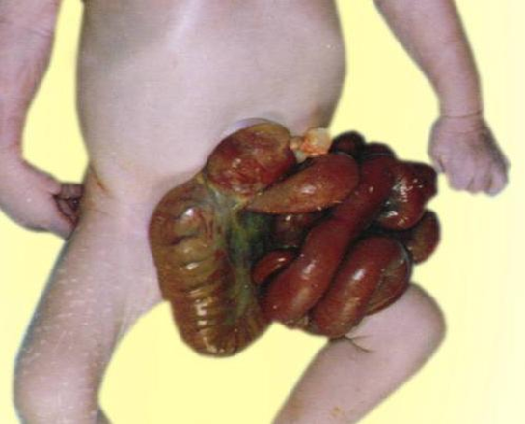
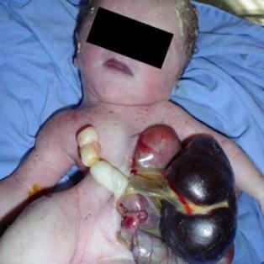
Diagnosis
Gastroschisis is usually easily recognized by the relation of the defect to the umbilical cord on physical examination after delivery
Differential diagnosis must exclude:
  Omphalocele
  Limb body-wall complex
Prenatal diagnoses should be confirmed postnatally
Photo courtesy of: Birth defects atlas of selected congenital anomalies
Photo courtesy of: ECLAMC
Gastroschisis
Limb body wall
Gastroschisis | 9
Notes:
As you can see gather from these pictures, gastroschisis is a defect that can be easily recognized after delivery. Some times it can also be diagnosed prenatally but the diagnosis should be confirmed after birth.
It is important to differentiate gastroschisis from omphalocele. Remember that in omphalocele the organs are out of the abdominal cavity through the umbilical cord, therefore they are covered by a membrane, unless this membrane ruptures. In gastroschisis the organs come out of the abdominal cavity through a defect lateral to the umbilical cord and they are not be covered by a membrane.
Limb body-wall complex can be differentiated by the associated musculoskeletal anomalies that are part of that conditiion.

Slide 10
Tips for reporting
Describe the defect in relation to the umbilical cord, and specify which organs are outside the abdome
Photographs are useful for review and should be taken with the umbilical cord clearly visible
Describe any additional malformations, if present
Indicate whether a clinical geneticist was consulted
Gastroschisis | 10
Notes:
Remember that one of the most important things to do is to describe d the defect the best you can, explain the relation of the defect and the extruded intraabdominal organs to the umbilical cord – this means if the defect is to the right or left of the cord and specify all the organs that are coming out through the defect. If possible take a photograph where the umbilical cord is visible. If the neonate has other anomalies make sure to describe them, and indicate whether a clinical geneticist was consulted.

Slide 11
ICD-10 RCPCH coding of gastroschisis
Relevant ICD-10 codes and RCPCH uses
  Q79 Congenital malformations of the musculoskeletal system, not elsewhere classified (avoid using this general code if more specific information is available)
    Q79.3 Gastroschisis
    Q79.5 other congenital malformations of abdominal wall (use this code ONLY when the diagnosis of gastroschisis is not confirmed)
Exclusions
  Q79.2 Exomphalos/omphalocele
  Q89.81 Limb–body wall complex
  Pentalogy of Cantrell
  Cloacal exstrophy
Gastroschisis | 11
Notes:
This slide shows the ICD-10 RCPCH codes for gastroschisis. In ICD-9 gastroschisis and omphalocele had the same code but in ICD-10 the coding was improved and now there are separate codes for gastroschisis and for omphalocele.
Avoid using the non-specific code Q79 when coding gastroschisis and use instead Q79.3
If the diagnosis can’t be confirmed use Q79.5 and include a good description of the defects and the organs that are outside the abdominal cavity; also, if possible, include a picture or a drawing to help the person(s) reviewing the case confirm the diagnosis.

Slide 12

Questions?
If you have questions please send an email to centre@icbdsr.org or to birthdefectscount@cdc.gov
Gastroschisis | 12
Notes:
Thank you very much for listening to this presentation. We hope you had enjoyed it. If you have questions please send an email to centre@icbdsr.org or to birthdefectscount@cdc.gov

Slide 13
References
Other useful references:
Hackshaw A, Rodeck C, Boniface S. Maternal smoking in pregnancy and birth defects: a systematic review based on 173 687 malformed cases and 11.7 million controls. Hum Reprod Update. 2011 Sep-Oct;17(5):589-604.
Werler MM, Mitchell AA, Moore CA, Honein MA. Is there epidemiologic evidence to support vascular disruption as a pathogenesis of gastroschisis? Am J Med Genet A. 2009 Jul;149A(7):1399-406.
Siega-Riz AM, Herring AH, Olshan AF, Smith J, Moore C; National Birth Defects Prevention Study. The joint effects of maternal prepregnancy body mass index and age on the risk of gastroschisis. Paediatr Perinat Epidemiol. 2009 Jan;23(1):51-7.
Stothard KJ, Tennant PW, Bell R, Rankin J. Maternal overweight and obesity and the risk of congenital anomalies: a systematic review and meta-analysis. JAMA. 2009 Feb 11;301(6):636-50.
Elliott L, Loomis D, Lottritz L, Slotnick RN, Oki E, Todd R. Case-control study of a gastroschisis cluster in Nevada. Arch Pediatr Adolesc Med. 2009 Nov;163(11):1000-6.
Draper ES, Rankin J, Tonks AM, Abrams KR, Field DJ, Clarke M, Kurinczuk JJ. Recreational drug use: a major risk factor for gastroschisis? Am J Epidemiol. 2008 Feb 15;167(4):485-91.
Richardson S, Browne ML, Rasmussen SA, et al. Associations between periconceptional alcohol consumption and craniosynostosis, omphalocele, and gastroschisis. Birth Defects Res A Clin Mol Teratol. 2011 Jul;91(7):623-30.
Gastroschisis | 13
Notes:
Alphabetical order

Slide 14
References
Feldkamp ML, Reefhuis J, Kucik J et al. Case-control study of self reported genitourinary infections and risk of gastroschisis: findings from the national birth defects prevention study, 1997-2003. BMJ. 2008 Jun 1;336(7658):1420-3.
Mastroiacovo P. Risk factors for gastroschisis. BMJ. 2008 Jun 21;336(7658):1386-7.
Feldkamp ML, Meyer RE, Krikov S, Botto LD. Acetaminophen use in pregnancy and risk of birth defects: findings from the National Birth Defects Prevention Study. Obstet Gynecol. 2010 Jan;115(1):109-15.
Rittler M, Castilla EE, Chambers C, Lopez-Camelo JS. Risk for gastroschisis in primigravidity, length of sexual cohabitation, and change in paternity. Birth Defects Res A Clin Mol Teratol. 2007 Jun;79(6):483-7.
Chambers CD, Chen BH, Kalla K, Jernigan L, Jones KL. Novel risk factor in gastroschisis: change of paternity. Am J Med Genet A. 2007 Apr 1;143(7):653-9.
Tinker SC, Reefhuis J, Dellinger AM, Jamieson DJ. Maternal injuries during the periconceptional period and the risk of birth defects, National Birth Defects Prevention Study, 1997-2005. Paediatr Perinat Epidemiol. 2011 Sep;25(5):487-96.
Lupo PJ, Langlois PH, Reefhuis et al. Maternal occupational exposure to polycyclic aromatic hydrocarbons: effects on gastroschisis among offspring in the National Birth Defects Prevention Study. Environ Health Perspect. 2012 Jun;120(6):910-5.
Waller SA, Paul K, Peterson SE, Hitti JE. Agricultural-related chemical exposures, season of conception, and risk of gastroschisis in Washington State. Am J Obstet Gynecol. 2010 Mar;202(3):241.e1-6.
Mattix KD, Winchester PD, Scherer LR. Incidence of abdominal wall defects is related to surface water atrazine and nitrate levels. J Pediatr Surg. 2007 Jun;42(6):947-9.
Kielb C, Lin S, Herdt-Losavio M et al. Maternal periconceptional occupational exposure to pesticides and selected musculoskeletal birth defects. Int J Hyg Environ Health. 2013 Jun 20.
Gastroschisis | 14

