Slide 1
Global Overview of Birth Defects
Workshop on Birth Defects Surveillance
Disclaimer: The findings and conclusions in this presentation have not been formally disseminated by the Centers for Disease Control and Prevention and should not be construed to represent any agency determination or policy.

Slide 2
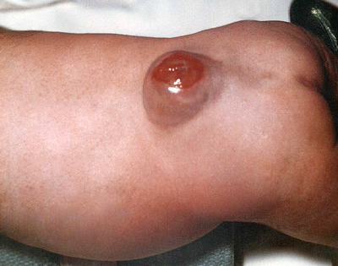
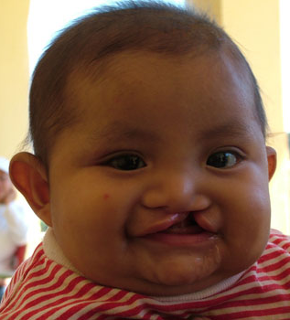
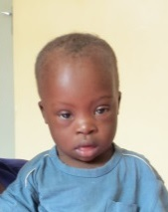
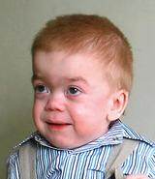
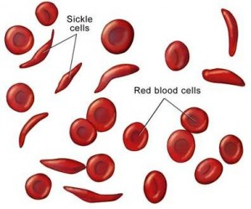
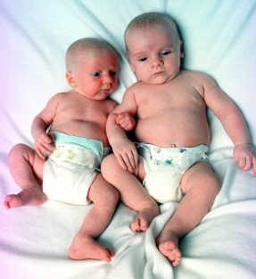
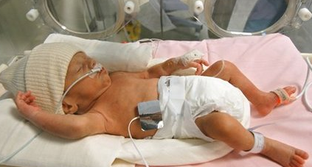
Not all children are born healthy Congenital conditions
Cleft lip
Down syndrome
Neural tube defect
Metabolic disease
Mucopolysaccharidosis
Premature birth
Thalassemia
Sickle cell anemia
Intrauterine growth
retardation (IUGR)
Cerebral palsy
Global Overview | 2
Notes:
Not all children are born healthy. Some children are born with congenital conditions which vary widely in physiology, severity, and impact on lifestyle. Some examples are cleft lip, down syndrome, neural tube defects, thalassemia, and cerebral palsy.
Just to put everyone on the same page, the term “congenital” refers to a disease or trait that is present from birth and has a prenatal origin.
---------
For discussion- What is the meaning of congenital conditions?
Here are some examples of congenital conditions- as you can see they include a variety of conditions such as malformations, syndromes, metabolic disorders, prematurity etc

Slide 3
Birth defects: five “take home messages”
Birth defects: a specific group under the category congenital conditions
Etiology: increasing knowledge allows for new opportunities for prevention
Burden: high globally; proportionally increasing in low and middle resource countries
Interventions: decrease the burden, implement widely
Public health surveillance: a necessary and powerful tool
Notes:
Throughout this presentation we will focus on “5 take home messages”. The first take home message about birth defects is that birth defects are only a specific type of congenital conditions. All birth defects are congenital conditions, but not all congenital conditions are birth defects.
----------
Birth defects are a specific group under the congenital conditions.
We will be discussing birth defects, their etiology, burden, interventions and surveillance (which includes the ascertainment of birth defects AND also the use of collecting the data)

Slide 4
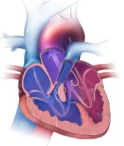
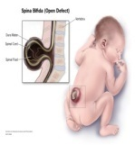
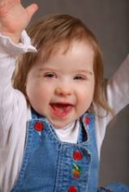
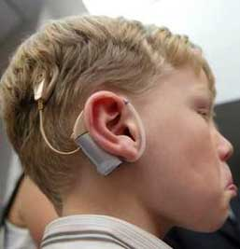
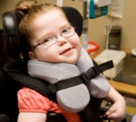
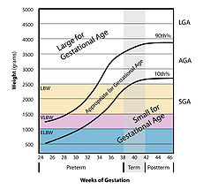
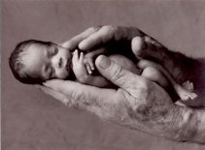
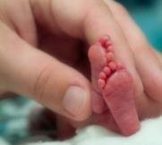
Congenital conditions
Structural
Birth
defects
Functional
IUGR
Other
Preterm birth
Notes:
As we see on this slide, birth defects are one specific group under the larger congenital conditions umbrella. Birth defects can be further classified as either structural or functional abnormalities.
Structural birth defects are abnormalities of body structure that can be internal or external. Examples include heart defects and neural tube defects.
Functional birth defects are abnormalities related to how a body part or system works. Some examples are deafness and cerebral palsy.
Note that there are other congenital conditions that are not classified as birth defects. Some examples include intrauterine growth retardation (IUGR) and preterm birth.
---------
As you can see birth defects are a group of congenital conditions. BD can be structural or functional. The focus of the rest of the presentation will be on structural birth defects.
Other congenital conditions include intrauterine growth retardation and preterm birth

Slide 5
Birth defects: classification
Abnormalities
of body structure
ICD-10 Chapter XVII
Q00-Q99
Deafness
Cerebral palsy
Developmental disabilities
Inborn error of metabolism
Hematologic diseases
Abnormalities
of function
Notes:
As stated previously birth defects can be structural or functional. Structural birth defects are abnormalities of body structure and are classified by Chapter 17 in the International Classification of Disease tool which is also known as ICD-10). The ICD-10 codes range from Q00 to Q99.
----------
The abnormalities of body structure are classified in ICD 10 in chapter 17 and include Q00 to Q99. Classification and coding will be discussed in more detail later in the training.

Slide 6
Birth defects: definition
Abnormalities of body structure or function that are present at birth and are of prenatal origin
Focus of this presentation is on abnormalities of body structure (Included in Chapter XVII of ICD-10 Classification of Diseases)
Sometimes also called:
Congenital anomalies
Congenital abnormalities
Congenital malformations
Notes:
As stated previously birth defects can be structural or functional. Structural birth defects are abnormalities of body structure and are classified by Chapter 17 in the International Classification of Disease tool which is also known as ICD-10). The ICD-10 codes range from Q00 to Q99.
----------
The abnormalities of body structure are classified in ICD 10 in chapter 17 and include Q00 to Q99. Classification and coding will be discussed in more detail later in the training.

Slide 7
Birth defects: Classification
External
Internal
Pathogenesis
Malformation
Deformation
Dysplasia
Disruption
Location
Health impact
Major
Minor
Clinical presentation
Isolated
Multiple
Notes:
Because of the wide heterogeneity of birth defects, oftentimes it is useful to describe or classify them. We typically use four descriptive categories: Location, pathogenesis, health impact, and clinical presentation.
------------
birth defects, oftentimes are classified in four descriptive categories: location, pathogenesis, health impact, and clinical presentation.

Slide 8
Location of Birth Defects
External:
Example: Spina Bifida
Easily recognizable at birth
Best choice when starting a surveillance program
Internal:
Example: Tetralogy of Fallot
Frequently delayed diagnosis
Requires imaging and/or other technology
Notes:
The first thing to consider when classifying birth defects is the location of the defect. This category is broken down into external and internal.
External birth defects are readily identified by inspection during physical examination. They can be reported in a variety of ways. There can be a specific diagnosis, a written description, an ICD code, or a photograph. Since external defects are easily recognizable at birth they are a good choice when starting up a surveillance program.
Internal birth defects require imaging techniques, surgery, autopsy or other specialized procedures. Because they are not visible upon simple assessment, they often result in a delayed diagnosis. Reporting is usually done AFTER the diagnostic studies are completed.
For both internal and external defects, those in stillbirth and terminated pregnancies will be underreported if prenatal imaging or autopsy reports are not included in the surveillance system.
-------------
Location- it refers to where is the birth defect in the body, external or internal. It does not refer to the exact location.
External birth defects are easily identified at birth. For example a neural tube defect. Internal birth defects require diagnostics studies and examiner expertise. An example of these types of defects are congenital heart defects.
Because external defects are easily recognizable at birth, surveillance of external birth defects are a good choice when starting up a bd surveillance program
Because internal birth defects some times require some level of imaging or other diagnostic technology, they often result on a delayed diagnosis.

Slide 9
Birth defects according to health impact
Major:
Significant medical, cosmetic and social impact
Focus of care, prevention and surveillance
Examples: spina bifida, cleft lip, amelia
Minor:
No significant medical, cosmetic and social impact
May accompany major malformations
May provide useful clues for diagnosing syndromes
Examples: clinodactyly, small nevi, lop ears
Notes:
Next lets talk about the health impact (or severity) of birth defects. Another way to think about it is how much of a problem the defect poses to the individual. A major birth defect causes significant medical, cosmetic, and social impact. This could be something like spina bifida or cleft lip. This is our focus of care, where we invest in prevention efforts and surveillance activities
Minor defects are changes which pose no significant health problems and tend to have limited consequences (like an ear tag for example, or an extra nipple). While not usually captured in birth defects surveillance systems, one thing to note about minor defects is that they sometimes provide useful clues for diagnosing syndromes.
___________
Next lets talk about health impact (or severity) or another way to think about it is how much of a problem the defect poses to the individual.
A major birth defect causes significant medical, and social impact. This could be something like spina bifida or anotia. Major defects are our focus in BD surveillance
Minor defects are changes which pose no significant health problems and tend to have limited consequences (like an ear tag for example, or clinodactily). While not usually captured in birth defects surveillance systems, one thing to note about minor defects is that they sometimes provide useful clues for diagnosing syndromes.

Slide 10
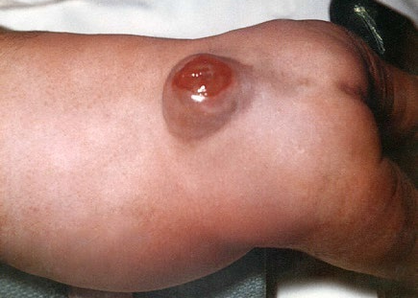
Malformations
Structural defect of an organ, part of an organ, or larger region of the body that arises during organogenesis, or during the initial formation of a structure as a result of an intrinsically abnormal process
Some malformations can be prevented
Neural tube defect
Notes:
The next way to classify birth defects is by Pathogenesis or the development of the disease. There are four types of pathogenesis that we will discuss.
First, some birth defects develop due to malformations. Malformations are structural defects that arise during the initial formation of a structure as a result of an intrinsically abnormal process.
One example of this process is neural tube defects which arise as a result of the failure of the neural tube to close in the first 28 days after conception. Many neural tube defect cases can be prevented by adequate folic acid intake.
-----------
Malformation is a structural defect that occurs during organogenesis as a result of an intrinsically abnormal process. An example – neural tube defects

Slide 11
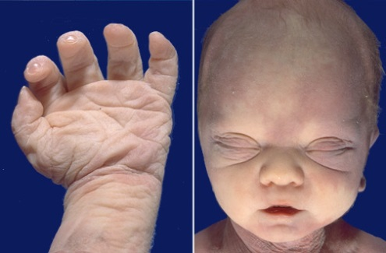
Deformations
Abnormal shape, form or position of a part of the body caused by mechanical forces
Initial formation of the structures is normal but mechanical forces affect their development
Potter sequence
http://library.med.utah.edu/WebPath/jpeg3/PERI230.jpg
Notes:
Second, birth defects may develop due to deformations. The origin of deformations is not in the initial formation of the structure. Rather, the structure develops normally, but later on mechanical forces lead to abnormal shape form or position of the body.
An example of a deformation is the potter sequence which is primarily characterized by a skin fold of tissue extending from the eye across the cheek. It is caused by a decrease in amniotic fluid.
---------
Deformation- Initial formation of the structure is normal but mechanical forces affect its development example- potter sequence

Slide 12
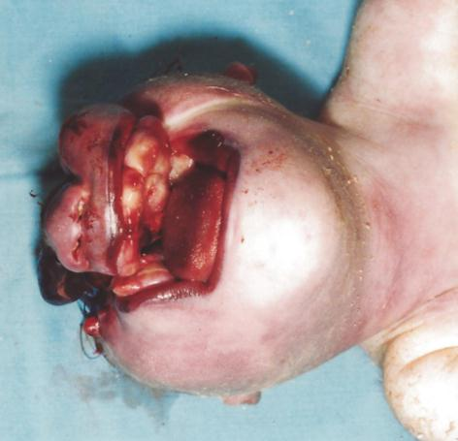
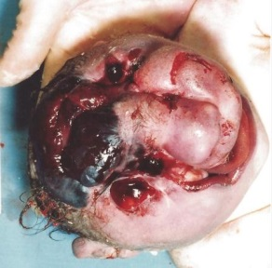
Disruptions
Structural defect of an organ, part of an organ, or larger region for the body resulting from the extrinsic breakdown of, or interference with an originally normal developmental process
Initial development is normal, but the process is interrupted or normally developed parts disrupted
Amniotic band sequence
CDC-Beijing Medical University collaborative project
Notes:
Third, the pathogenesis of birth defects may be due to disruptions. Disruptions are structural defects of a body structure resulting from the extrinsic breakdown of, or interference with an originally normal developmental process.
In this example, amniotic band sequence, strands of the amniotic sac tissue entangle limbs or other parts of the fetus, causing disruption of the affected areas.
---------
Initial development is normal but the process is interrupted or disrupted. Example- amniotic bands

Slide 13
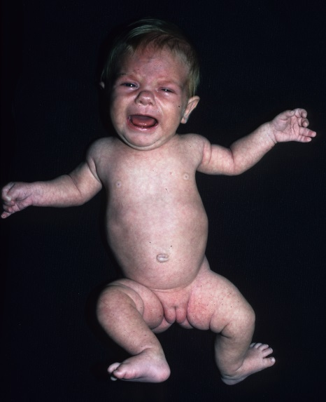
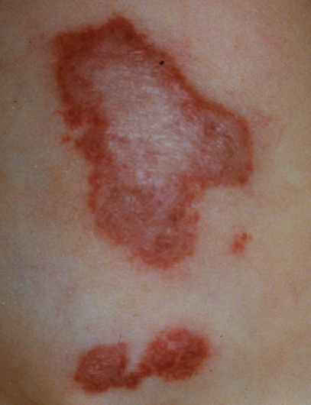
Dysplasias
Abnormalities of histogenesis or formation of tissues
Dysplasias generally affect the skin, brain, cartilage or bone and can either be localized (confined to one area of the body) or be generalized
Achondroplasia
Hemangioma
Notes:
Fourth, the pathogenesis of birth defects may be due to dysplasias which are abnormalities of histogenesis or tissue formation. Dysplasias generally affect the skin, brain, cartilage or bone.
They can be localized to one area of the body or generalized.
---------
Abnormalities of histogenesis or formation of tissue

Slide 14
Clinical presentation: Isolated and multiple defects
Isolated birth defect
Single major defect
75% of major birth defects are isolated
Sequence
Multiple birth defect
More than one major unrelated defect
Associations – pattern of multiple anomalies that occur with a higher than random frequency and that is not a sequence or a syndrome
Syndromes – pattern of multiple anomalies thought to be pathogenically related, but not representing a sequence
Notes:
Finally, another common classification is according to clinical presentation. Under clinical classification, there are isolated birth defects and multiple birth defects.
Isolated defects have no other unrelated major anomaly present. They comprise about 75 % of all major birth defects. Sequences are also considered isolated defects. A sequence is a pattern of related anomalies that are known to come from ONE source (for example, a primary anomaly or a primary mechanical factor). SO that ONE source is what makes it isolated. A sequence is a cascade of anomalies that are consequences of that SINGLE malformation, disruption or deformation. An example is hydrocephalus, spina bifida, and talipes. The hydrocephalus and talipes are consequences of the primary malformation of spina bifida.
Multiple defects are two or more major defects that are unrelated. For example a child could randomly have both a limb deformity and hypospadias. Under multiple defects are two other subcategories, called associations and syndromes. An association is a pattern of anomalies that occur with a higher frequency than what would be expected from random occurrences. So in other words you know you see this pattern more often than you would expect if it were random, but there is no identifiable common pathway (the pathogenesis is not known) as to why.
Syndromes are pathogenically related multiple anomalies arising from a single CAUSE, such as down syndrome or congenital rubella syndrome.
Related syndromes refers to a pattern of multiple defects belonging to the same organ system [so for example anotia (no ear) and microtia (small ear)] that are thought to be pathogenically related.
------------
Under clinical presentation you classify the defects as isolated birth defects or multiple birth defects.
Isolated defects have no other unrelated major anomaly present. They comprise about 75 % of all major birth defects. Sequences are also considered isolated defects. A sequence is a cascade of anomalies that are consequences of a SINGLE malformation. An example is hydrocephalus, spina bifida, and talipes. The hydrocephalus and talipes are consequences of the primary malformation of spina bifida.
Multiple defects are two or more major defects that are unrelated. For example the child could have a limb deformity and also have hypospadias. Under multiple defects are two other subcategories, called associations and syndromes. As association is a pattern of anomalies that occur with a higher frequency than what would be expected from random occurrences. VACTERL stands for vertebral defects, anal atresia, cardiac defects, tracheo-esophageal fistula, renal anomalies, and limb abnormalities
Syndromes are pathogenically related multiple anomalies arising from a single CAUSE. For example down syndrome or congenital rubella syndrome.

Slide 15
Birth defects: five “take home messages”
Birth defects: a specific group under the category congenital conditions
Etiology: increasing knowledge allows for new opportunities for prevention
Burden: high globally; proportionally increasing in low and middle resource countries
Interventions: decrease the burden, implement widely
Public health surveillance: a necessary and powerful tool
Notes:
The second take home message we are going to focus on is the etiology, or cause, of birth defects. It is an important topic area, because the more that we know, the greater our opportunities for prevention become.

Slide 16
Etiology of birth defects
Single gene
(14%)
Chromosomal
(10%)
Environmental
(10%)
Unknown*
(66%)
* Includes multifactorial determination
Source: Nelson K, Holmes LB. Malformations due to presumed spontaneous mutations in newborn infants. N. Engl. J.
Med. 1989;320:19–23. ; Brent RL. Environmental causes of human congenital malformations: the pediatrician’s role in
dealing with these complex clinical problems caused by a multiplicity of environmental and genetic factors. Pediatrics.
2004;113:957–68.
Notes:
It is estimated that approximately 14% of birth defects are caused by single gene disorders, 10% are caused by chromosomal abnormalities, and another 10% are due to environmental factors. However, as you can see from the pie chart, a large proportion of birth defects are of an unknown or multifactorial etiology. Therefore, there is still a lot we have to learn about birth defects.
------
Here are some percentages on the etiology of BD. As you can see the cause of BD is still unkwown for 66% of bd

Slide 17
Examples of known modifiable risk factors for birth defects
Infections
Rubella
Varicella
Lifestyle and vitamins
Alcohol
Cigarette smoke
Folate insufficiency
Medications
Retinoic acid
Antiseizure medications
Maternal Diseases and Conditions
Diabetes
Obesity, overweight
Others
Hyperthermia
Mercury
Notes:
The list above provides examples of some known modifiable risk factors that can help reduce a woman’s risk of having a child born with a birth defect. Although this list is not exhaustive, some examples of modifiable risk factors include alcohol consumption, use of antiseizure medications, and obesity.
----
Some things we know, and therefore the potential for prevention is available

Slide 18
Birth defects: five “take home messages”
Birth defects: a specific group under the category congenital conditions
Etiology: increasing knowledge allows for new opportunities for prevention
Burden: high globally; proportionally increasing in low and middle resource countries
Interventions: decrease the burden, implement widely
Public health surveillance: a necessary and powerful tool
Notes:
The next take home message we will discuss is the burden of birth defects.

Slide 19
Risk factors and relative risks
Risk factor | Related Birth Defect | Relative Risk * (95% CI)
Insufficient folic acid | Neural tube defects | 3.57 (1.92-6.67)
Hyperthermia | Neural tube defects | 2.90 (2.22-3.79)
Valproic acid | Spina bifida | 12.7 (7.7-20.7)
Obesity@, severe (BMI≥35) | Congenital heart defects | 1.38 (1.20-1.59)
Diabetes | Congenital heart defects | 3.8 (3.0-4.9)
Smoking | Cleft lip w/out palate | 1.62 (1.35-1.95)
* Relative risk is usually given by metanalysis or other robust studies.
@ Without diabetes
Notes:
The table on this slide presents the relative risk for well documented risk factors and related birth defects. As you can see, the risk varies and some risk factors present a greater risk than others.
De-Regil LM, Fernández-Gaxiola AC, Dowswell T, Peña-Rosas JP. Effects and safety of periconceptional folate supplementation for preventing birth defects. Cochrane Database Syst Rev. 2010 Oct 6;(10):CD007950. doi: 10.1002/14651858.CD007950.pub2. Review. PubMed PMID: 20927767; PubMed Central PMCID: PMC4160020.
Butali A, Little J, Chevrier C, Cordier S, Steegers-Theunissen R, Jugessur A, Oladugba B, Mossey PA. Folic acid supplementation use and the MTHFR C677T polymorphism in orofacial clefts etiology: An individual participant data pooled-analysis. Birth Defects Res A Clin Mol Teratol. 2013 Aug;97(8):509-14. doi: 10.1002/bdra.23133. Epub 2013 May 13. PubMed PMID: 23670871; PubMed Central PMCID: PMC3745533.
Dreier JW, Andersen AM, Berg-Beckhoff G. Systematic review and meta-analyses: fever in pregnancy and health impacts in the offspring. Pediatrics. 2014 Mar;133(3):e674-88. doi: 10.1542/peds.2013-3205. Epub 2014 Feb 24. Review. PubMed PMID: 24567014.
Cai GJ, Sun XX, Zhang L, Hong Q. Association between maternal body mass index and congenital heart defects in offspring: a systematic review. Am J Obstet Gynecol. 2014 Aug;211(2):91-117. doi: 10.1016/j.ajog.2014.03.028. Epub 2014 Mar 14. Review. PubMed PMID: 24631708.
Simeone RM, Devine OJ, Marcinkevage JA, Gilboa SM, Razzaghi H, Bardenheier BH, Sharma AJ, Honein MA. Diabetes and Congenital Heart Defects: A Systematic Review, Meta-Analysis, and Modeling Project. Am J Prev Med. 2014 Oct 6. pii: S0749-3797(14)00502-9. doi: 10.1016/j.amepre.2014.09.002. [Epub ahead of print] PubMed PMID: 25326416.
Jentink J, Loane MA, Dolk H, Barisic I, Garne E, Morris JK, de Jong-van den Berg LT; EUROCAT Antiepileptic Study Working Group. Valproic acid monotherapy in pregnancy and major congenital malformations. N Engl J Med. 2010 Jun 10;362(23):2185-93. doi: 10.1056/NEJMoa0907328. Review. PubMed PMID: 20558369.

Slide 20
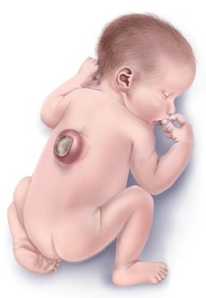
Etiologic heterogeneity of spina bifida
Give Protection
Micronutrient supplementation
Manage Conditions
Previous NTD-affected pregnancy
Gene mutations (e.g., VANGL1, MTHFR)
Diabetes and obesity
Avoid Exposure
Valproate (anti-seizure medications)
Environmental toxins (e.g., fumonisins)
Notes:
Some birth defects have several well known risk factors and causes, therefore, there are multiple things women can do to reduce their risk for having a child born with a birth defect. For example, to reduce the risk of spina bifida (the birth defect shown) a women should consume an adequate amount of folic acid periconceptionally through either fortified foods and/or supplements. She should also manage conditions that are related to an increased risk of having a child with spina bifida such as previously having an NTD-affected pregnancy, gene mutations, diabetes, obesity, and avoiding exposure to known teratogens such as valproate/valproic acid and environmental toxins such as fumonisins.
** Volproate in this slide and valproic acid in the previous slide**
Spina Bifida Source: CDC/NCBDDD
Heterogeneity= multiple causes for same birth defect
----
Some things we know, and therefore the potential for prevention is available

Slide 21
Important concepts related to risk factors
Increasing knowledge allows for new opportunities for prevention
Known and modifiable risk factors can be:
qualified (birth defects; IUGR, preterm)
quantified
population prevalence
risk magnitude for each related outcome
population attributable fraction
Impact of preventive interventions varies according to etiologic heterogeneity of birth defects
Notes:
It is important to note that the more we learn about birth defects the more opportunities we have for prevention.
The modifiable risk factors we know about can be described qualitatively through classification and descriptions and they can be quantified through population prevalence, risk magnitude, and the fraction of birth defects that can be attributed to each risk factor.
Depending on the etiology of a birth defect, it may or may not be preventable. For example, birth defects that are only due to single gene disorders may not be as preventable as spina bifida which may be due to the failure of the neural tube to properly close because of insufficient folic acid.

Slide 22
Birth defects: five “take home messages”
Birth Defects: a specific group under category congenital conditions
Etiology: increasing knowledge allows for new opportunities for prevention
Burden: high globally; proportionally increasing in low and middle resource countries
Interventions: decrease the burden, implement widely
Public health surveillance: a necessary and powerful tool
Notes:
To decrease the burden of birth defects is important that interventions be implemented widely. Interventions include both treatments and prevention of birth defects.

Slide 23
One or more risk factor: Effect of primary prevention
One causal factor,
e.g.: cong. rubella syndrome
Multiple causal factors,
e.g.: spina bifida
Factor
A
Disease
B
Disease
B
Factor
A
Disease
B
Disease
B
X = Effect of the preventive intervention
Notes:
The effect of primary prevention will depend on whether the birth defect has one or more risk factors.
Since a birth defect or disease such as congenital rubella syndrome is due to only one causal factor (rubella virus), the preventative intervention, vaccination, will prevent the birth defect.
However, other birth defects such as spina bifida which are due to multiple factors which include insufficient folic acid intake, obesity, and valproic acid may not be prevented by only one preventative intervention. For example, a women who takes folic acid supplements may still have a baby born with spina bifida due to other causal factors.

Slide 24
Hidden burden of birth defects
Easier to measure
Metrics readily avaiable
Prevalence
Mortality:
Neonatal
Infant
Under-5
Elective terminations
Spontaneous abortions
Stillbirths
Co-morbidities
Medical/surgical treatment
Hospitalizations
Long term disability
Quality of life
Social/emotional impact
Economic cost
Difficult to measure
Evaluated less frequently
Notes:
First, it is important to note that the true burden of birth defects is likely underestated. We can only count the burden of birth defects using metrics that are readily available such as neonatal, infant, and under-5 mortality. Other metrics that are harder to measure include deaths due to terminations, abortions, still births and other costs of birth defects such as co-morbidities, treatment costs, quality of life, and social or emotional impact.

Slide 25
Prevalence of birth defects
The prevalence of birth defects around the world shows a wide variation, which can be due to:
real population differences
methodological issues (e.g., definition, case ascertainment)
Notable variations in prevalence that appear to be real:
NTDs
Oral clefts
Gastroschisis
Down syndrome & other trisomies (maternal age)
Notes:
The variation in prevalence of birth defects worldwide can be due to two factors. First, the differences in prevalence may be due to real population differences. However, the prevalence difference may also be due differences in methodological issues such as case ascertainment and definitions.
Variations in the prevalence of NTDs, oral clefts, gastroschisis, down syndrome and other trisomies appear to be due to real population differences.

Slide 26
Mortality
ETOPFA*
Stillbirths
Perinatal mortality
Neonatal mortality
Infant mortality
Under-five years mortality
∗ Elective termination of pregnancy for fetal anomalies
Notes:
Mortality due to birth defects can be measured in different ways including elective termination of pregnancy for fetal anomalies, still births, perinatal, neonatal, infant, and under-five years mortality. Generally, each of these measures should have a standardized definition although some like still births may be calculated differently. For example, some surveillance programs may only count stilllbirths before 20 gestational week while others may count stillbirths before 28 gestational weeks.

Slide 27
Overall under – 5 year mortality (line) and % of deaths due to birth defects (bars) by WHO region and country income
Legend
Countries income: H= High, UM=Upper-Middle, LM=Lower-Middle , L=Low
WHO Regions: AFR=Africa, AM= Americas, EM=Eastern Mediterranean, EUR=Europe, SEA=South East Asia; WP=Western Pacific
World Health Statistics 2010 data http://apps.who.int/gho/data/view.main.POP2020?lang=en
Notes:
This graph plots the under 5-mortality rate per 10,000 births in each WHO region and country income level (shown by the line) by the percent of deaths due to birth defects which is shown by the bars.
The graph shows that as the overall under-5 year mortality rate decreases, the percent of deaths due to birth defects increases proportionally.

Slide 28
Accurate diagnosis
Prenatal
Post-natal
Anomalies (external/internal)
Syndromes
Experience, team,
clinical geneticist,
diagnostic help network
http://www.skeldys.org/
Notes:
For treatment to be possible, first an accurate diagnosis should be made. The diagnosis to identify anomalies and syndromes can be made prenatally, post-natally and can require a team of experienced professionals.

Slide 29
Effective counseling
Before birth
At birth or at time of diagnosis
Recurrence risk counseling
Counseling is an art,
but can be learned:
Guidelines
Skotko GB et al. Pediatrics 2009;124;e751;
Sheets BK et al. J Genet Counsel (2011) 20:432–441
Notes:
Effective counseling of parents is an important intervention and can occur before birth to prevent birth defects or at time of diagnosis to help parents learn how to effectively care for, treat, cope, and prevent recurrence of a birth defect in future pregnancies.

Slide 30
Treatment Options
Surgical
Before birth (e.g., spina bifida, diaphragmatic hernia)
Soon after birth
After birth
Medical treatment (examples)
Neonatal Intensive Care Unit
Palliative care (life-limiting illness)
Supportive care and management*
Provision of primary care as for any child
Anticipatory guidance (e.g., feeding, toileting, behavior)
Early diagnosis of co-morbidities
Individualized education program and family supportive plan, including leisure and recreational activities
Physical and/or speech treatment
∗ Guidelines available for some conditions)
Notes:
There are many treatment options for birth defects ranging from surgical to medical to supportive care and management.
Surgical treatment can occur prenatally or postnatally depending on the condition.

Slide 31
Social integration issues
Help when joining the community
Parent associations
Mainstreaming (school)
Sports
Work
Rights of Persons with Disabilities
13 Dec 2006, UN, New York
www.un.org/disabilities/default.asp?id=150
Notes:
Many children with birth defects are able to fully integrate in society and live happy, health lives. However, it is important that they recieve support from parents, schools, and the organizations they are involved with. Legislation can help remove barriers for disabled persons to further integrate in society.

Slide 32
Prevention opportunities
Primary
Avoidance / management of recognized protective and modifiable risk factors
Reproductive health promotion and preconception care
Folic acid, vaccines, avoid alcohol, smoking, and use of certain medicines
Secondary
Newborn screening
Metabolic diseases
Before conception or after a prenatal diagnosis
Counseling
Notes:
There are different measures that women can take to help prevent birth defects. For primary prevention women should avoid and a manage recognized risk factors such as avoiding alcohol consumption, smoking, and use of certain medications. They should also be aware of certain preconception care techniques such as folic acid consumption. Secondary prevention methods focus on newborn screenings. Such screenings include diagnostic tests for metabolic disorders.
Furthermore, women should seek counseling from an appropriate health care provider either before conception or after a prenatal diagnosis.

Slide 33
Birth defects: five “take home messages”
Birth defects: a specific group under the category congenital conditions
Etiology: increasing knowledge allows for new opportunities for prevention
Burden: high globally; proportionally increasing in low and middle resource countries
Interventions: decrease the burden, implement widely
Public health surveillance: a necessary and powerful tool
Notes:
The final take home message we want to leave you with today is that public health surveillance is a necessary and powerful tool.

Slide 34
Public health surveillance: a necessary tool
Defined as the ongoing and systematic collection, analysis, and interpretation of health data essential to the planning, implementation and evaluation of public health practice
Essentials: ongoing, systematic, linked to public health practice (information for action)
Notes:
Public Health surveillance is defined as the ongoing and systematic collection, analysis and interpretation of health data essential to the planning, implementation and evaluation of public health practice. Public health surveillance is a necessary tool because it helps us monitor trends in the prevalence of different types of congenital anomalies among a defined population, detect clusters or outbreaks of congenital anomalies, provides a basis for epidemiological research and prevention programs, allows for the evaluation of prevention programs, and produces findings and data that can be interpreted and disseminated by partner organizations in a timely fashion.

Slide 35
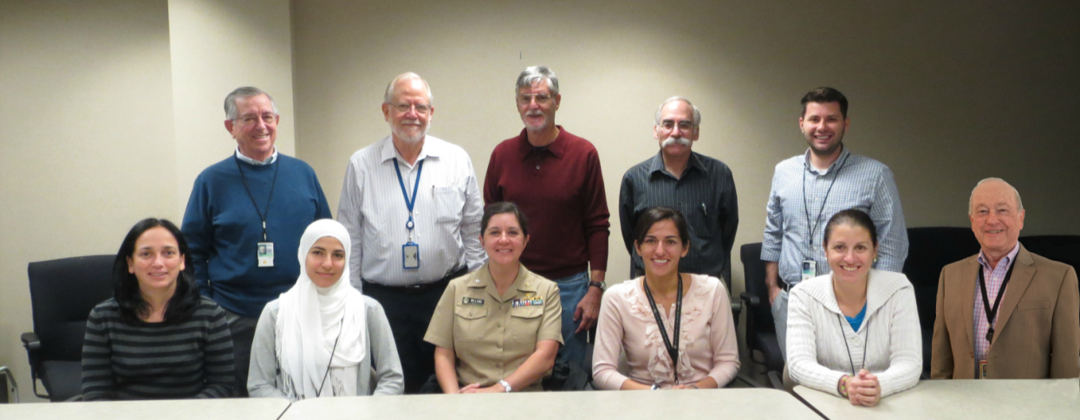
Acknowledgements
International Clearinghouse on Birth Defects Surveillance and Research
Pierpaolo Mastroiacovo
Lorenzo Botto
World Health Organization/Headquarters
Juan Pablo Peña- Rosas
CDC National Center for Birth Defects and Developmental Disabilities
Surveillance Working Group
Notes:
35
35
35
Lastly, we would like to thank our partners and colleagues at ICBD, WHO and CDC who helped prepare this presentation.

Slide 36
Questions? If you have any questions, please send an email to birthdefectscount@listserv.cdc.gov
Global Overview | 36

