Slide 1



Idiopathic Talipes Equinovarus
(Congenital Clubfoot)
Disclaimer: The findings and conclusions in this presentation have not been formally disseminated by the Centers for Disease Control and Prevention and should not be construed to represent any agency determination or policy.

Slide 2
Learning Objectives
By the end of this presentation participants will be able to describe:
  Clinical features of talipes equinovarus
  Main epidemiological features of talipes equinovarus
  Elements for reporting and coding
Talipes | 2
Notes:
By the end of this presentation we would like you to be able to describe:
the main clinical features of talipes equinovarus,
the main epidemiological features of talipes equinovarus, and
key elements and tips for reporting and coding

Slide 3
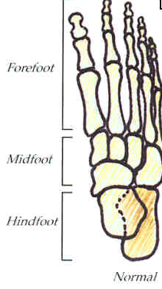
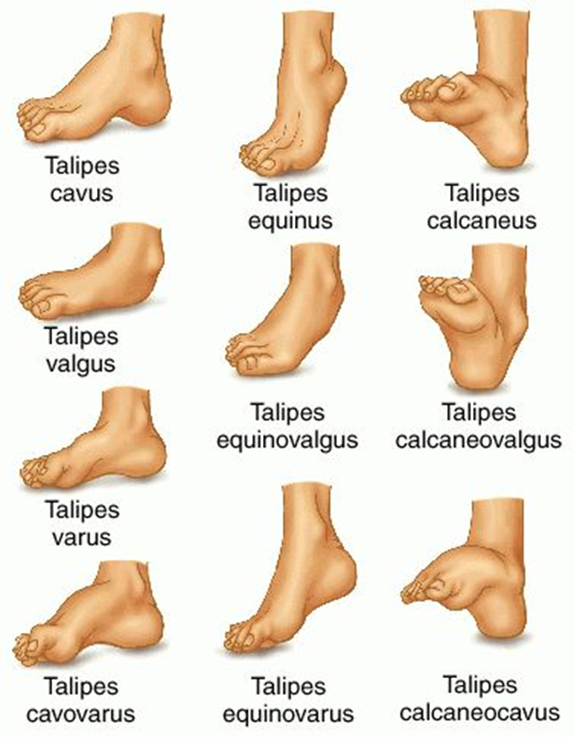
Anatomy of the Foot
Normal Foot
Anomalies of the Foot
Forefoot
Midfoot
Navicular
Talus
Hindfoot
Calcaneus
Illustration source: http://medicaldictionary.thefreedictionary.com/_/viewer.aspx?path=dorland&name=talipes.jpg&url=http%3A%2F%2Fmedical-dictionary.thefreedictionary.com%2Ftalipes
Talipes | 3
Notes:
Here you can see on the left the normal anatomy of the foot and the parts in which the foot is divided:
the hindfoot, includes the calcaneous and talus ( some experts also include the navicular bone as well);
the midfoot, includes cuboid, and 3 cuneiform bones and, according to some, the navicular*
the forefoot, includes the metatarsals and phalanges.
The illustration on the right shows the different types of congenital positional abnormalities of the feet.
This presentation focuses on is talipes equinovarus
We will refer to a couple of others as well to help make distinctions for diagnosis and coding.

Slide 4



Talipes Equinovarus
Equinus: plantar flexed (talus pointing down)
Varus: deviation of heel (calcaneus) and forefoot (inward)
Supination: foot rests on outer side (upward rotation)
Equinus
Varus
Supination
Talipes | 4
Notes:
What makes a talipes equinovarus?
So let’s review the meaning of these terms:
Talipes equinovarus has three main characteristics: equinus, varus and supination.
Equinus means that the talus bone is pointing down and the heel up
Varus means that the heel or calcaneus bone and the forefoot are deviated inward
Supination means that there is an upward rotation and the foot ends up resting on the outer side.

Slide 5
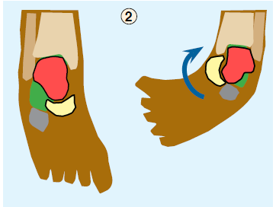
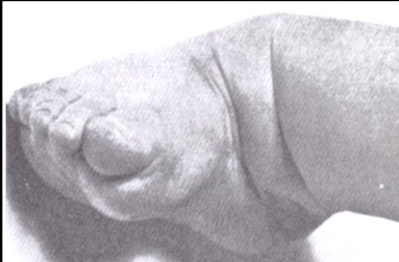
Talipes Equinovarus
talus=ankle, pes=foot
Talus
Navicular
Calcaneus
Normal
Talipes
The talus is deformed and the navicular is medially displaced
The foot is rotated around the head of the talus (arrow)
Illustration source: http://medicaldictionary.thefreedictionary.com/_/viewer.aspx?path=dorland&name=talipes.jpg&url=http%3A%2F%2Fmedical-dictionary.thefreedictionary.com%2Ftalipes
Photo Source: Staheli-Clubfoot:Ponseti Management –www.global-help.org
Talipes | 5
Notes:
Talipes comes from 2 Latin words – Talus meaning ankle and pes meaning foot.
The left side of the diagram shows a normal foot and 3 of the ankle bones that are involved in this defect: the calcaneous, the navicular and the talus.
On the right side of the diagram you see how the bones are affected. To the right of the slide you see an actual photograph of a baby’s foot with Talipes.
The diagram illustrates how the hindfoot or heel is pulled upward, as if to allow walking on the toes, a condition known as hindfoot equinus.
The back portion of the hindfoot is also tilted inward, a condition known as hindfoot varus. In addition, the toes are often pointed inwards as well, (also known as forefoot adduction), giving the foot the appearance of a bean.
You can’t see it in the diagram but in severe cases the foot can have a high arch, called midfoot cavus. (click) You can see it in the picture on the right. You can also see in the picture how the foot rests on its side and this is call supination (click). Children who have clubfoot and grow up without being treated will be seen walking on the sides of their feet
The foot is generally less flexible than normal and the foot and calf muscles may be atrophied, or thin, and, as well, there can be shortening of tendons at the ankle.
Relevant anatomy
Bone •Tibia: Slight shortening is possible.
•Fibula: Shortening is common.
•Talus: In equinus in the ankle mortise, with the body of the talus being in external rotation, the body of the talus is extruded anterolaterally and is uncovered and can be palpated. The neck of the talus is medially deviated and plantar flexed. All relationships of the talus to the surrounding bones are abnormal.
•calcaneous: Medial rotation and an equinus and adduction deformity are present.
•Navicular: The navicular is medially subluxated over the talar head.
•Cuboid: The cuboid is medially subluxated over the calcaneal head.
•Forefoot: The forefoot is adducted and supinated; severe cases also have cavus with a dropped first metatarsal.
Muscle
•Atrophy of the leg muscles, especially in the peroneal group, is seen in clubfeet.
•The number of fibers in the muscles is normal, but the fibers are smaller in size.
•The triceps surae, tibialis posterior, flexor digitorum longus (FDL), and flexor hallucis longus (FHL) are contracted.
•The calf is of a smaller size and remains so throughout life, even following successful long-lasting correction of the feet.
Tendon sheaths: Thickening frequently is present, especially of the tibialis posterior and peroneal sheaths.
Joint capsules: Contractures of the posterior ankle capsule, subtalar capsule, and talonavicular and calcaneocuboid joint capsules commonly are seen.
Ligaments: Contractures are seen in the calcaneofibular, talofibular, (ankle) deltoid, long and short plantar, spring, and bifurcate ligaments.
Fascia: The plantar fascial contracture contributes to the cavus, as does contracture of fascial planes in the foot.

Slide 6
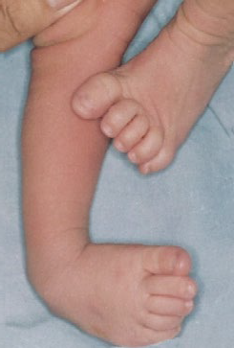
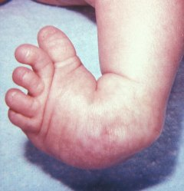
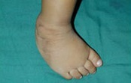
Talipes Equinovarus
Common musculoskeletal birth defect that if untreated causes long-term functional disability
Varying severity
Photos courtesy of CDC-Beijing Medical University collaborative project
Talipes | 6
Notes:
Talipes equinovarus is one of the most common musculoskeletal birth defects.
If untreated it causes long-term functional disability. The condition can vary in its degree of severity. Ranging from quite mild to very severe.
There are treatments to cure this condition making it very important that when a baby is diagnosed with this birth defect that he or she be quickly sent for consultation to specialists or clinics trained to take care of the defect.
The picture in the left shows a more mild case while the picture in the right shows a severe case.

Slide 7
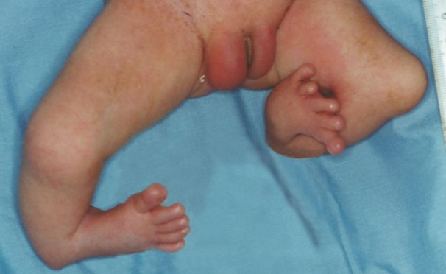
Differential Diagnosis
Positional clubfoot
  Can be manipulated into a normal position
  Most times do not require treatment
Clubfoot associated with neuromuscular diagnoses or syndromes, such as
  spina bifida (sequence)
  arthrogryposis multiplex congenita
  congenital myotonic dystrophy
  diastrophic dysplasia
  chromosomal abnormalities
Tibial and other limb deficiencies can mimic clubfoot
Tibial reduction defect
Photo courtesy of CDC-Beijing Medical University collaborative project
Talipes | 7
Notes:
The diagnosis of talipes equinovarus has to take into account other conditions that are similar but should not always be coded and or counted as talipes equinovarus.
For example:
There is positional clubfoot-this means that the feet can be manipulated into a normal position- the feet are flexible and in some cases do not require treatment-This condition should never be coded or counted.
Sometimes clubfoot presents with other defects. One example is when a baby is born with spina bifida and talipes. This sequence was discussed in the neural tube defects presentation. In this case the clubfoot is coded, but since it is part of a sequence it will not be counted as isolated talipes equinovarus.
It may also be part of syndromes like the ones listed on the slide that include clubfoot and, occasionally, in some chromosomal abnormality syndromes.
Finally, other birth defects of the foot or leg that might look like a clubfoot, For example, a deficiency of the tibial bone in the leg causing the foot to look like talipes-- like in this photo of a tibial reduction defect. This defect is not clubfoot and it should not be coded or counted as such.
The most important thing is to refer all patients with probable talipes to an orthopedist or a specialist.

Slide 8
Etiology
Poorly understood
Generally considered to be multifactorial
  Evidence for a genetic contribution*
    Prevalence varies among ethnic groups
    Twin studies showing higher concordance in monozygotic than in dizygotic twins
    Runs in families
  Evidence for environmental contribution
    Smoking
*Source: Miedzybrodzka Z. 2003. J. Anat. 202:37–42
Talipes | 8
Notes:
Not much is known about what causes talipes equinovarus. In general it is considered to have a multifactorial determination, which means that it is caused by an interplay of genetic and environmental factors. The evidence for a genetic contribution is attributed to different prevalence estimates among different ethnic groups and in twin studies that show higher prevalence in monozygotic twins. In addition, clubfoot runs in families- this means that you see it occurring more frequently in patients with a family history of talipes. We also know that there is evidence of possible environmental contribution to the occurrence of talipes such as smoking during pregnancy.

Slide 9
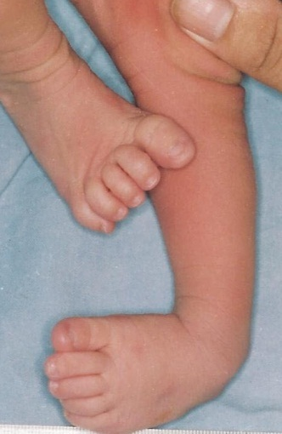
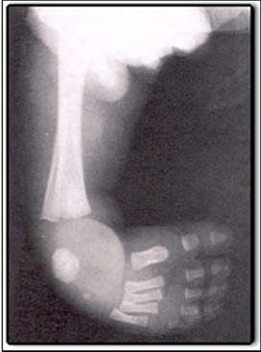
Diagnosis
Talipes equinovarus is usually diagnosed by physical exam, but at times an x-ray may be necessary
Clinical evaluation
X-Rays
Prenatal diagnoses should not be included in surveillance data unless it is confirmed postnatally.
Photo courtesy of CDC-Beijing Medical University collaborative project
Talipes | 9
Notes:
A physical examination of the newborn is typically enough to make a diagnosis. However, sometimes an x-ray or another imaging study may provide supplemental information – this can be useful especially in those cases where the defect is less severe or to differentiate from cases where a bone is missing and it is not really a talipes.
It is possible that talipes can be identified by a sonogram during pregnancy but unless it is confirmed at birth it should not be included in the surveillance counts.

Slide 10
Epidemiologic Features of Talipes Equinovarus
Feature | Typical Findings
Prevalence* | Varies among ethnic groups Asian populations: 6 per 10,000 live births Caucasians: 10 to 30 per 10,000 live births Polynesian ancestry: 60 per 10,000 live births
Sex differences* | Male to female ratio 2:1
Laterality* | Bilateral talipes: about 50% of cases Unilateral talipes: right more common than left
Associations** | Most common associated conditions: spina bifida (4.4% of children with talipes); cerebral palsy (1.9%), and arthrogryposis (0.9%)
  *Source: Parker, et al, Birth Defects Research (Part A) 2009
  **Source: Ching et al, Am J Hum Genet 1969.
Talipes | 10
Notes:
The prevalence varies among ethnic groups. As you can see, the lowest prevalence occurs in Asian populations, while the highest occurs in people with Polynesian ancestry
Male fetuses are predominantly affected.
Bilateral cases are more common and it occurs more in the right than in the left foot,
and some, as mantioned before, are associated with other anomalies …..

Slide 11
Elements for Description
Describe laterality: right, left, or bilateral
Describe mobility of foot – rigid vs flexible
Describe additional malformations when present
A photograph should be taken; it can be useful for review, but it is not sufficient for confirmation
Talipes | 11
Notes:
When you identify a talipes equinovarus, make sure to describe the laterality of the defect (right, left, bilateral) in the data collection form. It is also very important to describe if the foot is flexible or rigid.
Please include and describe any other malformations present. For example, if the baby also has spina bifida or arthrogryposis.
A photograph is recommended as it will be useful for the reviewer of the case, but the photograph alone in this case will not provide sufficient information for confirmation of the defect. For example, a picture will not be able to tell you or any person reviewing the case if the clubfoot is positional or if it is a real talipes equinovarus.

Slide 12
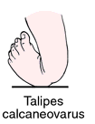
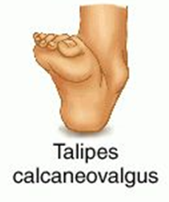
Relevant ICD-10 Codes
Q66 Congenital deformities of feet (avoid using this general code if more specific information is available)
Q66.0 Talipes equinovarus
Q66.1 Talipes calcaneovarus
Q66.4 Talipes calcaneovalgus
Q66.8 Other congenital deformities of feet
Clubfoot unspecified
Exclusions
Clubfoot, positional
Clubfoot associated with:
- neuromuscular diagnoses (e.g., spina bifida sequence) - syndromes, such as arthrogryposis ,multiplex congenita, congenital myotonic dystrophy, or diastrophic dysplasia
Talipes | 12
Notes:
Here is a list of ICD10 codes you will use when a clubfoot is identified. Be aware on the fact that there are other kinds of foot deformities that will use the term clubfoot to describe them. If possible is better to use the more specific code.
Also, be aware that Q66 is a generic code , and if possible it should not be use for coding talipes equinovarus.
The most common congenital deformity of feet is talipes equinovarus, and is the one we have been discussing during this presentation. However, there are other forms of clubfoot that are also coded. Diagrams of talipes calcanoevarus and talipes calcaneovalgus are presented to the right of the slide.
Q66.8 will include all unspecified congenital deformities of feet as clubfoot unspecified. If the description matches a talipes equinovarus avoid using the unspecified code.
Remember the exclusions and also that tibial and other limb deficiencies can mimic clubfoot, as mentioned earlier.

Slide 13
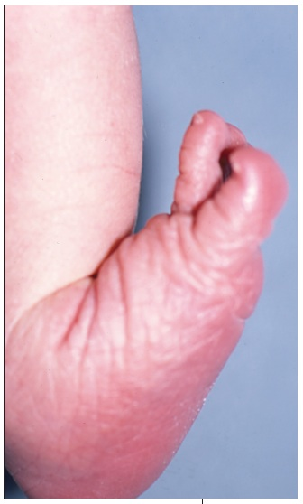
Talipes Calcaneovarus
Excessive dorsiflexion of the foot that allows its dorsum to come into contact with the anterior aspect of the lower leg—the toes point upward, the arch is flat
Talipes | 13
Notes:
Here is a definition for talipes calcaneovarus and a photograph for you review.

Slide 14
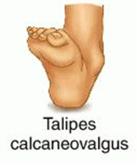
Talipes Calcaneovalgus
The axis of calcaneovalgus deformity is in the tibiotalar joint, where the foot is positioned in extreme hyperextension. The foot has an "up and out" appearance, with the dorsal forefoot practically touching the anterior aspect of the
ankle and lower leg.
Illustration source: http://www.human-phenotype-ontology.org/hpoweb/showterm?id=HP:0001884
Talipes | 14
Notes:
Here is a brief description of talipes calcaneovalgus for your review.

Slide 15

Questions?
If you have questions please send an email to centre@icbdsr.org or to birthdefectscount@cdc.gov
Talipes | 15
Notes:
Thank you very much for listening to this presentation. We hope you had enjoyed it. If you have questions please send an email to centre@icbdsr.org or to birthdefectscount@cdc.gov

