Slide 1
Newborn Examination
Identifying Reportable Congenital Anomalies
Disclaimer: The findings and conclusions in this presentation have not been formally disseminated by the Centers for Disease Control and Prevention and should not be construed to represent any agency determination or policy.
Notes:
[Greetings}
The purpose of this training module is to enable the attendees to confidently examine a newborn and correctly identify and report major external congenital anomalies.

Slide 2

Supplies Needed for the Exam
  Camera to take photographs
  Birth defects data collection form
  Clean gloves to use when examining the neonate
  Tape measure or a measuring board
  A scale to weigh the neonate, and paper/mats on which to place the neonate
  Light source (e.g., flashlight) to visualize the inside of neonate’s mouth and any other areas that need more light

Slide 3

Photographs
If parental consent is required for taking photographs, ensure that you have a consent form with you and ask the parents to sign it before taking photographs
  If parents do not consent to photographs, the neonate should still be included in the surveillance program
When taking photographs, place tape measure beside the neonate or next to the defect, to serve as a reference scale, or place the neonate on the measuring board

Slide 4
The Exam
  Perform the exam as soon after birth as possible
    Note: If the neonate has a birth defect(s) that requires immediate attention, wait until the appropriate moment to do the examination
    An exam usually takes 10-15 minutes
  Wear gloves to complete the exam
  Wash your hands before and after putting on the gloves
  The exam should be performed with the neonate undressed
  Place the neonate on a clean, soft surface in a well-heated area
    Never turn your back on the neonate or leave the neonate alone
  Dress the neonate when the exam is complete
  Consider having an assistant or family member present during the exam to help soothe or pacify the neonate

Slide 5

Describing Findings
If any defects are found during the exam, please make sure you include the following information in the newborn’s file:
A detailed description of the birth defect in the data collection form
Photographs, drawings, and/or illustrations
Any doctor's reports, radiographs, or tests

Slide 6
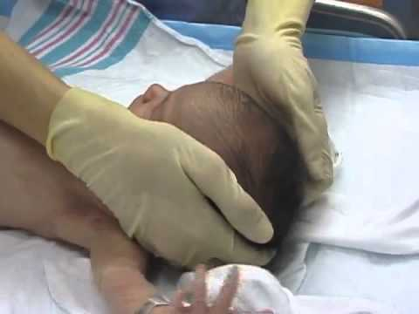
Performing the Exam: Overview
Measure infant weight
Measure infant length
Measure infant head circumference
Examine the head
Examine the body
Examine the limbs

Slide 7
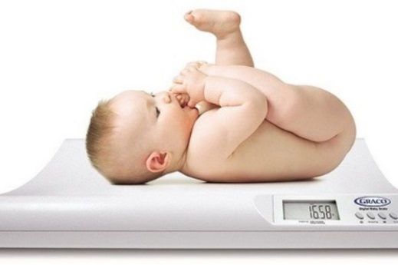
The Exam: Measuring Weight
When weighing the neonate, make sure that all of the equipment is clean
  Be extra careful with neonates who have open defects such as spina bifida, omphalocele, or gastroschisis
If possible, first place a barrier (e.g., paper towel, blanket) between the scale and where the infant will lay
Zero the scale
Place the infant on the scale and record the weight in grams
Source: http://www.zuga.cl/que-es-el-percentil/
Notes:
.

Slide 8
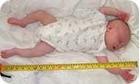
The Exam: Measuring Length
Measure the neonate’s length with a tape measure or measuring board that is marked in centimeters
  If neonate is flexing legs, gently extend legs as flat as possible lengthwise
Clean the measuring board or use a clean tape measure
If possible, place a barrier (paper towel, blanket, etc.) between the measuring surface and the neonate
When measuring the neonate, record the length to the nearest tenth of a centimeter
Source: http://www.embarazoyparto.net/bebes/como-medir-la-talla-del-bebe/
Notes:
.

Slide 9
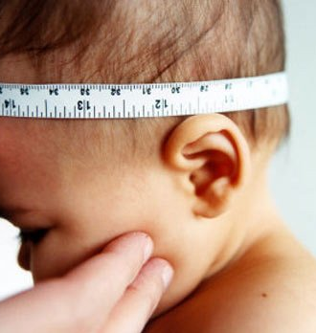
The Exam: Measuring Head Circumference
Look at the neonate’s head
Place a tape measure around the widest part of the head, above the eyebrows and ears
Take special care if the neonate has a defect affecting the head
  Use gloves if defect is open
Record the head circumference to the nearest tenth of a centimeter
Source: http://www.crecerfeliz.es/El-bebe/Primer-mes/Primera-visita-al-pediatra

Slide 10
How to Examine the Head
Gently feel the top, back, and sides of the head
  Note whether there is any absence of brain and/or skull bones
  Note whether brain tissue is bulging
    If yes, note the location of the bulge on the skull
  Note whether the anterior fontanelle (front soft spot) is bulging
    This can be an indication of hydrocephalus
Check the eyes
  Note whether they are present
  Note whether they are of equal size and appear normally spaced
  Note whether cataracts, colobomas (fissure of the iris), cloudy corneas are present
Check the ears
  Note whether they are present
  Note any unusual shape and location
Check the mouth
  Use a light source to check inside the mouth for any abnormalities
  Use a gloved finger to feel the upper palate for any abnormalities
  Note if there are fissures (opening/cleft) in the upper lip and/or at the top of the palate

Slide 11
How to Examine the Body
Check the baby’s chest
  Note any unusual findings (e.g., protruding or sunken breast bone)
Check the umbilical cord
  Note if there is protrusion of organs into the cord or next to the cord
Check the baby’s back
  Note if there are any protrusions of the spinal cord
Check the baby’s genitalia
  Note any unusual findings (e.g., hypospadias)
Check the skin
  Note any colored markings, or raised bumps – if present, note size, color, location, whether it's a flat discoloration or raised, whether hair is present

Slide 12
How to Examine the Limbs
Check for overall tone and movement
  Note whether the neonate is moving all limbs
Check the upper limbs
  Note whether there are any missing segments
  Note whether limb(s) are of an unusual shape
  Note the number of fingers, position of hands, any abnormalities of hands/fingers
Check the lower limbs
  Note whether there are any missing segments
  Note whether limb(s) are of an unusual shape
  Note any abnormalities with feet or toes
  Note position of feet
    If abnormal position of foot, check to see if it is rigid or moveable

Slide 13
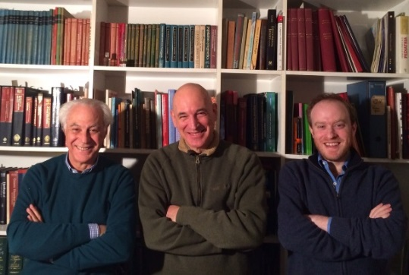
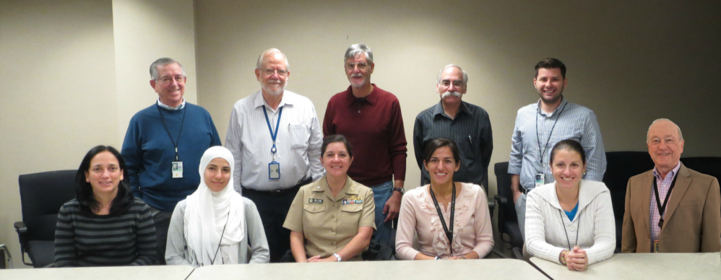
Acknowledgements
International Clearinghouse on Birth Defects Surveillance and Research
  Pierpaolo Mastroiacovo
  Lorenzo Botto
  Boris Groisman
CDC National Center on Birth Defects and Developmental Disabilities
  Surveillance Working Group
Pictured top, left to right: Jaime Frías, RJ Berry, Joseph Mulinare, Jorge Rosenthal, Ibrahim Zaganjor
Pictured bottom, left to right: Diana Valencia, Ahlia Sekkarie, Jennifer Williams, Hilda Razzaghi, Alina Flores, J. Fernando Arenas
Not pictured: Michael Cannon, Yan Ping Qi, Christina Hillard
Notes:
13
13
13

Slide 14
Descriptions of Select Reportable Congenital Malformations that Might be Seen during Newborn Exam
Advanced Slide-set
Newborn Examination
Disclaimer: The findings and conclusions in this presentation have not been formally disseminated by the Centers for Disease Control and Prevention and should not be construed to represent any agency determination or policy.

Slide 15
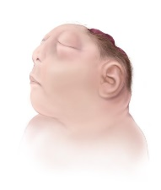
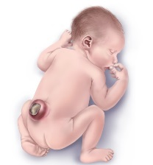
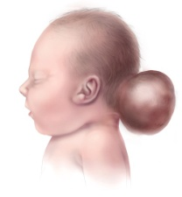
Neural Tube Defects
Checklist
Describe in detail (see below for specific recommendations)
Include photographs: useful for diagnosis and review
Describe additional malformations, if present
Specify consultations: particularly genetics and neurosurgery
Specific recommendations
Spina bifida:
  Level of lesion: e.g., T6-T9 or midthoracic, etc.
  Presence/absence of hydrocephalus and talipes
  Presence/absence of skin or membrane covering the defect
  Associated anomalies
  Report from neurosurgery, if available
Anencephaly:
  Distinguish from acrania (absent skull bones with all brain present), and from acephaly in monozygotic twins (recipient twin has acardia-acephaly)
  Associated anomalies (uncommon)
Encephalocele
  Location: occipital, nasal, frontal, orbital, parietal
  Associated anomalies: more common in encephalocele than in spina bifida or anencephaly
  Report from neurosurgery, if available
Coding: ICD-10 or ICD-10 RCPCH (Royal College of Paediatrics and Child Health)
anencephaly: Q00.XX
encephalocele: Q01.XX
spina bifida: Q05.XX
General guidelines: include details for 4th and 5th digits, and avoid only using general codes (e.g., “Q00”, “Q01”, “Q05”)
Notes
Talipes: often present with spina bifida, code it separately (Q66.X)
Craniorachischisis: anencephaly with a contiguous spinal defect without meninges covering the neural tissue is cranioraschischisis: code as single defect (Q00.1). However, if the neural tube defects are not contiguous, code each defect separately.
Do not include: spina bifida occulta (Q76.0), atypical defects (usually due to amniotic bands), acrania, or acephaly.
Examples
Anencephaly
(Q00.00)
Lumbosacral
spina bifida
(Q05.7)
Occipital
encephalocele
(Q01.2)

Slide 16
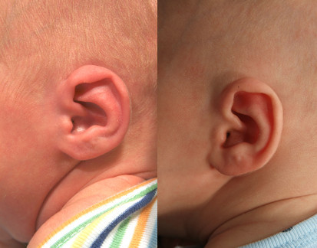
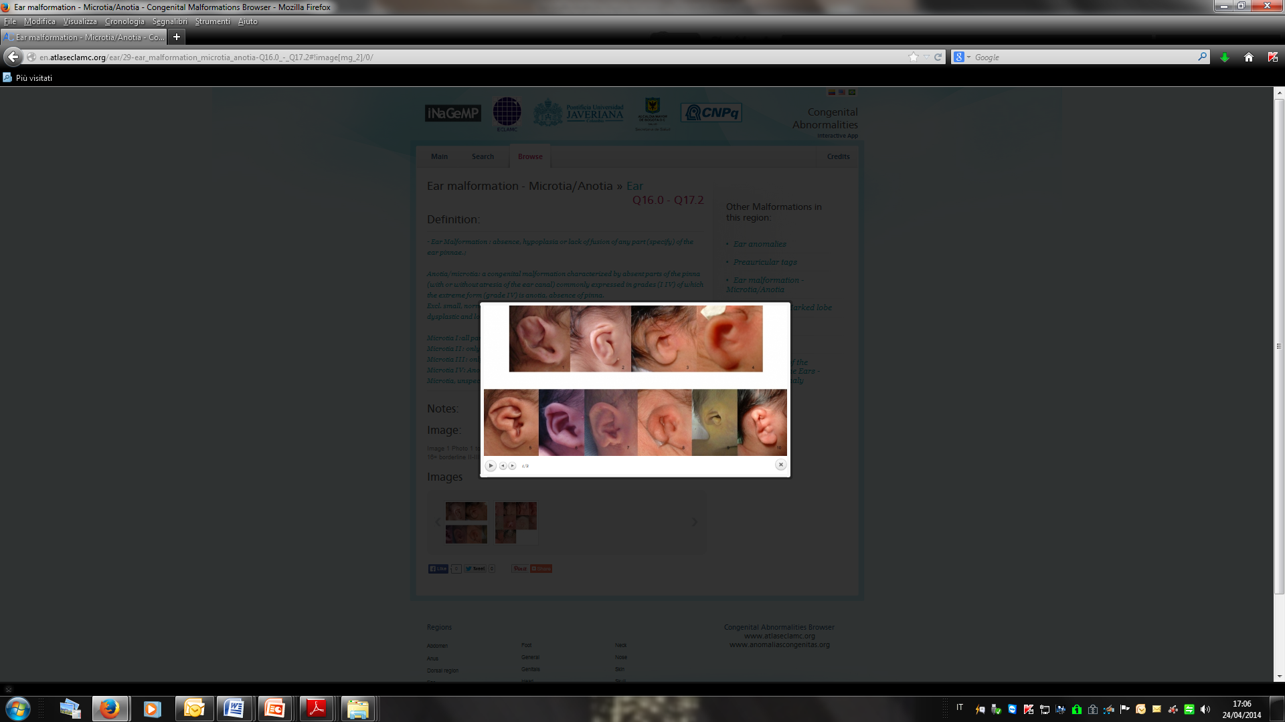
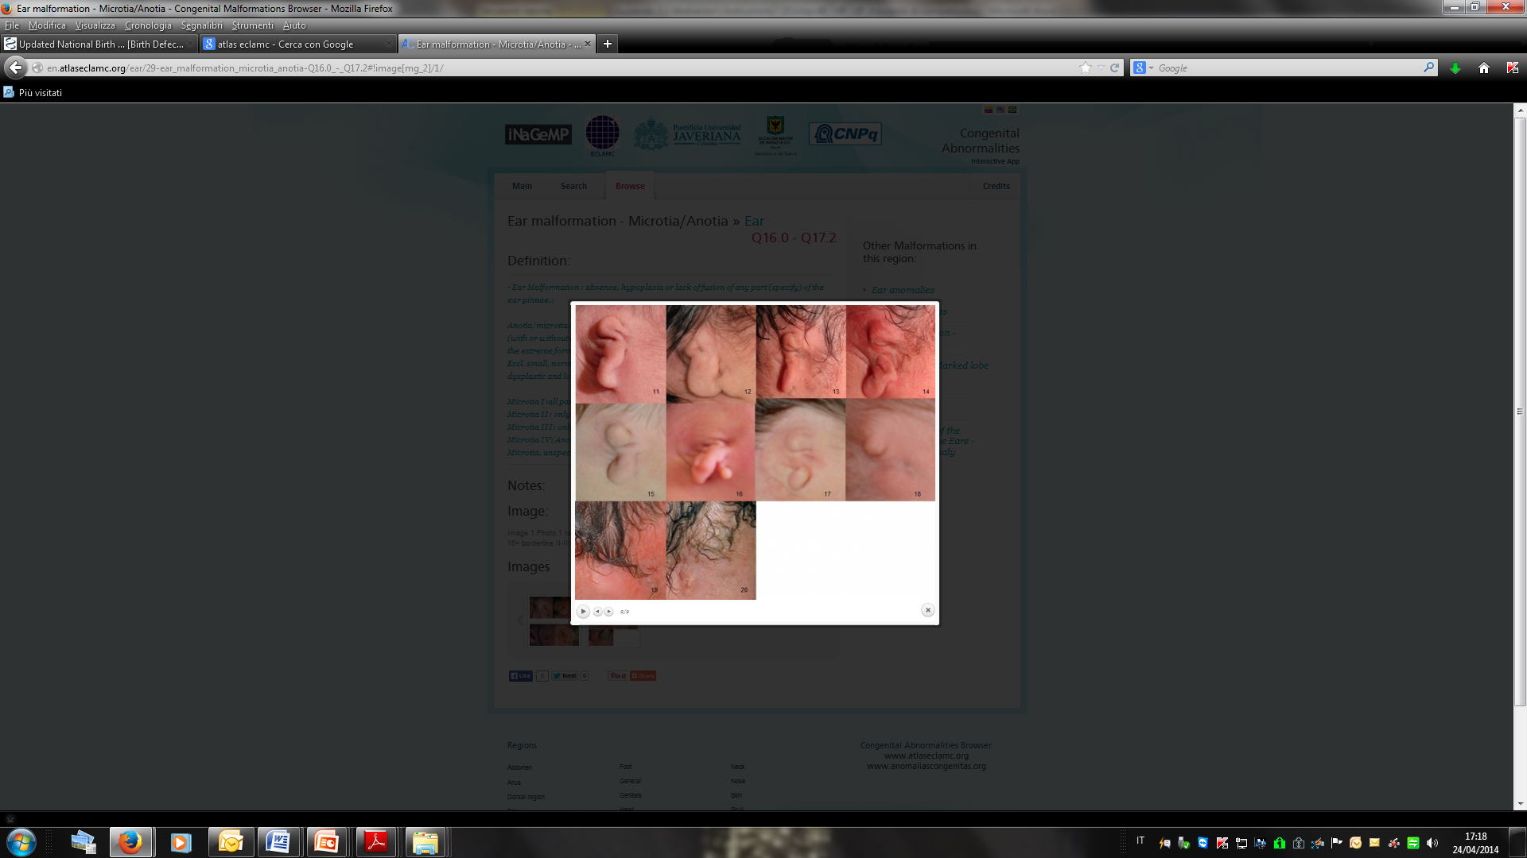
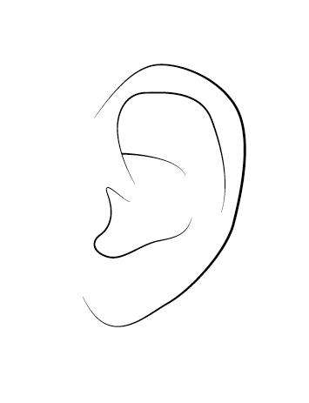
Microtia – Anotia
Coding
Choose image (left)
closest to case
If photo is unavailable, draw malformation (use drawing below as template)
2.7 cm
Normal: 3-4cm
Microtia I
Q17.21
Microtia II
Q17.22
Microtia III
Q17.23
Microtia IV /Anotia
Q16.0
Photographs: http://www.earmolding.org/photo-gallery/lidding/ & http://en.atlaseclamc.org.
Checklist
Identify severity (type I-IV) and laterality (L-R-Bilateral)
  Microtia type I – a small, but normally formed ear; usually considered a minor anomaly; check protocol
Take photographs, side and front
Check for (and if present, describe)
  Preauricular tag or pits (describe, code)
  Down-slanting palpebral fissures, small jaw, eyelid coloboma
  Cervical vertebral anomalies (radiograph recommended)
  Kidney ultrasound (only if multiple congenital anomalies or possible syndromes)
  Atresia choanae, coloboma iris or retinae, genital anomalies, heart defects
  Any other major anomaly
Report any additional specialty consultation(s) and results
http://tiny.cc/ik5pby
Notes:
Original link for the two drawings: http://design.tutsplus.com/tutorials/how-to-illustrate-dynamic-hair-using-adobe-illustrators-paintbrush-tool--vector-3846

Slide 17
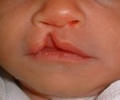
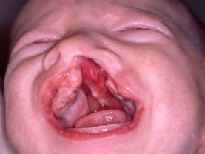
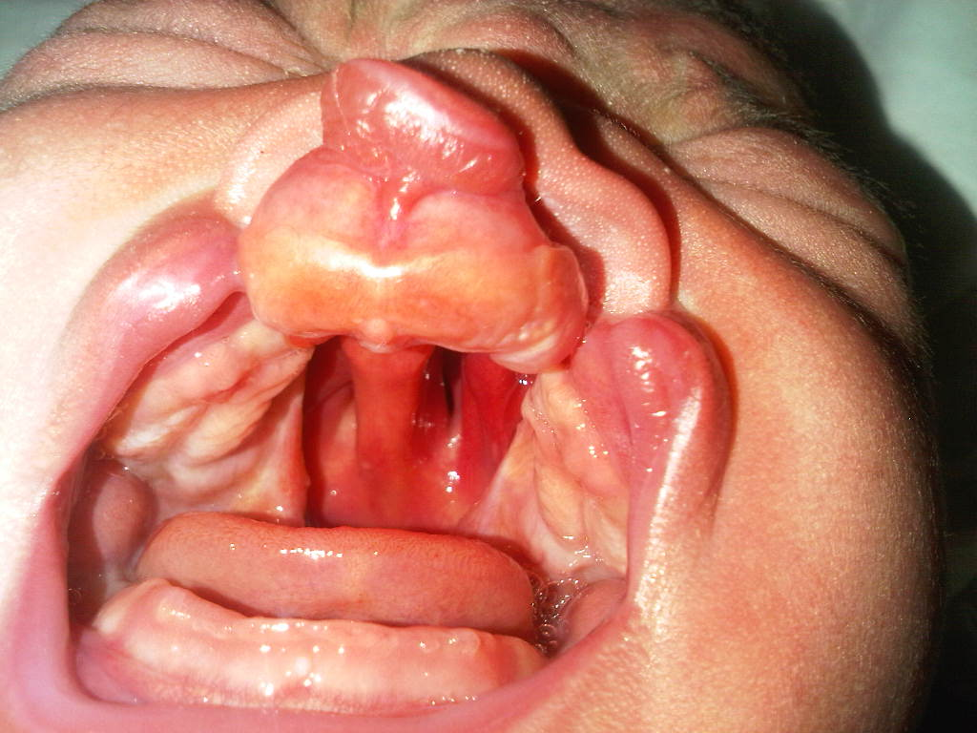
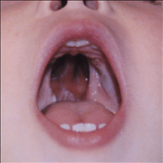
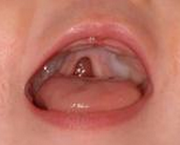
Cleft Palate (CP), Cleft Lip (CL), Cleft Lip and Palate (CLP)
Checklist
Coding: ICD-10 or ICD-10 RCPCH
Describe in detail:
  Laterality: right, left, or bilateral
  Lower lip: pits present or absent
  Extension of the cleft lip: minimum, partial or total; any involvement of the gum and nasal sill
  Extension of cleft palate: hard and/or soft
  Shape of cleft palate; “U” shape or “V” shape
  Significant micrognathia or glossoptosis: present or absent
Additional anomalies: describe evaluations and
findings
Photographs: very useful, can be crucial for review
Specialty consultations: report which were done (including genetics) and results
Q35.XX : cleft palate
Q36.XX : cleft lip
Q37.XX : cleft lip and palate
Include 4th and 5th digits: avoid only using general
codes (e.g., “Q35”, “Q36” or “Q37”)
Do not include in the group the following conditions:
  median cleft lip (Q36.1)
  cleft uvula (Q35.7)
  facial fissures (oro-orbital, oro-auricular)
  atypical facial clefts
Unilateral CL (Q36.90)
Cleft hard and soft palate with unilateral CL (Q37.50)
Cleft hard and soft palate with bilateral CL (Q37.4)
Cleft hard palate (Q35.1)
Cleft soft palate (Q35.3)

Slide 18
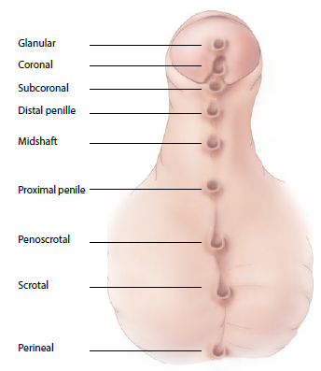
Hypospadias
Checklist
Identify position of external meatus
Use illustration (right): check the box and use the associated term
Use most specific code: add 5th digit if needed
Chordae: present (Q54.4) or absent
Cryptorchidism: present (unilateral Q53.1 or bilateral Q53.2) or absent
Take photograph: show clearly the urethral meatus (may be challenging)
Associated malformations: describe evaluations done and findings
Specialty consultation(s): report if done (including genetics, surgery, urology) and results
Coding: ICD-10 or ICD-10 RCPCH
Q54 Hypospadias
Avoid using just the general code: be specific
Q54.0
Q54.1
Q54.2
Q54.3

Slide 19
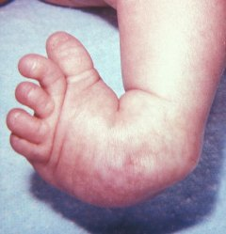
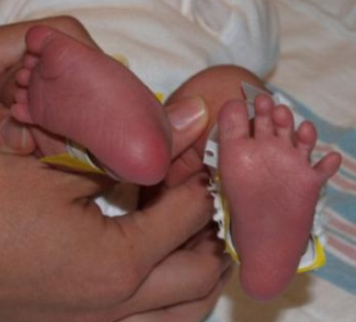
Clubfoot: Talipes Equinovarus
Checklist
Coding: ICD-10 or ICD-10 RCPCH
Describe the presentation precisely, including:
  Laterality: right, left, or bilateral
  Mobility of foot: rigid vs. flexible (flexible is the same as positional, and excluded in most surveillance systems)
Photograph: useful for review, not sufficient as
confirmation
Additional anomalies: describe evaluations and
findings
Specialty consultations: report which were done (including genetics and orthopedics) and results
Notes
Flexible/positional talipes equivarus: exclude
  Except if specifically included in protocol: inclusion discouraged because of variability, frequency, and minor health impact
Talipes calcaneovarus and calcaneovalgus: usually not considered an eligible birth defect (provide clear rule in protocol)
Q66 Congenital deformities of feet
(avoid using this general code if
more specific information is
available)
Q66.0 Talipes equinovarus
Q66.1 Talipes calcaneovarus
Q66.4 Talipes calcaneovalgus
Q66.8 Other congenital deformities of feet; clubfoot unspecified
Talipes equinovarus
Talipes calcaneovalgus

Slide 20
Limb Deficiencies
Checklist
Use figures provided: select type most similar to case
Describe in detail (not only “diagnostic term”):
  Note each segment involved (see figures) for each limb affected; describe what is deficient or absent
  Laterality: right, left, or bilateral
  Soft tissue nubbins: present vs. absent (in transverse defects)
  Amniotic band and/or soft tissue ring constriction: present vs. absent
Photographs: crucial for review and classification
Radiographs: crucial for review and classification (at times even more than photographs)
Additional anomalies: describe evaluations and findings
  Also note structures evaluated and found normal: (i.e., heart, kidneys, gastrointestinal system, genitalia)
Specialty consultations: report which were done (including genetics and orthopedics) and results
Coding
ICD-10 or ICD-10 RCPCH
Use figures on the next four slides to identify the most similar to the observed case

Slide 21
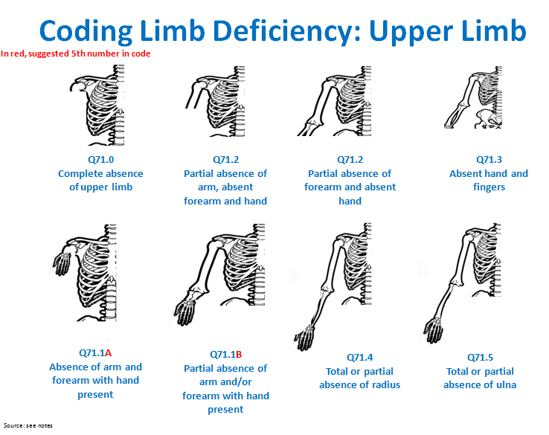
Notes:
Modified from: Bedard T, Lowry RB, Sibbald B, Kiefer GN, Metcalfe A. Congenital limb deficiencies in Alberta-a review of 33 years (1980-2012) from the Alberta Congenital Anomalies Surveillance System (ACASS). Am J Med Genet A. 2015 Nov;167A(11):2599-609.

Slide 22
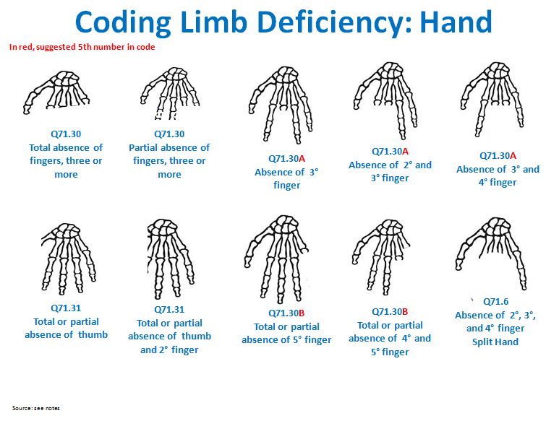
Notes:
Modified from: Bedard T, Lowry RB, Sibbald B, Kiefer GN, Metcalfe A. Congenital limb deficiencies in Alberta-a review of 33 years (1980-2012) from the Alberta Congenital Anomalies Surveillance System (ACASS). Am J Med Genet A. 2015 Nov;167A(11):2599-609.

Slide 23
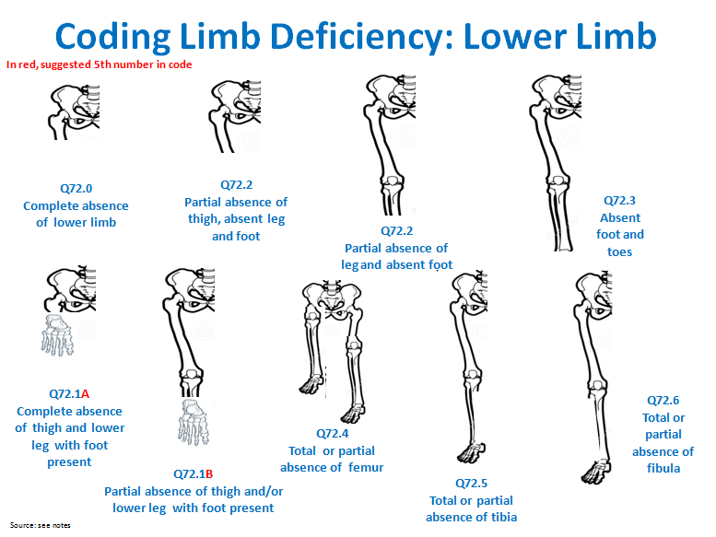
Notes:
Modified from: Bedard T, Lowry RB, Sibbald B, Kiefer GN, Metcalfe A. Congenital limb deficiencies in Alberta-a review of 33 years (1980-2012) from the Alberta Congenital Anomalies Surveillance System (ACASS). Am J Med Genet A. 2015 Nov;167A(11):2599-609.

Slide 24
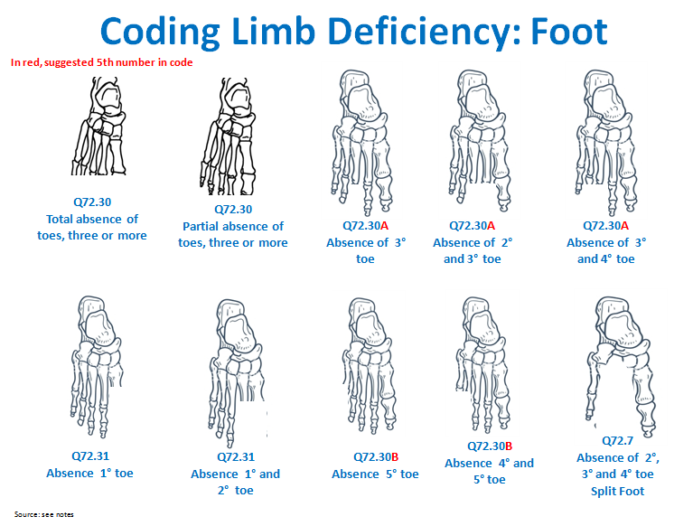
Notes:
Modified from: Bedard T, Lowry RB, Sibbald B, Kiefer GN, Metcalfe A. Congenital limb deficiencies in Alberta-a review of 33 years (1980-2012) from the Alberta Congenital Anomalies Surveillance System (ACASS). Am J Med Genet A. 2015 Nov;167A(11):2599-609.

Slide 25
Limb Deficiency Coding and Classification Tool
Provides a mapping from codes to the main classification groups for analysis
Code | Upper limb | Code | Lower limb
Q71.0 | Transverse terminal | Q.72 | Transverse terminal
Q71.1A | Transverse intercalary, typical phocomelia | Q72.1A | Transverse intercalary, typical phocomelia
Q71.1B | Transverse intercalary, atypical phocomelia | Q72.1B | Transverse intercalary, atypical phocomelia
Q71.2 | Transverse terminal | Q72.2 | Transverse terminal
Q71.3 | Transverse terminal | Q72.3 | Transverse terminal
Q71.30 | Transverse terminal | Q72.30 | Transverse terminal
Q71.30A | Transverse terminal | Q72.30A | Transverse terminal
Q71.30B | Transverse terminal | Q72.30B | Transverse terminal
Q71.4 | Longitudinal preaxial | Q72.4 | Longitudinal preaxial
Q71.31 | Longitudinal preaxial | Q72.31 | Longitudinal preaxial
Q71.5 | Longitudinal postaxial | Q72.5 | Longitudinal preaxial
Q71.6 | Longitudinal axial, split hand | Q72.6 | Longitudinal postaxial
 |  | Q72.7 | Longitudinal axial, split foot

Slide 26
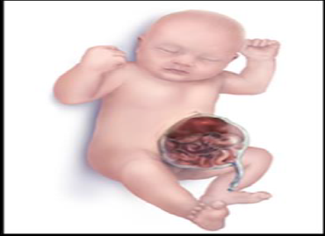
Omphalocele
Checklist
Describe in detail: do not limit to using “omphalocele” but add detail on the following elements
  Cord insertion: describe if midline, over umbilicus
  Covering membranes: yes/no, intact/ruptured
  Size: measure/estimate (in centimeters)
  Extruded organs: small intestine, liver, spleen, etc.
  Photographs: show clearly umbilical cord/membrane
Associated defects: describe in detail
Syndromes: if known, describe (e.g., Beckwith-Wiedemann syndrome) or, if not known, describe relevant minor anomalies
Procedures: describe procedures to assess additional malformations
Specialty consultations: report which were done (including genetics, surgery) and results
Code ICD-10 RCPCH
Q79.2: Omphalocele
Describe the three most important features:
midline defect, insertion through cord, membrane

Slide 27
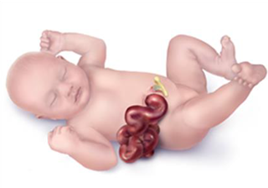
Gastroschisis
Checklist
Describe in detail: do not limit to using “gastroschisis” but add detail on the following elements
  Side relative to the umbilical cord: right/left
  Covering membranes: yes/no
  Size: extension of the abdominal defect (in cm)
  Extruded organs: specify also bowel segment involved
Associated defects: describe
  Photographs: show clearly the umbilical cord
Procedures: describe procedures to assess additional malformations
Specialty consultations: report which were done (including genetics and surgery) and results
Code ICD-10 RCPCH
Q79.3: Gastroschisis
Describe the two most important features: defect and umbilical cord

Slide 28
Down Syndrome
Checklist
Karyotype available: report results
Karyotype not available:
  Check clinical signs (see right) on which diagnosis was based
  Take photographs
In all cases, report :
Associated malformations
Specialty consultations: including genetics, cardiology and results
Check for the presence of the following signs
General
Hypotonia
Head/Neck
Brachycephaly
Large anterior fontanel
Short neck
Excess nuchal skin
Protruding tongue
Narrow palate
Flat nasal bridge
Upslanting palpebral fissures
Epicanthal folds
Nystagmus
Brushfield spots on iris
Small ears (<3cm)
Overfolded helix (ear)
Chest
Absent breast buds
Extremities
Short broad hands
5th finger clinodactyly
5th finger single flexion crease
Single palmar crease
Wide gap between 1st and 2nd toes
Coding ICD-10 RCPCH
Q90 Down syndrome
Q90.0 Trisomy 21, meiotic nondisjunction
Q90.1 Trisomy 21, mosaicism (mitotic nondisjunction)
Q90.2 Trisomy 21, translocation
Q90.9 Down syndrome, unspecified
Karyotype available
Clinical diagnosis, only

Slide 29
Acknowledgements
International Clearinghouse on Birth Defects Surveillance and Research
  Pierpaolo Mastroiacovo
  Lorenzo Botto
  Boris Groisman
CDC National Center on Birth Defects and Developmental Disabilities
  Surveillance Working Group
Pictured top, left to right: Jaime Frías, RJ Berry, Joseph Mulinare, Jorge Rosenthal, Ibrahim Zaganjor
Pictured bottom, left to right: Diana Valencia, Ahlia Sekkarie, Jennifer Williams, Hilda Razzaghi, Alina Flores, J. Fernando Arenas
Not pictured: Michael Cannon, Yan Ping Qi, Christina Hillard
Notes:
29
29
29

