Slide 1
Omphalocele
Presenter
Notes:
This presentation is about omphalocele. You might have already seen the presentation on gastroschisis. Information in this presentation is important for both topics.

Slide 2
Learning Objectives
By the end of this presentation participants will be able to
Describe clinical features of omphalocele
Understand main epidemiological features of omphalocele
Apply helpful tips for coding and reporting
Onfalocele | 2
Notes:
By the end of this presentation, participants will be able to 1) Describe clinical features of omphalocele; 2) understand the main epidemiological features of omphalocele, and; 3) Apply helpful tips for coding and reporting.

Slide 3
Main Developmental and Clinical Features
Feature | Typical Findings
Embryology | Abnormal persistence of intestine through the umbilical ring. Normally midgut elongates into the base of body stalk after 6 week and returns to the abdominal cavity by 12 weeks
Associated malformations (*) | 30-70%; chromosome abnormalities 12-29%; other syndromes/complexes 10-15%
Syndromes | Beckwith-Wiedemann, Donnai-Barrow, Fryns Trisomy 18 and 13
(*) Abnormalities of bowel as malrotation, bowel atresia not considered as associated
Omphalocele | 3
Notes:
During the 6th week of development, the midgut undergoes a physiologic herniation through the umbilicus at which time intestinal rotation and elongation occurs. Around weeks 10 to 12, the midgut returns into the abdominal cavity where it assumes its normal anatomical position. Omphalocele represents a disturbance in this process, but the exact mechanism by which this occurs is not known.
Infants with omphalocele often have other birth defects including chromosomal abnormalities such as trisomy 18 and 13 and other syndromes or complexes. Examples of syndromes associated with omphalocele include Beckwith-Wiedemann, a congenital growth disorder characterized by large body size, large tongue (macroglossia), and large abdominal organs among other anomalies. Donnai-Barrow, a rare, often severe, multiple congenital malformation syndrome with typical facial dysmorphism, ocular findings, hearing loss, agenesis of the corpus callosum, and variable intellectual disability. And Fryns syndrome, another genetic condition, characterized by congenital diaphragmatic hernia, short, stubby fingers and toes, and distinctive facial features.

Slide 4
Main Epidemiological Features
Feature
Prevalence | *U.S.: 1 per 5,386 babies born in the United States each year is born with an omphalocele 2.5-3.0 per 10,000
Variability of prevalence | Misclassification with gastroschisis, cloacal exstrophy, limb-body wall complex. Inclusion/exclusions ETOPFA chromosome. Higher prevalence in non-hispanic black; lower in Asians, including Japanese
Modifiable risk factor | Pregestational diabetes, obesity; folic acid insufficiency?
* Source: (http://www.cdc.gov/ncbddd/birthdefects/omphalocele.html#ref)
Omphalocele | 4
Notes:
Omphalocele occurs in approximately 3 in 10000 live births. Misclassification with gastroschisis, cloacal exstrophy, limb-body wall complex, and the inclusion or exclusion of ETOPFAs all contribute to the variability in observed prevalence of omphalocele. A higher prevalence of omphalocele is observed among non-Hispanic Blacks, while lower prevalence is found among Asians. A higher risk of omphalocele has been associated with pregestational diabetes, obesity, and, not with strong evidence, in folic acid insufficiency.

Slide 5
Diagnosis
Omphalocele is easily recognized on physical examination after delivery
Differential diagnosis must be done with:
Umbilical hernia: always covered by skin
Gastroschisis: umbilical cord is in its normal position and not part of the defect, there is not a membrane covering the herniated intestine
Pentalogy of Cantrell
Cloaca exstrophy
Limb body wall complex
Prenatal diagnoses not confirmed postnatally
Since may be difficult to distinguish omphalocele from gastroschisis on prenatal ultrasound the diagnosis should not be included without postnatal confirmation
Omphalocele | 5
Notes:
Omphalocele is usually easily diagnosed upon physical examination of the newborn at delivery. However, careful assessment is necessary to differentiate omphalocele from umbilical hernia, gastroschisis, pentalogy of Cantrell, cloaca exstrophy, and limb body-wall complex. Because it may be difficult to distinguish omphalocele from gastroschisis on prenatal ultrasound, all prenatal diagnoses should be confirmed postnatally.

Slide 6
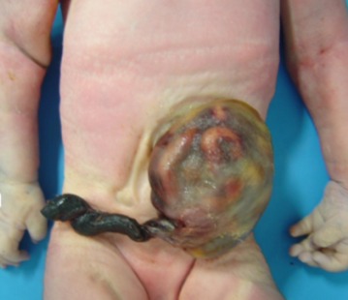
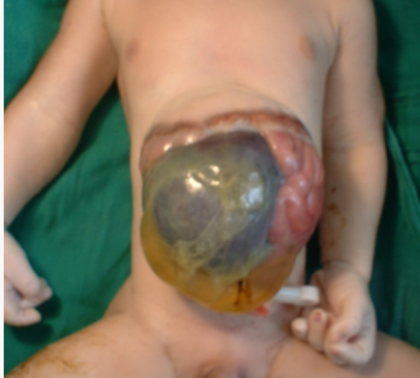
Variability of size, content, location
Size: Small: < 4 cm diameter Medium: 4-6 cm diameter Giant: > 6 cm diameter
Content: Only intestines or Intestines and liver
Location: central - most common
high - rare
low - very rare
Photos courtesy of: http://en.atlaseclamc.org
Omphalocele | 6
Notes:
The size of omphaloceles ranges from small (less than 4 cm in diameter) to medium (4 to 6 cm), and giant (over 6 cm), with small- and medium-size being more common than giant omphaloceles. The content also varies; small- and medium-sized omphaloceles tend to only have herniation of intestines, whereas giant-sized omphaloceles usually have herniation of intestines and intraabdominal organs. The location of omphaloceles is usually central, but may be high in rare cases and exceptionally have a low position.

Slide 7
Tips for reporting
Describe the defect, specifying organs outside the abdomen
Describe the umbilical cord status, may be ruptured
A photograph should be taken, useful for review
Describe additional malformations, if present, and procedures used to assess them
Indicate whether a clinical geneticist was consulted
Omphalocele | 7
Notes:
When reporting an omphalocele in the data collection form, be sure to describe the defect and specify the organs herniated outside the abdomen. Please describe the status of the umbilical cord and whether the covering membrane is ruptured. If possible, a photograph should be taken. If present, additional malformations and any procedures used for their assessment should be described. Any consultation with a clinical geneticist should also be indicated.

Slide 8
ICD-10 RCPCH List and coding of Omphalocele
Q79 Congenital malformations of the musculoskeletal system, not elsewhere classified Excludes: congenital (sternomastoid) torticollis (Q68.0)
Q79.0 Congenital diaphragmatic hernia Excludes: congenital hiatus hernia (Q40.1)
Q79.00 Congenital anterior (foramen of Morgagni) hernia
Q79.01 Congenital posterolateral (foramen of Bochdalek) hernia
Q79.1 Other congenital malformations of diaphragm Congenital malformation of diaphragm NOS
Q79.10 Congenital eventration of diaphragm
Q79.11 Congenital absent hemidiaphragm, (unilateral)
Q79.12 Congenital absent diaphragm Congenital absent hemidiaphragm, bilateral
Q79.2 Exomphalos Omphalocele Excludes: umbilical hernia (K42.-)
Q79.3 Gastroschisis
Q79.4 Prune belly syndrome
Q79.5 Other congenital malformations of abdominal wall Excludes: umbilical hernia (K42.-)
Q79.6 Ehlers-Danlos syndrome
Q79.8 Other congenital malformations of the musculoskeletal system Accessory muscle Popliteal web syndrome Congenital shortening of tendon Excludes: achilles tendon (Q66.81)
Q79.80 Congenital constriction bands
Q79.81 Absence of muscle and/or tendon
Q79.82 Poland's anomaly [syndrome]
Q79.9 Congenital malformation of musculoskeletal system, unspecified Congenital: .anomaly NOS } .deformity NOS} of musculoskeletal system NOS Unspecified anomalies of muscle, tendon, bones, cartilage or connective tissue
Omphalocele | 8
Notes:
This slide lists ICD-10 codes for omphalocele along with codes for associated syndromes and differential diagnoses.

Slide 9
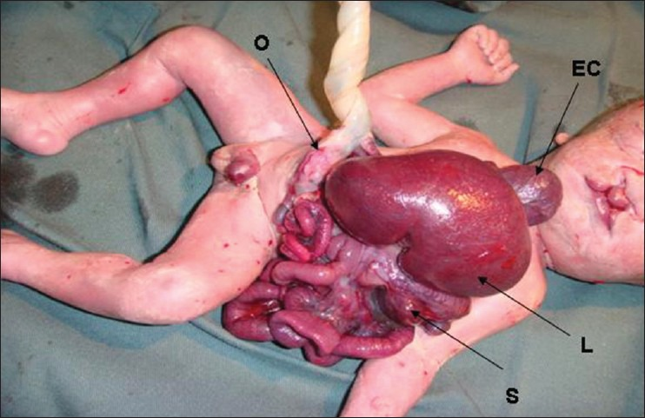
Pentalogy of Cantrell
Upper midline abdominal wall abnormality
Lower sternal defect
Anterior diaphragmatic defect
Heart abnormalities: ectopia, pericardial defect
Omphalocele, high
EC – ectopia cordis; L – liver; S – spleen; O – omphalocele
Photo courtesy of: Chandran S, Ari D. J Clin Neonatol. 2013 Apr;2(2):95-7.
Omphalocele | 9
Notes:
Pentalogy of Cantrell is a rare congenital pattern of malformation characterized by a combination of defects affecting the upper midline of the abdominal wall, the sternum, diaphragm, pericardium, the heart. Pentalogy of Cantrell occurs with varying degrees of severity, potentially causing severe, life-threatening complications. Most infants do not develop all of the defects and the variability of the disorder from one individual to another can be significant. The exact cause of pentalogy of Cantrell is unknown. Most cases are sporadic.

Slide 10
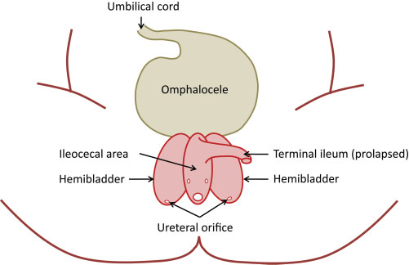
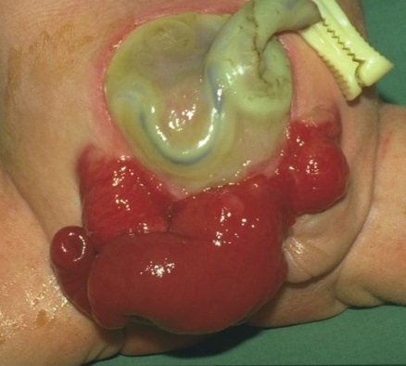
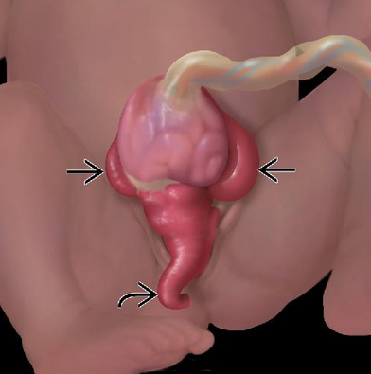
Cloacal Exstrophy
The cardinal findings of cloacal exstrophy
include exstrophy of the hemibladders
with hindgut extrusion and imperforate anus
Feldkamp ML et al. Am J Med Genet C Semin Med Genet. 2011 Nov 15;157C(4):333-43.
Figure 1
Figure 2
Referred to as OEIS complex:
Omphalocele
Exstrophy of the bladder or cloaca
Imperforate anus
Spinal defects
to simplify the common components observed in infants with cloacal exstrophy
Prevalence: 0.76 per 100,000
Feldkamp ML et al. Cloacal exstrophy: an epidemiologic study from the International Clearinghouse for Birth Defects Surveillance and Research.
Am J Med Genet C Semin Med Genet. 2011 Nov 15;157C(4):333-43.
Figure 1 courtesy of http://cai.md.chula.ac.th/lesson/atlas/N/ImgBig/
Figure 2 courtesy of http://pediatricimaging.wikispaces.com/Smith-001-Cloacal+Exstrophy
Omphalocele | 10
Notes:
The cloacal exstrophy complex is a rare pattern of malformation (prevalence ranges from 1 in 200,000 to 400,000 births) that characterized by a spectrum of anomalies that includes omphalocele, exstrophy of the cloaca, imperforate anus, phallic separation with epispadias, pubic diastasis, and spinal defects. This condition is also refer to as the OEIS complex, even though this may have either exstrophy of the bladder or exstrophy of the cloaca.

Slide 11
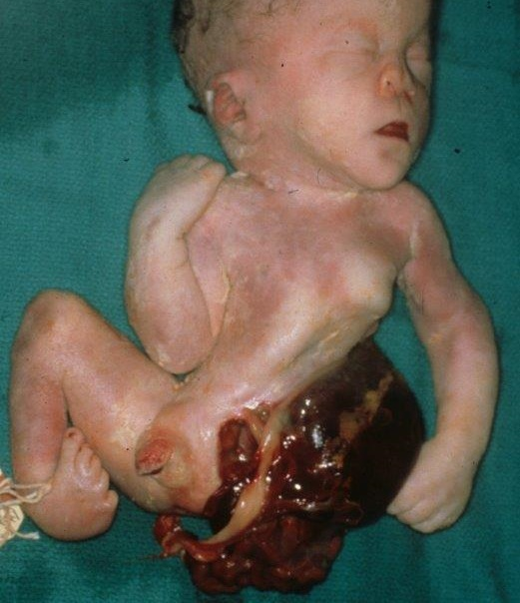
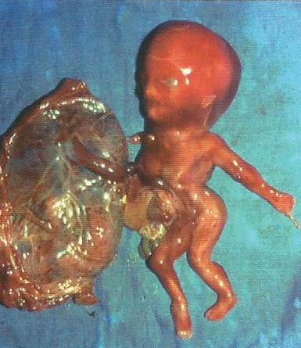
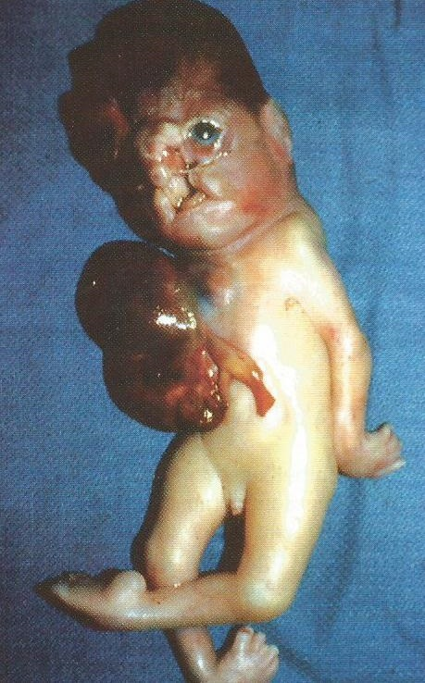
Limb Body Wall Complex
Photos courtesy of: Jones LK, Jones CM, del Campo M. Smith’s Recognizable Patterns of Human Malformations. Elsevier Saunders. 2013
Thoraco- and/or abdominoschisis and limb deficiency, frequently associated with atypical exencephaly/encephalocele and atypical facial clefts; High frequency of associated malformations
Omphalocele | 11
Notes:
A complex anomaly involving lateral body wall defects, limb reduction defects, and occasionally neural tube defects, heart defects, and other anomalies.

Slide 12
ICD-10 RCPCH List and coding of Abdomen and anterior thorax wall defects
Q24.8 Other specified congenital malformations of the heart Ectopia cordis
Q64 Other congenital malformations of urinary system
Q64.0 Epispadias Excludes: hypospadias (Q54.-)
Q64.1 Exstrophy of urinary bladder Ectopia vesicae Extroversion of bladder
Q64.10 Cloacal exstrophy Ectopia cloacae
Q76.7 Congenital malformation of sternum Misshapen sternum
Excludes: pectus excavatum (Q67.6) pectus carinatum (Q67.7)
Q76.70 Congenital absence of sternum
Q76.71 Sternum bifidum
Q76.78 Other specified congenital malformation of sternum
Q76.8 Other congenital malformations of bony thorax
Q76.9 Congenital malformation of bony thorax, unspecified
Q79.2 Exomphalos Omphalocele Excludes: umbilical hernia (K42.-)
Q79.3 Gastroschisis
Q79.4 Prune belly syndrome
Q79.5 Other congenital malformations of abdominal wall
Part of pentalogy of Cantrell
Omphalocele | 12
Notes:
This slides lists ICD-10 RCPCH codes for some of the anomalies that may be found in the conditions previously discussed.

Slide 13
Tips for Coding
Omphalocele, gastroschisis, prune belly; ectopia cordis and anterior thorax abnormalities; bladder exstrophy, cloaca exstrophy have their own code
OEIS complex, limb-body wall complex, pentalogy of Cantrell does not have its own code and may be coded within the generic Q87.8: Other specified congenital malformation syndromes, not elsewhere classified, with a specific local extension or adding OMIM or Orphanet Codes
If the diagnosis of omphalocele was not confirmed the code Q79.5 should be used
Omphalocele | 13
Notes:
Please note that omphalocele, gastroschisis, prune belly; ectopia cordis and anterior thorax abnormalities; bladder exstrophy, cloaca exstrophy have their own code. OEIS complex, limb-body wall complex, pentalogy of Cantrell do not have their own codes and may be coded within the generic Q87.8: Other specified congenital malformation syndromes, not elsewhere classified, with a specific local extension or adding OMIM or Orphanet Codes. If the diagnosis of omphalocele was not confirmed the code Q79.5 should be used.

Slide 14
Questions?
If you have questions please send an email to centre@icbdsr.org or to birthdefectscount@cdc.gov
Omphalocele | 14
Notes:
Thank you very much for listening to this presentation. We hope you had enjoyed it. If you have questions please send an email to centre@icbdsr.org or to birthdefectscount@cdc.gov

