Slide 1
Orofacial Clefts
Disclaimer: The findings and conclusions in this presentation have not been formally disseminated by the Centers for Disease Control and Prevention and should not be construed to represent any agency determination or policy.

Slide 2
Learning Objectives
By the end of this presentation participants will be able to
Recognize the different types of orofacial clefts
Describe clinical features of orofacial clefts
Understand some epidemiological features of orofacial clefts
Apply tips for coding and reporting
Orofacial Clefts | 2
Notes:
By the end of this presentation you should be able to:
Recognize the different types of orofacial clefts, describe their clinical features understand some of their main epidemiological features, and apply tips for coding and reporting that we will review later.

Slide 3
Anatomy of the Lip
Nasal sill
Philtrum
Vermillion
Cupid’s bow
Photo courtesy of Alina Flores
Orofacial Clefts | 3
Notes:
This picture depicts anatomical features in the orofacial area that are usually mentioned when discussing the anatomy of orofacial clefts. These include the philtrum, nasal sill, Cupid’s bow and the vermillion.

Slide 4
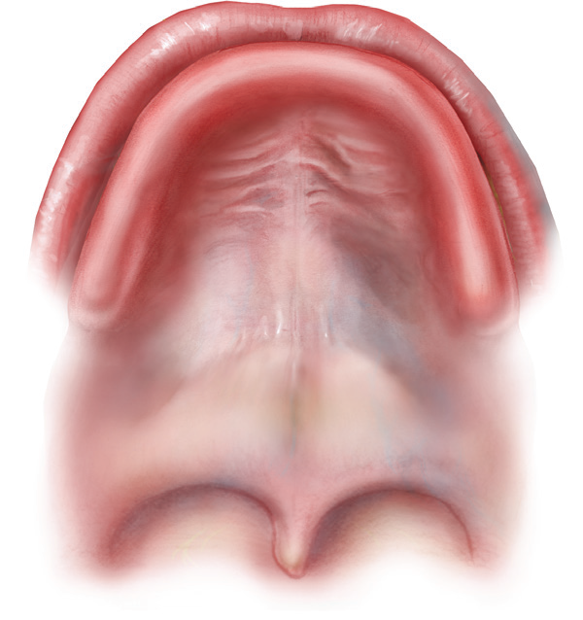
Anatomy of the Palate
Primary palate
Lip
Alveolar ridge (Gum)
Incisor foramen
Hard palate
Secondary palate
Soft palate
Uvula
Orofacial Clefts | 4
Notes:
This sketch shows the anatomy of the palate. You can see the primary palate, which is the triangular area in front of the incisor foramen, including part of the alveolar ridge, and the secondary palate, which extends from the incisor foramen to the uvula. The secondary palate is divided into the hard and soft palate.

Slide 5
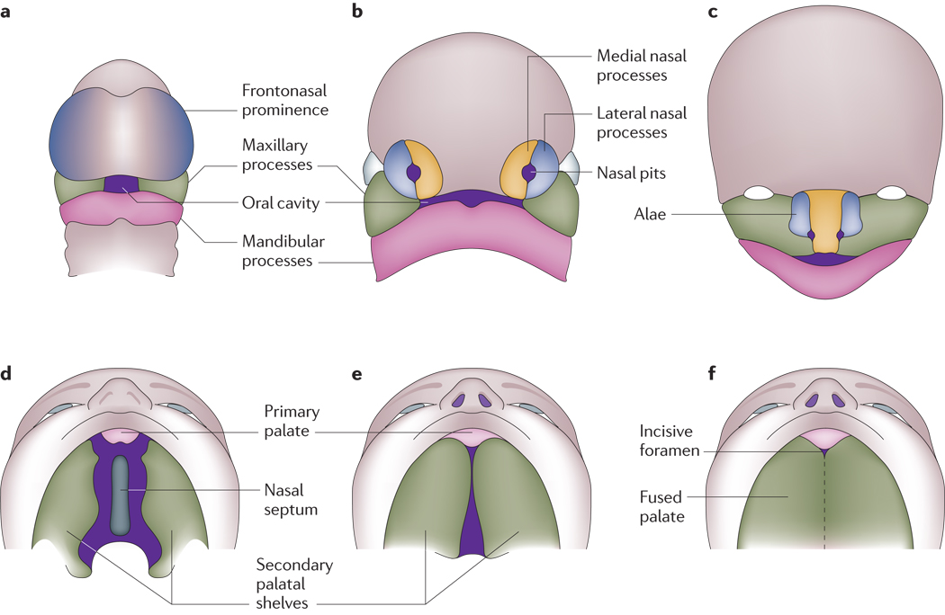
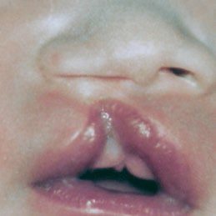
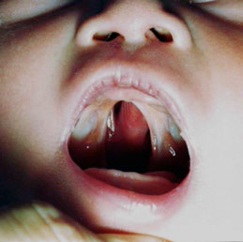
Lip and Palate Formation
Photos courtesy of
CDC-Beijing Medical University collaborative project
Illustration source: Nat Rev Genet. 2011 March; 12(3): 167–178
http://www.ncbi.nlm.nih.gov/pmc/articles/PMC3086810/
Orofacial Clefts | 5
Notes:
Here you can see the schematic diagrams of the development of the lip and palate in humans. The first sketch (A) shows the developing frontonasal prominence, paired maxillary processes and paired mandibular processes that surround the primitive oral cavity by the fourth week of embryonic development. Sketch B shows the formation of the nasal pits, which occur by the fifth week and lead to formation of the paired medial and lateral nasal processes. In sketch C the medial nasal processes have merged with the maxillary processes to form the upper lip and primary palate by the end of the sixth week. The lateral nasal processes form the nasal alae. Similarly, the mandibular processes fuse to form the lower jaw. Sketch D is during the sixth week of embryogenesis, the secondary palate develops as bilateral outgrowths from the maxillary processes which grow vertically down the side of the tongue. Subsequently, shown on sketch E, the palatal shelves elevate to a horizontal position above the tongue, contact one another and commence fusion. The final sketch (F) is where the fusion of the palatal shelves ultimately divides the oronasal space into separate oral and nasal cavities.
Figure is modified with permission from REF ⁶⁸ Copyright permission**

Slide 6
In Summary…
The primary palate is completely formed by the end of week 8 of gestation
The secondary palate is completely formed by the end of week 9 of gestation
Therefore, anything that happens after week 9 of gestation is unlikely to cause or prevent a cleft lip or a cleft palate
Orofacial Clefts | 6
Notes:
To summarize the previous slides:
The primary palate in completely formed by the end of week 8 of gestation and the secondary palate is completely formed by the end of week 9 of gestation; therefore, anything that happens after week 9 of gestation is unlikely to cause or prevent a cleft lip or a cleft palate.

Slide 7
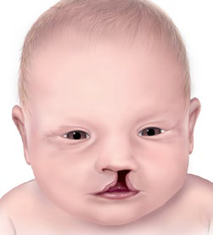
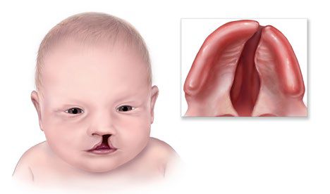
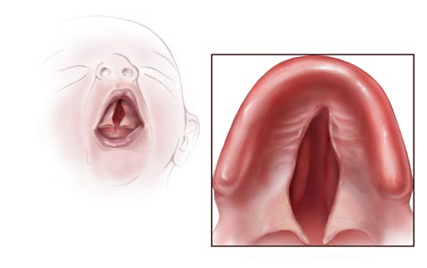
Common Orofacial Clefts
This presentation will focus on cleft lip only, cleft lip and palate, and cleft palate only.
Cleft
Lip Only
Partial or complete fissure of the upper lip.
It can be unilateral or bilateral, and can be associated with a cleft of the gum.
Cleft of the upper lip extending through the primary and secondary palates, with or without extension through the soft palate. Cleft lip and palate is the most common orofacial cleft.
Cleft Lip
With Cleft Palate
Cleft Palate Only
Fissure of the palate, which can affect the soft and hard palate, or only the soft palate.
Orofacial Clefts | 7
Notes:
Orofacial clefts are commonly divided into three subtypes. These are: cleft lip only, cleft lip with cleft palate, and cleft palate only. In this presentation we will focus on these three subtypes.
Cleft lip only is defined a the partial or complete fissure of the upper lip. Cleft lip can be unilateral or bilateral and can be associated with a cleft gum.
Cleft lip with cleft palate is the most common subtypes of orofacial clefts and is defined as the cleft of the upper lip extending through the primary and secondary palates, with or without extension through the soft palate as seen the second sketch.
Cleft palate only is defined as the fissure of the palate, which can affect the soft and hard palate, or only the soft palate.

Slide 8
Selected Epidemiologic Features of Orofacial Clefts
Feature | Typical Findings
Prevalence | Affects an estimated 185,000 births per year worldwide* Cleft lip only ≈ 3.3 per 10,000** Cleft lip and palate ≈ 6.7 per 10,000*** Cleft palate only ≈ 5.0 per 10,000*** Total orofacial clefts ≈ 15.0 per 10,000
Variability of prevalence*** | Varies among populations and race/ethnic groups Cleft lip only or cleft lip and palate : Japan 21 per 10,000; Norway 13.26 per 10,000; China 13.49 per 10,000 Cleft palate only : Malta 16 per 10,000; Finland 14 per 10,000
Associations **** | Orofacial clefts may be isolated or associated with other birth defects 25-30% of cleft lip and cleft lip and palate are associated with other defects (~half are due to syndromes); more common in bilateral cases estimated 25-50% cleft palate only are associated with other defects
Orofacial Clefts | 8
Notes:
As a whole, orofacial clefts affect an estimated 185,000 births per year worldwide with a total prevalence of 15.0 per 10,000 births. As it was mentioned earlier, cleft lip with cleft palate are the most common subtype of orofacial clefts with a prevalence of 6.7 per 10,000 births. The prevalance of cleft lip only is 3.3 per 10,000 births and the prevalence of cleft palate only I 5.0 per 10,000 births. The prevalence of orofacial clefts varies among populations and race/ethnic groups. For example the prevalence of cleft lip only or cleft lip with cleft palate is 21 per 10,000 births in Japan and 13.26 per 10,000 birth in Norway and the prevalence of cleft palate only is 16 per 10,000 in Malta and 14 per 10,000 in Finland.
Orofacial clefts may occur as isolated birth defects or be associated with other birth defects. It is estimated that 25-30% of cleft lip only and cleft lip with cleft palate are associated with other birth defects, half of which are due to syndromes, and are more common in bilateral cases. Furthermore, it is estimated that 25-50% of cleft palate only are associated with other birth defects.
* MOD 2006.
**IPDTOC Working Group. Cleft Palate Craniofac J. 2011 Jan;48(1):66-81.
***WHO/CDC/ICBDSR. Birth defects surveillance: a manual for programme managers. Geneva: World Health Organization; 2014.
****Mossey P, Little J. Epidemiology of oral clefts: an international perspective. In: Wyszynski DF, ed. Cleft Lip and Palate: From Origin to Treatment . New York: Oxford University Press; 2002:127–158

Slide 9
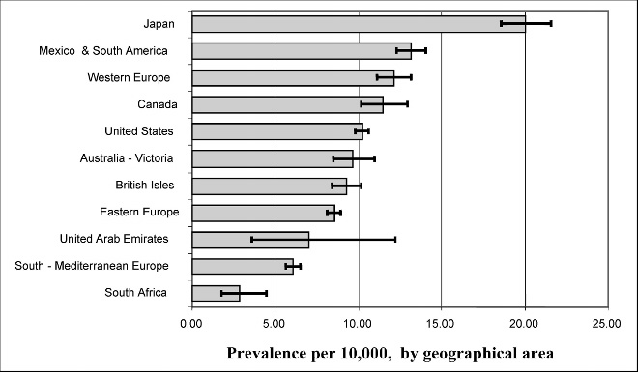
Prevalence of CL±P by Geographic Area (per 10,000)
Source: 2010_ Cleft Palate-Craniofacial Journal, January 2011 Vol 48 No 1. Prevalence at Birth of Cleft Lip With or Without Cleft Palate:
Data From the International Perinatal Database of Typical Oral Clefts (IPDTOC).
Orofacial Clefts | 9
Notes:
As mentioned in the previous slide, prevalence of orofacial cleft varies by populations and race/ethnicity. This slide provides a picture of how the prevalence of orofacial clefts varies by geographical area with lowest prevalences reported in South Africa and highest prevalences reported in Japan.
Source: 2010_ Cleft Palate-Craniofacial Journal, January 2011 Vol 48 No 1. Prevalence at Birth of Cleft Lip With or Without Cleft Palate: Data From the International Perinatal Database of Typical Oral Clefts (IPDTOC).

Slide 10
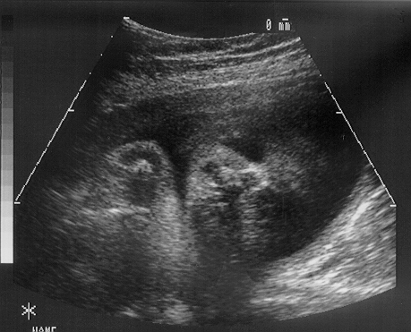
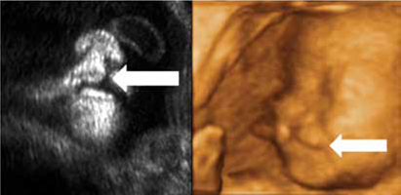
Diagnosis
Cleft lip only is usually easily recognized on physical examination after delivery
Direct visualization of the pharynx after delivery is needed to detect a cleft palate
When visualization is difficult, palpation of palate with a finger may be useful
Prenatal diagnoses should not be included in surveillance data unless it is confirmed postnatally
Prenatal Image of cleft lip only
Photo courtesy of Alberto de la Vega MD, FACOG
Reproduced with permission from the Hong Kong Medical Journal (To WW. Prenatal diagnosis and assessment of facial clefts: where are we now? Hong Kong Med J 2012;18:146-52), 2012, Hong Kong Academy of Medicine.
Postnatal image of cleft lip only
Orofacial Clefts | 10
Notes:
Cleft lip only is easily recognized on physical examination of the newborn. Celft palate is detected by direct visualization of the pharynx after delivery; palpation of the palate with a finger may be useful when visualization is difficult, especially for the detection of soft palate cleft. Cleft lip may be diagnosed prenatally; however, diagnosis should not be included in surveillance data unless it is confirmed

Slide 11
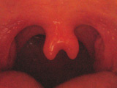
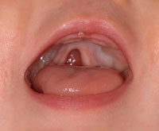
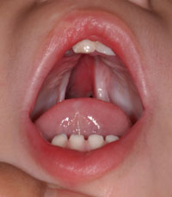
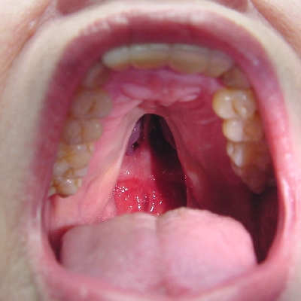
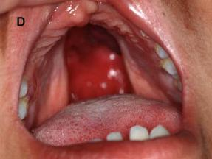
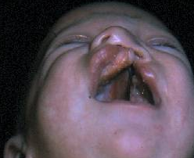
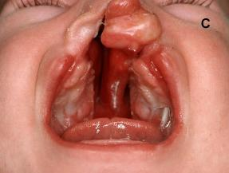
Cleft Palate: Heterogeneous Phenotype
Bifid Uvula
Cleft hard palate
Cleft hard palate
Cleft hard palate
Cleft hard palate
Cleft hard palate
Cleft hard palate with cleft lip, specified as unilateral
Cleft hard palate with bilateral cleft lip
Photos courtesy of Dr. Peter Mossey
Orofacial Clefts | 11
Notes:
These photographs present different phenotypes of cleft palate.

Slide 12
Main Clinical Features
Feature | Typical Findings
Sex differences | Cleft lip with or without cleft palate: 60-80% are males Isolated clefts of secondary palate more frequent in females
Site of clefts | Cleft lip only: 21% Cleft lip with cleft palate: 46% Cleft of secondary palate only: 33%
Laterality of cleft lip | Unilateral clefts More common in the left side (2:1) More common than bilateral (9:1) Associated with cleft palate in 68% of cases Bilateral cleft lip is associated with cleft palate in 86% of cases
Types of cleft lip | Microform (presence of vertical groove and vermilion notching) not counted in surveillance of orofacial clefts Unilateral cleft lip (complete or incomplete) Bilateral cleft lip
Types of cleft palate | Cleft palate associated with cleft lip Cleft palate only Cleft palate (hard or soft palate) Submucous cleft palate
Source: Harold Chen. Atlas of Genetic Diagnosis and Counseling. Humana Press 2006
Orofacial Clefts | 12
Notes:
Some of the main features of orofacial cleft include:
Cleft lip with or without cleft palate is usually more frequent in males, whereas isolated clefts of secondary palate are more frequent in females.
The most common type of clefts include cleft lip with cleft palate (46%) followed by cleft of secondary palate only (33%) and cleft lip only (21%).
Unilateral clefts are more common than bilateral clefts with a ratio of 9:1, are more common on the left side, and are associated with cleft palate in 68% of the cases. Bilateral cleft lip is associated with cleft palate in 86% of the cases.
Types of cleft lip include microform, which is the presence of vertical groove and vermilion notching and is not counted in surveillance of orofacial clefts, unilateral cleft lip, and bilateral cleft lip.
Type of cleft palate include cleft palate associated with cleft lip and cleft palate only which could include cleft hard or soft palate and submucous cleft palate.
Source: Harold Chen. Atlas of Genetic Diagnosis and Counseling. Humana Press 2006

Slide 13
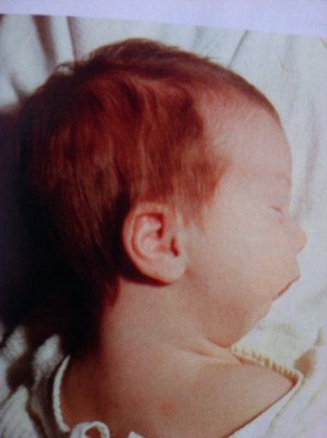
Robin Sequence
Robin sequence is characterized by small jaw in size (micrognathia) or set back from the upper jaw (retrognathia)
As a result, the tongue tends to be displaced back towards the throat, where it can fall back and obstruct the airway (glossoptosis)
Most infants, but not all, will also have a cleft palate, but none will have a cleft lip
Some cases may present a “U” shaped cleft of the palate
Photo courtesy of Jones LK, Jones CM, del Campo M. Smith’s Recognizable Patterns of Human Malformations. Elsevier Saunders. 2013
Photo courtesy of http://en.atlaseclamc.org/
Orofacial Clefts | 13
Notes:
Robin sequence is characterized by a lower jaw that is small or set back from the upper jaw. As a result, the tongue tends to be displaced back. This may interfere with the elevation of the palatal shelves, frequently resulting in a “U”-shaped cleft palate. Cleft lip is not part of the Robin sequence. In severe cases, the tongue may block the airway, requiring specialized pediatric care.

Slide 14
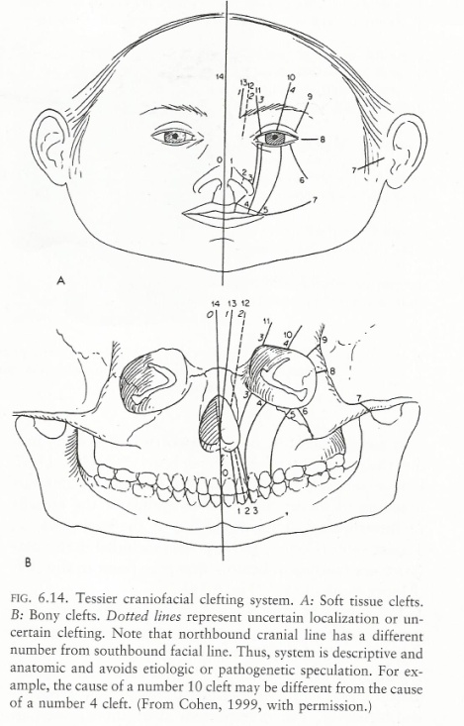
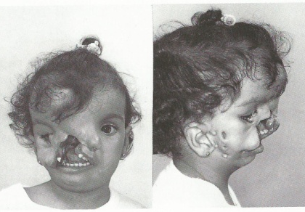
Atypical Facial Clefts
Clefts involving lip, face and possibly palate
Two main types (classification by Tessier)
Oro-auricular clefts occur with incomplete merging of maxillary and mandibular processes and are otherwise known as lateral clefts of the mouth.
Oro-orbital clefts do not follow the normal lines of facial fusion and may be more bizarre, leading to disruption and distortion of normal anatomy, particularly of the eye and nose.
Many are disruptions (amniotic band sequence or limb-body wall complex).
Photos courtesy of Stevenson ER and Hall GJ. Human Malformations and Related Anomalies. 2nd Ed. Oxford Univ Press. 2006.
Orofacial Clefts | 14
Notes:
Atypical clefts may involve the lip, face, and/or palate. The two main types are oro-auricular—with incomplete merging of maxillary and mandibular processes—and oro-orbital—which do not follow the normal lines of facial fusion and may distort or disrupt the eye or nose.

Slide 15
Tips for Describing
A photograph should be taken, useful for review
Essential in atypical types
Use a drawing if photograph is not possible
Describe precisely:
Laterality: right, left, bilateral
Lower lip: pits present or not
Extension of the lip’s cleft: minimum, partial or total
Involvement of the gum
Involvement of the nasal sill
Premaxilla status: present or absent
Extension of the palate’s cleft: hard and/or soft
Presence of significant micrognathia and glossoptosis
Shape of palate’s cleft: “U” shape or “V” shape
Describe any additional malformations if present
In presence of a median cleft lip it is important to evaluate whether it is secondary to holoprosencephaly; do not include median clefts in surveillance of cleft lip and palate
Indicate whether a clinical geneticist was consulted
Orofacial Clefts | 15
Notes:
To help in the description of a birth defect, take a photograph. This is especially important for atypical types. If a photograph is not possible, make a drawing. Be sure to precisely describe: laterality, the presence of pits in the lower lip, the extension of the lip’s cleft, the involvement of the gum and nasal sill, the premaxilla status, the extension of the palate’s cleft, the presence of significant micrognathia or glossoptosis, and the shape of the palate’s cleft. Describe any additional malformations if present and indicate whether a clinical geneticist was consulted. Finally, in the presence of a median cleft lip it is important to evaluate whether it is secondary to holoprosencephaly; do not include median clefts in surveillance of cleft lip and palate.

Slide 16
ICD-10 RCPCH Coding of Cleft Palate
Q35 Cleft palate (avoid using this general code if more specific information is available) Fissure of palate; Palatoschisis
Q35.1 Cleft hard palate
Q35.3 Cleft soft palate
Q35.5 Cleft hard palate with cleft soft palate
Q35.59 Complete cleft palate
Cleft hard palate with cleft soft palate
Q35.9 Cleft palate, unspecified
Q87.0 Robin (sequence or defect; includes micrognathia, posterior displacement of the tongue, cleft palate)*
Note: most specialists do not agree on the existence of cleft palate laterality, as this defect is the result of a failure of the palatal shelves to fuse in the midline. For this reason, the preferred codes are: Q35.1 Cleft hard palate; Q35.3 Cleft soft palate; Q35.59 Cleft hard palate with cleft soft palate; Q35.9 Cleft palate and Q87.0 Robin (sequence or defect; includes micrognathia, posterior displacement of the tongue, cleft palate).
Exclusions
Q35.7 Cleft uvula
Bifid uvula
Q35.9 Submucous cleft Q37–Q37.9 Cleft palate with cleft lip **
Q38.5 Absence of uvula
* ICD-10 lists Robin sequence as an exclusion from the Q35 series. However, because it is such a common condition, the 87.0 code is suggested.
Orofacial Clefts | 16
Notes:
Here is a list of ICD-10 codes you will use when a cleft palate is identified. Be aware that Q35 is a generic code, and if possible it should not be use for coding cleft palate.

Slide 17
ICD-10 RCPCH Coding of Cleft Lip
Q36 Cleft lip (avoid using this general code if more specific information is available) Cheiloschisis; Congenital fissure of lip; Harelip; Labium leporinum
Q36.0 Cleft lip, bilateral
Q36.9 or Q36.90 Cleft lip unilateral
Q36.99 Cleft lip, unspecified
Exclusions
Q36.1 Cleft lip, median
Pseudocleft or microform cleft lip (no associated ICD-10 codes)
Oblique facial clefts (Tessier type facial clefts) (no associated ICD-10 codes)
Orofacial Clefts | 17
Notes:
Here is a list of ICD-10 codes you will use when a cleft lip is identified. A cleft lip is given a Q36 code, but Q36 is a generic code, and if possible it should not be use for coding cleft lip. Instead, it is better to use the more specific code. Specific codes include Q36.0 for Cleft lip, bilateral; Q36.9 or Q36.90 for Cleft lip unilateral; and Q36.99 for Cleft lip, unspecified.
Remember that a median cleft lip should be excluded from cleft lip coding.

Slide 18
ICD-10 RCPCH Coding of Cleft Lip and Palate
Q37 Cleft palate with cleft lip (avoid using this general code if more specific information is available)
Q37.0 Cleft hard palate with bilateral cleft lip
Q37.10 Cleft hard palate with cleft lip, specified as unilateral
Q37.19 Cleft hard palate with cleft lip, unspecified
Q37.2 Cleft soft palate with bilateral cleft lip
Q37.3 Cleft soft palate with unilateral cleft lip
Q37.4 Cleft hard palate and soft palate with bilateral cleft lip
Q37.5 Cleft hard palate and soft palate with unilateral cleft lip
Q37.59 Cleft hard palate and soft palate with cleft lip, unspecified
Q37.8 Unspecified cleft palate with bilateral cleft lip
Q37.9 Unspecified cleft palate with unilateral cleft lip
Q37.99 Cleft palate with cleft lip, unspecified
Exclusions
Oblique facial clefts (Tessier type facial clefts)
Q04.2 Cases with known or probable holoprosencephaly
Q79.80 Cases with known or probable amniotic band/constriction band presence *
*ICBDSR recommends using Q79.80 to identify the presence of an amniotic band. The anomaly is coded as the code for the specific anomaly, as well as the Q79.80 amniotic band code.
Orofacial Clefts | 18
Notes:
Here is a list of ICD-10 codes you will use when a cleft palate with cleft lip is identified. Be aware that Q37 is a generic code, and if possible it should not be use for coding cleft palate with cleft lip. Instead, it is better to use the more specific code.
Remember that oblique facial clefts, which include cases with known or probable holoprosencephaly, amniotic band, or constriction band presence are excluded.

Slide 19
Tips for coding Robin sequence
Robin sequence has its own code: Q87.08, this sequence may have or not a cleft palate, each individual code should be coded, if present:
Micrognathia: K07.00
Glossoptosis: Q38.3 dislocation or displacement of tongue
Cleft palate Q35 heading with the appropriate fourth digit
Orofacial Clefts | 19
Notes:
Be aware that Robin sequence has its own ICD-10 code, but associated defects, such as micrognathia, glossoptosis, or cleft palate, should also be given their specific codes.

Slide 20
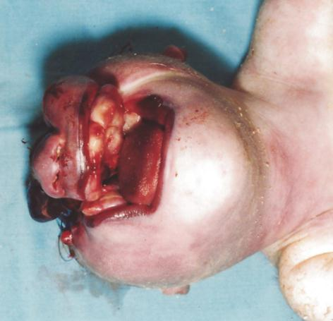
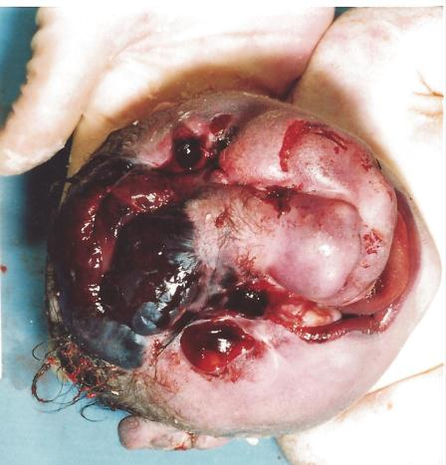
Amniotic Band Sequence
Birth defects caused by entrapment of fetal parts in fibrous amniotic bands while in utero
This should not be counted as cleft lip and palate
Note: The ICBDSR uses Q79.80 to identify the presence of an amniotic band. The anomaly is coded as the code for the specific
congenital anomaly, as well as the Q79.80 amniotic band code.
Photo courtesy of CDC-Beijing Medical University collaborative project
Orofacial Clefts | 20
Notes:
An amniotic band sequence is a pattern of birth defects caused by entrapment of fetal parts in fibrous amniotic bands while in utero. This should not be counted as cleft lip and palate.

Slide 21
Further information useful for reporting, extracting or coding: minor anomalies of mouth
Mouth Minor Anomalies | 21
Notes:
When reporting birth defects surveillance, information on minor anomalies of the mouth can be useful.

Slide 22
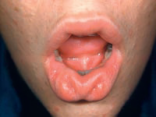
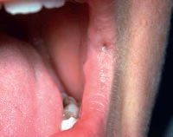
Labial pit/fistula Q38.00
Definition : Depression located on the vermilion of the lower lip, usually paramedian
Evaluation: Objective
Lower lip pits are typically seen in the van der Woude syndrome, which also includes cleft lip and/or cleft palate
Lip pits may be connected to minor salivary glands in the lower lip. Occasionally, a lip pit may have a surrounding tissue elevation
Lip pits should be differentiated from pits located at the labial commissure (cheilion), known as commissural pits, which have no clinical relevance
Lower lip pits
Note: these are usually just lateral to the midline.
Commissural pit
Note: these are always located at the same position at the corners of the oral aperture
Photso courtesy of Carey JC, Cohen MM Jr, Curry CJ, Devriendt K, Holmes LB, Verloes A. Elements of morphology: standard terminology for the lips, mouth, and oral region. Am J Med Genet A. 2009 Jan;149A(1):77-92.
Mouth Minor Anomalies | 22
Notes:
Cleft lip and/or cleft palate associated with pits of the lower lip constitute an autosomal dominant condition known as the van der Woude syndrome. As shown in the left-hand picture, these pits are found lateral to the midline of the lower lip and may be connected by a fistula to salivary glands. In some cases, the pits are in the center of a tissue elevation. Lip pits found in the labial comissure, as seen in the right-hand picture, known as comissural pits, are different and have no clinical significance.

Slide 23
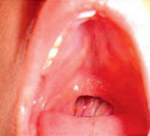
Absence of uvula Q38.5
Definition: Lack of the uvula
Evaluation: Objective
Comment: Rare anomaly
Photo courtesy of Carey JC, Cohen MM Jr, Curry CJ, Devriendt K, Holmes LB, Verloes A. Elements of morphology: standard terminology for the lips, mouth, and oral region. Am J Med Genet A. 2009 Jan;149A(1):77-92.
Mouth Minor Anomalies | 23
Notes:
The lack of a uvula is a rare anomaly that has an ICD-10 code of Q38.5.

Slide 24
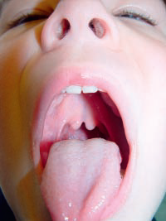
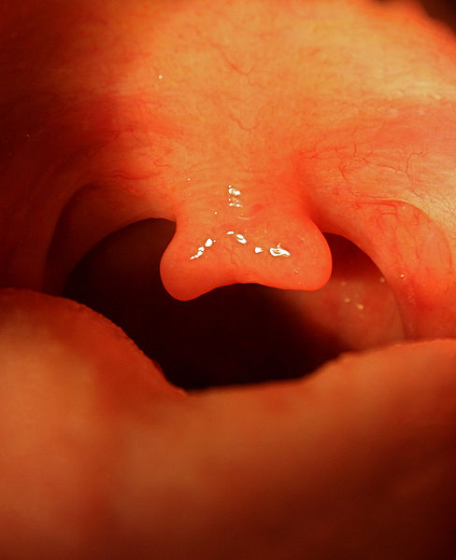
Bifid uvula Q35.7
Definition: Uvula separated into two parts most easily seen at the tip
Evaluation: Objective
Comments: Although this relationship has not been fully confirmed, some have regarded bifid uvula as a marker for submucous cleft palate and have coded it under the heading Q35, which identifies cleft palate. Bifid uvula is considered a minor anomaly and should be coded as Q35.7
Synonym: Double uvula
Photo courtesy of Carey JC et al. Elements of morphology: standard terminology for the lips, mouth, and oral region. Am J Med Genet A. 2009 Jan;149A(1):77-92.
Photo courtesy of http://en.wikipedia.org/wiki/Wikipedia:Featured_picture_candidates/Bifid_uvula
Mouth Minor Anomalies | 24
Notes:
When the uvula is divided into two parts it is known as bifid uvula and is coded as Q35.7. Even though without consistent evidence, some authors have regarded bifid uvula as a marker for submucous cleft palate and coded the anomaly under the heading Q35, which identifies cleft palate.

Slide 25
Questions?
If you have questions please send an email to centre@icbdsr.org or to birthdefectscount@cdc.gov
Orofacial Clefts | 25
Notes:
Thank you very much for listening to this presentation. We hope you have enjoyed it. If you have questions please send an email to centre@icbdsr.org or to birthdefectscount@cdc.gov

