Slide 1
Introduction to preconception health for birth defects surveillance professionals
Disclaimer: The findings and conclusions in this presentation have not been formally disseminated by the Centers for Disease Control and Prevention and should not be construed to represent any agency determination or policy.

Slide 2
Learning objectives
Define preconception health
Describe the importance of preconception health in relation to the prevention of birth defects
Identify risk factors during the preconception period that contribute to birth defects
Describe preconception health recommendations for healthcare practitioners
© 2014 Arturo Sanabria, Courtesy of Photoshare

Slide 3
Defining preconception health and health care
Preconception health
Personal health during the reproductive years
Focuses on optimizing a woman’s health to promote a future healthy pregnancy, regardless of pregnancy plans
Preconception health care
Medical care to promote both a woman’s health and that of her future baby
© 2012 Akintunde Akinleye/NURHI, Courtesy of Photoshare
Sources: http://www.cdc.gov/preconception/overview.html; http://www.cdc.gov/mmwr/preview/mmwrhtml/rr5506a1.htm

Slide 4
Main goals of preconception care
In 2008, CDC released the Clinical Content of Preconception Care with three main goals for preconception care – providing protection, avoiding harmful exposures, and managing conditions
Providing protection | Avoiding harmful exposures | Managing conditions
Examples Promote weight and nutrient management, including folic acid Promote pregnancy planning Promote spacing between pregnancies Provide immunizations | Examples Counseling and referral for use of tobacco, alcohol, and illicit drugs Discuss use of prescription drugs that may cause birth defects or other negative pregnancy outcomes | Examples Chronic diseases (e.g., diabetes, epilepsy, obesity, hypertension) Infectious diseases (e.g., HIV, malaria, syphilis) Provide treatment options best suited for healthy reproductive outcomes
Table Source, Modified: Preconception Health Promotion: The Foundation for a Healthier Tomorrow; 2013 March of Dimes Foundation

Slide 5
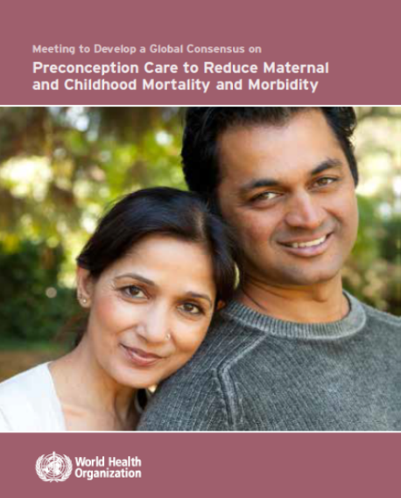
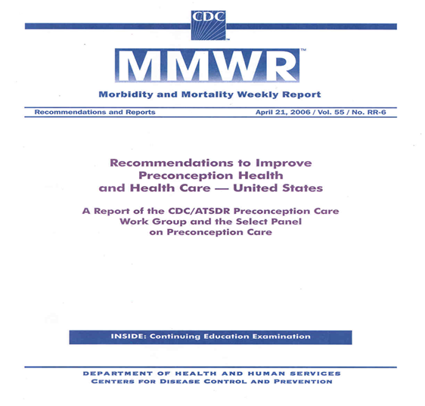
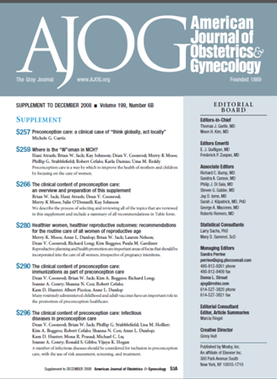
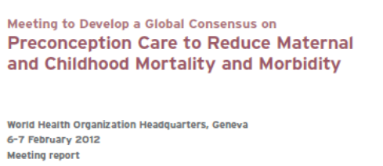
Evidence informs preconception health programs
Recommendations to Improve Preconception Health – United States by the Centers for Disease Control and Prevention (2006)
Systematic Review of Preconception Evidence by the Aga Khan University in Karachi, Pakistan (2011)
SUPPLEMENT TO DECEMBER 2008. Volume 199, Number 6B

Slide 6
Preconception health care reduces risks of many adverse neonatal outcomes
Birth defects
Preterm birth
Low birth weight
Small or large for gestational age
Neonatal mortality
HIV infection
Source: Adapted from http://www.who.int/maternal_child_adolescent/documents/concensus_preconception_care/en/

Slide 7
Preconception guidance for preventing birth defects: Examples
Healthcare provider counseling on
Folic acid consumption/nutrition
Healthy weight/diabetes/obesity
Infectious diseases
Vaccinations
Tobacco and illicit drugs cessation
Alcohol use during pregnancy
Medications use
Family history
Harmful environmental exposures
Source: http://www.cdc.gov/ncbddd/birthdefects/prevention.html

Slide 8
Preconception care and birth defects: Selected topics
© 2013 A Fantasy Traveler, Courtesy of Photoshare

Slide 9
Nutrition: Folic acid
Healthcare providers should encourage folic acid consumption before and during pregnancy
Folic acid, a B-vitamin, can prevent the majority of neural tube defects (NTDs)
All women capable of becoming pregnant should consume 400 micrograms of folic acid daily
All women who have already had an NTD-affected pregnancy should consult with their healthcare provider about consuming 4000 micrograms of folic acid daily beginning one month before they start trying to get pregnant and continuing through the first three months of pregnancy
Source: Source: http://www.cdc.gov/ncbddd/folicacid/recommendations.html

Slide 10
Sources of folic acid
Pills… folic acid-containing dietary supplements
Fortification … folic acid added to foods - flour, rice, pasta, breakfast cereals
Diet…natural foods such as vegetables, fruits, beans, yeast, liver
Source: CDC. MMWR Recomm Rep 1992 Sep 11;41(RR-14):1-7
Notes:
10
10
10

Slide 11
Periconception 400 micrograms of folic acid: Relative risk reduction
Randomized Controlled Trials
Meta-analysis
Observational Studies
Meta-analysis
Observational Studies
Meta-analysis
72%
28%
30%
Anencephaly – Spina Bifida
Heart Defects
Cleft lip
Observational Studies
Meta-analysis
Observational Studies
Meta-analysis
Large
Cohort Study
25%
27% &
47%
49% &
45%
Small for Gestational Age < 5th centile
Brain tumors & Neuroblastoma
Autism & Severe Language Delay
Sources: See notes
Notes:
Sources:
Feng Y, Wang S, Chen R, Tong X, Wu Z, Mo X. Maternal folic acid supplementation and the risk of congenital heart defects in offspring: a meta-analysis of epidemiological observational studies. Sci Rep. 2015 Feb 17;5:8506.
Hodgetts VA, Morris RK, Francis A, Gardosi J, Ismail KM. Effectiveness of folic acid supplementation in pregnancy on reducing the risk of small-for-gestational age neonates: a population study, systematic review and meta-analysis. BJOG. 2015 Mar;122(4):478-90. doi: 10.1111/1471-0528.13202. Epub 2014 Nov 26. Review.
Butali A, Little J, Chevrier C, Cordier S, Steegers-Theunissen R, Jugessur A, Oladugba B, Mossey PA. Folic acid supplementation use and the MTHFR C677T polymorphism in orofacial clefts etiology: An individual participant data pooled-analysis. Birth Defects Res A Clin Mol Teratol. 2013 Aug;97(8):509-14. doi: 10.1002/bdra.23133. Epub 2013 May 13.
Goh YI, Bollano E, Einarson TR, Koren G. Prenatal multivitamin supplementation and rates of pediatric cancers: a meta-analysis. Clin Pharmacol Ther. 2007 May;81(5):685-91. Epub 2007 Feb 21. Review.
Surén P, Roth C, Bresnahan M, Haugen M, Hornig M, Hirtz D, Lie KK, Lipkin WI, Magnus P, Reichborn-Kjennerud T, Schjølberg S, Davey Smith G, Øyen AS, Susser E, Stoltenberg C. Association between maternal use of folic acid supplements and risk of autism spectrum disorders in children. JAMA. 2013 Feb 13;309(6):570-7.
Roth C, Magnus P, Schjølberg S, Stoltenberg C, Surén P, McKeague IW, Davey Smith G, Reichborn-Kjennerud T, Susser E. Folic acid supplements in pregnancy and severe language delay in children. JAMA. 2011 Oct 12;306(14):1566-73.

Slide 12
Healthy weight
Healthcare providers should encourage women to achieve a healthy weight prior to pregnancy
Obesity is a modifiable risk factor and often associated with other conditions (e.g., diabetes)
Obesity increases risk of some birth defects

Slide 13
Diabetes
© 2008 David G Bragin, Courtesy of Photoshare
Healthcare providers should
Counsel women with diabetes about the importance of having tight glycemic control prior to and throughout pregnancy
Women with gestational diabetes are at an increased risk for later developing diabetes
Screen all women for gestational diabetes during pregnancy
Women with diabetes can have a higher risk for having a baby with a birth defect as compared to women without diabetes¹
¹Source: Bell, et al. (2012). Peri-conception hyperglycaemia and nephropathy are associated with risk of congenital anomaly in women with pre-existing diabetes: a population-based cohort study. Diabetologia, 55(4), 936-947.

Slide 14
Infectious diseases
Healthcare providers should counsel couples about screening for infectious diseases before pregnancy such as
Syphilis
Maternal syphilis can be passed through the placenta causing congenital syphilis
HIV, Malaria, Tuberculosis, Hepatitis B, Hepatitis C, Herpes
Evidence of adverse outcomes for the baby (prematurity, low birth weight, infection in the baby)
Zika virus
All pregnant women should be asked about recent travel – those with a history of travel to an area with Zika virus transmission and who report two or more symptoms consistent with Zika virus disease during or within 2 weeks of travel, or who have ultrasound findings of fetal microcephaly or intracranial calcifications, should be tested for Zika virus infection in consultation with their state or local health department.
Treat and manage diagnosed infectious diseases
¹Coonrod, D. V., Jack, B. W., Stubblefield, P. G., Hollier, L. M., Boggess, K. A., Cefalo, R., et al. (2008). The clinical content of preconception care: infectious diseases in preconception care. American Journal of Obstetrics and Gynecology, 199(6), S296-S309; ²Petersen EE, Staples JE, Meaney-Delman D, et al. Interim guidelines for pregnant women during a Zika virus outbreak—United States, 2016. MMWR Morb Mortal Wkly Rep 2016;65:30–3.

Slide 15
Vaccinations
Healthcare providers should counsel women during the preconception period about the importance of having their vaccinations up to date before pregnancy
Some vaccine-preventable infectious diseases can cause adverse pregnancy outcomes such as
Rubella during pregnancy can lead to spontaneous abortion, stillbirth, and congenital rubella syndrome¹
Varicella during early pregnancy can lead to fetal death and varicella embryopathy²
A preconception care program should include assessment of a woman’s vaccination/immunity status for vaccine-preventable infectious diseases
CDC/OPA has guidance on conducting a family planning visit³ – healthcare providers can refer to this guidance for assistance
¹Coonrod, D. V., Jack, B. W., Boggess, K. A., Long, R., Conry, J. A., Cox, S. N., et al. (2008). The clinical content of preconception care: immunizations as part of preconception care. American Journal of Obstetrics and Gynecology, 199(6), S290-S295.
²Committee on Infectious Diseases. (2015). Red Book. Available at: http://redbook.solutions.aap.org/book.aspx?bookid=1484
3CDC. Providing quality family planning services: Recommendations of CDC and the U.S. Office of Population Affairs. MMWR; 63(4); 2014. Available at: http://www.cdc.gov/mmwr/pdf/rr/rr6304.pdf

Slide 16
Tobacco
Healthcare providers should counsel women during the preconception period about the harmful effects of tobacco use and exposure, regardless of pregnancy plans
Tobacco exposure
Smoking cessation interventions should be administered prior to conception
A meta-analysis¹ showed significant association between maternal smoking in pregnancy and cardiovascular, musculoskeletal, facial and gastrointestinal birth defects
Causally associated with orofacial clefts²
Smoking causes preterm birth, low birth weight, SIDS, and orofacial clefts, in addition to many other health problems^{2,3}
Nicotine adversely affects fetal brain development³
¹Hackshaw, A., Rodeck, C., & Boniface, S. (2011). Maternal smoking in pregnancy and birth defects: a systematic review based on 173 687 malformed cases and 11.7 million controls. Human Reproduction Update, 17(5), 589-604.
2 Honein, M.A., et al., Prevention of orofacial clefts caused by smoking: Implications of the Surgeon General's report. Birth Defects Res A Clin Mol Teratol. 2014;100(11):822–5.
³USDHHS. The health consequences of smoking - 50 years of progress: A report of the surgeon general. 2014. Available at: http://www.surgeongeneral.gov/library/reports/50-years-of-progress/full-report.pdf

Slide 17
Alcohol use
Healthcare providers should counsel women during the preconception period about the harmful effects of alcohol use during pregnancy
Fetal alcohol spectrum disorders (FASDs)
A group of conditions that can occur in a person whose mother drank alcohol during pregnancy
Are completely preventable if a woman does not drink alcohol during pregnancy
Babies of women who drink alcohol during pregnancy are exposed to alcohol in the mother’s blood through the umbilical cord
Can cause physical, behavior and learning problems
Source: http://www.cdc.gov/ncbddd/fasd/facts.html

Slide 18
Medications
Health professionals should counsel women during the preconception period about the harmful effects of certain medication use during pregnancy
Some medications are known teratogens (e.g., isotretinoin, warfarin)
Known teratogens should be avoided whenever possible when planning to conceive and during pregnancy
Many women need to take medication during pregnancy to appropriately manage their health conditions
In some cases, avoiding or stopping medication use during pregnancy may be more harmful than taking a medication (e.g., epilepsy treatments)
It is important that before women start or stop any medication use, they speak with their healthcare providers about the safest medication choices during pregnancy
Source: http://www.cdc.gov/pregnancy/meds/treatingfortwo/

Slide 19
Other considerations
Health professionals should counsel women during the preconception period about
Family planning¹
Preconception care should be part of overall family planning
Birth spacing helps improve a mother’s health and birth outcomes
Preconception/prenatal care
Important for women to receive regular medical care before and during pregnancy
Allows screening and detection of risk factors, and/or monitoring of existing conditions
Genetic counseling²
Informs couples about their genetic risks (e.g., consanguinity)
¹Source: http://www.who.int/mediacentre/factsheets/fs351/en/
²Source: http://www.cdc.gov/ncbddd/genetics/genetic_counseling.html
© 2014 Basil Safi, Courtesy of Photoshare

Slide 20
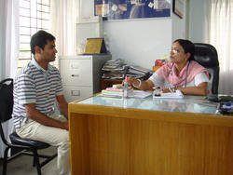
Target audiences for preconception health
Healthcare providers should counsel both women and men about preconception health
© 2006 Bangladesh Center for Communication
Programs. Courtesy of Photoshare
Why include men?
Men and women make reproductive plans together
Men and women help each other practice healthy lifestyle
Men can protect their partners from sexually transmitted diseases by protecting themselves
Men who smoke expose their partners to secondhand smoke
Father’s health/nutrition impacts baby’s health
Source: http://www.cdc.gov/preconception/men.html

Slide 21
Resources
World Health Organization
http://www.who.int/maternal_child_adolescent/documents/concensus_preconception_care/en/
http://www.who.int/nutrition/publications/micronutrients/9241594012/en
March of Dimes Preconception
http://www.marchofdimes.org/nursing/index.bm2?cid=00000003&spid=ne_s2_1_3_2&tpid=ne_sm01_preconception_home
CDC Preconception Health and Health Care
http://www.cdc.gov/preconception/hcp/recommendations.html
Food Fortification Initiative
http://www.ffinetwork.org/
Before and Beyond
http://beforeandbeyond.org/
CDC Show Your Love Campaign
http://www.cdc.gov/preconception/showyourlove/index.html

Slide 22
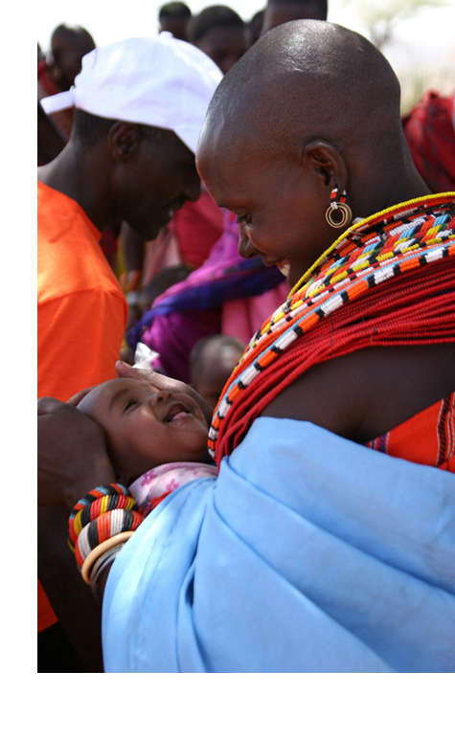
Acknowledgements
This presentation was developed by the March of Dimes Foundation in collaboration with:
U.S. Centers for Disease Control and Prevention’s Division of Birth Defects and Developmental Disabilities Surveillance Working Group
International Clearinghouse for Birth Defects Surveillance and Research
World Health Organization
© 2007 Wendy MacNaughton Courtesy of Photoshare

