Slide 1



Congenital Limb Deficiencies
Limb reduction defects
Presenter
Notes:
Greetings –
We will be talking about congenital limb deficiencies also known as congenital limb reduction defects

Slide 2
Learning Objectives
By the end of this presentation participants will be able to describe:
  Classification of limb deficiencies
  Clinical features of limb deficiencies
  Elements of coding and reporting
  Main epidemiological features of limb deficiencies
Limb deficiencies | 2
Notes:
By the end of this presentation you will be able to understand the different types of limb deficiencies, describe clinical features, understand how to classify and code the limb deficiencies and also describe some epidemiological features of limb defects.

Slide 3
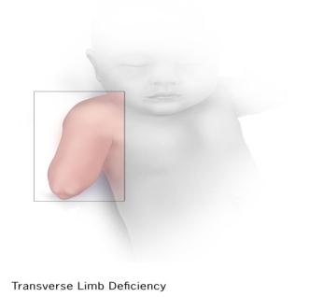
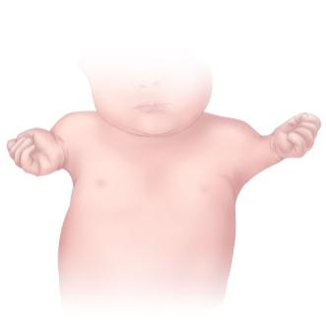
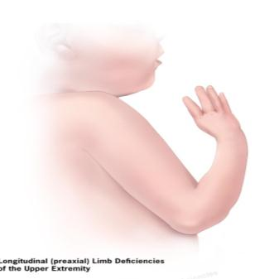
Limb Deficiencies
Limb deficency defects are characterized by total or partial absence or different degrees of hypoplasia of the skeletal structures of the limbs
Classified into three large groups: transverse, intercalary and longitudinal
Some cases may have anomalies that fit into more than one of these groups (Mixed)
Transverse
Intercalary
Longitudinal
Limb deficiencies | 3
Notes:
Limb deficiencies are a category of congenital anomalies that are characterized by total or partial absence of bones of the limbs, or different degrees of hypoplasia.
These deficiencies are typically classified into three large groups: transverse, intercalary, and longitudinal.
In the presentation, we will go into more detail about each of these categories.
It is important to mention that the use of a medication called Thalidomide during early pregnancy can cause severe limb deficiencies like phocomelia. This discovery launched birth defects surveillance systems around the world.

Slide 4
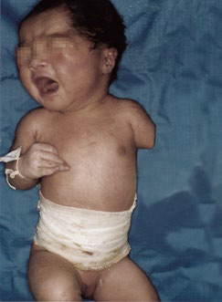
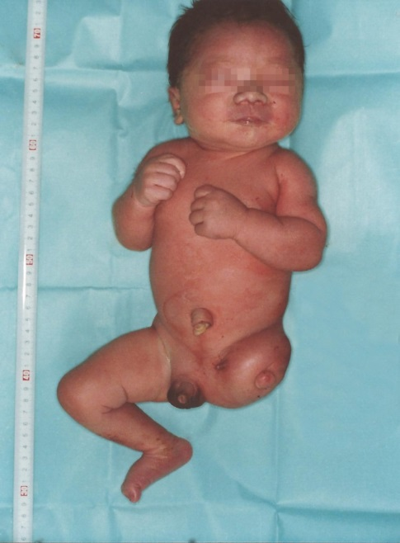
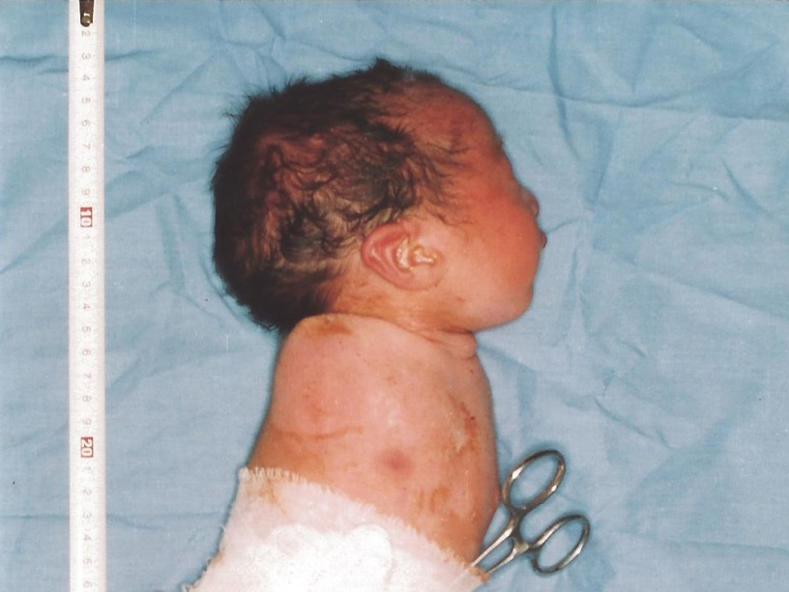
Transverse Limb Deficiencies
Complete or partial absence of distal structures of a limb in a transverse plane at the point where the deficiency begins, with proximal structures being essentially intact
Congenital complete absence of upper limbs/Amelia of upper limb
(Q71.0)
Congenital absence
of both forearm and hand
(Q71.2)
Congenital complete absence of lower limb/Amelia of lower limb (Q72.0)
Source: CDC-Beijing Medical University collaborative project
Limb deficiencies | 4
Notes:
Now we are going to talk a little bit more about transverse limb deficiencies.
Transverse means that there is a complete or partial absence of structures of a limb after the point where the defect begins. The limb structures before the point of the defect remain intact.

Slide 5
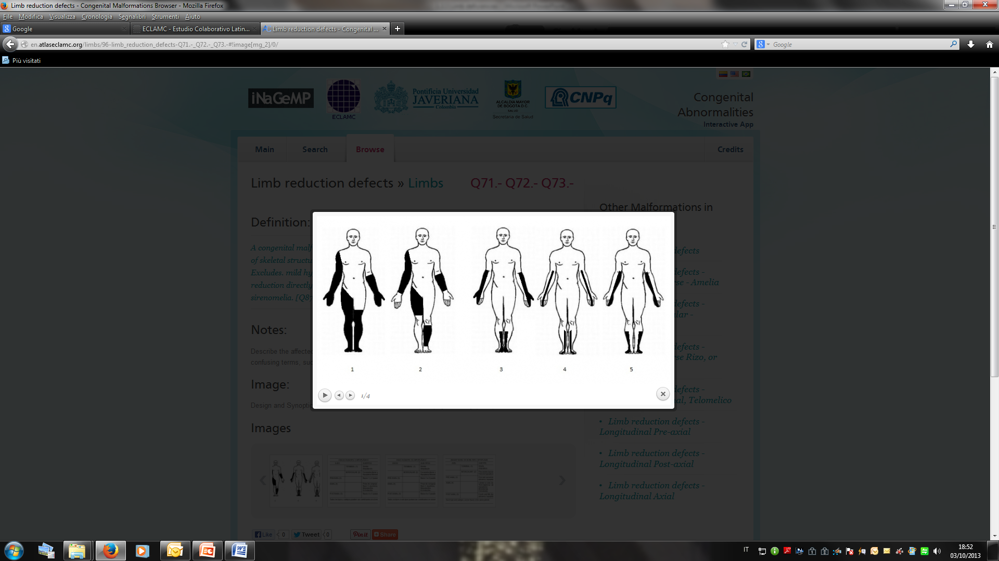
Transverse Limb Deficiencies
Complete
(Amelia)
Partial
Birth defects atlas. www.eclamc.org
Congenital Limb Deficiencies | 5
Notes:
This slide shows an illustration of transverse limb deficiencies. The dark colors are showing the parts of the limbs that can be missing in transverse limb deficiencies.
When the limb is completely absent is also known as amelia.

Slide 6
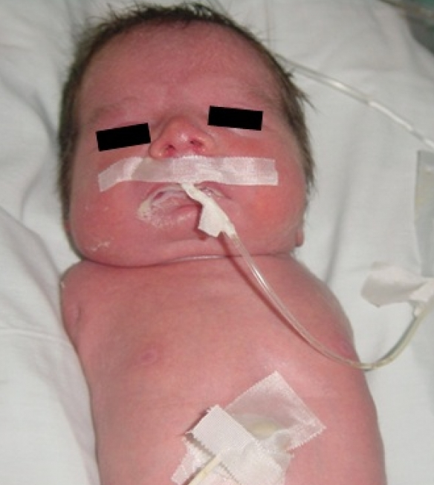
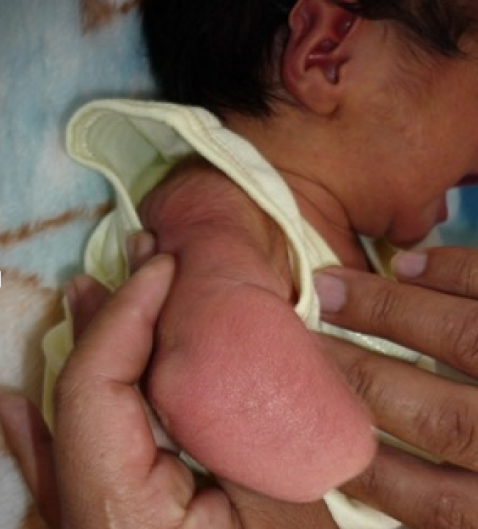
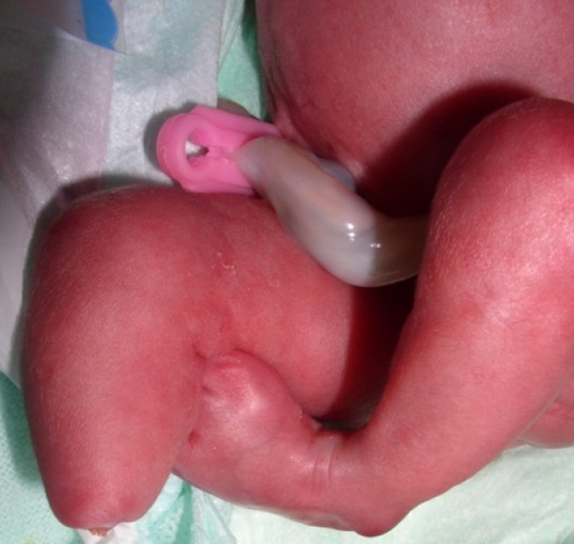
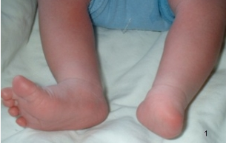
Transverse Limb Deficiences: Examples
Congenital complete absence of upper limbs/Amelia of upper limb
(Q71.0)
Congenital absence of both forearm and hand (Q71.2)
Congenital absence of foot and toes (Q72.3)
Congenital absence of lower leg and foot (Q72.2)
Source: Birth defects atlas. www.eclamc.org
Congenital Limb Deficiencies | 6
Notes:
The photos in this slide represent neonates with transverse limb deficiencies. You can see in the pictures that there is no limb structure after the point of the defect.

Slide 7
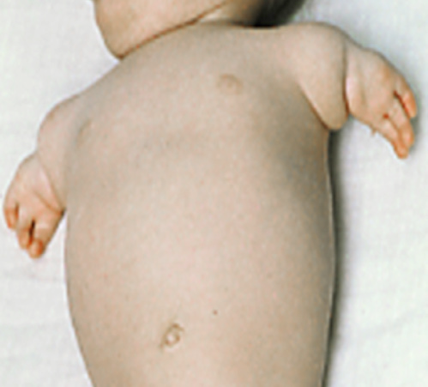
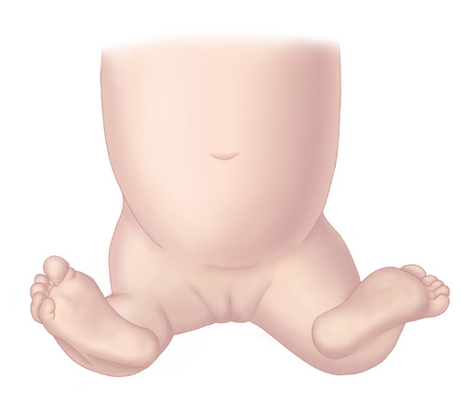
Intercalary Limb Deficiencies
Complete or partial absence of proximal and/or middle segment(s) of a limb with all or part of the distal segment present
Complete, or nearly complete, absence of proximal and middle segments is also called phocomelia
Distal segments may be normal
Congenital absence of upper arm and forearm with hand present (Q71.1)
Congenital absence of thigh and lower leg with foot present (Q72.1)
Congenital Limb Deficiencies | 7
Source: Dr Jaime Frias
Notes:
Intercalary deficiencies are categorized by a missing middle segment of a limb with some proximal and distant segments still present. The distal segments that are present are often near normal. You can see in the photograph on the left how the hands are missing fingers. This defect is often referred to as phocomelia.

Slide 8
Intercalary Limb Deficiencies Continued
Absence of all limb bones proximal to the hand (foot) which is often near normal
Absence of humerus or both radius-ulna with a hand which is often near normal
Femoral hypoplasia/aplasia
(particular type of intercalary limb deficiency)
Absence of femur or tibia-fibula with a foot which is often near normal
Birth defects atlas. www.eclamc.org
Congenital Limb Deficiencies | 8
Notes:
Here is an illustration showing the different types of intercalary deficiencies. Although the illustration portrays a “normal” hand and foot, this is not typically the case.
Let’s look at the left side of the illustration. The dark color on the right arm illustrates the section of the arm that is missing, while the hand is present. The dark color on the right leg illustrates that the femur is absent, while the lower leg is present and would be attached to the groin.
Now let’s look at the right side of the illustration. The dark color on the left arm illustrates that the radius and ulna are missing (forearm), while the upper part of the arm and the hand are present. The dark color on the left leg illustrates that the tibia-fibula are absent, while the upper part of the leg and the foot are present.

Slide 9
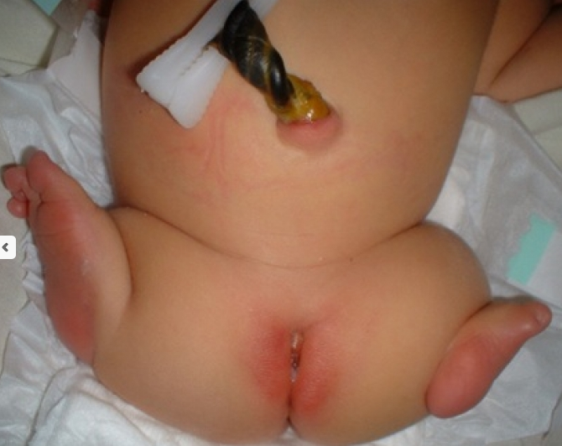
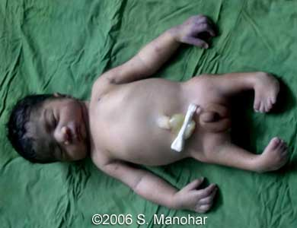
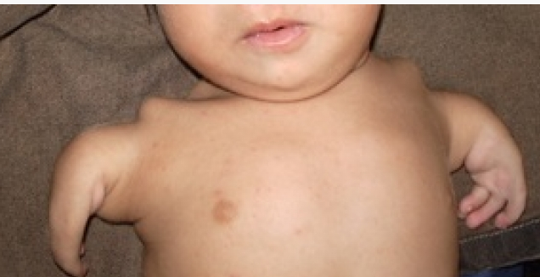
Examples of Intercalary Limb Deficiencies
Congenital absence of upper arm and forearm with hand present
(Q71.1)
Congenital absence of thigh and lower leg with foot present
(Q72.1)
Bilateral femoral hypoplasia
Source: Birth defects atlas; www.eclamc.org
Source:http://sonoworld.com/fetus/page.aspx?id=1954
Congenital Limb Deficiencies | 9
Notes:
Here are some photographs of infants with intercalary limb deficiencies. Note how the hands and feet are not well formed.

Slide 10
Longitudinal Limb Deficiencies
Partial absence of one or more bones of a limb extending parallel to the long axis of the limb
Deficiencies involve specific areas of the limbs:
  Pre-axial: affects radial side of the arm and/or tibial side of the leg
  Central/Axial: affects central digits and metacarpals and/or metatarsals
  Post-axial: affects ulnar side of the arm and/or the fibular side of the leg
Congenital Limb Deficiencies | 10
Notes:
The third type of limb deficiencies we will discuss today are longitudinal limb deficiencies. Longitudinal deficiencies occur when one or more bones of a limb are absent parallel to the long axis of the limb.
Longitudinal limb deficiencies are classified as preaxial, central or axial, and postaxial. For these types of deficiencies, X-rays are very useful for final diagnosis.
In a preaxial longitudinal deficiency, the radius or the tibia are absent.
In a central/axial longitudinal deficiency, the central digits and metacarpals are absent
In a postaxial longitudinal deficiency, the ulna or fibula are absent
In the next slides we will discuss examples of these three types of longitudinal defects
Note: Instructor can ask: “Do you know what post axial and pre axial means?. Illustrate pre and post axial using your arms and legs.”

Slide 11
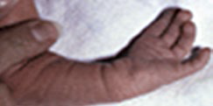
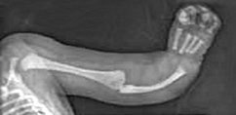
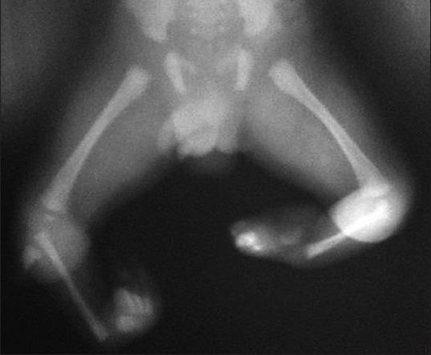
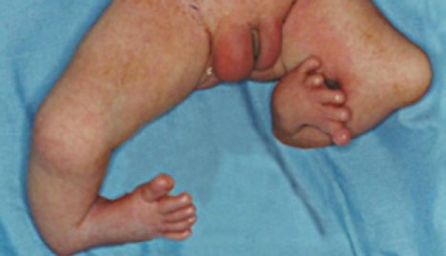
Longitudinal Limb Deficiencies
Pre-axial
Longitudinal reduction defect of radius
(Q71.4)
Source: Birth defects atlas. www.eclamc.org
Longitudinal reduction defect of tibia
(Q72.5)
Courtesy of CDC-Beijing Medical University collaborative project in: WHO/CDC/ICBDSR.
Birth defects surveillance: a manual for programme managers. Geneva: World Health Organization; 2014.
Congenital Limb Deficiencies | 11
Notes:
As I mentioned in the previous slide, in pre axial deficiencies either the radius or the tibia can be absent. The dark color on the illustration to the left of the slide shows the absence of the radius and tibia. To the right of the slide you see photographs and X-rays of neonates with an absent radius – the top two images, and an absent tibia - the bottom two images.

Slide 12
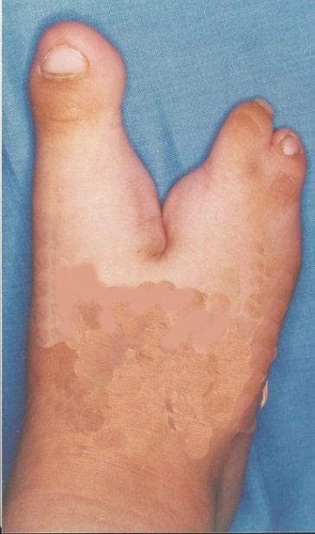
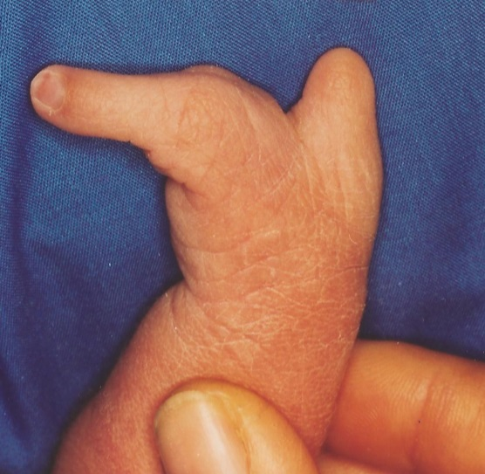
Longitudinal Limb Deficiencies
Central/Axial
Split hand
(Q71.6)
Split foot
(Q72.7)
Birth defects atlas. www.eclamc.org
Courtesy of CDC-Beijing Medical University collaborative project in: WHO/CDC/ICBDSR.
Birth defects surveillance: a manual for programme managers. Geneva: World Health Organization; 2014.
Congenital Limb Deficiencies | 12
Notes:
In central or axial deficiencies, the central digits are missing, as are some metacarpals and/or metatarsals. This type of defect is also commonly referred to as split hand or split foot.
In the past, this defect was sometimes referred to as lobster claw; however, this term should no longer be used.

Slide 13
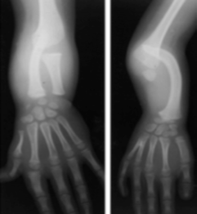
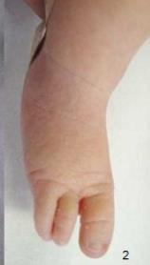
Longitudinal Limb Deficiencies
Post-axial
Longitudinal reduction defect of ulna (Q71.5)
Absence of toes on the fibular
side of the left leg
Birth defects atlas. www.eclamc.org
Longitudinal reduction defect of fibula
(Q72.6)
Congenital Limb Deficiencies | 13
Notes:
In postaxial defects, either the ulna or the fibula can be absent. The dark color on the illustration to the left of the slide shows the absence of the ulnas and fibulas. To the right of the slide you see a photograph and X-rays of an infant with an absent ulna – in the top image, and an absent fibula – in the bottom images. Note that the foot is also abnormal.

Slide 14
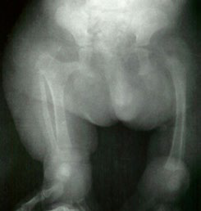
Limb Deficiencies
Mixed Subtypes
Limb deficiencies in which the anomalies can be classified into more than one category.
For example,
  Missing right hand + absence of left radius
  Absence of third finger of right hand + absence of right ulna
  Right sided femoral aplasia and left-sided femoral and
  fibular aplasia (image below)
Femoral aplasia on the right (Q72.4) and femoral (Q72.4) and fibular aplasia (Q72.6) (on the left)
Congenital Limb Deficiencies | 14
Notes:
There are times when a neonate presents with more than one type of limb deficiency. These are referred to as mixed subtypes. It is important to classify each defect in its own category. In the X-ray, you can see both the absence of the right femur as well as the absence of the left fibula.
Robert JM, Guibaud P, Robert E.. A local outbreak of femoral hypoplasia or aplasia and femoral fibula-ulnar-complex. J Genet Hum. 1981 Dec;29(4):379-94.

Slide 15
Diagnosis of Limb Deficiencies
Usually easily recognized upon physical examination at delivery; however:
  X-ray or autopsies might be required for confirmation
  Absence of phalanges may be undetected at birth
In general, if prenatal diagnosis is not confirmed postnatally, it should not be counted; however:
  When the degree of certainty is high (e.g., severe deficiency;
  high resolution ultrasound), the program protocol would
  determine whether the defect is included
Congenital Limb Deficiencies | 15
Notes:
How are limb deficiencies diagnosed?
Limb deficiencies are easily recognized at delivery while the neonate is being examined. However, sometimes is not easy to determine exactly which bones are missing until an X-ray or an autopsy (in case of a stillbirth or neonatal death) is done. If a prenatal diagnosis was done, it is still important to confirm the prenatal diagnosis at birth.
What are the causes of limb deficiencies? Although we do not always know the exact cause for a limb deficiency, studies have found that these types of deficiencies can be attributed to presumed vascular disruption, syndromes, chromosomal abnormalities, maternal health conditions, or exposure to teratogens.
Kim K et al. Prevalence and Trends of Selected Congenital Malformations in New York State, 1983 to 2007. Birth Defects Research (Part A) 2013; 97:619-27.
New York State: 4.38/10,000
Gold NB, Westgate MN, Holmes LB.et al. Anatomic and etiological classification of congenital limb deficiencies. Am J Med Genet A. 2011; 155 A:1225-35.
Brigham and Women's Hospital, Boston: 7.9/10,000
Stoll C et al. Associated malformations in patients with limb reduction deficiencies. European J Med Genet. 2010; 53:286e290.
Strasbourg, France: 7.8/10,000
Froster-Iskenius UG & Baird PA. Limb Reduction Defects in Over One Million Consecutive Livebirths. Teratology. 1989; 39:127-135
British Columbia: 5.97/10,000

Slide 16
Main Epidemiological Features
Feature | Typical Findings
Prevalence | Global estimate (2004-2008): 2.0 – 11.0 per 10,000* New York State, US (1983-2007): 4.38/10,000** Strasbourg, France (2010): 7.8/10,000*** British Columbia, Canada (1989): 5.97/10,000****
Variability of prevalence | Under-ascertainment of less severe defects (digits and phalanges) Over-reporting of mild cases that do not require treatment Higher prevalence in non-Hispanic American Indians
Associations | Estimated 40-50% of all limb deficiencies have associated malformations Associated defects are more frequent in pre-axial types
ICBDSR Annual Report, 2010.
Stoll C et al. Associated malformations in patients with limb reduction deficiencies. European J Med Genet. 2010; 53:286e290.
Strasbourg, France: 7.8/10,000
Froster-Iskenius UG & Baird PA. Limb Reduction Defects in Over One Million Consecutive Livebirths. Teratology. 1989; 39:127-135
British Columbia: 5.97/10,000
Kim K et al. Prevalence and Trends of Selected Congenital Malformations in New York State, 1983 to 2007. Birth Defects Research (Part A) 2013; 97:619-27.
New York State: 4.38/10,000
Congenital Limb Deficiencies | 16
Notes:
The prevalence of limb deficiencies varies from 2 per 10,000 births to 11 per 10,000 births. For example one publication indicated the prevalence of limb deficiencies in New York (USA) as 4.38 per 10,000 births while another publication estimated the prevalence in Starsbourg (France) to be 7.8 per 10,000 births. As you will see in the next slide, it is important to keep in mind that differences seen in prevalence can be due to ascertainment issues – either underreporting or over reporting.
Further, because limb deficiencies often accompany other defects , it is important to check for other defects in a neonate who presents with a limb deficiency.

Slide 17
Variation in prevalence of limb deficiency in 43 surveillance programs
(ICBDSR, 2004-2008)
Prevalence per 10,000 births
ICBDSR Programs
Congenital Limb Deficiencies | 17
Notes:
Note to instructor – Ask participants: “What is this graph telling you?” Allow time for responses.
As you can see in this slide, there is wide variation in the prevalence of limb deficiencies. Although these differences can be true differences, there is also the possibility that wide variation in prevalence estimates for limb deficiencies might be due, in some cases, to differences in the way a case was ascertained. Programs with prenatal ascertainment, or countries with high numbers of terminations of pregnancy might have very different estimates from countries with no prenatal ascertainment or where terminations of pregnancy are not allowed.

Slide 18
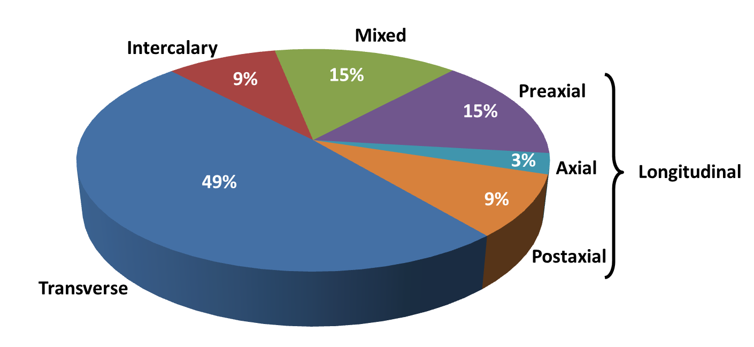
Approximate Proportion of Various Subtypes of Limb Deficiencies
Congenital Limb Deficiencies | 18
Notes:
The proportion of the various subtypes of limb deficiencies varies. In this slide you can see the approximate proportion by limb deficiency type. The largest proportion is among transverse deficiencies.
There is some evidence that folic acid might help prevent some of the transverse limb deficiencies.

Slide 19
Tips for Reporting
Describe the defect(s) precisely, indicating the bones involved
Deficiencies affecting upper and lower limbs, even if different, are considered a single anomaly
Take photographs; they are useful for review but not sufficient for confirmation of diagnosis
Describe additional malformations if present
Indicate whether a specialist was consulted
Congenital Limb Deficiencies | 19
Notes:
Now that we have discussed how to identify and classify limb anomalies, the next step is to know how to report and code them.
Describe! Describe! Describe! This is the most important part. When a neonate presents with a limb defect, it is critical to provide a written, comprehensive description of what you are seeing. For example, which limbs are affected?, what parts of the limb?, are there other defects? In your description, note whether any additional malformations are present.
If possible take a photograph. If this is not possible, please make a drawing or use an illustration to indicate what the defect is and where it is located.
Indicate whether a specialist was consulted.

Slide 20
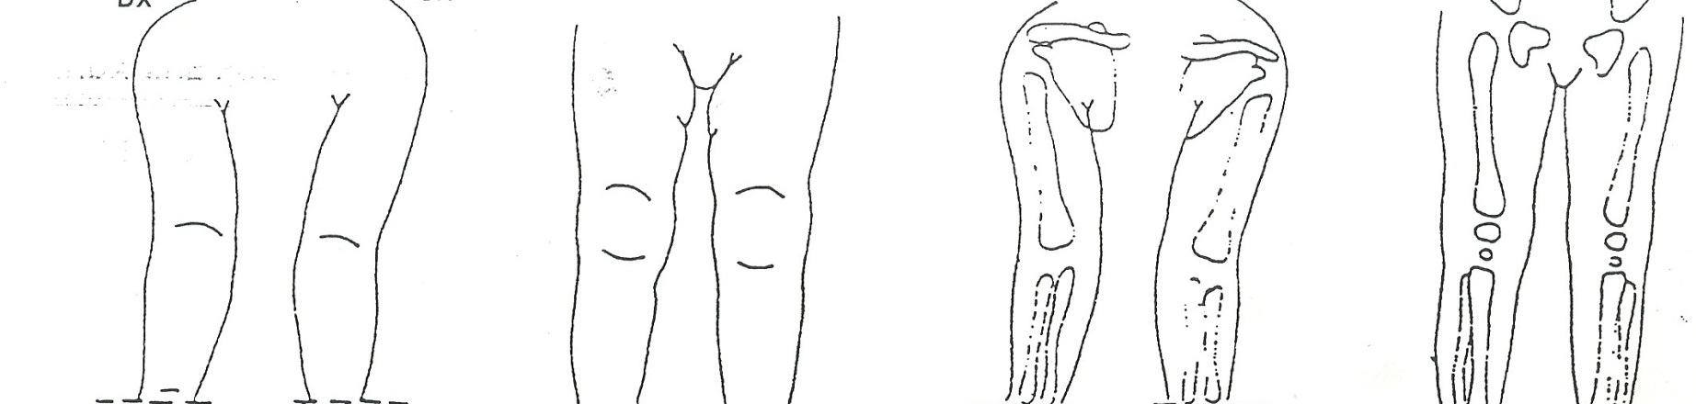
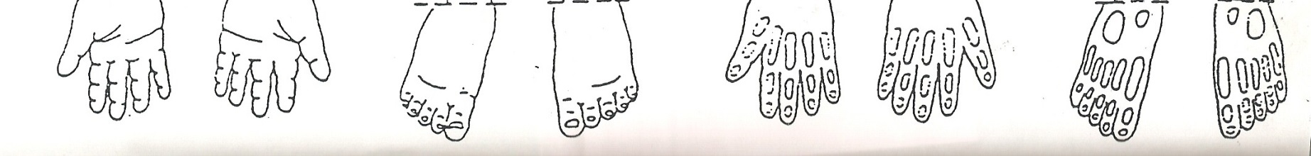
Example of Standard Drawing
Congenital Limb Deficiencies | 20
Notes:
This is an example of a drawing that can be developed if it is not possible to take a photograph. You can use this illustration to indicate where the limb defect is located on the body and which bones are likely absent.

Slide 21
Relevant ICD-10 Codes and
RCPCH Recommendations
Reduction defects of upper limbs
Q71 Reduction defects of upper limb (avoid using this general code if more specific information is available)
Q71.0 Congenital complete absence of upper limb(s)
Amelia of upper limb
Q71.1 Congenital absence of upper arm and forearm with hand present
Phocomelia of upper limb
Q71.2 Congenital absence of both forearm and hand
Q71.3 Congenital absence of hand and finger(s)
Q71.30 Congenital absence of finger(s)
(Remainder of hand intact)
Aphalangia: absent phalanx (an individual bone in a finger) or phalanges
Adactyly: absence of fingers (generally refers to all fingers on a hand, although soft tissue nubbins without bones can be present)
Oligodactyly: fewer than 10 complete fingers
Q71.31 Absence or hypoplasia of thumb
(Other digits intact)
Q71.4 Longitudinal reduction defect of radius
Radial aplasia/hypoplasia
Clubhand (congenital)
Radial clubhand
Q71.5 Longitudinal reduction defect of ulna
Ulnar aplasia/hypoplasia
Q71.6 Lobster-claw hand
Split hand
Congenital cleft hand
Q71.8 Other reduction defects of upper limb(s)
Congenital shortening of upper limb(s)
Q71.9 Reduction defect of upper limb, unspecified
Congenital Limb Deficiencies | 21
Notes:
This is a list of the ICD 10 RCPCH codes for limb deficiencies. The list is long and is divided into upper and lower limb deficiencies.
The codes for upper deficiencies begin with Q 71.XX
The codes for lower deficiencies begin with Q 72.XX
The code for unspecified limb deficiencies Q73.XX can be applied when the individual who is completing the information does not describe where the defect is; however, this is not recommended. It is critical to try and describe the defects as best as possible so that they can be captured under codes Q71 or Q72.

Slide 22
Relevant ICD-10 Codes and
RCPCH Recommendations
Reduction defect of lower limbs
Q72 Reduction defects of lower limb (avoid using this general code if more specific information is available)
Q72.0 Congenital complete absence of lower limb(s)
Amelia of lower limb
Q72.1 Congenital absence of thigh and lower leg with foot present
Phocomelia of lower limb
Q72.2 Congenital absence of both lower leg and foot
Q72.3 Congenital absence of foot and toe(s)
Q72.30 Congenital absence or hypoplasia of toe (s) with remainder of foot intact
Aphalangia: absent phalanx (an individual bone in a toe) or phalanges
Adactyly: absence of toes (generally refers to all toes on a foot, although soft tissue nubbins without bones can be present)
Oligodactyly: fewer than 10 complete toes
Q72.31 Absence or hypoplasia of first toe with other digits present
Q72.4 Longitudinal reduction defect of femur (commonly referred to as Femoral aplasia/hypoplasia)
Proximal femoral focal deficiency
Q72.5 Longitudinal reduction defect of tibia
Tibial aplasia/hypoplasia
Q72.6 Longitudinal reduction defect of fibula
Fibular aplasia/hypoplasia
Q72.7 Split foot
Q72.8 Other reduction defects of lower limb(s)
Congenital shortening of lower limb(s)
Q72.9 Reduction defect of lower limb, unspecified
Congenital Limb Deficiencies | 22
Notes:
This slides shows the codes for lower limb deficiencies

Slide 23
Relevant ICD-10 Codes and
RCPCH Recommendations Continued
Reduction defect of unspecified limb
Q73 Reduction defects of unspecified limb (avoid using this general code if more specific information is available)
Q73.0 Congenital absence of unspecified limb(s)
Amelia NOS
Q73.1 Phocomelia, unspecified limb(s)
Phocomelia NOS
Q73.8 Other reduction defects of unspecified limb(s)
Longitudinal reduction deformity of unspecified limb (s)
Ectromelia NOS
Hemimelia NOS
Reduction defect NOS
Q73.80 Absent digits, unspecified
Congenital Limb Deficiencies | 23
Notes:
This slide shows the codes for unspecified limb deficiencies.

Slide 24
Relevant ICD-10 Codes and
RCPCH Recommendations Continued
Exclusions
Q77.0–Q77.9, Q78.0–Q78.9 Generalized limb shortening including skeletal dysplasias (osteochondrodysplasias)
Q79.80 Amniotic band/constriction band - known or probableª
Q84.6 Nail hypoplasia
Q89.80 Lower extremity deficiencies with caudal dysgenesis
Q87.2 Sirenomelia
All types of brachydactyly (no associated ICD-10 codes)
Short limb without deficiency or severe abnormal shape
Absence of middle phalanx of fifth finger or small fingers (Q68.1) or toes (minor)
ªICBDSR recommends using Q79.80 to identify the presence of an amniotic band.
Other defect codes should be additionally used for specified birth defects as well.
Congenital Limb Deficiencies | 24
Notes:
The defects listed on this slide should not be counted as limb deficiencies. They have their own codes and are not to be coded under Q71 or Q72 coding.

Slide 25
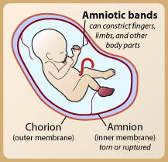
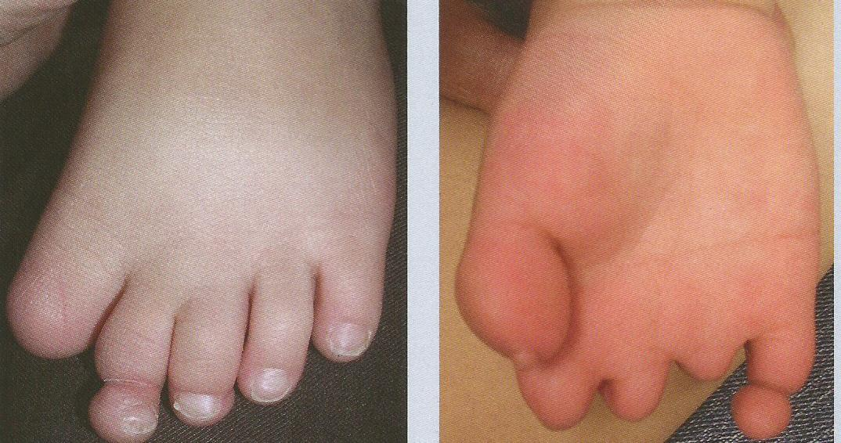
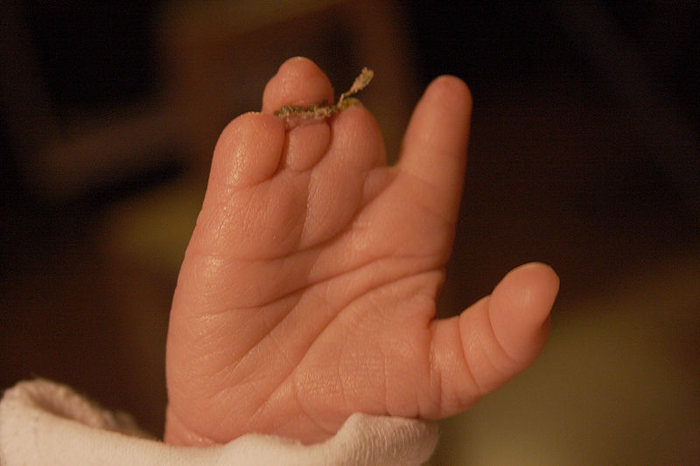
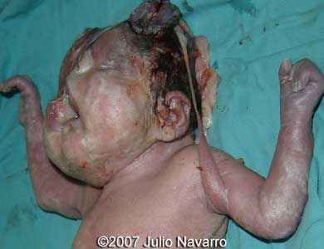
Some Terminal Transverse Deficiencies As “Disruptions”
Some transverse limb deficiencies are not “malformations” but “disruptions”, presumably due to vascular disruption and/or hypovascularization, or amniotic rupture/band
It is believed that amniotic band syndrome occurs when the inner membrane (amnion) ruptures, or tears, without injury to the outer membrane (chorion). The developing fetus is still in fluid but is then exposed to the floating tissue (bands) from the ruptured amnion. This floating tissue can become entangled around the fetus.
http://en.wikipedia.org/wiki/Amniotic_band_constriction
Sadler TW. Langman’s Medical Embryology 12th Ed.. 2012
http://fetus.ucsfmedicalcenter.org/amniotic/learn_more.asp
http://sonoworld.com/fetus/page.aspx?id=2318
Congenital Limb Deficiencies | 25
Notes:
On this slide, there are some examples of limb defects that are not malformations but rather due to disruptions, or hypovascularization or amniotic bands.
These also should not be coded using Q71 or Q72 codes. They have their own coding.

Slide 26

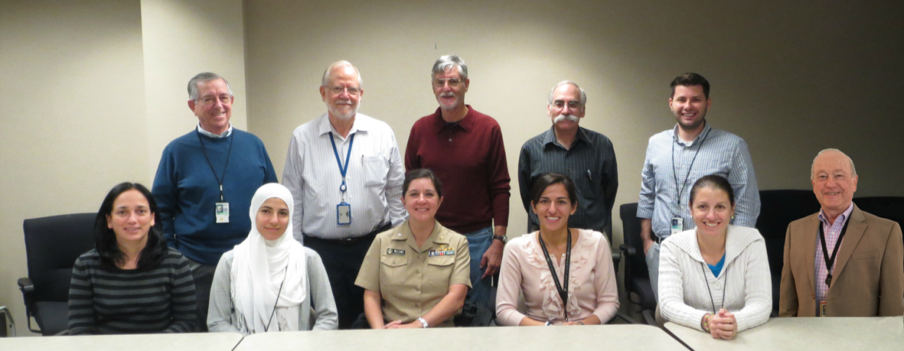
Acknowledgements
International Clearinghouse on Birth Defects Surveillance and Research
  Pierpaolo Mastroiacovo
  Lorenzo Botto
CDC National Center for Birth Defects and Developmental Disabilities
  Surveillance Working Group
Limbs | 26
Notes:
26
26
26
This presentation was prepared by ICBDSR and CDC

Slide 27
Questions?
If you have questions please contact:
icbd@icbd.org
or
birthdefectscount@cdc.gov
National Center on Birth Defects and Developmental Disabilities
Division of Birth Defects and Developmental Disabilities

