Slide 1
DATA2020 Tutorial

Slide 2
DATA2020-What is it?
A dynamic web tool for the Healthy People community
    Data
    Technical information
    Visual displays
Notes:
Slide 2
Data2020 is one part of the HealthyPeople.gov website where you can find:
Data for objectives
Technical information about objectives and data sources
Visual displays of data.

Slide 3
DATA2020
DATA
  National data
  State-level estimates (when available)
  Demographic groups
  Measures of variability (Confidence intervals and/or Standard errors)
  Health disparities
  Progress towards the Healthy People 2020 Target
Notes:
Slide 3
We have primarily national-level data and also state-level data for some objectives.
We display data for a variety of demographic groups, in addition to confidence intervals and standard errors.
As one of the goals of healthy people 2020 is to “Achieve health equity, eliminate disparities, and improve the health of all groups” we also have disparities data for our population-level objectives.
We track progress towards the targets that were set for objectives at the beginning of the decade.

Slide 4
DATA2020
TECHNICAL INFORMATION
  Numerator and Denominator definitions for each objective
  Methodology Notes
  Data Limitations or Trend issues
  Rank the strength of evidence-based resources available for interventions to reach targets
  Historical and technical details about data sources
Notes:
Slide 4
The technical information on DATA2020 includes:
Numerator and denominator information for objectives,
Methodological notes,
Data limitations and trend issues
Strength of evidence based resources
and historical and technical information on the data sources that are used in Healthy People

Slide 5
DATA2020
VISUAL DISPLAYS
  Charts/Graphs – Including Health Disparities data
  Maps (State-level data)
Notes:
Slide 5
Finally, for visual displays of data, we have charts and graphs of demographic and disparities data as well as state-level maps for some objectives.

Slide 6
DATA2020
Data
Visual Displays
Technical Information
National
State-level estimates (when available)
Demographic groups
Measures of variability (Confidence intervals and/or Standard errors)
Disparities
Progress towards target
Numerator and Denominator definitions for each objective
Methodology Notes
Data Limitations or Trend issues
Historical and technical details about data sources
Charts/Graphs
Maps
Notes:
Slide 6
We will be briefly touching on each of these items throughout the rest of the presentation so that you know how to locate all of them on the site.

Slide 7
DATA2020
Focus on:
Topics and Objectives Tab
Data Search Tab
Notes:
Slide 7
Next we will go through a demonstration of DATA2020
With a focus on two parts of the site:
1-Topics and Objectives Tab
2-Data Search Tab

Slide 8
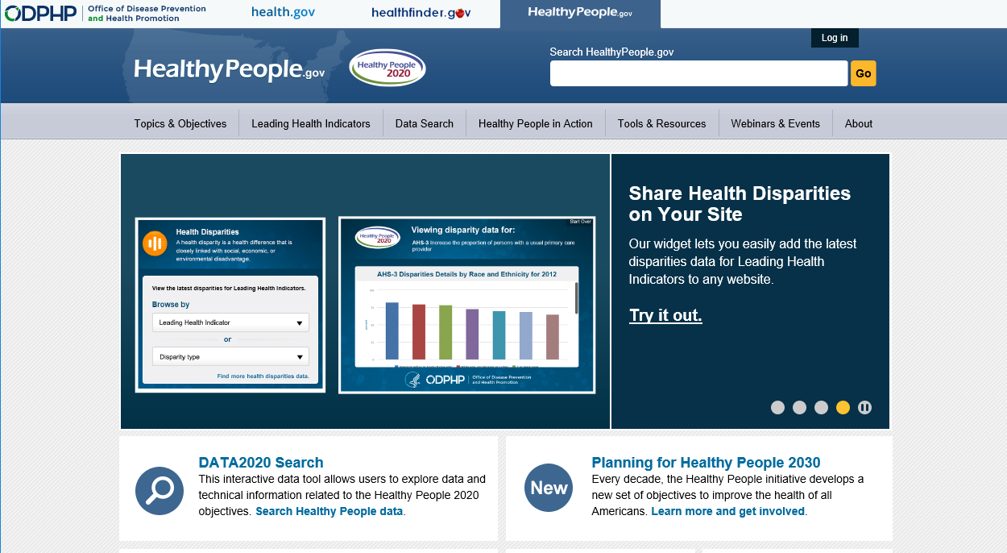
DATA2020
Notes:
Slide 8
Let’s start on the home page for the HealthyPeople.gov site
HP.gov has a lot of different information on it, including a section on the LHIs, resources and information on webinars and events.
But for today we will be looking at the topics and objectives tab and data search tabs only.
Let’s first click on the topics and objectives tab.

Slide 9
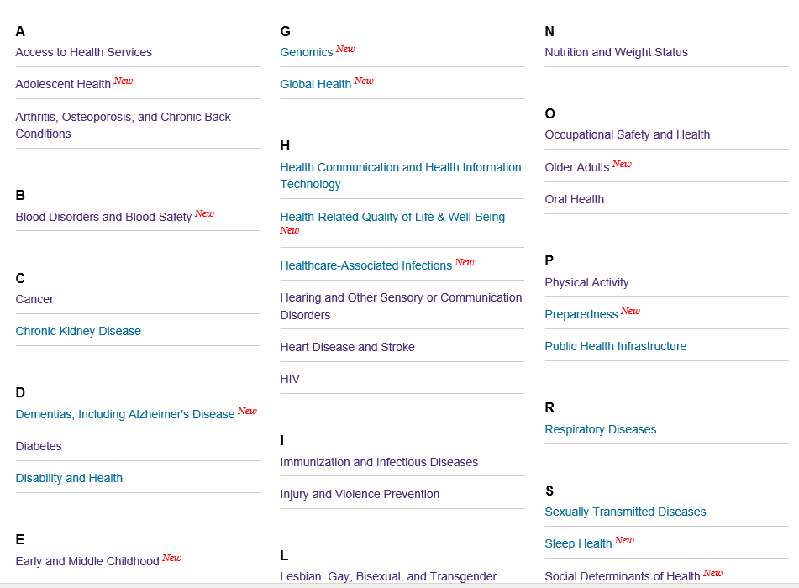
Topics and Objectives
Notes:
Slide 9
This page is a list of all the topic areas in Healthy People 2020, in alphabetical order.

Slide 10
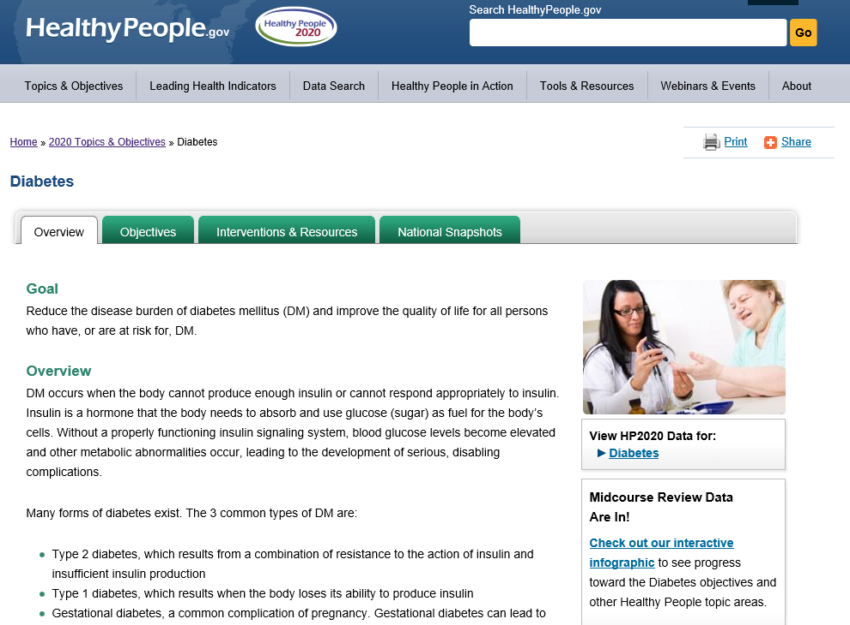
Diabetes Topic Area
Notes:
Slide 10
If you click on any of the topic area names, let’s choose Diabetes, you will be taken to an overview page.
On the main overview page, you can find information on
The Goal of the Topic Area in Healthy People.
A general overview
An explanation about why this TA is important in our current health system
Emerging issues
And
Relevant references

Slide 11
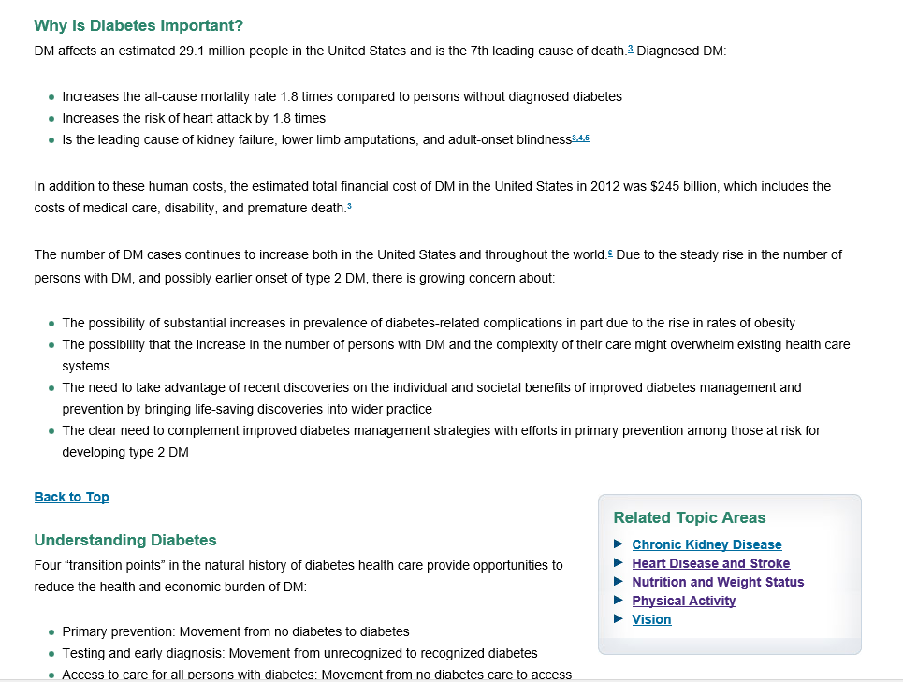
Diabetes Topic Area
Notes:
Slide 11
First, you’ll find an explanation about why this TA is important in our current health system…

Slide 12
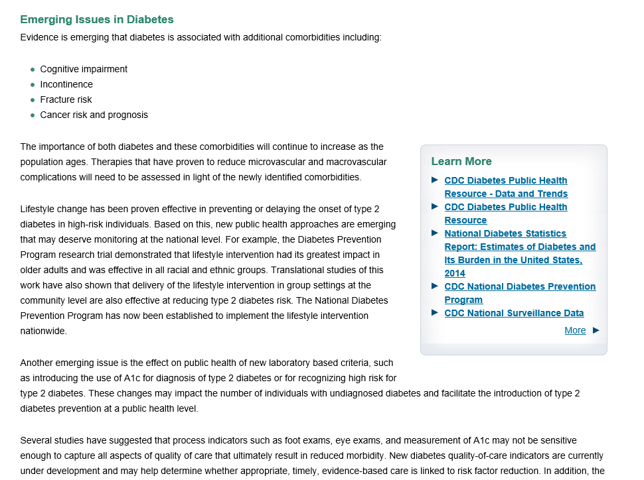
Diabetes Topic Area
Notes:
Slide 12
Emerging Issues…

Slide 13
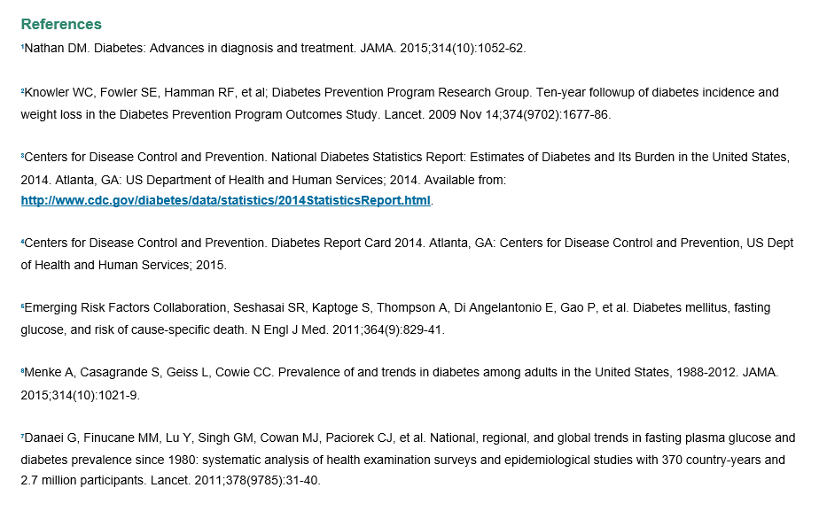
Diabetes Topic Area
Notes:
Slide 12
And Relevant references

Slide 14
Diabetes Topic Area
Notes:
Slide 14
At the top, there are several tabs:
Overview
Objectives
Interventions and Resources
National Snapshots

Slide 15
Diabetes Topic Area
Notes:
Slide 15
Let’s quickly look at the interventions tab

Slide 16
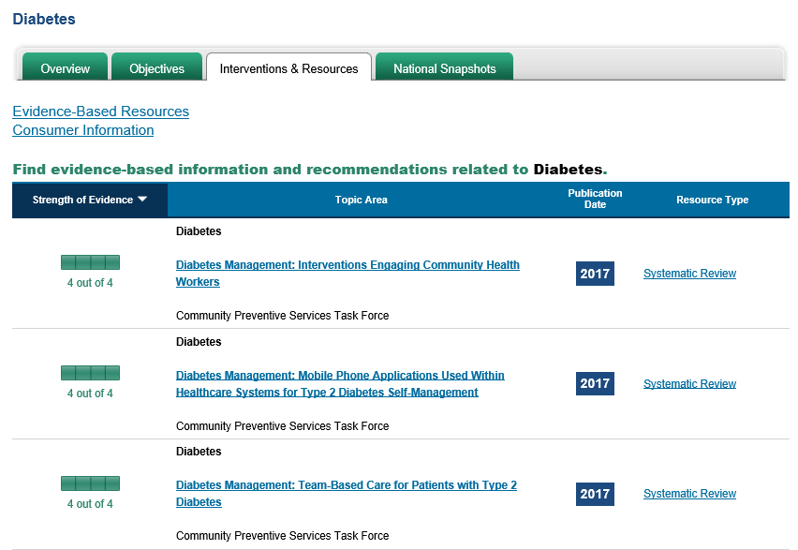
Diabetes Topic Area-Interventions
Notes:
Slide 16
Interventions tab-
From this page you can access the evidence-based resources that have been identified for the Topic Area by subject matter experts.
Next to the resource name, you can see the publication date and the type of resource.
On the left hand side, there is a gradient that reflects how strong the evidence is for each resource.
With a 4 out of 4 meaning that the resource is supported by rigorous evidence.

Slide 17
Diabetes Topic Area
Notes:
Slide 17
Now we are going to look at the objectives tab. If you click on that, you will be taken to a list of all the objectives in the Diabetes Topic Area

Slide 18
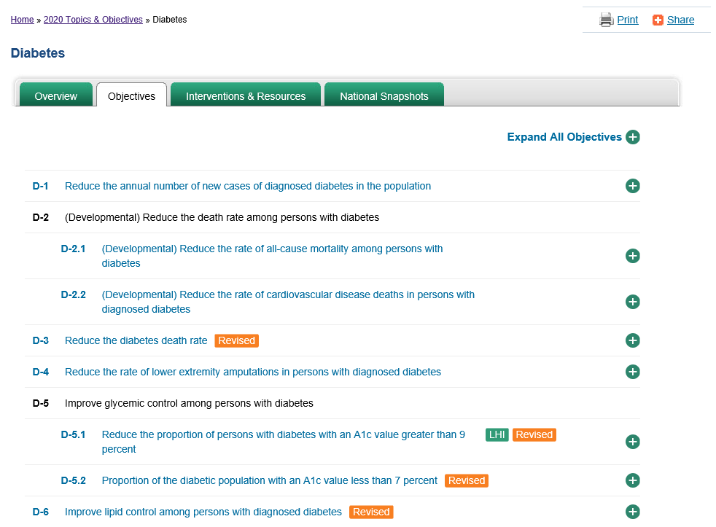
Diabetes-Objective List
Notes:
Slide 18
Some areas have just a few objectives while others have many. So the length of this page will differ by Topic Area
Let’s move on to another topic area, so you can see that regardless of the topic area, the format and the information you can find will always be the same

Slide 19
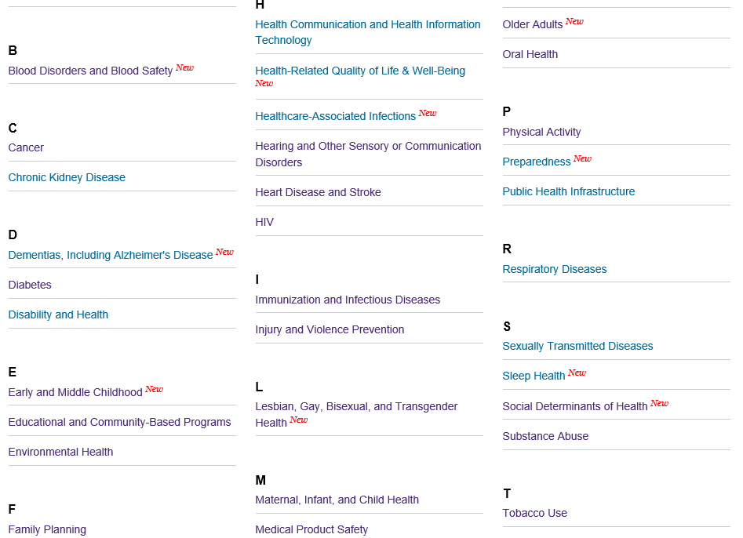
Topic Area List
Notes:
Slide 19
Return to the topic area page and choose the Immunization and Infectious Disease Topic Area

Slide 20
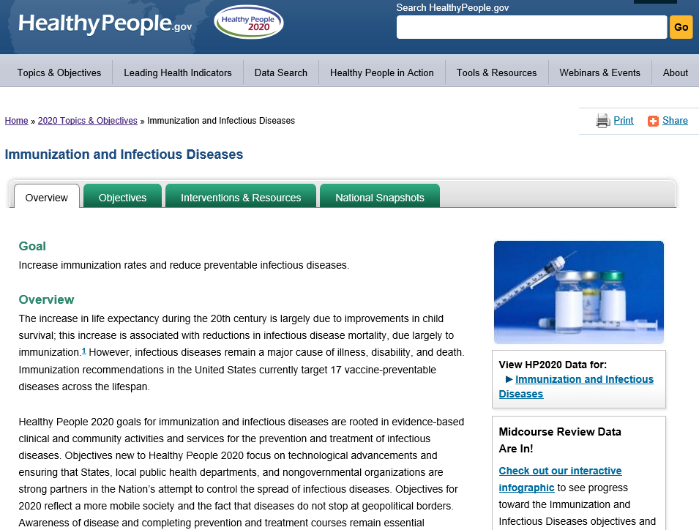
DATA2020
Notes:
Slide 20
and then choose the objectives tab near the top.

Slide 21
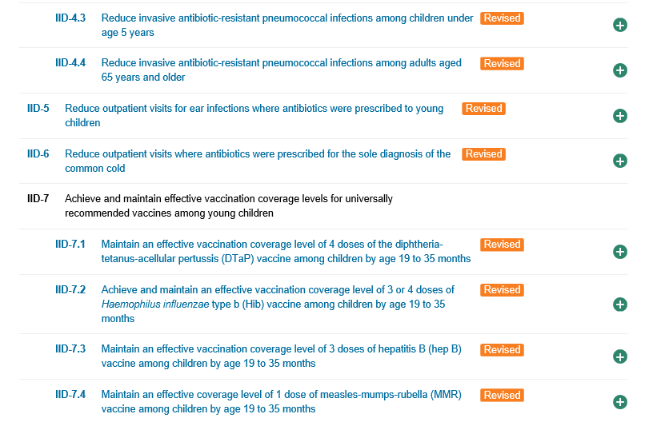
IID-Objective List
Notes:
Slide 21
Now as we look through the list of objectives, I want to point out the tags that are in orange.
These tags are present for objectives that have had MAJOR changes since the launch of HP2020. Examples of a major change include a change in the data source or a change in measurement.
Since HP2020 is a dynamic Initiative and is based on the latest science available -when a change happens to a survey, or recommendations change or new research becomes available…. We have the ability to modify our indicators accordingly.
Next to each of the objectives is a plus sign and if you click on that (for objective IID-7.1 Maintain an effective vaccination coverage level….), you will get what is known in HP Lingo as the Objective Block-

Slide 22
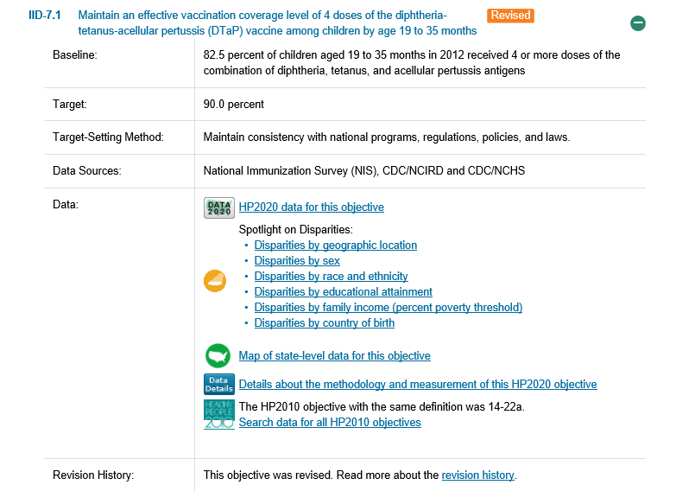
Objective Block
Notes:
Slide 22
Objective blocks are uniform across objectives and topic areas and always consist of a minimum of 5 fields of data.
The 5 fields are-
1-The baseline-which is a plain language statement of the first data value and data year that is tracked in HP2020 for this objective.
2-The target- which is the goal we are striving to reach
3-The target-setting method- that we are using to set the target
4-The Data source-which is what is used to measure the objective
5-And the DATA section
Which includes links to various items:
The Data for this objective
Disparities data
A link to a map of state-level data, if it’s available
The Data Details-- about the methodology and measurement of this objective
-And-
The HP2010 Objective with the same definition: Meaning - If the objective is either exactly the same or modified from an objective in HP2010, that objective number will be listed here.
Finally, if the objective has a tag referring to a change since launch, there will be a section called revision history, where you can get more information on what exactly has changed.
Right now:
Let’s look at the specific options within the DATA section of the objective block

Slide 23
Objective Block
Notes:
Slide 23
HP2020 Data for this objective will take you to the actual data for all years that are available for this objective

Slide 24
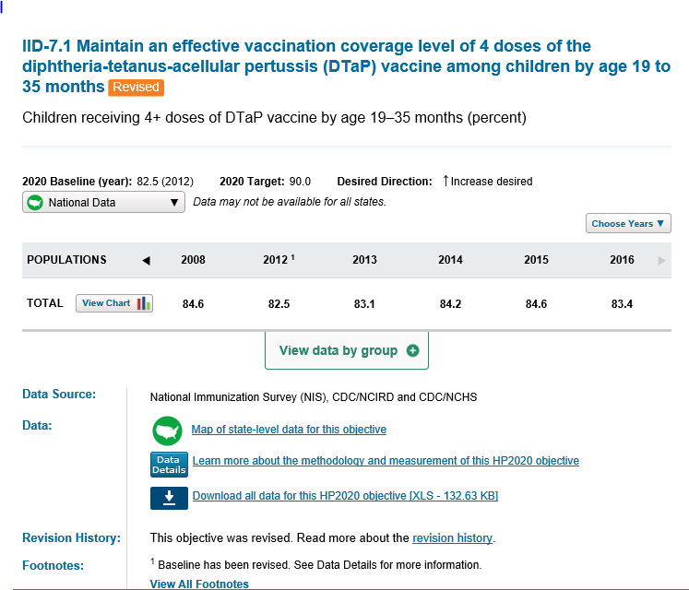
HP2020 Data for this Objective
Notes:
Slide 24
We will come back to this data table in more detail later

Slide 25
Objective Block
Notes:
Slide 25
Spotlight on Disparities links will take you to the Overview on Disparities Charts (for a particular population group)

Slide 26
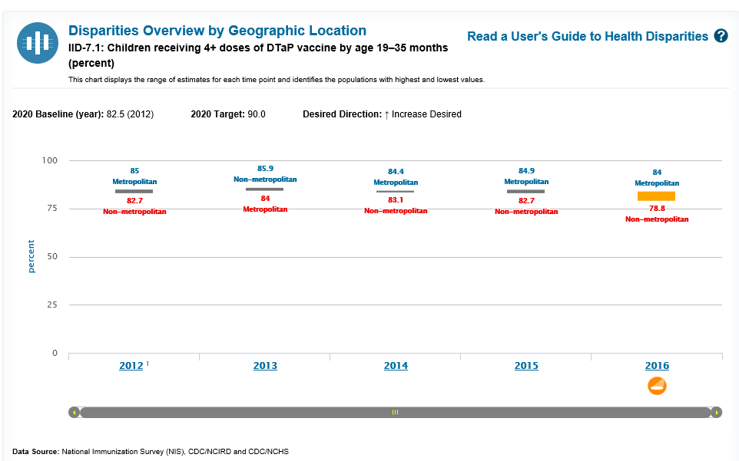
Disparities Data
Notes:
Slide 26
We will come back to this disparities chart in more detail later.

Slide 27
Objective Block
Notes:
Slide 27
If you click on maps, you will be taken to the map for objective IID-7.1 …

Slide 28
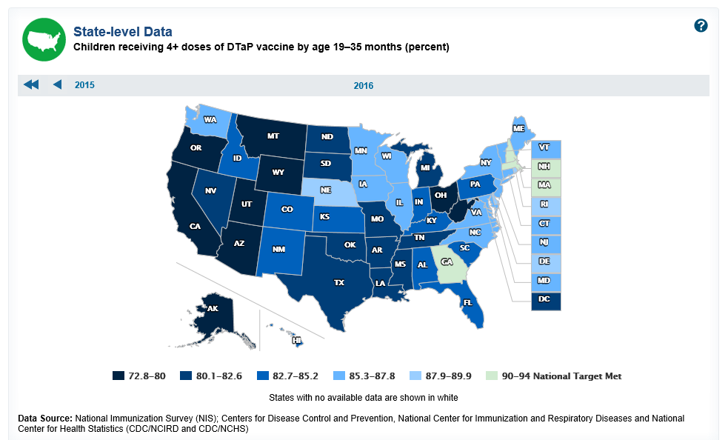
State-Level Maps
Notes:
Slide 28
… as shown here.

Slide 29
Objective Block
Notes:
Slide 29
Data details gives you all of the metadata for this objective …

Slide 30
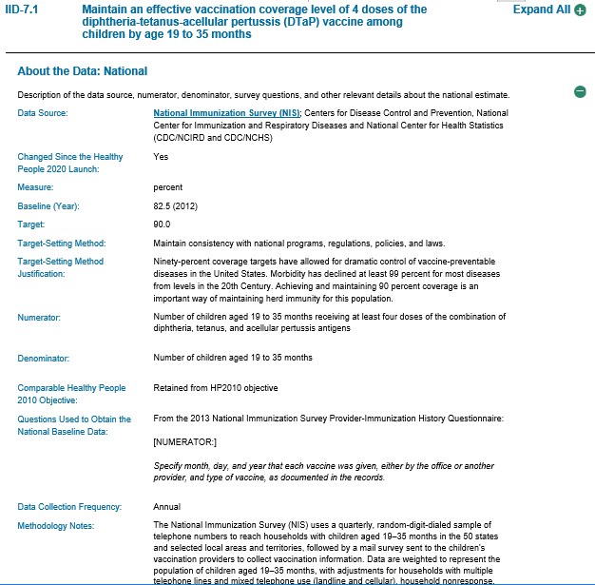
Data Details
Notes:
Slide 30
… including the definition of the objective, information on how it is calculated, methodological issues

Slide 31
DATA2020
Three ways to access data
Please note that the data/information on the slides are as of November 2018.
Notes:
Slide 31
What about the actual data-how do you get to that?
There are three ways.

Slide 32
How to Access the Data
`
Notes:
Slide 32
First, if we head back to the topics and objectives tab, choose the Access to Health Services Topic Area as an example.

Slide 33
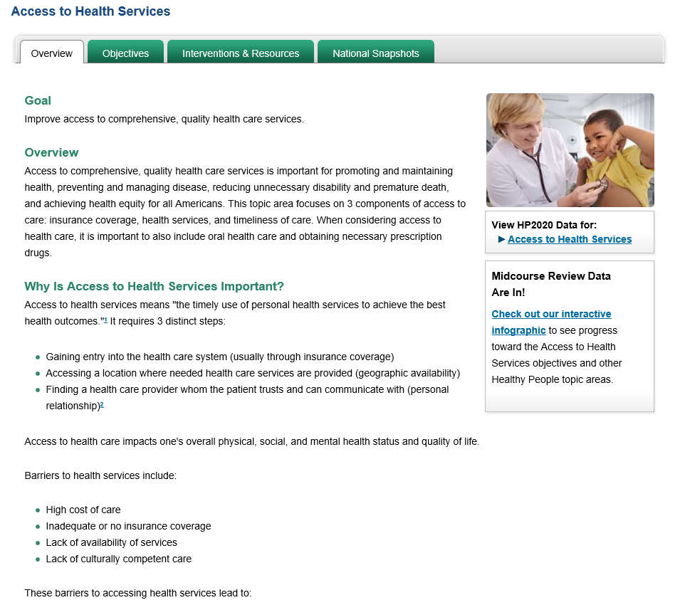
How to Access the Data
Notes:
Slide 33
When you come to the overview page, choose the option that says
“VIEW HP2020 DATA for:” on the right hand side.
You will be taken all 26 objectives in the AHS Topic Area and all of the data associated with those objectives.

Slide 34
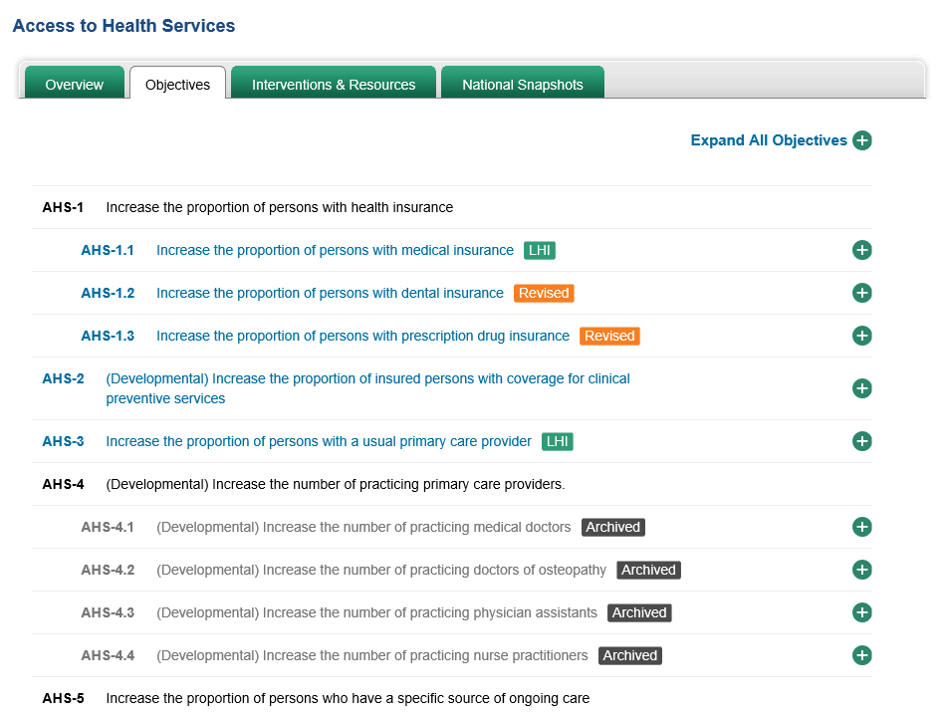
How to Access the Data
Notes:
Slide 34
Second, if you know which specific objective you are interested in you can click on the objectives tab

Slide 35
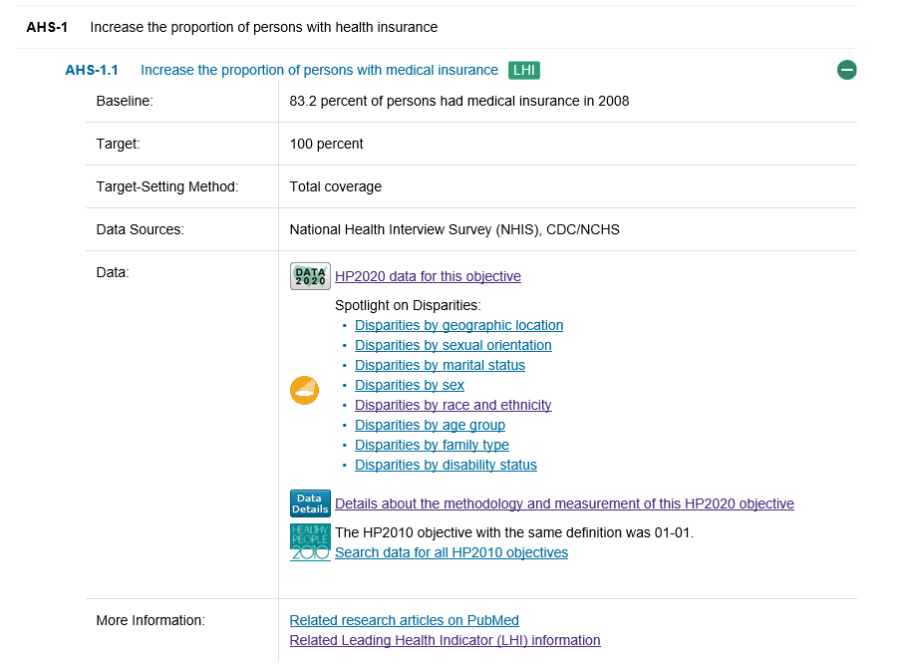
How to Access the Data
Notes:
Slide 35
Click on the name for the objective and then the option for “HP2020 data for this objective”.
This will take you to the data for just the objective you selected—this is what we did before.
We have a lot of data in HP2020 and it’s all displayed in a consistent manner, so once you understand how to search within one topic area or one objective, that process can be applied throughout the Initiative.

Slide 36
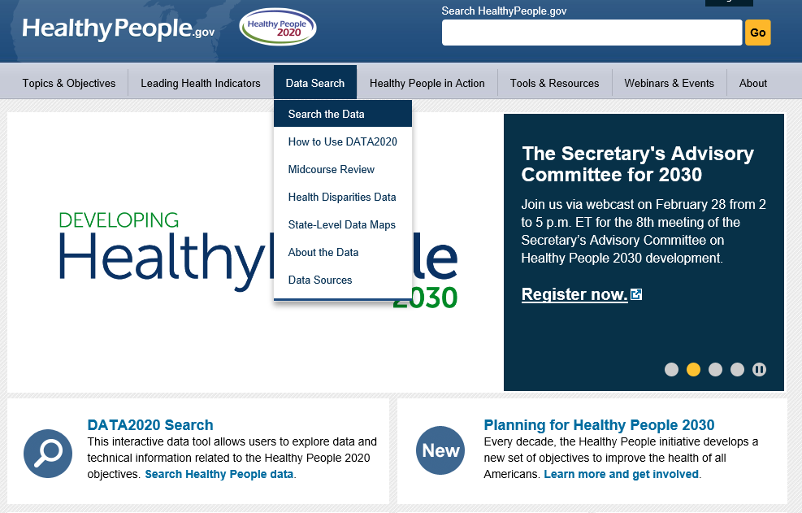
How to Access the Data
Notes:
Slide 36
Finally, you can get to the data through the DATA SEARCH tab at the top of the home page.
Choose Search the data

Slide 37
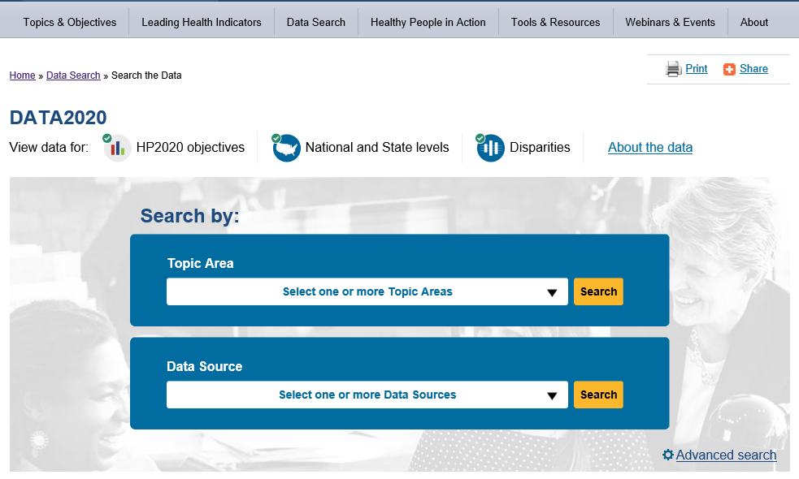
Data Search Feature
Notes:
Slide 37
Which will take you to the data search feature

Slide 38
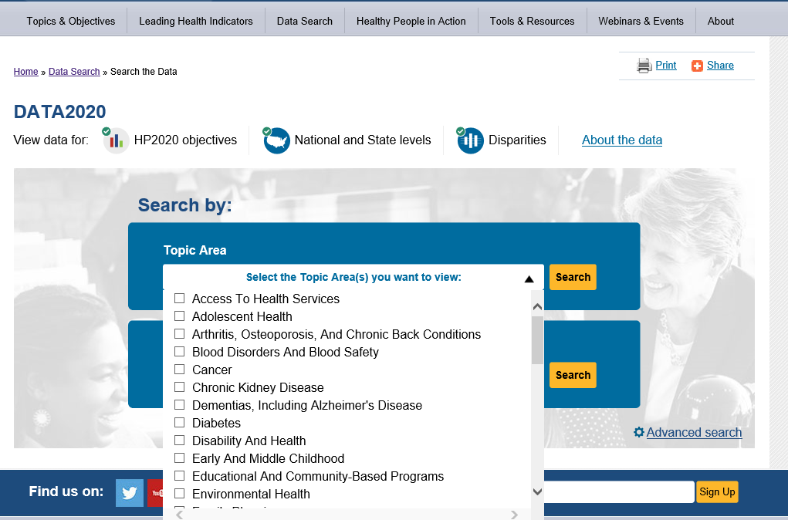
Data Search Feature
Notes:
Slide 38
Let’s look in detail at the DATA SEARCH
In the middle of the page you have the option to use the Quick Drop Down to filter by Topic Area or by Data Source as a starting point.
Topic Area Drop Down
You can choose multiple topic areas or just one.

Slide 39
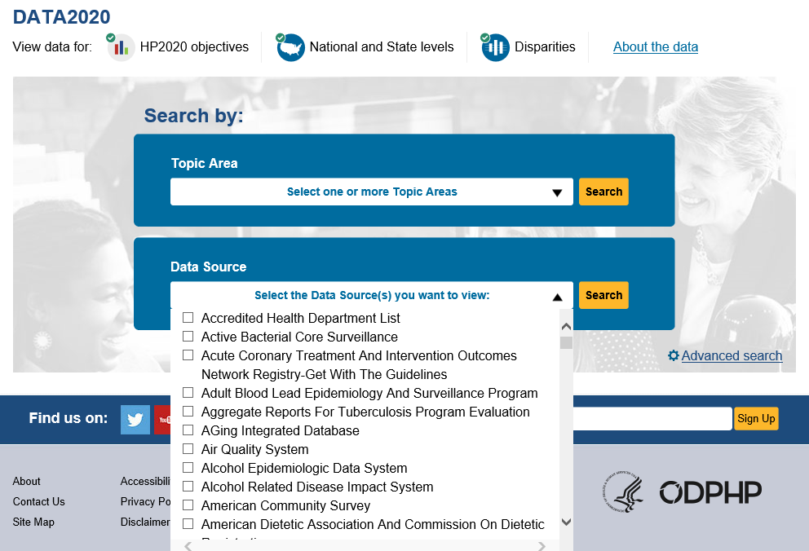
How to Access the Data
Notes:
Slide 39
Data Source Drop Down
Or you could quickly filter by data source.
There are over 180 data sources used in the HP Initiative, some supply data for only one objective while others supply data for over 100.

Slide 40
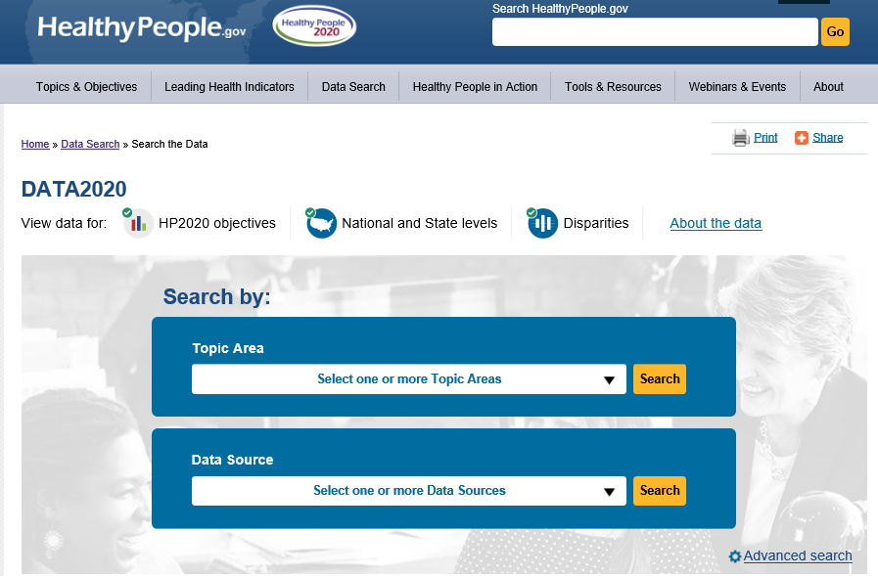
How to Access the Data
Notes:
Slide 40
Or, the broadest search you can do is simply to click on the Advanced Search option.

Slide 41
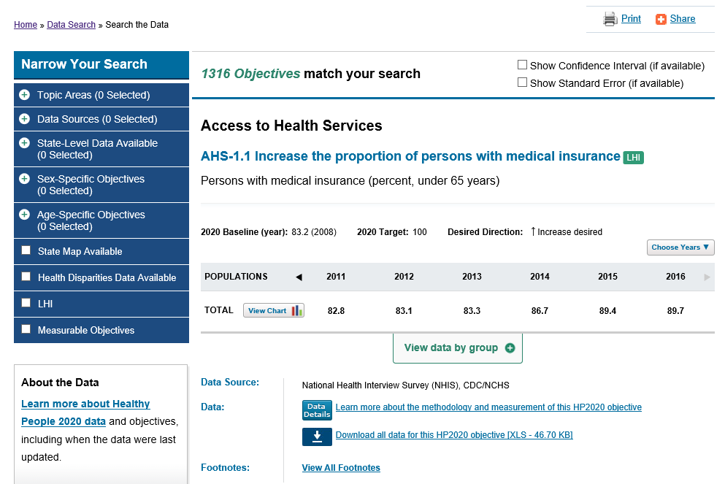
Notes:
Slide 41
If you do that, and scroll down, you will get a list of all 1316 objectives that are currently in the Healthy People 2020 Initiative.

Slide 42
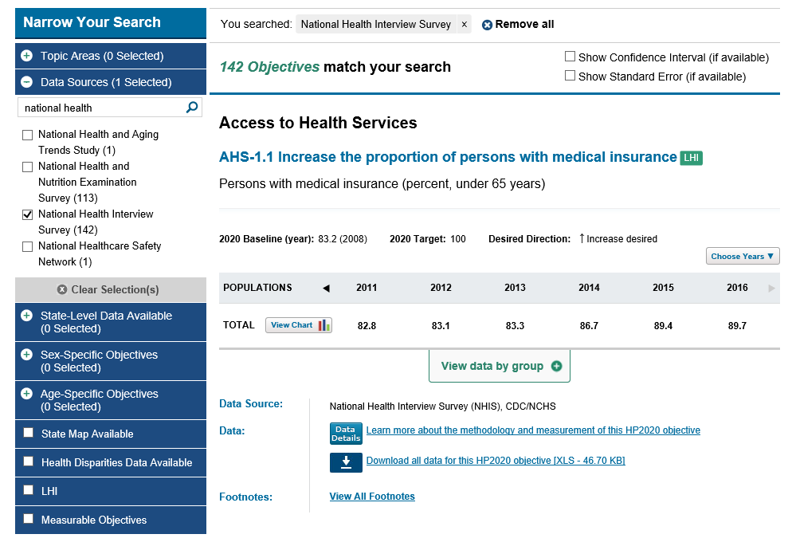
Data Search-Filters
Notes:
Slide 42
If you want to drill down using multiple filters at one time, you can use the “narrow your search” option on the left hand side.
Let’s look at an example and we will start by looking for objectives that use the National Health Interview Survey as the data source.
The NHIS is a nationally-representative survey administered by the National Center for Health Statistics and is considered one of the major data sources in Healthy People because it is used by so many objectives.
When you choose the NHIS–the number of objectives in the search drops from 1316 to 142 objectives that come from multiple topic areas.

Slide 43
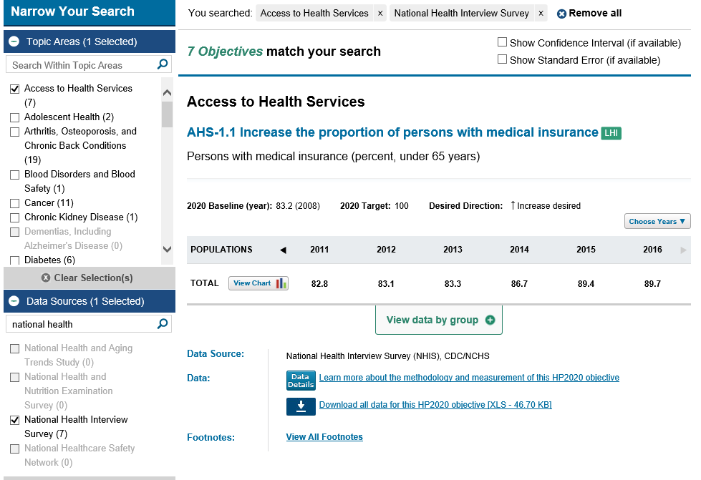
Data Search-Filters
Objective number, title and relevant tags
Basic set-up of a data table
Baseline, target and desired direction towards to reach the target
Nationally representative data
Data Source, technical details link and footnotes
Data Label and Unit of Measurement
The
Notes:
Slide 43
Let’s say you work on issues related to Access to Health Care and you’re trying to find data for a project you are working on. You can refine your search and choose the AHS Topic Area.
And now we have narrowed our search from 142 to 7 objectives.
Because the search is dynamic, if you were to go back to the topic area drop down, you will see that some topic areas are bolded while others are now greyed out. This reflects which topic areas have NHIS data in them.
Let’s spend some time looking in detail at one of the objectives that came up in our search-AHS-1.1
The basic view for any data table will include:
Objective number
Title
Relevant tags
Data label
The unit of measurement
Baseline information
Target
Desired direction which matches the objective text.
Nationally-Representative data for relevant data years
Data source
Link to information on how this objective is measured (data details)
Footnotes that may be applicable
There may be many years of data available if the objective was carried over from HP2010, and you can use the arrows at the top of the table to scroll through and see what is available.

Slide 44
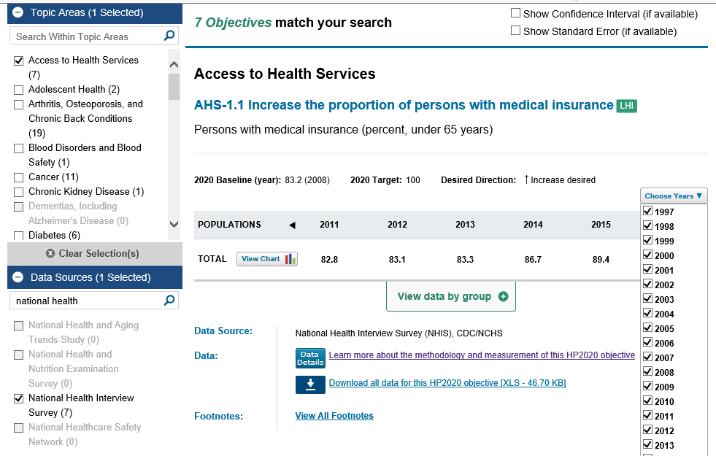
Data Table
Notes:
Slide 44
Or you can choose which years you would like to view or suppress using the “Choose Year” drop down.
Whenever demographic data are available, the option to “view data by group” will appear on the bottom of the table.

Slide 45
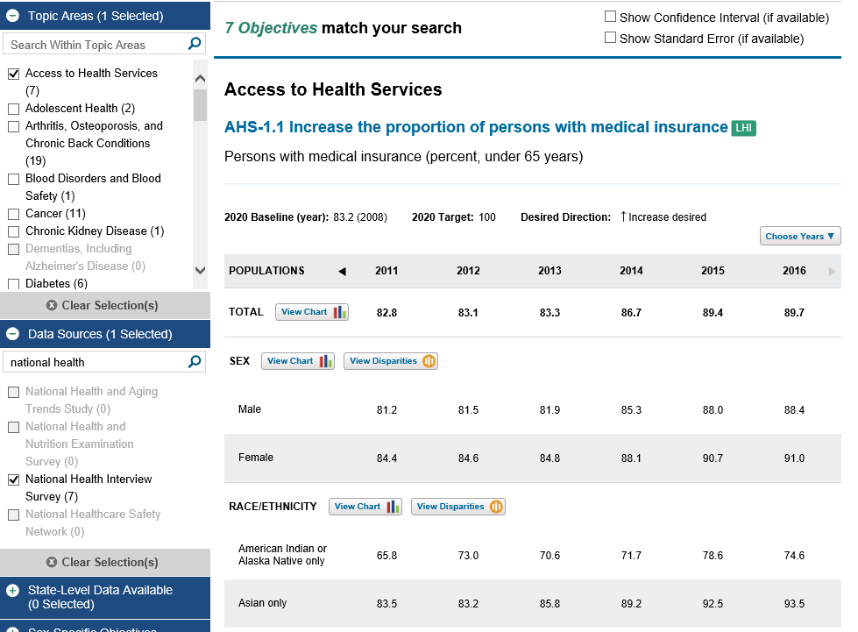
DATA2020
Notes:
Slide 45
If you click on that option you will see all the demographic groups available for the objective.
The default is to not show measures of variability in the data tables, but if you would like that information you can click on the options at the top of the page and they will display.
Just want to point out that you can find footnotes at the bottom of the page.

Slide 46
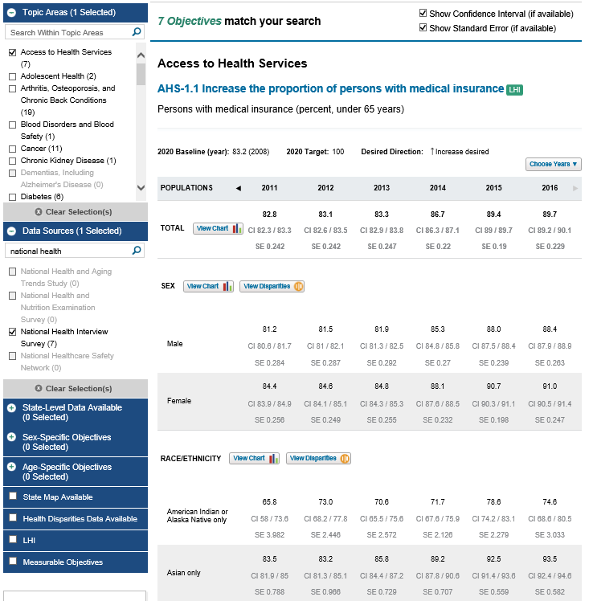
DATA2020
Notes:
Slide 46
Here is an example of data table with the Confidence Intervals and Standard Errors showing

Slide 47
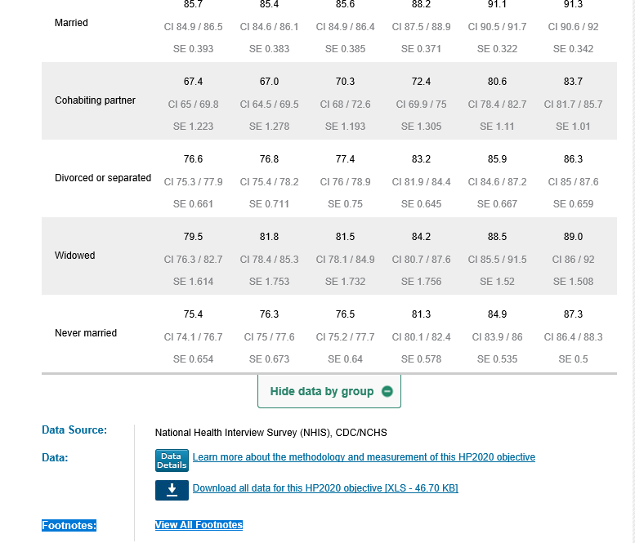
Notes:
Slide 47
Just want to point out that you can find footnotes at the bottom of the page.

Slide 48
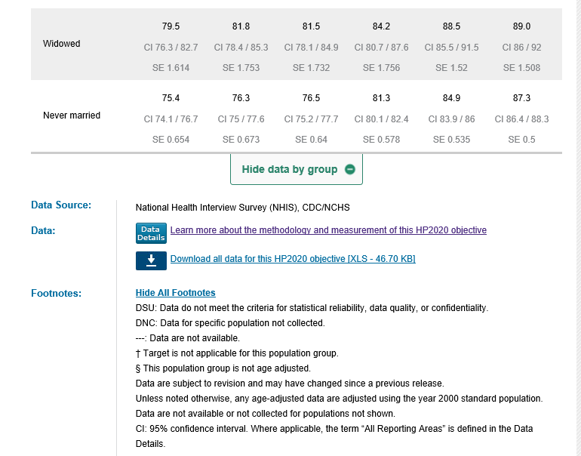
Notes:
Slide 48
And here are the footnotes associate with this table.

Slide 49
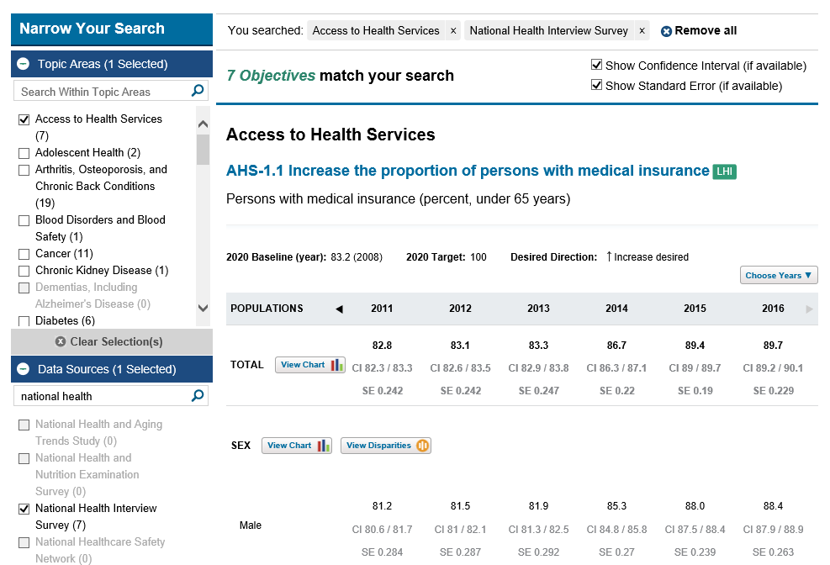
Data Search-Reset Filter
Notes:
Slide 49
If, at any point, you would like to reset your search:
Clicking on either remove all (or just the specific filter you wish to reset) will allow you to do that.

Slide 50
Data Search-Reset Filter
Notes:
Slide 50
Removing all filters will take us back to a listing of all 1316 objectives

Slide 51
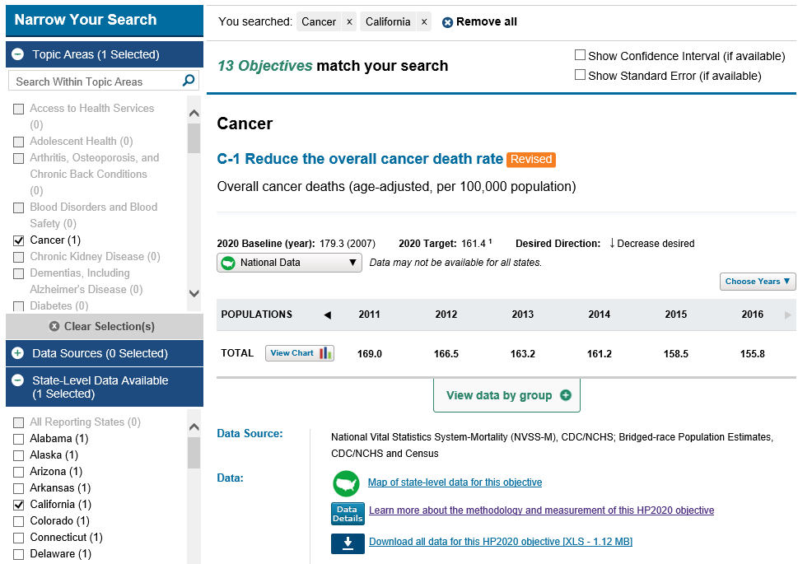
Data Search-State Data
Notes:
Slide 51
Now, in addition to national data, I mentioned earlier that we also have some state-level data in Healthy People 2020.
Let’s say we are interested in data for California and we are also interested in the Cancer Topic Area.
We can again use the objective filters on the left hand side to drill down for objectives that meet our criteria.
Here we get 13 objectives and the first is C-1, Reduce the overall cancer death rate.

Slide 52
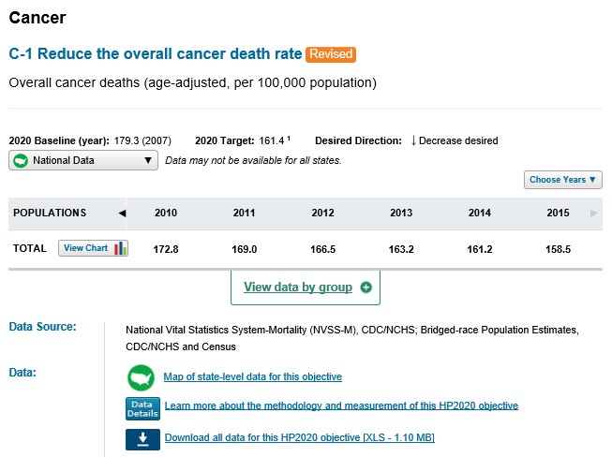
State-Level Data
Notes:
Slide 52
Let’s look a little further at C-1
For any objective that does have sub-national data, there will be a drop down box when you access the data and you can choose which state you would like to see.

Slide 53
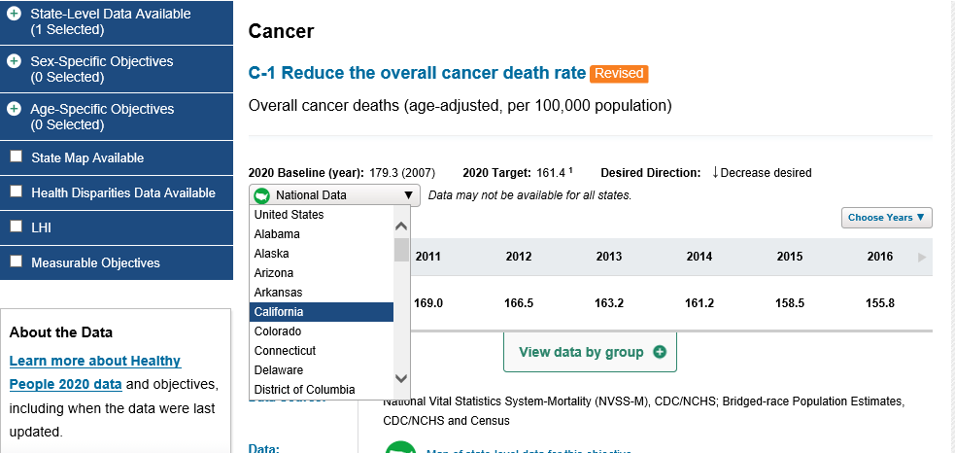
State-Level Data
Notes:
Slide 53
If you click on California, you will be taken to a data table that shows the State you are interested in as well as National level data
Remember that we saw similar links from the objective block in our example from IID topic area.
So, as you can see there are multiple ways to reach the same spot within DATA2020.

Slide 54
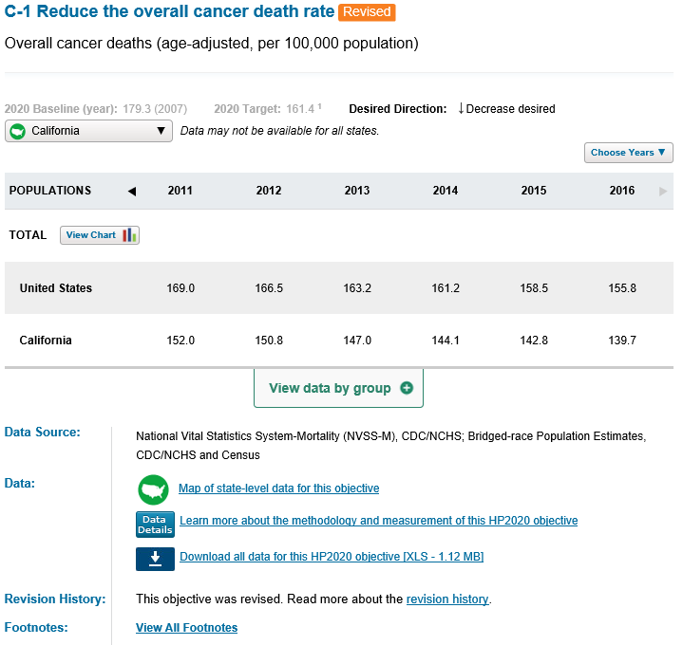
State-Level Data
Notes:
Slide 54
At the bottom of the table you will see a link to the state-level map.
And to the data details.

Slide 55
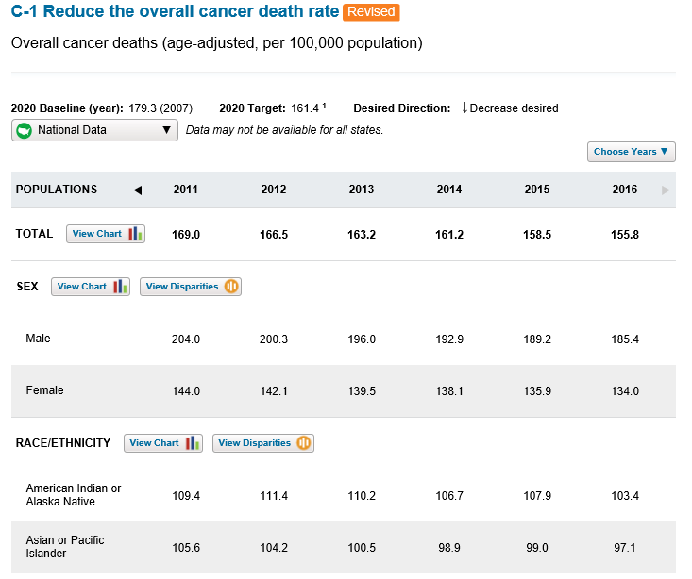
Charting Feature
Notes:
Slide 55
Let’s return to the National level data now and learn how to access the charts and graphs that are available.
A nice feature on HP.GOV is the ability to look at a charts and graphs for different demographic groups-and you can reach those charts, directly from the data tables.
Let’s click on the View Chart icon for the Sex Category

Slide 56
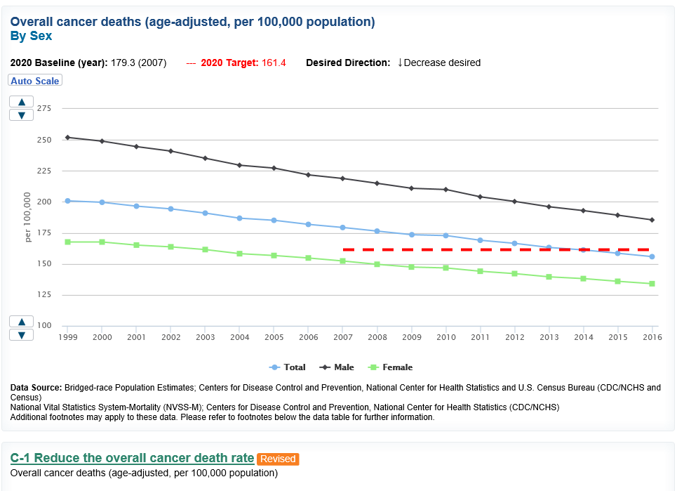
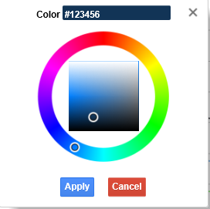
Charting Feature
Notes:
Slide 56
All charts feature:
A target line
An option to change scale
The ability to change colors of trend lines or bars

Slide 57
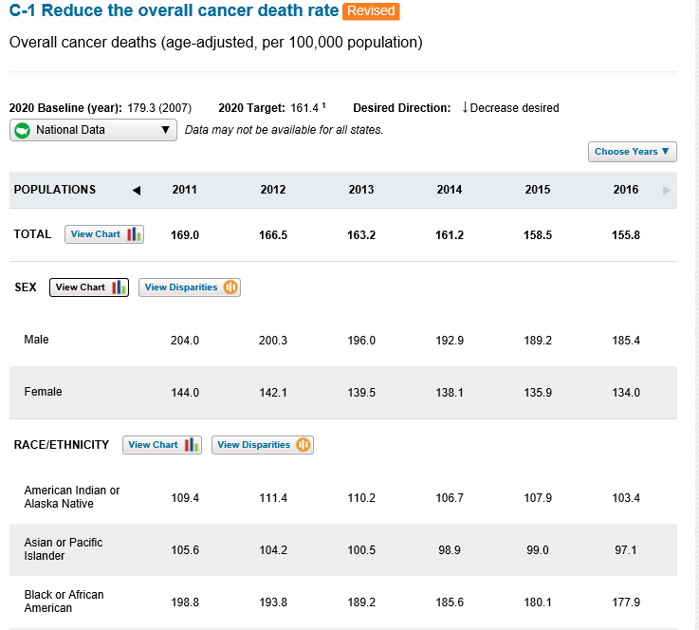
Disparities Data
Notes:
Slide 57
We can also access disparities data directly from the data tables by clicking on the “View Disparities icon”
Let’s look at View Disparities for Race/Ethnicity

Slide 58
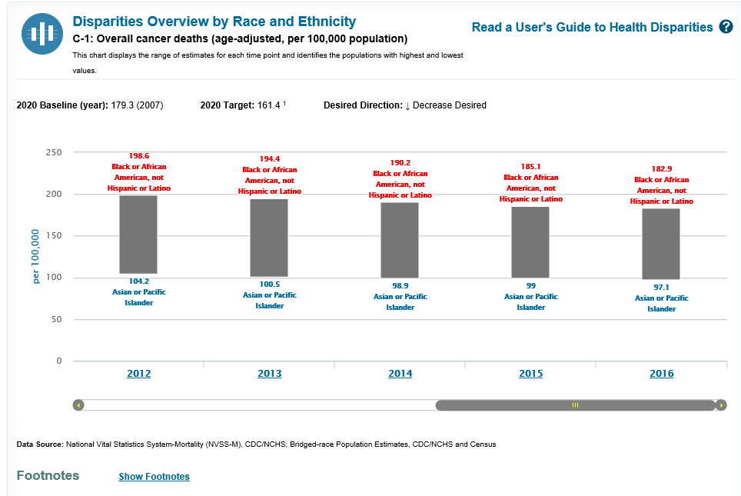
Disparities Data
Notes:
Slide 58
This graph displays the range of estimates for each time point for the best and worst group.
By clicking on the year you can access more detailed information.

Slide 59
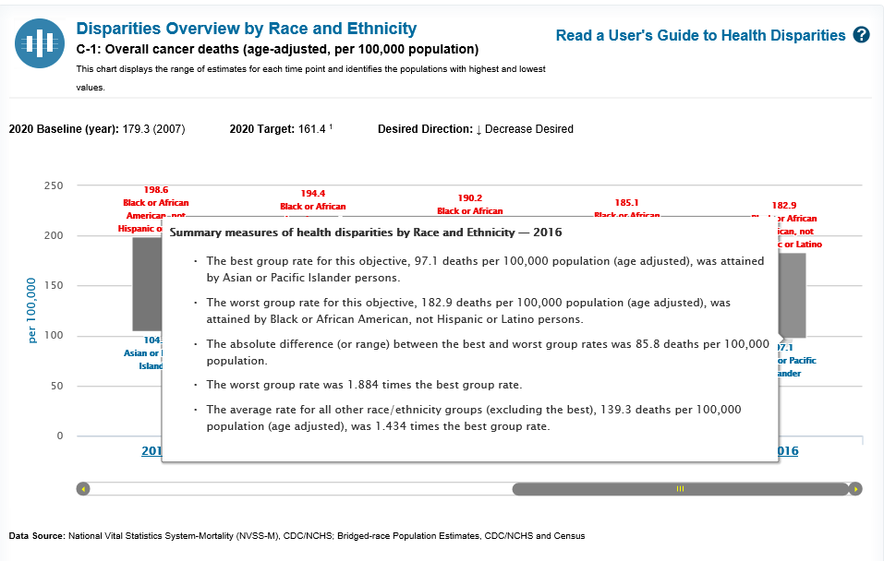
Disparities Data
Notes:
Slide 59
One example is Summary measures for health disparities, which are displayed in the hover boxes.

Slide 60
DATA2020
Explore Data
Visual Displays
Technical Information
National
State-level estimates (when available)
Demographic groups
Measures of variability (Confidence intervals and/or Standard errors)
Disparities
Progress towards target
Numerator and Denominator definitions for each objective
Methodology Notes
Data Limitations or Trend issues
Historical and technical details about data sources
Charts/Graphs
Maps
Notes:
Slide 60
So far we have briefly touched on:
How to access information on topic areas and objectives
Gone over the fields that constitute an objective block-which will also be required for HP2030
Learned how to find data details, and discussed what additional information may be needed for objective development proposals.
We then moved on to:
The three ways to find data for an objective,
Looked at the format of the data tables, chart and disparities data
and the availability of state-level data and maps
Two final areas I want to discuss are progress toward targets and the data source page

Slide 61
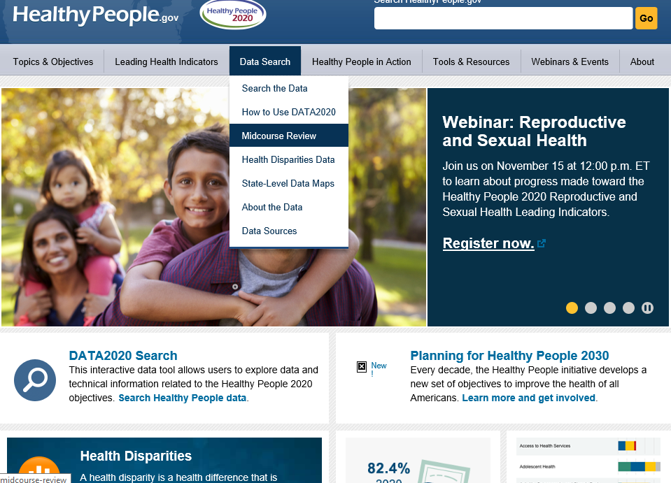
Additional Resources-Progress
Notes:
Slide 61
First let’s discuss a snapshot of progress during the midpoint of the decade---
If you click on the data search tab, half way through you will see an option for the midcourse review.

Slide 62
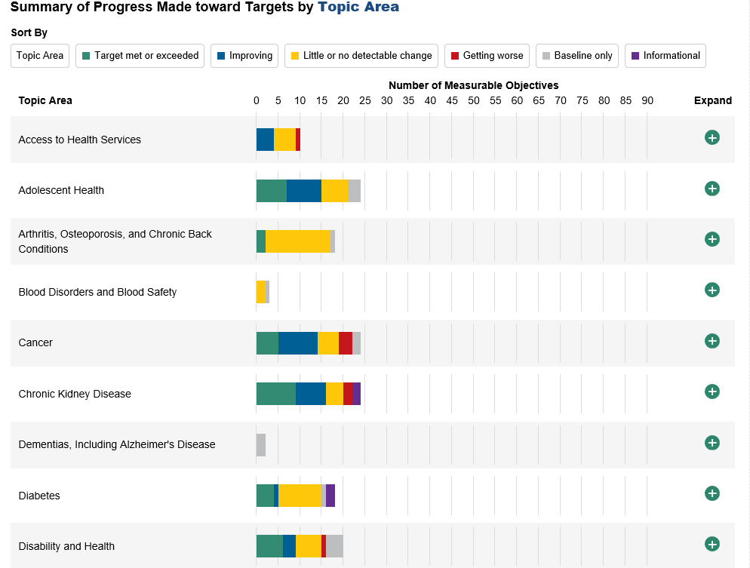
Progress towards Target
Notes:
Slide 62
By choosing to view the infographics for all topic areas you will be taken to a Summary of Progress

Slide 63
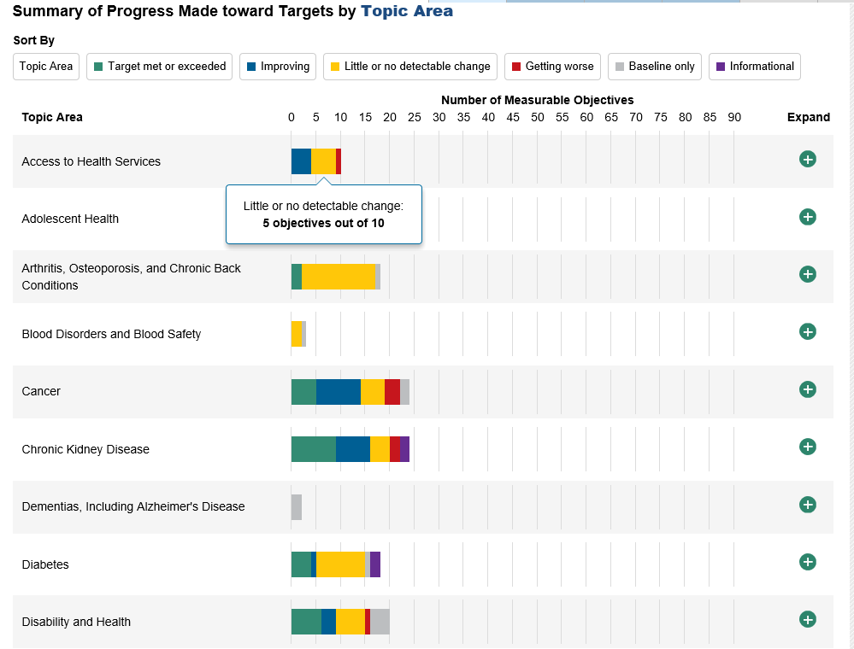
Progress towards Target
Notes:
Slide 63
If you hover on the graph you can get detailed information on how many objectives fall into different categories

Slide 64
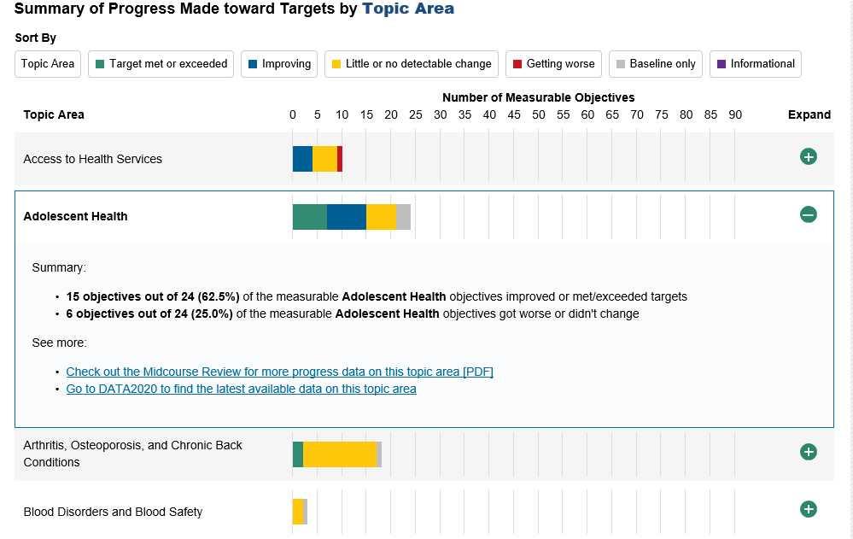
Progress towards Target
Notes:
Slide 64
You can hit the expand button to get more information about any one topic area

Slide 65
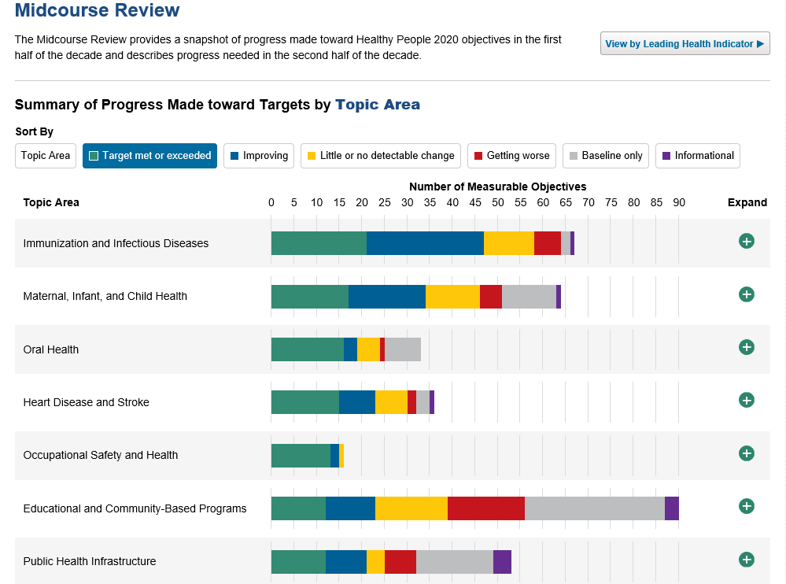
Progress towards Target
Notes:
Slide 65
Or you can sort by any of these categories - and the bar graphs will adjust accordingly.

Slide 66
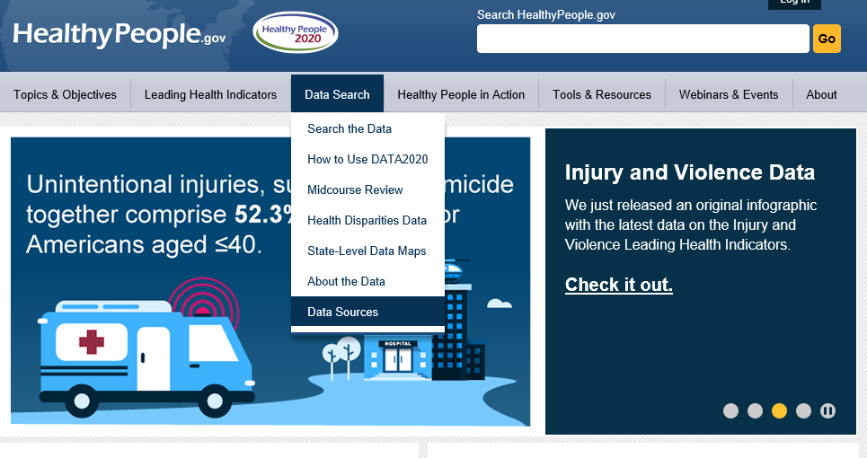
Data Sources
Notes:
Slide 66
As I mentioned before, there are over 180 data sources that provide data for HP2020 objectives.

Slide 67
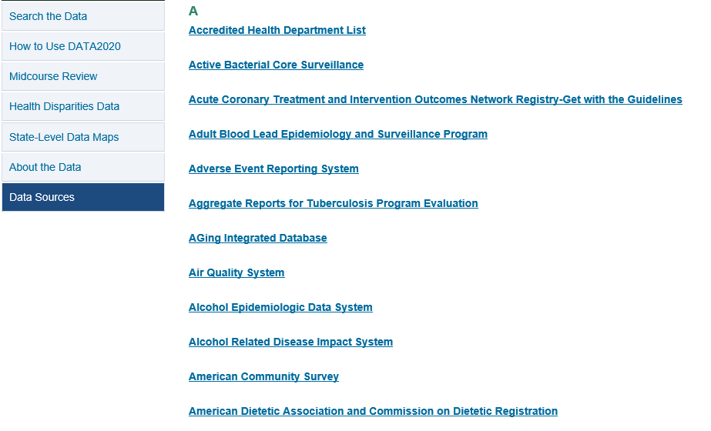
Data Sources
Notes:
Slide 67
This link will give you an alphabetical list of all the data sources used in Healthy People

Slide 68

Data Sources
Notes:
Slide 68
By clicking any of the names, you can get a lot of info on the data source itself –Choose BRFSS

Slide 69

Data Sources-BRFSS
Notes:
Slide 69
Such as:
Description
Data years available
How frequently data are collected
Populations they cover

Slide 70

Data Sources-BRFSS, Cont.
Notes:
Slide 70
…plus more.
We include as much information as possible for the data sources and are continually working to update the data source listings, as needed

Slide 71
DATA2020
Data
Visual Displays
Technical Information
National
State-level estimates (when available)
Demographic groups
Measures of variability (Confidence intervals and/or Standard errors)
Disparities
Progress towards target
Numerator and Denominator definitions for each objective
Methodology Notes
Data Limitations or Trend issues
Historical and technical details about data sources
Charts/Graphs
Maps

Slide 72
To access DATA2020 go to HealthyPeople.gov
Please note that the data/information on the slides are as of November 2018.

