Slide 1



Healthy People 2020
Progress Review

Slide 2

Preserving Your Healthy Lifespan:
Preventing and Managing Chronic Musculoskeletal and Cardiovascular Diseases
Jewel Mullen, MD, MPH, MPA
Principal Deputy Assistant Secretary for Health
February 28, 2017

Slide 3
Agenda and Presenters
Chair
Jewel Mullen, MD, MPH, MPA, Principal Deputy Assistant Secretary for Health, U.S. Department of Health and Human Services
Presentations
Charles Rothwell, MBA, MS, Director, National Center for Health Statistics
Gary Gibbons, MD, Director, National Heart Lung and Blood Institute, NIH
Walter Koroshetz, MD, Director, National Institutes of Neurological Disorders and Stroke, NIH
Wayne Giles MD, MS, Director, Division for Heart Disease and Stroke Prevention, CDC
Joan McGowan, PhD, Director of the Division of Musculoskeletal Diseases, National Institute of Arthritis Musculoskeletal and Skin Diseases, NIH
Kurt Greenlund, PhD, Acting Director, Division of Population Health, CDC
Community Highlight
Matt Longjohn, MD, MPH National Health Officer, Vice President of Community Integrated Health, YMCA of the USA

Slide 4
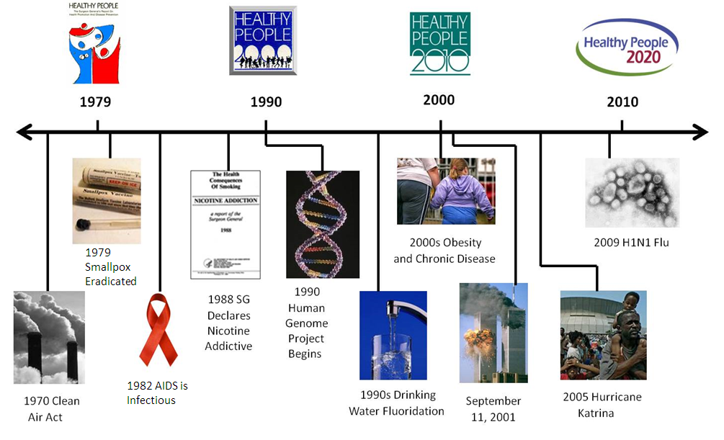
Healthy People at the Forefront of Public Health
4

Slide 5
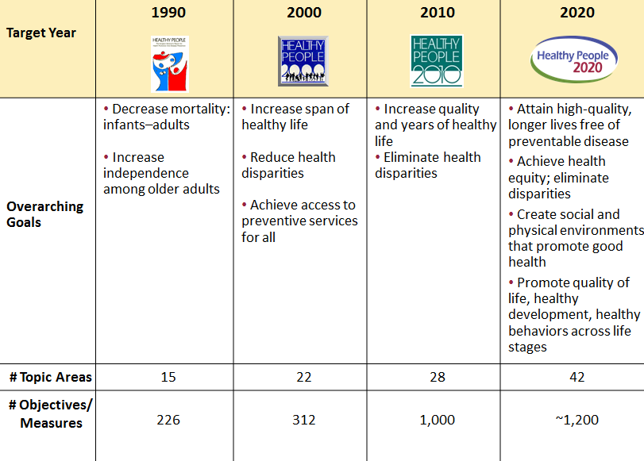
Evolution of Healthy People

Slide 6
Heart Disease and Stroke in the United States
Heart Disease is the leading cause of death in the U.S.
It includes several types of heart conditions, such as:
  Coronary artery disease
  Chest pain (angina)
  Heart attack
Stroke, the 5th leading cause of death, occurs when the flow of oxygenated blood to the brain is blocked
Cardiovascular diseases (CVD) cost $316.1 billion annually in 2012-2013
  $189.7 billion direct costs
  $126.6 billion indirect costs
SOURCE: https://www.healthypeople.gov/2020/topics-objectives/topic/heart-disease-and-stroke https://www.cdc.gov/heartdisease/

Slide 7

Prevention Matters
Controllable risk factors
  High blood pressure
  High cholesterol
  Cigarette smoking
  Diabetes
  Poor diet and physical inactivity
  Overweight and obesity
29.5% of adults are affected by high blood pressure, half of them have it under control
SOURCE: https://www.healthypeople.gov/2020/topics-objectives/topic/heart-disease-and-stroke

Slide 8
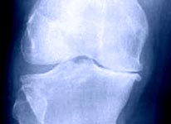
Arthritis, Osteoporosis, and Chronic Back Conditions
Arthritis - more than 100 types
Commonly occurs with other chronic conditions
  Diabetes
  Heart disease
  Obesity
Osteoporosis is marked by low bone mass and a reduction in bone strength
  Increased risk of broken bones
Chronic back pain
  Lasts for more than three months
  Can become progressively worse and reoccur
  Outlasts the usual healing process
SOURCE: https://www.healthypeople.gov/2020/topics-objectives/topic/Arthritis-Osteoporosis-and-Chronic-Back-Conditions

Slide 9

Arthritis in the United States
1 in 5 adults has arthritis
Arthritis is a leading cause of disability
Costs are projected to increase over time
SOURCE: https://www.healthypeople.gov/2020/topics-objectives/topic/Arthritis-Osteoporosis-and-Chronic-Back-Conditions

Slide 10

Osteoporosis and Chronic Back Conditions
5.3 million people (50 years and older) have osteoporosis at the hip
Half of all women and 1 in 4 men will have osteoporosis related fractures in their lifetime
80% of Americans experience low back pain in their lifetime
SOURCES: https://www.healthypeople.gov/2020/topics-objectives/topic/Arthritis-Osteoporosis-and-Chronic-Back-Conditions
https://www.ninds.nih.gov/Disorders/Patient-Caregiver-Education/Fact-Sheets/Low-Back-Pain-Fact-Sheet

Slide 11
Preserving Musculoskeletal Health
Start early with healthy habits
  Adequate dietary calcium and vitamin D, and,
  Physical activity
Maintain physical activity and a healthy weight throughout life for bone, joint, and spine health
Avoid sports injuries through proper training and equipment use
SOURCE: https://www.niams.nih.gov/health_info/bone/SGR/surgeon_generals_report.asp

Slide 12
Charles Rothwell, MBA, MS
Director, National Center for Health Statistics
Centers for Disease Control and Prevention

Slide 13
Presentation Overview
Tracking the Nation’s Progress
Arthritis, Osteoporosis, and Chronic Back Conditions
Heart Disease and Stroke
13

Slide 14
Tracking the Nation’s Progress
  18 HP2020 Measurable Arthritis, Osteoporosis, and Chronic Back Conditions Objectives:
  37 HP2020 Measurable Heart Disease and Stroke Objectives:
2 | Target met
133 | Little or no detectable change Getting worse
15 8 | Target met Improving
10 2 1 1 | Little or no detectable change Getting worse Baseline data only Informational
NOTES: The Arthritis, Osteoporosis, and Chronic Back Conditions Topic Area added 4 developmental objectives on generic pain issues in 2014, which are not addressed in this Progress Review. The Heart Disease and Stroke Topic Area contains 13 developmental objectives. Measurable objectives are defined as having at least one data point currently available, or a baseline, and anticipate additional data points throughout the decade to track progress. Informational objectives are also measurable objectives, however, they do not have a target associated with their data.
14

Slide 15
Presentation Outline
Tracking the Nation’s Progress
Arthritis, Osteoporosis, and Chronic Back Conditions
  Burden
  Activity Limitations due to Arthritis and Chronic Back Conditions
  Counseling for Weight Reduction and Physical Activity among Adults with Arthritis
  Osteoporosis Prevalence
Heart Disease and Stroke
15

Slide 16
Burden of Arthritis
Arthritis is a leading cause of disability.
In 2015, 55.4 million (22.9%) adults aged 18 and over in the United States had doctor-diagnosed arthritis.
In 2015, 58% of adults with doctor-diagnosed arthritis were in the working age population (18-64); 42% were in the older adult population (65+).
By 2040, the prevalence of arthritis is projected to increase 42% to 78.4 million (25.9% of U.S. adults).
SOURCES: Brault MW, Hootman JM, Helmick CG, Theis KA, Armour BS. Prevalence and most common causes of disability among adults--United States, 2005. MMWR: Morbidity and Mortality Weekly Report. 2009;58(16):421-6. Blackwell DL, Villarroel MA. Tables of Summary Health Statistics for U.S. Adults: 2015 National Health Interview Survey. National Center for Health Statistics. 2016. Available from: https://ftp.cdc.gov/pub/Health_Statistics/NCHS/NHIS/SHS/2015_SHS_Table_A-4.pdf. Hootman JM, Helmick CG, Barbour KE, Theis KA, Boring MA. Updated projected prevalence of self-reported doctor-diagnosed arthritis and arthritis-attributable activity limitation among US adults, 2015-2040. Arthritis and Rheumatology. 2016;68(7):1582-7
16

Slide 17
Burden of Osteoporosis and Chronic Back Conditions
Osteoporosis is a major risk factor for fracture.
In 2013-14, 7.3% of adults aged 50 and over had osteoporosis at the hip (age-adjusted).
Common causes of chronic back pain are osteoarthritis and disc degeneration.
In 2015, 8.4 million adults aged 18 and over had activity limitations due to chronic back or neck pain.
In 2015, among broad age groups of adults, prevalence of low back or neck pain is highest for persons aged 45 to 64.
SOURCES: US Dept. of Health and Human Services, Public Health Service, Office of the Surgeon General. Bone health and osteoporosis: A report of the Surgeon General. Rockville, MD: US GPO; 2004, p. 436. Available from: http://www.ncbi.nlm.nih.gov/books/NBK45513/pdf/TOC.pdf
National Health and Nutrition Examination Survey (NHANES), CDC/NCHS. National Health Interview Survey (NHIS), CDC/NCHS. Manek NJ, Macgregor AJ. Epidemiology of back disorders: Prevalence, risk factors, and prognosis. Curr Opin Rheumatol. 2005;17:134-40.
17

Slide 18
Activity Limitations Due to Arthritis, Adults 18+ Years with Arthritis, 2015
HP2020 Target: 35.5%
Decrease desired
NOTES: = 95% confidence interval. *2008 Total = HP2020 baseline. Data are for adults aged 18 years and over with doctor-diagnosed arthritis who are limited in any way in usual activities because of arthritis or joint symptoms. Black and White exclude persons of Hispanic origin. Persons of Hispanic origin may be any race. American Indian includes Alaska Native. Respondents were asked to select one or more races. Data for the single race categories shown are for persons who reported only one racial group. Data are age-adjusted to the 2000 standard population.
I
SOURCE: National Health Interview Survey (NHIS), CDC/NCHS.
Obj. AOCBC-2
18

Slide 19
Activity Limitations Due to Chronic Back or Neck Conditions, Adults 18+ Years, 2015
HP2020 Target: 27.6
Decrease desired
Educational Attainment (Ages 25+)
NOTES: = 95% confidence interval. *2008 Total = HP2020 baseline. Data are for adults with a limitation in activity due to chronic back or neck problems. Data (except those by education) are for adults 18 years and over. Black and White exclude persons of Hispanic origin. Persons of Hispanic origin may be any race. American Indian includes Alaska Native. Respondents were asked to select one or more races. Data for the single race categories shown are for persons who reported only one racial group. Education data are for adults aged 25 years and over. Data are age-adjusted to the 2000 standard population.
I
SOURCE: National Health Interview Survey (NHIS), CDC/NCHS.
Obj. AOCBC-12
19

Slide 20
Weight Reduction Counseling, Overweight or Obese Adults 18+ Years with Arthritis
Percent
HP2020 Target: 45.3%
Women
Total
Men
NOTES: *2006 = HP2020 baseline. Data are for overweight and obese adults aged 18 and over with doctor-diagnosed arthritis who received weight-reduction counseling from their health care provider to help arthritis or joint symptoms. Data are age-adjusted to the 2000 standard population.
Obj. AOCBC-7.1
Increase desired
SOURCE: National Health Interview Survey (NHIS), CDC/NCHS.

Slide 21
Counseling for Physical Activity or Exercise, Adults 18+ Years with Arthritis, 2014
HP2020 Target: 57.4%
Increase desired
NOTES: = 95% confidence interval. *2006 Total = HP2020 baseline. Data are for adults aged 18 years and over with doctor-diagnosed arthritis who received health care provider counseling for physical activity or exercise to help arthritis or joint symptoms. Black and White exclude persons of Hispanic origin. Persons of Hispanic origin may be any race. American Indian includes Alaska Native. Respondents were asked to select one or more races. Data for the single race categories shown are for persons who reported only one racial group. Data are age-adjusted to the 2000 standard population.
I
SOURCE: National Health Interview Survey (NHIS), CDC/NCHS.
Obj. AOCBC-7.2
21

Slide 22
Osteoporosis at the Hip,
Adults 50+ Years, 2013-2014
HP2020 Target: 5.3%
Decrease desired
Age (years)
NOTES: = 95% confidence interval. *2005-2008 Total = HP2020 baseline. Data are for adults aged 50 years and over with a femoral neck bone mineral density (BMD) value ≤ 0.56 gm/cm² based on dual-energy X-ray absorptiometry (DXA) measurements. Data (except those by age group) are age-adjusted to the 2000 standard population. The categories Asian, Black and White exclude persons of Hispanic origin. Persons of Hispanic origin may be any race. Respondents were asked to select one or more races. Data for the single race categories are for persons who reported only one racial group. Target does not apply to age groups.
I
SOURCE: National Health and Nutrition Examination Survey (NHANES), CDC/NCHS.
Obj. AOCBC-10

Slide 23
Presentation Outline
Tracking the Nation’s Progress
Arthritis, Osteoporosis, and Chronic Back Conditions
Heart Disease and Stroke
  Burden
  Deaths
  Hypertension Prevalence and Control
  Awareness of Stroke Symptoms and Response
23

Slide 24
Burden of Heart Disease and Stroke
In 2015, heart disease (633,842 deaths) was the leading cause of death, and stroke (140,323 deaths) was the fifth leading cause of death in the United States.
In 2014, about 16.5 million adults aged 20 and over had coronary heart disease (CHD).
  Each year, approximately 1.0 million adults aged 35 and over experience a new or recurrent heart attack or fatal CHD.
In 2014, 7.2 million adults aged 20 and over have ever had a stroke.
  Each year approximately 795,000 people (all ages) experience a new or recurrent stroke.
SOURCES: National Vital Statistics System—Mortality (NVSS-M), CDC/NCHS; Bridged-Race Population Estimates, CDC/NCHS and Census. Benjamin EJ, Blaha MJ, Chiuve SE, et al. Heart Disease and Stroke Statistics-2017 Update: A Report From the American Heart Association. Circulation. 2017;135:00–00.
24

Slide 25
Burden of Heart Disease and Stroke
The leading modifiable risk factors for heart disease and stroke are:
  High blood pressure
  High cholesterol
  Cigarette smoking
  Diabetes
  Poor diet and physical inactivity
  Overweight and obesity
In 2011-14:
  29.5% of adults aged 18 and over had hypertension (75 million U.S. adults)
  50.3% of adults aged 18 and over with hypertension had their condition under control
  47.9% of adults aged 20 and over had normal total cholesterol levels (<200 mg/dL)
NOTES: Hypertension is defined among adults, excluding pregnant women, as systolic blood pressure ≥140 mmHg or diastolic blood pressure ≥90 mmHg or taking blood pressure lowering medication. Blood pressure control is defined as systolic blood pressure <140 mmHg and diastolic blood pressure <90 mmHg among adults with hypertension. Data are age-adjusted to the 2000 standard population.
SOURCES: Merai R, Siegel C, Rakotz M, et al. CDC Grand Rounds: A Public Health Approach to Detect and Control Hypertension. MMWR Morb Mortal Wkly Rep 2016;65:1261–1264. National Health and Nutrition Examination Survey (NHANES), CDC/NCHS.
25

Slide 26
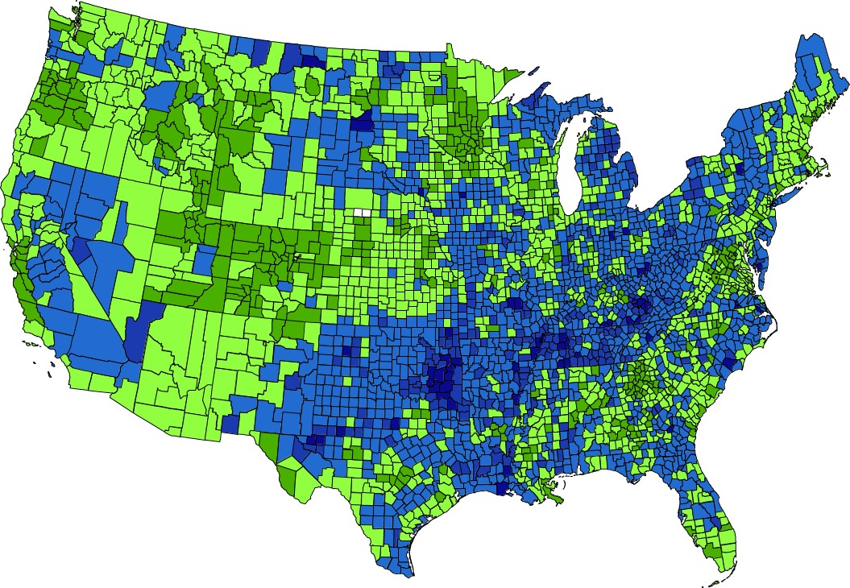
Coronary Heart Disease Deaths by County, 2013–2015
National Target = 103.4 per 100,000 population ● National Total = 99.6 per 100,000 population
Rate per 100,000
0.0 - 75.0
75.1 - 103.4
103.5 - 152.7
152.8 - 195.1
195.2 - 319.3
Insufficient data
Counties shown in green met the national target.
NOTES: Data are for ICD-10 codes I20-I25 reported as the underlying cause of death. Rates are age-adjusted to the 2000 standard population. Rates are spatially smoothed to enhance the stability of rates in counties with small populations. Data are displayed by a modified Jenks classification for U.S. counties which creates categories that minimize within-group variation and maximize between-group variation.
Obj. HDS-2
Decrease desired
SOURCES: National Vital Statistics System—Mortality (NVSS—M), CDC/NCHS; Bridged—race Population Estimates,
CDC/NCHS and Census. Interactive Atlas of Heart Disease and Stroke, CDC/NCCDPHP http://nccd.cdc.gov/DHDSPAtlas/ .
26

Slide 27
Coronary Heart Disease Deaths
Black
Total
White
Hispanic
HP2020 Target: 103.4
Am Indian
Asian
NOTES: *2007 = HP2020 baseline. Data are for ICD-10 codes I20–I25 reported as underlying cause of death and are age-adjusted to the 2000 standard population. Prior to 2003, only one race could be recorded; recording more than one race was not an option. Beginning in 2003 multiple-race data were reported by some states; multiple-race data were bridged to the single-race categories for comparability. American Indian includes Alaska Native. Asian includes Pacific Islander. Black and White exclude persons of Hispanic origin. Persons of Hispanic origin may be of any race.
Obj. HDS-2
Decrease desired
SOURCE: National Vital Statistics System—Mortality (NVSS—M), CDC/NCHS; Bridged—race Population Estimates for Census 2000 and 2010, CDC/NCHS and Census.
27

Slide 28
Stroke Deaths
Rate per 100,000
Black
Total
White
HP2020 Target: 34.8
Asian
Hispanic
Am Indian
NOTES: *2007 = HP2020 baseline. Data are for ICD-10 codes I60–I69 reported as underlying cause of death and are age-adjusted to the 2000 standard population. Prior to 2003 only one race category could be recorded; recording more than one race was not an option. Beginning in 2003 multiple-race data were reported by some states; multiple-race data were bridged to the single-race categories for comparability. American Indian includes Alaska Native. Asian includes Pacific Islander. Black and White exclude persons of Hispanic origin. Persons of Hispanic origin may be of any race.
SOURCE: National Vital Statistics System—Mortality (NVSS—M), CDC/NCHS; Bridged—race Population Estimates, CDC/NCHS and Census.
Obj. HDS-3
Decrease desired
28

Slide 29
Blood Pressure Control, Adults 18+ Years with Hypertension, 2011–2014
HP2020 Target: 61.2%
Increase desired
Health Insurance
Age (years)
NOTES: = 95% confidence interval. *2005-2008 Total = HP2020 baseline. Blood pressure control is defined as systolic blood pressure <140 mmHg and distolic blood pressure <90 mmHg among adults with hypertension. Hypertension is defined among adults, excluding pregnant women, as systolic blood pressure ≥140 mmHg or diastolic blood pressure ≥90 mmHg or taking blood pressure lowering medication. Data (except those by insurance status) are for adults aged 18 years and over unless otherwise stated. Data by health insurance status are for adults aged 18-64 years. Data (except those by age group) are age-adjusted to the 2000 standard population. The categories Asian, Black and White exclude persons of Hispanic origin. Persons of Hispanic origin may be any race. Respondents were asked to select one or more races. Data for the single race categories are for persons who reported only one racial group. Target does not apply to age groups.
I
Obj. HDS-12
29
SOURCE: National Health and Nutrition Examination Survey (NHANES), CDC/NCHS.

Slide 30
Hypertension Prevalence and Blood Pressure Control, Adults 18+ Years
Percent
Blood Pressure Control
Hypertension
NOTES: Blood pressure control is defined as systolic blood pressure <140 mmHg and distolic blood pressure <90 mmHg among adults aged 18 years and over with hypertension. Hypertension is defined among adults aged 18 years and over, excluding pregnant women, as systolic blood pressure ≥140 mmHg or diastolic blood pressure ≥90 mmHg or taking blood pressure lowering medication. Data are age-adjusted to the 2000 standard population.
Related Objs. HDS-5.1, 12
30
SOURCE: National Health and Nutrition Examination Survey (NHANES), CDC/NCHS.

Slide 31
Prescribed Blood Pressure Medication Use,
Adults 18+ Years with Hypertension, 2011–2014
HP2020 Target: 69.5%
Increase desired
Health Insurance
Age (years)
NOTES: = 95% confidence interval. *2005-2008 Total = HP2020 baseline. Data are for adults with hypertension who are taking prescribed medication to lower their blood pressure. Hypertension is defined among adults, excluding pregnant women, as systolic blood pressure ≥140 mmHg or diastolic blood pressure ≥90 mmHg or taking blood pressure lowering medication. Data (except those by insurance status) are for adults aged 18 years and over unless otherwise stated. Data by health insurance status are for adults aged 18-64 years. Data (except those by age group) are age-adjusted to the 2000 standard population. The categories Asian, Black and White exclude persons of Hispanic origin. Persons of Hispanic origin may be any race. Respondents were asked to select one or more races. Data for the single race categories are for persons who reported only one racial group. Target does not apply to age groups.
I
SOURCE: National Health and Nutrition Examination Survey (NHANES), CDC/NCHS.
Obj. HDS-11
31

Slide 32
Awareness of Stroke Symptoms and the Importance of Calling 9–1–1, Adults 20+ Years
Percent
2009
2014
HP2020 Target: 94.7%
HP2020 Target: 59.3%
Symptoms Awareness
Call 9-1-1
NOTES: I = 95% confidence interval. Data are for adults aged 20 years and over who are aware of the early warning symptoms and signs of a stroke and the importance of accessing rapid emergency care by calling 9-1-1 or another emergency number. Data are age-adjusted to the 2000 standard population.
Objs. HDS-17.2, 17.3
Increase desired
SOURCE: National Health Interview Survey (NHIS), CDC/NCHS.

Slide 33
Key Takeaways - Arthritis, Osteoporosis, and Chronic Back Conditions
Arthritis
  Prevalence is increasing.
  Arthritis is a leading cause of disability.
  Although counseling for physical activity/exercise and weight reduction met the targets, activity limitations due to arthritis is getting worse.
  Disparities persist by race and sex.
Osteoporosis
  Prevalence is increasing, and is higher among women than men.
Chronic Back Conditions
  There was little or no change in activity limitations.
  Disparities persist by race, sex, and education.
33

Slide 34
Key Takeaways - Heart Disease and Stroke
Heart disease and stroke deaths are the first and fifth leading causes of death, respectively.
Coronary heart disease deaths declined, meeting the HP2020 target. Rates varied by county with half meeting the HP2020 target.
Stroke symptom awareness and response have improved.
Although there has been little or no change in hypertension prevalence, there has been improvement in hypertension treatment and control.
Disparities persist by race/ethnicity, sex, age, educational attainment, and health insurance status.
34

Slide 35
NIH Activities Supporting
Heart Disease and Stroke Objectives
Gary H. Gibbons, MD
Director
National Heart, Lung, and Blood Institute
National Institutes of Health
Walter Koroshetz, MD
Director
National Institute of Neurologic Disorders and Stroke
National Institutes of Health

Slide 36


NIH Mission
Turning Discovery into Health
NIH's mission is to seek fundamental knowledge about the nature and behavior of living systems and the application of that knowledge to enhance health, lengthen life, and reduce illness and disability.
Heart Disease and Stroke Risk Factors
High blood pressure
Cigarette Smoking
High blood cholesterol
Overweight/Obesity
Physical Inactivity
Diabetes
Family history
Age
Select HP2020 Heart Disease and Stroke Objectives
Increase overall cardiovascular health
Reduce deaths from heart disease and stroke
Reduce high blood pressure
Increase adherence to lifestyle guidelines
Increase appropriate response to heart attack and stroke

Slide 37
The Myth: CVD is a Disease of Elderly Men
The Science: CVD Risk Emerges Early in Life
Heart Disease and Stroke Risk Factors
High blood pressure
Smoking
High blood cholesterol
Overweight/Obesity
Physical inactivity
Diabetes
Family history
Age
Risk emerges early. High blood cholesterol in early adulthood, if untreated, predicts worse outcomes later in life. Focus on diet, body weight and maintenance of physical activity are important early in life.
HP2020 Goal: Increase overall cardiovascular health in the U.S. population.
Murthy et al. JAMA. 2016; 5:e003934.

Slide 38
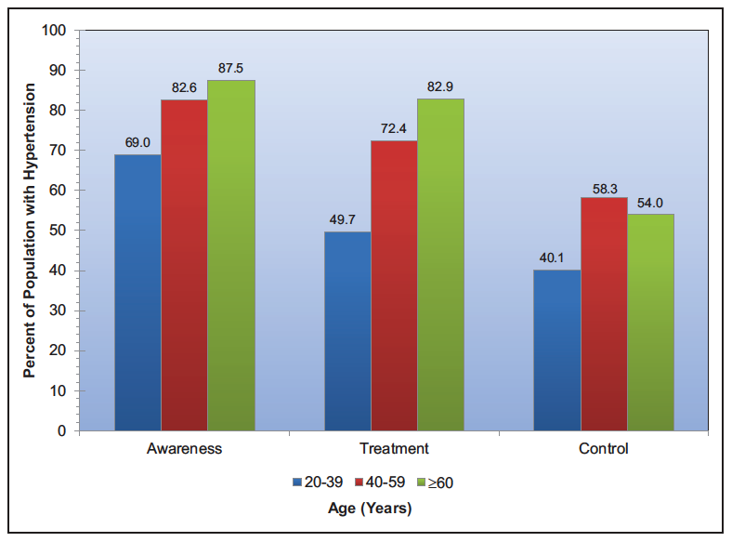

High Blood Pressure: Unfinished Business and New Opportunities to Seize
Leading risk factor for heart disease and stroke
Present in 34% of adults
Present in almost 50% of African Americans
Only ~50% have their high blood pressure controlled.
HP2020 Goal: Increase measurement and awareness of blood pressure
A randomized trial of intensive versus standard blood pressure control: Target SBP <120 mmHg for CVD prevention
Benjamin E et al. Circulation. 2017;135:00

Slide 39

What are innovative strategies to improve HBP control?
The HyperLink Study
Compared to usual care, telephone monitoring and pharmacist case management resulted in better blood pressure control during the intervention and afterwards.
HP2020 Goal: Reduce the proportion of adults with high blood pressure.
JAMA. 2013;310(1):46-56
39

Slide 40
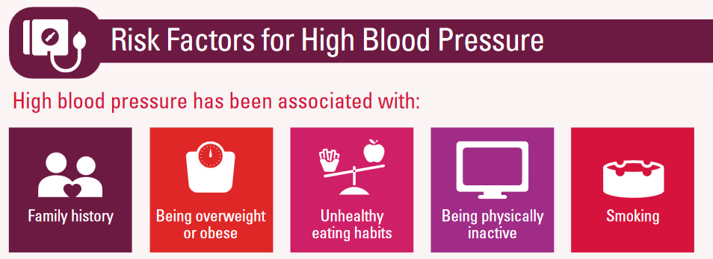
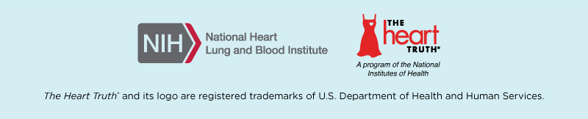

Raising Heart Disease Awareness:
February is American Heart Month
Promoting awareness of heart disease and its risk factors.
Educating and motivating towards action to prevent the disease and control its risk factors.
Small changes can make a big differences

Slide 41
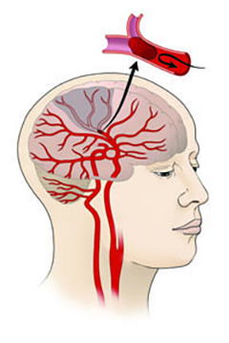
Programs Addressing Stroke and Hypertension Disparities
Reasons for Geographic and Racial Differences in Stroke (REGARDS) (http://www.regardsstudy.org/): national cohort study of ~30,000 U.S. adults
Higher stroke death rates in blacks vs whites, and for stroke belt residents vs non-stroke belt residents
Higher mortality in blacks likely due to 3x higher stroke rates in middle age and higher prevalence of modifiable risk factors
Excess stroke in blacks costs over $3 billion per year
NINDS Stroke Prevention Intervention Research Program
Stroke prevention, blood pressure control interventions in minority communities in 4 regions across the country
Multi-level: health systems, healthcare providers, communities, patients
Stakeholder engagement, dissemination and implementation efforts
Health Systems interventions work – disparities in hypertension, cholesterol, and glucose control were eliminated for blacks in Kaiser health plans in the West (Ayanian et al., 2014, NEJM)

Slide 42
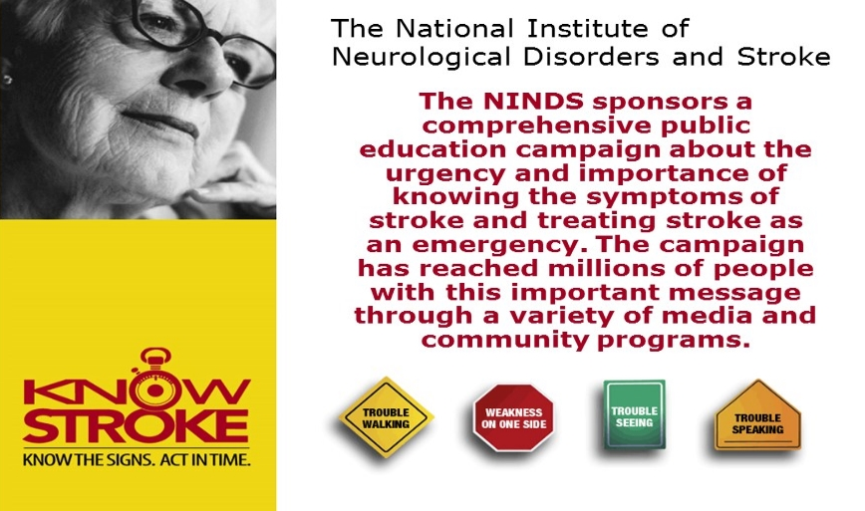

Know Stroke: Know the Signs.
Act in Time.

Slide 43

Mind Your RisksSM
NINDS-led public education campaign in partnership with Million Hearts®, the National Institute on Aging and NHLBI.
Campaign goals:
Raise awareness that controlling blood pressure in mid-life may decrease risk for dementia
Provide scientific evidence for doctors to discuss this topic with patients
Promote existing blood pressure management tools
43

Slide 44

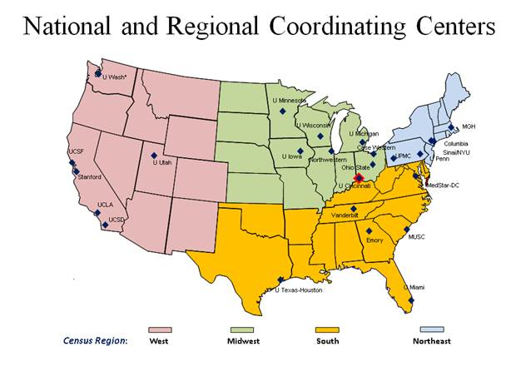

NIH StrokeNet
Established in 2013
25 regional centers, 300 satellite stroke hospitals, two coordinating centers
Clinical trials and research to advance acute treatment, prevention, and recovery and rehabilitation.
Increased trial efficiency
Stable infrastructure and research capacity
Improved data sharing
Coordination and public-private partnerships with non-profits, industry, and international partners

Slide 45
Key Points and Opportunities
Heart disease and stroke burden remains high, disparities persist
Hypertension is the major modifiable risk factor, drives disparities
Evidence-based strategies to improve risk factor control and reduce heart disease and stroke at the population level and in diverse settings:
  Increase general awareness of the risk of hypertension
  Promote rapid utilization and uptake of new evidence into treatment
  Integrate health systems-level changes, such as protocol-driven care
  Improve community and clinical linkages as recommended by the Community Guide (e.g. utilization of community health workers)
45

Slide 46
Heart Disease and Stroke Federal Partners/Contributors
National Institute of Neurological Disorders and Stroke (NINDS)
    Katie Pahigiannis, PhD
National Heart, Lung, and Blood Institute (NHLBI)
    Joylene John-Sowah, MD, MPH
Centers for Disease Control and Prevention (CDC)
    Yuling Hong, MD, PhD
    Fleetwood Loustalot, PhD, FNP
    Angela Thompson-Paul, PhD
    Kimberly Hurvitz, MHS
Office of the Assistant Secretary for Health (OASH)
    Emmeline Ochiai, JD, MPH
46

Slide 47

Activities Supporting Heart Disease and Stroke Objectives
Wayne H. Giles, MD, MS
Director of CDC’s Division for Heart Disease and Stroke Prevention, National Center for Chronic Disease Prevention and Health Promotion
47

Slide 48

Core Functions of the Division for
Heart Disease and Stroke Prevention
  Applied Research and Evaluation
  Epidemiology and Surveillance
  Program Development and Support
  Policy and Communication
48

Slide 49


Major Areas of Focus
Keeping People Healthy
Optimizing Care
COMMUNITY
Priority Populations
49

Slide 50
Million Hearts®
Goal: Prevent 1 million heart attacks
and strokes by 2017
U.S. Department of Health and Human Services initiative, co-led by:
  Centers for Disease Control and Prevention (CDC)
  Centers for Medicare & Medicaid Services (CMS)
Partners across federal and state agencies and private organizations
50
50

Slide 51

Million Hearts® Successes
About 115,000 cardiovascular events were prevented during the first 2 years of the initiative
Hypertension control is projected to increase 8.3% between 2009-2010 and 2015-2016.
Improvements in care of at least 70% have been demonstrated across diverse clinical settings
51

Slide 52
Million Hearts® 2022 Domains
Keeping People Healthy
Reduce Sodium Intake
Decrease Tobacco Use
Increase Physical Activity
Optimizing Care
Aspirin When Appropriate
Blood Pressure Control
Cholesterol Management
Smoking Cessation
Improving Outcomes for Priority Populations
Blacks/African-Americans
35-64 year olds
People who have had a heart attack or stroke
People with mental illness or substance use disorder
Others
52

Slide 53

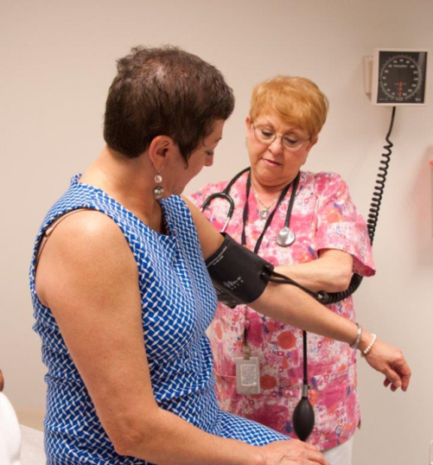

State and Local Public Health
Programs
  Multi-faceted, state-wide initiative
  Funded for 5 Years (2013—2018)
  Funding awarded to all 50 states, 4 large city health departments and the territories
  Reduce health disparities among adults through a combination of community and health system interventions
53

Slide 54
WISEWOMAN
Funds 21 programs
Provides cardiovascular screening, referral, and lifestyle invention services to women
aged 40–64
  eligible through participation in the CDC National Breast and Cervical Cancer Early Detection Program
  Provides cardiovascular screening
  Lifestyle programs
    the YMCA
    Weight Watchers
    Diabetes Primary Prevention Programs
Between July 2014 and July 2015, participants received over 19,000 screenings and more than 28,000 evidence-based services, according to preliminary numbers.
54

Slide 55
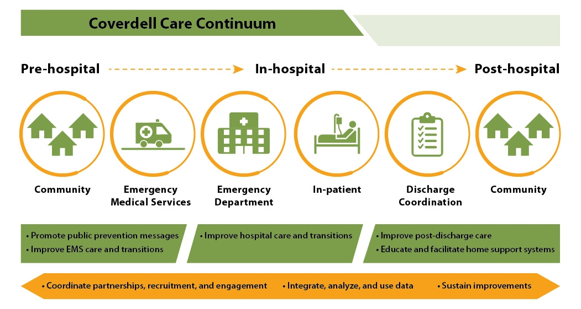
Paul Coverdell National Acute Stroke Program (PCNASP) Program Care Continuum
55

Slide 56
Paul Coverdell National Acute Stroke Program (PCNASP) Successes
Funded 9 States to improve stroke care across the continuum of care
2005-mid-2015, more than 620,802 patients benefitted from hospital participation in the PCNASP
The Coverdell program and Georgia Department of Public Health worked with EMS to improve “door-to-needle” time for receipt of tPA, resulting in a 32% improvement as the average time dropped from 85 to 58 minutes.
56

Slide 57
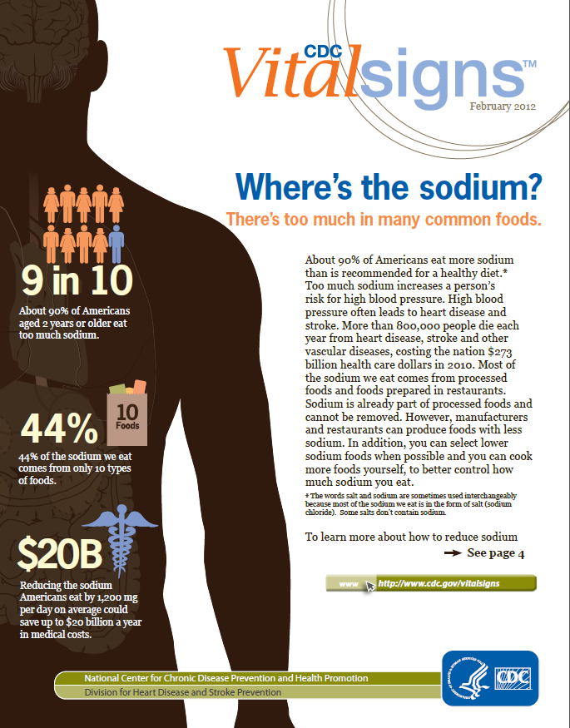
CDC Vital Signs
2016
  Blood Pressure Control --- Helping Patients Take Their Medicine
2015
  Heart Age – Is Your Heart Older Than You?
2014
  Reducing Sodium in Children’s Diets
2013
  Preventable Deaths from Heart Disease & Stroke
2012
  Getting Blood Pressure Under Control
  Where’s the Sodium?
2011
  High Blood Pressure and Cholesterol
57

Slide 58
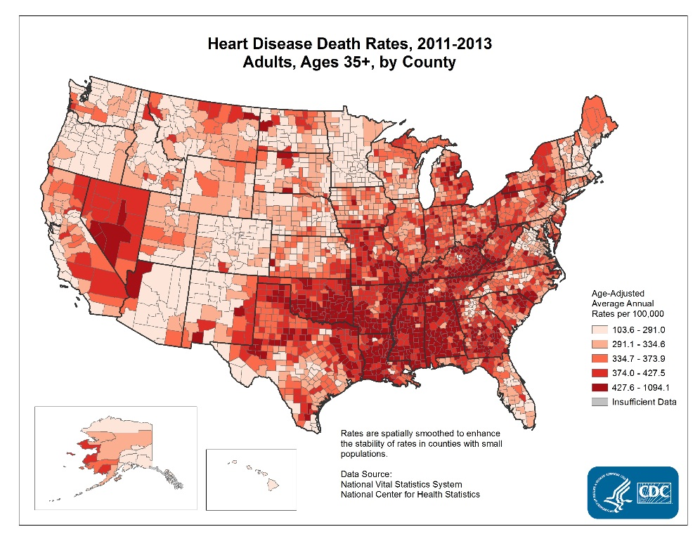
Making Data Accessible
Interactive Atlas of Heart Disease and Stroke
  CDC’s Interactive Atlas of Heart Disease and Stroke is an online mapping tool that allows users to create county-level maps of heart disease and stroke by race/ethnicity, gender, and age group, along with maps of social and economic factors and health services for the entire United States or for a chosen state or territory.tes or for a chosen state or territory.
58

Slide 59
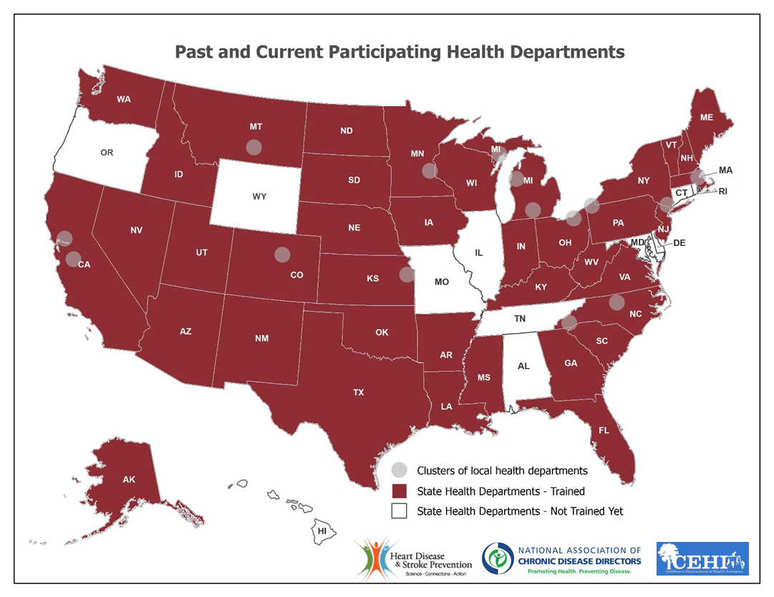
Building GIS Capacity for Chronic Disease
Surveillance in State and Local Health Departments
59

Slide 60
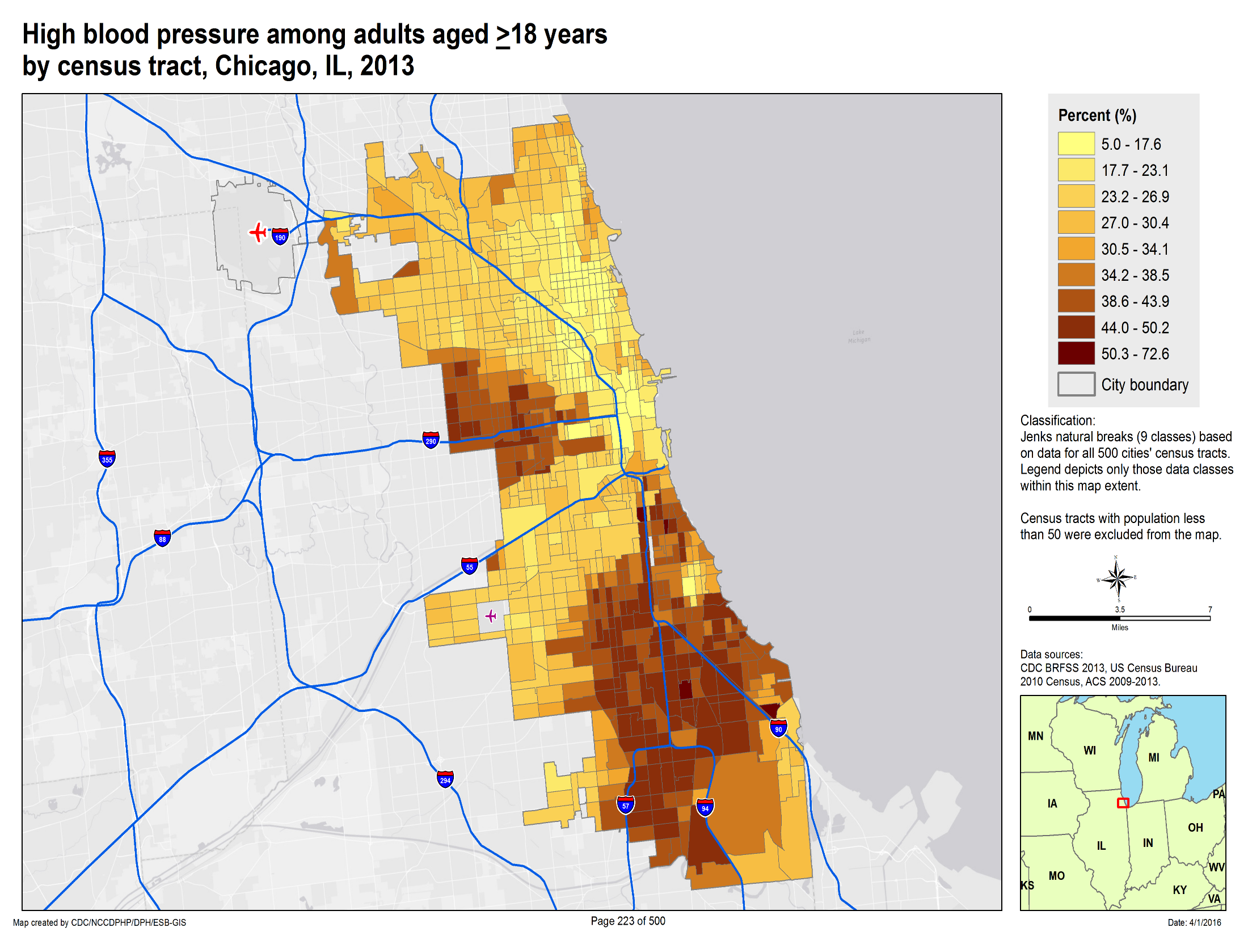

Slide 61
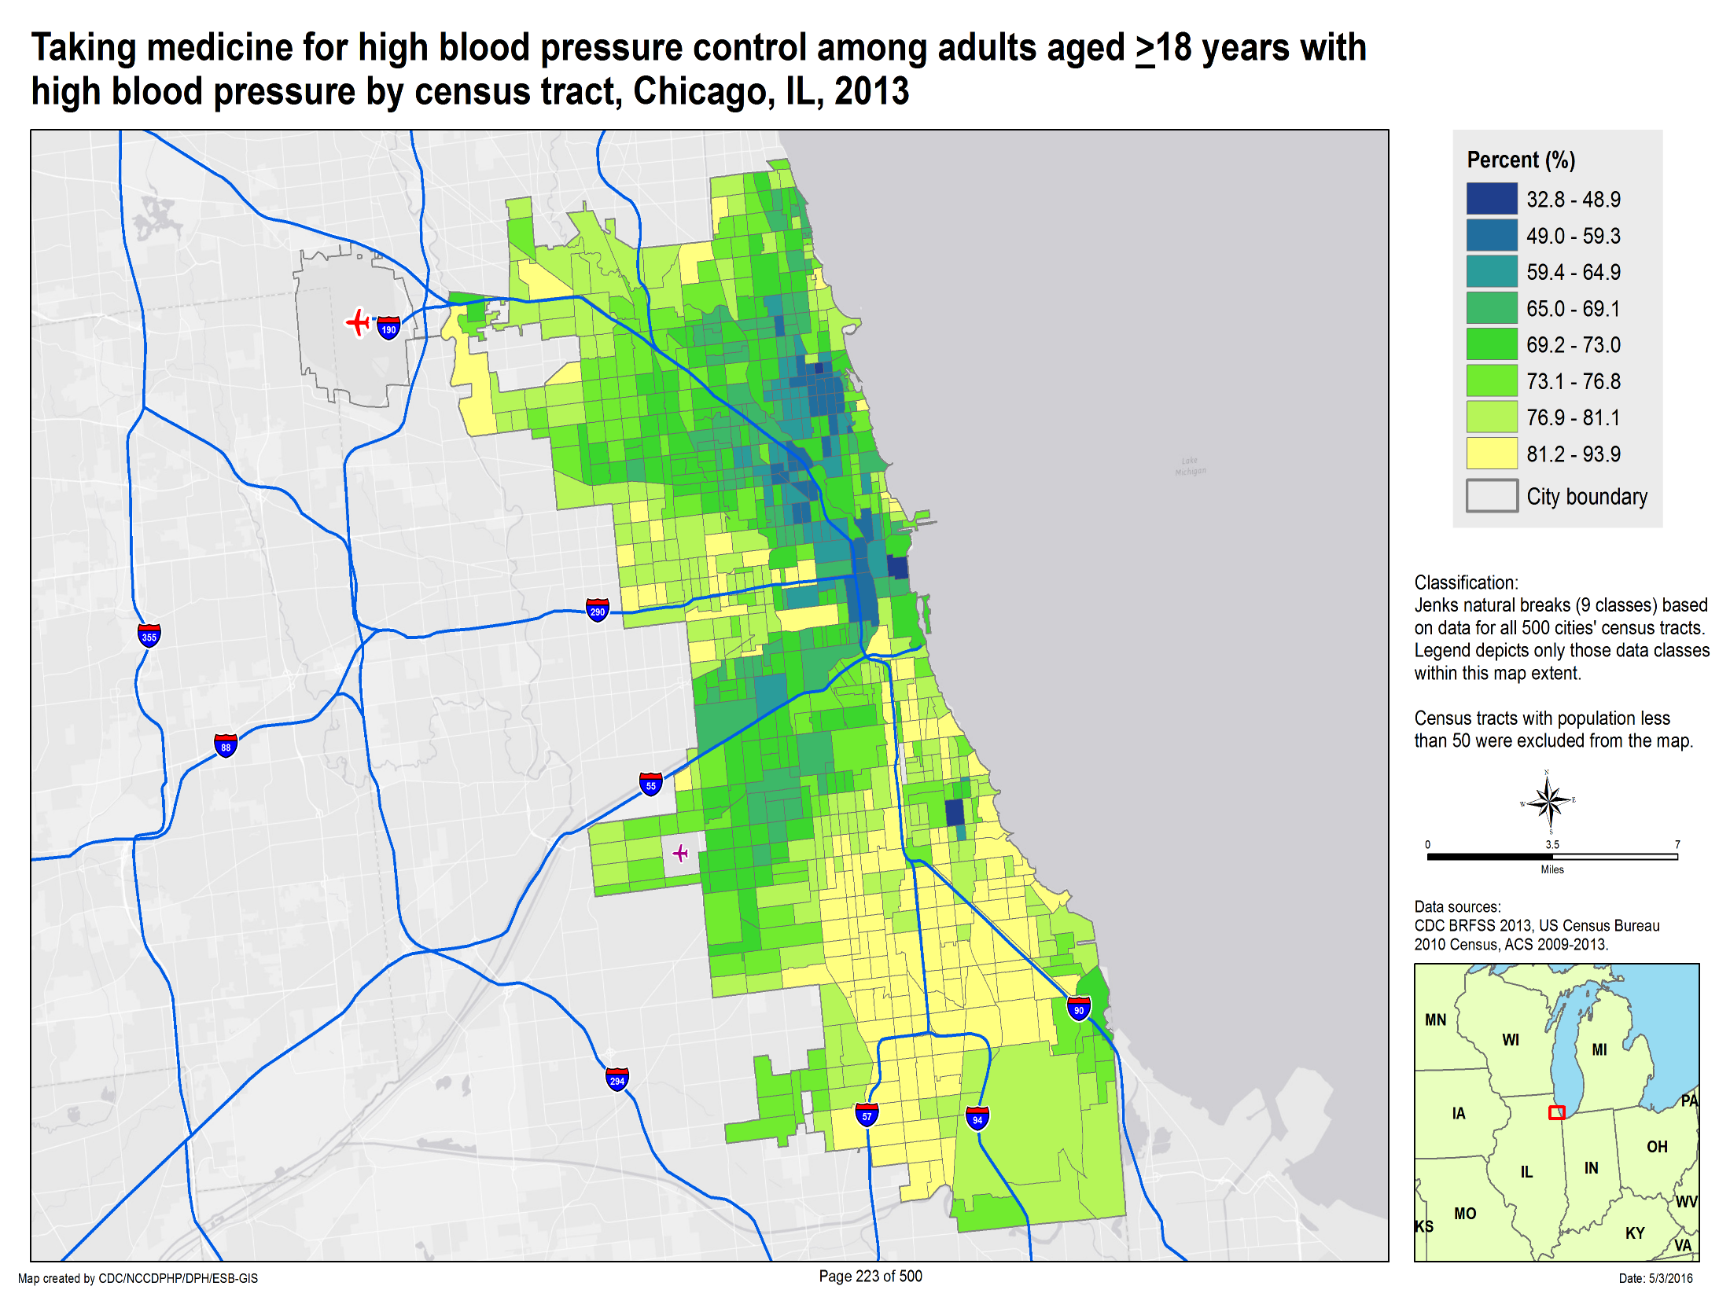

Slide 62
Tools and Resources
DHDSP Programs
  https://www.cdc.gov/dhdsp/
Million Heart® Initiative
  http://millionhearts.hhs.gov/
Chronic Disease GIS Exchange
  Community forum to help public health personnel use the power of geographic information systems (GIS) to address chronic disease through sharing maps, training materials, and resources
  http://www.cdc.gov/dhdsp/maps/gisx/
500 Cities
  http://www.cdc.gov/500cities
62

Slide 63

NIH Programs to Improve Outcomes in People with Arthritis, Osteoporosis, and Chronic Back Conditions
Joan A. McGowan, PhD
Director, Division of Musculoskeletal Diseases NIAMS

Slide 64
NIH Support for Arthritis, Osteoporosis and Chronic Back Conditions in 2015
NIH supports basic, translational and clinical research in Arthritis, Osteoporosis and Chronic Back Conditions
  Arthritis $214 million
    Osteoarthritis $76 million
  Osteoporosis $146 Million
  Chronic Pain Conditions $391 Million
    Source: NIH Estimates of Funding for Various Research, Condition, and Disease Categories (RCDC)
64

Slide 65
Arthritis

Slide 66
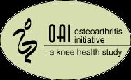



Epidemiology: Basic Science of
Public Health
The Keys to Prevention
Identification of risk factors
Discovery and testing of novel diagnostic tools
Generation of hypotheses to drive intervention studies
66

Slide 67
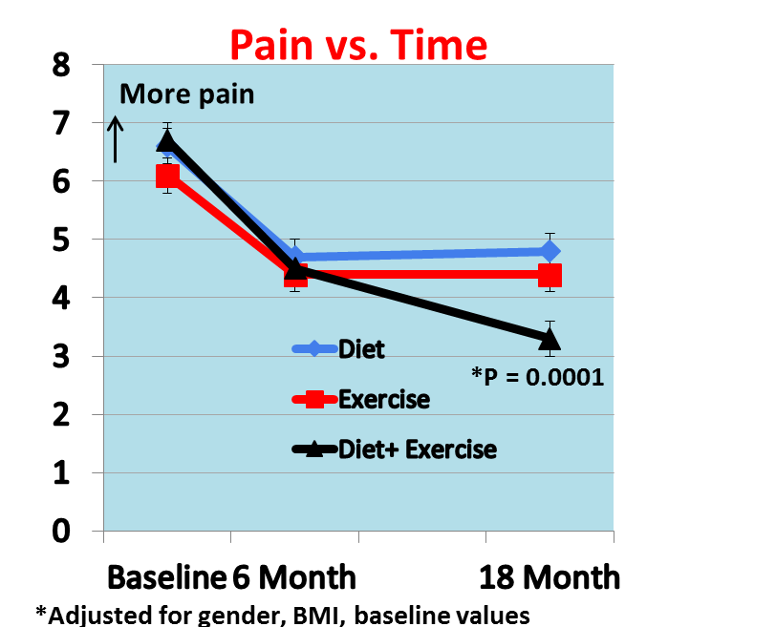
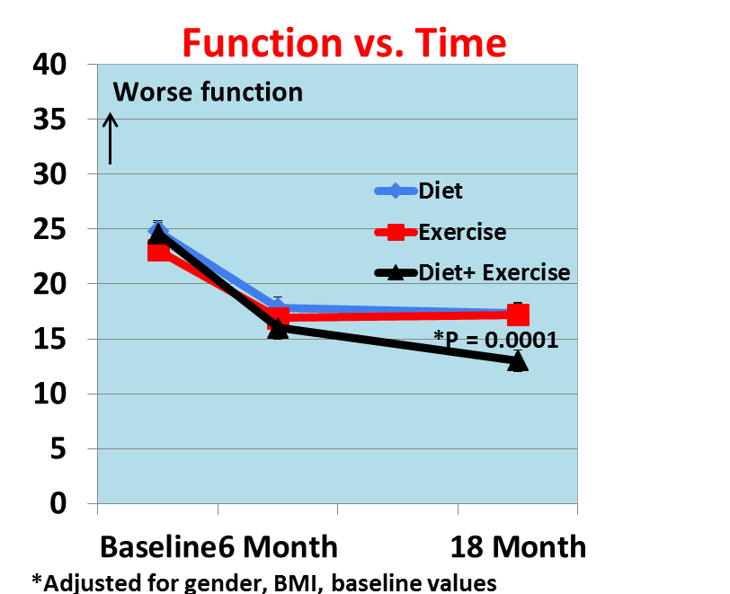
Improving Pain and Function in Knee Osteoarthritis
On the road to a public health strategy
Messier et al. JAMA 2013
67

Slide 68
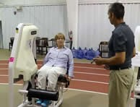

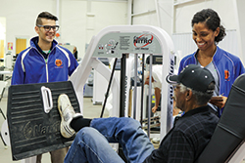
WE-CAN – Weight Loss and Exercise for Communities with Arthritis in North Carolina
In January of 2016 investigators put years of highly-controlled clinical study results to the test in a real-world setting.
To demonstrate that community-based intervention programs can make a difference in people’s lives and health.
68

Slide 69
Osteoporosis and Fractures

Slide 70




Osteoporosis & Hip Fractures:
Epidemiology
Study of Osteoporosis in Women Framingham Osteoporosis Project
1986 1988
Rochester Osteoporosis Project Osteoporotic Fractures in Men
1997 2000
70

Slide 71
US Hip Fracture Trends 2002-2015 Medicare Data
  Despite significant decreases in hip fracture incidence before 2010, recent data suggest a flattening or reversal in the trend
  Adapted from Lewiecki EM et al J Bone Miner Res 2016; 31 (Suppl 1) with permission from ASBMR
71

Slide 72
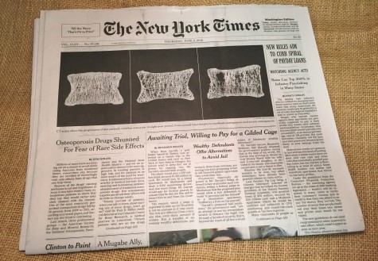
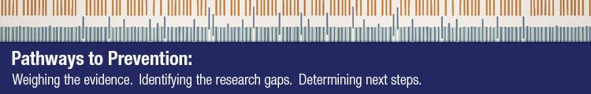
“Crisis in Osteoporosis”?
          Considerable data and media attention have highlighted a potential "crisis" in the treatment of osteoporosis. Specifically, despite the availability of several effective drugs to prevent fractures, many patients who need pharmacological therapy are either not being prescribed these medications or if prescribed a medication, are simply not taking it. Khosla S J Bone Miner Res.(2017)3074
NIAMS/NIA/ODP
72

Slide 73
Chronic Back Conditions

Slide 74
Chronic Back Conditions
Activity limitations due to chronic back conditions
Low back and neck pain – third most costly health condition
The increase in spending for low back and neck pain between 1996 and 2013 was larger than that for almost all other areas of health care.
Evidence based prevention strategy – exercise!
US Spending on Personal Health Care and Public Health 1996-2013
JAMA. 2016;316(24):2627-2646
Percent
NOTES: Data are adults aged 18 years and over with limitation in activity due to
chronic back or neck problems.
Data are age-adjusted to the 2000 standard population.
SOURCE: National Health Interview Survey (NHIS), CDC/NCHS.
74

Slide 75

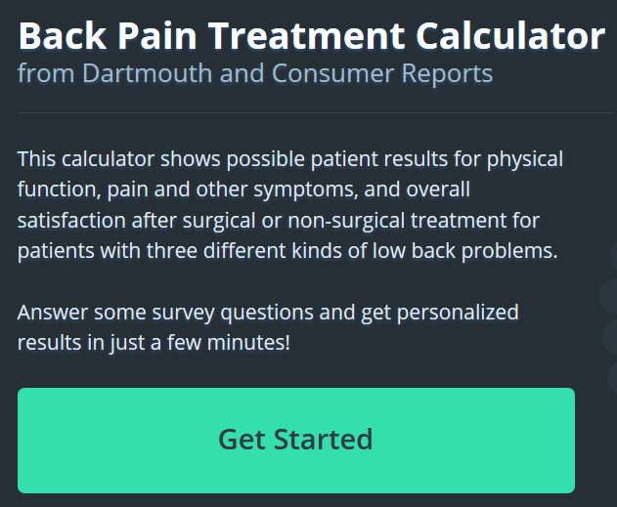


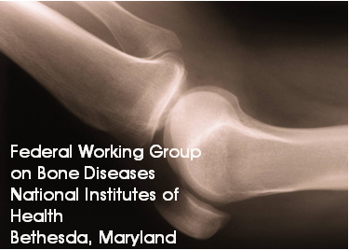

Evidence-Based Prevention Communication Efforts
Publications and Outreach Campaigns Decision Tools
Working Groups
https://bones.nih.gov/
https://nihseniorhealth.gov/
https://go4life.nia.nih.gov/
75

Slide 76
CDC Arthritis Program
Kurt J. Greenlund, Ph.D.
Director (Acting), Division of Population Health

Slide 77
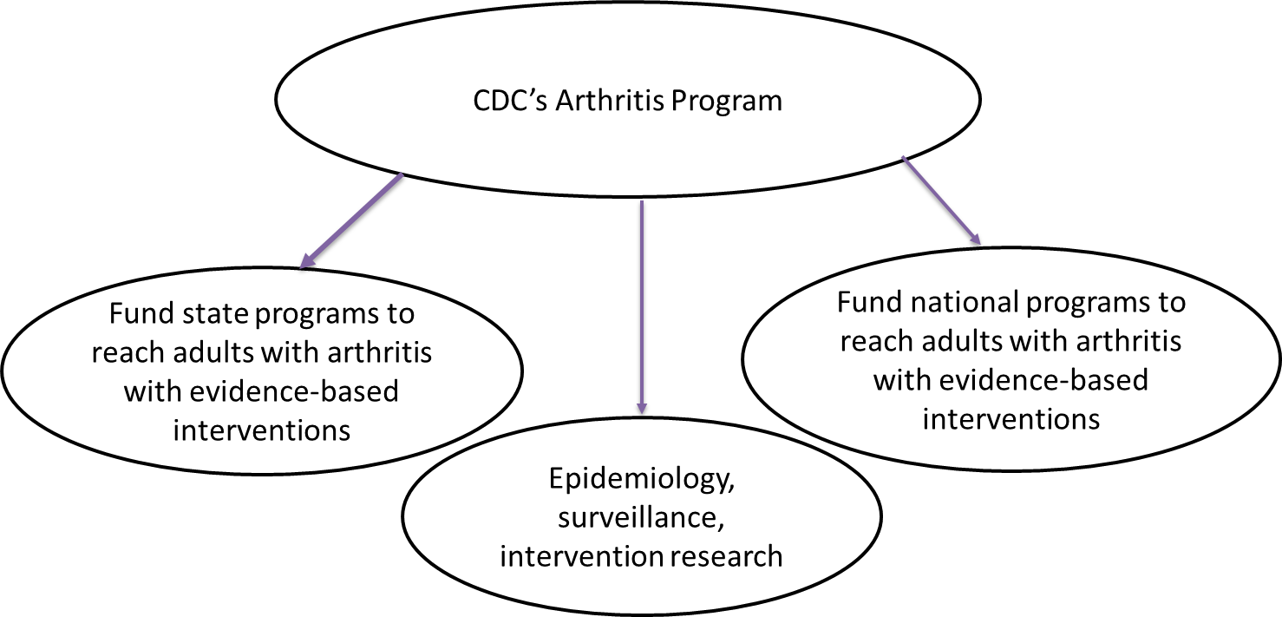
CDC Arthritis Program Mission
77

Slide 78

The Good News…
Arthritis interventions create a triple win:
Evidence-based interventions reduce arthritis’ impacts.
Same interventions help multiple chronic conditions.
Same infrastructure can address multiple conditions.
78

Slide 79
Intervention Evidence-Base
(Meta-analyses of 20-40 studies)
Self Management Education
Persistent small to moderate effects on
  Self-efficacy
  Anxiety/depression
  Fatigue/Energy
  Exercise
Physical Activity
Clinically significant changes in
  Pain
  Function
  Psychological well-being
Brady et al, Preventing Chronic Disease, 2013
Kelley et al, Arthritis Care & Research, 2011
79

Slide 80
CDC Arthritis Program
Menu of Evidence-Based Interventions
Self Management Education
Physical Activity
Fit & Strong!
Active Living Every Day
EnhanceFitness (EF)
Walk with Ease (WWE)
Arthritis Self Management Program (English & Spanish) (ASMP)
Chronic Disease Self -Management Program (CDSMP)
(English & Spanish)
Communication Campaign
Physical Activity. The Arthritis Pain Reliever
Buenos Dias, Arthritis
80

Slide 81
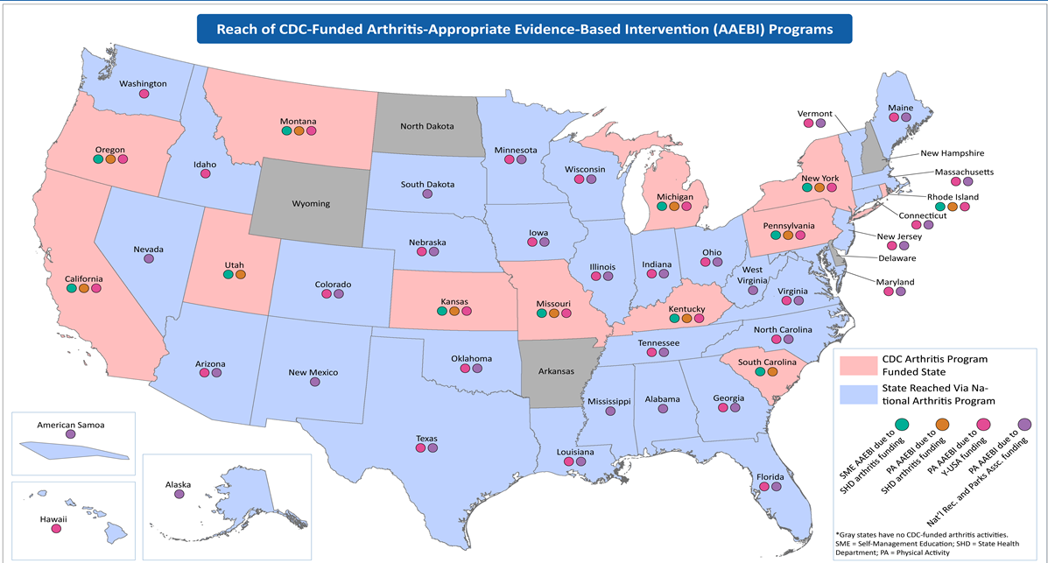

State & National Arthritis Program
Impact as of 2016

Slide 82
CDC State Arthritis Program
2012-2017
12 Funded State Arthritis Programs
  Average Funding ~ $420k
Evolving Strategic Approach
  Focus on dissemination of packaged PA & SME interventions
  Embed interventions in delivery systems
  Emphasis on “reach” numbers
  Expand arthritis-related media coverage
  Monitor burden; disseminate data

Slide 83
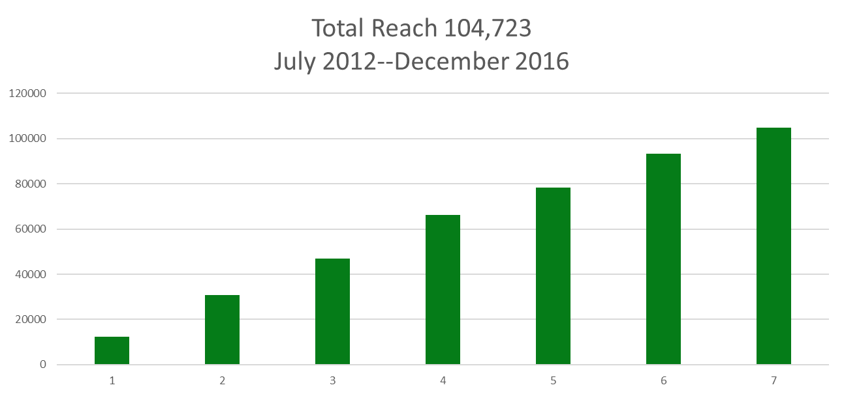
State Arthritis Program
Cumulative Reach
By 6-Month Reporting Period (RP)
83

Slide 84
CDC Arthritis Program
National Programs 2011-2016
Grantee
Arthritis Foundation (AF)
  Toll free consumer hotline & resources
  Walk With Ease dissemination pilot via large & multi-site workplaces
  Online Arthritis Self-Management Program marketing & dissemination pilot
  OA Action Alliance initiation
84

Slide 85
CDC Arthritis Program
National Programs, continued
Grantee
NACDD (National Association of Chronic Disease Directors)
  Arthritis intervention delivery pilot in local parks via NRPA
  American Physical Therapy Association pilot to refer patients to interventions
  Arthritis Council operation to facilitate state support & technical assistance
  National Conference of State Legislators project: to identify & report insights into working with state legislators to promote & adopt interventions.
  Medworks project: to explore potential mechanisms & opportunities for financing interventions via employee wellness & insurance benefits.
85

Slide 86
CDC Arthritis Program
National Programs, continued
Grantee
YMCA of the USA
  National embedding: EnhanceFitness (EF) becomes a Signature Y program
  Program expansion: start-up grants issued to increase local EF initiation
  Health equity: EF training & support in economically disenfranchised areas
  Clinic to Community: Focus on increasing provider referrals for EF
  Sustainability: Exploration into sustainable financing options for EF
  Marketing: EF specific marketing research, updates and expansion
86

Slide 87
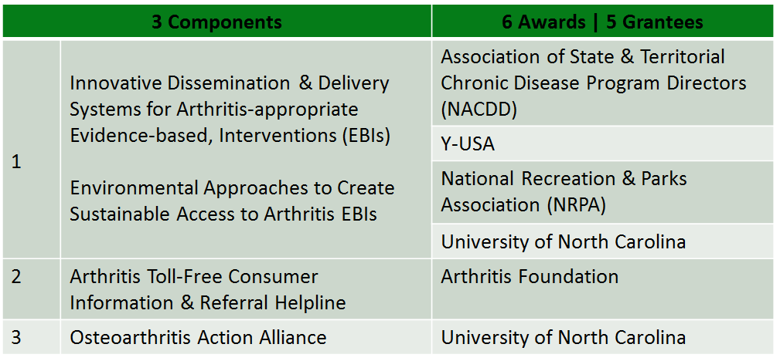
CDC Arthritis Program
National Programs 2016-2021
Advancing Arthritis Public Health Approaches through National Organizations
87

Slide 88

National partners continue to grow the reach of evidence-based arthritis interventions:
CDC Arthritis Program
Select Partner Activities
Y –USA has adopted EnhanceFitness as a signature program and offers it in more than 320 sites across 37 states.
NRPA has disseminated WWE, ALED & AFEP via more than 45 local parks and recreation agencies across 32 states.
AF disseminated WWE via large worksite systems (e.g., Delta Airlines, State Universities, and county and state health departments). More than 28 companies have participated.

Slide 89
Next Steps
Continue to work with states and national organizations.
Work more closely with diabetes, heart disease, and obesity programs. These conditions occur together frequently.
  HHS initiative to address multiple chronic conditions
Seek new avenues to expand the availability of these evidence-based, underused interventions.
89

Slide 90
Key References
CDC Arthritis Program
  https://www.cdc.gov/arthritis
CDC’s Arthritis Funded National Programs
  https://www.cdc.gov/arthritis/partners/funded-national.htm
CDC’s Arthritis Funded State Programs
  https://www.cdc.gov/arthritis/partners/funded-states.htm
Arthritis At-a-Glance
  http://www.cdc.gov/chronicdisease/resources/publications/aag/arthritis.htm

Slide 91

Measurable Progress
Unlimited Support
The Y’s support of HP2020 Goals for Hypertension and arthritis
Matt Longjohn, MD MPH
VP and National Health Officer
YMCA of the USA
February 28, 2017

Slide 92







The (wh)Y

Slide 93
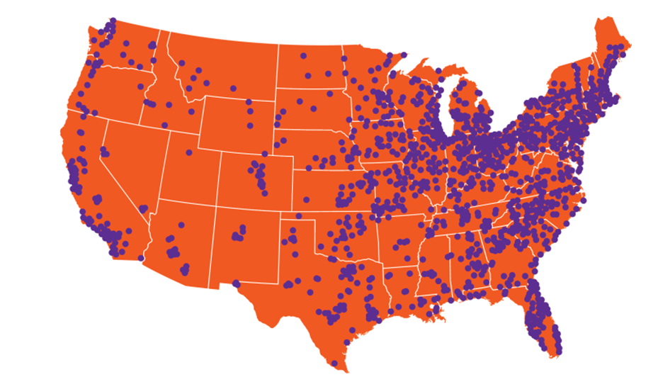
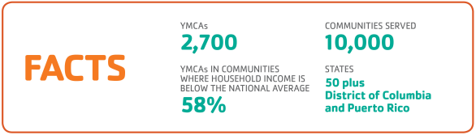
The Y: ASSOCIATIONS & BRANCHES
OUR REACH

Slide 94
80% of “health’ happens outside the clinic
94

Slide 95
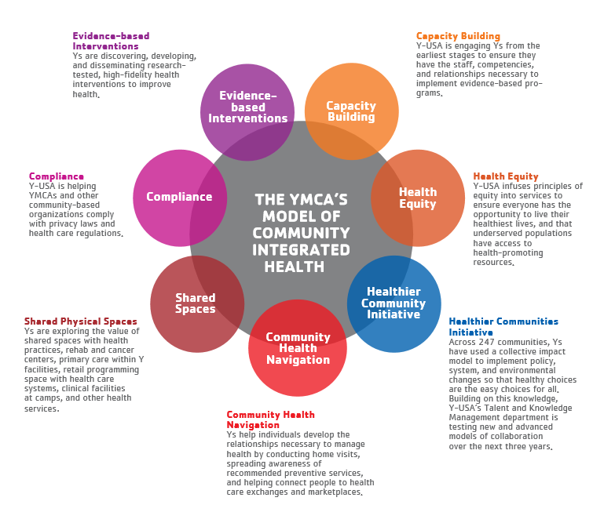
Community Integrated Health

Slide 96
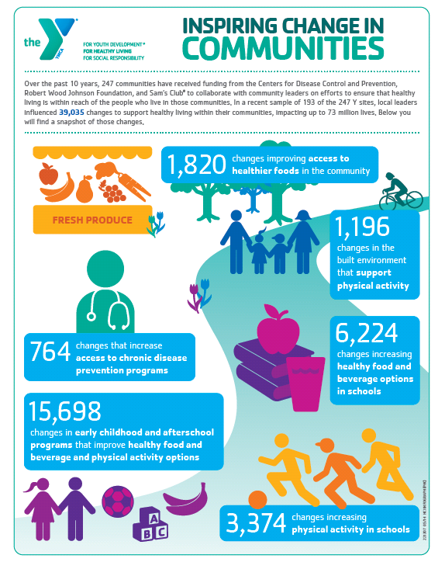
Collaborating for health-promoting policy/system/environmental changes
To date, the Y with their community partners have advanced more than 39,000 strategies impacting up to 73 million lives
96

Slide 97
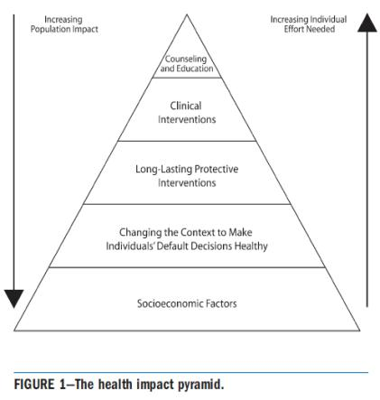
we meet health-seekers where they are…
Reclaim Health
Reduce Risks
Promote Wellness
Frieden, AJPH 2010
97

Slide 98
The Y’s Pipeline of evidence-based (RCT Proven) programs
DISCOVERY
DEVELOPMENT
DISSEMINATION
Efficacy
Validation
Translation
Scaling
Dissemination
YMCA’s Diabetes Prevention Program
Enhance Fitness (Arthritis Self-Management)
LIVESTRONG at the YMCA (Cancer Survivorship)
Moving For Better Balance (Falls Prevention)
Blood Pressure Self-Monitoring
Childhood Obesity Intervention
Brain Health
Parkinson’s
Tobacco Cessation
98

Slide 99

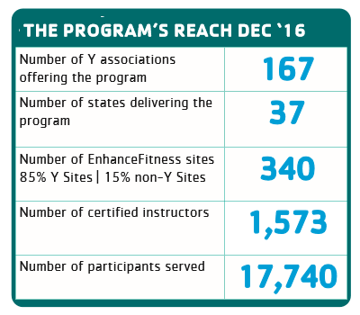
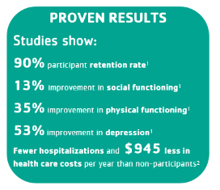

Delivering Outcomes at Scale:
Falls Prevention/Arthritis Self-Management

Slide 100
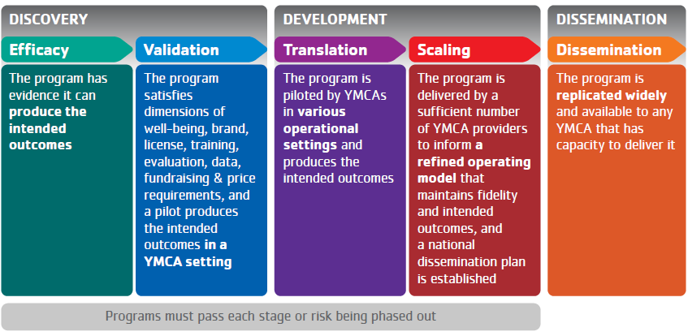
Blood Pressure Self-Monitoring
2013
3 YMCAs
Building the model
2014
7 YMCAs
Getting the Outcomes
2015
17 YMCAs
Ensuring success
2016
63 YMCAs
Scaling broadly
2018
Available
to ALL
YMCAs

Slide 101
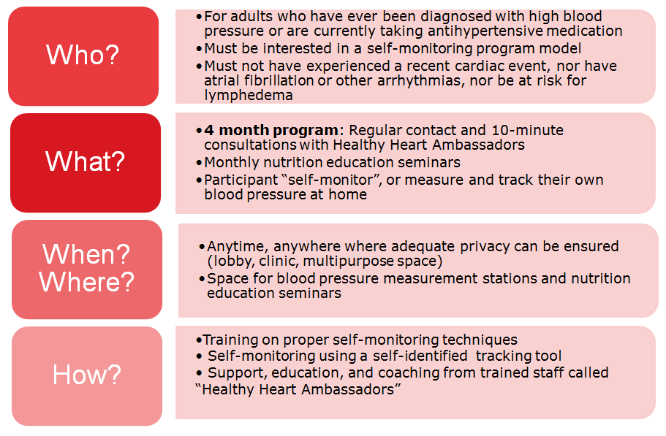
Blood Pressure Self-monitoring Program: The basics

Slide 102

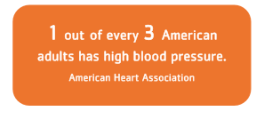
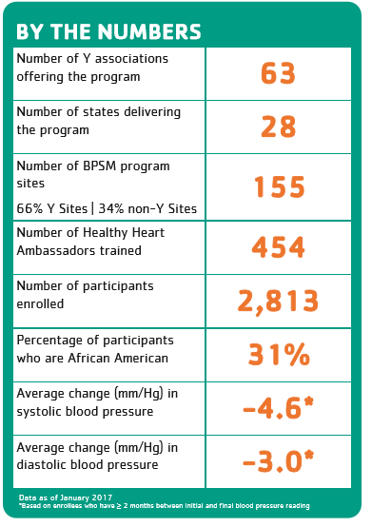
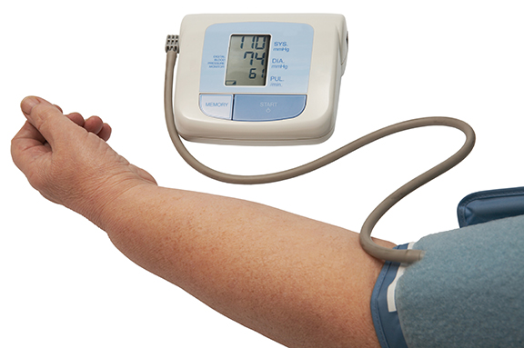
Delivering Outcomes at Scale:
Blood Pressure Self-Monitoring
102

Slide 103
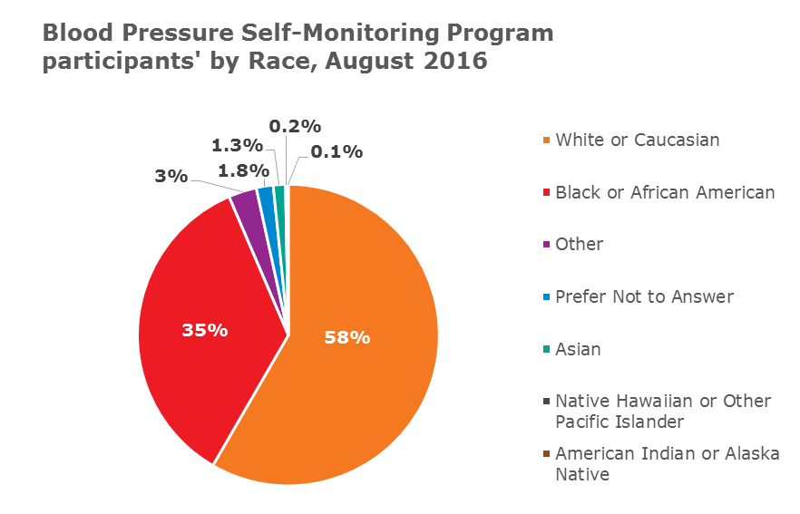
Participant demographics
69% Female; 31% Male
Average Age of a Participant: 61 (min: 18; max: 98)
Race/Ethnicity
    10% of participants self-identified as Hispanic

Slide 104
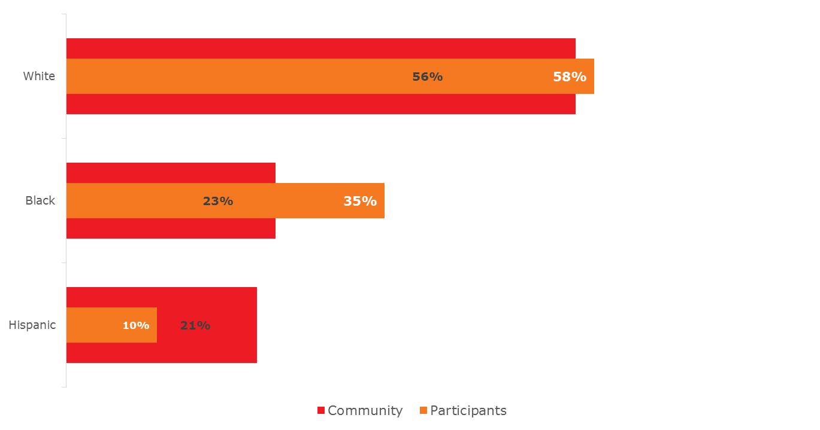
THE PERCENTAGE of BLACK/AFRICAN AMERICANS SERVED IN THE BLOOD PRESSURE SELF-MONITORING PROGRAM IS GREATER THAN THE COMMUNITY

Slide 105
Participant characteristics
49% of participants indicated they were diagnosed with high blood pressure within the 12 months prior to enrollment
79% of participants were taking prescription medication for high blood pressure at the time of enrollment
56% of participants did not have a home blood pressure cuff at the time of enrollment
54% of participants are Y members; 28% non-Y members; 18% unknown

Slide 106
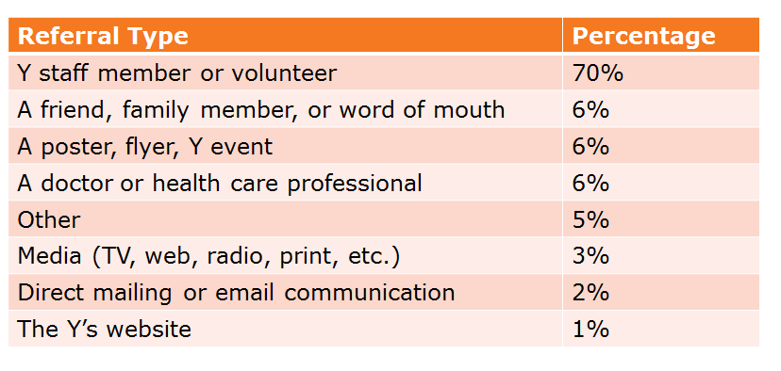
Referral sources

Slide 107
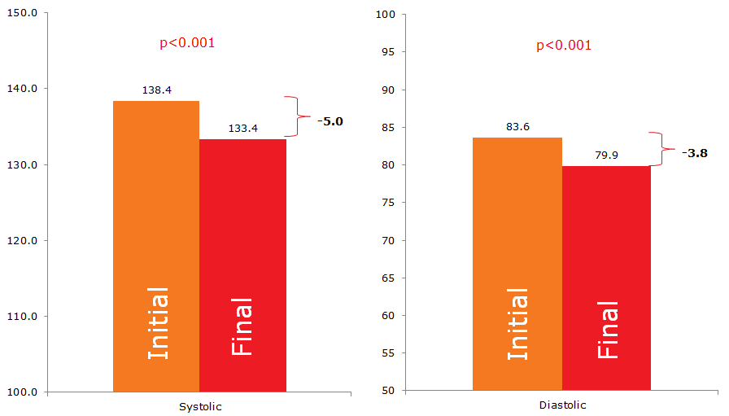
There is a statistically significant difference in Systolic and Diastolic BP between initial and final readings.
p<0.001
p<0.001
-5.0
-3.8
Initial
Final
Initial
Final

Slide 108
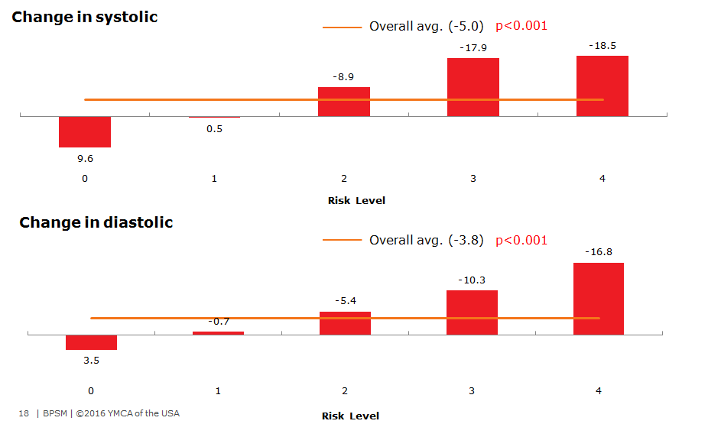
Participants with the highest initial bp readings demonstrate a significantly greater change in SBP and DBP.
*Based on the AHA risk levels

Slide 109
Focus Areas for 2016-2018
Spread
Develop a virtual learning solution to train and onboard YMCA staff
Spread the program to more YMCAs (engage ≥65 in 2016)
Scale
Offer the program at a larger number of program delivery sites (YMCA & non-YMCA locations) to more people with high blood pressure across the country
Sustainability
Develop a business model that ensures sustainability of the program model, decreasing reliance on grant funding
Equity
Continue to focus on equity among African American populations
Clinical Integration
Collaborate with CDC/ACPM, AHA, AMA, to leverage RWJF / YUSA investments and initiate clinical referrals

Slide 110
Thank You
YMCA OF THE USA
800 872 9622

Slide 111
Roundtable Discussion
Carter Blakey
Deputy Director, Office of Disease Prevention and Health Promotion

Slide 112
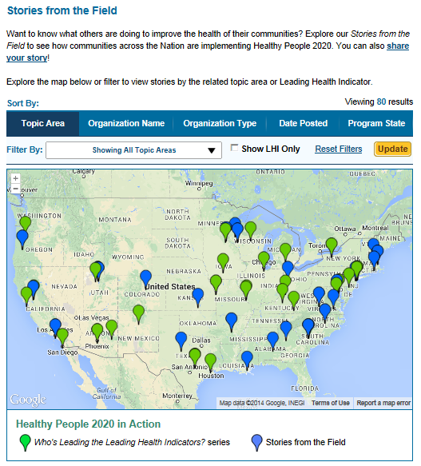
Healthy People 2020 Stories from the Field
A library of stories highlighting ways organizations across the country are implementing Healthy People 2020
Healthy People in Action
http://www.healthypeople.gov/2020/healthy-people-in-action/Stories-from-the-Field

Slide 113


Who’s Leading the Leading Health Indicators? Webinar
Please join us on Thursday, March 13th from 12:00 to 1:00 pm ET for a Healthy People 2020 Who’s Leading the Leading Health Indicators? webinar on Mental Health.
Registration on HealthyPeople.gov available soon

Slide 114
Progress Review Planning Group
  Charles Helmick (CDC/ONDIEH)
  Joan McGowan (NIH/NIAMS)
  Kristy Nicks (NIH/NIAMS)
  Kamil Barbour (CDC/ONDIEH)
  Yuling Hong (CDC/ONDIEH)
  Fleetwood Loustalot (CDC/ONDIEH)
  Angela Thompson-Paul (CDC/ ONDIEH)
  Joylene John-Sowah (NIH/NHLBI)
  Katie Pahigiannis (NIH/NINDS)
  Stan Lehman (CDC/OD)
  Jennifer Villani (NIH/OD)
  Irma Arispe (CDC/NCHS)
  David Huang (CDC/NCHS)
  Leda Gurley (CDC/NCHS)
  Asel Ryskulova (CDC/NCHS)
  Kimberly Hurvitz (CDC/NCHS)
  LaJeana Hawkins (CDC/NCHS)
  Carter Blakey (HHS/ODPHP)
  Emmeline Ochiai (HHS/ODPHP)
  Theresa Devine (HHS/ODPHP)
  Ayanna Johnson (HHS/ODPHP)
  Yen Lin (HHS/ODPHP)

Slide 115




Stay Connected
Web healthypeople.gov
Email healthypeople@hhs.gov
Twitter @gohealthypeople
LinkedIn Healthy People 2020
YouTube ODPHP (search “healthy people”)
Join the Healthy People Listserv & Consortium

