Slide 1



Progress Review Webinar: Hearing and Other Sensory or Communication Disorders and Vision
February 22, 2018

Slide 2
The Diagnosis, Prevention, and Treatment of Sensory and Communication Disorders
Don Wright, MD, MPH
Deputy Assistant Secretary for Health
Health Promotion and Disease Prevention
U.S. Department of Health and Human Services

Slide 3
Agenda and Presenters
Chair
Don Wright, MD, MPH, Deputy Assistant Secretary for Health, Disease Prevention and Health Promotion, U.S. Department of Health and Human Services
Presentations
Charles Rothwell, MBA, MS, Director, National Center for Health Statistics
James F. Battey, Jr., MD, PhD, Director, National Institute on Deafness and Other Communication Disorders, National Institutes of Health
Paul Sieving, MD, PhD, Director, National Eye Institute, National Institutes of Health
Community Highlight
Nicole Marrone, PhD, CCC-A, Department of Speech, Language and Hearing Sciences, University of Arizona

Slide 4
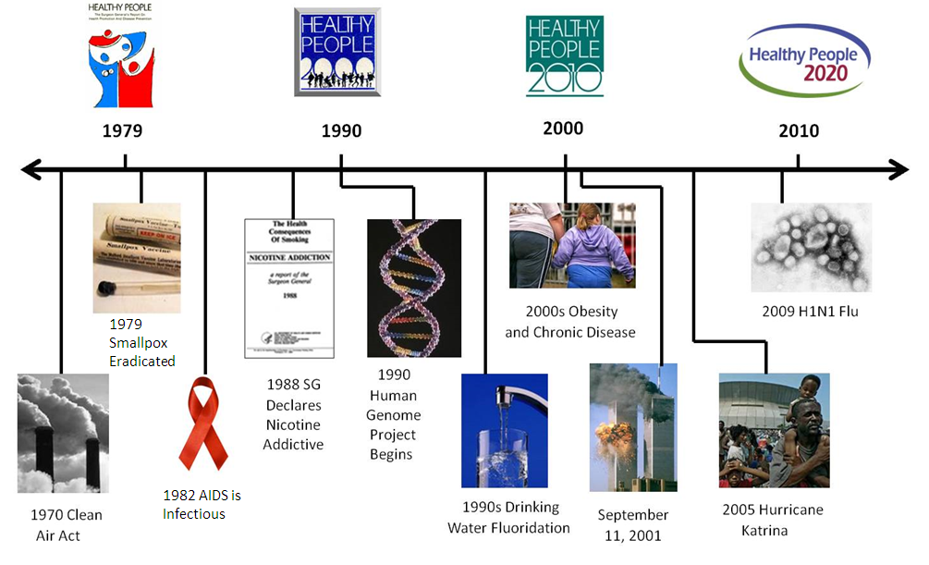
Healthy People at the Forefront of Public Health

Slide 5
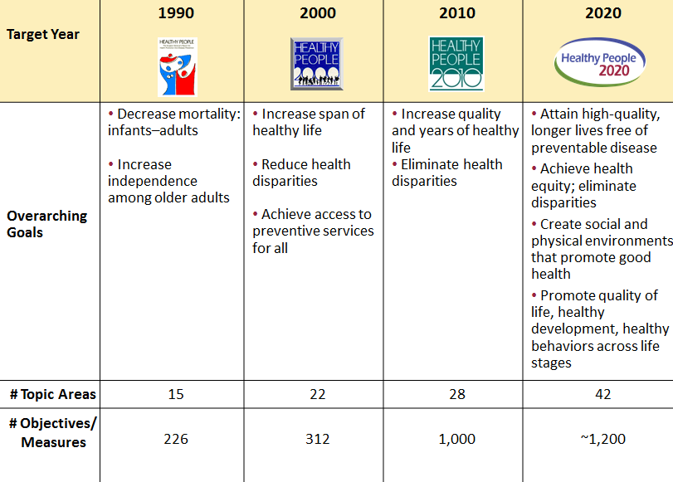
Evolution of Healthy People

Slide 6
The Public Health Importance of Human Communication
Communication Disorders cross all ethnic and socioeconomic lines, and reduce our ability to interact with each other. They can lead to social isolation and difficulty at school or work. At least 20% of U.S. adults have significant impairment of hearing, balance, taste, smell, voice, speech, or language.
Newborn Hearing Screening helps identify hearing problems early, to enable language intervention if needed. Children begin to learn speech and language in the first six months of life.
Hearing Aid Use can be critical to help some adults with hearing loss maintain their ability to communicate. Despite this, most adults who could benefit from hearing aids do not use them, often because the devices are not accessible or they are too costly.

Slide 7
The Public Health Importance of Human Communication
Noise-Induced Hearing Loss – Loud sounds can damage the inner ear, resulting in permanent hearing loss. Many people don’t realize that every day activities can damage hearing just as much as noise on the job.
Tinnitus is the #1 disability for military veterans. Tinnitus is ringing, roaring, buzzing, or other sound in the ears or head when no external sound is present.
Balance and Dizziness problems can cause falls. Falls are the leading cause of injury and death in older Americans, according to the CDC.
Chemosensory (Taste & Smell) Disorders – We need our sense of taste and smell to detect poisonous fumes and spoiled food. Taste and smell disorders can also lead to unhealthy eating habits and poor nutrition.
Source: https://www.cdc.gov/media/releases/2016/p0922-older-adult-falls.html

Slide 8
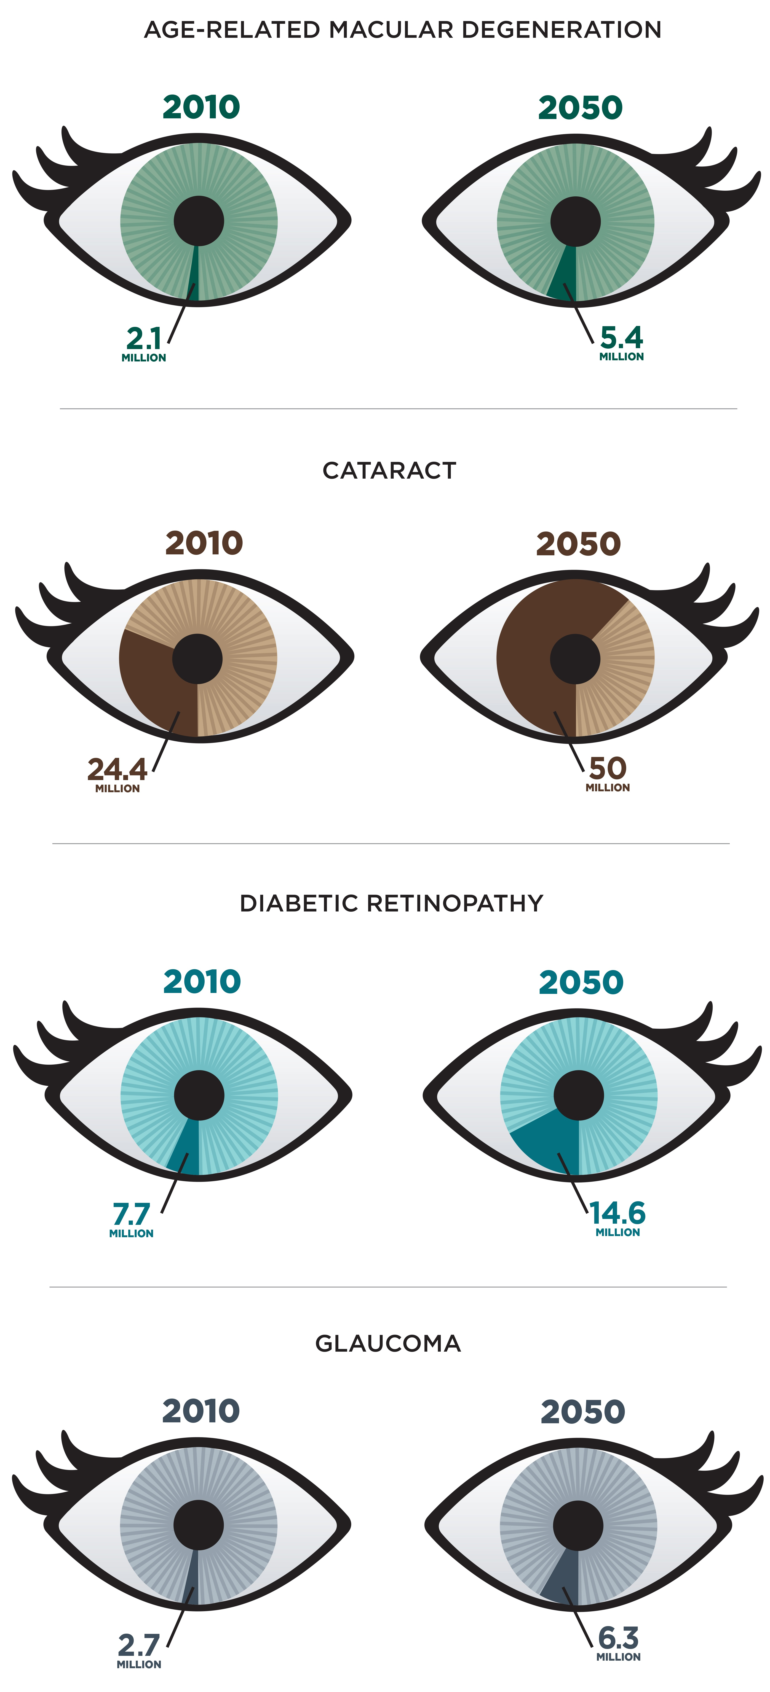
Causes of Vision Loss/Blindness
Leading causes of vision loss and blindness are age-related eye diseases
Age-related Macular Degeneration—blurs sharp, central vision needed for straight-ahead activities like reading and driving
Cataract—clouding of the lens of the eye
Diabetic Retinopathy—diabetes complication that affects small blood vessels in the eye
Glaucoma—damages the optic nerve which carries vision messages from the eye to brain
NOTES: https://www.nei.nih.gov
Each eye represents 80 million people, the estimated number of Americans aged 65 and over in 2050

Slide 9
Burden of Vision Impairment
U.S. Burden 3.22 million people over age 40 with vision loss
1.02 million people are blind
$139 billion, total costs and lost productivity
Correctable vision impairment includes
Cataract, lens replacement surgery to restore good vision
Refractive Errors, (e.g., nearsightedness), corrected by eyeglasses, contact lenses, or laser surgery (e.g., LASIK)
Uncorrected refractive error impairs vision in 8.2 million people
Uncorrectable vision impairment from eye disease or trauma
Prevention and Therapies can reduce vision loss if caught early
Eye Care: Only half of the estimated 61 million adults in the United States at high risk for serious vision loss visited an eye doctor last year
NOTES: https://www.nei.nih.gov/eyedata/ ; https://www.cdc.gov/visionhealth/basics/index.html

Slide 10


Charles Rothwell, MBA, MS Director, National Center for Health Statistics Centers for Disease Control and Prevention

Slide 11
Presentation Overview
Tracking the Nation’s Progress
Hearing and Other Sensory or Communication Disorders
Vision

Slide 12
Tracking the Nation’s Progress
27 HP2020 Measurable Hearing and Other Sensory or Communication Disorders Objectives:
14 HP2020 Measurable Vision Objectives:
7 | Target met
3 | Improving
9 | Little or no detectable change
2 | Getting worse
6 | Baseline data only
6 1 | Target met Improving
6 1 | Little or no detectable change Baseline data only
NOTES: The Hearing and Other Sensory or Communication Disorders Topic Area has 9 developmental objectives. The Vison Topic Area has 1 developmental objective. Measurable objectives are defined as having at least one data point currently available, or a baseline, and anticipate additional data points throughout the decade to track progress. The developmental objectives do not have a national baseline value.

Slide 13
Presentation Overview
Tracking the Nation’s Progress
Hearing and Other Sensory or Communication Disorders
Newborn screening, evaluation, and intervention services
Noise-induced hearing loss
Referral to audiologist or otolaryngologist due to tinnitus
Falls caused by dizziness or imbalance
Visits to healthcare providers by adults with chemosensory disorders
Vision

Slide 14
Newborn Hearing Screening, Evaluation, and Intervention Services
Percent
Hearing screening
2020 Target = 90.2%
Audiologic evaluation
2020 Target = 72.6%
2020 Target = 55.0%
Intervention services
NOTES: 2007*= HP2020 baseline. Hearing screening data are for newborns aged 1 month and under who had screening for hearing loss; audiologic evaluation data are for infants aged 3 months and under who did not pass the hearing screening and received audiologic evaluation; intervention services data – for infants aged 6 months and under with confirmed hearing loss enrolled for intervention services.
SOURCE: State-based Early Hearing Detection and Intervention Program Network (EHDI), CDC/NCBDDD.
Objs. ENT-VSL-1.1 through 1.3
Increase desired

Slide 15
Noise-Induced Hearing Loss, Adults 20-69 Years, 2011–12
HP2020 Target: 109.3
Decrease desired
Education
Rate per 1,000
NOTES: = 95% confidence interval. 2003-04* = HP2020 baseline. Except for education, data are for adults aged 20 to 69 years who had elevated hearing thresholds, or audiometric notches, in high frequencies (3, 4, or 6 kHz) in both ears, signifying noise-induced hearing loss. The categories Asian, black, and white exclude persons of Hispanic origin. Persons of Hispanic origin may be any race. Respondents were asked to select one or more races. Data for the single race categories are for persons who reported
only one racial group. Educational attainment data are for adults aged 25-69 years. Data are age-adjusted to the 2000
standard population. SOURCE: National Health and Nutrition Examination Survey (NHANES), CDC/NCHS.
I
ENT-VSL-8

Slide 16
Referrals to Specialists, Adults with Tinnitus, 2014
HP2020 Target: 50.4%
Increase desired
Disability status
Education
Percent
NOTES: = 95% confidence interval. 2007* = HP2020 baseline. Except for education, data are for adults aged 18 years and over bothered by the onset of tinnitus in the past 5 years and for whom it is a moderate, big, or very big problem, and who had been seen or been referred to an audiologist or otolaryngologist. Educational attainment data are for
adults aged 25 and over. Except for age-specific estimates, data are age-adjusted to the 2000 standard population. Target is not applicable to age groups.
SOURCE: National Health Interview Survey (NHIS), CDC/NCHS.
I
ENT-VSL-9.2

Slide 17
Falls Due to Dizziness, Vertigo, or Imbalance, Adults with Balance and Dizziness Problems, 2016
HP2020 Target: 50.0%
Decrease desired
Education
Age (years)
Percent
NOTES: = 95% confidence interval. 2008* = HP2020 baseline. Except for education, data are for adults aged 18 years and over with dizziness or balance problems who have fallen in the past 5 years while having dizziness, vertigo, or imbalance just before or around the time they fell. Educational attainment data are for adults aged
25 and over. Data, except for age groups, are age-adjusted to the 2000 standard population. Target is not applicable to age groups.
SOURCE: National Health Interview Survey (NHIS), CDC/NCHS.
I
Obj. ENT-VSL-15.1

Slide 18
Healthcare Provider Visit, Adults 40+ Years with Smell or Taste Disorders, 2013–14
Increase desired
Age (years)
*
Disability status
Percent
NOTES: = 95% confidence interval. *Data are not statistically reliable. Data are for adults aged 40 years and older who had smell or taste disorders and who had discussed their problem with a healthcare provider in the past 12 months. The categories Asian, black, and white exclude persons of Hispanic origin. Persons of Hispanic origin may be any race. Respondents were asked to select one or more races. Data for the single race categories are for persons who reported only one racial group. Except for age-specific groups, data are age-adjusted to the 2000 standard population.
SOURCE: National Health and Nutrition Examination Survey (NHANES), CDC/NCHS.
I

Slide 19
Presentation Overview
Tracking the Nation’s Progress
Hearing and Other Sensory or Communication Disorders
Vision
Vision screening and eye examination
Visual impairment
Rehabilitation services and adaptive devices use by adults with visual impairment
Occupational eye injuries
Use of protective eyewear

Slide 20
Vision Screening, Children 5 Years and Under, 2016
HP2020 Target: 44.1%
Increase desired
Family income
(% poverty threshold)
Percent
NOTES: = 95% confidence interval. 2008* Total = HP2020 baseline. Data are for children aged 5 years and under who have ever had their vision tested by a doctor or other health professional. American Indian includes Alaska Native. Black and white exclude persons of Hispanic origin. Persons of Hispanic origin may be any race. Respondents were asked to
select one or more races. Data for the single race categories are for persons who reported only one racial group.
SOURCE: National Health Interview Survey (NHIS), CDC/NCHS.
I
Obj. V-1

Slide 21
Dilated Eye Examination in the Past 2 Years, Adults 18+ Years, 2016
HP2020 Target: 60.5%
Increase desired
Education
Percent
NOTES: = 95% confidence interval. 2008* Total = HP2020 baseline. Except for education, data are for adults 18 years and over, who report they had a dilated eye exam within the past two years. American Indian includes Alaska Native. NHOPI is Native Hawaiian or other Pacific Islander. Black and white exclude persons of Hispanic origin. Persons of Hispanic origin may be any race. Respondents were asked to select one or more races. Data for the single race categories are for persons
who reported only one racial group. Educational attainment data are for adults aged 25 and over. Data are age-
adjusted to the 2000 standard population. SOURCE: National Health Interview Survey (NHIS), CDC/NCHS.
I
Obj. V-4

Slide 22
Visual Impairment and Blindness, Children 17 Years and Under, 2016
HP2020 Target: 25.4
Decrease desired
Family income
(% poverty
threshold)
Age
(years)
Rate per 1,000
NOTES: = 95% confidence interval. 2008* Total = HP2020 baseline. Data are for children aged 17 years and under who have trouble seeing even when wearing glasses or contact lenses or were blind. Black and white exclude persons of Hispanic origin. Persons of Hispanic origin may be any race. Respondents were asked to select one or more races. Data for the single race categories are for persons who reported only one racial group.
SOURCE: National Health Interview Survey (NHIS), CDC/NCHS.
I
Obj. V-2

Slide 23
Self-Reported Visual Impairment, Adults with Diagnosed Eye Diseases
Rate per 1,000
2008
2016
HP2020 Target: 99.0
HP2020 Target: 30.8
HP2020 Target: 12.5
HP2020 Target: 14.0
Diabetic retinopathy
18+
Glaucoma
Macular degeneration
Cataract
65+
Age (years):
45+
NOTES: I = 95% confidence interval. Data are for adults aged 18 years and over who have ever been told by a doctor or healthcare
professional that they had diabetic retinopathy; persons aged 45 years and over who have ever been told they had glaucoma or
macular degeneration; and persons aged 65 years and over who have ever been told they had cataract, and
reported vision loss due to these conditions. Data, except estimates for adults with diagnosed cataract, are
age-adjusted to the 2000 standard population.
SOURCE: National Health Interview Survey (NHIS), CDC/NCHS.
Objs. V-5.2 through 5.5

Slide 24
Vision Rehabilitation Services, Adults with Visual Impairment
Rate per 1,000
2008
2016
HP2020 Target: 33.2
Total
Female
Male
18-44
45-64
65+
Age (years)
NOTES: I = 95% confidence interval. Data are for adults aged 18 years and over who reported trouble seeing even when wearing
glasses or contact lenses and use of vision rehabilitation services such as job training, counseling, or training in daily
living skills and mobility. Except for age-specific estimates, data are age-adjusted to the 2000 standard population.
Target is not applicable to age groups.
SOURCE: National Health Interview Survey (NHIS), CDC/NCHS.
Obj. V-7.1

Slide 25
Visual Assistive and Adaptive Devices, Adults with Visual Impairment, 2016
HP2020 Target: 12.3%
Increase desired
Education
Percent
NOTES: = 95% confidence interval. 2008* = HP2020 baseline. Except for education, data are for adults 18 years and over, who have trouble seeing and use any visual assistive and adaptive devices such as telescopic or other prescriptive lenses, magnifiers, large print or talking materials, CCTV, white cane, or guide dog. Black and white exclude persons of Hispanic origin. Persons of
Hispanic origin may be any race. Respondents were asked to select one or more races. Data for the single race categories
are for persons who reported only one racial group. Educational attainment data are for adults aged 25 and over. Data
are age-adjusted to the 2000 standard population. SOURCE: National Health Interview Survey (NHIS), CDC/NCHS.
I
Obj. V-7.2

Slide 26
Occupational Eye Injuries
Rate per 10,000
Eye injuries treated in Emergency Departments
Decrease desired
HP2020 Target: 11.6
Eye injuries resulting in lost workdays
HP2020 Target: 2.6
NOTES: 2008* = HP2020 baseline. Rate per 10,000 full-time equivalent workers aged 16 years and older. Data are for occupational eye injuries or illnesses treated in hospital emergency departments; and for occupational eye injuries among private industry employees that required medical treatment beyond first aid and that resulted in one or more days away from work.
The eye injury or illness resulted from an event in the work environment.
SOURCES: National Electronic Injury Surveillance System (NEISS), CPSC; Current Population Survey (CPS),
Census and DOL/BLS; Survey of Occupational Injuries and Illnesses (SOII), DOL/BLS.
Objs. V-3.1 & 3.2

Slide 27
Protective Eyewear Use at Home: Always or Most of the Time
Percent
2008
2016
HP2020 Target: 43.7%
HP2020 Target: 18.2%
Total
Female
Male
Total
Female
Male
Children
Adults
NOTES: I = 95% confidence interval. Data are for children 6-17 years and adults aged 18 years and over who
were involved in activities that can cause eye injury and who wore protective eyewear always or most of the time.
Adult data are age-adjusted to the 2000 standard population.
SOURCE: National Health Interview Survey (NHIS), CDC/NCHS.
Objs. V-6.1 & 6.2

Slide 28
Key Takeaways – Hearing and Other Sensory or Communication Disorders
Between 2007 and 2015, the percent of newborns and infants who received hearing screening, evaluation, and intervention services increased. One objective has met its HP2020 target and two objectives are improving.
Noise-induced hearing loss among adults aged 20-69 years decreased between 2003-04 and 2011-12. The objective met its HP2020 target.
In 2014, 61.8% of adults aged 18 years and over with tinnitus had been seen or referred to specialists.
In 2016, 42.1% of adults aged 18 years and over with dizziness or balance problems reported falls caused by dizziness or imbalance.
In 2013-14, 12.1% of adults aged 40 years and over with smell or taste disorders discussed their problem with a healthcare provider in the past 12 months.

Slide 29
Key Takeaways – Vision
In 2016, 47.1% of children aged 5 years and under had a vision screening and 57.4% of adults aged 18 years and over had a dilated eye examination.
Between 2008 and 2016, the rates of visual impairment due to diabetic retinopathy, glaucoma, and cataract showed little or no detectable change. The objective on visual impairment due to macular degeneration has met its target.
Vision rehabilitation and visual adaptive device use among adults with visual impairment remained low. These objectives showed little or no detectable change between 2008 and 2016.
In 2016, the objectives on occupational eye injuries have met their Healthy People 2020 targets.
In 2016, 23.4% of children 6-17 years and 45.0% of adults aged 18 years and over participating in activities that can cause eye injury used protective eyewear always or most of the time. These objectives have met their Healthy People 2020 targets.

Slide 30


Healthy People 2020: NIDCD Efforts to Prevent, Diagnose, and Treat Communication Disorders
James F. Battey, Jr., M.D., Ph.D.
Director, National Institute on Deafness and Other Communication Disorders, NIH
February 22, 2018

Slide 31
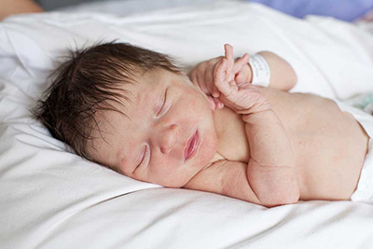
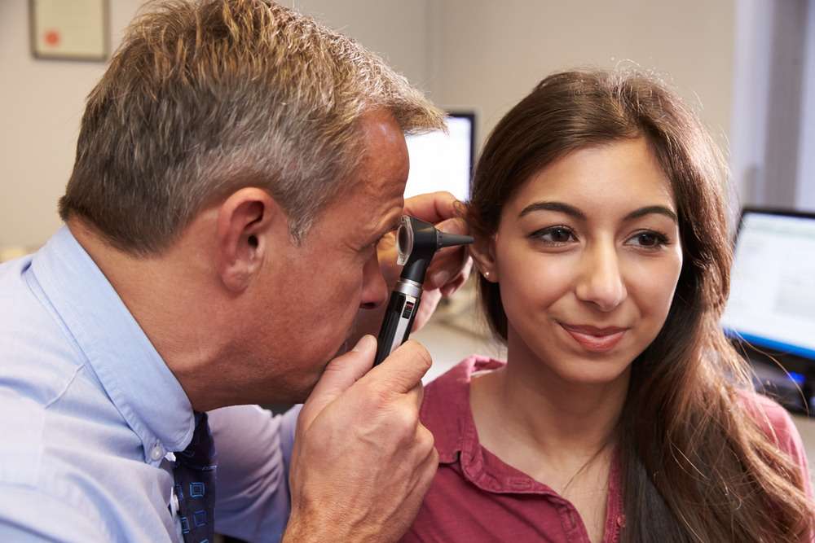


The NIDCD’s Mission
To support research and research training to prevent, detect, diagnose, and treat conditions in hearing and balance, taste and smell, and voice, speech, and language.
We seek to improve the lives of more than 65 million people in the United States who have a communication disorder.

Slide 32
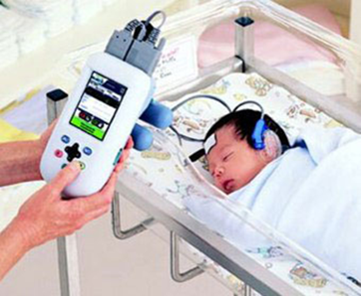
Objectives 1.1, 1.2, 1.3 Newborn Hearing Screening
Before 1993, fewer than 1 in 10 newborns in the U.S. were screened for hearing loss.
In 2000, the NIDCD supported a multicenter study that established the necessary technologies to screen newborns for hearing loss. These noninvasive tests are still used today.
Today, about 90% of infants are screened for hearing loss during the first month of life and 98% during their first year.
NOTE: https://www.cdc.gov/ncbddd/hearingloss/2014-data/2014_ehdi_hsfs_summary_h.pdf [PDF - 437 KB]

Slide 33



Objectives 1.1, 1.2, 1.3 Newborn Hearing Screening
New Law Strengthens Early Hearing Screening Program
October 2017 – President Trump signed the Early Hearing Detection and Intervention Act.
It reauthorizes the NIH, the CDC, and HRSA to continue a long-standing partnership to coordinate and advance a national program for the early identification and diagnosis of hearing loss and intervention services for newborns, infants, and young children.

Slide 34
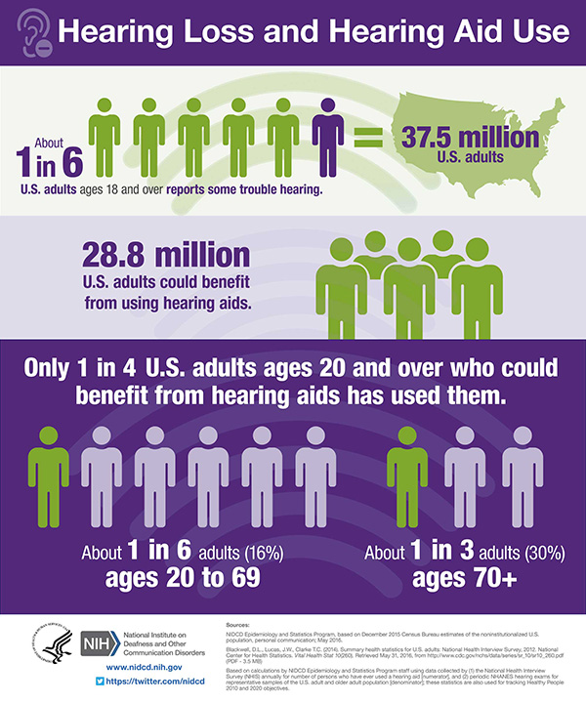
Objectives 3.1 and 3.3 Hearing Aid Use in Adults
Low Use of Hearing Aids
2009 – The NIDCD began supporting research on accessible and affordable hearing health care.
Two reports stress the need for improving hearing health care access and affordability:
October 2015 – President’s Council of Advisors on Science and Technology
June 2016 – National Academies of Sciences, Engineering, and Medicine
August 2017 – President Trump signed law authorizing the FDA to develop guidelines for a class of over-the-counter hearing aids.
NOTE: https://www.nidcd.nih.gov/shareable-images/infographic-hearing-loss-and-hearing-aid-use

Slide 35
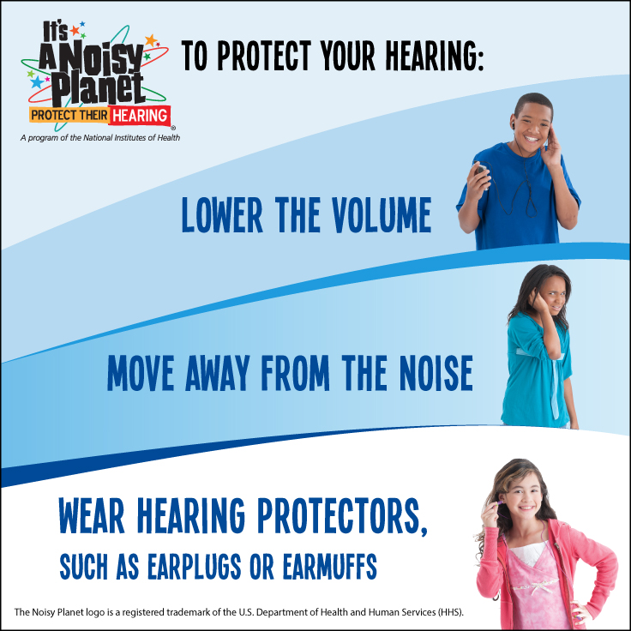
Objective 7 Noise-Induced Hearing Loss in Adolescents
Campaign to Prevent Hearing Loss
The NIDCD’s It’s a Noisy Planet. Protect Their Hearing.® public education campaign is aimed at preteens (children ages 8 to 12), their parents, and other educators on the causes and prevention of NIHL.
Launched in 2008, the campaign has reached about 6 million people.
About 827,000 materials in English and Spanish have been distributed.
Since 2010, about 20,000 students in the Washington, DC, area have been reached through school presentations.
https://www.noisyplanet.nidcd.nih.gov

Slide 36
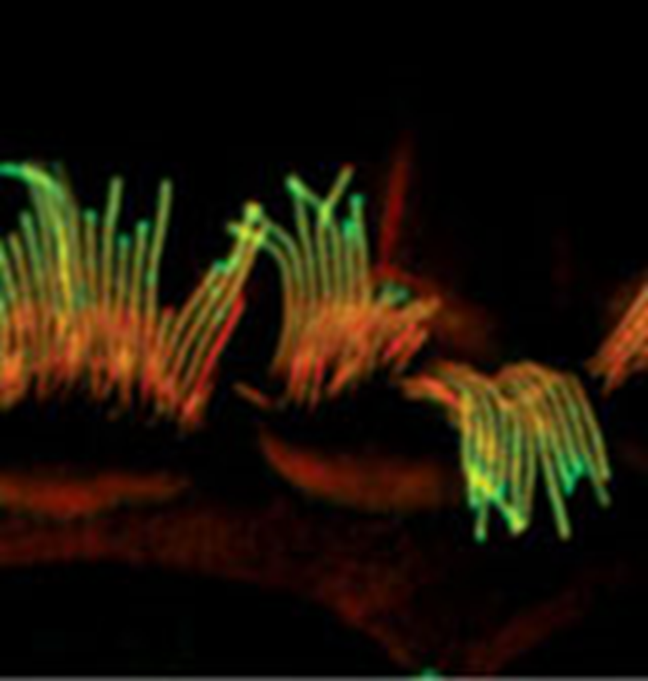
Objective 8 Noise-Induced Hearing Loss (NIHL) in Adults
As many as 24% of American adults under age 70 may have hearing loss due to noise exposure.
The NIDCD’s research on NIHL includes:
Identifying gene mutations that make individuals more susceptible to NIHL.
Studying cellular mechanisms that lead to noise-induced hearing damage.
Understanding ways that the ear protects itself from noise damage.
Developing molecules/drugs that can prevent or treat noise-induced hearing damage.
Noise-damaged hair cells of the inner ear.
NOTE: https://www.nidcd.nih.gov/health/noise-induced-hearing-loss

Slide 37
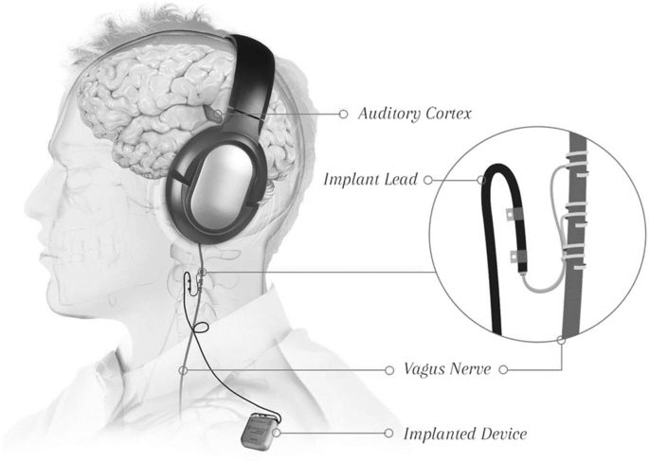
Objective 9.2 Tinnitus
Approximately 10% of U.S. adults has had tinnitus lasting at least 5 minutes in the past year.
NIH-supported clinical trials of treatments for tinnitus:
A study of a device to stimulate the vagus nerve to rewire brain connections
Brain stimulation studies
Setup pairing Vagus Nerve Stimulation (VNS) with tones. The inset shows the electrode lead wrapped around the vagus nerve. A pulse generator is implanted under the chest wall.
Image courtesy of MicroTransponder, Inc.
NOTE: https://www.nidcd.nih.gov/health/statistics/quick-statistics-hearing

Slide 38

Objective 15.1 Balance and Dizziness
About 15% of American adults (35 million) reported having a balance or dizziness problem during the past year.
The NIDCD is supporting a clinical trial to develop tools that can help hospital emergency room physicians better diagnose balance problems.
NOTE: https://apha.confex.com/apha/2017/meetingapp.cgi/Paper/384250.

Slide 39

Objective 16 Chemosensory (Taste and Smell) Disorders
Roughly 12% (13 million) of Americans aged 40 or older had an impaired sense of smell. As the population ages, more people will likely be affected.
Effective, evidence-based ways to prevent or treat taste and smell disorders have not been developed. More clinical research on these disorders is needed.
To address this need, the NIDCD is dedicated to building a critical mass of clinical researchers to conduct patient-oriented studies and develop treatments for taste and smell problems.
NOTES: https://www.ncbi.nlm.nih.gov/pmc/articles/PMC5033684/

Slide 40



Connect With the NIDCD
The NIDCD would like to thank NCHS.
Web: https://www.nidcd.nih.gov
Twitter: https://twitter.com/nidcd
Facebook: https://www.facebook.com/NoisyPlanet
Content Syndication: https://www.nidcd.nih.gov/content-syndication
NIDCD Information Clearinghouse:
Voice: (800) 241-1044
Email: nidcdinfo@nidcd.nih.gov

Slide 41

Healthy People 2020 Progress Review: The Diagnosis, Prevention, and Treatment of Sensory Disorders
Paul A. Sieving, M.D., Ph.D.
Director, National Eye Institute, NIH

Slide 42
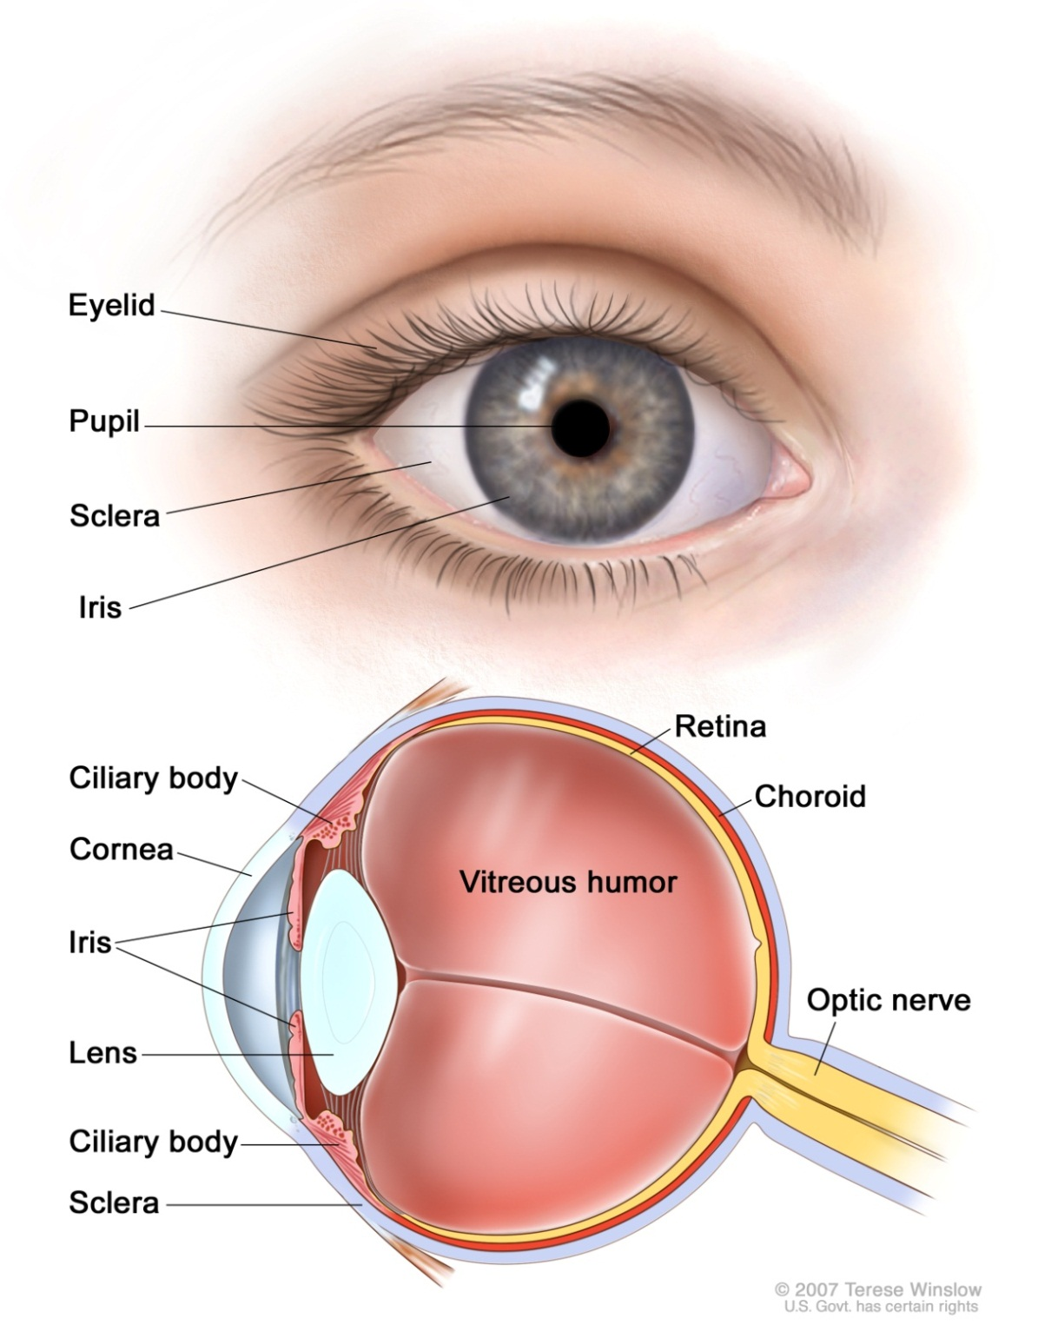
NEI Mission
Research to Improve Vision Health:
Population Research
Clinical Research
Basic Laboratory Research
Public Outreach and Education
Vision Rehabilitation

Slide 43
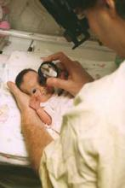
Objective V-2 Reducing Visual Impairment in Children
Technology Identifies Blinding Disease in Premature Babies
Retinopathy of prematurity (ROP)—a blinding disorder affecting very premature infants
Prompt diagnosis and treatment can improve outcomes
NEI Telemedicine trial demonstrated that remote screening is highly successful
Trained non-physicians reviewed eye images
Correctly identified 159/162 cases (98%)
Infants needing specialty care referred to doctor, improving outcomes
Expands eye care options for rural and underserved communities

Slide 44
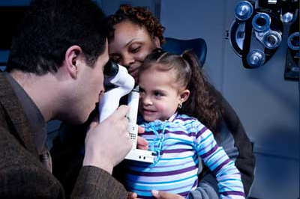
Objective V-1 Vision Screening in Preschoolers
Vision Screening is Critical for School Readiness
Early detection and treatment can reduce vision loss
Vision In Preschoolers (VIP) Study
Vision impairment leads to reading and learning deficits
Well trained nurses can effectively screen children
Children needing eye care referred to an eye care professional
US Preventive Services Task Force recommends vision screening in children ages 3-5

Slide 45

Objective V-2 Reducing Visual Impairment in Children
Research Shines Light on Reducing Myopia in Children
Children with myopia cannot see distance objects clearly
Myopia can be corrected with eyeglasses or contact lenses
Prevalence of myopia is increasing
The CLEERE study examined the impact of “near work”:
Children who spent more time outdoors (>14 hrs/wk) reduced their risk of myopia
Exercise may play a role, but bright sunlight seems to be the key
Encourage children to play outdoors!

Slide 46
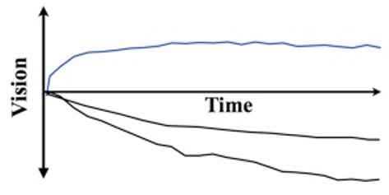
Objective V-5.2 Diabetic Retinopathy
Develop Therapies through Diabetic Retinopathy Network
Diabetic Retinopathy (DR) is leading cause of vision loss in working-age adults
DR Clinical Trial Network brings together academic and community clinics
Private-Public Partnership
Anti-VEGF Therapy
Anti-VEGF Therapy is better than laser
Without treatment, vision continues to deteriorate
Drugs stopped vision loss, and improved vision
Changed standard of care
Laser Therapy
No Treatment

Slide 47

Objective V-5.5 Age-Related Macular Degeneration
New Prevention and Treatments for AMD
Age-Related Macular Degeneration is leading cause of vision loss in adults age ≥ 65
Prevention— Age-Related Eye Disease Studies (AREDS) demonstrated 27% risk reduction through nutritional supplements
Vitamins
Antioxidants based on leafy green vegetables
Zinc and copper
Genomics— Discovery of 34 risk genes opens door to future therapies
Environment— Smoking UV exposure Unhealthy diet
Treatment— Anti-VEGF drugs for one form of AMD

Slide 48
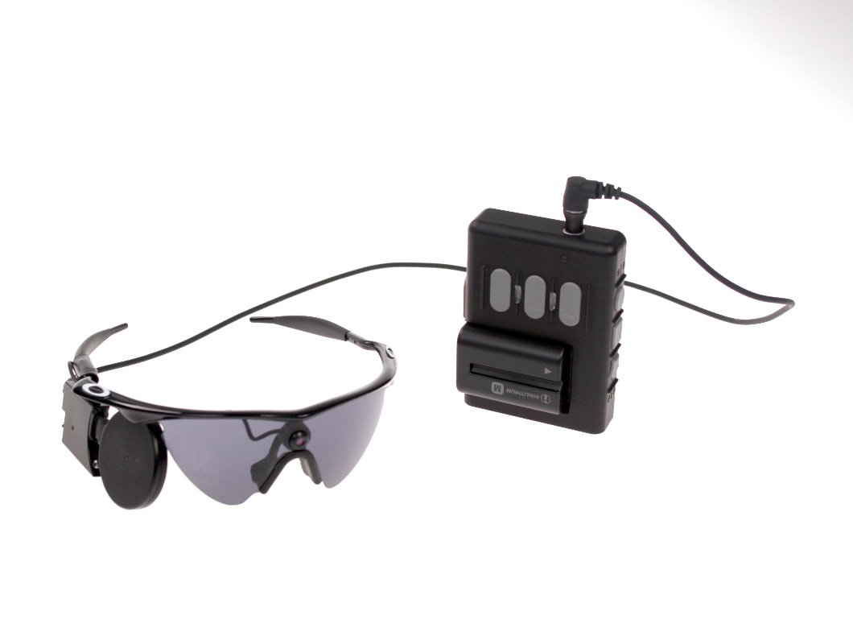
Objective V-7 Increase Vision Rehabilitation
Improving Quality of Life for People with Low Vision
Rehabilitation training, uses brain plasticity
Audio-based “video” game environment
Assistive devices and navigational aids
Smartphone aps that read street signs or convert drug labels to text
Robotic walking cane that detects objects and talks to user
Artificial Retina Prosthesis (ARGUS II)—FDA approved in 2013; restores vision to patients with inherited blinding disease
Camera on glasses relays visual scenes to wireless electrode array implanted in the eye
Small Business grants—Product development to bring tools to market

Slide 49

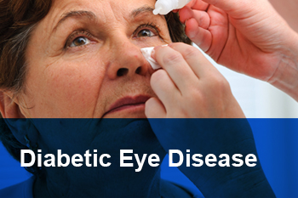

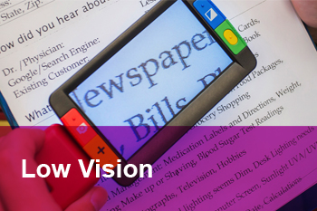

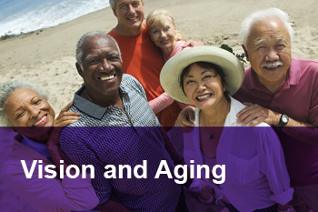
Objective V-4 Increase Comprehensive Eye Exams
Public Eye Health Education and Awareness
National Eye Health Education Program (NEHEP) teaches eye health literacy to the public
Educates medical providers and patients about science-based treatments and preventions
Conducted through public-private partnerships
Targets populations at increased risk for eye diseases (African Americans, Hispanics/Latinos, and older adults)
Focuses on increasing clinical care for diabetic eye disease and glaucoma
Encourages vision rehabilitation for low vision patients

Slide 50
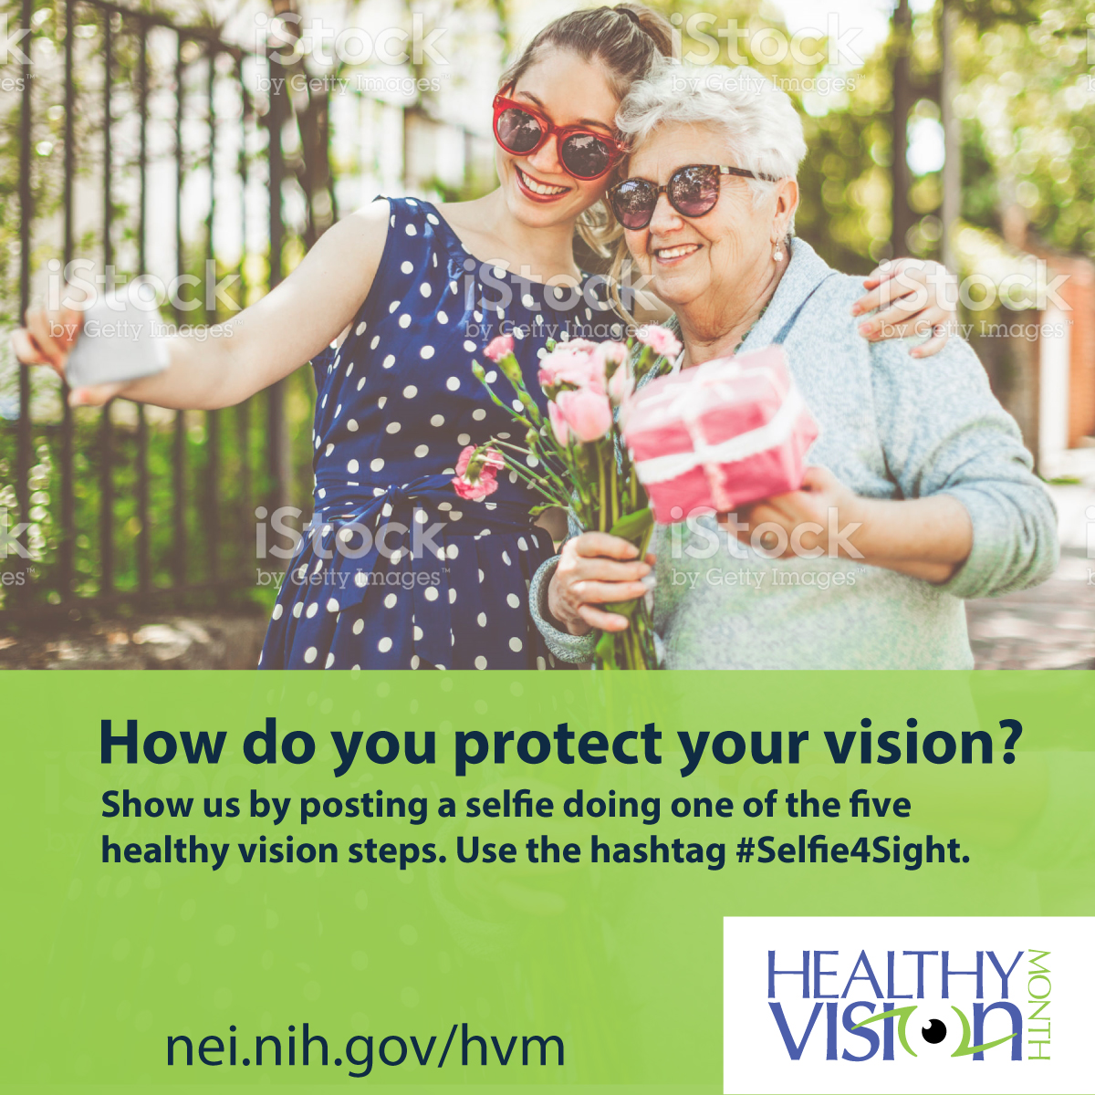
Objective V-6 Use Protective Eyewear
Achieving Healthy People Objectives through Healthy Vision Month
NEI established May as Healthy Vision Month to promote eye health as a priority
Messages for social media, campaigns, and TV ads:
Get a comprehensive dilated eye exam
Live a healthy lifestyle, including
Healthy foods
Healthy weight
Managing chronic conditions
Not smoking
Know your family history
Use protective eyewear
Wear sunglasses

Slide 51
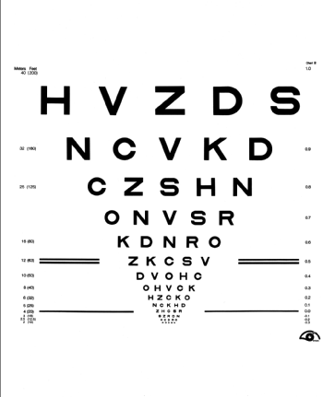
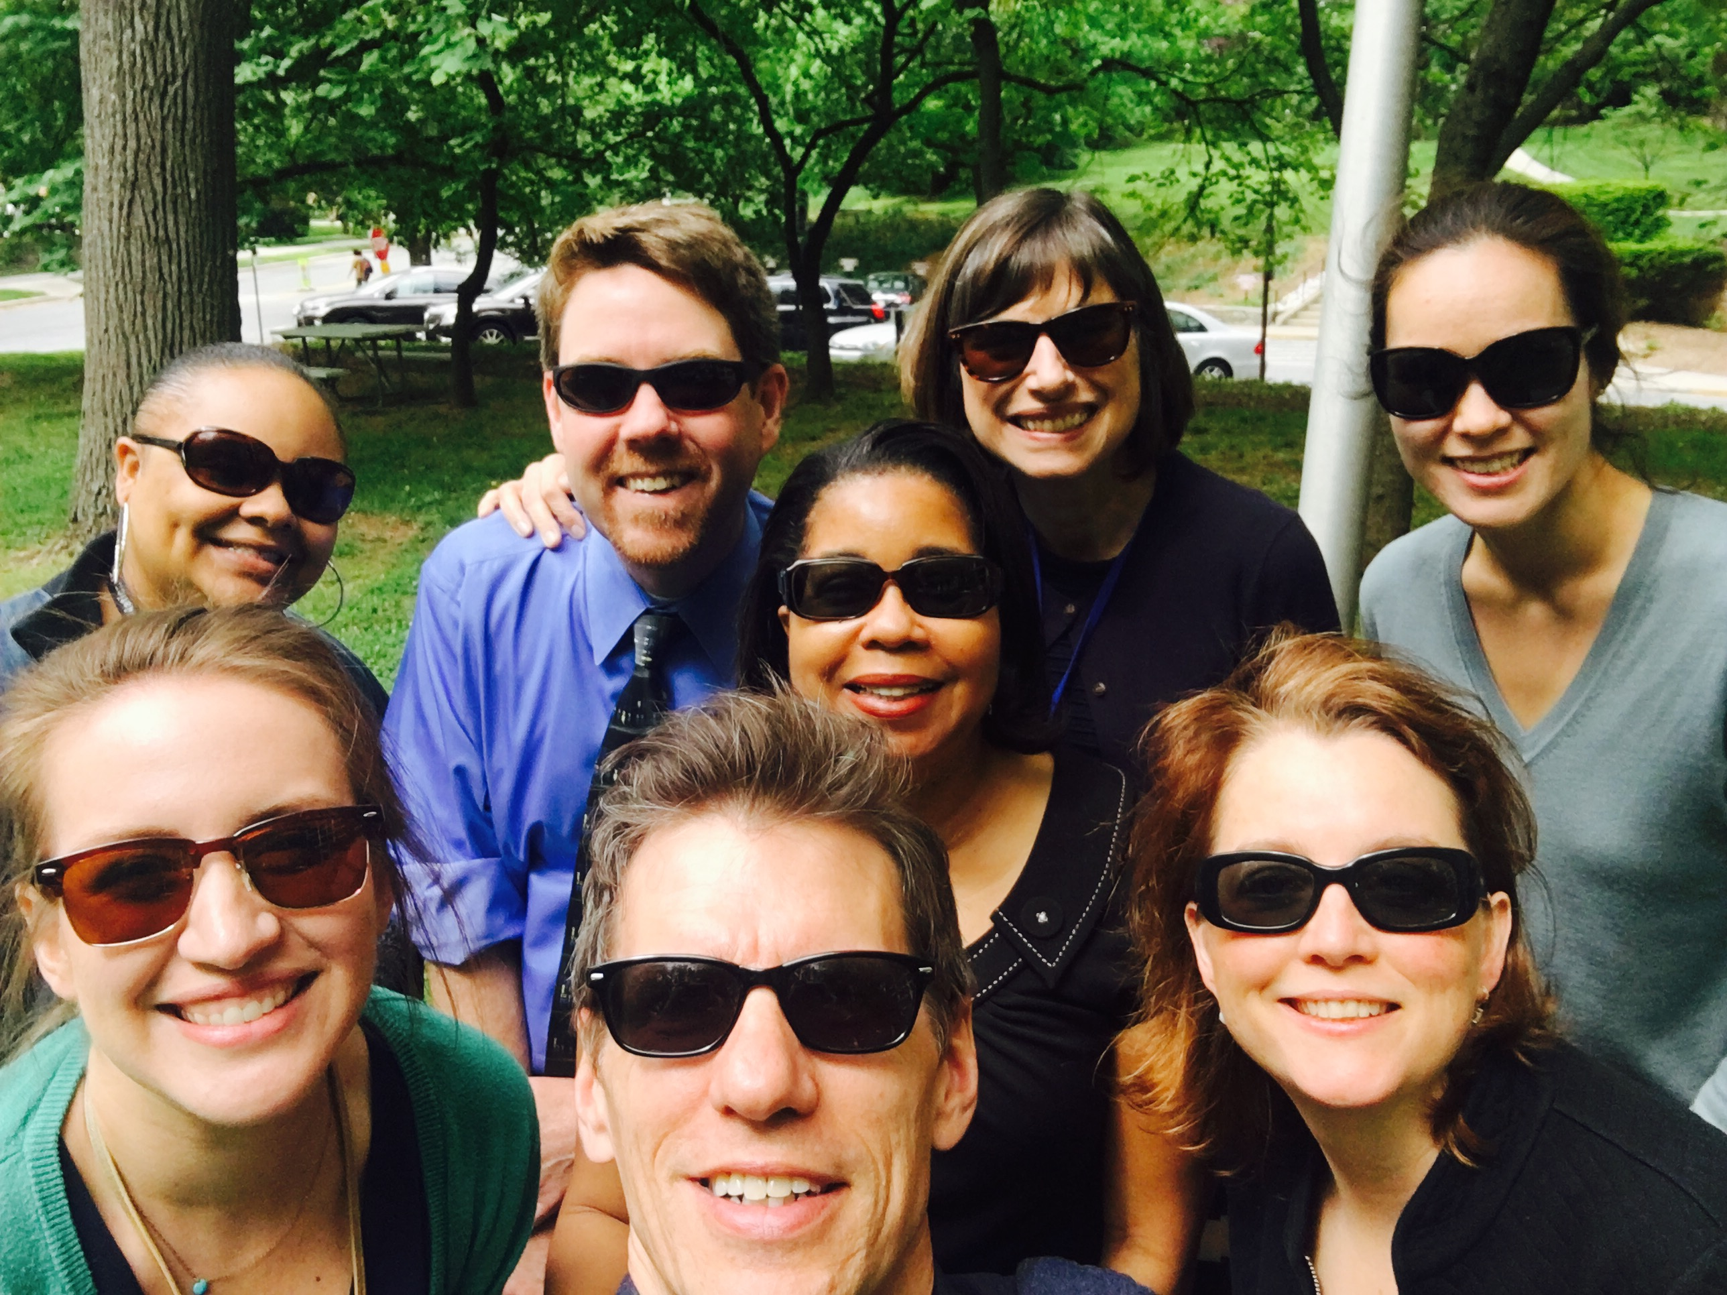
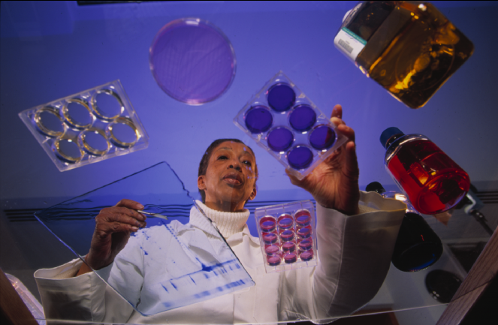
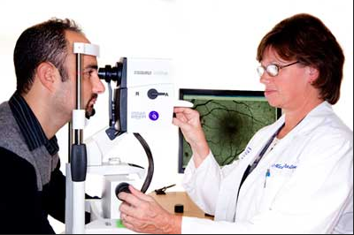
Stay Connected to NEI
National Eye Health Education Program nei.nih.gov/nehep
Facebook: www.facebook.com/NationalEyeHealthEducationProgram
NEI Social Media: nei.nih.gov/tools/stay_connected
Phone: (301) 496-5248—English and Spanish
Email: 2020@nei.nih.gov
Web: www.nei.nih.gov

Slide 52

Development of a Community-based Hearing Health Education and Support Program for Adults with Hearing Loss and their Families
Nicole Marrone, Ph.D., CCC-A
James S. and Dyan Pignatelli/UniSource Clinical Chair in Audiologic Rehabilitation for Adults
Assistant Professor, Department of Speech, Language, and Hearing Sciences,
University of Arizona, Tucson, Arizona
Funded by: NIH NIDCD
R21/R33 DC013681
Healthy People 2020 Progress Review
February 22, 2018

Slide 53
Overview
Seeking
Comprehensive
Audiologic Care
Developing
a Community-based Program
Tracking Promising Outcomes
Importance of equity in access to quality care
National challenges
Barriers in our region
Needs assessment
Our innovation
Results of pilot program
Overcoming barriers in access to care
Future directions

Slide 54
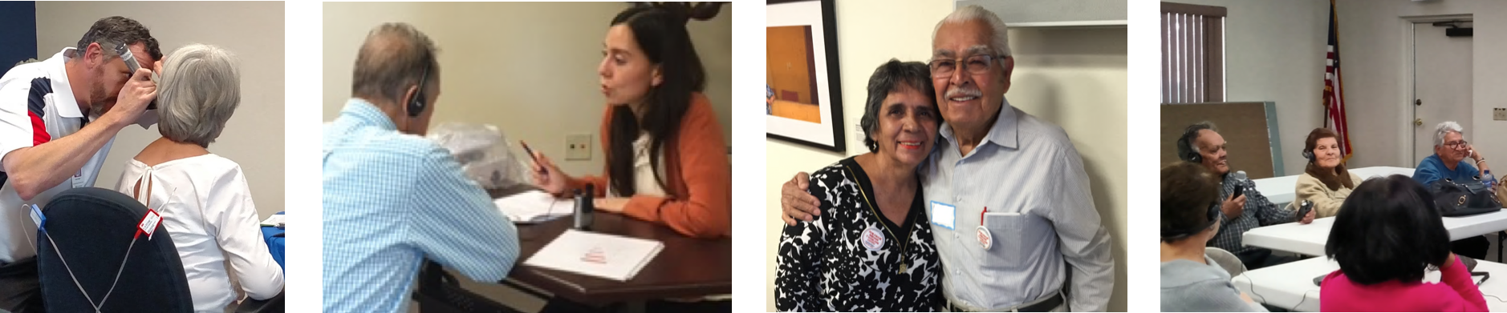
Access to comprehensive hearing health care is important for the health and wellbeing of all Americans.
Medical services
e.g., Screening and assessing the auditory system; Otolaryngology
Diagnostic audiology services
e.g., Evaluate degree, type, configuration of hearing loss and its functional impacts on daily life
Rehabilitative
audiology services
e.g., Family-centered care, counseling, amplification, assistive technology, ongoing management and aural rehabilitation
Preventive services
e.g., Health education, hearing conservation
(“It’s a Noisy Planet:
Protect Their Hearing”)

Slide 55
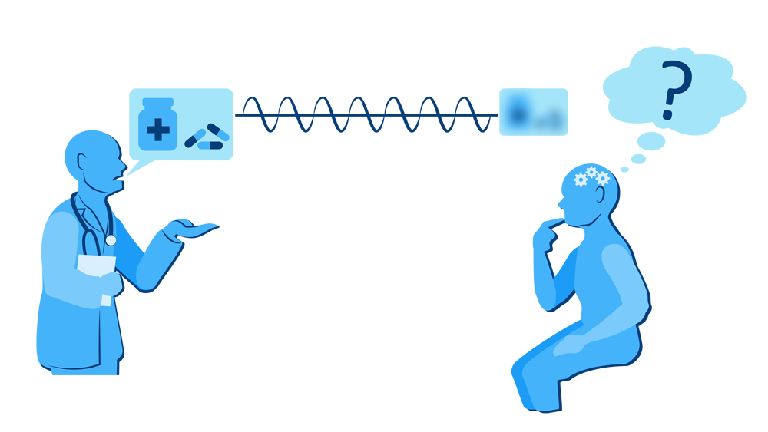
Hearing loss affects health and quality of life, like other sensory and communication disorders.
Hearing health impacts:
Communication access
Participation in communities
Overall health & quality of life
National Academies of Sciences, Engineering,
and Medicine, 2016
Artist: Timothy Wong
Nearly 2 in 3 Americans age 70+ are living with hearing loss.

Slide 56
Challenges in access to comprehensive audiologic care in the U.S.
Significant gaps in care, between self-reporting hearing loss and receiving evaluation, treatment, and rehabilitation services (Mahboubi, Lin, & Bhattacharyya, 2017).
Nationally, rehabilitative services from audiologists are not covered by Medicare (National Academies of Sciences, Engineering, and Medicine, 2016).
Coverage varies across state Medicaid systems for adults (Arnold, Hyer, & Chisolm, 2017).
Adults with lower socioeconomic status are less likely to use hearing aids (Bainbridge & Ramachandran, 2014).

Slide 57
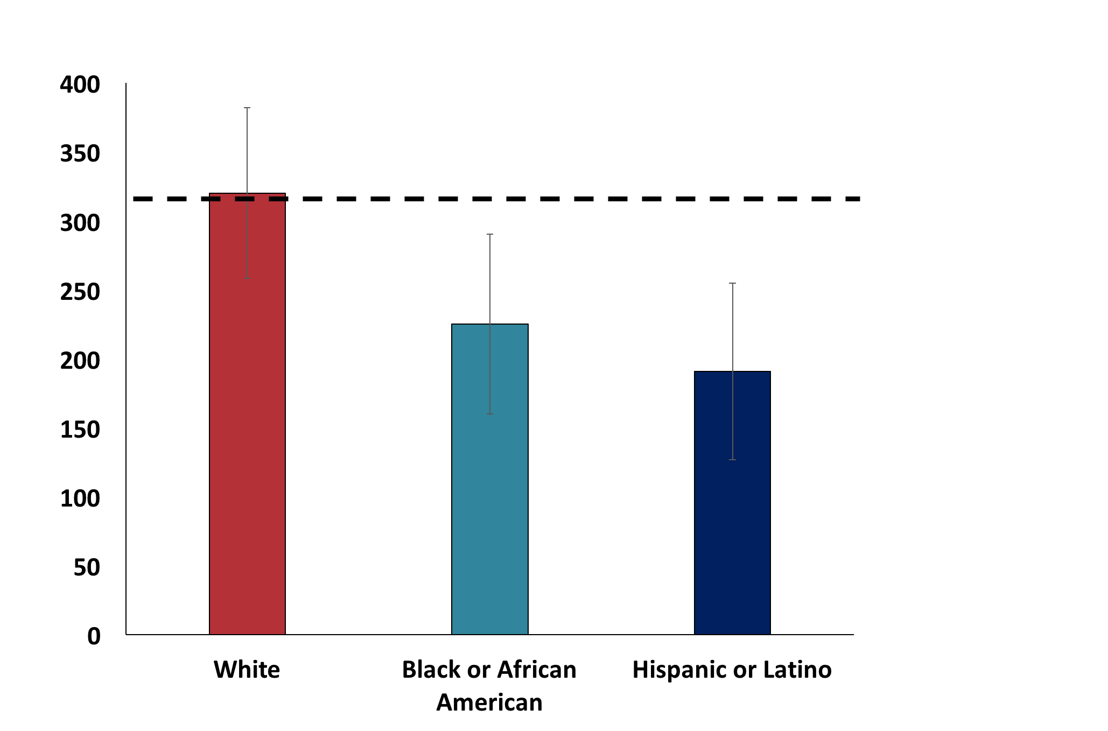
Hearing Aid Use in the U.S. by race/ethnicity
Rate per 1,000 Adults 70+ years with moderate or greater hearing impairment
Healthy People 2020 Target
See also Nieman, Marrone, Szanton, Thorpe, & Lin (2016), J Aging Health
Data Source:
HP2020
ENT-VSL-3.3
2011-2013
Accessed 02/01/18
Error bars + 95% CI
White
Americans
Black or
African Americans
Hispanic or
Latino Americans

Slide 58
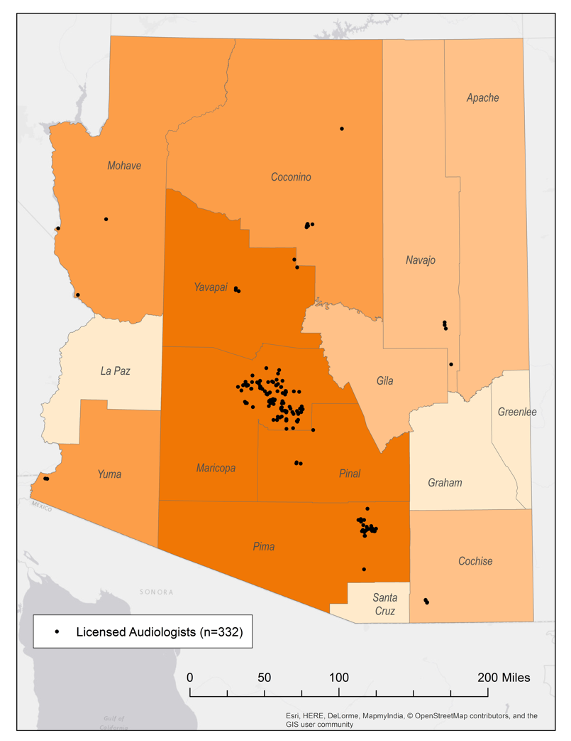
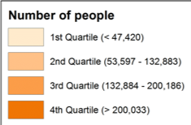
Availability of Health Care Providers in Rural Areas
Rural USA: shortages of health care providers (Chan et al., 2017; Goins et al. 2005; Rosenblatt et al., 2006).
Arizona: 6 non-metro counties without any audiologists (Coco, Sorlie Titlow, & Marrone, submitted)
Data Source: Licensed dispensing audiologist practice locations; list accessed 06/17/17 from Arizona Department of Health and Human Services

Slide 59
Our Approach: Community-Based Participatory Research
Public Health
Audiology
Federally Qualified Health Center
Spanish and Translation Studies
Community with hearing loss
A strategy for reducing health disparities in underserved communities that:
Helps define health needs;
Increases trust and bridges cultural gaps;
Enhances relevance of research and accuracy of study findings.

Slide 60
Our Innovation: Collaboration between Audiologists and Community Health Workers
Audiologists
are health care professionals who provide care in the prevention, diagnosis, treatment, and management of hearing loss, other auditory and balance disorders
(Bureau of Labor and Statistics, 2018).
Community health workers
are “frontline,” lay public health workers who share sociocultural characteristics with their community and provide culturally-relevant health education
(American Public Health Association).
For our research, audiologists have trained community health workers on recognizing hearing concerns and communicating effectively with people with hearing loss in their programs and community (Sánchez et al., 2017).

Slide 61
Community Needs Assessment
Ingram et al. (2016), Frontiers in Public Health
n = 206
Community engagement
Data collection
Data
analysis
Community
hearing screenings
Trainings for community
health workers
Community survey (n = 100)
5 community focus groups (n=47)
20 patient interviews
3 family focus groups (n=27)
12 provider interviews
Theory-based within
Health Belief & Social-ecological models

Slide 62
Key barriers to be addressed
Lack of knowledge and resources on hearing loss
Perception that the “only” intervention (i.e., hearing aid) is out of reach
High perceived severity of issue
Many concerns related to depression, reduced participation
Low perceived self-efficacy
Social withdrawal and lack of support
Frustrations of family
Gaps in access to care
Medical providers not referring to Specialists due to perceived costs
Limited availability of local options
Limited trust of care requiring out-of-pocket expenses
Ingram et al. (2016),
Frontiers in Public Health
Illustrative Quotes
“Many people assume, ‘well, this is how I am, and this is how I’ll stay.’ We don’t seek help, but the problem is serious.”
“I know it is expensive so I don’t do anything.”
“Other health concerns have more attention and resources.”

Slide 63

“Hearing Well”
Hearing assessment and counseling by an audiologist at enrollment in program
Each weekly session facilitated by community health workers
Week 1
Communication Strategies Overview
Week 2
How We Hear
& Visual Cues
Week 3
Coping and Emotions
Week 4
Hearing Aids, Assistive Devices, & Americans with Disabilities Act
Week 5
Hearing Health Care Pathways, Self-Advocacy &
Hearing Protection
Outcomes assessment
Pilot study: n = 21 (2 communication partners withdrew)
Marrone, Ingram, Somoza, Sánchez, Sanchez, Adamovich, & Harris (2017) Seminars in Hearing
See also: Colina, Marrone, Sánchez, & Ingram (2017); Coco, Colina, Atcherson, & Marrone (2017)

Slide 64
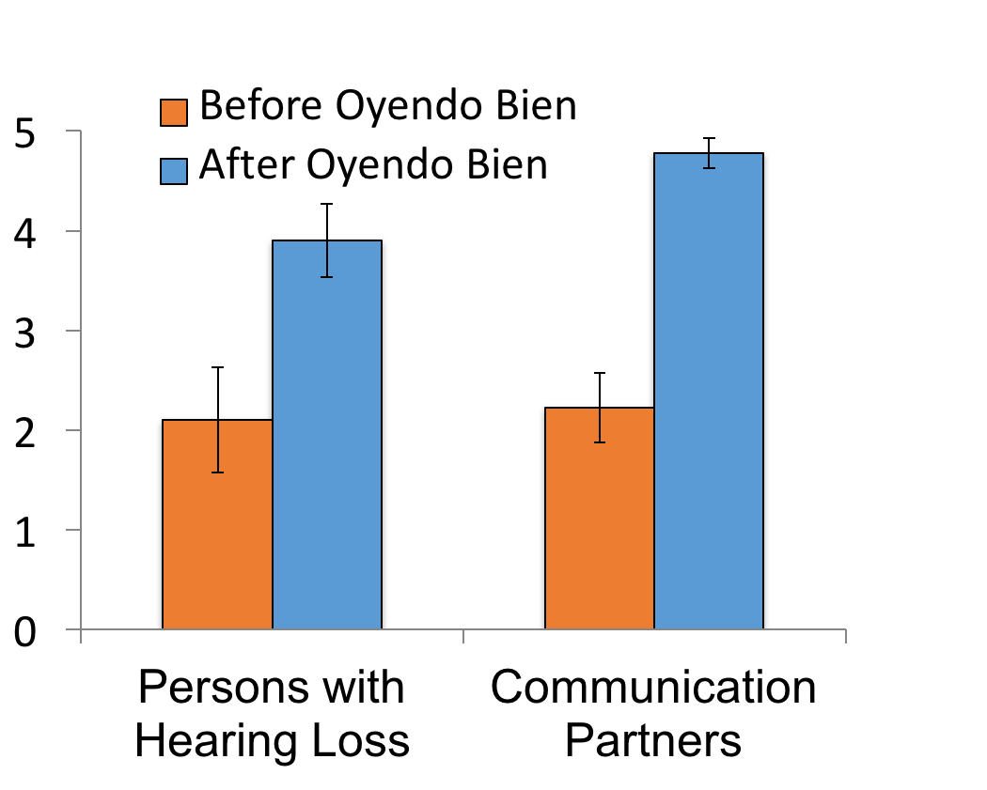
Pilot study results: Spoke slowly & clearly
Almost always
Often
Sometimes
Rarely
Never
Error bars:
+ 1 standard error
n = 10
n = 9

Slide 65
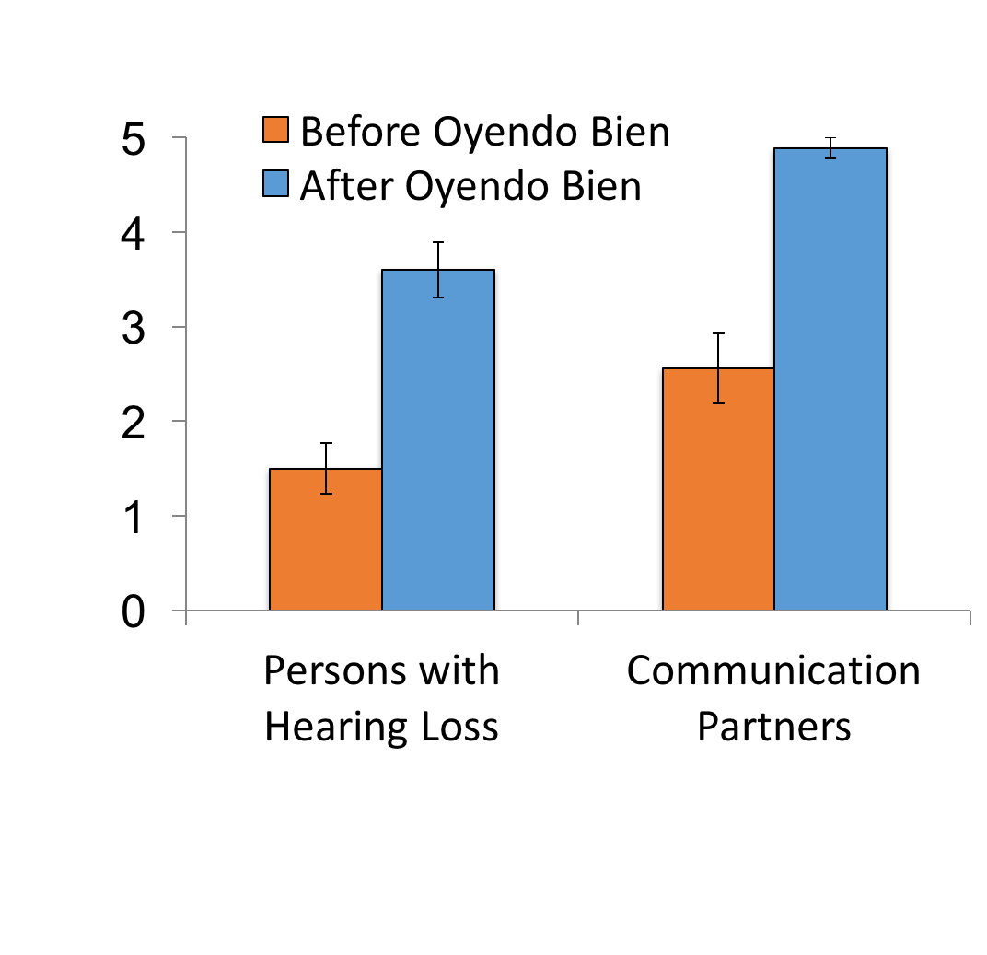
Pilot study results: Helped plan activities so partner with hearing loss can hear and participate
Almost always
Often
Sometimes
Rarely
Never
Error bars:
+ 1 standard error
n = 10
n = 9

Slide 66
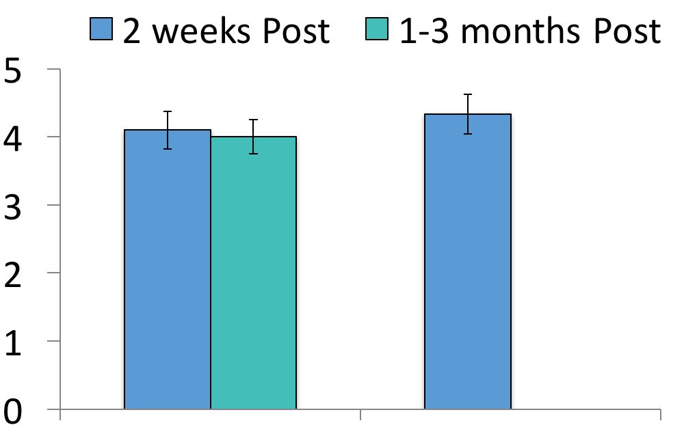
Pilot study results: Enjoyment of Life
International Outcomes Inventory –Alternative Interventions Scale (Noble, 2002)
After Oyendo Bien
3 months post program
Very much better
Quite a lot better
Slightly better
No change
Worse
Persons with Hearing Loss
(n = 10)
Communication Partners
(n = 9)
Error bars:
+ 1 standard error

Slide 67
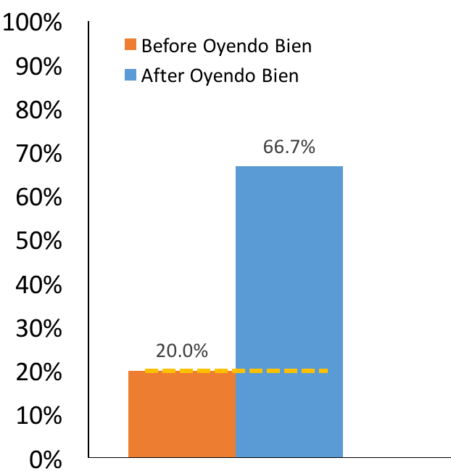
Overcoming barriers in access to care: Hearing health care utilization outcomes 1 year post pilot study
“You all taught us something new. Before attending the classes, I had almost no hearing. I now have one hearing aid and I have to go back in three weeks for a second…”
Hispanic/Latino adults with hearing loss
using hearing aids (%)
Pilot study outcomes:
Marrone et al. (2017)
Current research: Ongoing randomized trial
ClinicalTrials.gov NCT03255161

Slide 68
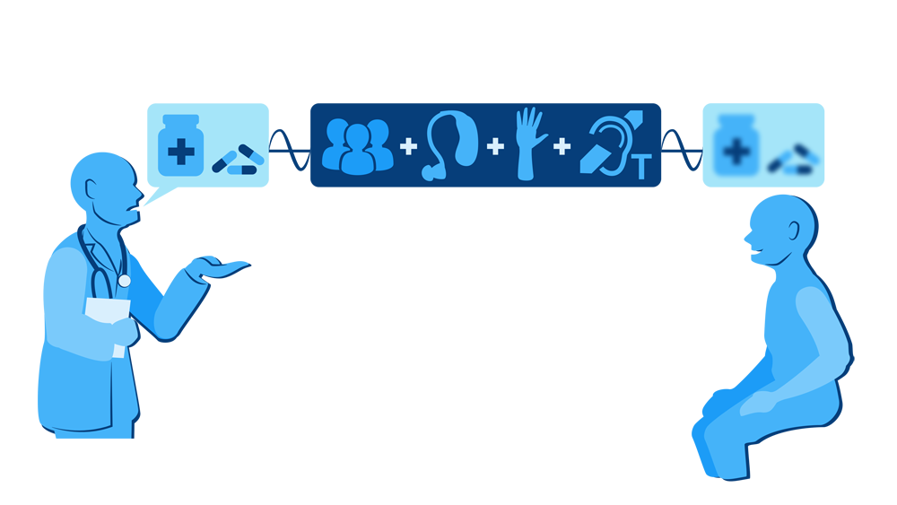
Returning to our example …
After Oyendo Bien,
a person may have more effective communication through:
Improved social supports;
Family working together to overcome barriers in access to care;
Developing skills in clarifying misunderstandings and confidence in using assistive technology;
… topics of ongoing and future research.
Artist: Timothy Wong

Slide 69
Summary
Collaboration between audiology, public health, and the community has led to a novel, culturally competent program with promising outcomes in quality of life and access to hearing health care (Marrone et al., 2017).
Community health workers may serve as a feasible link between underserved communities and the hearing health care system; continued research is needed in this area and in other communities across the U.S. (e.g., Baltimore HEARS, Nieman et al., 2017).
Achieving health equity includes increasing access to, and use of, comprehensive audiologic care for all Americans.

Slide 70
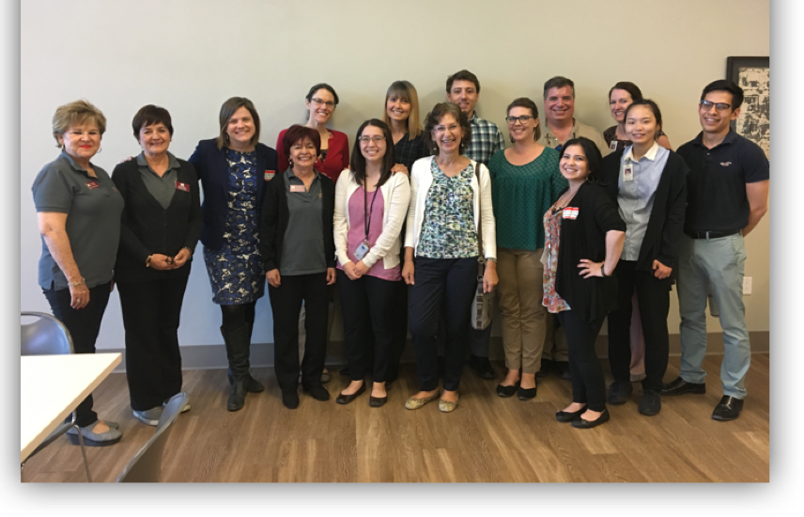
Thank you
University of Arizona
Speech, Language, & Hearing Sciences: Nicole Marrone, PhD (PI), Aileen Wong, AuD, Adriana Sanchez, Laura Coco, AuD, Frances Harris, PhD, Clemente Morales, Alyssa Everett, Diane Cheek, Giau Le, AuD, Daisey Sánchez Jacob, AuD, Anette Real-Arrayga
Public Health: Maia Ingram, MPH, Scott Carvajal, PhD, Jill de Zapien, Melanie Bell, PhD, Tanyha Zepeda
Spanish & Portuguese: Sonia Colina, PhD
Geography: Kyle Sorlie Titlow
Mariposa Community Health Center
Cecilia Navarro, Rosie Piper, Alicia Sander, Conchita Somoza, Patty Molina, Eladio Pereira, MD, Susan Kunz, MPH, Ed Sicurello
Research funded by:
NIH/NIDCD R21/R33 DC013681, University of Arizona Foundation, Pignatelli Clinical Chair in Audiologic Rehabilitation
hearing2020@email.arizona.edu

Slide 71
Roundtable Discussion Carter Blakey Deputy Director, Office of Disease Prevention and Health Promotion

Slide 72
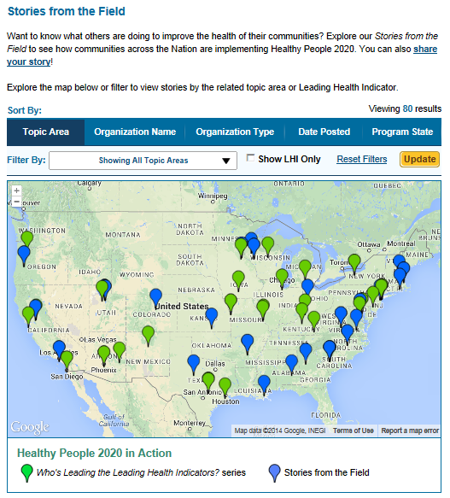
Healthy People 2020 Stories from the Field
A library of stories highlighting ways organizations across the country are implementing Healthy People 2020
Healthy People in Action
http://www.healthypeople.gov/2020/healthy-people-in-action/Stories-from-the-Field

Slide 73
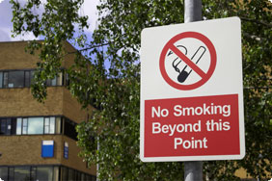
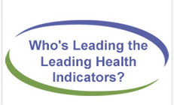
Who’s Leading the Leading Health Indicators? Webinar
Please join us on
Thursday, March 22, 2018
from 12:00 to 1:00 pm ET
for a Healthy People 2020 Who’s Leading the Leading Health Indicators? webinar on Environmental Quality Prevention.
Registration on
HealthyPeople.gov
available soon

Slide 74
Progress Review Planning Group
Jennifer Villani (NIH/OD)
Howard Hoffman (NIH/NIDCD)
May Chiu (NIH/NIDCD)
Chuan-Ming Li (NIH/NIDCD)
Lonnie Lisle (NIH/NIDCD)
Baldwin Wong (NIH/NIDCD)
Laura Cole (NIH/NIDCD)
Susan Dambrauskas (NIH/NIDCD)
Christa Themann (CDC/NIOSH)
Shefa Gordon (NIH/NEI)
Mary Frances Cotch (NIH/NEI)
David Huang (CDC/NCHS)
Leda Gurley (CDC/NCHS)
Asel Ryskulova (CDC/NCHS)
Cheryl Rose (CDC/NCHS)
Carter Blakey (HHS/ODPHP)
Angie McGowan (HHS/ODPHP)
Debbie Hoyer (HHS/ODPHP)
Ayanna Johnson (HHS/ODPHP)
Yen Lin (HHS/ODPHP)

Slide 75


Stay Connected
Web healthypeople.gov
Email healthypeople@hhs.gov
Twitter @gohealthypeople
YouTube ODPHP (search “healthy people”)
Join the Healthy People Listserv & Consortium

