Slide 1



Progress Review Webinar: Family Planning and Maternal, Infant, and Child Health
October 25, 2017

Slide 2
Healthy People 2020 Progress Review: Optimizing Birth Outcomes Through Preconception and Interconception Health
Vanila Singh, MD, MACM
Chief Medical Officer
U.S. Department of Health and Human Services

Slide 3
Agenda and Presenters
Chair
Vanila Singh, MD, MACM, Chief Medical Officer, U.S. Department of Health and Human Services
Presentations
Charles Rothwell, MBA, MS, Director, National Center for Health Statistics
Teresa Manning, MA, JD, Deputy Assistant Secretary for Population Affairs, U.S. Department of Health and Human Services
Wanda Barfield, MD, MPH, RADM USPHS, Director, Division of Reproductive Health, CDC
Michael Kogan, PhD, Director, Office of Epidemiology and Research, Maternal and Child Health Bureau, HRSA
Community Highlight
Faye Johnson, Chief Executive Officer, Northeast Florida Healthy Start Coalition, Magnolia Project, Jacksonville, Florida

Slide 4
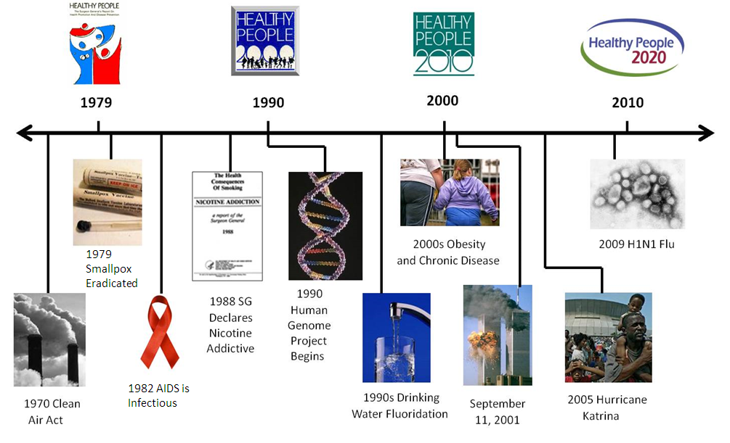
Healthy People at the Forefront of Public Health

Slide 5
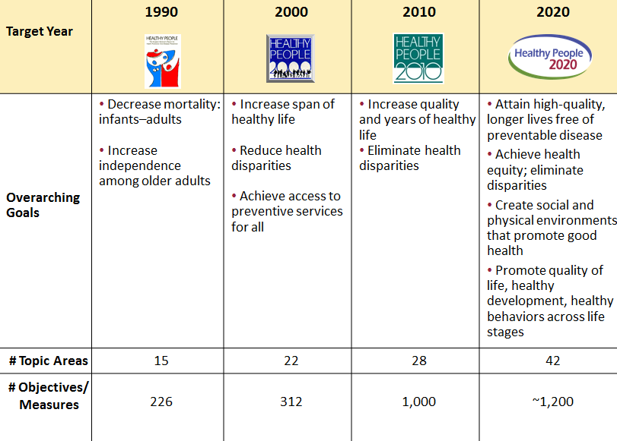
Evolution of Healthy People

Slide 6

Understanding Family Planning
Family Planning includes a set of services intended to aid individuals and couples in determining their desired number and spacing of children, and increasing the likelihood that those children are born healthy.
Family Planning services include:
Education
Counseling
Clinical services
Prevention of unplanned pregnancies
Unintended pregnancies occur among women of all incomes, educational levels, and ages.

Slide 7
Understanding Family Planning Continued
Unintended pregnancies can be associate with negative health and economic consequences, such as:
Delays in initiating prenatal care
Reduced likelihood of breastfeeding
Increased risk of maternal depression
Increased risk of physical violence during pregnancy
Almost half of all pregnancies in the United States are unintended
Each year, publicly funded family planning services prevent 1.9 million unintended pregnancies, including 440,000 teen pregnancies
$7 in medical expenditure is saved for pregnancy-related care for every $1 spent

Slide 8

Understanding Maternal, Infant, and Child Health
Preconception health initiatives are aimed at improving the health of women before they become pregnant through evidence-based interventions.
The risk of maternal and infant mortality and pregnancy-related complications can be reduced by increasing access to quality preconception and interconception (between pregnancies) care.

Slide 9
Understanding Maternal, Infant, and Child Health Continued
Pregnancy can provide an opportunity to identify existing health risks in women, such as:
Hypertension and heart disease
Diabetes
Depression
Genetic conditions
Intimate Partner violence
Tobacco, alcohol, and substance use
Inadequate nutrition
Healthy weight
Cognitive and physical development of infants and children is influenced by the health, nutrition, and behaviors of their mothers during pregnancy and early childhood

Slide 10

Charles Rothwell, MBA, MS Director, National Center for Health Statistics Centers for Disease Control and Prevention

Slide 11
Presentation Overview
Tracking the Nation’s Progress
Family Planning (FP)
Maternal, Infant, and Child Health (MICH)

Slide 12
Tracking the Nation’s Progress
43 Measurable HP2020 Family Planning Objectives:
3 Target met
4 Improving
25 Little or no detectable change
5 Getting worse
6 Baseline data only
67 Measurable HP2020 Maternal, Infant, and Child Health Objectives:
16 Target met
18 Improving
16 Little or no detectable change
5 Getting worse
11 Baseline data only
1 Informational
NOTES: Measurable objectives are defined as having at least one data point currently available, or a baseline, and anticipate additional data points throughout the decade to track progress. The MICH topic area has 6 developmental objectives, and both FP and MICH have 1 archived objective that are not discussed in this Progress Review.

Slide 13
Presentation Overview
Tracking the Nation’s Progress
Family Planning
Intended Pregnancies
Pregnancies Conceived Within 18 Months of a Previous Birth
Sexually Experienced Females and Males who Received Reproductive Health Services in the Past 12 Months
Use of the Most/Moderately Effective Contraception
Maternal, Infant, and Child Health

Slide 14
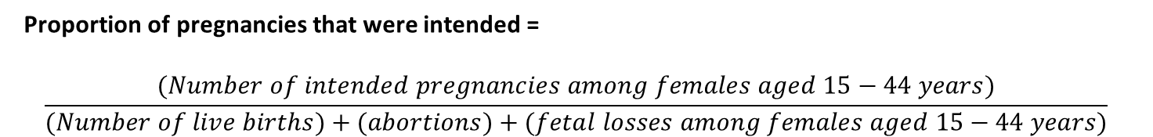
Intended Pregnancies
Intended pregnancies are defined as pregnancies that occurred at the right time or later than desired.
Three data sources are used to create the estimate for intended pregnancies in a given year:
NVSS-N: Birth certificate data for number of live births
NSFG: Estimate of pregnancies ending in spontaneous fetal loss
Estimate of intended pregnancies (live births and fetal losses)
APS: Number and intendedness of abortions in the year
Proportion of pregnancies that were intended =
$$\frac{(Number of intended pregnancies among females aged 15−44 years)}{(Number of live births)+(abortions)+(fetal losses among females aged 15−44 years)}$$
NOTES: NVSS-N = National Vital Statistics System-Natality, NSFG = National Survey of Family Growth, APS = Abortion Provider Survey.

Slide 15
Intended Pregnancies: Females Aged 15 to 44 Years, 2011
HP2020 Target: 56.0%
Increase desired
Educational Attainment
NOTES: Black and white exclude persons of Hispanic origin. Persons of Hispanic origin may be of any race.
SOURCES: National Survey of Family Growth (NSFG), CDC/NCHS; National Vital Statistics System–Natality (NVSS–N), CDC/NCHS; Surveillance Data for Abortion, CDC/NCCDPHP; Guttmacher Institute Abortion Provider Census (APC), Guttmacher Institute; Abortion Patient Survey (APS), Guttmacher Institute.
Obj. FP-1

Slide 16
Pregnancies Conceived Within 18 Months of a Previous Birth: Females Aged 15 to 44 Years, 2011–2015
HP2020 Target: 29.8%
Decrease desired
Health
Insurance
NOTES: = 95% confidence interval. A female is considered to have had a pregnancy within 18 months of a previous birth if she reported at least 2 pregnancies and the 2nd most previous pregnancy ended in a live birth. The most recent pregnancy can be a current pregnancy. Black and white exclude persons of Hispanic origin. Persons of Hispanic origin may be of any race.
I
SOURCE: National Survey of Family Growth (NSFG), CDC/NCHS.
Obj. FP-5

Slide 17
Receipt of Reproductive Health Services in the Past 12 Months: Sexually Experienced Females Aged 15 to 44 Years, 2011–2015
HP2020 Target: 86.5%
Increase desired
Family
Income
(% Poverty
Threshold)
NOTES: = 95% confidence interval. A female is considered to have received reproductive health services if she reported receiving at least one of the following services in the last 12 months: a birth control method; birth control counseling; birth control checkup or test; sterilization counseling; emergency contraception counseling; pelvic exam; pap smear; pregnancy test; and STD counseling, testing, or treatment. Sexually experienced refers to females who have ever had intercourse. Black and white exclude persons of Hispanic origin. Persons of Hispanic origin may be of any race.
I
SOURCE: National Survey of Family Growth (NSFG), CDC/NCHS.
Obj. FP-7.1

Slide 18
Receipt of Reproductive Health Services in the Past 12 Months: Sexually Experienced Males Aged 15 to 44 Years, 2011–2015
HP2020 Target: 16.3%
Increase desired
Family
Income
(% Poverty
Threshold)
NOTES: = 95% confidence interval. A male is considered to have received reproductive health services if he reported at least one of the following services in the last 12 months: birth control advice or counseling about female methods of birth control, birth control advice or counseling about male methods of birth control, sterilization advice, STD advice, or HIV advice. Sexually experienced refers to males who have ever had intercourse. Black and white exclude persons of Hispanic origin. Persons of Hispanic origin may be of any race.
I
SOURCE: National Survey of Family Growth (NSFG), CDC/NCHS.
Obj. FP-7.2

Slide 19
Use of the Most/Moderately Effective Contraception: Females Aged 20 to 44 Years Who Are at Risk of Unintended Pregnancy, 2011–2015
HP2020 Target: 69.3%
Total
Hispanic
Black
White
NOTES: = 95% confidence interval. The most effective methods of contraception are male or female sterilization, implants, intrauterine devices or systems (IUD/IUS). Moderately effective methods of contraception are injectables, oral pills, patch, ring, or diaphragm. At risk of unintended pregnancy is defined as women who have ever had sex, are fecund, or are neither pregnant nor seeking pregnancy.
Black and white exclude persons of Hispanic origin. Persons of Hispanic origin may be of any race.
I
Obj. FP-16.1
Increase desired
SOURCE: National Survey of Family Growth (NSFG), CDC/NCHS

Slide 20
Use of the Most/Moderately Effective Contraception: Females Aged 15 to 19 Years Who Are at Risk of Unintended Pregnancy, 2011–2015
HP2020 Target: 54.1%
Total
Hispanic
Black
White
NOTES: = 95% confidence interval. The most effective methods of contraception are male or female sterilization, implants, intrauterine devices or systems (IUD/IUS). Moderately effective methods of contraception are injectables, oral pills, patch, ring, or diaphragm. At risk of unintended pregnancy is defined as women who have ever had sex, are fecund, or are neither pregnant nor seeking pregnancy.
Black and white exclude persons of Hispanic origin. Persons of Hispanic origin may be of any race.
I
Obj. FP-16.2
Increase desired
SOURCE: National Survey of Family Growth (NSFG), CDC/NCHS.

Slide 21
Presentation Overview
Tracking the Nation’s Progress
Family Planning
Maternal, Infant, and Child Health
Healthy Pregnancies - Healthy Infants
Preconception / Interconception Health and Behaviors

Slide 22
Folic Acid Consumption: Nonpregnant Females Aged 15 to 44 Years
2011–2014
NOTES: I = 95% confidence interval. Data are for nonpregnant women aged 15–44 years with usual daily total intake of folic acid of ≥400 micrograms.
Obj. MICH-14
Increase desired
SOURCE: National Health and Nutrition Examination Survey (NHANES), CDC/NCHS.

Slide 23
Preconception & Interconception Behaviors: Women with a Recent Live Birth, 2012
Preconception
Interconception
HP2020
Target:
33.3%
Preconception
counseling
Multivitamins/folic acid
No smoking
No alcohol
“Healthy”
weight
Effective contraception
NOTES: I = 95% confidence interval. Data are for women with a recent live birth (2–6 months after a live birth) who reported: preconception counseling prior to pregnancy, taking multivitamins/folic acid every day 1 month prior to pregnancy, no smoking 3 months prior to pregnancy, no alcohol 3 months prior to pregnancy, a “healthy” weight (BMI: 18.5–24.9 kg/m²) prior to pregnancy, using most/moderately effective contraception 2-8 months after delivery (interconception).
SOURCES: Pregnancy Risk Assessment Monitoring System (PRAMS), CDC/NCCDPHP; California's
Maternal and Infant Health Assessment (MIHA), California Department of Public Health (CDPH).
Objs. MICH-16.1–16.6
Increase desired

Slide 24
Daily Multivitamins/Folic Acid 1 Month Prior to Pregnancy: Women with a Recent Live Birth, 2012
HP2020 Target: 33.3%
Increase desired
Family Income
(% Poverty
Threshold)
NOTES: = 95% confidence interval. *2007 Total = HP2020 baseline. Data are for women with a recent live birth (2–6 months after a live birth) who reported taking multivitamin/folic acid every day in the month prior to pregnancy. American Indian includes Alaska Natives. Native Hawaiian includes other Pacific Islanders. Black and white exclude persons of Hispanic origin. Persons of Hispanic origin may be of any race. Respondents were asked to select one or more races. Data for the single race categories are for persons who reported only one racial group.
SOURCES: Pregnancy Risk Assessment Monitoring System (PRAMS), CDC/NCCDPHP; California's
Maternal and Infant Health Assessment (MIHA), California Department of Public Health (CDPH).
I
Obj. MICH-16.2

Slide 25
No Alcohol 3 Months Prior to Pregnancy: Women with a Recent Live Birth, 2012
HP2020 Target: 55.6%
Increase desired
Family income
(% Poverty
Threshold)
Health
Insurance
NOTES: = 95% confidence interval. *2007 Total = HP2020 baseline. Data are for women with a recent live birth (2–6 months after a live birth) who reported not drinking alcohol at all in the 3 months prior to pregnancy. Black and White exclude persons of Hispanic origin. Persons of Hispanic origin may be of any race. Respondents were asked to select one or more races. Data for the single race categories are for persons who reported only one racial group. Health insurance status data reflect preconception insurance coverage of the mother.
SOURCES: Pregnancy Risk Assessment Monitoring System (PRAMS), CDC/NCCDPHP; California's
Maternal and Infant Health Assessment (MIHA), California Department of Public Health (CDPH).
I
Obj. MICH-16.4

Slide 26
Most/Moderately Effective Contraception Use: Postpartum Women with a Recent Live Birth, 2012
HP2020 Target: 58.5%
Increase desired
Family Income
(% Poverty
Threshold)
Health
Insurance
Age Group
(Years)
NOTES: = 95% confidence interval. Data are for women with a recent live birth who reported using a most effective or moderately effective contraceptive 2-8 months after delivery. Excludes pregnant women and those who had a hysterectomy. Most effective contraceptives are male or female sterilization, implants, and intrauterine devices or systems (IUD/IUS). Moderately effective contraceptives are injectables, oral pills, patch, ring, or diaphragm. Health Insurance status data reflect postpartum insurance coverage of mother.
SOURCES: Pregnancy Risk Assessment Monitoring System (PRAMS), CDC/NCCDPHP; California's
Maternal and Infant Health Assessment (MIHA), California Department of Public Health (CDPH).
I
Obj. MICH-16.6

Slide 27
Key Takeaways – Family Planning
The percentage of pregnancies not conceived within 18 months of a previous birth met the national target, but disparities exist.
Black males were the only racial/ethnic group shown that met the national target for receiving reproductive health services in the past 12 months among sexually experienced persons 15-44 years.
61% of females aged 20-44 years and 45% of females aged 15-19 years who were at risk of unintended pregnancy used the most or moderately effective methods of contraception.

Slide 28
Key Takeaways – Maternal, Infant, and Child Health
With the release of the 2012 PRAMS data, we are now able to measure most of the evidence-based prevention objectives.
The objective tracking the percentage of women who reported taking multivitamins/folic acid prior to pregnancy has met the HP2020 target. When taken before or between pregnancies, folic acid can help prevent major birth defects of the baby’s brain and spine.
The percentage of women reporting not having used alcohol 3 months prior to pregnancy declined from 2007 to 2012, moving away from the HP2020 target.

Slide 29
Connecting Family Planning and Maternal, Infant and Child Health
Teresa R. Manning, JD, MA
Deputy Assistant Secretary for Population Affairs
Office of Population Affairs

Slide 30
OPA strives to improve the health of mothers, fathers, infants, children, and the entire family through evidence-based clinical family planning services and related research and evaluation addressing the clinical, educational and counseling needs of our clients.

Slide 31
Office of Population Affairs – Title X
Title X statute authorized in 1970
Amended the Public Health Service Act to provide for special project grants for the provision of family planning services, and related research, training, and technical assistance -cited as “Family Planning Amendments of 1970”
Priority is for services for those from low-income families
Authority under five main provisions of the Act to award grants and/or contracts
Section 1001 – Services (42 CFR § Subpart A)
Section 1003 – Training (42 CFR § Subpart C)
Section 1004 – Research
Section 1005 – Information and Education
Section 1008 – Prohibition of Abortion

Slide 32
Office of Population Affairs – Title X
Title X family planning services “offer a broad range of acceptable and effective family planning methods and services (including natural family planning methods, infertility services, and services for adolescents). To the extent practicable, entities which receive grants or contracts under this subsection shall encourage family participation in projects assisted under this subsection.”
These projects provide educational, comprehensive medical, and social services necessary to aid individuals to determine freely the number and spacing of their children (42 CFR § 59.1).

Slide 33
Office of Population Affairs – Title X
The Family Planning Annual Report (FPAR) is an annual (CY) data collection instrument which provides data and information about the Title X grant program.
2016 Network Profile
Grantees – 91
Service sites – 3,898
Unduplicated clients – 4,007,552 (89% female/11% male)
Proportion of clients under 100% FPL – 64%

Slide 34
Office of Population Affairs – Title X
The Title X Program is guided by statute & regulations and also program priorities, which include:
Assuring activities that promote positive family relationships for the purpose of increasing family participation in family planning and healthy decision-making;
Education and counseling that prioritize optimal health and life outcomes for every individual and couple; and other related health services.

Slide 35
Family Planning Services
Family planning includes services for both men and women as they plan their families.
Such services include postponing, preventing, achieving, or facilitating the spacing of pregnancy. It also includes infertility services, health screenings and exams, lab tests and related health services which are important to family planning and to male and female reproductive health, improving the likelihood of a healthy pregnancy and birth, should conception occur.
They may also include information, education, and counseling related to family planning; and referral services as indicated.

Slide 36
Office of Population Affairs – Title X
Title X Family Planning Program
Importance of counseling and education:
Fertility awareness
Pre-conception counseling and care
Pregnancy counseling
Importance of high-quality family planning services
Client, couple and family-centered approach
Provider competency
System capacity

Slide 37

Office of Population Affairs – Title X
Pre-conception health services should be offered to men and women
Aim to identify and modify biomedical, behavioral, and social risks
Promote health before conception, reducing pregnancy-related adverse outcomes
Low birth weight
Premature birth
Infant mortality

Slide 38
Office of Population Affairs – Title X
Title X Performance Measurements
OPA, as part of its annual budget justification and performance reporting process, collects data on annual performance measures.
These measures are intended to provide benchmarks for our services, training, education and publications and include increasing the number of unduplicated clients we serve and increasing client and couple satisfaction.

Slide 39
Office of Population Affairs – Title X
Healthy People 2020 Progress Review Measures:
Title X seeks to provide a diversity of options for clients with the intention of improving overall service provision, increasing the numbers of those served, and expanding the breadth of services available in the states and regions. Family planning services include services for both men and women as they plan their families.

Slide 40
Office of Population Affairs – Title X
Title X Family Planning Program
Overall, OPA is continuing to concentrate on improving the quality of family planning and health services to all who want and need them, with priority for services to low-income individuals.
As the program moves forward, OPA will continue to focus on the needs of the family and client-and couple-centered care, encouraging family participation where practicable, providing pre-conception counseling and services, education and counseling that will lead to healthy pregnancies.

Slide 41

Thank You
Teresa R. Manning, JD, MA
Deputy Assistant Secretary for Population Affairs

Slide 42


CDC’s Division of Reproductive Health (DRH)
RADM Wanda D. Barfield, MD, MPH, FAAP
Assistant Surgeon General, US Public Health Service
Director, Division of Reproductive Health
National Center for Chronic Disease Prevention and Health Promotion

Slide 43
Our Mission
To promote optimal and equitable health in women and infants through public health surveillance, research, leadership, and partnership to move science to practice.

Slide 44
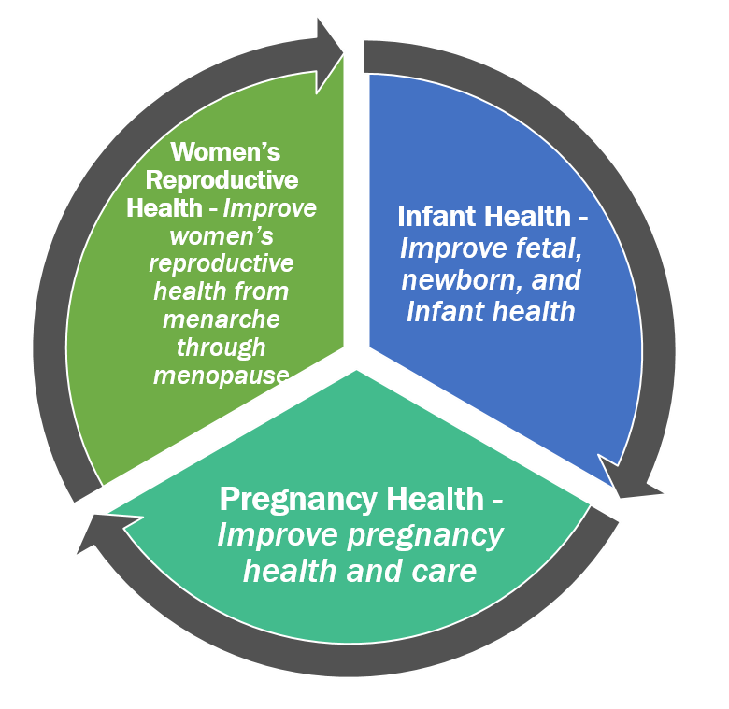

Priority Areas

Slide 45
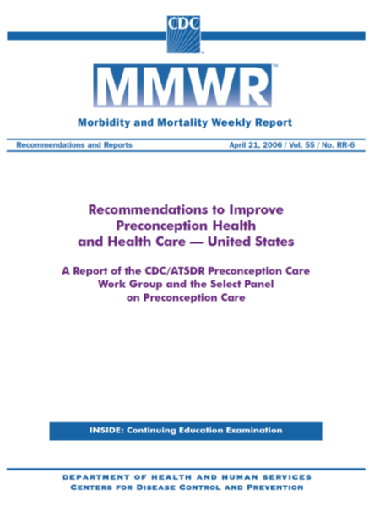
Preconception Health Recommendations - 2006
Convened the Preconception Care Work Group and Select Panel on Preconception Care
Developed 10 recommendations with 40 action steps
Formed the Preconception Health and Health Care (PCHHC) initiative – a public/private partnership to guide implementation of the recommendations and action steps

Slide 46
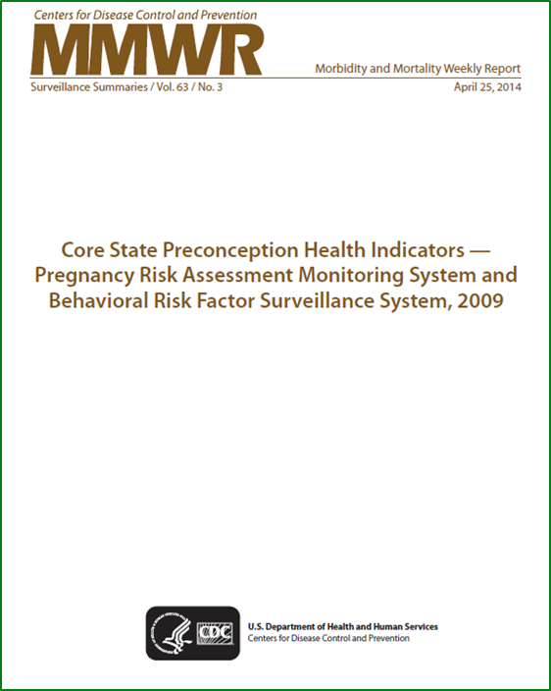
Preconception Health State Core Indicators – 2014
Presented data on 39 of 45 of preconception health indicators selected by the Public Health Workgroup
Align with Healthy People 2020 Family Planning (FP) and Maternal, Infant, and Child Health (MICH) objectives
FP-1
MICH-16.2, 16.3, 16.4, 16.5, 16.6

Slide 47
MMWR Surveillance Summaries In Progress
Trends in Healthy Prepregnancy Weight — United States 2011-2015 (MICH-16.5)
Receipt of Selected Preventive Services for Women and Men of Reproductive Age — United States, 2011–2013 (FP-7.1 and FP-7.2)
Disparities in Preconception Health Indicators— Behavioral Risk Factor Surveillance System (2013-2015) and Pregnancy Risk Assessment Monitoring System (2013-2014) (FP-1, FP-16.1, MICH-14, MICH-16.4, MICH-16.5, MICH-16.6)

Slide 48
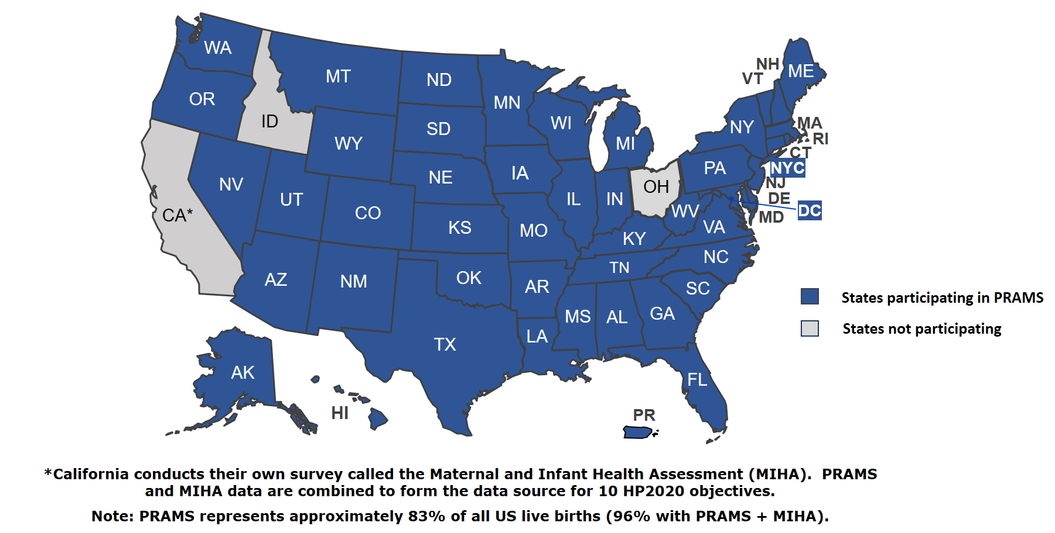
PRAMS Participating States, 2017

Slide 49
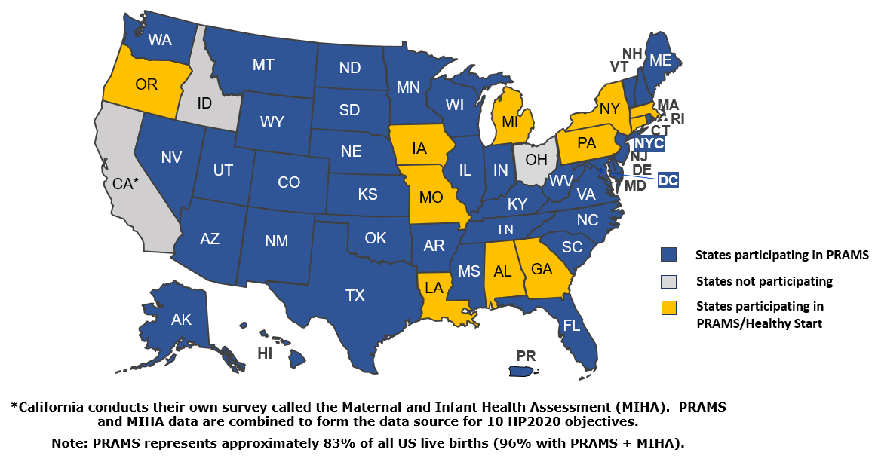
PRAMS and Healthy Start Participating States, 2017

Slide 50
Preconception and Interconception Health and Behaviors Collected by PRAMS
Prior to pregnancy
Preconception counseling (MICH-16.1)
Preconception tobacco use (MICH-16.3)
Preconception alcohol use (MICH-16.4)
Prepregnancy healthy weight (MICH-16.5)
Folic acid consumption in month prior to pregnancy (MICH-16.2)
After delivery
Postpartum maternal checkup (MICH-19)
Postpartum contraception use (MICH-16.6)
Postpartum depressive symptoms (MICH-35)

Slide 51
Using PRAMS Preconception Health Data to Inform State Programs: Every Woman Connecticut Program
2013 Connecticut PRAMS Data Highlights:
27% of women talked to a doctor, nurse or other health care worker about how to improve their health before pregnancy.
45% of women entered pregnancy overweight or obese.
45% of women took a multivitamin 4 or more days/week in the month before pregnancy.
PRAMS data demonstrated the need for preconception and interconception care
Every Woman Connecticut Program:
Any encounter with health professionals is an opportunity to improve a woman’s health, regardless of her desire to become pregnant.

Slide 52

Every Woman Connecticut Program
Goal: Give babies in CT a healthy start and ensure that all women and men are as healthy as they can possibly be throughout the course of their life, whether they want to start a family or not.
Primary Intervention: One Key Question (OKQ) initiative, which seeks to promote the integration of pregnancy intention screening into routine care in both clinical and community-based settings
Key Question: Would you like to become pregnant this year?

Slide 53
Preconception Health – Select Research and Programmatic Efforts
Balance After Baby – web-based lifestyle intervention program in the first year postpartum to prevent diabetes in women diagnosed with gestational diabetes
Program in Support of Moms (PRISM) – program to integrate depression screening and treatment into obstetric practices to address perinatal depression
ASTHO Learning Collaborative – program focused on improving access to contraception and improving birth spacing

Slide 54
Tools and Resources
DRH Programs
https://www.cdc.gov/reproductivehealth
PRAMS
https://www.cdc.gov/prams/
Every Woman Connecticut
https://www.everywomanct.org/
Preconception Health and Health Care Initiative Website
https://beforeandbeyond.org/
Preconception Health MMWRs
https://www.cdc.gov/mmwr/pdf/rr/rr5506.pdf
https://www.cdc.gov/mmwr/pdf/ss/ss6303.pdf
54

Slide 55



Thank you
For more information, please contact:
Centers for Disease Control and Prevention
Telephone: 1-800-CDC-INFO (232-4636)/TTY: 1-888-232-6348
E-mail: cdcinfo@cdc.gov Web: http://www.cdc.gov
The findings and conclusions in this report are those of the authors and do not necessarily represent the official position of the Centers for Disease Control and Prevention.
55

Slide 56

HRSA’s Role in Preconception and Interconception Health
Michael D. Kogan, PhD
Director, Office of Epidemiology and Research
Maternal and Child Health Bureau (MCHB)
Health Resources and Services Administration (HRSA)

Slide 57
Health Resources and Services Administration (HRSA)
Every year, HRSA programs serve tens of millions of people, including women, mothers and their families, and those otherwise unable to access quality health care.

Slide 58
HRSA’s Programs
Various programs throughout HRSA touch on Maternal and Child Health, such as:
Bureau of Primary Health Care (BPHC) – Health Center Data collects data on women’s health, prenatal and perinatal care
HIV/AIDS Bureau (HAB) – Part D Family Centered primary care for women, infants, children and youth living with HIV
For the purposes of this presentation we will be focusing on the Maternal and Child Health Bureau programs that address preconception and interconception Health.

Slide 59

Maternal and Child Health Bureau (MCHB) Mission and Vision
At the Maternal and Child Health Bureau (MCHB), our mission is to improve the health of America’s mothers, children, children with special health care needs and families. We envision an America where all children and families are healthy and thriving.
Our Vision aligns with the broader goals of HRSA:
Improve access to quality health care and services
Strengthen the health workforce
Build healthy communities
Improve health equity
Strengthen program operations

Slide 60
MCHB Women’s Health Goals
We focus our efforts on three key strategic priorities:
Improving women’s health before, during, and beyond pregnancy and across their life course;
Improving the quality and safety of maternity care;
Improving systems of maternity care including both clinical and public health systems

Slide 61
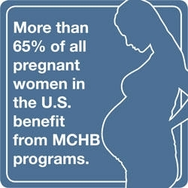
Our role in addressing Preconception and Interconception Health Behaviors
Women’s Preventive Services Initiative
Identify preventive services/screenings
Title V Maternal and Child Health Block Grant Program
Largest funding method; nation’s public health system
Alliance for Innovation in Maternal Health (AIM)
Maternal death and morbidity prevention
Healthy Start
Improve pregnancy outcomes

Slide 62
Title V Program Highlights
The Maternal and Child Health Block Grant works to improve the health of America’s children and families in all 50 states, District of Columbia (D.C.), and the territories
The Block Grant serves more than 57 million women and children annually, including:
More than ½ of all pregnant women
1/2 of all children, (including 97% infants)
4 million children with special healthcare needs

Slide 63
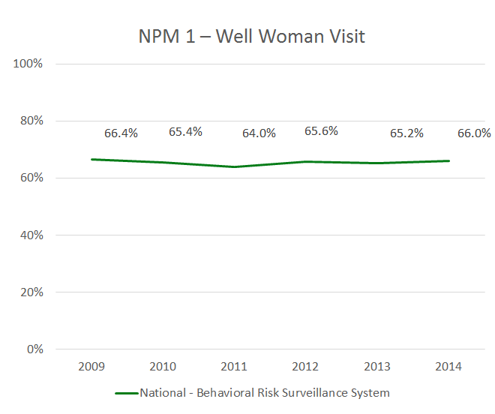
Title V National Performance Measure 1 (NPM 1) Well Woman Visit
NPM 1 definition: The percent of women with a past year preventive medical visit
MICH-16.1: percent women delivering live birth, who discussed preconception health with HCP
Data: Behavioral Risk Factor Surveillance System (BRFSS)

Slide 64
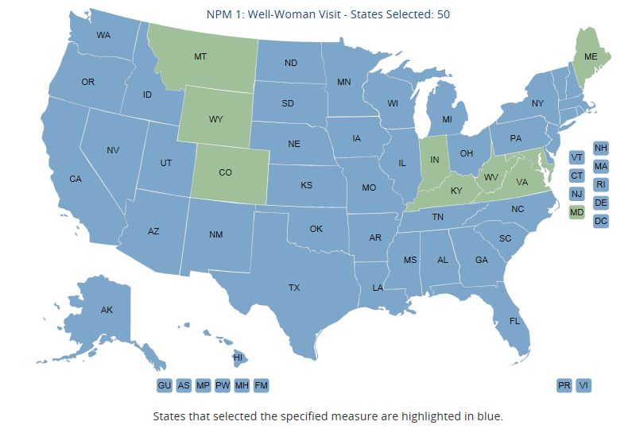
Title V National Performance Measure 1

Slide 65
State/Jurisdiction Strategies and National Performance Measure #1 (cont.)
Framework for analysis of State Evidence-based strategy measures (ESM’s):
Interdisciplinary provider training
Primary/preventive consumer education
Promoting access to comprehensive primary care ensuring effective screening of all women, with appropriate referral to family planning and specialty care
Interagency collaboration to assure adequate insurance/reimbursement
Partnering with federal/state/local agencies and professional organizations promoting quality standards and policies (WIC, Title X, FQHC’s, CMS/Medicaid, AAP, ACOG, CDC)

Slide 66
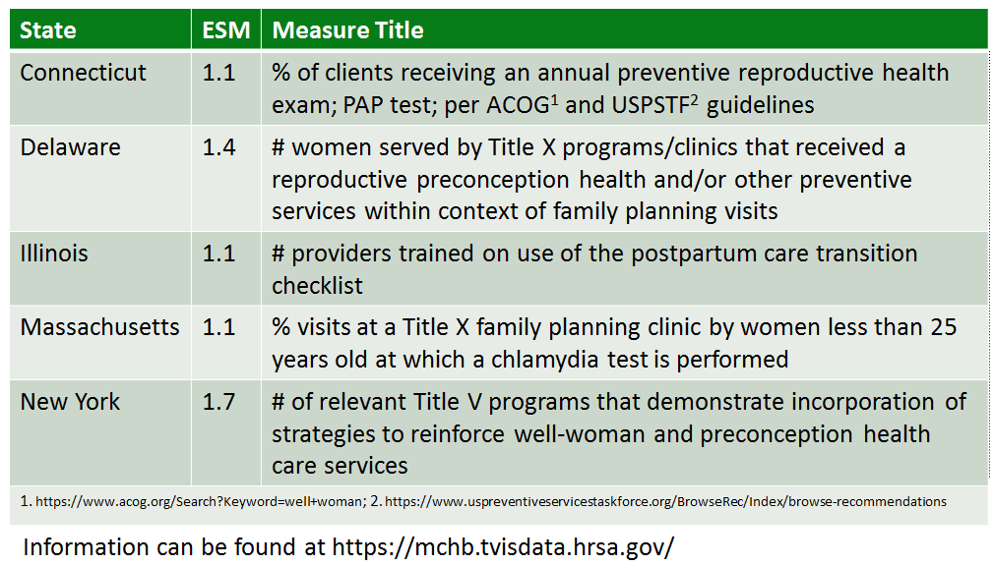
Evidence-Based Strategy Measures (ESM’s) Best Practice Examples

Slide 67
Healthy Start Program Highlights
Purpose: to improve perinatal health outcomes & reduce racial /ethnic disparities in perinatal outcomes
Program:
Supports communities with infant mortality (IM) rates > 1½ times the U.S. Average.
Provides services, facilitates access to comprehensive health and social services for women, infants, and their families.
Served 75,463 clients in CY 2016
5 Healthy Start Approaches:
Improve Women’s Health
Promote Quality Services
Increase Accountability
Strengthen Family Resilience
Achieve Collective Impact

Slide 68
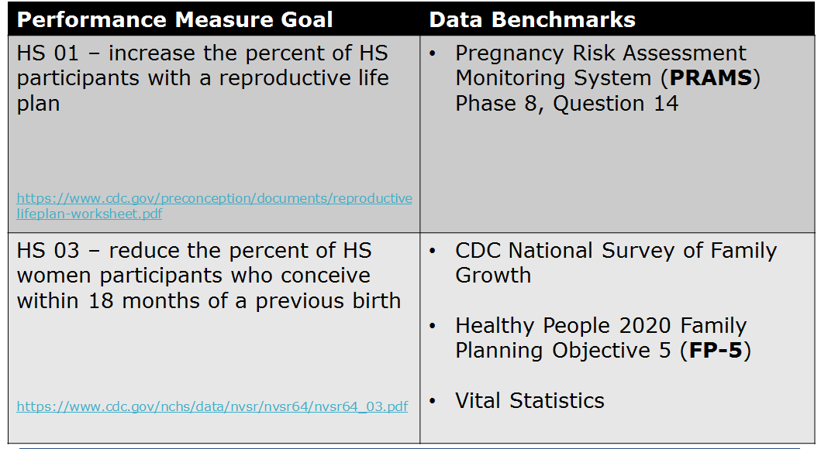
Healthy Start Performance Measures

Slide 69
Healthy Start Evaluation
Goal: To determine the impact of Healthy Start on changes in participant-level characteristics (e.g., health services utilization, preventive behaviors, and health outcomes)
Process evaluation (data sources)
Applications and Progress Reports of Funded Grantees
National Healthy Start Program Survey (NHSPS)
Outcome evaluation (data sources)
Healthy Start Information System (Screening Forms)
Vital Records (linking infant birth and death records)
Pregnancy Risk Assessment Monitoring System (comparing HS program participants vs. non-participants)
Data analysis and reports

Slide 70
Tools and Resources
Materials/Where to find Information | Web link
Maternal and Child Health Bureau | http://mchb.hrsa.gov/
Maternal/Womens Health Title V Program Healthy Start Program | https://mchb.hrsa.gov/maternal-child-health-topics/maternal-and-womens-health https://mchb.hrsa.gov/maternal-child-health-initiatives/title-v-maternal-and-child-health-services-block-grant-program https://mchb.hrsa.gov/maternal-child-health-initiatives/healthy-start
Healthy People 2020 MICH Objectives | https://www.healthypeople.gov/2020/topics-objectives/topic/maternal-infant-and-child-health/objectives
Well-Woman Examination Infographic (ACOG) | https://www.acog.org/Patients/FAQs/Annual-Well-Woman-Exam-Infographic

Slide 71

Thank You

Slide 72

The Magnolia Project Empowering Women’s Health & Wellness Federal Healthy Start Funded by: HRSA #H49MC00051

Slide 73
The Magnolia Project
Northeast Florida Healthy Start Coalition and federal Healthy Start program
Launched in Duval county, Jacksonville Florida in 1999
Address the biggest contributing factor in infant deaths – women’s health prior to pregnancy
Preconception, prenatal and interconception initiative aimed at reducing racial disparities in infant mortality by providing:
Targeted outreach
Screening
Case management and risk reduction
Health education
Prenatal and well-woman care
Primary care

Slide 74

The Magnolia Project Mission
To improve the health and well-being of women during
their childbearing years by
empowering communities
to address medical, behavioral,
cultural, and social services needs.

Slide 75
The Magnolia Project’s Approach
Respond to an analysis of Perinatal Periods of Risk (PPOR) that shows the health of women before pregnancy is a primary factor contributing to poor outcomes, particularly among African-Americans.
Utilize a life-course approach to impact poor birth outcomes and disparities that addresses health and development over the mothers’/families’ life course.
Broaden the focus of maternal and child health to include social equity.

Slide 76
Snapshot of Jacksonville, Florida
Infant Mortality driven by disparities
45% of births to Blacks & other nonwhites
Blacks historically have poorer outcomes in Jacksonville than other urban areas of state
IM rate 2.5x higher than White rate

Slide 77
Magnolia Health Zone 1 Population
Health Zone 1 is disproportionately impacted by economic, health, and social disparities. It has the largest proportion of non-white residents, the lowest median income, highest rates of total and childhood poverty and lowest educational attainment of the 6 Health Zones.
The population is 78.1% African-American
There are 21,632 women of childbearing age; nearly one-fourth of families live below the federal poverty level.
There was an average of 1,706 births annually in the project area during 2014-2016, accounting for about 13 percent of the births in Jacksonville.

Slide 78

Services
Case Management
Cantering Prenatal
Centering Parenting (new)
Community Action Network
Health Education
Healthy Weight
Home Visitation
Leadership Academy
Life Course Plan/Group Education
Mental Wellness (Freedom)
Nutrition Counseling
Primary Care
Reproductive Health Services
Reproductive Life Planning
Yoga

Slide 79
Life Course Plan
Life Course Plan domains:
Access to preventive health care and related risk reduction services
Basic reproductive health services
GYN care and family planning
Chronic diseases like diabetes, hypertension and obesity care
Family and Community support
Healthy relationships
Connectedness with communities through civic engagement and participation.
Reduction of poverty and social inequities
Education completion and job skills
Confronting discrimination and racism
Financial literacy.
Adopted from the Contra Costa Health Services: 12 point plan

Slide 80
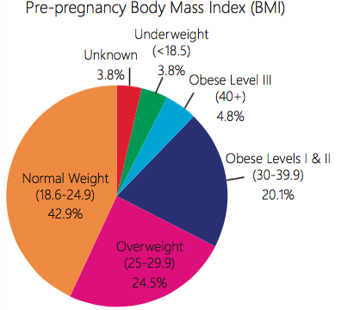
Preconception Health - Integrating Primary Care
Many women in Northeast Florida enter into pregnancy with high BMIs, too soon after their last pregnancy, smoking or with STDs.
Half of women who give birth in Northeast Florida are overweight (25%) or obese (25%) at the time they get pregnant.
Being overweight or obese during pregnancy can lead to high blood pressure, preeclampsia, blood clotting problems and other issues.

Slide 81

Reproductive Life Plan
Show Your Love Reproductive Life Plan is reviewed with clinic staff in the lobby or in the home
The Health Educator reviews each plan with the participants during an individual session to ask the One Key Question as part of the clinical appointment.
The discussion includes the importance of baby spacing on reducing the risk of preterm birth, and all family planning choices that the woman chooses.

Slide 82
HRSA MCH – Five Strategic Approaches
Improve Women’s Health
Promote Quality Services
Strengthen Family Resilience
Achieve Collective Impact
Increase Accountability, Quality

Slide 83

Improve Women’s Health
Improves the health of women before, during and after pregnancy
Provide preventive, pre- and interconception health care to women of childbearing age
Integrate reproductive life planning into case management and clinical services provided by the project.
Comprehensive assessment that includes:
A screening tool to identify participants’ health, and psychosocial risk factors, as well as protective factors
Edinburgh Depression Screen and Perceived Stress Scale (PSS)

Slide 84
Promote Quality Services
Coordinated Intake and Referral System is established as the backbone of home visiting
Incorporates health promotion and prevention in project-level interventions
Project staff trained to meet core competencies established for MCH and early childhood providers
Uses standardized, research-informed and evidence-based curricula, tools and interventions.
Evidence-based and Research
Informed Programs, Curricula & Tools
Centering Prenatal and Parenting Model
Nurse Family Partnership (MIECHV)
Healthy Families Jacksonville
Early Head Start
Partners for a Healthy Baby
Magnolia Project Standardized Health
Education Curriculum
Make a Noise! Make a Difference Lay Health
Advocate Curriculum
SCRIPT Smoking Cessation
Strengthening Families
24/7 Dad, Boot Camp for New Dads, Mom as
Gateway
Foundations for Success in Parenting
Edinburgh Depression Screen, Perceived
Stress scale, ACE Questionnaire, JHP
Contextualized Stress Measure, WEB
ASQ, ASQ-SE

Slide 85
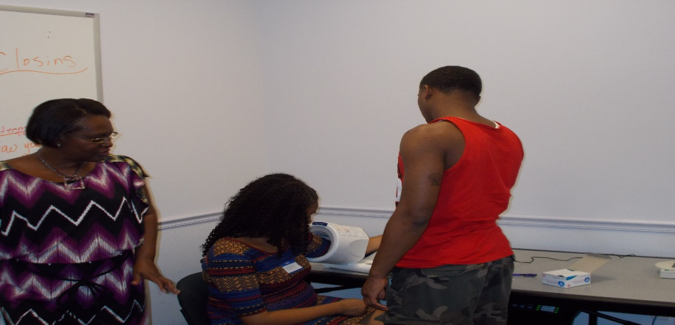
Strengthen Family Resilience
Adverse Childhood Experiences
Barbers for Babies
Centering Prenatal Model
Centering Parenting Model
Fatherhood Classes
Male involvement activities
Mental health counseling services as part of case management

Slide 86
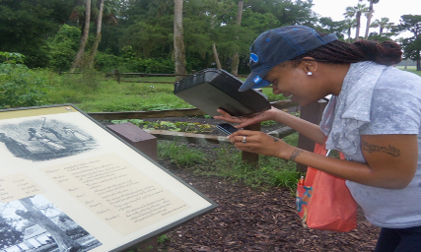
Achieve Collective Impact
The Community Action Network (CAN) partners collectively with the community to focus on a specific topic such as; toxic stress to achieve collective impact within a community. Partners and community residents implement a common agenda, and shared measurement.
The Leadership Academy is a 16 week program to develop leadership and advocacy skills, and promote civic engagement of residents in neighborhoods.
Leadership Academy Training Topics Include:
Foundations of Racial Disparities
Racism and Power
Local Community Icons
Effective Leadership Tools
Leadership
Your Personal Leadership Style
Conflict Resolution
Problem Solving
Sharing the Work Through Delegation
Kingsley Plantation Fieldtrip
Historical Inequality and the Foundation of Infant Mortality Disparities
Historical Account of Health Disparities

Slide 87
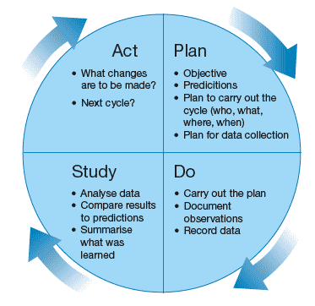
Increase Accountability, and Quality
Complete at lease two Continuous Quality Improvement plan (CQI) annually.
The Magnolia Project used the Plan Do Study Act rapid cycle to test how to improve the rate of postpartum visits.
The Magnolia Project Data System (MPDS) generated baseline data and measured the impact of changes undertaken after each the cycle.
The plan provided a timeline for refinement and further testing of interventions.

Slide 88
Increase Accountability and Quality CQI Activity
Increase the proportion of participants who receive a postpartum visit.
FY 2016, 83.8 percent of participants completed their postpartum visit (an 48.3% increase from the baseline 2014 of 56.5 percent).
Healthy Start 2017 Performance Measure: Goal 80%

Slide 89
Participants who receive a postpartum visits1 HP2020 Postpartum care visit with a health worker
1Healthy Start Performance Measure: 2017:80%

Slide 90
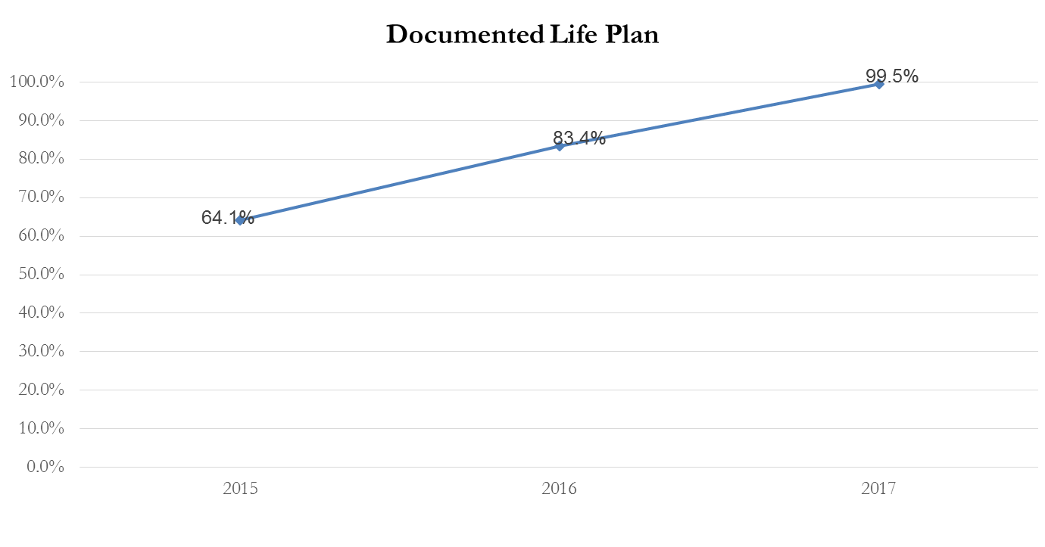
Participants who have a documented reproductive life plan to 90%
1Healthy Start Performance Measure: 2017:90%
Notes:
The reproductive life plan is a major focus of the project. We changed the process to ensure participants clearly understood their reproductive life plan. Prior to the change the plan was administered in a form of a check off list. The revised changed includes the health educator reviewing and discussing the plan and explaining what it meas. Also, we also incorporated the reproductive life plan in to the home visits and assessment process.
Next slide

Slide 91
Proportion of well-woman visits among HS participants1.
1Healthy Start Performance Measure: 2017:70%

Slide 92
Healthy People 2020 Objectives
MICH-14 Increase the proportion of women of childbearing potential with intake of at least 400 µg of folic acid daily from fortified foods or dietary supplements.
MICH-16.3 Increase the proportion of women delivering a live birth who did not smoke prior to pregnancy
Screening and health education conducted on the risk factors of smoking
Refer to smoking resources for assistance
SCRIPT – The Smoking Cessation and Reduction in Pregnancy Treatment Program
MICH-16.4 Increase the proportion of women delivering a live birth who did not drink alcohol prior to pregnancy
Screening and health education conducted on the risk factors of alcohol and drug use
Refer to drug treatment resources for assistance
MICH-16.5 Increase the proportion of women delivering a live birth who had a healthy weight prior to pregnancy
Health educator tracks BMI of clinic participants and provide health education and exercise, and nutrition resources.

Slide 93

Participant Story
Risk Factors: 26 years old, two miscarriages, wanted to become pregnant, no health insurance, domestic violence, high stress, marijuana use
Services Received: Well Woman Visit, health education, support, stress prevention, multivitamins
Outcome: Became pregnant, received prenatal care, support and health education and delivered a healthy baby boy!

Slide 94

Every Baby, Every Day!
The Magnolia Project
Thank You
Faye Johnson, CEO
Northeast Florida Healthy Start Coalition
Contact Information
fjohnson@nefhsc.org

Slide 95
Roundtable Discussion Carter Blakey Deputy Director Office of Disease Prevention and Health Promotion U.S. Department of Health and Human Services

Slide 96
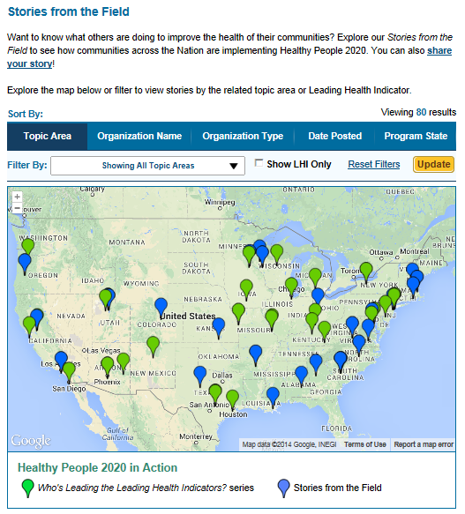
Healthy People 2020 Stories from the Field
A library of stories highlighting ways organizations across the country are implementing Healthy People 2020
Healthy People in Action
http://www.healthypeople.gov/2020/healthy-people-in-action/Stories-from-the-Field

Slide 97

JOIN HEALTHY PEOPLE AT APHA 2017!
Come hear more about Healthy People at this year’s American Public Health Association Annual Meeting:
Monday, November 6 10:30 AM – 12:00 PM
Session 3121.0: Developing National Health Objectives for 2030: Healthy People 2030
Tuesday, November 7 12:30 PM – 2:00 PM
Session 4199.2: Healthy People 2030 Listening Session: Developing National Health
Objectives for 2030
Tuesday, November 7 2:30 PM – 4:00 PM
Session 4295.0: Breastfeeding Oral Session: Law and Policy as Critical Tools to Increase Breastfeeding and Reduce Disparities
Wednesday, November 8 8:30 AM – 10:00 AM
Session 5041.0: In It Together: System Strategies for Suicide Prevention

Slide 98


Who’s Leading the Leading Health Indicators? Webinar
Please join us on
Thursday, November 16, 2017
from 12:00 to 1:00 pm ET
for a Healthy People 2020 Who’s Leading the Leading Health Indicators? webinar on Nutrition, Physical Activity, and Obesity.
Registration on
HealthyPeople.gov
available soon

Slide 99
Progress Review Planning Group
Susan Moskosky (HHS/OASH)
David Johnson (HHS/OASH)
Holly Shulman (CDC/NCCDPHP)
Sheree Boulet (CDC/NCCDPHP)
Cheryl Broussard (CDC/NCBDDD)
Reem Ghandour (HRSA)
Jessica Minnaert (HRSA)
Gladys Martinez (CDC/NCHS)
Stan Lehman (CDC/OD)
Emily DeCoster (HRSA)
Irma Arispe (CDC/NCHS)
David Huang (CDC/NCHS)
Leda Gurley (CDC/NCHS)
Elizabeth Jackson (CDC/NCHS)
Mark Montgomery (CDC/NCHS)
Cheryl Rose (CDC/NCHS)
Carter Blakey (HHS/ODPHP)
Theresa Devine (HHS/ODPHP)
Tiffani Kigenyi (HHS/ODPHP)
Ayanna Johnson (HHS/ODPHP)
Yen Lin (HHS/ODPHP)

Slide 100




Stay Connected
Web healthypeople.gov
Email healthypeople@hhs.gov
Twitter @gohealthypeople
YouTube ODPHP (search “healthy people”)
Join the Healthy People Listserv & Consortium

Slide 101
Appendix

Slide 102
Office of Population Affairs – Title X Appendix Slide
2016 Title X Network Profile
Grantees – 91; Service sites – 3,898
Unduplicated clients – 4,007,552
Clients: 3.553M (89%) Females and 454 K Males (11%)
Clients under the age of 25 : 1.75M (43.7% of total)
Proportion of clients under 100% FPL – 64%
Title X family planning services are provided in :
All 50 states and Washington, DC
Puerto Rico and the Virgin Islands
American Samoa, Guam, the Commonwealth of the Northern Mariana Islands, Republic of Palau, Republic of the Marshall Islands and the Federated States of Micronesia

Slide 103
Appendix: Every Woman Connecticut Program
One Key Question: “Would you like to become pregnant this year?”
Customized technical assistance, implementation toolkit, and materials on implementing pre-/inter-conception health interventions
Patient/Client materials to support providers on topics related to contraceptive options, birth spacing, and preconception health
Integration into home visitation programs, adolescent well visits, routine OB/GYN visits, well child visits, mental health and addiction services, oral health visits, and community health programs

