Slide 1
APPENDIX

Slide 2
Objective Status: Public Health Infrastructure
Target met Improving Little/No change Getting worse Baseline only Developmental Informational
Public Health Workforce
PHI-1.2 (Developmental) Increase the proportion of tribal public health agencies that incorporate Core Competencies for Public Health Professionals into job descriptions and performance evaluations
PHI-1.3.1 Increase the proportion of state public health agencies that incorporate Core Competencies for Public Health Professionals into job descriptions
PHI-1.3.2 Increase the proportion of state public health agencies that incorporate Core Competencies for Public Health Professionals into performance evaluations
PHI-1.4.1 Increase the proportion of local public health agencies that incorporate Core Competencies for Public Health Professionals into job descriptions
PHI-1.4.2 Increase the proportion of local public health agencies that incorporate Core Competencies for Public Health Professionals into performance evaluations
PHI-2.1 (Developmental) Increase the proportion of tribal public health agencies that use Core Competencies for Public Health Professionals in continuing education for personnel
PHI-2.2 Increase the proportion of state public health agencies that use Core Competencies for Public Health Professionals in continuing education for personnel
PHI-2.3 Increase the proportion of local public health agencies that use Core Competencies for Public Health Professionals in continuing education for personnel
PHI-3 Increase the proportion of Council on Education for Public Health (CEPH) accredited schools of public health, CEPH accredited academic programs, and schools of nursing (with a public health or community health component) that integrate Core Competencies for Public Health Professionals into curricula

Slide 3
Objective Status: Public Health Infrastructure
Target met Improving Little/No change Getting worse Baseline only Developmental Informational
PHI-4.1 Increase the number of public health or related graduate degrees and post-baccalaureate certificates awarded
PHI-4.2 Increase the number of public health or related bachelor’s degrees awarded
PHI-5 (Developmental) Increase the proportion of 4-year colleges and universities that offer public health or related majors and/or minors that are consistent with the core competencies of undergraduate public health education
PHI-6.1 Increase the number of public health or related sub-baccalaureate certificates and associate degrees awarded
Data and Information Systems
PHI-7.1 Increase the proportion of population-based Healthy People 2020 objectives for which national data are available by race and ethnicity
PHI-7.2 Increase the proportion of population-based Healthy People 2020 objectives for which national data are available by sex
PHI-7.3 Increase the proportion of population-based Healthy People 2020 objectives for which national data are available by socioeconomic status
PHI-8.1 Increase the proportion of Healthy People 2020 objectives that have at least one data point
PHI-8.2 Increase the proportion of Healthy People 2020 objectives that have at least two data points
PHI-8.3 Increase the proportion of Healthy People 2020 objectives that are tracked at least every 3 years

Slide 4
Objective Status: Public Health Infrastructure
Target met Improving Little/No change Getting worse Baseline only Developmental Informational
PHI-9 Increase the proportion of Healthy People 2020 objectives for which national data are released within 1 year of the end of data collection
PHI-10.1 Increase the number of states that record vital events using the latest U.S. standard certificate of birth
PHI-10.2 Increase the number of states that record vital events using the latest U.S. standard certificate of death
PHI-10.3 Increase the number of states that record vital events using the latest U.S. standard report of fetal death
Public Health Organizations
PHI-11.1 Increase the proportion of tribal and state public health agencies that provide or assure comprehensive laboratory services to support disease prevention, control, and surveillance
PHI-11.2 Increase the proportion of tribal and state public health agencies that provide or assure comprehensive laboratory services that incorporate integrated data management
PHI-11.3 Increase the proportion of tribal and state public health agencies that provide or assure comprehensive laboratory services that support reference and specialized testing
PHI-11.4 Increase the proportion of tribal and state public health agencies that provide or assure comprehensive laboratory services in support of environmental health and protection
PHI-11.5 Increase the proportion of tribal and state public health agencies that provide or assure comprehensive laboratory services in support of food safety

Slide 5
Objective Status: Public Health Infrastructure
Target met Improving Little/No change Getting worse Baseline only Developmental Informational
PHI-11.6 Increase the proportion of tribal and state public health agencies that provide or assure comprehensive laboratory services that advance laboratory improvement and regulation
PHI-11.7 Increase the proportion of tribal and state public health agencies that provide or assure comprehensive laboratory services that support policy development
PHI-11.8 Increase the proportion of tribal and state public health agencies that provide or assure comprehensive laboratory services in support of emergency response
PHI-11.9 Increase the proportion of tribal and state public health agencies that provide or assure comprehensive laboratory services in support of public health-related research
PHI-11.10 Increase the proportion of tribal and state public health agencies that provide or assure comprehensive laboratory services that support training and education
PHI-11.11 Increase the proportion of tribal and state public health agencies that provide or assure comprehensive laboratory services that foster partnerships and communication
PHI-12.1 Increase the proportion of public health laboratory systems (including State, Tribal, and local) that perform at a high level of quality in the monitoring of health status to identify and solve community health problems
PHI-12.2 Increase the proportion of public health laboratory systems (including State, Tribal, and local) that perform at a high level of quality in support of diagnosing and investigating health problems and health hazards in the community
PHI-12.3 Increase the proportion of public health laboratory systems (including State, Tribal, and local) that perform at a high level of quality with respect to informing, educating, and empowering people about health issues

Slide 6
Objective Status: Public Health Infrastructure
Target met Improving Little/No change Getting worse Baseline only Developmental Informational
PHI-12.4 Increase the proportion of public health laboratory systems (including State, Tribal, and local) that perform at a high level of quality in mobilizing community partnerships and action to identify and solve health problems
PHI-12.5 Increase the proportion of public health laboratory systems (including State, Tribal, and local) that perform at a high level of quality in developing policies and plans that support individual and community health efforts
PHI-12.6 Increase the proportion of public health laboratory systems (including State, Tribal, and local) that perform at a high level of quality in the enforcement of laws and regulations that protect health and ensure safety
PHI-12.7 Increase the proportion of public health laboratory systems (including State, Tribal, and local) that perform at a high level of quality in linking people to needed personal health services and assure the provision of health care when otherwise unavailable
PHI-12.8 Increase the proportion of public health laboratory systems (including State, Tribal, and local) that perform at a high level of quality in assuring a competent public and personal health care workforce
PHI-12.9 Increase the proportion of public health laboratory systems (including State, Tribal, and local) that perform at a high level of quality in evaluating effectiveness, accessibility, and quality of personal and population-based health services
PHI-12.10 Increase the proportion of public health laboratory systems (including State, Tribal, and local) that perform at a high level of quality in supporting research into new insights and innovative solutions to health problems

Slide 7
Objective Status: Public Health Infrastructure
Target met Improving Little/No change Getting worse Baseline only Developmental Informational
PHI-13.1 Increase the proportion of State Epidemiologists with formal training in epidemiology in State public health agencies
PHI-13.2 (Developmental) Increase the proportion of Tribal public health agencies that provide or assure comprehensive epidemiology services to support essential public health services
PHI-13.3 Increase the proportion of State public health agencies that provide or assure comprehensive epidemiology services to support essential public health services
PHI-13.4 Increase the proportion of local public health agencies that provide or assure comprehensive epidemiology services to support essential public health services
PHI-14.1 Increase the proportion of State public health systems that conduct a public health system assessment using national performance standards
PHI-14.2 Increase the proportion of local public health systems that conduct a public health system assessment using national performance standards
PHI-15.1 (Developmental) Increase the proportion of Tribal agencies that have developed a health improvement plan
PHI-15.2 Increase the proportion of State public health agencies that have developed a health improvement plan
PHI-15.3 Increase the proportion of local public health agencies that have developed a health improvement plan
PHI-15.4 Increase the proportion of local public health agencies that have health improvement plans linked to their State plan

Slide 8
Objective Status: Public Health Infrastructure
Target met Improving Little/No change Getting worse Baseline only Developmental Informational
PHI-16.1 (Developmental) Increase the proportion of Tribal public health agencies that have implemented an agency-wide quality improvement process
PHI-16.2 Increase the proportion of State public health agencies that have implemented an agency-wide quality improvement process
PHI-16.3 Increase the proportion of local public health agencies that have implemented an agency-wide quality improvement process
PHI-17.1 Increase the number of Tribal public health agencies that are accredited
PHI-17.2 Increase the proportion of State public health agencies that are accredited
PHI-17.3 Increase the proportion of local public health agencies that are accredited

Slide 9
Current HP2020 Objective Status: Public Health Infrastructure
NOTE: Progress current as of 03/23/2018.
Notes:
Definitions
Target met: Target met or exceeded
Improving – Change is toward the target:
Change in objective is statistically significant*, OR
Objective has achieved 10% or more of the targeted change
Little/No change:
Objective has achieved less than 10% of the targeted change (and is not statistically significant*), OR
Objective has a deficit of less than 10% relative to its baseline which it needs to regain before starting to move toward the target (and is not statistically significant*), OR
No change between baseline and most recent data point
Baseline only: Baseline data only; progress cannot be assessed
Notes
*Statistical significance is only assessed when estimates of variability are available
Percent of targeted change achieved = 100 × (Most recent value – Baseline value) / (HP2020 target – Baseline value)
Percent in deficit = 100 × |Most recent value – Baseline value| / (Baseline value)

Slide 10
Objective Status: Preparedness
Target met Improving Little/No change Getting worse Baseline only Developmental Informational
PREP-1 (Developmental) Reduce the time necessary to issue official information to the public about a public health emergency
PREP-2 Reduce the time necessary to activate designated personnel in response to a public health emergency
PREP-4 Reduce the time for State public health agencies to establish after action reports and improvement plans following responses to public health emergencies and exercises
PREP-5.1 Increase the percentage of school districts that required schools to include family reunification plans
PREP-5.2 Increase the percentage of school districts that required schools to include procedures for responding to pandemic flu or other infectious disease outbreaks
PREP-5.3 Increase the percentage of school districts that required schools to include specific provisions for students and staff with special needs
PREP-5.4 Increase the percentage of school districts that required schools to include specific provisions for mental health services for students, faculty, and staff after a crisis has occurred
PREP-6 (Developmental) Increase the proportion of parents and/or guardians aware of the emergency or evacuation plan in their child(ren)'s school including the evacuation location and how to get information about the child in the event of a disaster
PREP-7 Increase the proportion of adults residing with children attending school who have an emergency plan and have household discussions of that emergency plan
PREP-8 (Developmental) Increase the proportion of adults who engage in preparedness activities for a widespread outbreak of a contagious disease after recently receiving preparedness information on outbreaks

Slide 11
Objective Status: Preparedness
Target met Improving Little/No change Getting worse Baseline only Developmental Informational
PREP-9 (Developmental) Increase the proportion of adults who are aware of their transportation support needs to evacuate in preparation of a hurricane, flood, or wildfire
PREP-10 (Developmental) Increase the proportion of adults who know how to obtain real-time alerts and warnings for disasters in their community
PREP-11 (Developmental) Increase the proportion of adults who received information about disaster preparedness in the last 6 months
PREP-12 (Developmental) Increase the proportion of adults who have taken actions to prepare for a possible disaster or emergency within 6 months after being made aware of preparedness information
PREP-13 Increase the proportion of adults whose household has an emergency plan that includes instructions for household members about where to go and what to do in the event of a disaster
PREP-14 (Developmental) Increase the number of states with statewide protocols or triage guidelines for EMS personnel during mass casualty situations
PREP-15.1 Increase the rate of bystander CPR for all non-traumatic cardiac arrests
PREP-15.2 Increase the rate of bystander AED use for non-traumatic cardiac arrests occurring in public locations
PREP-15.3 Increase the rate of survival to hospital discharge for all patients who receive bystander intervention through CPR and/or AED application
PREP-15.4 Increase the rate of survival to hospital discharge for patients that have a bystander witnessed non-traumatic cardiac arrest that presents in a shockable rhythm and who receive bystander intervention through CPR and/or AED application

Slide 12
Objective Status: Preparedness
Target met Improving Little/No change Getting worse Baseline only Developmental Informational
PREP-16.1 Increase the percentage of Medical Reserve Corps (MRC) units participating in preparedness training and exercise activities
PREP-16.2 Increase the percentage of Medical Reserve Corps (MRC) units participating in public health activities
PREP-16.3 Increase the percentage of Medical Reserve Corps (MRC) units compliant with the National Incident Management System (NIMS)
PREP-17.1 Increase the number of preparedness training and exercise activities in which Medical Reserve Corps (MRC) units participate
PREP-17.2 Increase the number of public health activities in which Medical Reserve Corps (MRC) units participate
PREP-18.1 Increase the overall membership of HPP-funded Healthcare Coalitions
PREP-19 Increase the number of states reporting 90% of emergency medical services (EMS) calls to the National EMS Information System (NEMSIS) using the currently accepted dataset standard
PREP-20.1 Increase the number of states that require regulated child care providers to have an evacuation plan that includes a relocation site
PREP-20.2 Increase the number of states that require regulated child care providers to have a plan to reunite families after a disaster in the event of a relocation
PREP-20.3 Increase the number of states that require regulated child care providers to have an emergency plan for children with access and functional needs including disabilities

Slide 13
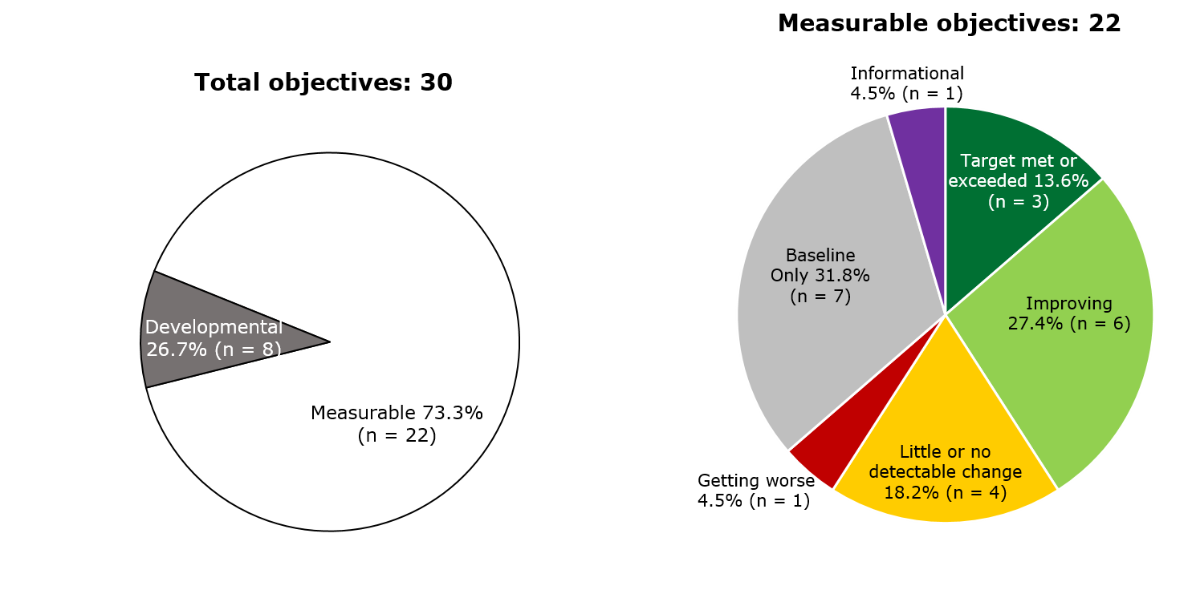
Current HP2020 Objective Status: Preparedness
NOTE: Progress current as of 03/23/2018.
Notes:
Definitions
Target met: Target met or exceeded
Improving – Change is toward the target:
Change in objective is statistically significant*, OR
Objective has achieved 10% or more of the targeted change
Little/No change:
Objective has achieved less than 10% of the targeted change (and is not statistically significant*), OR
Objective has a deficit of less than 10% relative to its baseline which it needs to regain before starting to move toward the target (and is not statistically significant*), OR
No change between baseline and most recent data point
Baseline only: Baseline data only; progress cannot be assessed
Notes
*Statistical significance is only assessed when estimates of variability are available
Percent of targeted change achieved = 100 × (Most recent value – Baseline value) / (HP2020 target – Baseline value)
Percent in deficit = 100 × |Most recent value – Baseline value| / (Baseline value)

