Slide 1
Notes:
CDC is building partnerships with health care purchasers, payers, and providers to improve health and control health care costs through efforts like the 6|18 Initiative.
Purchasers refer to larger employers who manage and hold risk for their health insurance plans
Payers refer to public funders of health insurance like Medicaid and Medicare as well as private health insurance companies
Providers refers to hospitals and physicians
The following slides provide the background, goals, and progress of this initiative.

Slide 2
Notes:
Changing health care landscape requires more public health and health care collaboration.
The US health care system is undergoing unprecedented change.
Major trends in health care are providing new opportunities for prevention and population health:
Over 90% of Americans now have health care coverage.
There is active movement away from the current fee-for-service payment and delivery model that reimburses providers for the number of procedures performed or visits conducted (quantity – or volume) to models that reimburse providers for reaching improved health outcomes, an improved patient experience, and reduced costs (quality – or value).
Value-based alternative payment models (such as Accountable Care Organizations and Patient-Centered Medical Homes) are more patient centered and facilitate the delivery of more comprehensive care, with new opportunities to deliver preventive services.
This provides new opportunities to pay for and deliver prevention.
These coverage trends have led to an increase need to improve health and control cost.
1-Robin A. Cohen, Ph.D., Emily P. Zammitti, M.P.H., and Michael E. Martinez, M.P.H., M.H.S.A Division of Health Interview Statistics, National Center for Health Statistics Health Insurance Coverage: Early Release of Estimates From the National Health Interview Survey, 2016

Slide 3
Notes:
This framework was developed by Dr. Neal Halfon at UCLA and illustrates the transformation of the health care delivery system now in progress. It describes the transition from an Acute Care System (1.0) to a Coordinated Seamless Health Care System (2.0) to a Community Integrated Health Care System (3.0).
These emerging payment and delivery models are creating increased opportunities to link clinical care and community health.

Slide 4
Notes:
In addition to changing health care landscape, there have also been changes to in public health.
Economic forces have affected state and local health departments. This has created an opportunity for public health to partner with the health care sector as it seeks to improve the patient experience of care, improve the health of populations and reduce the cost of health care.
It has also created new opportunities for public health to add value by focusing attention on improving population health through the broad application of prevention strategies to individuals and communities.
http://nacchoprofilestudy.org/wp-content/uploads/2015/04/2015-Forces-of-Change-Slidedoc-Final.pdf

Slide 5
Notes:
SOURCE: Auerbach J. The 3 Buckets of Prevention. J Public Health Management Practice 201http://journals.lww.com/jphmp/Citation/publishahead/The_3_Buckets_of_Prevention_.99695.aspx
To address these emerging trends, CDC developed a Prevention and Population Health framework, referred to as the “Three Buckets of Prevention.” This framework describes population-based prevention in clinical and community settings.
In clinical settings, population health typically refers to health care delivered to populations of patient panels. In community settings, population health typically refers to comprehensive health – in and outside the health care delivery system – provided to all individuals in geographically defined communities. The three buckets characterize prevention in different settings:
Bucket 1 includes traditional clinical preventive services, many of which are now covered benefits without cost-sharing for most health plans under the Affordable Care Act. They are typically delivered in clinical settings, to individuals who are healthy, as primary or secondary prevention. Examples here include immunizations or colorectal cancer screening tests.
Bucket 2 includes innovative services that extend care from the clinic to the community, also delivered to individuals but in community settings. An example here includes the use of a community health worker to assess asthma triggers in the home as a way to augment asthma control in a clinical setting.
Bucket 3 includes community-wide interventions delivered not to individuals but to entire populations/environmental structures to benefit the health of the whole community. An example here is a school-based program to increase physical activity among children which is associated with positive long term health effects.
Health will be improved through attention to all three buckets.
The 6|18 Initiative focuses on Buckets 1 and 2, and can be valuable to health care purchasers, payers, and providers by highlighting preventive interventions that improve health and reduce costs.
The Health Impact in 5 Years (HI-5) initiative highlights non-clinical, community-wide approaches that have evidence reporting positive health impacts resulting within five years, and cost effectiveness and/or cost savings over the lifetime of the population or earlier.
Aligning work in all three buckets ensures the greatest impact.

Slide 6
Notes:
Hester, J. A., J.Auerbach, L. Seeff, J. Wheaton, K. Brusuelas, and C. Singleton 2015. CDC’s 6|18 Initiative: Accelerating evidence into action.
National Academy of Medicine, Washington, DC. http://nam.edu/wp-content/uploads/2016/02/CDCs-618-Initiative-Accelerating-Evidence-into-Action.pd
The 6|18 Initiative highlights the importance of health systems and public health collaboration to improve population health and to ensure that preventive services are available barrier-free to all insured persons.
CDC has developed the 6|18 Initiative to support the adoption by health care purchasers, payers, and providers of evidence-based interventions to improve health and control costs in the short term – in less than 5 years.
The name “6|18” comes from the initial focus on 6 high-burden, high-cost health conditions and, initially, 18 evidence-based interventions that can improve health and control costs. The number of interventions may fluctuate over time.

Slide 7
Notes:
The initiative goals are as follows:
To improve health and control costs using specific evidence-based interventions
To develop sustainable collaboration between public health and health care sectors

Slide 8
Notes:
The 6 in 6|18 represents the 6 initial health conditions, including: Tobacco Use, High Blood Pressure, Health Care-Associated Infections, Asthma, Unintended Pregnancies, and Diabetes.
These conditions were selected because they meet the following criteria:
They affect large numbers of people
They are associated with high health care costs
Evidence-based interventions are available to prevent or control these conditions in a short time horizon (less than 5 years)
The evidence-based interventions can be implemented by the health care sector - health care purchasers, health plans, and providers.
To learn more about each condition and its interventions, please visit our website https://www.cdc.gov/sixeighteen/

Slide 9
Notes:
Evidence demonstrates that CDC’s 6|18 Initiative interventions can improve health and control costs of the 6 conditions. The 6|18 Initiative provides this evidence to health care purchasers, payers, and providers. This slide illustrates how the interventions were selected.
Step 1: CDC identified a short list of health conditions that:
Affect large numbers of people
Are associated with high health care costs
Have CDC evidence-based interventions that may improve health and reduce health care costs
Step 2: Identify interventions that corresponded to the conditions. Identified types of evidence that payers consider when selecting new services, and consulted individual experts from across health care industry for candidate interventions.
Interventions were prioritized based on the following criteria:
High potential health impact
Evidence of effectiveness among certain population/payer groups
With payer coverage opportunities where
intervention is not widely covered, or at all
intervention is covered, but uptake is low
Could be delivered by payers or providers
Step 3: CDC consulted with individual experts from public health and the health care delivery system and the following sources for candidate interventions:
Health and medical databases
The Guide to Community Preventive Services
United States Preventive Services Task Force
Agency for Healthcare Research and Quality
Step 4: CDC used two CDC frameworks* to define level and types of evidence.
Only interventions with moderate or higher level of evidence were included as defined in CDC’s, “Seeking Best Practices: A Conceptual Framework for Planning and Improving Evidence-Based Practices.” For moderate level of evidence, intervention studies that did not mention case size or that used small case sizes were excluded.
Moderate level includes intervention evaluations without peer review of practice or publication that have evidence of impact (e.g., case studies with appropriate evaluation, evaluation reports, peer-reviewed abstracts and presentations).
Strong level includes case-control or cohort analytic studies; peer-reviewed journal publications; published reports from consensus panels such as the Advisory Committee on Immunization Practices (e.g., nonsystematic review of published intervention evaluations with peer review of practices that have evidence of impact).
Rigorous level includes intervention evaluations or studies with systematic review that have evidence of impact (e.g., meta-analyses, Guide to Community Preventive Services)
Using criteria from the “CDC Policy Analytical Framework,” interventions were prioritized if they are feasible, have public health impact, and have available economic and budgetary impact information. Feasibility is defined as likelihood that the policy can be successfully adopted and implemented.

Slide 10
Notes:
The 18 in 6|18 represents a set of, initially, 18 evidence-based interventions associated with each of the 6 conditions that health care purchasers, payers, or providers can implement.
The number of interventions may fluctuate over time. Currently, there are 16 evidence-based interventions to date.
Please visit www.cdc.gov/sixeighteen/ for more information on each of the evidence-based interventions.

Slide 11
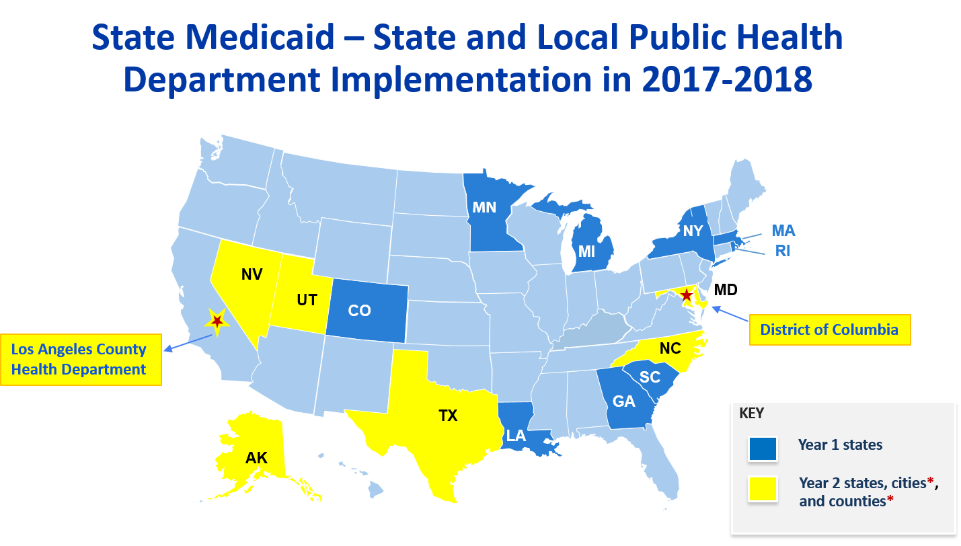
Notes:
There are 17 Medicaid and Public Health teams partnering with CDC to implement the 6|18 interventions to date.
Year 1 States launched February 2016: CO, GA, LA, MA, MI, MN, NY, RI, SC
Year 2 States launched June 2017: AK, D.C., MD, NC, NV, TX, UT, Los Angeles County
Activities include:
Shared learning platform
Baseline data being collected
State Plan Amendments
Managed Care Organization (MCO) contractual negotiations
Member and provider education tools and training
The teams focus areas are: Tobacco, Asthma, Unintended Pregnancy Prevention, Diabetes, High Blood Pressure, Health Care Associated Infections

Slide 12
Notes:
Through working together in a number of states, Public Health and Medicaid agencies have engaged in many opportunities for complementary work.
Public health’s focus on evidence at the population level complements Medicaid’s expertise in delivering services at the patient level.
As one example, public health practitioners have helped translate epidemiologic evidence into a business case for coverage while a Medicaid Agency utilized available mechanisms to improve coverage and enhance increased uptake of services.
Crawford, M., & Somers, S. (2017, April 06). Medicaid-Public Health Partnerships: Untapped Potential to Improve Health Care and Reduce Costs - CHCS Blog. Retrieved December 08, 2017, from https://www.chcs.org/medicaid-public-health-partnerships-untapped-potential-improve-health-care-reduce-costs/

Slide 13
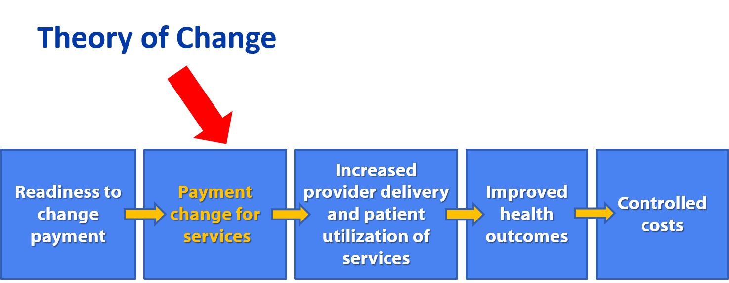
Notes:
This slide represents the theory of change underpinning CDC’s 6|18 Initiative, and illustrates the steps that will need to occur to move from readiness to changing payment policy to improved health outcomes and controlled health care costs that will ultimately result from improved access to these services.
The red arrow indicates the payment policy changes that are a focus of the 6|18 Initiative.
GA Hospital Association: Integrating Population Health, Community Health Needs Assessments and Community Benefits April 17, 2017

Slide 14
Notes:
There have been many early successes highlighting partnerships between state Public Health and state Medicaid programs.
CDC’s 6|18 Initiative has created an opportunity for states to expand and grow their plan of action including Medicaid reimbursement and removal of medication co-payments.
For more examples of partnerships between state Public Health and state Medicaid programs, explore CDC’s infographic: https://www.cdc.gov/sixeighteen/resources/docs/6-18-infographic.pdf

Slide 15
Notes:
This slide summarized some initial steps that state Medicaid Agencies and health departments took to address payment changes related to the 6|18 interventions:
Baseline coverage and utilization assessment of the 6|18 interventions by Medicaid Managed Care Organizations,
Submission of state plan amendments to CMS
Changes in billing systems to be able to bill for covered 6|18 services
MCO contractual negotiations
new scope of practice to allow providers to deliver specific services Outreach and education for providers and members
Crawford, M., & Somers, S. (2017, April 06). Medicaid-Public Health Partnerships: Untapped Potential to Improve Health Care and Reduce Costs - CHCS Blog. Retrieved December 08, 2017, from https://www.chcs.org/medicaid-public-health-partnerships-untapped-potential-improve-health-care-reduce-costs/

Slide 16
Notes:
CDC is also engaging with several commercial health plans in aligned 6|18 conditions and interventions.
Participating health plans have an opportunity to access tools and resources in the 6|18 shared learning platform.
Additional issues that payers would like to address through interactions with public and private health plans in the context of the 6|18 Initiative include:
Behavioral economics
Provider engagement
Targeted member engagement

Slide 17
Notes:
Public Health programs, Medicaid programs , insurers, health care providers, and other stakeholders all play a role in improved health for patients and consumers.
This slide offers complementary roles of partners in improving health and controlling costs, with patients and consumers highlighted in the center of these efforts:
Health care purchasers and health plans use CDC evidence to prioritize health outcomes, and cover, expand and deploy the prevention interventions
Providers deliver and implement the interventions and collaborate with CDC to disseminate operational best practices.
Public health accelerates evidence into action by understanding and measuring the burden of the conditions and by monitoring the health impact of implementing prevention interventions. Public health also complements 6|18 implementation partnering with health insurers and providers in their health assessments and health campaigns and by promoting the 6|18 initiative and other evidence based interventions.
Other key stakeholders, such as foundations and NGOs, use CDC evidence to support efforts that align with the high-burden conditions, support implementation of the interventions, and advance 6|18 through community engagement activities.
Crawford, M., & Somers, S. (2017, April 06). Medicaid-Public Health Partnerships: Untapped Potential to Improve Health Care and Reduce Costs - CHCS Blog. Retrieved December 08, 2017, from https://www.chcs.org/medicaid-public-health-partnerships-untapped-potential-improve-health-care-reduce-costs/
Advancing Implementation of the CDC's 6|18 Initiative. (2016, April). Retrieved December 08, 2017, from https://www.chcs.org/project/advancing-public-commercial-payers-implementation-cdcs-618-initiative/

Slide 18
Notes:
Moving forward, CDC would like to create a sustainable environment where evidence can be translated into action.
State Medicaid Agency and Health Department teams are participating in a Shared Learning Platform to facilitate peer-to-peer learning across states, where states have identified priorities such as the development of State Plan Amendments to broaden coverage of services, and the assessment of baseline coverage of interventions among managed care organizations as a first step towards contract negotiations
CDC is collaborating with health care purchasers, health plans and providers who are implementing CDC’s 6|18 Initiative and evaluating health and cost control over time.
Technical assistance is offered to state Medicaid agencies and health departments. Technical assistance includes:
Individual monthly calls to discuss progress and identify challenges and technical assistance needs.
Facilitated peer-to-peer learning calls focused on topics specific to each health condition held every other month.
Webinars that address cross-cutting topics of interest to all states held on a quarterly basis.

Slide 19
Notes:
Achieving lasting impact on health outcomes requires a focus not just on patient care but also on community-wide approaches that improve the health of populations and of the community. Conditions in the places where we live, learn, work, and play have as much impact on our health as the health care we receive.
CDC offers tools and resources that emphasize community-wide approaches which complement CDC’s 6|18 Initiative. These community and population-oriented initiatives include:
CDC’s Social Determinants of Health website which highlights sources of social determinants of health data, tools for action, and programs. This website is designed to support efforts by public health, community organizations, and health care systems to improve community well-being.
The Community Health Improvement Navigator which provides a framework and set of tools for those working to improve the health of their communities. One of the drivers behind this tool is a new requirement for tax-exempt hospitals to engage in community health improvement activities. However, it can be used by any community, health group or health system. A key feature of the “Navigator” is a searchable database of proven community interventions to improve health and well-being.
The HI-5 (“high-five”), or Health Impact in Five Years Initiative which is a tool that highlights non-clinical, evidence-based community-wide interventions. Each intervention has been shown to improve health within five years or less and achieves cost effectiveness and/or cost savings over the lifetime of the population.

Slide 20
Notes:
Please visit our website at https://www.cdc.gov/sixeighteen/ for the Evidence Summaries which include a detailed summaries of the 6|18 interventions, based on scientific studies and expert consultations.

