Slide 1

Building Confidence in COVID-19 Vaccines
Among Your Patients
Tips for the Healthcare Team
Developed by:
CDC COVID-19 Response
Vaccine Task Force
January 2021
Notes:
A critical part of increasing COVID-19 vaccine uptake will be building vaccine confidence among members of the healthcare team, so that they can build confidence among their patients.
This slide deck is for use by immunization coordinators, health department staff or others responsible for training members of the healthcare team.

Slide 2

Presentation Overview
COVID-19 vaccines
mRNA vaccine technology
Vaccine safety monitoring
Elements of vaccine confidence
Strategies for building vaccine confidence
Strategies for talking with patients about COVID-19 vaccine
Notes:
Thanks for joining us today. Whether in your office or through a telehealth visit, building confidence in COVID-19 vaccination among your patients is critical to setting expectations, ensuring vaccine uptake, and helping protect our communities. And before you can build confidence among your patients, you need to be confident about getting the vaccine yourselves.
Vaccine confidence may seem like a vague concept, but there are concrete things we can do to foster it and help make it visible in our health system or clinic.
Here’s what we will be discussing in this presentation:
COVID-19 vaccines pending authorization;
Vaccine safety monitoring;
Elements of vaccine confidence;
Strategies for building vaccine confidence and
Strategies for talking with patients about COVID-19 vaccine.

Slide 3
COVID-19 vaccines, mRNA Vaccine Technology, and Vaccine Safety Monitoring

Slide 4


Healthcare personnel: A priority for COVID-19 vaccination
On the front lines and at risk of exposure
Can potentially transmit the virus that causes COVID-19 to patients, their families, and their communities
Can positively influence vaccination decisions of peers, patients, friends, and family
Healthcare personnel = paid and unpaid persons serving in healthcare settings who have the potential for direct or indirect exposure to patients or infectious materials – not exclusive to medical personnel,
includes administration, support staff, etc.
Notes:
Healthcare personnel like you have been identified as a top priority to have access to COVID-19 vaccines, in addition to residents of long-term care facilities.
You are on the front lines of this pandemic and are at high risk of exposure. They can potentially transmit COVID-19 to patients, including older adults and those with high-risk medical conditions, as well as their family and community.
We also know that you are influential when it comes to building vaccine confidence. The general public will be looking to them and taking their lead when it comes to COVID-19 vaccination. If they get vaccinated and recommend the vaccine to patients, this will help increase uptake among their patients, their friends, and their families.
For the purposes of this presentation, healthcare personnel (HCP) refers to all paid and unpaid persons serving in healthcare settings who have the potential for direct or indirect exposure to patients or infectious materials, including body substances (e.g., blood, tissue, and specific body fluids); contaminated medical supplies, devices, and equipment; contaminated environmental surfaces; or contaminated air.
These HCP may include, but are not limited to, emergency medical service personnel, nurses, nursing assistants, physicians, technicians, therapists, phlebotomists, pharmacists, students and trainees, contractual staff not employed by the health care facility, and persons (e.g., clerical, dietary, environmental services, laundry, security, maintenance, engineering and facilities management, administrative, billing, and volunteer personnel) not directly involved in patient care but potentially exposed to infectious agents that can be transmitted among from HCP and patients.

Slide 5
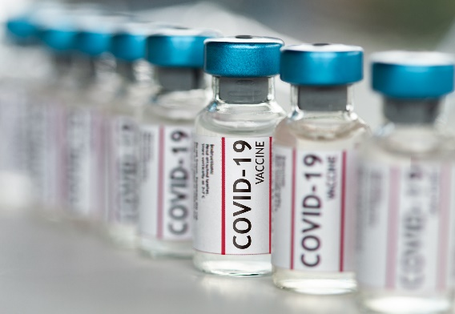
COVID-19 vaccines under development
The federal government is funding and coordinating the development of multiple vaccine candidates, several of which are in large-scale (Phase 3) trials and some of which have been authorized by the FDA.
COVID-19 vaccines are being held to the same safety standards as all other vaccines.
Notes:
The federal government is funding and coordinating the development of multiple vaccine candidates, several of which are in large-scale Phase 3 trials.
It’s important to note that COVID-19 vaccines are being help to the same safety standards as all other vaccines.

Slide 6
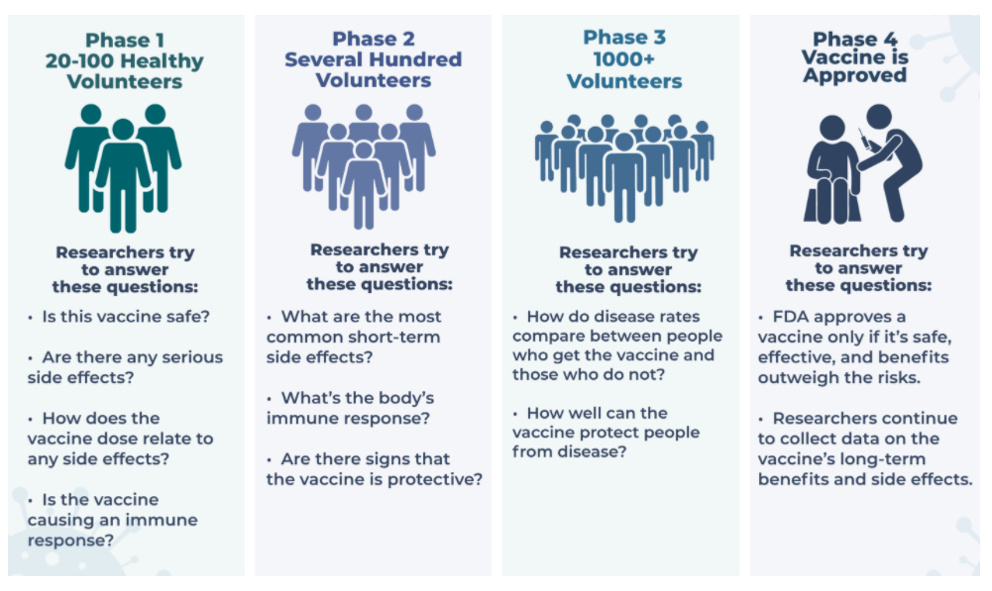
Phases of clinical trials
Source: https://covid19community.nih.gov/resources/understanding-clinical-trials
Notes:
These four phases are standard to all vaccine clinical trials. The idea for a clinical trial often starts in the lab. After researchers test new treatments or procedures in the lab, the most promising treatments are moved into clinical trials. As new treatments move through a series of steps called phases, more information is gained about the treatment, its risks, and how effective it is.
This graphic shows the four phases of vaccine clinical trials:
The first phase involves 20 to 100 health volunteers. Researchers try to answer questions like:
Is this vaccine safe?
Are there any serious side effects?
How does the vaccine dose relate to any side effects? and
Is the vaccine causing an immune response?
The second phase involves several hundred volunteers. Researchers try to answer questions like:
What are the most common short term side effects? and
What’s the body’s immune response?
Are there signs that the vaccine is protective?
The third phase involves a thousand or more volunteers. Researchers try to answer questions like:
How do disease rates compare between people who get the vaccine and those who do not? And
How well can the vaccine protect people from disease?
It is important to note that safety data on these vaccines are collected in all three phases of the clinical trials.
The fourth phase happens after the vaccine is authorized or approved. In this phase, researchers continue to collect data on the vaccine’s long-term benefits and side effects.

Slide 7
COVID-19 vaccines that have received FDA Emergency Use Authorizations
Two vaccines have received FDA Emergency Use Authorizations (EUAs):
  Pfizer/BioNTech (BNT162b2) – 95% effective (manufacturer data)
  Moderna (mRNA-1273) – 94.5% effective (manufacturer data)
Both are mRNA vaccines with a 2-dose schedule. People being vaccinated should complete the two-dose series with the same vaccine product.
Duration of protection is not yet known.
For the latest information about authorized vaccines, visit www.fda.gov/emergency-preparedness-and-response/coronavirus-disease-2019-covid-19/covid-19-vaccines.
Sources: https://www.pfizer.com/news/press-release/press-release-detail/pfizer-and-biontech-conclude-phase-3-study-covid-19-vaccine
https://investors.modernatx.com/news-releases/news-release-details/modernas-covid-19-vaccine-candidate-meets-its-primary-efficacy
Notes:
Two vaccines are expected to receive Emergency Use Authorizations (EUAs) from the FDA: One is produced by Pfizer and BioNTech and the other is produced by Moderna.
Manufacturer data from the Phase 3 trials demonstrated that both vaccines were approximately 95% effective at preventing COVID disease.
These are both mRNA vaccines with a 2-dose schedule. COVID-19 vaccines are not interchangeable with other COVID-19 vaccine products, and the safety and efficacy of a mixed-product series have not been evaluated. Persons initiating vaccination with the Pfizer-BioNTech or Moderna COVID-19 vaccine should complete the two-dose series with the same product. If two doses of different mRNA COVID-19 vaccine products are inadvertently administered, no additional doses of either product are recommended at this time.
The duration of protection is not yet known. As those data become available, they will be communicated via the CDC website and through other communication channels reaching clinicians.

Slide 8
COVID-19 vaccine trials by the numbers
As of December 21, 2020
Pfizer/BioNTech
  45,302 enrolled
    43,125 received 2nd dose
  150 clinical sites
    39 U.S. states
  Racial/ethnic distribution
    13% - Hispanic
    10% - African American
    6% - Asian
    1% - Native American
  40% ages 56-85
Moderna
  30,000 enrolled
    25,654 received 2nd dose
  89 clinical sites
    32 U.S. states
  Racial/ethnic distribution
    63% - White
    20% - Hispanic
    10% - African American/Black
    4% - Asian
    3% - All others
  64% ages 45 and older
    39% ages 45-64
    25% ages 65+
Sources: https://www.pfizer.com/science/coronavirus/vaccine; https://www.modernatx.com/cove-study
For more information, visit www.clinicaltrials.gov
Notes:
Many people want more information about the vaccine trials that led to the release of the COVID-19 vaccines that are available now.
As of December 21, 2020, more than 45,000 volunteers were enrolled in Phase 3 of the Pfizer and BioNTech COVID-19 vaccine trial. These volunteers received the first dose of the vaccine; more than 43,000 have received the 2nd dose. The vaccine trials are being conducted at approximately 150 sites domestically and internationally, Thirty-nine U.S. states are represented in the study. Among U.S. participants, 13% identified as Hispanic, 10% as African American, 6% as Asian, and 1% as Native American. Forty-five percent were aged 56-85.
As of October 21,2020 (the most recent data available), more than 30,000 volunteers were enrolled in Phase 3 of the Moderna COVE COVID-19 vaccine trial. These volunteers received the first dose of the vaccine. The vaccine trials are being conducted at approximately 100 sites across the United States. Among participants, 20% identified as Hispanic, 10% as African American/Black, 4% as Asian, and 3% as all other non-whites. Sixty-four percent of participants were ages 45–65 and older.
As you can see, both vaccines were tested in diverse adult populations, including minorities and older adults. Data from the clinical trials show that both vaccines are safe and effective at preventing COVID-19.

Slide 9
How COVID-19 mRNA vaccines work
mRNA vaccines carry genetic material that teaches our cells how to make a harmless piece of “spike protein,” which is found on the surface of the SARS-CoV-2 virus.
  Genetic material from the vaccine is destroyed by our cells once copies of the spike protein are made and it is no longer needed.
Cells display this piece of spike protein on their surface, and an immune response is triggered inside our bodies. This produces antibodies to protect us from getting infected if the SARS-CoV-2 virus enters our bodies.
mRNA vaccines do not affect our DNA; mRNA does not enter the cell nucleus.
mRNA vaccines cannot give someone COVID-19.
mRNA vaccines are new, but the technology is not. mRNA vaccines have been studied for influenza, Zika, rabies, and cytomegalovirus (CMV).
Sources: College of Physicians of Philadelphia. What is an mRNA vaccine? https://historyofvaccines.blog/2020/07/29/what-is-an-mrna-vaccine/
JAMA. COVID-19 and mRNA Vaccines—First Large Test for a New Approach. https://jamanetwork.com/journals/jama/fullarticle/2770485
Notes:
You may be wondering about messenger RNA, or mRNA, vaccines, given that they are a relatively new technology. Here are a few key facts:
To trigger an immune response, many vaccines put a weakened or inactivated germ into our bodies. Not mRNA vaccines. Instead, they teach our cells how to make a harmless piece of what is called the “spike protein.” The spike protein is found on the surface of SARS-CoV-2, the virus that causes COVID-19. This protein piece serves as an antigen to trigger an immune response inside our bodies. That immune response, which produces antibodies, is what protects us from getting infected when the real virus enters our bodies.
It’s important to note, however, that the mRNA does not enter the cell nucleus, so it does not affect or interact with our DNA in any way. This is a common myth about mRNA vaccines. mRNA in COVID-19 vaccine does not interact with DNA.
One advantage of mRNA vaccines is that they are not produced using infectious antigens. The vaccines cannot give someone COVID-19.
While there are no currently licensed vaccines using mRNA technology, this technology has been studied for decades in vaccine trials for influenza, Zika, rabies, and cytomegalovirus. Beyond vaccines, cancer research has used mRNA to trigger the immune system to target specific cancer cells.

Slide 10
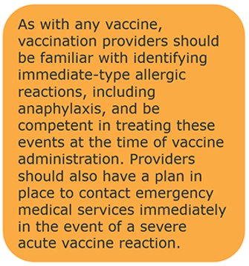
About these COVID-19 mRNA vaccines
At least 8 weeks of safety data were gathered after participants received their 2nd dose in the trials. It is unusual for side effects to appear more than 8 weeks after vaccination.
These mRNA vaccines produce common side effects after vaccination, especially after the 2nd dose.
  Side effects may include:
    Fever
    Headache
    Muscle aches
No significant safety concerns were identified in the clinical trials, although a small number of severe allergic reactions have been reported during the initial phases of rollout.
Source: https://www.cdc.gov/vaccines/hcp/acip-recs/vacc-specific/covid-19/clinical-considerations.html
Notes:
So what do we know about these mRNA COVID-19 vaccines? It’s important to note that at least 8 weeks of safety data were gathered in the trials. It is unusual for side effects to appear more than 8 weeks after vaccination.
These mRNA vaccines produce common side effects after vaccination, especially after the 2nd dose. These may include fever, headache, and muscle aches. These are similar to side effects you may experience after other adult vaccines like the flu vaccine and the shingles vaccine.
Both vaccines are well-tolerated and the clinical trials did not reveal any significant safety concerns, although a small number of severe allergic reactions have been reported during the initial phases of rollout.
[For the latest information about authorized vaccines, visit the FDA website.]

Slide 11

Safety of COVID-19 vaccines is a top priority
COVID-19 vaccines are being held to the same safety standards as all vaccines.
FDA’s Vaccines and Related Biological Products Advisory Committee (VRBPAC) reviews applications for EUAs.
The Advisory Committee on Immunization Practices (ACIP) considers safety and efficacy data before recommending use.
VRBPAC and ACIP are independent committees
composed of scientific and clinical experts.
FDA and CDC monitor vaccine safety and side
effects once vaccines are in use.
Notes:
We realize there are many concerns about the safety of COVID-19 vaccines, given that they use new technology and have been developed quickly.
It’s important to know that these vaccines are being held to the same safety standards as all vaccines. Several expert and independent groups evaluate the safety of vaccines being given to people in the United States.
FDA’s Vaccines and Related Biological Products Advisory Committee (VRBPAC) reviews applications for EUAs.
The Advisory Committee on Immunization Practices, or ACIP, considers safety and efficacy data before recommending use.
Both of these are independent committees comprised of scientific and clinical experts.
Once the vaccines are in use, both FDA and CDC continue to monitor the safety of vaccines.
Existing data systems have analytic methods that can rapidly detect statistical signals for possible vaccine safety problems, systems that are the global gold standard for vaccine safety. These systems are being scaled up for COVID-19 vaccine introduction to fully meet the needs of the nation. Additional systems and data sources are also being developed to further enhance safety monitoring capabilities.

Slide 12

Robust vaccine safety monitoring systems exist
Existing systems and data sources are used to monitor safety of vaccines post-authorization and post-licensure, such as:
  Vaccine Adverse Event Reporting System (VAERS)
  Vaccine Safety Datalink (VSD)
  Clinical Immunization Safety Assessment (CISA)
  Biologics Effectiveness and Safety System (BEST)
New systems have been developed to monitor COVID-19
vaccine safety, such as v-safe:
  Active surveillance that uses text messaging to initiate web-based survey monitoring.
  Will provide telephone follow up to anyone who reports medically significant adverse events.
Notes:
The United States has a robust post-licensure monitoring system that has been in place for decades to ensure the safety of routine vaccines. Components of this system include:
VAERS, which collects and analyzes reports of adverse events that happen after vaccination.
The Vaccine Safety Data Link and the Post-Licensure Rapid Immunization Safety Monitoring System, which are networks of healthcare organizations that actively analyze the healthcare information of millions of people; and
The Clinical Immunization Safety Assessment, or CISA, which is a collaboration between CDC and 7 medical research centers. CISA assists healthcare providers with complex vaccine safety questions and conducts clinical research studies to better understand vaccine safety.
FDA’s Biologics Effectiveness and Safety System, or BEST, which is a system of electronic health record, administrative, and claims-based data for active surveillance and research
These existing data systems have validated analytic methods that can rapidly detect statistical signals for possible vaccine safety problems. These systems are being scaled up to fully meet the needs of the nation.
New systems have been developed to further enhance safety monitoring capabilities. One example is V-Safe—an active surveillance system that uses text messaging to initiate web-based survey monitoring. V-safe will provide telephone follow up to anyone who reports medically significant adverse events. V-safe will complement the existing safety monitoring systems. People who use v-safe can still submit reports to VAERS.
As you can see, robust systems on vaccine safety are in place for these COVID-19 vaccines, just as any other vaccine. And it’s important to note that the safety monitoring for both VAERS and vsafe are required to monitor safety effects by race and ethnicity.

Slide 13
How was the vaccine development timeline accelerated while ensuring safety?
Researchers used existing clinical trial networks to begin conducting COVID-19 vaccine trials.
Manufacturing was started while the clinical trials were still underway. Normally, manufacturing doesn’t begin until after completion of the trials.
mRNA vaccines are faster to produce in large amounts than traditional vaccines.
FDA and CDC are prioritizing review, authorization, and recommendation of COVID-19 vaccines.
*For more information, visit the COVID-19 Prevention Network: www.coronaviruspreventionnetwork.org/about-covpn
Notes:
Many people have been wondering how COVID-19 vaccines could be developed so quickly without sacrificing safety. There are a few ways:
Researchers used existing clinical trial networks, like those that study HIV treatments and vaccines, to begin quickly conducting COVID-19 vaccine trials.
Another critical piece has been the investment in manufacturing, even before COVID-19 vaccines have been proven effective. The U.S. government and vaccine manufacturers have invested millions of dollars to scale up vaccine production while clinical trials have been in progress, greatly reducing the amount of time between vaccine authorization and vaccine implementation. Because of the great financial risk, the investment in manufacturing normally doesn’t happen until later in the development process.
mRNA vaccines are also faster to produce than traditional vaccines.
Finally, given the unprecedented public health emergency, both FDA and CDC are prioritizing the review, approval and recommendation of COVID vaccines.
For more information about trials networks, visit the COVID-19 Prevention Network website listed on this slide.

Slide 14
Elements of Vaccine Confidence

Slide 15


The Challenge: Need to instill vaccine confidence​
Only 58% of the general public said they would receive a COVID-19 vaccine
(Data from October 2020 Harris poll)
Factors weighing on acceptance
  Are there side effects?
  Does it work?
  Is it safe?
  How much does it cost?
Tyson, A, Johnson, C, & Funk, C. (2020, September 17). U.S. Public Now Divided Over Whether to Get COVID-19 Vaccine. Pew Research Center. https://www.pewresearch.org/science/2020/09/17/u-s-public-now-divided-over-whether-to-get-covid-19-vaccine/
Notes:
Unfortunately, we know that many people may be hesitant to get a COVID-19 vaccine, and this number has been increasing over time.
According to this Harris poll conducted in October, before a vaccine was authorized or available, only about half of people said they would get a hypothetical COVID-19 vaccine. We know there are several factors that can impact vaccine acceptance, including concern about side effects, vaccine efficacy, risk perception, and associated costs.

Slide 16

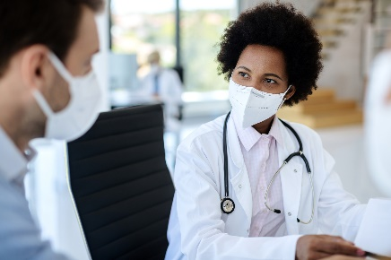
The Challenge: Increasing acceptability​
COVID-19 vaccine would more acceptable if
  Healthcare team said it was safe
  No costs to the individual
  It would help get back to school and work
  They could get it easily
Jackson, C., & Newall, M. (2020, September 29). Despite COVID-19 spike, few individual behaviors are changing. Ipsos. https://www.ipsos.com/en-us/news-polls/axios-ipsos-coronavirus-index/
Notes:
We also know that people will be more likely to get a vaccine if their healthcare provider says it’s safe, if the vaccine is free, if it helps people get to work and school, and if it’s easily available.
Worries and concerns about COVID-19 vaccine can impact people’s willingness to get vaccinated, which is why we need to address them fully so people can be confident in the decision to get vaccinated.

Slide 17
Vaccine hesitancy among healthcare providers
American Nursing Foundation Survey (Oct 2020)
  63% were somewhat or very confident that the vaccine will be safe and effective.
  34% would voluntarily receive COVID-19 vaccine.
  57% are comfortable discussing COVID-19 vaccines with patients.
CDC web survey of healthcare providers (Sept-Oct 2020)
  63% said they would get a COVID-19 vaccine.
  Sources:
  American Nurses Foundation, Pulse on the Nation’s Nurses COVID-19 Survey Series: COVID-19 Vaccine, October 2020. https://www.nursingworld.org/practice-policy/work-environment/health-safety/disaster-preparedness/coronavirus/what-you-need-to-know/covid-19-vaccine-survey
  Lindley, et al. CDC COVID-19 Response Team. Report in progress.
Notes:
We also know there is likely to be vaccine hesitancy among healthcare providers like you. The American Nursing Foundation conducted a survey in October, again before any vaccines were authorized or available, showing that while over half of nurses were confident in the safety and efficacy of a hypothetical COVID-19 vaccine, only about a third would voluntarily receive it. And only slightly more than half said they would feel comfortable discussing with patients. Some vaccine hesitancy among providers may also be due to cultural or religious beliefs. When looking at this data among minority populations who completed the survey, 51% were somewhat or very confident that the vaccine will be safe and effective, and only 22% said they would voluntarily receive it.
Similarly, a CDC web survey conducted this fall showed that only 63% of providers said they would get a COVID-19 vaccine.
These data are worrisome, because if providers decline to get vaccinated, they could be putting themselves and their patients at risk of infection and potentially serious disease.

Slide 18

Defining vaccine confidence
Vaccine confidence is the trust that patients, parents, or providers have in:
  recommended vaccines;
  providers who administer vaccines; and
  processes and policies that lead to vaccine development, licensure, manufacturing, and recommendations for use.
Notes:
So how can we address vaccine hesitancy? By building vaccine confidence, which is a multi-faceted concept, based largely on trust.
Vaccine confidence is the trust that patients, parents, or providers have in:
recommended vaccines;
providers who administer vaccines; and
processes and policies that lead to vaccine development, licensure, manufacturing, and recommendations for use.
A person must have trust in all three of these items to feel fully confident in their decision to get vaccinated. The foundation of trust is critical, and this is something that must be built over time. This is a critical concept to think about when working with patient populations who may have a history of mistrust in the medical establishment or the government.
As providers, you obviously have an impact on the second sub-bullet – helping patients to trust you in your role as vaccine administrators.
It’s important to note, though, that you can also help build trust in vaccines as well as the processes and policies by helping your patients to understand new vaccine technologies, what to expect in terms of vaccine side effects, and how these vaccines are being continuously monitored for safety. Being honest about what you don’t know is also important for building trust.

Slide 19
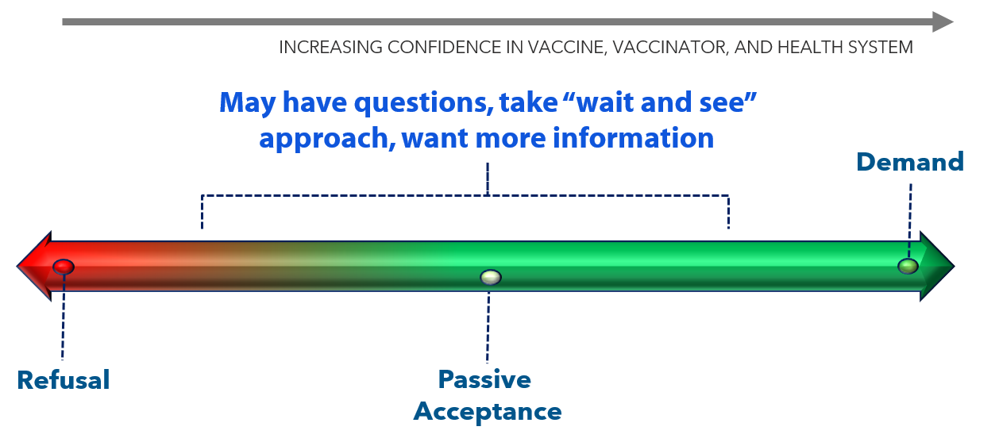
Willingness to accept a vaccine falls on a continuum
Notes:
In order to curb the pandemic, it is critical to increase demand for a COVID-19 vaccine. This slide shows how the willingness to accept a vaccine falls on a continuum.
The vaccine demand continuum illustrates behaviors, whereas confidence is both a feeling and can be acted on. Most people may fall in the middle of this spectrum with a wait-and-see approach.
We want to move people toward the right. The closer you get to active demand on the right side of the continuum, the increasing confidence the person likely feels in the vaccine, the vaccinator, and the health system, because they actively chose vaccination. This requires effort.
People vote with their feet. If there is sufficient confidence and trust and ability, then people will seek out vaccines, overcoming barriers to do so. People with less confidence or motivation or ability may be less willing to overcome real or perceived barriers, such as transportation or getting time off work.
It’s also important to note that where a person falls on the continuum may depend on whether the person is considering this relative to themselves or others that they care about such as minor child, adult child with disabilities, an older adult parent, etc.

Slide 20
Strategies for Building Vaccine Confidence

Slide 21
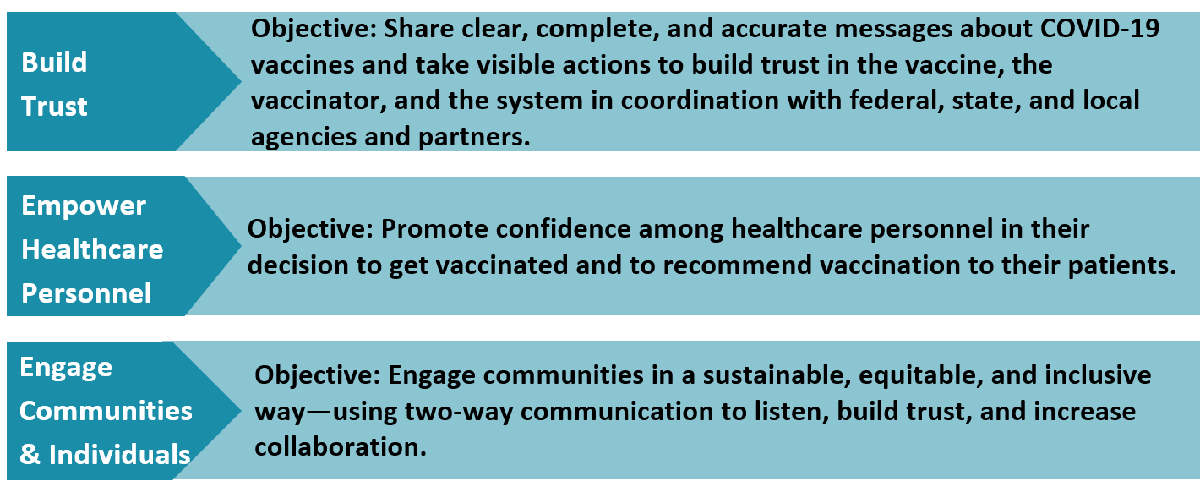
A National Strategy to Reinforce Confidence in COVID-19 vaccines
20
Notes:
This slide shows CDC’s Vaccinate with Confidence strategy, which aims to build confidence in COVID vaccine, the providers who vaccinate, and the vaccination system. It’s not a communication campaign, but rather a framework for thinking about interventions to increase vaccine confidence.
There are three components to the framework. The first aims to build trust by sharing clear, complete, and accurate messages about COVID-19 vaccine in collaboration with federal, state, and local agencies and partners.
The second aims to empower healthcare personnel by helping them to feel confident in their own decision to get vaccinated and to recommend vaccination to their patients. This is the element that is most important for our discussion today.
The third focuses on how to engage communities in a sustainable, equitable, and inclusive way in order to increase collaboration. This is closely related to the first element about building trust.

Slide 22
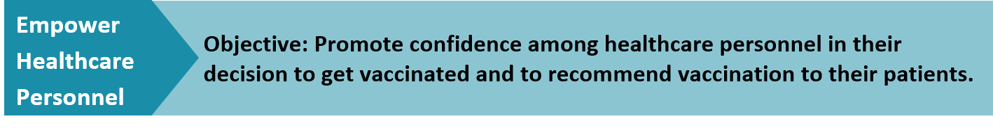
A component of the National Strategy to Reinforce Confidence in COVID-19 vaccines
Tactics
  Engage local and national professional associations, health systems, and healthcare personnel often and early to ensure a clear understanding of the vaccine development and approval process, new vaccine technologies, and the benefits of vaccination.
  Ensure healthcare systems and medical practices are equipped to create a culture that builds confidence in COVID-19 vaccination.
  Strengthen the capacity of healthcare professionals to have empathetic vaccine conversations, address myths and common questions, provide tailored vaccine information to patients, and use motivational interviewing techniques when needed.
Notes:
These are some of the tactics that CDC will be using to empower healthcare personnel.
Engaging national professional associations, health systems, and healthcare personnel often and early to ensure a clear understanding of the vaccine development and approval process, new vaccine technologies, and the benefits of vaccination.
Ensuring healthcare systems and medical practices are equipped to create a culture that builds confidence in COVID-19 vaccination.
Strengthening the capacity of healthcare professionals to have empathetic vaccine conversations, address myths and common questions, provide tailored vaccine information to patients, and use motivational interviewing techniques when needed.
As member of the healthcare team, you have an important role to play in all three of these tactics. We will talk more about this in the coming slides.
Of course, it’s also important to acknowledge that engaging communities will be necessary for driving patients to come into for vaccination.

Slide 23
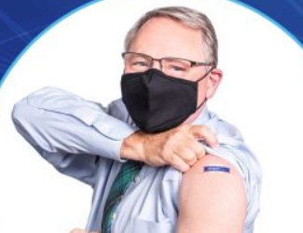
Vaccine confidence starts with you!
As part of the healthcare team, you will likely be in the first phase to receive a COVID-19 vaccine.
Get a COVID-19 vaccine, when it is available to you.
Share your experience and your personal reasons for getting vaccinated with your patients, family, and friends.
Visibly show you received the vaccine, by wearing a sticker, button, or lanyard and sharing on social media or other communication channels.
Notes:
At the health system or clinic level, though, vaccine confidence starts with you. The members of the healthcare team.
As mentioned earlier, YOU will be in the first phase to receive a COVID-19 vaccine.
You can help instill confidence in other healthcare personnel and in patients by:
Getting a COVID-19 vaccine when it’s available;
Sharing your experience and your personal reasons for getting vaccinated with your patients, family, and friends; and
Visibly showing that you received a vaccine by wearing a sticker, button, or lanyard and sharing on social media [CUSTOMIZE THIS ACCORDING TO WHAT IS AVAILABLE IN YOUR FACILITY].
The importance of your role cannot be overemphasized.

Slide 24
Talking with Patients about COVID-19 Vaccination

Slide 25
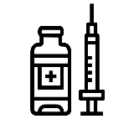



Prepare for COVID-19 vaccine conversations
Choose to get vaccinated
Start conversations early
Engage in effective conversations
Be prepared for questions
Notes:
You may already be getting questions from patients about these vaccines. Although we do not have all the information about COVID-19 vaccines yet, you can start planning now for how to communicate with patients about the vaccines when they become available.
Here are some things to begin thinking about:
As I just mentioned, vaccine confidence starts with you. Patients will likely ask you if you have been vaccinated yourself. If you have not, this could negatively impact their willingness to get the vaccine.
It’s also important to start vaccine conversations early, even before the vaccine is widely available to your patients. Start telling them that it’s coming and ask what they have heard from friends, family, or the media. Use this as an opportunity to debunk any myths or misconceptions.
Learn how to engage in effective conversations and be prepared for questions. State the facts. We will talk more about this in the coming slides.

Slide 26
Know the elements of effective vaccine conversations
Start from a place of empathy and understanding.
Assume patients will want to be vaccinated but be prepared for questions.
Give your strong recommendation.
Address misinformation by sharing key facts.
Listen to and respond to patient questions.
Proactively explain side effects.
“I strongly recommend you get a COVID-19 vaccine once it is widely available…”
“…This shot is especially important for you because of your [job or underlying health condition].”
Notes:
Communication may not seem very scientific, but there are, in fact, evidence-based steps you can follow to make your conversations more effective.
Start from a place of empathy and understanding
The pandemic has been stressful for many people. The first step is to acknowledge the disruption COVID-19 has caused in all our lives, providing an opportunity to recognize common concerns that can be addressed by a vaccine.
Assume patients will want to be vaccinated but be prepared for questions, including questions about when to expect vaccines.
Consider providing the following general information to patients about the timeline for COVID-19 vaccines:
Limited COVID-19 vaccine doses may be available in 2020.
It is anticipated that vaccine supply will increase substantially in 2021.
The goal is for everyone to be able to easily get a COVID-19 vaccine as soon as large quantities are available. However, not everyone will be able to get vaccinated right away.
It is understandable how concerning it could be for your patients if they cannot be vaccinated right away. Encourage them to continue taking steps to protect themselves from COVID-19 and let them know how you plan to share updates about vaccine availability.
Give Your Strong Recommendation
Let your patients know you plan to recommend COVID-19 vaccination for them. Patients consistently rank healthcare providers as their most trusted source for vaccine information. In this unique position, you are able to provide a strong recommendation that is critical for vaccine acceptance. Share the importance of COVID-19 vaccines to protect patients’ health, as well as the health of those around them, or talk about your personal plans to get a COVID-19 vaccine.

Slide 27

Address misinformation about COVID-19 vaccination by sharing key facts
People who have already gotten sick with COVID-19 may still benefit from getting vaccinated
COVID-19 vaccines can not give you COVID-19
Getting vaccinated can help prevent getting sick with COVID-19
COVID-19 vaccines will not cause you to test positive on COVID-19 viral tests*
https://www.cdc.gov/coronavirus/2019-ncov/vaccines/facts.html
*https://www.cdc.gov/coronavirus/2019-ncov/hcp/testing-overview.html
Notes:
Use the conversation as a chance to address misinformation by sharing key facts. Ask what your patients have heard from friends and family or on social media. Let them know that it’s easy to be confused by all the information that is circulating, some of which may be conflicting. CDC has facts to counteract common myths on this page, such as:
COVID-19 vaccines will not give you COVID-19
People who have gotten sick with COVID-19 may still benefit from getting vaccinated
Getting vaccinated can help prevent getting sick with COVID-19
COVID-19 vaccines will not cause you to test positive on COVID-19 viral tests*
You can find responses to these myths at https://www.cdc.gov/coronavirus/2019-ncov/vaccines/about-vaccines/vaccine-myths.html
NOTE: While COVID-19 vaccination will not cause a positive result on viral tests, there is a possibility that it could cause a positive result on a serologic (antibody) test.

Slide 28
Answering Common Patient Questions about COVID-19 Vaccination
Notes:
Patients will likely have a lot of questions about COVID-19 vaccines. This doesn’t necessarily mean they won’t accept a COVID-19 vaccine. And questions don’t necessarily equal concerns. Sometimes patients simply want your answers to their questions.
Your willingness to listen to their concerns will play a major role in building trust in you and your recommendation. Make it clear that you understand they have questions and you want to answer them, so they feel confident in choosing to get vaccinated.
Seek to understand your patients’ concerns and provide information they need in a way they can understand. Explore some of the vaccine questions patients ask about most and find tips for how to answer their questions: Answering Patient’s Questions.
In the next few slides, I’ll present some common questions with answers on how to respond to them.

Slide 29
Q: How do we know if COVID-19 vaccines are safe?
Explain:
  FDA carefully reviews all safety data from clinical trials.
  FDA authorizes emergency vaccine use only when the expected benefits outweigh potential risks.
  ACIP reviews safety data before recommending any vaccine for use.
  FDA and CDC will continue to monitor the safety of COVID-19 vaccines to make sure even very rare side effects are identified.
“COVID-19 vaccines were tested in large clinical trials to make sure they meet safety standards. Many people were recruited to participate in these trials to see how the vaccines offer protection to people of different ages, races, and ethnicities, as well as those with different medical conditions.”
Notes:
One question you are likely to get is "How do we know if COVID-19 vaccines are safe?"
Explain that:
FDA carefully reviews all safety data from clinical trials.
FDA authorizes emergency vaccine use only when the expected benefits outweigh potential risks.
ACIP reviews safety data before recommending any COVID-19 vaccine for use.
FDA and CDC will continue to monitor the safety of COVID-19 vaccines to make sure even very rare side effects are identified.
For example, you can say:"“COVID-19 vaccines were tested in large clinical trials to make sure they meet safety standards. Many people were recruited to participate in these trials to see how the vaccines offer protection to people of different ages, races, and ethnicities, as well as those with different medical conditions.”

Slide 30
Q: Is it safe to get a COVID-19 vaccine if I have allergies?
Ask what kind of allergies they are concerned about.
Explain that people should not get vaccinated if they are allergic to any ingredient in COVID-19 vaccines.
Explain that people with other types of allergies may still be vaccinated, and that you can help determine if it is safe for them.
If you have ever had a severe allergic reaction to any ingredient in a COVID-19 vaccine, you should not get that the vaccine. If you have had an immediate allergic reaction of any severity to other vaccines or injectable therapies, I will help you decide if it is safe for you to get vaccinated. You may still get vaccinated if you have severe allergies to oral medications, food, pets, insect stings, latex, or environmental irritants like pollen or dust.

Slide 31
Q: Is it safe to get a COVID-19 vaccine if I am pregnant or breastfeeding?
Explain that there is limited data about the safety of COVID-19 vaccines during pregnancy and breastfeeding, but that experts do not believe it poses a risk.
Clarify that patients may choose to get vaccinated if they are part of a recommended group.
Emphasize that vaccination is a personal decision and offer to discuss it in more depth.
There is limited information about the safety of COVID-19 vaccines during pregnancy. However, based on what we know about how these vaccines work, experts believe they are unlikely to pose a risk for pregnant patients. You may choose to get vaccinated if you are part of a group that is recommended for COVID-19 vaccine. We can talk through this decision together.

Slide 32
Q: Have these vaccines been tested in all populations?
Explain that the clinical trials recruited a diverse mix of participants.
Be specific and provide the percentages of people from communities of color, people with underlying health conditions, and older adults included in the trials.
Reiterate that no serious safety concerns were identified.
“The first two mRNA vaccines in line for FDA authorization were tested in a diverse group of people. About 30% of U.S. participants were Hispanic, African American, Asian or Native American. About half were older adults. There were no significant safety concerns identified in these or any other groups.”
Notes:
People may have concerns that the vaccines have not been tested in people who are similar to themselves. For example, news stories report concerns from communities of color are not being accounted for in the vaccine development process. The December 19, 2020 Kaiser Family Foundation COVID-19 Vaccine Monitor reported that 48% of Black adults say that they are not confident that the development of a COVID-19 took the needs of Black people into account. This report indicated that what people of color hear and learn about side effects, efficacy, and access to the vaccine will be important in shaping their ultimate decision about whether and when to get vaccinated.
Explain that the clinical trials recruited a diverse mix of participants.
Share any you have about the percentages of people from communities of colors, people with underlying health conditions, and older adults included in the trials.
Reiterate that no serious safety concerns were identified.

Slide 33
Q: Is it better to get natural immunity rather than immunity from vaccines?
Explain the potential serious risk COVID-19 poses to them and their loved ones if they get the illness or spread it to others, adding that the disease can be serious even if they are not in a high-risk group.
Explain that scientists are still learning more about the virus that causes COVID-19. It is not known whether getting COVID-19 disease will protect everyone against getting it again or, if it does, how long that protection might last.
“Both this disease and the vaccine are new. We don’t know how long protection lasts for those who get infected or those who are vaccinated. What we do know is that COVID-19 has caused very serious illness and death for a lot of people. If you get COVID-19, you also risk giving it to loved ones who may get sick. Getting a COVID-19 vaccine is a safer choice.”
Notes:
Some patients may ask: "Is it better to get natural immunity rather than immunity from vaccines?"
Explain the potential serious risk COVID-19 poses to them and their loved ones if they get the illness or spread it to others, adding that the disease can be serious even if they are not in a high-risk group.
Explain that scientists are still learning more about the virus that causes COVID-19. And it is not known whether getting COVID-19 disease will protect everyone against getting it again or, if it does, how long that protection might last.
For example, you can say “Both this disease and the vaccine are new. We don’t know how long protection lasts for those who get infected or those who are vaccinated. What we do know is that COVID-19 has caused very serious illness and death for a lot of people. If you get COVID-19, you also risk giving it to loved ones who may get sick. Getting a COVID-19 vaccine is a safer choice.”

Slide 34
Q: Will the shot hurt? Will it make me sick? What about the side effects?
Explain that they cannot get COVID-19 from the vaccine.
Explain what the most common side effects from vaccination are, how severe they may be, and that they typically go away on their own within a week.
  Make sure patients know that a fever is a potential side effect.
Provide a comparison if it is appropriate for the patient (for example, pain after receiving the shingles vaccine for older adults who have received it).
“These side effects are signs that your immune system is doing exactly what it is supposed to do. It is working and building up protection to disease.”
“Most people do not have serious problems after getting a vaccine. However, your arm may be sore or swollen. These symptoms usually go away on their own within a week. Some people report getting a headache, fever, fatigue, or body aches after getting a vaccine. “
Notes:
Some people may ask if the shot will hurt, make them sick or have any side effects.
Explain that they cannot get COVID-19 from the vaccine.
Explain what the most common side effects from vaccination are, how severe they may be, and that they typically go away on their own within a week.
Provide a comparison if it is appropriate for the patient (for example, pain after receiving Shingrix for older adults who have received it).
Make sure patients know that a fever is a potential side effect.
You can say "“These side effects are signs that your immune system is doing exactly what it is supposed to do. It is working and building up protection to disease.”
You can then give more detail: “Most people do not have serious problems after getting a vaccine. However, your arm where you got the shot may be sore or swollen. These symptoms usually go away on their own within a week. Some people report getting a headache fever, fatigue, or body aches when getting a vaccine. “

Slide 35
Q: How do we know these vaccines are safe when they are so new? What about long-term side effects?
Explain how FDA and CDC are continuing to monitor safety.
Let patients know that ACIP will take action to address any potential safety problems detected.
Compare the potential serious risk of COVID-19 illness with what is currently known about the safety of COVID-19 vaccines.
“COVID-19 vaccines are being tested in large clinical trials to learn more about their safety and effectiveness. However, it does take time and more people getting vaccinated before we can learn about very rare or long-term side effects. That is why safety monitoring will continue. CDC has an independent group of experts that reviews all the safety data as they come in and provides regular safety updates. Any possible problems will be quickly investigated to find out if the issue is related to the COVID-19 vaccine and determine the best course of action.”
Notes:
Others may be more worried about vaccine safety and long-term side effects, given that the vaccines are so new.
Explain how FDA and CDC are continuing to monitor safety.
Let patients know that ACIP will take action to address any potential safety problems detected.
Compare the potential serious risk of COVID-19 illness with what is currently known about the safety of COVID-19 vaccines.
For example, you can say "“COVID-19 vaccines are being tested in large clinical trials to assess their safety and efficacy. However, it does take time and more people getting vaccinated before we learn about very rare or long-term side effects. That is why safety monitoring will continue. CDC has an independent group of experts that reviews all the safety data as they come in and provides regular safety updates. Any possible problems will be quickly investigated to determine if the issue is related to the COVID-19 vaccine and determine the best course of action.”

Slide 36
Q: How many doses are needed and why?
Explain that two shots are needed to provide the best protection against COVID-19 for both mRNA vaccines. The first shot primes the immune system, helping it recognize the virus, and the second shot strengthens the immune response.
Explain that COVID-19 vaccines may differ in the number of doses needed and the spacing between doses.
When applicable, explain the dosing options available in your office and encourage the patient to set up an appointment before they leave to come back for a second dose.
“Nearly all COVID-19 vaccines being studied in the United States require two shots. The first shot starts building protection, but everyone has to come back a few weeks later for the second one to get the most protection the vaccine can offer.”
Notes:
Other people may wonder how many doses are needed and why.
Explain that two shots are needed to provide the best protection against COVID-19 for both mRNA vaccines. The first shot primes the immune system, helping it recognize the virus, and the second shot strengthens the immune response.
Explain that COVID-19 vaccines may differ in the number of doses needed and the spacing between doses.
When applicable, explain the dosing options available in your office and encourage the patient to set up an appointment before they leave to come back for a second dose.
For example, you can say "“Nearly all COVID-19 vaccines being studied in the United States require two shots. The first shot starts building protection, but everyone has to come back a few weeks later for the second one to get the most protection the vaccine can offer.”

Slide 37
Q: Do I have to continue to wear a mask and avoid close contact with others after I have been vaccinated?
Explain that there is not enough information currently available to say if or when CDC will stop recommending that people wear masks and avoid close contact with others. Factors that are being considered include how many people get vaccinated and how the virus is spreading in communities.
Explain that we don’t yet know if the vaccine reduces transmission of SARS-CoV-2.
Emphasize that these precautions will need to be observed until the vaccine is in widespread use and disease rates start to decline.
Right now, experts don’t know how long the vaccine will protect you, so it is important to keep covering your mouth and nose with a mask, washing hands often, and staying at least 6 feet away from others after getting each dose of the vaccine. We also know not everyone will be able to get vaccinated right away, so it’s still important to protect yourself and others. Everyone who gets vaccinated should continue taking these precautions until the vaccine is in widespread use and COVID-19 rates have declined.

Slide 38

Proactively explain side effects
Extremely important because:
  New COVID-19 vaccines are reactogenic. They are likely to cause side effects, especially after the 2nd dose.
  Patients may confuse these side effects with COVID-19 or flu symptoms.
  Patients may worry that the vaccine gave them COVID-19.
Things to emphasize:
  Side effects indicate a good immune response.
  Side effects are generally short-lived.
  It is important to return for second dose, even
  if the first dose has unpleasant side effects.
Notes:
If the patient doesn’t ask about side effects, it’s important to mention them before ending the conversation. This is important for any vaccine, but it will be extra important for COVID-19 vaccine because:
As we discussed earlier, new COVID-19 vaccines are reactogenic and likely to cause side effects, especially after the 2nd dose.
Some of these may mimic COVID-19 or flu symptoms, so patients may mistakenly assume they are ill.
Patients may worry that the vaccine gave them COVID-19—we know this is a common myth that has been circulating.
When discussing side effects, be sure to emphasize that:
Side effects are an indication of a good immune response—so while they may be unpleasant, it means the vaccine is doing its job.
Side effects are generally short-lived, and the patient should feel better within a day or two.
It’s very important to return for the second dose for best protection, even if they didn’t feel well after receiving the first dose.

Slide 39
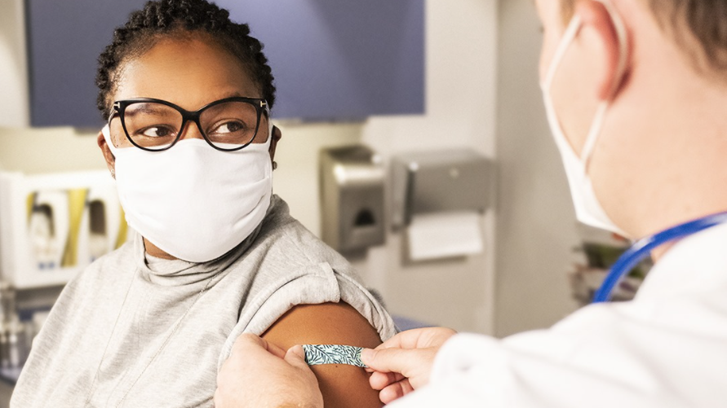
Wrapping up the conversation
Encourage patients to take at least one action.
For example:
  Schedule the second-dose appointment
  (if they got vaccinated that day).
  Read additional information you
  provide them (if they declined
  vaccination).
If they decline, continue to remind them about the importance of getting a COVID-19 vaccine during future routine visits.
Wrap up the conversation by letting your patient know that you are open to continuing the discussion and answering any additional questions they may have.
Notes:
Once you’ve answered questions and explained side effects, encourage your patients to take at least one action, such as:
Scheduling the second-dose appointment right away if they got vaccinated that day; or
Reading the additional information you provide them about COVID-19 vaccination if they declined vaccination.
If they decline, continue to remind them about the importance of getting a COVID-19 vaccine during future routine visits and wrap up the conversation by letting them know that you are open to continuing the discussion and answering any additional questions they may have.

Slide 40

Know where to go for the latest information about COVID-19 vaccines
CDC and FDA websites:
  www.cdc.gov/covid-19/vaccines
  www.fda.gov/emergency-preparedness-and-response/coronavirus-disease-2019-covid-19/covid-19-vaccines
Your professional association
Your state or local health department
Your facility’s immunization coordinator
Notes:
The COVID-19 landscape is changing rapidly. Every week there are announcements about clinical trial data for new vaccines, and soon there will be news about the safety and efficacy of authorized vaccines once they are put into widespread use. Find a way to keep up with the latest developments. Here are some places you can go:
CDC and FDA are both updating their websites frequently with the latest vaccine information.
Many professional associations are committed to educating their members about COVID-19 vaccines and sharing the latest news. Make the time to read any emails you get from your professional association, even though you are extremely busy.
Your state or local health department should also have the latest information. Find out if they have a way to subscribe for email updates.
Your facility's immunization coordinator [GIVE YOUR NAME IF YOU ARE THE IMMUNIZATION COORDINATOR]

Slide 41
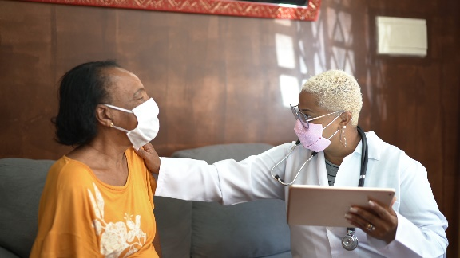
Provider resources for COVID-19 vaccine conversations with patients
Preparing to Provide COVID-19 Vaccines
Talking to Patients about COVID-19 Vaccines
Understanding and Explaining mRNA COVID-19 Vaccines
Making a Strong Recommendation for COVID-19 Vaccination
Answering Patients’ Questions
More tools coming soon!
www.cdc.gov/vaccines/hcp/covid-conversations
Notes:
You can find more information within this suite of resources that CDC has created to help providers with COVID-19 vaccine conversations.
CDC has created a suite of materials to help you plan for vaccination, as well as to assess patients’ vaccine information needs and communicate effectively to meet those needs. These include:
These include:
Preparing to Provide COVID-19 Vaccines
Talking to Patients about COVID-19 Vaccines
Understanding and Explaining mRNA COVID-19 Vaccines
Making a Strong Recommendation for COVID-19 Vaccination
Answering Patients’ Questions
There will be more materials available in the coming months.

Slide 42
COVID-19 vaccine clinical training resources
COVID-19 Vaccine Training: General Overview of Immunization Best Practices for Healthcare Professionals
Webinars about ACIP recommendations and vaccine products
Clinical forms, trackers, and FAQs
Educational materials about each authorized vaccine:
  Online training module
  Vaccine preparation and administration summary
  Storage and handling summary
  Temperature log for freezer units
  Beyond use date tracker labels for refrigerator storage
  Standing orders template
https://www.cdc.gov/vaccines/covid-19/vaccination-resources.html
Notes:
Healthcare professionals who are knowledgeable about evidence-based immunization strategies and best practices are critical to implementing a successful vaccination program. They are key to ensuring that vaccination is as safe and effective as possible. Some healthcare professionals administering COVID-19 vaccine may have extensive experience with immunization practices, since they routinely administer recommended vaccines in their clinical practice. For others, administering COVID-19 vaccine may be their first clinical experience with vaccination.
Here are some of the COVID-19-vaccine-specific clinical resources that CDC is developing for providers.
COVID-19 Vaccine Training: General Overview of Immunization Best Practices for Healthcare Professionals
Webinars about ACIP recommendations and vaccine products
Clinical forms, trackers, and FAQs
Educational materials about each authorized vaccine:
Online training module
Vaccine preparation and administration summary
Storage and handling summary
Temperature log for freezer units
Beyond use date tracker labels for refrigerator storage
Standing orders template

Slide 43
Notes:
Feel free to contact me directly if you have any additional questions [SHARE CONTACT INFORMATION].
You can also call CDC directly at 800-CDC-INFO.

